Slide 1
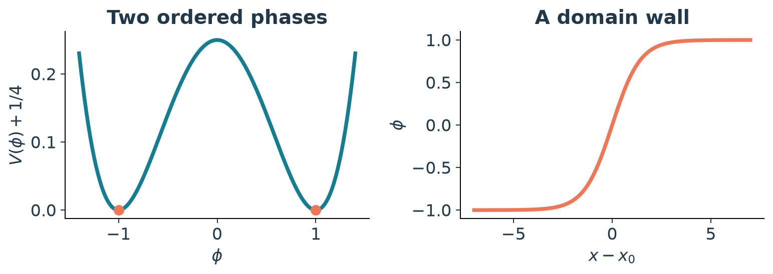
Simulating 1D & 2D TDGL
∂φ/∂t = φ − φ³ + ∇²φ
Real scalar field Nonconserved dynamics Periodic boundaries
P20 / Model-A TDGL
01
Notes:
Sources: Verma et al., Physical Review E 107, 034207 (2023), supplied PDF; Yadav, Verma & Puri, Physical Review E 110, 044130 (2024), supplied PDF. Numerical data: IDC_P20/results/raw. Independent evidence: IDC_P20/audit. The allocation asks for numerical simulation. The dimensionless Model A follows from the GL free energy. The uniform state zero is unstable to homogeneous perturbations and ±1 are stable. The single tanh is an infinite-line solution, used only for an interior residual test.

Slide 2
Finite differences in a periodic box
φⁿ⁺¹ = φⁿ + Δt [φⁿ − (φⁿ)³ + Δₕφⁿ]
1
1D L = 100 N = 1024
Δx = 0.09765625 Δt = 0.001
1
−4
1
2D L = 128 N = 128 × 128
Δx = 1 Δt = 0.01
1
Δt ≤ Δx² / (Δx² + 2D)
2D stencil / Δx²
Linear bound around φ = ±1
P20 / Model-A TDGL
02
Notes:
Sources: Verma et al., Physical Review E 107, 034207 (2023), supplied PDF; Yadav, Verma & Puri, Physical Review E 110, 044130 (2024), supplied PDF. Numerical data: IDC_P20/results/raw. Independent evidence: IDC_P20/audit. Parameters and linear stability bound: Yadav et al. (2024), Table I, Sec. III and Eq. 35. Euler is first-order in time; central spatial differences are second-order. Discrete energy uses forward edge differences to match the stencil. The chosen dt/bound ratios are 0.2107152 and 0.05. The criterion is not unconditional nonlinear stability.

Slide 3
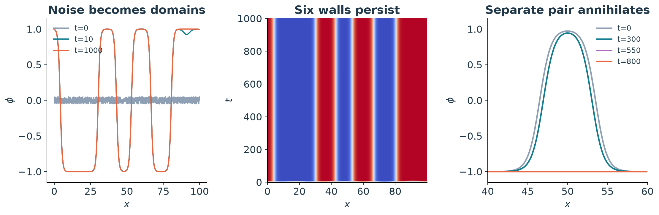
1D: domains form and walls persist
Random quench: 6 walls at t = 1000
Separate pair: R₀ = 7, uniform by t = 800
P20 / Model-A TDGL
03
Notes:
Sources: Verma et al., Physical Review E 107, 034207 (2023), supplied PDF; Yadav, Verma & Puri, Physical Review E 110, 044130 (2024), supplied PDF. Numerical data: IDC_P20/results/raw. Independent evidence: IDC_P20/audit. Random seed 42, noise uniform in [-0.05,0.05]. The random run has six periodic sign changes at t=1000; full ordering is not observed. The separate kink-antikink demonstration uses x1=46.5,x2=53.5, a shorter separation than the 2023 paper R0=10. It reaches the uniform -1 state. Actual time coordinates are used in the space-time image.

Slide 4
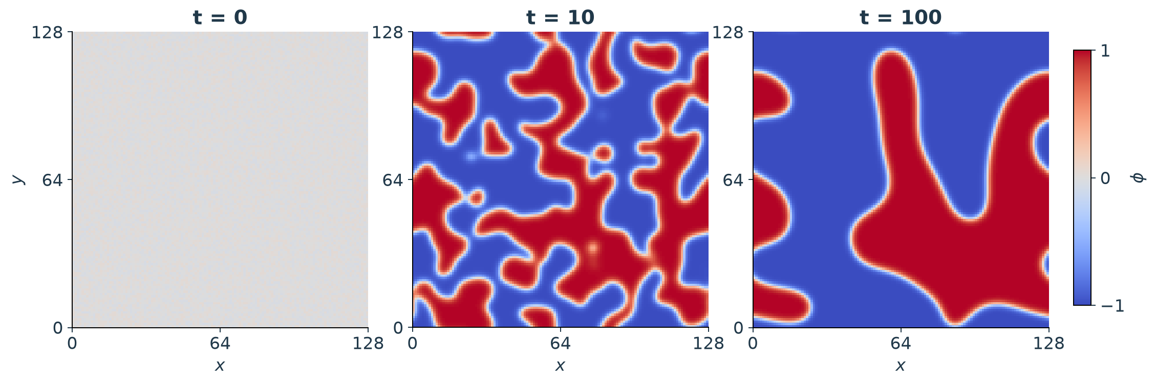
2D: small domains disappear
128 × 128 grid Seed 42 t = 0 to 100
Coarsening morphology; no growth exponent fitted
P20 / Model-A TDGL
04
Notes:
Sources: Verma et al., Physical Review E 107, 034207 (2023), supplied PDF; Yadav, Verma & Puri, Physical Review E 110, 044130 (2024), supplied PDF. Numerical data: IDC_P20/results/raw. Independent evidence: IDC_P20/audit. Reference settings match Yadav et al. (2024), Table I. The final mean is -0.187712 and mean square is 0.906062. The dx=1 grid is coarse relative to the sqrt(2) tanh scale; no continuum accuracy or ensemble growth law is claimed. These are actual saved simulation fields.

Slide 5
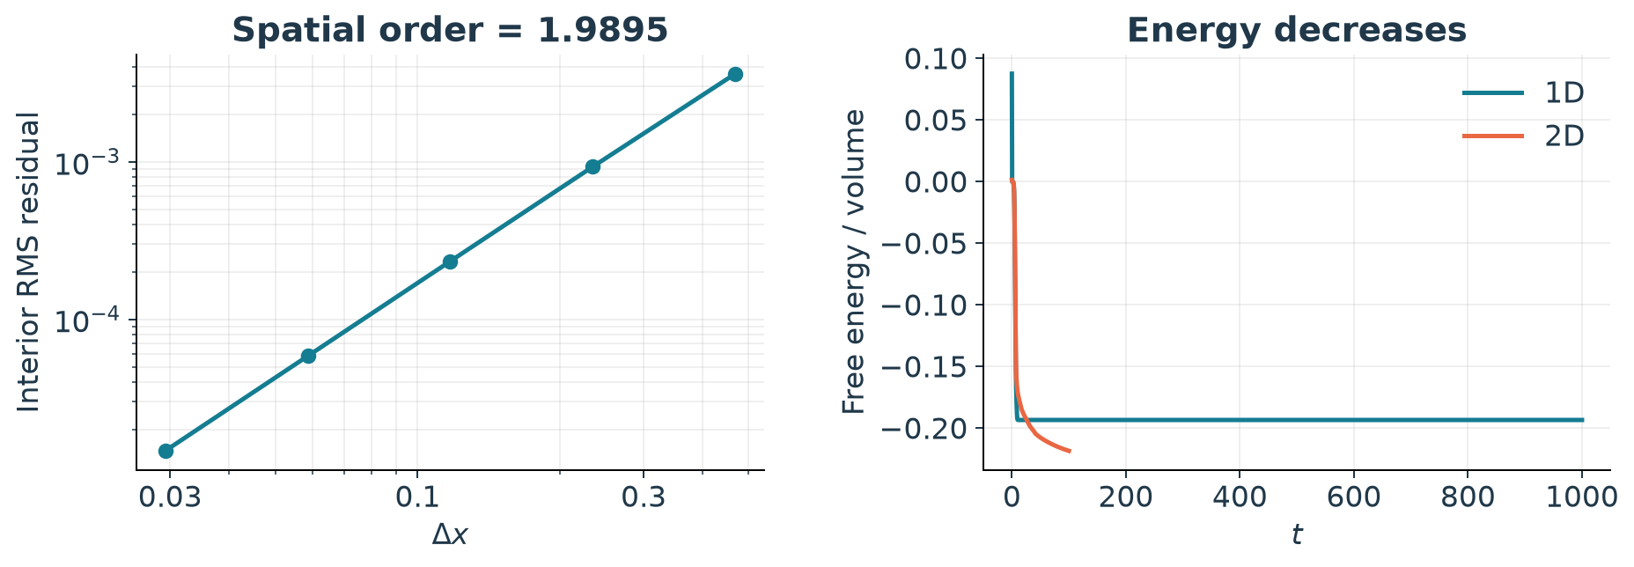
Validation of the executed runs
1.9895
0.9986
1.81 million
spatial order
time order
steps checked
Fixed points, periodic modes and energy consistency pass
P20 / Model-A TDGL
05
Notes:
Sources: Verma et al., Physical Review E 107, 034207 (2023), supplied PDF; Yadav, Verma & Puri, Physical Review E 110, 044130 (2024), supplied PDF. Numerical data: IDC_P20/results/raw. Independent evidence: IDC_P20/audit. Spatial order is the interior RMS residual of a single tanh, not a periodic kink equilibrium. Independent exact homogeneous nonlinear-solution temporal check yields p=0.9986015 in both dimensions. Independent full replay covers 1,000,000 random 1D + 10,000 random 2D + 800,000 pair steps; zero energy violations above 1e-9 and snapshot discrepancy below 2.5e-12. F/volume curves use compatible forward-edge discrete energy. The project unit test suite currently has 13 passing tests. Optional spectra are in the report/package with caveats.

