Slide 1
Machine Learning for Spatial Enhancement of PM2.5 Prediction over India
CAMS EAC4 reanalysis · India · 2020–2024
Course project 3
Notes:
Our project: can we estimate fine-particle pollution (PM2.5) over India from weather and aerosol data, at places the model has never seen, and use this to make finer maps?

Slide 2
Six research questions
1
Accuracy
2
Models
3
Features
How well can PM2.5 be estimated from CAMS aerosol and weather data?
How do the ML models compare?
Which features matter most?
4
Regions & seasons
5
New locations
6
ML vs interpolation
Where and when does it work well or badly?
How well does it work at grid cells not used in training?
Is ML better than standard spatial interpolation?
PM2.5 over India with machine learning
2
Notes:
These six questions come from the project brief. The rest of the talk answers them one by one.

Slide 3
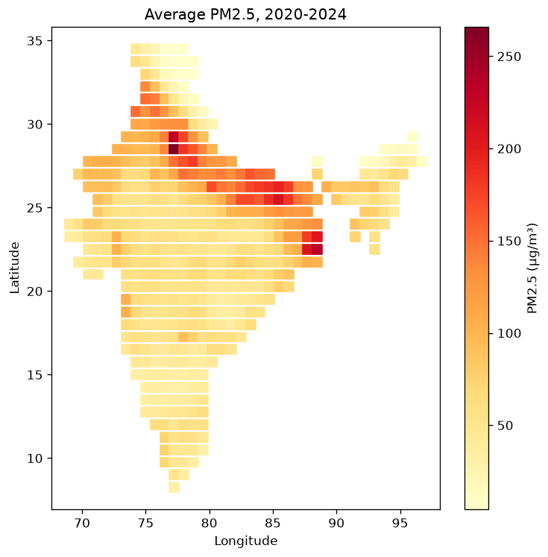
Data: CAMS EAC4 reanalysis over India
494
grid cells in India (0.75°, about 80 km)
1,827
days, 2020–2024 (daily averages of 3-hourly data)
0.9 M
rows (cell × day), no missing values
Target
PM2.5 (µg/m³)
Features
AOD, wind u/v, temperature, dewpoint, surface pressure, lat, lon, month
PM2.5 over India with machine learning
3
Notes:
CAMS EAC4 is a model of the atmosphere corrected with satellite data. We averaged the 8 values of each day, so we work with daily PM2.5. AOD is aerosol optical depth: how much the particles dim sunlight. Surface pressure mainly tells altitude.

Slide 4
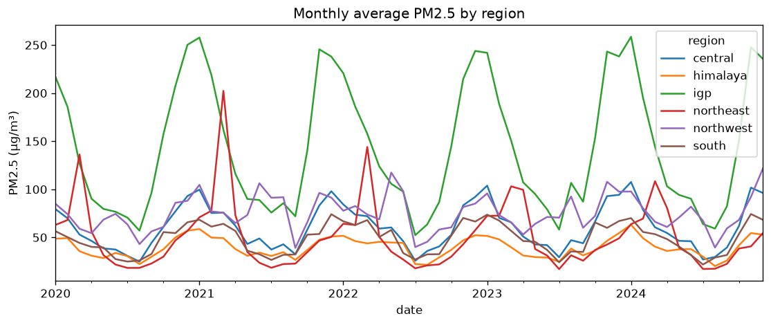
PM2.5 is highest in the IGP, in winter
IGP: winter mean 218 µg/m³, 2–4× other regions
Monsoon: cleanest season everywhere (rain)
Northeast: peak before the monsoon (fire season)
AOD: strongest link with PM2.5 (correlation 0.56)
PM2.5 over India with machine learning
4
Notes:
Before modelling we looked at the data. The same yearly cycle repeats every year: high in winter, low in the monsoon. The Indo-Gangetic Plain is by far the worst.

Slide 5
Workflow: six steps, one script each
1
2
3
Prepare data
Explore
Split
60 monthly files → daily table
averages, correlations, maps
hold out 5 × 5-cell blocks
4
5
6
Train models
Evaluate
Maps 0.25°
IDW, linear regression, random forest
RMSE, MAE, R², bias; importance
interpolation vs random forest
PM2.5 over India with machine learning
5
Notes:
Each step is one short Python script, step1 to step6. The whole project runs in about five minutes on a laptop.

Slide 6
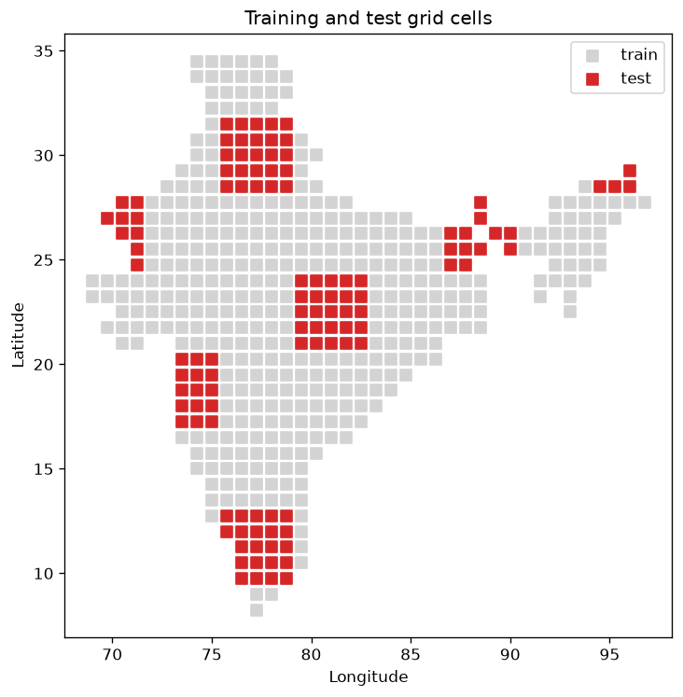
Testing at new places: hold out whole blocks
Problem: neighbouring cells have almost the same PM2.5, so random test cells would be too easy
Solution: cut India into blocks of 5 × 5 cells (~380 km); every 5th block, in a diagonal pattern, goes to the test set
Balance: every region has 12–28% of its cells in test
112
382
23%
test cells
training cells
of cells in test
PM2.5 over India with machine learning
6
Notes:
This is the most important design choice. The models never see the red cells during training, so the scores show how well they work at new places.

Slide 7
Three methods compared
IDW interpolation
Linear regression
Random forest
Standard method: uses PM2.5 of nearby training cells
ML model 1: uses the features at the cell itself
ML model 2: uses the features at the cell itself
Weighted mean of the 8 nearest training cells; weight = 1 / distance²
PM2.5 = a × AOD + b × wind + … (a straight-line formula)
Average of 100 decision trees; can learn curved links
Both ML models: scikit-learn, trained on the 698,000 rows of the training cells, random seed 42.
PM2.5 over India with machine learning
7
Notes:
IDW only looks at PM2.5 in nearby cells. The ML models only look at the weather and aerosol at the cell itself. So we can compare the two ideas directly.

Slide 8
Random forest is the best method
Method | RMSE | MAE | Bias
IDW | 35.3 | 20.4 | −6.8
Linear regr. | 46.7 | 32.1 | −12.9
Random forest | 31.9 | 17.8 | −5.6
RMSE, MAE, bias in µg/m³
Random forest explains 74% of the daily variation at new places
Better than IDW interpolation (R² 0.68)
Linear regression far behind: the links are not straight lines
PM2.5 over India with machine learning
8
Notes:
Answer to RQ1 and RQ2, and the overall part of RQ6. At grid cells the models never saw, the random forest has a typical error of 18 µg/m³.

Slide 9
By region: ML wins where neighbours differ
Northeast & Himalaya
Nearest training cells have different pollution, so IDW fails. The random forest does not need neighbours: R² 0.74–0.78.
IGP and south
Hard for every method (R² ≈ 0.5): IGP PM2.5 is very high and changes fast.
PM2.5 over India with machine learning
9
Notes:
Answer to RQ4 and RQ6 by region. Linear regression is even worse than guessing the average in the south (R² −1.8).

Slide 10
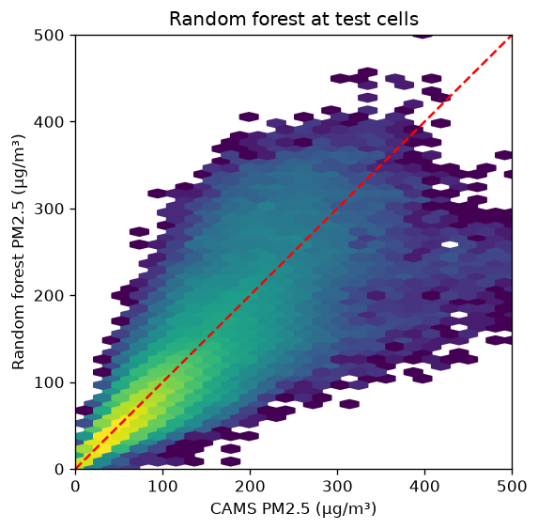
By season: best in the monsoon
Random forest vs CAMS at test cells: close to the line, a bit too low at the highest values.
PM2.5 over India with machine learning
10
Notes:
RQ4 by season. The random forest is the best in every season. The scatter plot shows it under-predicts the most extreme days.

Slide 11
AOD is the most important feature
Random forest importance
How much each feature helps the trees split the data (all add up to 1).
AOD tells how many particles are in the air
Surface pressure tells the altitude (mountains vs plains)
Wind matters least
PM2.5 over India with machine learning
11
Notes:
Answer to RQ3. The correlations in step 2 agree: AOD first, then surface pressure.

Slide 12
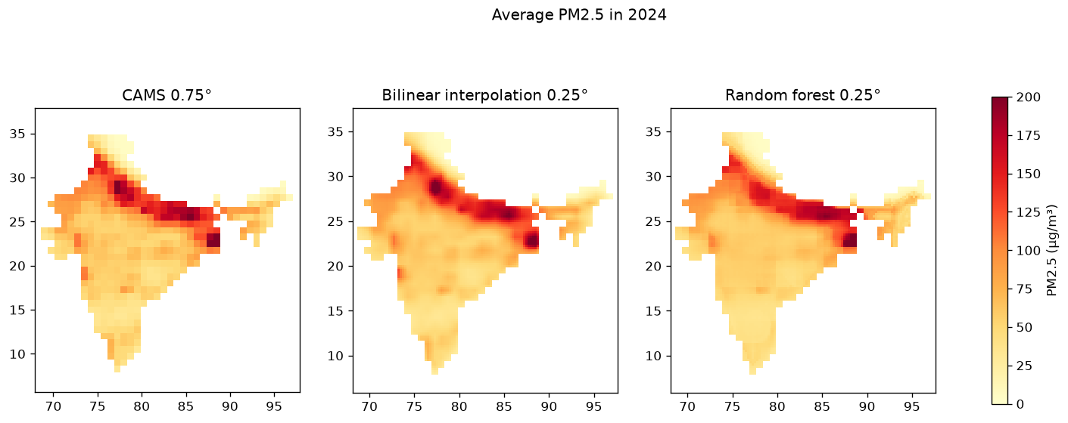
Finer maps: 0.25° instead of 0.75°
Bilinear: smooths CAMS PM2.5. Random forest: interpolate the features, then predict at every 0.25° point. 2024 mean: CAMS 72.8, bilinear 72.4, random forest 71.5 µg/m³.
PM2.5 over India with machine learning
12
Notes:
RQ6 for maps. Both fine maps keep the CAMS pattern. The random forest map shows sharper edges where AOD and terrain change, for example at the foot of the Himalaya. There is no finer truth to check these maps against.

Slide 13
Limitations
!
CAMS is not ground truth
!
PM2.5 and AOD from one model
Scores measure agreement with the CAMS model, not with measured air quality
Part of AOD's usefulness is built into CAMS
!
No truth below 0.75°
!
Daily averages
The fine maps can be shown but not checked
We do not look at the daily cycle (day vs night)
PM2.5 over India with machine learning
13
Notes:
These limits apply to every result in the talk.

Slide 14
Conclusions
RQ1
Daily PM2.5 at new places: R² 0.74, typical error 18 µg/m³
RQ2
Random forest ≫ linear regression (R² 0.74 vs 0.45)
RQ3
AOD most important, then surface pressure; wind least
RQ4
Best: Himalaya, central India, monsoon. Worst: south, IGP, pre-monsoon
RQ5
Works at grid cells never used in training (blocks of ~380 km)
RQ6
Random forest beats IDW; far better in the northeast and Himalaya
PM2.5 over India with machine learning
14
Notes:
Main message: a simple random forest estimates PM2.5 at new places better than standard interpolation, especially where neighbouring cells are not similar. Thank you.

