Slide 1
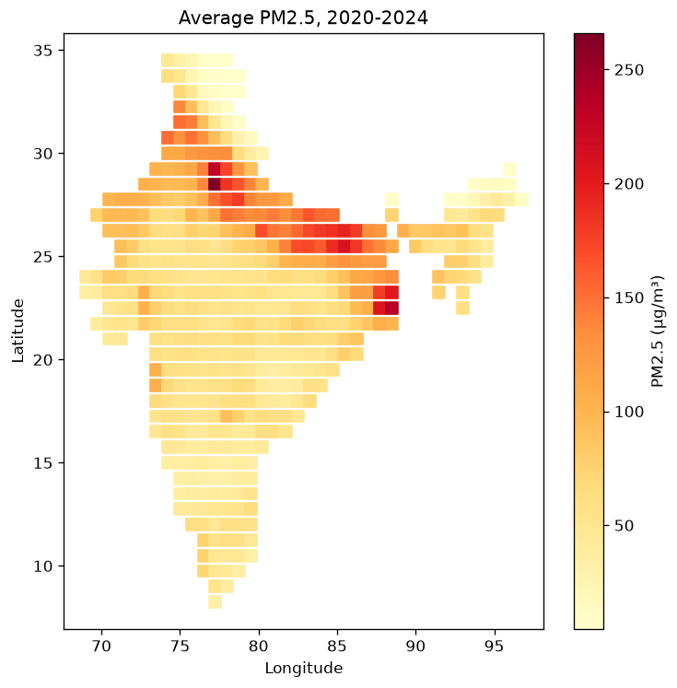
PM₂.₅ estimation and spatial enhancement over India
Objective
Estimate daily CAMS PM₂.₅ at withheld locations using aerosol and weather inputs.
Compare linear regression and random forest with IDW, then produce exploratory 0.25° maps.
Harsh Meshram • Chandranil Das
Dhrubojyoti Saha • Dineshwar Okram
Tanuj Singh
Indian Institute of Technology Kanpur
EE708 • Group 1 • Project 3
1/5
Notes:
Target 1:30. Introduce all five members. Our project asks whether aerosol and weather information can estimate daily PM2.5 at locations withheld from training. The reference is CAMS EAC4 over India for 2020 to 2024. The map shows the five-year average on the native grid, with elevated values across the Indo-Gangetic Plain. We compare two machine learning models with a spatial interpolation baseline. We also combine the trained forest with interpolated inputs to create a finer map. These are two related outputs: a quantitative held-out-location assessment and an exploratory fine-grid visualization. We do not claim that a finer image proves finer accuracy. The work addresses accuracy, model comparison, important features, regional and seasonal differences, spatial generalization, and comparison with interpolation. Our final result is a random forest that improves the overall withheld-location score, while retaining regional weaknesses and substantial errors during some extreme events. Source: supplied PROJECT.md, processed CSV and map_mean_pm25.png.

Slide 2
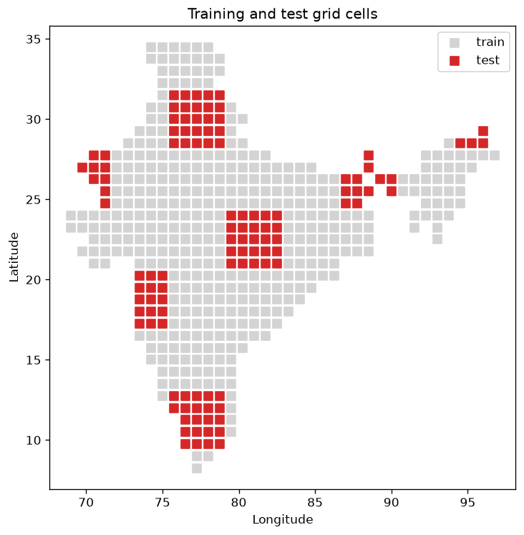
Data preparation and spatial validation
902,538 daily records
494 cells • 1,827 days • 2020–2024
Native grid: 0.75°
Preprocessing
Daily averages of 3-hourly samples
Unit conversion and India mask
No missing or duplicate processed rows
382 training cells / 112 held-out cells
All dates of a cell stay in the same set
No future-year test or separate tuning set
EE708 • Group 1 • Project 3
2/5
Notes:
Target 1:45. The processed dataset contains 494 cells and 1827 days, giving 902538 records. The preparation script reads 60 monthly files, averages the three-hourly values by day, converts PM2.5 to micrograms per cubic metre, temperature to Celsius, and pressure to hectopascals. The supplied India mask selects the study cells. We checked the processed data for missing values and duplicate date-location keys and found neither. Our inputs are AOD, two wind components, temperature, dewpoint, pressure, coordinates and month. For evaluation we use five by five spatial blocks. The red cells are withheld across every date, so the model never fits PM2.5 from those locations. There are 382 training cells and 112 test cells, with each region represented. Blocks reduce the problem of scattering isolated test cells among training neighbours, but boundary cells can still be close to training locations. We use the held-out spatial test as the validation assessment required for this presentation. We have no separate tuning set and have not tested future-year forecasting. Source: supplied cells.csv, daily CSV and split_map.png.

Slide 3
Model architecture, training performance and efficiency
Nine inputs → 100 regression trees → average PM₂.₅
Bootstrap samples • minimum 10 samples per leaf • seed 42
Linear regression and 8-neighbour IDW provide baselines
RF assessment | RMSE | MAE | R²
Training | 18.85 | 8.47 | 0.915
Held-out locations | 31.89 | 17.82 | 0.742
6.89 million nodes • 3.44 million leaves • maximum depth 39
HDF5 model: 182.93 MB • 204,624 predictions: ~0.42 s*
Errors: µg/m³. *Review environment, excludes file reading. Training scores are resubstitution.
EE708 • Group 1 • Project 3
3/5
Notes:
Target 2:00. A random forest is an ensemble of regression trees. Each tree learns threshold rules from a bootstrap sample of training records, and the forest averages their outputs. Our forest uses all nine predictors, 100 trees, at least ten samples per leaf, and seed 42. The comparison models are global linear regression and inverse distance weighting. IDW averages same-day PM2.5 from eight nearby training cells, using inverse squared distance. The ML models instead use atmospheric predictors at the test cell, so their available information differs. The table separates training fit from held-out performance. Training R squared is about 0.915, while the held-out value is 0.742. The gap is important: training accuracy alone would overstate generalization. We also measured forest complexity. It has approximately 6.89 million nodes, 3.44 million leaves and maximum depth 39. The genuine numeric HDF5 export is about 183 megabytes, so this is not a particularly compact forest. Batch prediction took about 0.42 seconds in our review environment, excluding loading and file reading. Runtime varies by hardware. The supplied loader reconstructs this forest from HDF5; it is not a Keras model. Source: executed model export and verified_metrics.json.

Slide 4
Random forest gives the best overall held-out score
Method | RMSE | MAE | R² | Bias
IDW | 35.34 | 20.43 | 0.683 | −6.75
Linear | 46.72 | 32.14 | 0.446 | −12.88
Random forest | 31.89 | 17.82 | 0.742 | −5.58
9.8% lower RMSE than IDW
RF wins in 4 of 6 regions and every season.
IDW wins in the IGP and northwest.
RF seasonal R²: 0.601 pre-monsoon to 0.805 monsoon.
AOD has highest model importance (0.305), followed by pressure (0.193).
EE708 • Group 1 • Project 3
4/5
Notes:
Target 2:00. The scores use all 204624 withheld records. Random forest has an RMSE of 31.89 and MAE of 17.82 micrograms per cubic metre, with R squared approximately 0.742. Compared with IDW, its RMSE falls by 9.8 percent. Linear regression is substantially weaker, suggesting that this particular global linear specification misses useful nonlinear relationships. The pooled R squared combines variation across locations and dates; it should not be interpreted as a separate daily forecasting score. Regional results qualify the overall ranking. Random forest wins in four of six regions, especially the northeast and Himalaya, but IDW wins in the Indo-Gangetic Plain and northwest. The forest wins in all four seasons. Its seasonal R squared ranges from about 0.601 before the monsoon to 0.805 during the monsoon. AOD has the highest built-in feature importance, followed by pressure. This measures how the fitted forest uses the variables, not their causal physical importance. All methods underestimate on average, and the forest still misses extreme pollution. We retain those extreme values in the reported metrics. Source: recomputed test_predictions.csv, regional and seasonal tables, feature_importance.csv.

Slide 5
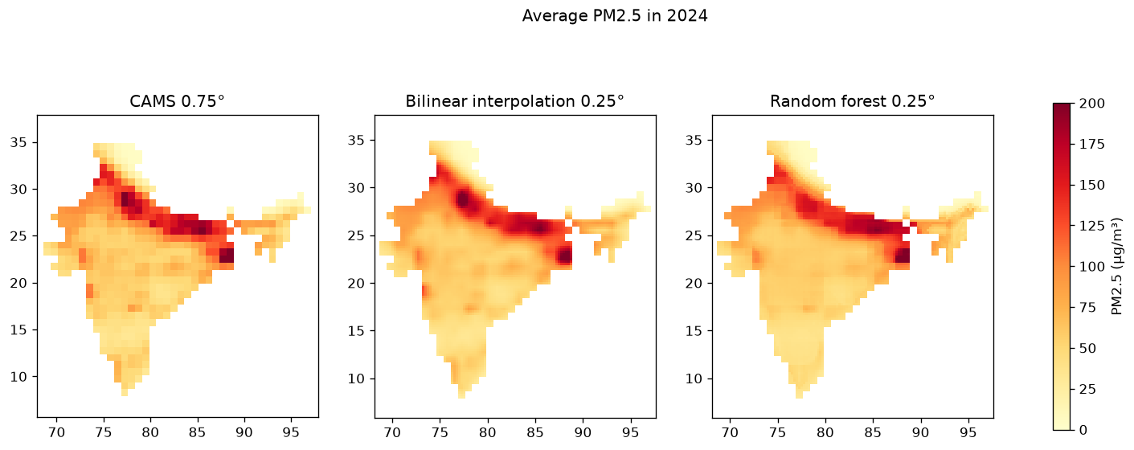
Finer maps and conclusions
Interpolate predictors to 0.25°, then apply the forest.
Verified benefit: better overall CAMS agreement at withheld native-grid cells.
Limits: extremes underestimated; no station or independent 0.25° validation.
Next: multiple spatial folds, compact forests and independent measurements.
EE708 • Group 1 • Project 3
5/5
Notes:
Target 1:45, leaving one minute of the ten-minute limit for transitions. The final figure compares native CAMS, bilinear interpolation and the forest at a quarter-degree grid. For the forest map, we interpolate the atmospheric predictors and then predict PM2.5. Both fine maps retain the broad CAMS pattern. Their unweighted grid means are about 72.37 for bilinear and 71.54 for random forest, compared with 72.80 for CAMS. Similar national means do not prove local accuracy or coarse-grid consistency. The bilinear map uses the full CAMS target field, including withheld cells, so it is a visualization comparison, separate from our held-out IDW evaluation. We have no independent quarter-degree truth or fine-resolution predictors, and no station validation. Extreme-event errors also remain: one withheld CAMS value of 1255 receives a forest prediction of about 186. Our defensible conclusion is that random forest improves overall agreement at withheld native-grid locations among the tested methods. The fine maps demonstrate the spatial enhancement workflow. Further validation and model-size reduction would strengthen the project. Source: supplied maps, map_check_2024.csv and verified held-out predictions.

