Slide 1

Hallucination Detection in Contextual Question Answering
BY
Team 3

Slide 2
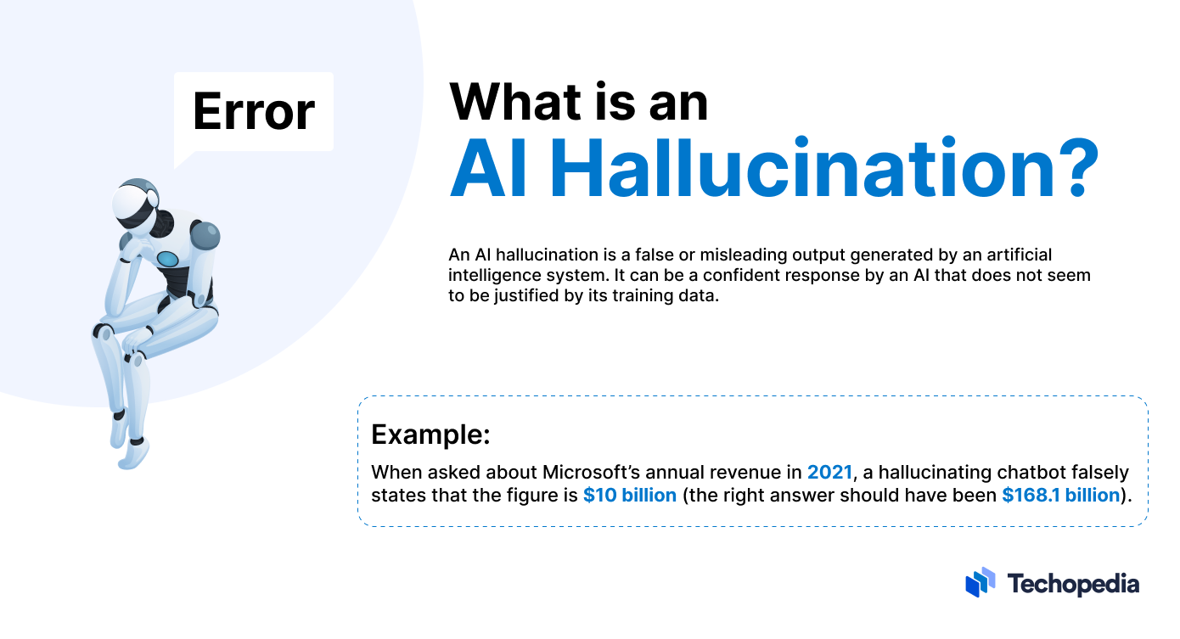

Slide 3
Process
1
Performed EDA (Exploratory Data Analysis)
2
Worked on 2 different models (2 members on each)
3
Used BERT and Logistic Regression in one of the models
4
Used TF-IDF vectorization and LinearSVC

Slide 4
Approach 1
Accuracy Score
F1 Score
Scores
Pipeline
TfidVectorizer
Scikitlearn
Pandas
Libraries
LinearSVC
Models

Slide 5
Problem Solving
Input the dataset given by user
Handling NULL Values
Splitting the dataset
Training the model
Making predictions
Checking F1 and accuracy scores
Saving csv files

Slide 6
Approach 2
Libraries
Pandas
Torch
Sklearn
Scores
F1 Score
Accuracy Score
Models
BERT Tokenizer
Transformer
BERT Model

Slide 7
Problem Solving
Loading the dataset
Converting context, question and answer into string types
Combining the three columns
Initializing BERT Tokenization and model (bert-base-uncased)
Trained the model using embeddings generated from BERT into Logistic Regression
Calculated accuracy and F1 score

Slide 8

Challenges Faced
Understanding the problem statement and dataset
Tried connecting to front end but unable to do so
Choosing the right model
Accuracy checks
Producing the result in Output Format

Slide 9

Thank You

