Slide 1
Smart Waste Segregation
VIDYA JYOTHI INSTITUTE OF TECHNOLOGY (Autonomous)
Under the guidance of:
K.Nirosha Mam
Assistant Professor
Department of AI
Signature :
By :
K Seshu Kumar – 22911A3522
K Chandra Shekar – 22911A3524
S Vaishnavi – 22911A3554
M RamTeja – 23915A306

Slide 2
Problem Statement
Design a smart waste segregation system that allows citizens to segregate the various types of solid waste they want to dispose and the municipal authorities to efficiently collect the same. The system should be mobile app (Android) based and IOT based.

Slide 3
Abstract
Massive human population, coupled with rapid urbanization, results in a substantial amount of garbage that requires daily collection. In urban areas, garbage often accumulates around dustbins without proper disposal at regular intervals, creating an unsanitary environment for humans, plants, and animals.
This situation significantly degrades the environment. To address this problem, a Smart Waste Management System is introduced in this paper, employing machine learning techniques for air quality level classification.
Furthermore, this system safeguards garbage collectors from severe health issues caused by inhaling harmful gases emitted from the waste. The proposed system not only proves cost-effective but also enhances waste management productivity by categorizing waste into three types: wet, dry, and metallic.
Ultimately, by leveraging machine learning techniques, we can classify air quality levels and garbage weight into distinct categories. This system is beneficial for improving the well-being of individuals residing in close proximity to dustbins, as it enables constant monitoring and reporting of air quality to relevant city authorities.

Slide 4
Literature Survey
S. No. | Title | Methodology | Metrics | Limitations
1 | Automated smart waste segregation system using IoT technology | Transfer Learning Techniques | Accurate waste classification using deep learning models. | Cost
2 | Smart Waste Management: Waste Segregation using Machine Learning | Train and test the machine learning models for waste segregation | Reduction in Labor Costs | Regulatory Compliance
3 | WasteSegNet: A Deep Learning Approach for Smart Waste Segregation in Urban Environments | Measure the computational efficiency of Waste Segregation during inference. | Robustness, Generalization Performance | Power Supply
4 | Smart Waste Segregation using ML Techniques | Use a test dataset containing various types of waste items and assess the system's ability | Monitoring Efficiency | Connectivity Issues

Slide 5
Literature Survey - Base paper
Paper 1: Automated smart waste segregation system using IoT technology
Authors: M R Chitale , S J Chitpur , A B Chivate, P D Chopade , S M Deshmukh and A A Marathe
Published by & Year: Journal of Physics: Conference Series & September 2023
About paper:
One of the major challenges faced not just by India but globally as well is waste management. India is the second most populous country and naturally generates tones of garbage daily. It is common to find dustbins overflowing with junk scattered everywhere, not to mention that segregation of waste is conveniently neglected. Many-a-times it is observed that despite providing separate bins for dry and wet trash, the convention is carelessly ignored. With the traditional methods of periodic garbage collection and manual segregation of wet, metallic, non-recyclable, and recyclable waste proving to be inefficient, there is a need for a better solution. With the help of IoT, a more effective solution is proposed to improve the current system and take a step forward toward the vision of smart cities. The proposed system uses smart garbage tracking, segregation, and collection systems, interfaced with ultrasonic sensors, rainfall/moisture sensors, inductive proximity sensors, and servo motors, along with the necessary hardware, with Arduino as the main controlling unit. The Arduino platform is used as a software platform for the working of the model and obtaining the expected results.

Slide 6
Literature Survey - Base paper
Paper 2: Smart Waste Management: Waste Segregation using Machine Learning
Authors: Gayathri Rajakumaran ,Shola Usharani ,Christie Vincent , Sujatha M
Published by & Year: Recent Advances in Wireless Communications & Emerging Technologies (RAWCET 2022) & April 2023
About paper
In the digitized era, the role of smart mechanisms plays a vital role and one among them is the segregation of waste. To make use of proper disposal and waste management techniques, the segregation of wastes is essential. In the existing systems, drones are used for identifying waste using image processing, and deep learning and use GPS, and GSM methods to identify and send locations to the authorities. The enhancement achieved is to analyze and implement waste segregation with the help of image classification and multi-object detection. Waste management may therefore be done more efficiently with an accuracy of 95% with a mean average of 87.4% which in turn helps significantly to reduce labor costs.

Slide 7
Literature Survey - Base paper
Paper 3: WasteSegNet: A Deep Learning Approach for Smart Waste Segregation in Urban Environments
Authors: Aatmaj Amol Salunke
Published by & Year: Department of Computer Science & Engineering Manipal University Jaipur & July 2023
About paper:
Efficient waste segregation is paramount for sustainable urban waste management. In this study, we present WasteSegNet, a custom-designed Convolutional Neural Network (CNN) for automated waste segregation into Organic and Recyclable categories. Trained on 22,564 waste images with a test set of 2,513 samples, WasteSegNet achieves an impressive accuracy of 87.5% on the test dataset. Comparative analysis with traditional methods highlights the superior performance of WasteSegNet in accurate waste item classification. The model's strength lies in its ability to discern intricate visual patterns, enabling effective segregation. By harnessing deep learning techniques, WasteSegNet offers a promising solution to optimize waste sorting processes, reduce landfill waste, combat environmental pollution, and foster sustainable waste management practices in smart cities

Slide 8
Literature Survey - Base paper
Paper 4: Smart Waste Segregation using ML Techniques
Authors: Dhruv Nrupesh Patel, Ashwin Sasi, Anand Chembarpu, Chandrashekar Dasari, Usha C S
Published by & Year: International Journal of Innovative Technology and Exploring Engineering (IJITEE) & September 2020
About paper:
Continuous urbanization and industrialization has led to increase in volume and type of waste generated. It is estimated that in 2006 the total amount of municipal solid waste generated globally reached 2.02 billion tons, representing a 7% annual increase since 2003 (Global Waste Management Market Report 2007). This poses a problem for local and national government to ensure sustainable and effective waste management. In this Project we have implemented a smart dustbin in which segregation is achieved using respective automated sensors and the wastage level both dry waste and wet waste of the dustbins are monitored and recorded simultaneously. It ultimately helps to keep cleanliness in the society and hence the expansion of diseases caused by waste material is reduced.

Slide 9
Existing Systems
Wastes are left scattered in the streets due to poor maintenance of garbage bins. The traditional way of manually monitoring the garbage bins is a complex, clumsy process and utilize more human effort, time and cost.
The existing system have no proper planning regarding the collection of garbage which makes the city or town unhygienic, don’t regularly update the level and odour of the garbage bin to the authority. It intimates the municipality only through SMS alert.
In some systems RFID tag and reader is used so whenever the garbage truck come near the bin it updates the current status of the bin to the worker in the truck. The worker then cleans the bin when it is filled. This method has a disadvantage of more fuel consumption and time consuming too.
The labours who are cleaning the dustbins are also not taking any responsibility which makes the system worse in urgent cases . The labours cannot always monitor the elevation and scent of the dustbin manually around all places of the city.

Slide 10
Limitations
Cost: Implementing IoT sensors in waste bins and developing a mobile app can be expensive. The cost of hardware components, software development, and maintenance should be carefully evaluated, especially for municipalities with limited budgets.
Regulatory Compliance: The design and operation of the waste segregation system must comply with relevant regulations and standards governing waste management, environmental protection, and data privacy. Failure to adhere to legal requirements could result in penalties or legal consequences.
Power Supply: IoT sensors require a stable power source to operate continuously. Ensuring reliable power supply to waste bins, especially in outdoor environments, may pose challenges. Battery-powered sensors may need frequent replacement or recharging, adding to maintenance costs.
Connectivity Issues: IoT devices rely on stable internet connectivity to transmit data to the mobile app and municipal authorities. However, connectivity issues such as network outages or weak signals can disrupt data transmission and affect system reliability

Slide 11
Proposed System / Innovation
Most of the times, the garbage bins are overflowing with excess waste and are scattered out in the street. These scattered wastes get either decayed or burnt in that place or overflows all over which leads to serious health issues to humans.
The wastes which are dumped are segregated by Humans which leads to health problems to them. To overcome this problem a well organized waste segregation and monitoring system has been designed.
It is an IoT based Waste Segregation and Monitoring system which is an innovative way to keep the cities clean and healthy. The foremost goal of this project is to automatically segregate the wastes and to perceive the level of the dustbins which is delivered through wireless mesh network.
With such information, litter bin providers and cleaning contractors are able to make better decision for the efficient disposal . IR sensor identifies the objects, Moisture and metal sensors detects the wet and metal waste. Ultrasonic sensor observes the levels of bin. The waste is dropped inside the bin where the sensor identifies the type of the waste.
The Bin consists of three partitions inside were each bin collects each waste respectively. The motor then rotates and respective partitions gets opened and respective wastes are collected. The status of the bin is displayed in Thing speak server.

Slide 12
Modules
User Registration and Authentication Module:Allow users (citizens) to register and create accounts in the mobile app.
Waste Segregation Module:Provide an intuitive interface in the mobile app for users to segregate different types of waste.
IoT Integration Module:Integrate IoT sensors into waste bins or containers to detect the fill-level and type of waste in real-time.Ensure IoT devices are capable of transmitting data securely and reliably to the central server.
Admin Dashboard Module:Create an admin dashboard for municipal authorities to monitor waste collection operations.Develop algorithms to optimize waste collection schedules based on factors such as fill-level, proximity, and traffic conditions.
Reporting and Feedback Module:Allow users to report issues or provide feedback related to waste segregation and collection. feedback mechanism for users to provide suggestions for improvement

Slide 13
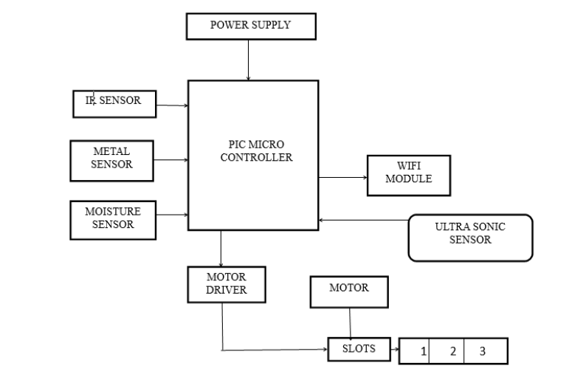
Block diagram

Slide 14
Result

Slide 15
Conclusion

Slide 16
VIDYA JYOTHI INSTITUTE OF TECHNOLOGY (Autonomous)
THANK YOU

