Slide 1
BIOS13 – Modelling Biological Systems
Question 3 - Introgression
Name – CHANDRASHEKAR cr

Slide 2

Overreaching Scope
Introgression, the movement of genes between populations, is a fundamental driver of evolutionary change, influencing everything from species adaptation to human history. Understanding the mechanisms governing introgression is essential for both conserving biodiversity and developing innovative computational solutions inspired by natural evolution.
Specific Scope
This study specifically focuses on how neutral processes, such as genetic drift and recombination, influence the spread and persistence of introduced genes within a population. By simulating a simplified scenario without selection, the study aims to isolate and understand the impact of these fundamental genetic mechanisms on the dynamics of introgression.
Notes:
The figures are based on the 2023 financial year.
PhD students are counted as employees, depending on their financing. They are students in all aspects except the financial one, which is important to point out since they bring up the staff number without being ”staff” per se.

Slide 3
Specific Question
The process of ‘foreign’ genes entering, and becoming established in, a population is called introgression. For example, one can follow the introgression of genes across hybrid zones, where genes can travel from one population (or species) to another. A famous example is the finding that all humans with ancestors from outside Africa have a small proportion of Neanderthal genes, probably a result of hybridization and introgression that happened a long time ago. We shall now study the process of introgression, keeping things as simple as possible.
Consider a haploid population of n individuals (n is fixed). Each individual carries a genome of L genes. The genes can be of two types, the old type and the ‘new’ type. If we represent the old type with zeros and the new type with ones, an individual that carries some old and some new genes could be represented by a sequence like 0110 (for the case L = 4).
Each generation, the individuals mate randomly and the offspring is formed through recombination. More precisely (see figure):
Start the simulation (generation 1) with a single individual with a completely foreign genome (orange in the figure).
For each individual of the next generation:
choose two parents randomly from the parent generation
pair up their genomes and choose a random point of gene crossover (dashed line in figure).
put the recombined offspring in the next generation
repeat until the new population is full
The new population then replaces the old one and the whole procedure repeats. There is no selection for or against the new genes.

Slide 4
Specific Question
If you would write a program to simulate this process, what would be an appropriate representation of the population, describing the current ‘system state’? (1p)
Write a function in R that takes two parent genomes as input and returns a single recombined offspring genome, following the procedure of recombination described above. (2p)
Write a script in R that uses the above function and simulates the population for 100 generations. For your own convenience, write it such that you can easily change the population size n and the genome size L. (2p)
Revise the script to calculate the proportion of new genes in the population for each generation. Plot the result as a proportion over time (example figure below). You may notice that quite often there is no introgression, i.e. the new type disappears from the population. Use L = 100 and n = 100. (1p)
Extra (no points!): After a long time, say 1000 generations, most new genes (out of the original L) have either gone extinct or come to fixation. The population now has a mixed genome of old and new genes (like non-African humans). Add a few lines to your script to also plot the frequency of new genes at each locus of the final population. You may find short sequences of introgressed genes spread out over the genome, but usually they occur together, side-by-side. Can you think of why? (0p)

Slide 5
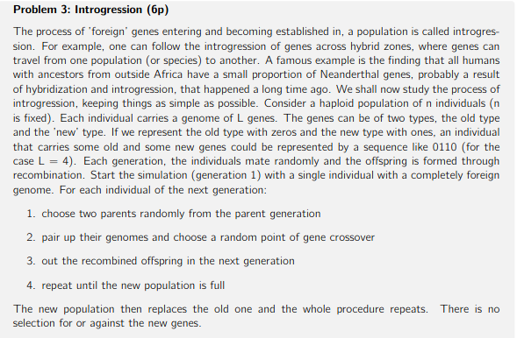
3a) General Description
To simulate the process if introgression, I described a suitable data structure for representing the population in a computer simulation. This involves using a matrix where each row represents an individual's genome, and each column represents a gene locus. The values within the matrix are either 0 (old type) or 1 (new type). This data structure allows for efficient storage and manipulation of the population data during the simulation.
Notes:
The figures are based on the 2021 financial year. Source: Kuben
Central government allocation – funding from the state.
Government grant providers – granted in competition, i.e. Vinnova, Vetenskapsrådet, Formas, etc.
Other Swedish grant providers – non governmental, i.e. Knut och Alice Wallenberg, Stiftelsen för strategisk forskning, Crafoord etc.
Foreign grant providers – granted in competition, i.e European Research Council etc.
Fees, remuneration and assignments – can be different things, for instance conferences, teaching at other universities, research done for other organizations an companies etc.

Slide 6
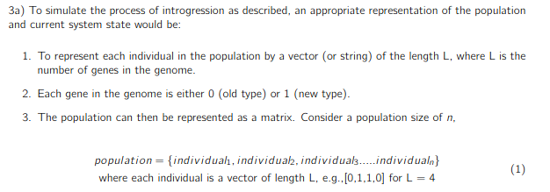
3a) Specific Description
Specifically, to answer the first question, I represent the population using a matrix. Each row of the matrix corresponds to the genome of an individual in the population.
Since each gene can be of two types (old or new), I represent the genes as binary values: 0 for the old type and 1 for the new type.
Therefore, each row in the matrix consists of a sequence of 0s and 1s, representing the genotype of an individual. For example, if an individual has a genome of length L = 4 and carries the genotype 0110, its corresponding row in the matrix would be [0 1 1 0].
This matrix-based representation provides a concise and efficient way to store and manipulate the genetic information of the entire population within the simulation.
Notes:
The number of students is including the paying and exchange students, but not commissioned education.
Pre-university course: 1 year
Bachelor’s program: 3 years
Master’s program: 1 or 2 years
Hospital physics program: 5 years
Postgraduate studies: 4 years

Slide 7
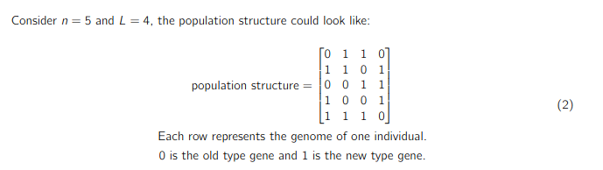
Results
To simulate the process of introgression, a matrix of genomes was created where each row corresponds to an individual's genome. Each genome is represented as a vector of 0s (old type) and 1s (new type). See the example given below. The key elements of the system state include population size (n), genome length (L), current generation and the population matrix.
Notes:
Technically it’s one Bachelor’s programme, with 12 specialisations.

Slide 8
Specific Question
If you would write a program to simulate this process, what would be an appropriate representation of the population, describing the current ‘system state’? (1p)
Write a function in R that takes two parent genomes as input and returns a single recombined offspring genome, following the procedure of recombination described above. (2p)
Write a script in R that uses the above function and simulates the population for 100 generations. For your own convenience, write it such that you can easily change the population size n and the genome size L. (2p)
Revise the script to calculate the proportion of new genes in the population for each generation. Plot the result as a proportion over time (example figure below). You may notice that quite often there is no introgression, i.e. the new type disappears from the population. Use L = 100 and n = 100. (1p)
Extra (no points!): After a long time, say 1000 generations, most new genes (out of the original L) have either gone extinct or come to fixation. The population now has a mixed genome of old and new genes (like non-African humans). Add a few lines to your script to also plot the frequency of new genes at each locus of the final population. You may find short sequences of introgressed genes spread out over the genome, but usually they occur together, side-by-side. Can you think of why? (0p)

Slide 9
3b) General Description
To write an R script that would simulate the process of recombination I created an R function that takes two parent genomes as input. Then the function randomly selects a crossover point within the genome length. Finally, an offspring genome is created by combining the first part of the first parent's genome with the second part of the second parent's genome at the selected crossover point.
3b) Specific Description
Parent genomes are represented as vectors of binary values (0s and 1s), symbolizing genes or alleles (different forms of the same gene at the same locus).
Function (recombination_func)
Check for Parent Genome Length:
Verify that both parent genomes have the same length
If lengths differ, raise an error or return an appropriate message.
Determine Genome Length:
Get the length of one of the parent genomes (both have the same length).
Generate Crossover Point:
Randomly select an integer between 1 and (genome_length - 1) as the crossover point.
Recombine Genomes:
Create the offspring genome by:
Taking the first part of the first parent's genome up to the crossover point.
Append the remaining part of the second parent's genome starting from the crossover point.
Return Offspring:
Return the newly created offspring genome
A random seed (set.seed(42)) is used to ensure that the random crossover point is the same every time the script is run, making the results reproducible.
Notes:
The figures are based on the 2021 financial year. Source: Kuben
Central government allocation – funding from the state.
Government grant providers – granted in competition, i.e. Vinnova, Vetenskapsrådet, Formas, etc.
Other Swedish grant providers – non governmental, i.e. Knut och Alice Wallenberg, Stiftelsen för strategisk forskning, Crafoord etc.
Foreign grant providers – granted in competition, i.e European Research Council etc.
Fees, remuneration and assignments – can be different things, for instance conferences, teaching at other universities, research done for other organizations an companies etc.

Slide 10
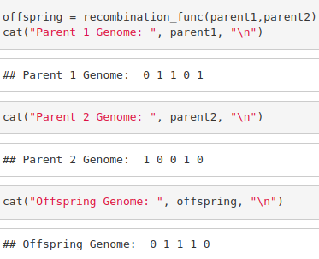
3b) Results
A function created to perform recombination between two parent genomes and produce an offspring.
Notes:
Technically it’s one Bachelor’s programme, with 12 specialisations.

Slide 11
Specific Question
If you would write a program to simulate this process, what would be an appropriate representation of the population, describing the current ‘system state’? (1p)
Write a function in R that takes two parent genomes as input and returns a single recombined offspring genome, following the procedure of recombination described above. (2p)
Write a script in R that uses the above function and simulates the population for 100 generations. For your own convenience, write it such that you can easily change the population size n and the genome size L. (2p)
Revise the script to calculate the proportion of new genes in the population for each generation. Plot the result as a proportion over time (example figure below). You may notice that quite often there is no introgression, i.e. the new type disappears from the population. Use L = 100 and n = 100. (1p)
Extra (no points!): After a long time, say 1000 generations, most new genes (out of the original L) have either gone extinct or come to fixation. The population now has a mixed genome of old and new genes (like non-African humans). Add a few lines to your script to also plot the frequency of new genes at each locus of the final population. You may find short sequences of introgressed genes spread out over the genome, but usually they occur together, side-by-side. Can you think of why? (0p)

Slide 12
3c) General Description
To simulate the process mentioned in (b) for a long time, I started with a population where one individual has all foreign genes (1s) while others have none (0s). Each generation involves randomly selecting pairs of parents who contribute their genes to create offspring through a process called recombination, where genes are mixed at a random point. The simulation runs for 10 generations with a population of 10 individuals, each having 8 genes. The code tracks and displays how these foreign genes spread through the population over time, showing the mixing process at each step.
Notes:
The figures are based on the 2021 financial year. Source: Kuben
Central government allocation – funding from the state.
Government grant providers – granted in competition, i.e. Vinnova, Vetenskapsrådet, Formas, etc.
Other Swedish grant providers – non governmental, i.e. Knut och Alice Wallenberg, Stiftelsen för strategisk forskning, Crafoord etc.
Foreign grant providers – granted in competition, i.e European Research Council etc.
Fees, remuneration and assignments – can be different things, for instance conferences, teaching at other universities, research done for other organizations an companies etc.

Slide 13
3c) Specific Description
Question c:
Initialize Parameters:
Set values for population size (n), genome length (L), and the number of generations (generations).
Initialize Population:
Empty matrix to store the population.
Set the first row of the matrix to represent the initial individual with a completely foreign genome (all 1s).
Create a Function to Simulate a Generation (simulate_generation):
Input: Current population, population size (n), genome length (L), and current generation number.
Output: The next generation population matrix.
Steps:
Create an empty matrix to store the next generation population.
Loop through everyone in the next generation:
Randomly select two parents from the current population.
Use recombination_func (defined in the previous problem) to generate an offspring from the selected parents.
Store the offspring in the next generation matrix.
Return the next generation population matrix.
Run the Simulation:
Loop through the specified number of generations:
Call the simulate_generation function to generate the next population.
Print the population at the end of each generation
Notes:
The number of students is including the paying and exchange students, but not commissioned education.
Pre-university course: 1 year
Bachelor’s program: 3 years
Master’s program: 1 or 2 years
Hospital physics program: 5 years
Postgraduate studies: 4 years

Slide 14
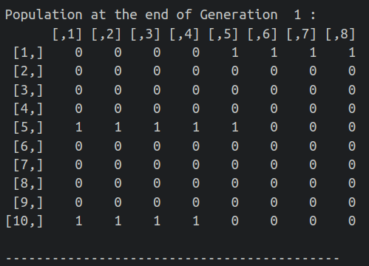
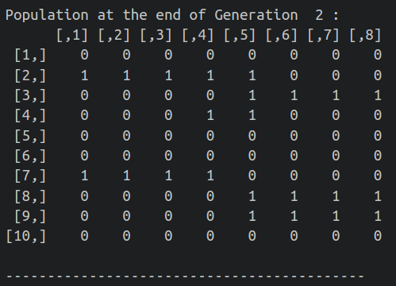
3c) Results
At the end of each generation we get this matrix to see the introduction of new genes in the population.
Notes:
Technically it’s one Bachelor’s programme, with 12 specialisations.

Slide 15
Specific Question
If you would write a program to simulate this process, what would be an appropriate representation of the population, describing the current ‘system state’? (1p)
Write a function in R that takes two parent genomes as input and returns a single recombined offspring genome, following the procedure of recombination described above. (2p)
Write a script in R that uses the above function and simulates the population for 100 generations. For your own convenience, write it such that you can easily change the population size n and the genome size L. (2p)
Revise the script to calculate the proportion of new genes in the population for each generation. Plot the result as a proportion over time (example figure below). You may notice that quite often there is no introgression, i.e. the new type disappears from the population. Use L = 100 and n = 100. (1p)
Extra (no points!): After a long time, say 1000 generations, most new genes (out of the original L) have either gone extinct or come to fixation. The population now has a mixed genome of old and new genes (like non-African humans). Add a few lines to your script to also plot the frequency of new genes at each locus of the final population. You may find short sequences of introgressed genes spread out over the genome, but usually they occur together, side-by-side. Can you think of why? (0p)

Slide 16
3d) General Description
In this part, I simulated genetic mixing in a larger population (100 individuals, each with 100 genes), starting with one individual having all foreign genes. Each generation, I calculated and tracked what proportion of all genes in the population were foreign genes (1s). I ran the simulation for 100 generations, with parents randomly selected and their genes mixed through recombination to create offspring. Finally, I created a line plot showing how the proportion of foreign genes changes over time, which helped me visualize whether these new genes persist in the population or disappear.
Notes:
The figures are based on the 2021 financial year. Source: Kuben
Central government allocation – funding from the state.
Government grant providers – granted in competition, i.e. Vinnova, Vetenskapsrådet, Formas, etc.
Other Swedish grant providers – non governmental, i.e. Knut och Alice Wallenberg, Stiftelsen för strategisk forskning, Crafoord etc.
Foreign grant providers – granted in competition, i.e European Research Council etc.
Fees, remuneration and assignments – can be different things, for instance conferences, teaching at other universities, research done for other organizations an companies etc.

Slide 17
3d) Specific Description
Genome Representation:
Each individual's genome is represented as a sequence of 0s and 1s, where 0 represents the old gene type and 1 represents the new gene type.
This binary representation simplifies calculations and allows for easy tracking of gene frequencies.
The genome length determines the number of genes in each individual.
Population Representation:
The population is represented as a matrix, where each row corresponds to an individual and each column corresponds to a gene locus. This matrix structure allows for efficient storage and manipulation of the population data. The values in the matrix are either 0 or 1, representing the gene type at each locus for each individual.
Recombination:
A recombination function simulates the process of genetic crossover, where genetic material is exchanged between two parent organisms during reproduction. This function randomly selects a crossover point within the genome and creates an offspring by combining the segments of the parent genomes before and after the crossover point. This process introduces genetic variation into the population.
Simulation Parameters:
Population size (constant), Genome length and Number of generations
Initialization: Population starts with all "old" genes except for one individual with all "new" genes.
Generation Simulation: Parents randomly selected (with replacement) and offspring created via recombination.
Tracking Gene Spread: Proportion of the new gene calculated each generation (total 1s / total genes).
Visualization: Line graph showing the proportion of the new gene across generations.
Notes:
The number of students is including the paying and exchange students, but not commissioned education.
Pre-university course: 1 year
Bachelor’s program: 3 years
Master’s program: 1 or 2 years
Hospital physics program: 5 years
Postgraduate studies: 4 years

Slide 18
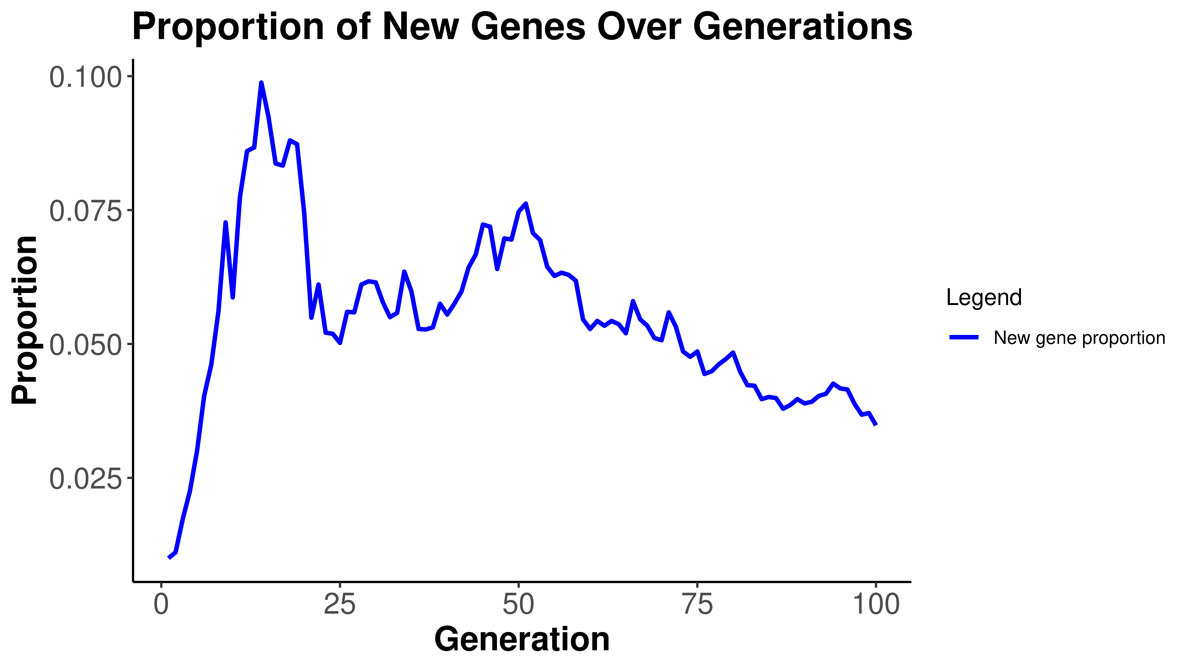
Results
The plot shows the proportion of new genes in the population over 100 generations. Initially, the proportion of new genes increases. This is expected because we started with a single individual carrying the entirely new genome. Through recombination, these new genes are introduced into the population. However, we observe that the proportion of new genes subsequently decreases over time. This decrease can be attributed to several factors:
Random genetic drift: Small population size increases the impact of random fluctuations in allele frequencies, leading to the loss of new genes.
Recombination: Recombination can break up potentially advantageous gene combinations.
Lack of selection: Without selective advantage, new genes are more likely to be lost due to random chance.
Notes:
Technically it’s one Bachelor’s programme, with 12 specialisations.

Slide 19
Specific Question
If you would write a program to simulate this process, what would be an appropriate representation of the population, describing the current ‘system state’? (1p)
Write a function in R that takes two parent genomes as input and returns a single recombined offspring genome, following the procedure of recombination described above. (2p)
Write a script in R that uses the above function and simulates the population for 100 generations. For your own convenience, write it such that you can easily change the population size n and the genome size L. (2p)
Revise the script to calculate the proportion of new genes in the population for each generation. Plot the result as a proportion over time (example figure below). You may notice that quite often there is no introgression, i.e. the new type disappears from the population. Use L = 100 and n = 100. (1p)
Extra (no points!): After a long time, say 1000 generations, most new genes (out of the original L) have either gone extinct or come to fixation. The population now has a mixed genome of old and new genes (like non-African humans). Add a few lines to your script to also plot the frequency of new genes at each locus of the final population. You may find short sequences of introgressed genes spread out over the genome, but usually they occur together, side-by-side. Can you think of why? (0p)

Slide 20
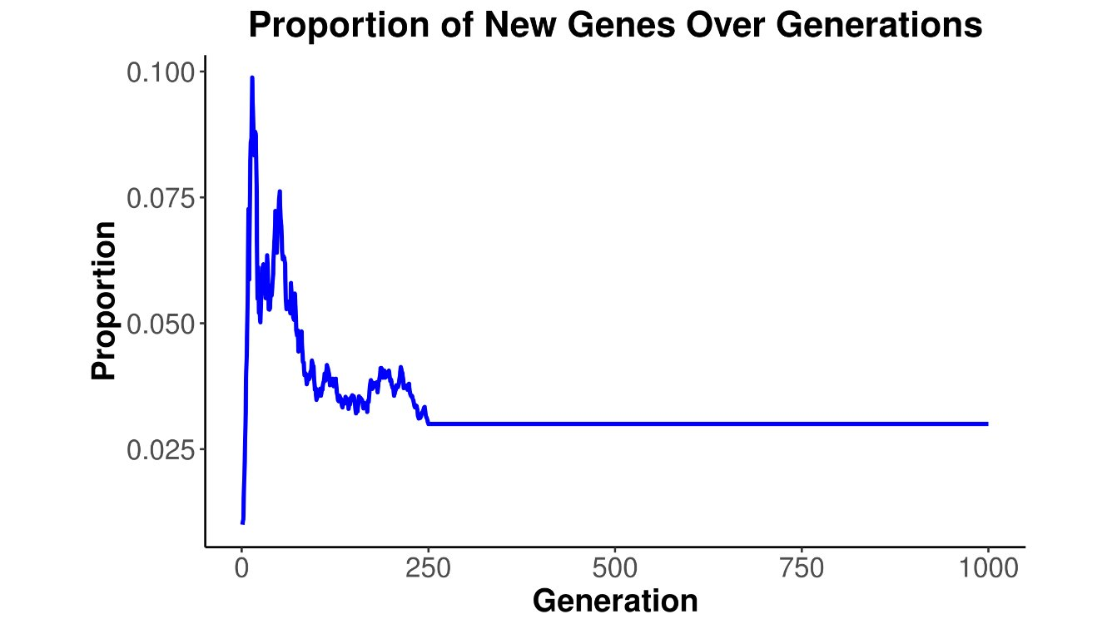
3e) Analysis (Extra)
Initial Population Dynamics
Sharp decrease in new gene proportion
Driven by genetic drift and selection pressure
Most new genes lost in early generations
Stochastic effects dominate early phase
Stabilization Process
Equilibrium reached after initial drop
Surviving genes show selective advantages
Population stabilizes at low proportion
Balance between fixation and extinction
Key surviving genes linked to fitness benefit
Notes:
There are specialisations within the programmes.
Master’s programmes = 2 years (with one exception: Environment and Health Science (1 year only))

Slide 21
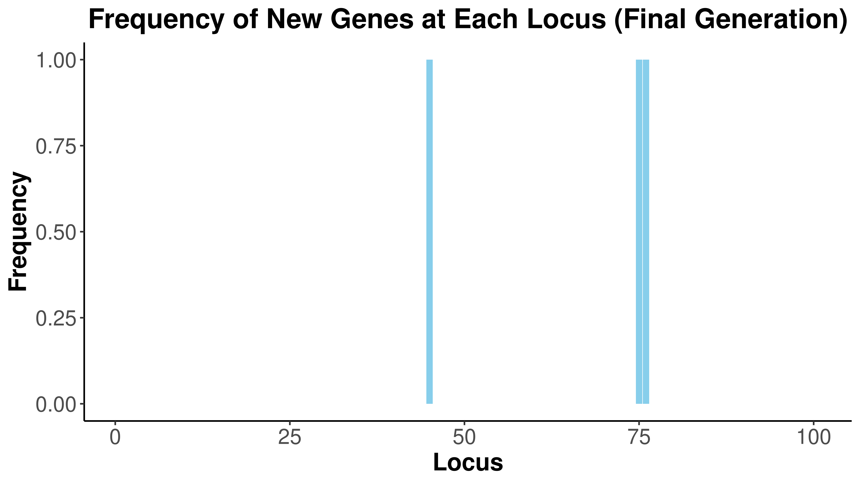
3e) Analysis (Extra)
Frequency Distribution
Binary pattern emerges (0 or 1 frequencies)
~75 contiguous loci show fixation
Few intermediate frequencies observed
Demonstrates complete selection outcomes
Pattern Formation Mechanics
Linkage disequilibrium drives clustering
Genetic hitchhiking of neutral genes
Recombination breaks long sequences
Short introgressed sequences spread genome-wide
Physical proximity influences inheritance patterns
Key Implications
Natural selection efficiency demonstrated
Adaptive advantage of clustered genes
Role of physical linkage in evolution
Impact of recombination on gene distribution
Notes:
There are specialisations within the programmes.
Master’s programmes = 2 years (with one exception: Environment and Health Science (1 year only))

Slide 22
Interpretation
The simulation demonstrates the influence of random genetic drift and recombination on the fate of introduced genes in a neutral scenario (no selection).
The results highlight the importance of considering these factors when studying real-world introgression events.
Notes:
There are specialisations within the programmes.
Master’s programmes = 2 years (with one exception: Environment and Health Science (1 year only))

Slide 23
Thank you !

