Slide 1
SC_CPROJECT · FUZZY LOGIC SYSTEMS
Fuzzy Inference System for Real-Time
Water Potability Classification
From Low-Cost Multi-Sensor Data — a Mamdani FIS that classifies drinking-water
safety in real time using four low-cost IoT sensors, no lab equipment required.
Presented by: SC_CProject Team
WHO Guidelines 2022 · BIS IS 10500:2012

Slide 2
INTRODUCTION
Problem Statement & Motivation
▸ Conventional water testing is slow & costly
  – Lab analysis requires trained personnel, days of turnaround, and is geographically limited.
▸ Hard-threshold classifiers create a “cliff-edge” effect
  – A tiny change in a sensor reading can flip the decision abruptly at a boundary — unrealistic for real water.
▸ Black-box ML models are not auditable
  – Neural networks give no traceable reasoning — unacceptable for safety-critical drinking-water decisions.
▸ Need: real-time, low-cost, interpretable classification
4
Low-cost IoT
sensors
45
WHO/BIS grounded
fuzzy rules
<₹8,000
Total hardware
cost
Fuzzy Inference System · Water Potability Classification
2/16

Slide 3
INTRODUCTION
Why Fuzzy Logic?
Approach | Weakness / Strength
Hard-threshold classifier | Cliff-edge effect at boundaries — tiny change causes drastic class jump
Neural network (black box) | High accuracy but not interpretable — cannot be audited for safety-critical use
Mamdani FIS (this project) | Graded membership, human-readable rules, WHO/BIS grounded, real-time capable
Design Philosophy
▸ Every decision must be traceable to a specific rule grounded in a WHO/BIS standard.
▸ Outputs should be continuous (0–10 WPI) rather than a binary safe/unsafe label.
▸ The system must run on low-cost edge hardware in real time — no cloud inference needed.
Fuzzy Inference System · Water Potability Classification
3/16

Slide 4
INTRODUCTION
Project Objectives
▸ Design a Mamdani Fuzzy Inference System for water potability using pH, Turbidity, TDS & Dissolved Oxygen
▸ Ground every membership function and rule in WHO (2022) / BIS IS 10500:2012 standards
▸ Apply temperature-compensated preprocessing to correct sensor drift (pH, DO)
▸ Build a real-time web dashboard for live visualization of readings, membership, and rule activation
▸ Validate the FIS against ML classifiers (Random Forest, KNN, SVM) on synthetic & real-world datasets
▸ Demonstrate deployability on a ₹5,350 sensor stack + ESP32 microcontroller
Fuzzy Inference System · Water Potability Classification
4/16

Slide 5
DESIGN
System Architecture
Sensor → Preprocessing → Mamdani FIS → Real-Time Dashboard
SENSOR LAYER
pH · Turbidity · TDS · DO · Temperature
(compensator)
PREPROCESSING
Temp. compensation → Z-score outlier
rejection → Moving avg (N=10) → Clamp
MAMDANI FIS ENGINE
Fuzzification → 45-Rule Evaluation →
MIN Implication → MAX Aggregation → Centroid Defuzz.
REAL-TIME DASHBOARD
Flask + Socket.IO — Arc gauge, sensor
cards, membership & rule visualisation
Fuzzy Inference System · Water Potability Classification
5/16

Slide 6
DESIGN
Sensor Selection & Hardware
# | Parameter | Sensor | Cost (INR) | WHO/BIS Limit
1 | pH | DFRobot SEN0161 | ~₹1,200 | 6.5 – 8.5
2 | Turbidity | DFRobot SEN0189 | ~₹800 | <1 NTU (WHO), <5 NTU (BIS)
3 | TDS | DFRobot SEN0244 | ~₹700 | <500 mg/L (BIS desirable)
4 | Dissolved Oxygen | DFRobot SEN0237 | ~₹2,500 | >6 mg/L (health benchmark)
5 | Temperature | DS18B20 (compensator) | ~₹150 | Calibration use only
Total cost: ~₹5,350
Microcontroller & Compensation
▸ ESP32 (Wi-Fi, 12-bit ADC, 240 MHz dual-core) streams JSON packets at 115,200 baud
▸ pH: ΔpH = 0.003 × (T − 25°C) | DO: corrected via Benson & Krause saturation model
Fuzzy Inference System · Water Potability Classification
6/16

Slide 7
FIS DESIGN
Fuzzy Inference System Design
Mamdani-type FIS
IMPLICATION
AGGREGATION
DEFUZZIFICATION
MIN
MAX
Centroid of Area
Variable | Range | Linguistic Terms
pH (input) | 0 – 14 | Acidic · Slightly Acidic · Neutral · Slightly Alkaline · Alkaline
Turbidity (input) | 0 – 100 NTU | Clear · Slightly Turbid · Turbid · Very Turbid
TDS (input) | 0 – 1500 mg/L | Pure · Acceptable · High · Very High
DO (input) | 0 – 20 mg/L | Very Low · Low · Acceptable · High
WPI (output) | 0 – 10 | Non-Potable · Marginal · Potable
Fuzzy Inference System · Water Potability Classification
7/16

Slide 8
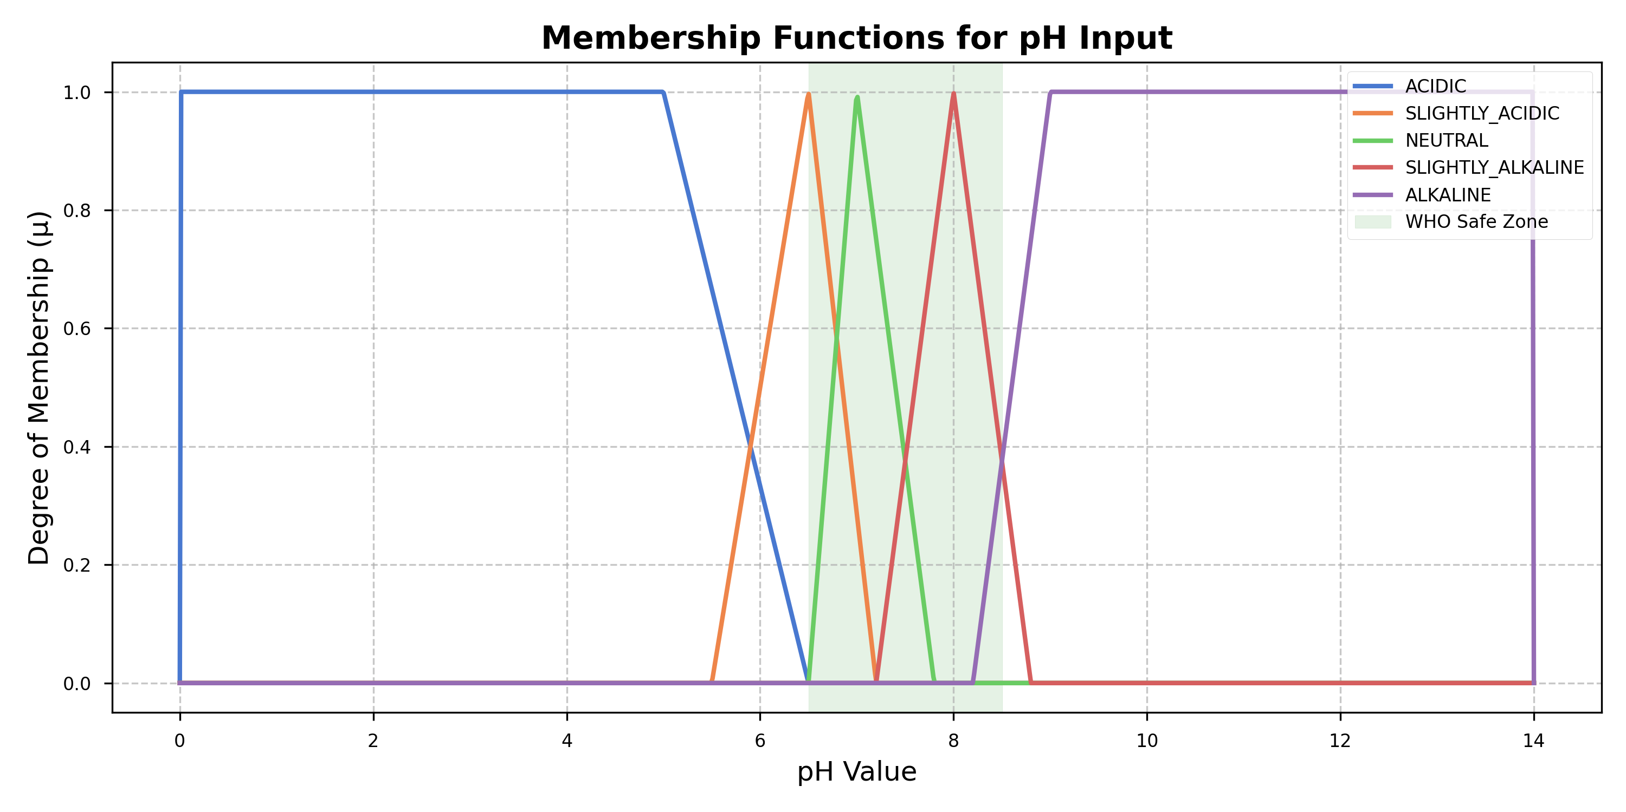
FIS DESIGN
Fuzzy Sets: pH Membership Functions
pH universe of discourse [0,14] with 5 overlapping fuzzy sets; green band = WHO safe zone (6.5–8.5)
Fuzzy Inference System · Water Potability Classification
8/16

Slide 9
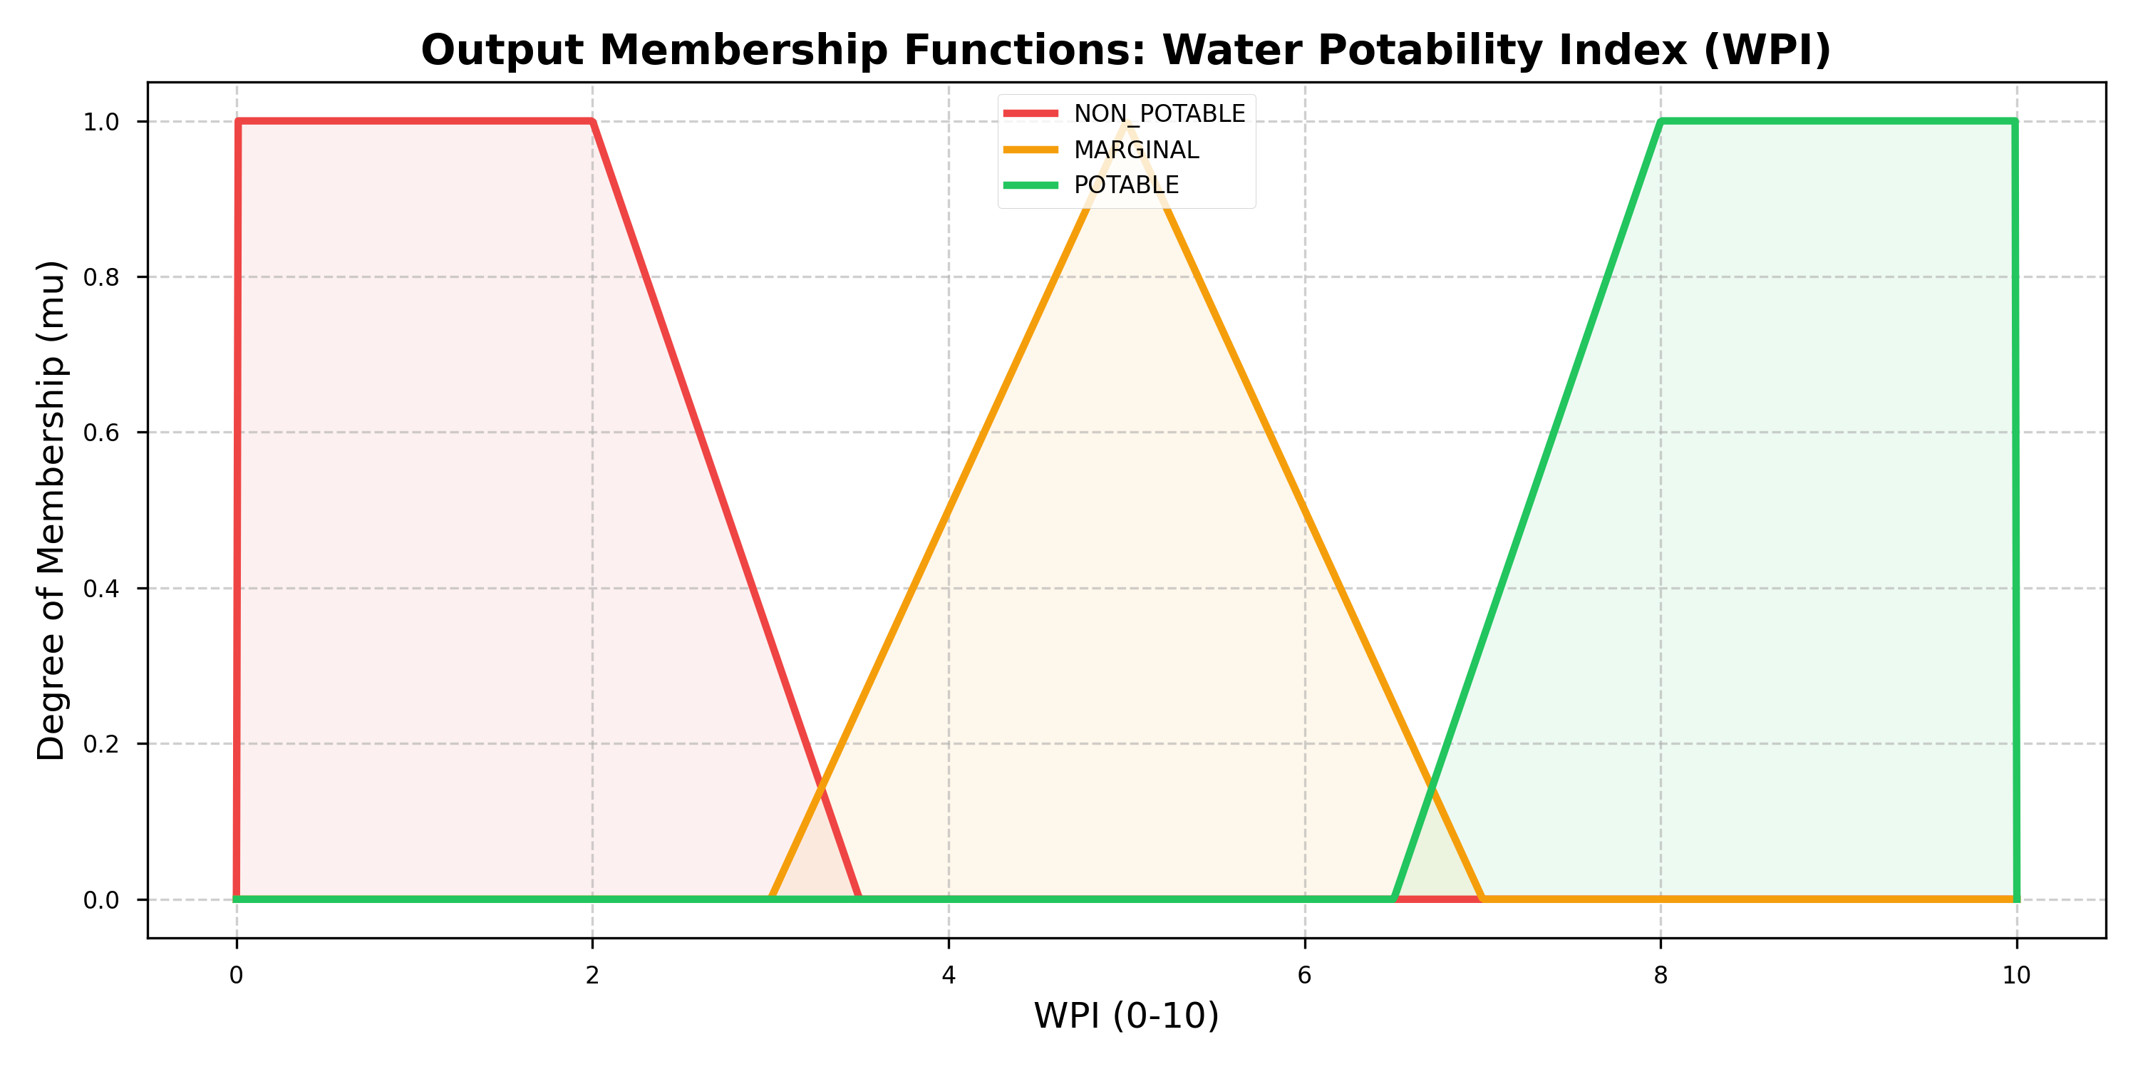
FIS DESIGN
Output Variable: Water Potability Index (WPI)
Three overlapping output sets on [0,10]: Non-Potable, Marginal, Potable
Fuzzy Inference System · Water Potability Classification
9/16

Slide 10
FIS DESIGN
Rule Base — 45 WHO/BIS-Grounded Rules
Rule Group | # Rules | Consequent
Fully potable (all parameters safe) | 8 | POTABLE
Hard non-potability triggers (single-param failure) | 5 | NON-POTABLE
Dual-parameter failures | 4 | NON-POTABLE
Single-parameter boundary violation | 13 | MARGINAL
Turbid + mixed parameters | 4 | MARGINAL / NON-POTABLE
Extreme scenarios | 3 | NON-POTABLE
Multi-parameter boundary cases | 8 | MARGINAL
Sample Rules
R1: IF pH=NEUTRAL AND Turbidity=CLEAR AND TDS=ACCEPTABLE AND DO=HIGH → WPI=POTABLE [w=1.0]
R9: IF pH=ACIDIC → WPI=NON_POTABLE [w=1.0] (critical trigger)
R18: IF pH=NEUTRAL AND Turbidity=SLIGHTLY_TURBID AND TDS=ACCEPTABLE AND DO=ACCEPTABLE → WPI=MARGINAL [w=0.80]
Fuzzy Inference System · Water Potability Classification
10/16

Slide 11
FIS DESIGN
Inference Pipeline & Defuzzification
▸ Stage 1 — Fuzzification
  – Compute μ(x) for every linguistic term of each crisp input.
▸ Stage 2 — Rule Evaluation
  – Strength = MIN(antecedent μ values) × rule weight, across 45 rules.
▸ Stage 3 — Implication + Aggregation
  – Clip each output MF at its rule strength (MIN); combine all via MAX.
▸ Stage 4 — Defuzzification
  – Centroid of Area yields a single crisp WPI ∈ [0, 10].
Centroid of Area
WPI = ∫ μ_agg(y)·y dy / ∫ μ_agg(y) dy
1000-point discretization for numerical integration
Fuzzy Inference System · Water Potability Classification
11/16

Slide 12
IMPLEMENTATION
Real-Time Web Dashboard
Flask + Socket.IO · http://127.0.0.1:5050
▸ WPI Arc Gauge — animated 0–10 scale with colour zones
▸ Sensor Cards — live pH / Turbidity / TDS / DO with status bars
▸ WPI Trend Chart — 60-second rolling time series
▸ Membership Visualisation — live μ(x) per linguistic term
▸ Active Rules Panel — which of the 45 rules are firing, and how strongly
▸ Manual Inference — slider-driven one-shot exploration of the FIS
▸ Scenario Selector — Normal, Ideal, Acidic, Turbid, Hard Water, Contaminated
Fuzzy Inference System · Water Potability Classification
12/16

Slide 13
RESULTS
Validation Methodology
▸ 5,000 synthetic samples labeled by a WHO/BIS hard-threshold oracle (config-defined class balance)
▸ Additionally cross-checked on a real-world Kaggle water-potability dataset
▸ Benchmarked against Random Forest, KNN (k=7), and SVM (RBF) classifiers
▸ Metrics: Accuracy, Macro F1-score, per-class precision/recall, confusion matrix
python main.py validate
Boundary-Region Advantage
▸ In the MARGINAL zone (WPI 3.5–6.5), hard thresholds produce abrupt, unrealistic jumps — the FIS's graded membership gives smooth, gradual transitions instead.
Fuzzy Inference System · Water Potability Classification
13/16

Slide 14
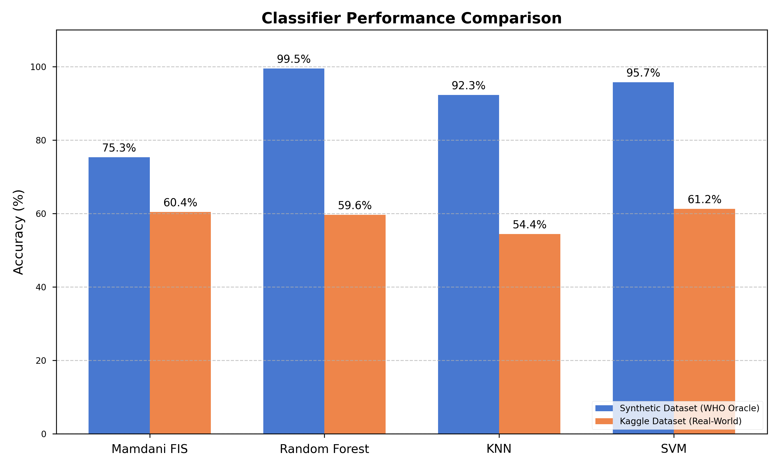
RESULTS
Benchmark Results
Synthetic (WHO oracle) vs. Kaggle real-world dataset
Fuzzy Inference System · Water Potability Classification
14/16

Slide 15
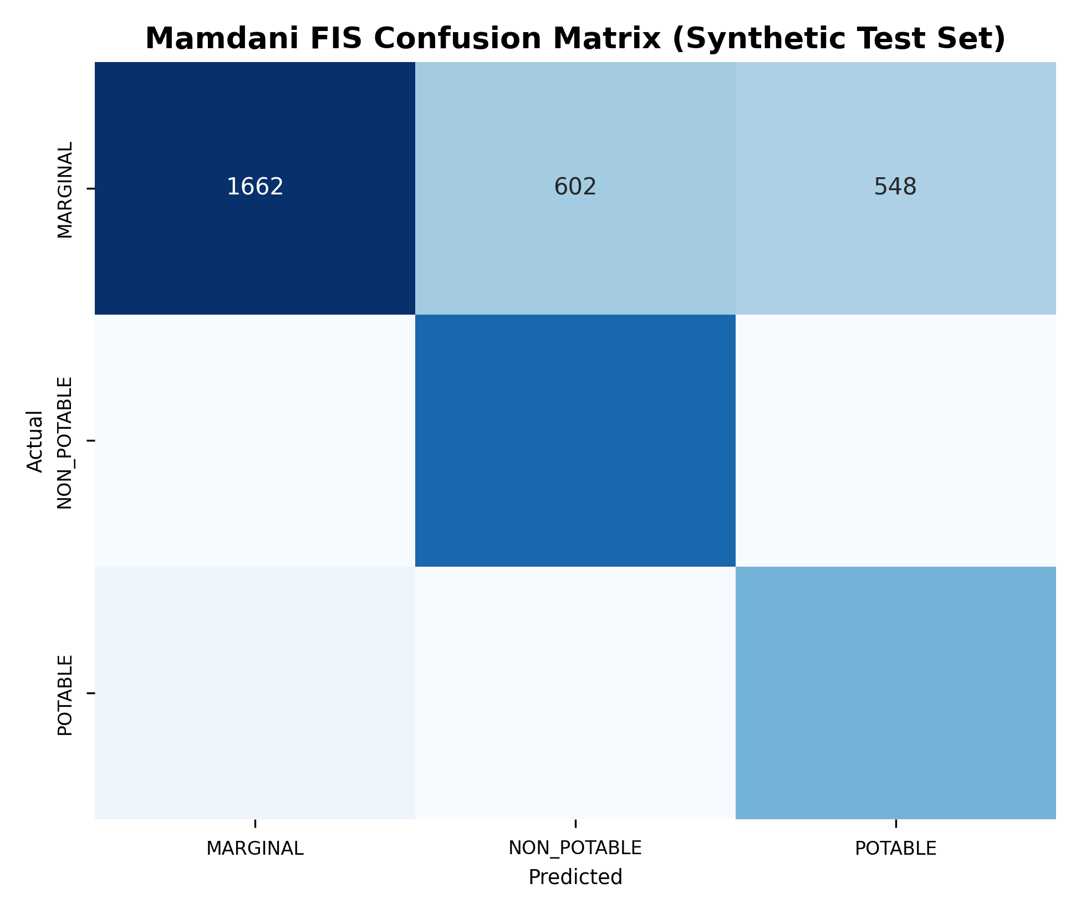
RESULTS
Interpretability vs. Accuracy Trade-off
Method | Accuracy | F1-Macro | Interpretable
Mamdani FIS (proposed) | 75.3% | 75.3% | Yes
Random Forest | 99.5% | 99.5% | No
KNN (k=7) | 92.3% | 91.0% | No
SVM (RBF) | 95.7% | 95.0% | No
The FIS trades accuracy for full interpretability: every decision traces back to specific WHO/BIS-grounded rules. For safety-critical and community-use deployments, this transparency outweighs the raw-accuracy gap versus black-box models.
Fuzzy Inference System · Water Potability Classification
15/16

Slide 16
Conclusion & Future Scope
▸ A Mamdani FIS on 4 low-cost sensors delivers real-time, interpretable water potability classification
▸ Every decision is traceable to WHO/BIS-grounded rules — critical for safety and regulatory trust
▸ Deployable end-to-end on a ~₹5,350 sensor stack + ESP32, with a live web dashboard
Future Scope
▸ Adaptive/learned membership functions via hybrid ANFIS tuning
▸ Field deployment & calibration across multiple real water sources
▸ Edge-native inference directly on ESP32 (no PC bridge required)
Thank you · Standards: WHO Guidelines 2022, BIS IS 10500:2012

