Slide 1

WALCHAND INSTITUTION OF TECHNOLOGY,
Solapur
Department of Electronics and Tele-Commuincation Engineering
Project Presentation on
IoT Based Safety, Monitoring
and
Alerting System for Mines.
By
Roll No. Name
19 Pranav Sonar
20 Pooja Thakur
21 Chandrashekar Yemul
Under Guidance of
Mr. K.R Biradar

Slide 2
CONTENTS
1
7
OVERVIEW
DIAGRAM
PROBLEM STATEMENT
2
8
INTRODUCTION
PROS & CONS
3
9
CONCLUSION
OBJECTIVES OF PROJECT
4
SCOPE OF PROJECTS
5
DESCRIPTION AND WORKING
6
SYSTEM REQUIREMENT

Slide 3
PROBLEM STATEMENT
In the mining industry, safety and security is a fundamental aspect of everything. To avoid any types of accidents, the mining industry follows some basic precautions. Accidents such as rise in temperature, and methane gas leakage.

Slide 4
INTRODUCTION
Mines are the world’s most dangerous place to work because of explosion such mishaps happen as a direct result of the old equipment and wired devices, mishandling, spillage of the noxious gases in the coal mines, pose tremendous hazards to the excavators inside the coal mines. In the project, we have tackled the issues by checking the information gathered by the sensors. Where information is utilized and the observed with the help of open source IoT platform. Control is possible by both automatically and manually.

Slide 5
OBJECTIVES OF PROJECT
Safety is an important aspect of any industry. Safety and security are extremely important in the mining business. We want to create a wearable device that will be used for the safety of workers. The sensors monitor the data and send it to the control unit where it will be analyzed. If a worker is in danger, they can use the SOS button (i.e. buzzer) to alert control unit.

Slide 6
SCOPE OF PROJECT
With the development of this model, future work of this experimentation may incorporate, greater improvement of the framework by utilizing other progressed sensors for checking the underground dangers. Likewise, every one of the underground tasks can be monitored from the beginning. New creating correspondence advancements can be utilized for fast information move in a mix with keen sensors for detecting the mine conditions. Additionally, more IOT-empowered frameworks can be created for further developed uses.

Slide 7
DESCRIPTION & WORKING
An IoT-based coal mine monitoring and alerting system using Arduino can be a useful tool for improving the safety and efficiency of mining operations. Such a system can be designed to monitor various parameters, such as temperature, humidity, gas levels and then send alerts if any of these parameters exceed pre-set thresholds.

Slide 8
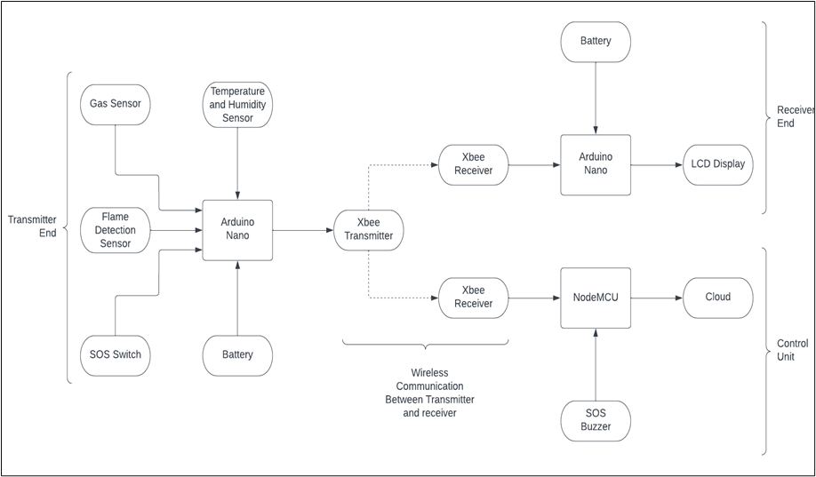
BLOCK DIAGRAM

Slide 9

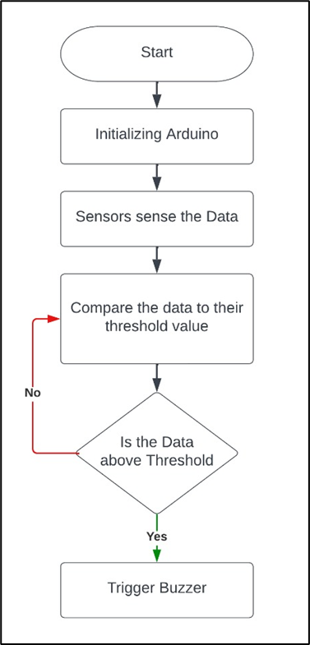
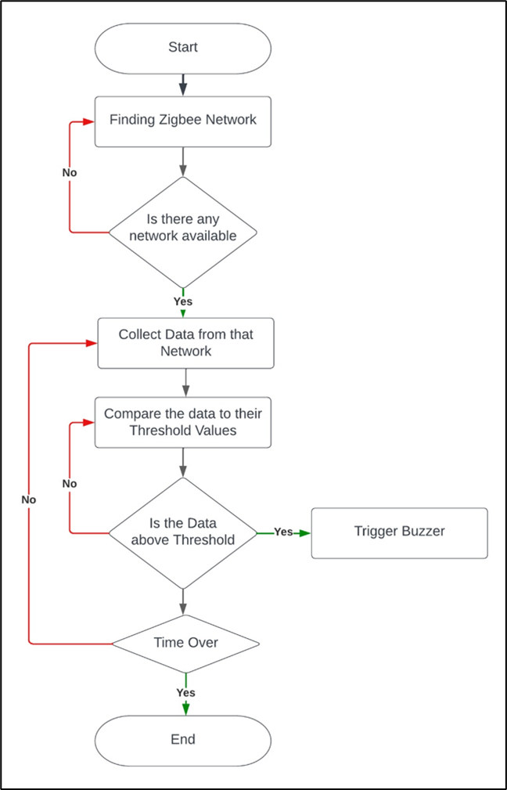
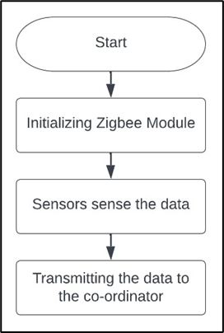
Flow Diagram:
Monitoring system for Sensor unit
Transmission End
Alerting system

Slide 10
Sensors on wearable devices capture temperature, humidity, gas levels, and flame data. Arduino boards enable data collection and transmission via ZigBee to a central hub.
Sensor data transmitted to central hub/gateway connected to network for real-time analysis and monitoring.
The wearable device is configured to send alerts if any of the parameters exceed pre-set thresholds
Piezoelectric buzzer used for quick alerts and prompt action in response to potential hazards, ensuring worker safety.
Data utilized for generating reports, trend analysis, and optimizing mining operations. Helps identify maintenance needs and areas requiring enhanced safety precautions.
IoT-based system enables remote monitoring and management of mine operations, ensuring environment and worker safety. Real-time alerts on hazards enhance accident prevention and improve mining efficiency.

Slide 11
SYSTEM REQUIREMENT
HARDWARE REQUIREMENT:
SOFTWARE REQUIREMENT:
1.Arduino nano
2.ZIGBEE
3.Temperature & Humidity Sensor
4.Gas Sensor(MQ5)
5.Piezoelectric Buzzer
6.Flame sensor
7.Node MCU
8.Zero PCB
1.Open-Source IoT platform:
Blynk

Slide 12
PROS & CONS
PROS
CONS
Crucial for health and safety of coal mine workers.
Remote IoT platform enables global monitoring of critical parameters within the mine.
Cost is low and maintenance is simple, making it an economical and low-maintenance option.
Stable internet connection is necessary for efficient IoT monitoring and alerting, ensuring accurate data transmission and maintaining safety and security.

Slide 13
CONCLUSION
The android-based totally programmed consists of signals and a database in which readings from sensors are presented and inserted the usage of hardware.
Wireless networks enhance mine safety by automating monitoring and delivering updates through cell networks, ensuring both safety and development in mining projects.
Project optimizes mining operations by using sensors to monitor the environment and a microcontroller to automatically activate/deactivate a buzzer in case of unstable conditions. Focus on ensuring employee and property safety without human intervention.
Sensors in coal mine security continually monitor and update mining protection data on IoT platforms to ensure employee safety.

Slide 14
THANK YOU

