Slide 1
PIP4004 - INTERNSHIP Review-1 Presentation SQL SERVER MANAGEMENT AND STANDARDISATION
Student Details
Name | CHANDRASHEKHAR K S
Roll No | 20211CSG0074
Section | 8CSD/CSG03-SEC10B
Batch No. | CSG-G10
Under the Supervision of,
Prof. Radhika Sreedharan
Assistant Professor
School of Computer Science and Engineering
Presidency University
Name of the Program: B-tech
Name of the HoD: Dr.Saira Banu Atham
Name of the Program Project Coordinator: Dr. vijay
Name of the School Internship/Project Coordinators: Mr. Md Ziaur Rahman /
Dr. Sampath A K / Dr. Abdul Khadar A

Slide 2
Content
Title
Abstract
Review Of Literature
Objectives
Problem Identification And Formulation Of Problem Statement
Road map, Impact And Advantages of the proposed work (Time line by Gantt Chart)
References

Slide 3
TITLE :
SQL Server Management and Standardization

Slide 4
Abstract:
The management and standardization of SQL Server environments are critical for ensuring efficient database performance, security, and scalability. This project focuses on developing a comprehensive framework for managing SQL Server instances, optimizing database operations, and standardizing best practices across the organization. The proposed solution will provide automated tools for routine database management tasks, standardized configurations for performance optimization, and a clear roadmap for database governance. The impact of this project includes reduced administrative overhead, improved database performance, and enhanced security compliance.

Slide 5
Review of Literature :
SQL Server management and standardization have been widely studied in the context of database administration. Research highlights the importance of automated tools, standardized practices, and efficient monitoring systems in managing SQL Server environments. Various studies emphasize the need for standardized configurations to prevent performance bottlenecks and ensure data integrity. Best practices in SQL Server management include regular backups, indexing strategies, and performance tuning, which form the foundation of this project.

Slide 6
Objectives :
To develop a framework for efficient SQL Server management.
To standardize database configurations and practices.
To automate routine database maintenance tasks.
To improve database performance and scalability.
To ensure security compliance through standardized policies.

Slide 7
Problem Identification and Formulation of Problem Statement :
Managing SQL Server environments manually is time-consuming, error-prone, and lacks standardization. The absence of standardized practices leads to inconsistent performance, security vulnerabilities, and increased administrative efforts. This project aims to address these challenges by developing a standardized framework for SQL Server management, ensuring efficient operations, enhanced security, and optimized performance.

Slide 8

Roadmap, Impact, and Advantages of the Proposed Work (Timeline by Gantt Chart):
The project will be executed in multiple phases:
Research and Requirement Gathering (Week 1-2)
Design and Framework Development (Week 3-4)
Implementation of Management Tools (Week 5-6)
Standardization of Configurations (Week 7-10)
Testing and Optimization (Week 11-12)
Documentation and Final Review (Week 12-14)

Slide 9
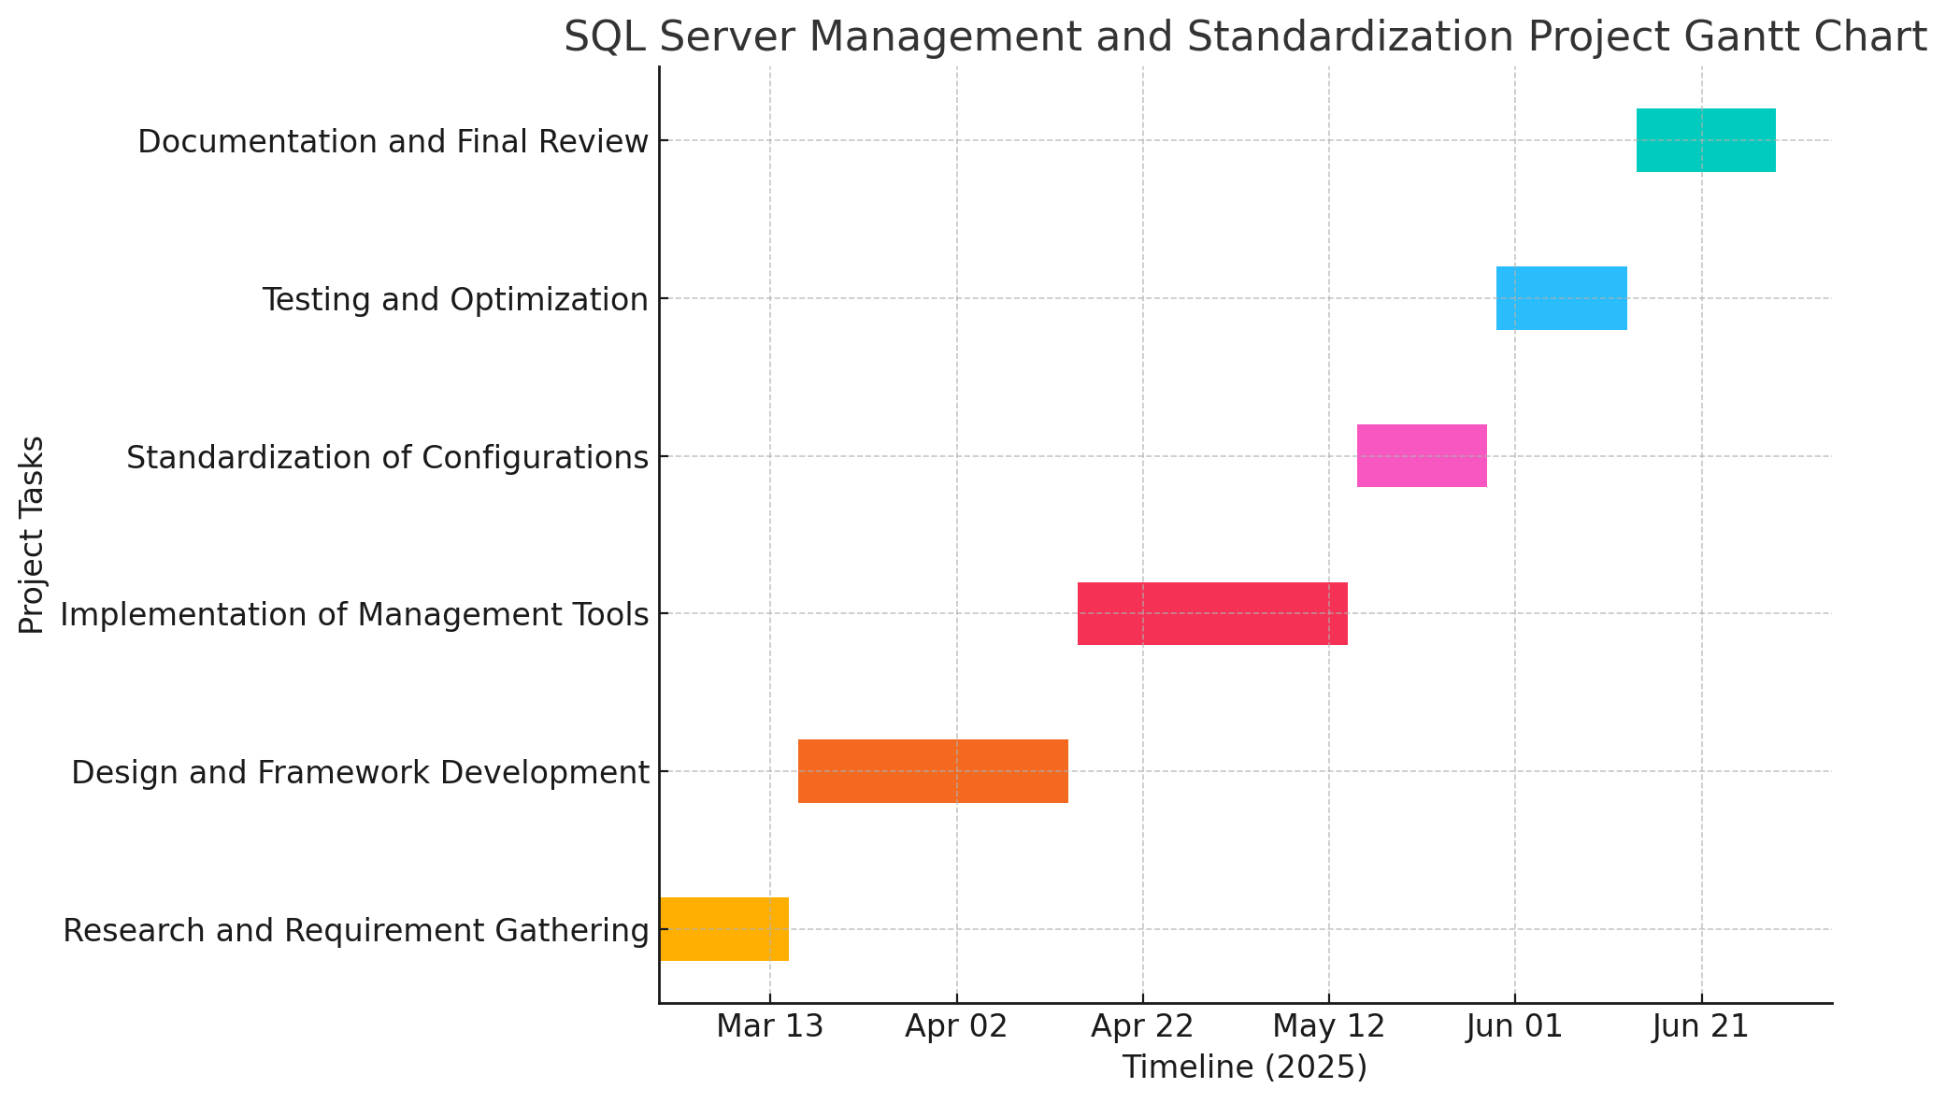
Gantt Chart :

Slide 10
Impact and Advantages:
Automated database management tasks reduce administrative efforts.
Standardized configurations ensure consistent performance
Enhanced security through standardized policies.
Improved scalability and reliability of SQL Server environments.
Comprehensive documentation for future reference and training.

Slide 11
References:
Microsoft SQL Server Documentation.
Best Practices for SQL Server Management by Redgate.
Database Administration: The Complete Guide by Craig S. Mullins.
Research papers on SQL Server standardization and performance tuning.

Slide 12
Q&A

Slide 13
Thank you !!

