Slide 1
INDUSTRY ORIENTED COURSE – CEG, Anna University Guindy
Scalable Enterprise Architectural
Deployments of Agentic AI Solutions
Week 2 · LLMs, Knowledge, Multi-Agent Orchestration, Enterprise Integration & Cloud Deployment
Presenter
Guide
Chandravadhana TK
Senior AI/ML Architect, UHG-Optum.AI
Research Scholar, CEG Anna University Guindy
Dr. K. Saravanan
Department of Information and Communication Engineering
Scalable Enterprise Architectural Deployments of Agentic AI Solutions
1
Notes:
[Sources]
Title and presenter details continued from the attached prior-session deck.
[/Sources]

Slide 2
COURSE OVERVIEW
Module Structure & Duration · This Week
3
LLMs, Tools, Memory & Knowledge Integration
1 Hr
4
Multi-Agent Systems & Orchestration Frameworks
1 Hr
5
Enterprise Integration Architecture
1 Hr
6
Scalability, Deployment & Cloud Architecture
1 Hr
Total Duration: 8 Hours
Scalable Enterprise Architectural Deployments of Agentic AI Solutions
2
Notes:
[Sources]
Module names and durations from the user-provided syllabus.
[/Sources]

Slide 3
Demos
Hands-On
Agent 1
Agent 2
Agent 1: Iterative Writer-Critic Refinement Graph
Agent 2: Hierarchical Multi-Agent Supervisor System
Clinical Agent
Superpowers
Plan-and-Solve / Multi-Step Sequential Reasoning Pattern
AI-DLC
Quiz
Live Interactive Reasoning
Scalable Enterprise Architectural Deployments of Agentic AI Solutions
49
Notes:
[Sources]
Assignment aligns to hands-on activities in Modules 3 through 6.
[/Sources]

Slide 4
MODULE 03
LLMs, Tools, Memory &
Knowledge Integration
1 Hour
Scalable Enterprise Architectural Deployments of Agentic AI Solutions
3
Notes:
[Sources]
Course module and duration from the user-provided syllabus.
[/Sources]

Slide 5
MODULE 03 · TOPICS COVERED
LLMs, Tools, Memory & Knowledge Integration
1
Enterprise LLM Selection Strategy
5
Vector Databases
2
Prompt Engineering for Agents
6
Long-term and Short-term Memory
3
Tool Calling and Function Invocation
7
Knowledge Graph Integration
4
Retrieval Augmented Generation (RAG)
8
Enterprise Knowledge Repositories
4
Scalable Enterprise Architectural Deployments of Agentic AI Solutions
4
Scalable Enterprise Architectural Deployments of Agentic AI Solutions
Notes:
[Sources]
Topics reproduced from the user-provided syllabus.
[/Sources]

Slide 6
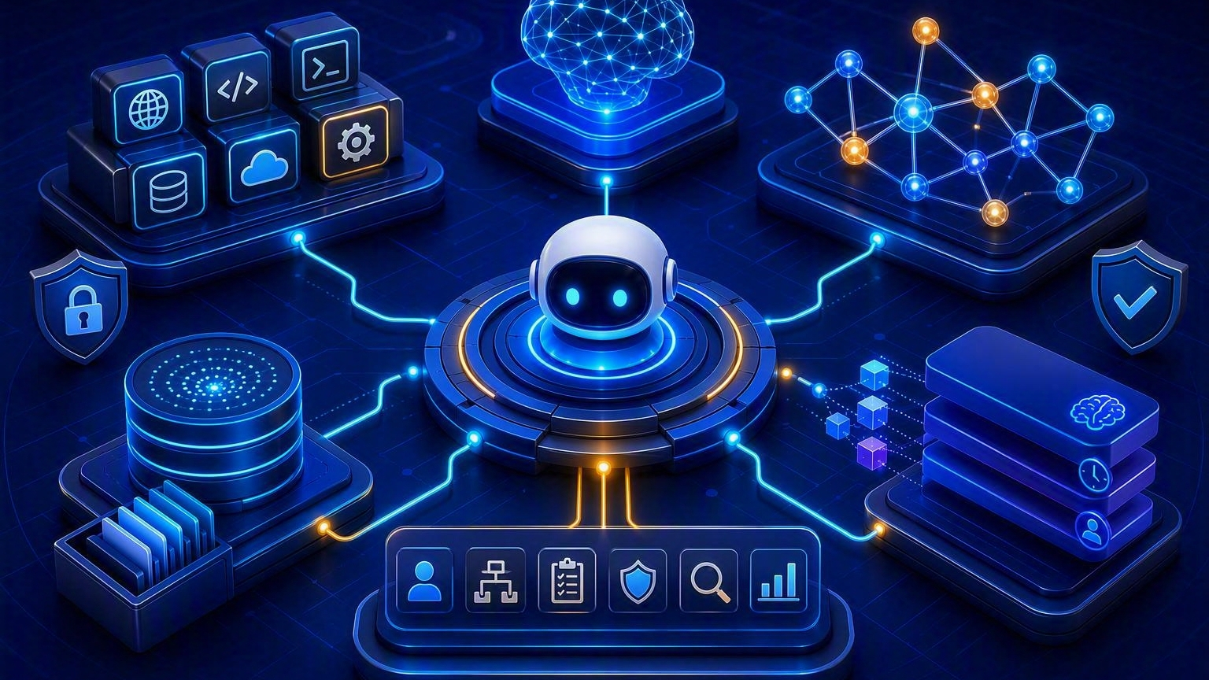
The Agent Intelligence Stack
A production agent combines model reasoning with tools, grounded knowledge and durable context
Architecture rule: isolate model choice from tool contracts, retrieval, memory and policy.
Scalable Enterprise Architectural Deployments of Agentic AI Solutions
5
Notes:
[Sources]
Visual on this slide was generated with Microsoft Copilot.
[/Sources]

Slide 7
Enterprise LLM Selection Strategy
Choose by workload fitness, not benchmark popularity
Task fit
Enterprise constraints
Operational profile
Reasoning depth
Instruction following
Tool-use reliability
Structured output quality
Data residency
Private networking
Identity integration
Provider risk
Latency and throughput
Context window
Rate limits
Regional availability
Economics
Quality evidence
Portability
Input/output token cost
Caching opportunity
Batching
Model routing
Domain eval set
Groundedness
Tool success rate
Safety tests
Provider abstraction
Version pinning
Fallback model
Exit strategy
6
Scalable Enterprise Architectural Deployments of Agentic AI Solutions
6
Notes:
[Sources]
Architecture guidance synthesized for instruction; model selection criteria are presented as a course framework.
[/Sources]

Slide 8
Prompt Engineering for Agents
Design prompts as versioned behavioral contracts
Role & objective
Context policy
Tool policy
State the bounded role, outcome and non-goals.
Define trusted context, untrusted content and precedence.
Specify when to call, when not to call, and required evidence.
Output contract
Control loop
Evaluation
Use schemas, citations, confidence and error fields.
Set iteration budget, stop conditions and escalation rules.
Regression-test prompt versions against representative tasks.
7
Scalable Enterprise Architectural Deployments of Agentic AI Solutions
7
Scalable Enterprise Architectural Deployments of Agentic AI Solutions
Notes:
[Sources]
Instructional design framework created for this course.
[/Sources]

Slide 9
Prompt Engineering for Agents
Design prompts as versioned behavioral contracts
🩺 Sample Operational Prompt — Clinical Agent
Role & Objective You are a clinical decision-support agent.
Goals: Provide structured, evidence-based insights, differential diagnoses, recommended tests, and guideline references.
Non-goals: Do not prescribe medications, replace physician judgment, or handle emergency triage.
Context Policy
Trusted: WHO, CDC, NICE, ICMR guidelines; peer-reviewed studies; verified patient records.
Untrusted: Anecdotal sources, unverified self-reports, non-medical forums.
Precedence: Guidelines > peer-reviewed studies > observational data > patient reports.
Tool Policy
Call tools: For guideline lookups, drug interactions, structured patient data.
Avoid tools: For speculative treatments or incomplete data.
Evidence: Always cite authoritative sources.
Output Contract
Format: JSON schema with patient_info, symptoms, possible_conditions, recommended_tests, treatment_guidelines, error_fields.
Confidence: Provide scores (0–1).
Citations: Mandatory for all medical claims.
Errors: Explicitly flag missing or contradictory data.
Control Loop
Iterations: Max 3 refinement cycles.
Stop: Confidence > 0.9 or guideline found.
Escalate: Confidence < 0.6 or conflicting evidence → clinician review.
Evaluation
Regression-test against representative tasks (e.g., diabetes, oncology, antibiotic stewardship).
Metrics: Guideline adherence, citation correctness, clarity.
Update: Quarterly with new guideline releases.
Instruction to Agent On receiving patient data, generate structured JSON output with:
Symptoms & possible conditions (with confidence scores).
Recommended diagnostic tests (with guideline references).
Treatment guidelines (with citations).
Error fields for missing/contradictory data. Always defer final judgment to the clinician.
8
Scalable Enterprise Architectural Deployments of Agentic AI Solutions
8
Scalable Enterprise Architectural Deployments of Agentic AI Solutions
Notes:
[Sources]
Microsoft Learn describes tool calling and OpenAPI-based APIs as agent architecture components: https://learn.microsoft.com/en-us/agents/architecture/components-of-agent-architecture
[/Sources]

Slide 10
Tool Calling & Function Invocation
Treat every tool as a typed, authorized and observable enterprise contract
User Goal
Planner
Tool Schema
Policy Gate
Executor
Observation
Natural-language intent
Selects next action
Validates arguments
Authorizes scope
Calls API / function
Returns typed result
User
Agent Decides
Tool Schema
Policy Gate checks
Executor
Observation
What is my current account balance?"
I need the account API.
getAccountBalance(accountId)
Is user authenticated?
Is user allowed?
Is account accessible?
Then API executes
Feedback loop
8
Scalable Enterprise Architectural Deployments of Agentic AI Solutions
8
Scalable Enterprise Architectural Deployments of Agentic AI Solutions
Notes:
[Sources]
Microsoft Learn describes tool calling and OpenAPI-based APIs as agent architecture components: https://learn.microsoft.com/en-us/agents/architecture/components-of-agent-architecture
[/Sources]

Slide 11
Retrieval Augmented Generation (RAG)
Ground the model in enterprise evidence before generation
Ingest
Chunk
Index
Retrieve
Rerank
Generate
Parse & classify
Structure content
Embed + lexical
Hybrid search
Prioritize evidence
Answer + citations
9
Scalable Enterprise Architectural Deployments of Agentic AI Solutions
9
Scalable Enterprise Architectural Deployments of Agentic AI Solutions
Notes:
[Sources]
The attached syllabus explicitly includes Retrieval Augmented Generation and vector databases in Module 3.
[/Sources]

Slide 12
Vector Databases: Architecture Decisions
The index is part of a retrieval system, not the complete knowledge layer
Index design
Retrieval design
Scale & operations
Embedding model
Dimension
Distance metric
Metadata schema
Dense / sparse / hybrid
Filters
Top-K
Reranking
Sharding
Replication
Freshness
Backup and restore
Governance
Quality
Selection lens
Tenant isolation
Document-level ACLs
Lineage
Right-to-delete
Recall@K
Precision@K
Context relevance
No-answer behavior
Managed vs self-hosted
Latency
Cost
Ecosystem integration
10
Scalable Enterprise Architectural Deployments of Agentic AI Solutions
10
Scalable Enterprise Architectural Deployments of Agentic AI Solutions
Notes:
[Sources]
Instructional architecture decision framework created for this course.
[/Sources]

Slide 13
Short-term vs Long-term Memory
Memory should be explicit, scoped, governed and expirable
Working memory
Conversation memory
Long-term semantic memory
Current task state
Plan and observations
Temporary intermediate values
Recent turns
Summaries
User-visible context
Stable facts and preferences
Retrieved when relevant
Episodic memory
Procedural memory
Controls
Prior cases, outcomes and feedback
Time-stamped and attributable
Reusable workflows, policies and strategies
Consent
TTL and deletion
Tenant isolation
Sensitive-data minimization
11
Scalable Enterprise Architectural Deployments of Agentic AI Solutions
11
Scalable Enterprise Architectural Deployments of Agentic AI Solutions
Notes:
[Sources]
The attached syllabus explicitly distinguishes long-term and short-term memory in Module 3.
[/Sources]

Slide 14
Ask:
"If I ask: Which suppliers are impacted by this regulation because they supply products used by hospitals in region X - would simple semantic search always be enough?"
Knowledge Graph Integration
Combine semantic retrieval with explicit entities and relationships
When graphs help
Graph-RAG flow
Multi-hop questions
Relationship reasoning
Entity resolution
Impact analysis
Entity extraction
Linking
Subgraph retrieval
Evidence synthesis
Enterprise semantics
Controls
Business glossary
Ontology
Canonical identifiers
Data lineage
Provenance
Access-aware traversal
Freshness
Graph quality checks
12
Scalable Enterprise Architectural Deployments of Agentic AI Solutions
12
Scalable Enterprise Architectural Deployments of Agentic AI Solutions
Notes:
[Sources]
The attached syllabus explicitly includes knowledge graph integration in Module 3.
[/Sources]

Slide 15
Enterprise Knowledge Repositories
Federate knowledge without bypassing source-system ownership
Sources
Ingestion
SharePoint and documents
Data lake / warehouse
Wikis and portals
Connectors
CDC and events
Parsing and metadata
Deduplication
Knowledge services
Governance
Search
Vector index
Graph
SQL / analytics
Catalog
Lineage
Classification
Retention
ACL propagation
13
Scalable Enterprise Architectural Deployments of Agentic AI Solutions
13
Scalable Enterprise Architectural Deployments of Agentic AI Solutions
Notes:
[Sources]
The attached syllabus explicitly includes enterprise knowledge repositories in Module 3.
[/Sources]

Slide 16
Hands-on: Agent with Tool Calling and RAG
Lab outcome: a grounded agent that retrieves evidence, calls one tool and returns an auditable result
Define
Prepare
Index
Connect
Orchestrate
Evaluate
Use case + policy
Load documents
Create retrieval
Register tool
Reason + act
Evidence + action
14
Scalable Enterprise Architectural Deployments of Agentic AI Solutions
14
Scalable Enterprise Architectural Deployments of Agentic AI Solutions
Notes:
[Sources]
Hands-on activity reproduced from the user-provided syllabus.
[/Sources]

Slide 17
MODULE 04
Multi-Agent Systems &
Orchestration Frameworks
1 Hour
Supervisor
├── Research Agent
├── Policy Agent
├── Finance Agent
└── Execution Agent
Scalable Enterprise Architectural Deployments of Agentic AI Solutions
15
Notes:
[Sources]
Course module and duration from the user-provided syllabus.
[/Sources]

Slide 18
MODULE 04 · TOPICS COVERED
Multi-Agent Systems & Orchestration Frameworks
1
Multi-Agent Collaboration Models
5
CrewAI Architecture
2
Agent Communication Protocols
6
LangGraph Fundamentals
3
Task Planning and Delegation
7
Microsoft AutoGen
4
Agent Orchestration Frameworks
8
Agent-to-Agent (A2A) Communication
16
Scalable Enterprise Architectural Deployments of Agentic AI Solutions
16
Scalable Enterprise Architectural Deployments of Agentic AI Solutions
Notes:
[Sources]
Topics reproduced from the user-provided syllabus.
[/Sources]

Slide 19
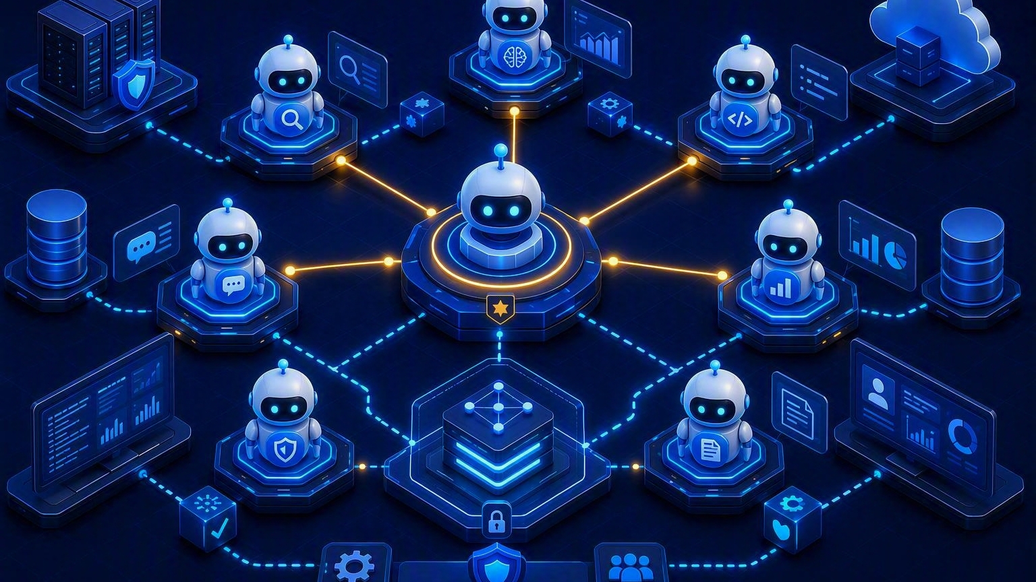
Multi-Agent Collaboration Models
Specialized agents coordinate through explicit roles, state and contracts
Architectural principle: add agents only when specialization, isolation or parallelism creates measurable value.
Scalable Enterprise Architectural Deployments of Agentic AI Solutions
17
Notes:
[Sources]
Visual on this slide was generated with Microsoft Copilot.
[/Sources]

Slide 20
Open Question: "For an insurance claim workflow, which architecture would you choose?"
Collaboration Models
Choose the topology by coordination semantics
Supervisor-worker
Sequential pipeline
Concurrent fan-out/fan-in
Central routing and aggregation
Clear ownership
Potential bottleneck
Fixed handoffs
Predictable order
Easy audit trail
Parallel specialists
Lower elapsed time
Requires aggregation
Supervisor
├── Worker A
├── Worker B
└── Worker C
→ A →
Request → B → Aggregator
→ C →
A → B → C → D
Group discussion
Dynamic handoff
Event-driven mesh
Shared thread
Iterative critique
Needs termination rule
Agent transfers ownership
Good for triage
Requires discovery
Loose coupling
Asynchronous scaling
Requires durable state
18
Scalable Enterprise Architectural Deployments of Agentic AI Solutions
18
Scalable Enterprise Architectural Deployments of Agentic AI Solutions
Notes:
[Sources]
Microsoft Azure Architecture Center documents sequential, concurrent, group chat and handoff-style orchestration patterns: https://learn.microsoft.com/en-us/azure/architecture/ai-ml/guide/ai-agent-design-patterns
[/Sources]

Slide 21
Agent Communication Protocols
Separate discovery, message transport, context exchange and tool invocation
OpenAPI / REST
Events / messaging
MCP
Synchronous service contracts and enterprise API governance.
Asynchronous commands, facts and workflow transitions.
Connect agents or hosts to tools, resources and prompts through a standard interface.
A2A
Internal state
Contract controls
Agent discovery, task exchange, status and artifacts across agent boundaries.
Graph state, checkpoints and shared working context.
Identity, schema, version, timeout, retry, idempotency and audit.
19
Scalable Enterprise Architectural Deployments of Agentic AI Solutions
19
Scalable Enterprise Architectural Deployments of Agentic AI Solutions
Notes:
[Sources]
Microsoft Learn describes OpenAPI-based APIs and MCP servers as agent architecture components: https://learn.microsoft.com/en-us/agents/architecture/components-of-agent-architecture
[/Sources]

Slide 22
Task Planning and Delegation
Turn one business goal into bounded, verifiable units of work
Goal
Planner
Router
Worker
Evaluator
Aggregator
Outcome + constraints
Task graph
Capability match
Execute task
Check evidence
Compose result
20
Scalable Enterprise Architectural Deployments of Agentic AI Solutions
20
Scalable Enterprise Architectural Deployments of Agentic AI Solutions
Notes:
[Sources]
Instructional workflow created for this course.
[/Sources]

Slide 23
Orchestration Framework Selection
Evaluate frameworks against enterprise operating requirements
Control model
State & durability
Human-in-the-loop
Graph, conversation, role or workflow orientation
Checkpointing
Pause/resume
Long-running tasks
Approval nodes
Interrupt and resume
Audit trail
Tool integration
Observability
Deployment
Functions
MCP
APIs
Enterprise connectors
Traces
Node state
Token and cost attribution
Runtime model
Scaling
Security
Provider portability
21
Scalable Enterprise Architectural Deployments of Agentic AI Solutions
21
Scalable Enterprise Architectural Deployments of Agentic AI Solutions
Notes:
[Sources]
Selection criteria are an instructional enterprise architecture framework.
[/Sources]

Slide 24
CrewAI Architecture
Role-oriented collaboration for crews and task execution
Core abstractions
Strengths
Agents
Tasks
Crews
Processes
Readable role modeling
Fast workflow composition
Delegation concepts
Example: Role Oriented
Research Agent
↓
Policy Agent
↓
Reporting Agent
Enterprise additions
Best-fit lens
Typed tools
External state
Identity
Policy gates
Tracing
Collaborative business workflows with recognizable roles and task ownership
22
Scalable Enterprise Architectural Deployments of Agentic AI Solutions
22
Scalable Enterprise Architectural Deployments of Agentic AI Solutions
Notes:
[Sources]
Architecture summary provided as instructional guidance.
[/Sources]

Slide 25
LangGraph Fundamentals
Model agent behavior as stateful nodes, edges and controlled transitions
Graph model
Durability
Nodes perform work
Edges route control
State carries task context
Checkpoint state
Resume execution
Support interruptions
Example: Graph with Conditional Routing
START
↓
Research
↓
Evaluate
↓
├── Good → END
└── Bad → Research
Control
Best-fit lens
Conditional routing
Cycles
Iteration limits
Human approval
Complex, stateful workflows requiring explicit control and inspectable execution
23
Scalable Enterprise Architectural Deployments of Agentic AI Solutions
23
Scalable Enterprise Architectural Deployments of Agentic AI Solutions
Notes:
[Sources]
Architecture summary provided as instructional guidance.
[/Sources]

Slide 26
Microsoft AutoGen
Conversation-oriented multi-agent patterns for collaborative task solving
Core model
Strengths
Conversable agents
Messages
Tools
Group interactions
Rapid multi-agent experimentation
Flexible conversational coordination
Example: Conversational
Agent A ↔ Agent B
↕
Agent C
Enterprise additions
Best-fit lens
Deterministic boundaries
Durable workflow state
Identity
Tool policy
Evaluation
Research, prototyping and collaborative agent interactions that benefit from dialogue
24
Scalable Enterprise Architectural Deployments of Agentic AI Solutions
24
Scalable Enterprise Architectural Deployments of Agentic AI Solutions
Notes:
[Sources]
Architecture summary provided as instructional guidance.
[/Sources]

Slide 27
A2A Communication Architecture
An enterprise agent network needs discovery, identity and task lifecycle contracts
Discovery
Task lifecycle
Agent card / capability description
Endpoint and supported interaction modes
Submit
Status
Streaming / updates
Completion or failure
Example: Lifecycle
Discovery
↓
Task submission
↓
Status
↓
Updates
↓
Completion
↓
Artifacts
Artifacts
Enterprise controls
Typed outputs
Evidence
Files or structured results
Mutual trust
Authorization
Data minimization
Audit
Version compatibility
25
Scalable Enterprise Architectural Deployments of Agentic AI Solutions
25
Scalable Enterprise Architectural Deployments of Agentic AI Solutions
Notes:
[Sources]
The attached syllabus explicitly includes Agent-to-Agent communication in Module 4.
[/Sources]

Slide 28
Hands-on: Multi-Agent Business Workflow
Lab outcome: a supervisor coordinates research, policy and execution agents with one approval gate
Intake
Supervisor
Research
Policy
Approval
Execution
Business request
Plan + route
Gather evidence
Validate rules
Human decision
Commit + report
User
↓
Supervisor
↓
Research Agent
↓
Policy Agent
↓
Human Approval
↓
Execution
26
Scalable Enterprise Architectural Deployments of Agentic AI Solutions
26
Scalable Enterprise Architectural Deployments of Agentic AI Solutions
Notes:
[Sources]
Hands-on activity reproduced from the user-provided syllabus.
[/Sources]

Slide 29
MODULE 05
Enterprise Integration
Architecture
1 Hour
Scalable Enterprise Architectural Deployments of Agentic AI Solutions
27
Notes:
[Sources]
Course module and duration from the user-provided syllabus.
[/Sources]

Slide 30
MODULE 05 · TOPICS COVERED
Enterprise Integration Architecture
1
Integrating Agents with Enterprise Systems
5
SQL and NoSQL Databases
2
APIs and Microservices
6
Event Streaming Platforms
3
ERP Integration
7
Enterprise Service Bus (ESB)
4
CRM Integration
8
Enterprise Data Governance
28
Scalable Enterprise Architectural Deployments of Agentic AI Solutions
28
Scalable Enterprise Architectural Deployments of Agentic AI Solutions
Notes:
[Sources]
Topics reproduced from the user-provided syllabus.
[/Sources]

Slide 31
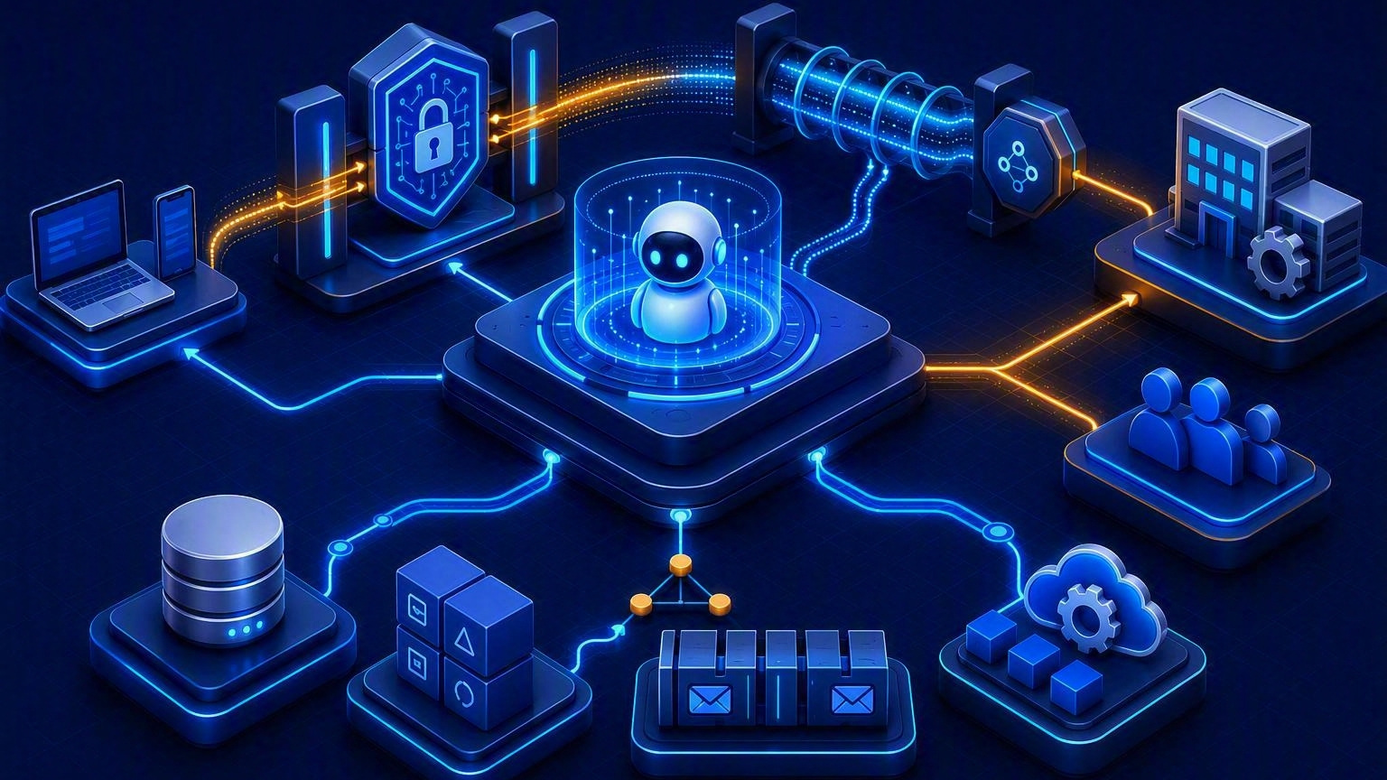
Enterprise Integration Architecture
Agents should integrate through governed contracts, not direct unrestricted connectivity
Use APIs for commands, events for facts, retrieval for knowledge, and approvals for consequential actions.
Scalable Enterprise Architectural Deployments of Agentic AI Solutions
29
Notes:
[Sources]
Visual on this slide was generated with Microsoft Copilot.
[/Sources]

Slide 32
Agent Integration Patterns
Select the interface by consistency, latency and ownership needs
Synchronous API
Asynchronous event
Workflow / BPM
Immediate request/response
Schema validation
Timeout and circuit breaker
Loose coupling
Replay
Independent scaling
Eventual consistency
Durable state
Human tasks
Compensation
Audit trail
Data access service
RAG connector
RPA adapter
Avoid raw credentials
Enforce row/column policy
Typed queries
Read-only knowledge grounding with source attribution
Legacy UI bridge
Use only with strong controls and monitoring
30
Scalable Enterprise Architectural Deployments of Agentic AI Solutions
30
Scalable Enterprise Architectural Deployments of Agentic AI Solutions
Notes:
[Sources]
Instructional integration pattern catalog created for this course.
[/Sources]

Slide 33
APIs & Microservices for Agents
Expose business capabilities as safe, narrow and observable tools
API gateway
Tool façade
Contract design
Authentication
Rate limits
Input limits
Threat protection
Task-oriented operation
Minimal parameters
Policy-aware defaults
OpenAPI / JSON schema
Versioning
Idempotency key
Correlation ID
Resilience
Observability
Security
Timeout
Retry budget
Circuit breaker
Fallback
Compensation
Trace agent → tool → system
Capture latency, errors and business outcome
On-behalf-of identity
Least privilege
Secrets isolation
Egress control
31
Scalable Enterprise Architectural Deployments of Agentic AI Solutions
31
Scalable Enterprise Architectural Deployments of Agentic AI Solutions
Notes:
[Sources]
Instructional API architecture guidance created for this course.
[/Sources]

Slide 34
ERP & CRM Integration
Preserve system-of-record controls while enabling agent-assisted workflows
Read pattern
Write pattern
Retrieve customer, order, contract, inventory or finance context through governed services.
Draft proposed changes and require approval for high-impact transactions.
Process pattern
Data controls
Trigger existing workflow, case or service operation rather than bypassing process controls.
Field-level authorization
PII minimization
Audit user and agent identity
Reconciliation
32
Scalable Enterprise Architectural Deployments of Agentic AI Solutions
32
Scalable Enterprise Architectural Deployments of Agentic AI Solutions
Notes:
[Sources]
The user-provided syllabus explicitly includes ERP and CRM integration in Module 5.
[/Sources]

Slide 35
SQL & NoSQL Database Integration
Choose access patterns that protect systems of record
SQL
Document / key-value
Vector store
Strong schema and relationships
Parameterized query service
Read replicas for analytics
Flexible task state and memory
Partition key design
TTL and conditional writes
Similarity retrieval
Metadata filters
Embedding lifecycle
Graph store
Agent safeguards
Data quality
Entity relationships
Multi-hop traversal
Semantic context
No arbitrary SQL in production
Allowlisted operations
Read-only by default
Freshness
Schema drift
Missing data
Reconciliation
Lineage
33
Scalable Enterprise Architectural Deployments of Agentic AI Solutions
33
Scalable Enterprise Architectural Deployments of Agentic AI Solutions
Notes:
[Sources]
Instructional database integration framework created for this course.
[/Sources]

Slide 36
Event Streaming & ESB
Events distribute facts; an ESB mediates enterprise services and transformations
Producer
Broker
Schema
Agent
Service
Audit
Business event
Topic / stream
Contract registry
Consume + decide
Execute action
Outcome event
34
Scalable Enterprise Architectural Deployments of Agentic AI Solutions
34
Scalable Enterprise Architectural Deployments of Agentic AI Solutions
Notes:
[Sources]
The attached syllabus explicitly includes event streaming platforms and enterprise service bus in Module 5.
[/Sources]

Slide 37
Enterprise Data Governance for Agents
Govern every path from source to context to action
Ownership
Classification
Access
Data owner
Product owner
Agent owner
Control owner
Public
Internal
Confidential
Regulated
Identity-aware retrieval
Row/document filtering
Purpose limitation
Lineage
Lifecycle
Quality & risk
Source → chunk → context → response → action
Freshness
Retention
Deletion
Versioning
Legal hold
Accuracy
Completeness
Bias
Leakage
Prompt injection in data
35
Scalable Enterprise Architectural Deployments of Agentic AI Solutions
35
Scalable Enterprise Architectural Deployments of Agentic AI Solutions
Notes:
[Sources]
Instructional governance framework created for this course.
[/Sources]

Slide 38
Hands-on: Enterprise Database & API Integration
Lab outcome: an agent reads governed data, calls an API and records an auditable result
Authenticate
Query
Reason
Invoke
Persist
Trace
User + agent
Read-only data
Apply policy
Typed API
Outcome record
End-to-end audit
36
Scalable Enterprise Architectural Deployments of Agentic AI Solutions
36
Scalable Enterprise Architectural Deployments of Agentic AI Solutions
Notes:
[Sources]
Hands-on activity reproduced from the user-provided syllabus.
[/Sources]

Slide 39
MODULE 06
Scalability, Deployment &
Cloud Architecture
1 Hour
Scalable Enterprise Architectural Deployments of Agentic AI Solutions
37
Notes:
[Sources]
Course module and duration from the user-provided syllabus.
[/Sources]

Slide 40
MODULE 06 · TOPICS COVERED
Scalability, Deployment & Cloud Architecture
1
Cloud-Native AI Architecture
5
Serverless AI Patterns
2
Kubernetes for Agentic AI
6
Load Balancing Strategies
3
Containerization using Docker
7
High Availability and Fault Tolerance
4
Distributed Agent Deployment
8
Cost Optimization Strategies
38
Scalable Enterprise Architectural Deployments of Agentic AI Solutions
38
Scalable Enterprise Architectural Deployments of Agentic AI Solutions
Notes:
[Sources]
Topics reproduced from the user-provided syllabus.
[/Sources]

Slide 41
Cloud-Native Agentic AI Architecture
Separate the control plane, execution plane and data plane
Experience plane
Control plane
Intelligence plane
Web, mobile, Teams and enterprise applications
Gateway
Identity
Policy
Orchestrator
Workflow state
Model gateway
Prompt registry
Embedding and reranking
Execution plane
Data plane
Operations plane
Tool adapters
Code sandbox
Microservices
Serverless workers
Knowledge stores
Operational DBs
Caches
Streams
CI/CD
Observability
Evaluation
Security
FinOps
39
Scalable Enterprise Architectural Deployments of Agentic AI Solutions
39
Scalable Enterprise Architectural Deployments of Agentic AI Solutions
Notes:
[Sources]
Instructional cloud-native reference architecture created for this course.
[/Sources]

Slide 42
Kubernetes for Agentic AI
Use Kubernetes when workloads need portable, controlled and independently scalable runtimes
Workload units
Scaling
Isolation
Agent API deployment
Worker jobs
Ingestion jobs
Tool services
Horizontal Pod Autoscaler
KEDA / queue depth
Cluster autoscaling
Namespaces
Service accounts
Network policies
Pod security
Reliability
State
Observability
Readiness/liveness
Disruption budgets
Anti-affinity
Rolling updates
External checkpoints
Managed databases
Object storage
Avoid pod-local memory
Metrics
Logs
Traces
Model/tool spans
SLO dashboards
40
Scalable Enterprise Architectural Deployments of Agentic AI Solutions
40
Scalable Enterprise Architectural Deployments of Agentic AI Solutions
Notes:
[Sources]
The attached syllabus explicitly includes Kubernetes for Agentic AI in Module 6.
[/Sources]

Slide 43
Containerization using Docker
Package agent runtimes as immutable, reproducible and minimal artifacts
Image design
Runtime contract
Small base image
Pinned dependencies
Non-root user
No embedded secrets
Health endpoint
Configuration via environment / files
Graceful shutdown
Supply chain
AI-specific concerns
SBOM
Image signing
Vulnerability scanning
Trusted registry
Model assets
Tokenizer versions
Native libraries
Cold-start profile
41
Scalable Enterprise Architectural Deployments of Agentic AI Solutions
41
Scalable Enterprise Architectural Deployments of Agentic AI Solutions
Notes:
[Sources]
The attached syllabus explicitly includes Docker containerization in Module 6.
[/Sources]

Slide 44
Distributed Agent Deployment
Partition by capability and scale each execution path independently
Gateway
Orchestrator
Queue
Workers
Tools
Store
Route tenant
Own task state
Buffer work
Scale by skill
Isolated access
Checkpoint + audit
42
Scalable Enterprise Architectural Deployments of Agentic AI Solutions
42
Scalable Enterprise Architectural Deployments of Agentic AI Solutions
Notes:
[Sources]
Instructional distributed deployment pattern created for this course.
[/Sources]

Slide 45
Serverless AI Patterns
Use serverless for bursty, short-lived and event-driven agent components
Good fit
Benefits
Webhook tools
Event handlers
Document processing
Scheduled evaluation
Scale to zero
Managed operations
Fast event integration
Watch-outs
Hybrid pattern
Execution duration
Cold starts
Payload limits
Connection management
Serverless ingress + durable orchestration + containerized long-running workers
43
Scalable Enterprise Architectural Deployments of Agentic AI Solutions
43
Scalable Enterprise Architectural Deployments of Agentic AI Solutions
Notes:
[Sources]
The attached syllabus explicitly includes serverless AI patterns in Module 6.
[/Sources]

Slide 46
Load Balancing Strategies
Balance more than HTTP requests
API traffic
Model traffic
L7 load balancer
Session strategy
Rate limiting
Tenant fairness
Provider/model routing
Quota awareness
Latency/cost policy
Fallback
Work queues
Knowledge services
Competing consumers
Priority queues
Backpressure
Dead-letter queue
Read replicas
Shard routing
Cache
Hot-partition controls
44
Scalable Enterprise Architectural Deployments of Agentic AI Solutions
44
Scalable Enterprise Architectural Deployments of Agentic AI Solutions
Notes:
[Sources]
Instructional load-balancing framework created for this course.
[/Sources]

Slide 47
High Availability & Fault Tolerance
Design every external dependency as fallible
Failure domains
Durable state
Resilience controls
Multiple zones
Regional strategy
Provider dependency mapping
Checkpoint before/after actions
Resume safely
Exactly-once business effect
Timeouts
Retries with jitter
Circuit breakers
Bulkheads
Degraded modes
Recovery
Safety
Fallback model
Read-only operation
Human queue
Cached knowledge
Backups
Runbooks
Chaos tests
RTO/RPO objectives
Idempotency
Compensation
Kill switch
Approval for recovery changes
45
Scalable Enterprise Architectural Deployments of Agentic AI Solutions
45
Scalable Enterprise Architectural Deployments of Agentic AI Solutions
Notes:
[Sources]
Instructional resilience framework created for this course.
[/Sources]

Slide 48
Cost Optimization Strategies
Optimize cost per successful business outcome, not cost per token alone
Model economics
Prompt & context
Compute
Route by complexity
Use smaller models where sufficient
Cache stable results
Reduce redundant context
Retrieve fewer better chunks
Summarize state
Autoscale
Right-size CPU/GPU
Scale ingestion separately
Use serverless selectively
Storage & retrieval
Agent behavior
FinOps metrics
Lifecycle old embeddings
Tune indexes
Cache hot knowledge
Iteration budget
Tool-call budget
Stop conditions
Avoid agent loops
Cost per task
Cost per successful action
Tenant / feature chargeback
46
Scalable Enterprise Architectural Deployments of Agentic AI Solutions
46
Scalable Enterprise Architectural Deployments of Agentic AI Solutions
Notes:
[Sources]
Instructional FinOps framework created for this course.
[/Sources]

Slide 49
Hands-on: Deploying Agents on Kubernetes
Lab outcome: containerize, deploy, expose, scale and observe an agent service
Package
Configure
Deploy
Expose
Scale
Observe
Docker image
Config + secret
K8s manifest
Service / ingress
HPA / queue
Logs + metrics
47
Scalable Enterprise Architectural Deployments of Agentic AI Solutions
47
Scalable Enterprise Architectural Deployments of Agentic AI Solutions
Notes:
[Sources]
Hands-on activity reproduced from the user-provided syllabus.
[/Sources]

Slide 50
KEY TAKEAWAYS
From intelligent components to scalable enterprise deployment
Grounded intelligence
Explicit orchestration
Separate models, prompts, tools, memory and knowledge into governed components.
Use role, state, protocol and task contracts for multi-agent collaboration.
Governed integration
Cloud operability
Connect through APIs, events and data services without bypassing systems of record.
Containerize, scale, recover and optimize agents as production distributed systems.
48
Scalable Enterprise Architectural Deployments of Agentic AI Solutions
48
Scalable Enterprise Architectural Deployments of Agentic AI Solutions
Notes:
[Sources]
Summary synthesizes Modules 3 through 6 from the user-provided syllabus.
[/Sources]

Slide 51
Take Home Assignment
Design and Develop
A
B
Agentic RAG with one typed tool and citations
Multi-agent workflow with supervisor, specialist workers and approval
C
D
Enterprise integration using one database, one API and one event
Docker + Kubernetes deployment with health checks, scaling and telemetry
Scalable Enterprise Architectural Deployments of Agentic AI Solutions
49
Notes:
[Sources]
Assignment aligns to hands-on activities in Modules 3 through 6.
[/Sources]

Slide 52
Demos
Hands-On
Agent 1
Agent 2
Agent 1: Iterative Writer-Critic Refinement Graph
Agent 2: Hierarchical Multi-Agent Supervisor System
Clinical Agent
Superpowers
Plan-and-Solve / Multi-Step Sequential Reasoning Pattern
AI-DLC
Quiz
Live Interactive Reasoning
Scalable Enterprise Architectural Deployments of Agentic AI Solutions
49
Notes:
[Sources]
Assignment aligns to hands-on activities in Modules 3 through 6.
[/Sources]

Slide 53
THANK YOU
Questions & Architecture Discussion
Chandravadhana TK
Senior AI/ML Architect, UHG-Optum.AI
Research Scholar, CEG Anna University Guindy
Modules 3–6 · LLMs & Knowledge · Multi-Agent Systems · Integration · Cloud Deployment
Scalable Enterprise Architectural Deployments of Agentic AI Solutions
50
Notes:
[Sources]
Presenter details continued from the attached prior-session deck.
[/Sources]

