Slide 1
INDUSTRY ORIENTED COURSE – CEG, Anna University Guindy
Scalable Enterprise Architectural
Deployments of Agentic AI Solutions
Week 3 · Security, Governance, Responsible AI, Observability & Capstone
Presenter
Guide
Chandravadhana TK
Senior AI/ML Architect, UHG-Optum.AI
Research Scholar, CEG Anna University Guindy
Dr. K. Saravanan
Department of Information and Communication Engineering
Scalable Enterprise Architectural Deployments of Agentic AI Solutions
1
Notes:
[Sources]
Title and presenter details continued from the attached prior-session decks.
[/Sources]

Slide 2
COURSE OVERVIEW
Session Structure & Duration · This Week
7
Security, Governance & Responsible AI
1 Hr
8
Observability, Monitoring & Optimization
1 Hr
9
Capstone Project & Presentations
0.5 Hr
Total Duration: 3 Hours
Scalable Enterprise Architectural Deployments of Agentic AI Solutions
2
Notes:
[Sources]
Module names and durations from the user-provided syllabus.
[/Sources]

Slide 3
MODULE 07
Security, Governance &
Responsible AI
1.5 Hours
Scalable Enterprise Architectural Deployments of Agentic AI Solutions
3
Notes:
[Sources]
Course module and duration from the user-provided syllabus.
[/Sources]

Slide 4
MODULE 07 · TOPICS COVERED
Security, Governance & Responsible AI
1
Enterprise AI Security Frameworks
5
Regulatory Compliance
2
Authentication and Authorization
6
Data Privacy and Protection
3
Secrets Management
7
Responsible AI Principles
4
AI Governance Frameworks
8
Risk Management
4
Scalable Enterprise Architectural Deployments of Agentic AI Solutions
4
Scalable Enterprise Architectural Deployments of Agentic AI Solutions
Notes:
[Sources]
Topics reproduced from the user-provided syllabus.
[/Sources]

Slide 5
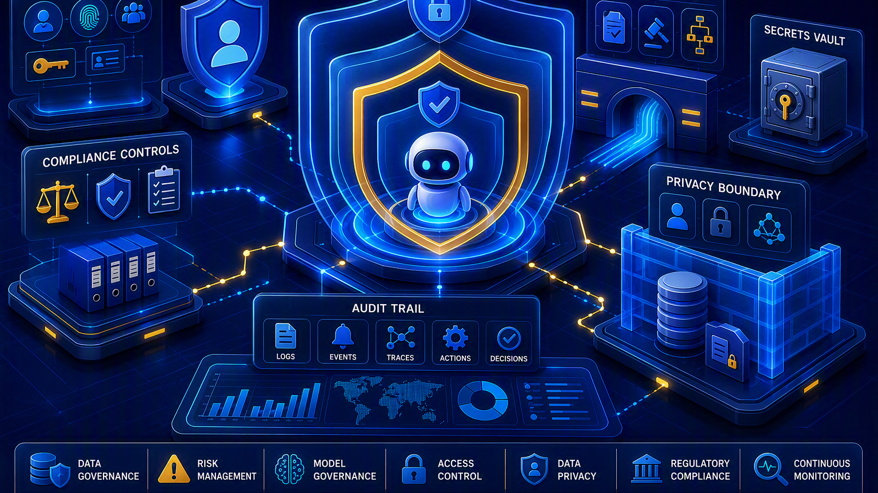
Secure & Governed Agentic AI
Security must protect identity, tools, data, model interactions and decisions end-to-end
Design rule: every agent action must be authenticated, authorized, policy-checked, traceable and revocable.
Scalable Enterprise Architectural Deployments of Agentic AI Solutions
5
Notes:
[Sources]
Visual on this slide was generated with Microsoft Copilot.
NIST AI RMF is intended to incorporate trustworthiness considerations into design, development, use and evaluation: https://www.nist.gov/itl/ai-risk-management-framework
[/Sources]

Slide 6
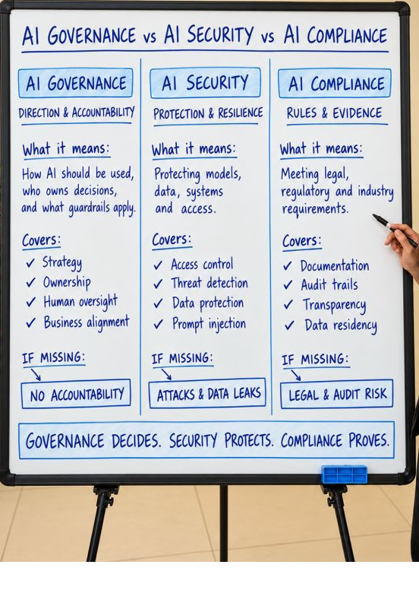

Slide 7
Enterprise AI Security Framework
Apply defense in depth across the complete agent attack surface
Identity layer
Input & context
Model access
User identity
Agent identity
Workload identity
Service accounts
Prompt injection defenses
Content classification
Context isolation
Input limits
Approved models
Private endpoints
Rate quotas
Safety filters
Tool execution
Data protection
Operations
Allowlisted tools
Typed schemas
Least privilege
Transaction limits
Classification
Encryption
DLP
Access-aware retrieval
Audit trails
Threat detection
Incident response
Kill switch
6
Scalable Enterprise Architectural Deployments of Agentic AI Solutions
6
Scalable Enterprise Architectural Deployments of Agentic AI Solutions
Notes:
[Sources]
Security framework is an instructional architecture synthesis aligned to the Module 7 syllabus.
[/Sources]

Slide 8
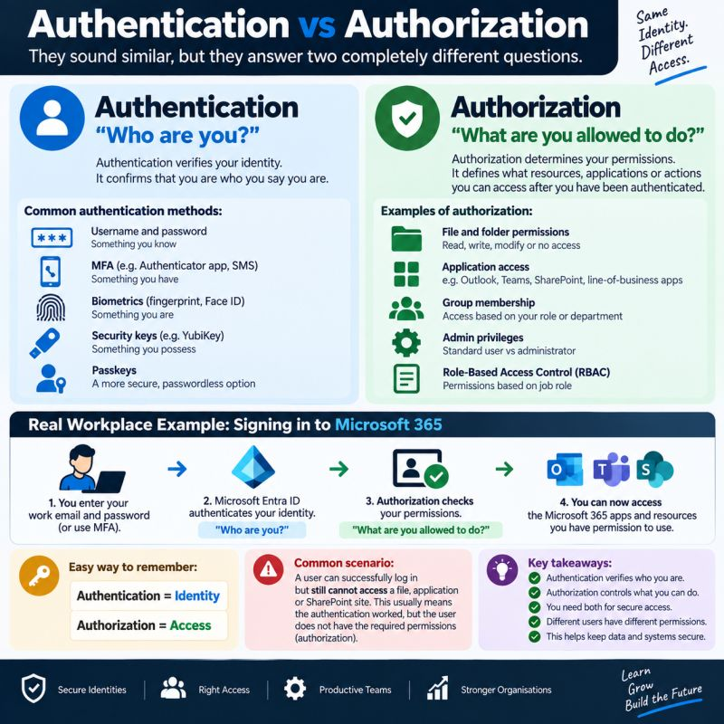

Slide 9
Authentication & Authorization
Authenticate every actor; authorize every requested capability
Authentication
Authorization
Delegated access
Verify the user, agent, service and workload identity.
Evaluate role, attribute, resource, action and business context.
Preserve user context for on-behalf-of operations.
Agent identity
Tool scopes
High-impact actions
Assign a unique non-human identity with owned lifecycle.
Grant narrow operations, resource boundaries and time limits.
Require step-up authentication or human approval before commit.
7
Scalable Enterprise Architectural Deployments of Agentic AI Solutions
7
Scalable Enterprise Architectural Deployments of Agentic AI Solutions
Notes:
[Sources]
Instructional identity and access-control framework created for this course.
[/Sources]

Slide 10
Secure Agent Access-Control Flow
Policy enforcement must occur before retrieval and before external action
User
Agent
Policy
Tool
Action
Audit
Authenticate
Establish identity
Evaluate context
Authorize scope
Execute safely
Record outcome
8
Scalable Enterprise Architectural Deployments of Agentic AI Solutions
8
Scalable Enterprise Architectural Deployments of Agentic AI Solutions
Notes:
[Sources]
Hands-on topic is implementing secure agent access controls, as specified in the user-provided syllabus.
[/Sources]

Slide 11
Secrets Management
Agents reference secrets; agents should never own or expose them
Central vault
Workload identity
Runtime delivery
Store API keys, certificates and credentials outside prompts, code and images.
Prefer identity-based access over long-lived static credentials.
Inject secrets only to the authorized process at execution time.
Rotation
Isolation
Telemetry safety
Automate renewal, revocation and emergency replacement.
Separate credentials by environment, tenant, agent and tool.
Redact secrets from prompts, traces, logs and error messages.
9
Scalable Enterprise Architectural Deployments of Agentic AI Solutions
9
Scalable Enterprise Architectural Deployments of Agentic AI Solutions
Notes:
[Sources]
Instructional secrets-management guidance created for this course.
[/Sources]

Slide 12
AI Governance Operating Model
Governance links business accountability, risk tier and technical controls
Business ownership
AI inventory
Risk classification
Use-case sponsor
Outcome accountability
Human decision owner
Agent, model, prompt, tools, data, version and deployment record
Impact
Autonomy
Data sensitivity
Reversibility
Lifecycle gates
Control evidence
Continuous oversight
Design review
Evaluation
Release approval
Change control
Test results
Access review
Trace samples
Incident records
Monitoring
Periodic review
Model drift
Retirement
10
Scalable Enterprise Architectural Deployments of Agentic AI Solutions
10
Scalable Enterprise Architectural Deployments of Agentic AI Solutions
Notes:
[Sources]
NIST describes AI RMF as supporting incorporation of trustworthiness into AI design, development, use and evaluation: https://www.nist.gov/itl/ai-risk-management-framework
[/Sources]

Slide 13
Regulatory Compliance
Translate obligations into enforceable architecture controls and evidence
Obligation mapping
Control mapping
Identify applicable sector, geography, contract and organizational requirements.
Map each obligation to identity, privacy, safety, logging, approval and retention controls.
Evidence collection
Change management
Preserve versions, decisions, approvals, test results, traces and incidents.
Reassess when models, prompts, tools, data, autonomy or deployment regions change.
11
Scalable Enterprise Architectural Deployments of Agentic AI Solutions
11
Scalable Enterprise Architectural Deployments of Agentic AI Solutions
Notes:
[Sources]
This slide provides an instructional compliance method; specific legal obligations require organizational legal and compliance review.
[/Sources]

Slide 14
Data Privacy & Protection
Minimize sensitive data from collection through retrieval, generation and telemetry
Minimize
Classify
Protect
Collect and send only the data necessary for the task.
Label data and apply policy based on sensitivity.
Encrypt in transit and at rest; isolate tenants and environments.
Retrieve safely
Retain intentionally
Observe safely
Enforce document, row and field-level access before context reaches the model.
Apply purpose, retention, deletion and legal-hold requirements.
Default to metadata-only telemetry; redact sensitive prompt, tool and output content.
12
Scalable Enterprise Architectural Deployments of Agentic AI Solutions
12
Scalable Enterprise Architectural Deployments of Agentic AI Solutions
Notes:
[Sources]
OpenTelemetry notes that prompt and tool content can contain sensitive data and is not captured by default in its referenced walkthrough: https://opentelemetry.io/blog/2026/genai-observability/
[/Sources]

Slide 15
Responsible AI Principles
Convert principles into measurable requirements and runtime controls
Reliability & safety
Fairness
Privacy & security
Defined operating boundaries
Failure testing
Fallback and escalation
Representative evaluation
Outcome analysis
Bias investigation
Data minimization
Access controls
Secure processing
Transparency
Accountability
Inclusiveness
User disclosure
Evidence and citations
Explainable workflow
Named owners
Human oversight
Appeal and incident process
Accessible interaction
Broader user needs
Usability testing
13
Scalable Enterprise Architectural Deployments of Agentic AI Solutions
13
Scalable Enterprise Architectural Deployments of Agentic AI Solutions
Notes:
[Sources]
NIST states its AI RMF supports trustworthiness considerations in AI systems: https://www.nist.gov/itl/ai-risk-management-framework
[/Sources]

Slide 16
Agentic AI Risk Management
Assess risk by threat, vulnerability, business impact and control strength
Threats
Failure modes
Impact
Prompt injection
Data poisoning
Tool abuse
Identity compromise
Hallucination
Incorrect routing
Runaway loops
Duplicate actions
Financial
Privacy
Safety
Regulatory
Reputational
Controls
Residual risk
Response
Preventive
Detective
Corrective
Human approval
Assess after controls and compare with approved tolerance.
Alert
Contain
Revoke
Compensate
Investigate
Improve
14
Scalable Enterprise Architectural Deployments of Agentic AI Solutions
14
Scalable Enterprise Architectural Deployments of Agentic AI Solutions
Notes:
[Sources]
NIST developed AI RMF to help manage risks to individuals, organizations and society associated with AI: https://www.nist.gov/itl/ai-risk-management-framework
[/Sources]

Slide 17
MODULE 08
Observability, Monitoring &
Optimization
1 Hour
Scalable Enterprise Architectural Deployments of Agentic AI Solutions
16
Notes:
[Sources]
Course module and duration from the user-provided syllabus.
[/Sources]

Slide 18
MODULE 08 · TOPICS COVERED
Observability, Monitoring & Optimization
1
Agent Monitoring Metrics
5
Cost Monitoring
2
Tracing Agent Actions
6
Agent Evaluation Techniques
3
Observability Frameworks
7
Continuous Improvement Loops
4
Performance Benchmarking
17
Scalable Enterprise Architectural Deployments of Agentic AI Solutions
17
Scalable Enterprise Architectural Deployments of Agentic AI Solutions
Notes:
[Sources]
Topics reproduced from the user-provided syllabus.
[/Sources]

Slide 19
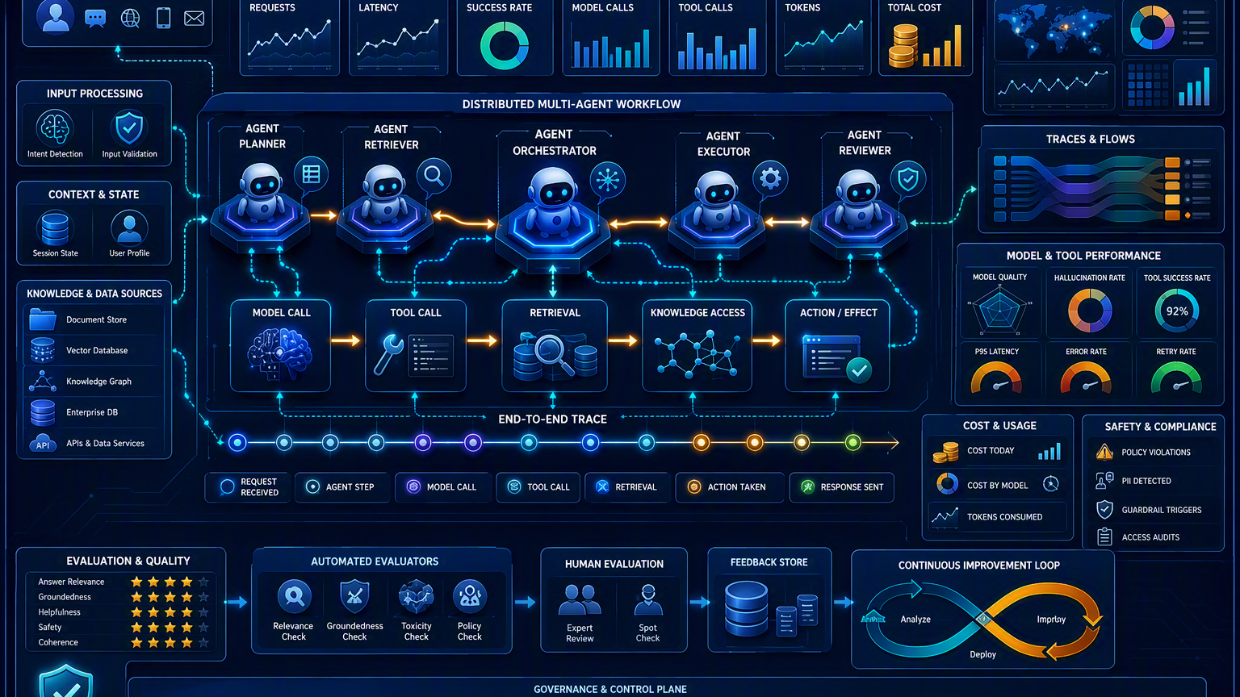
End-to-End Agent Observability
Make the entire reasoning-to-action path visible without exposing sensitive data
Observe the complete task: request → agent steps → model → retrieval → tools → action → outcome.
Scalable Enterprise Architectural Deployments of Agentic AI Solutions
18
Notes:
[Sources]
Visual on this slide was generated with Microsoft Copilot.
OpenTelemetry GenAI conventions standardize recording model calls, token counts and optionally prompt, completion and tool content: https://opentelemetry.io/blog/2026/genai-observability/
[/Sources]

Slide 20
Agent Monitoring Metrics
Measure service health, agent behavior, output quality and business outcome
Service health
Agent behavior
Model usage
Request volume
Availability
Error rate
Latency percentiles
Steps per task
Retries
Loop depth
Escalation rate
Model/version
Input/output tokens
Rate-limit events
Cache usage
Tool operations
RAG quality
Business outcome
Tool-call success
Latency
Authorization denials
Duplicate actions
Retrieval latency
Context relevance
Groundedness
Citation coverage
Task completion
Human acceptance
Resolution time
Successful action
19
Scalable Enterprise Architectural Deployments of Agentic AI Solutions
19
Scalable Enterprise Architectural Deployments of Agentic AI Solutions
Notes:
[Sources]
OpenTelemetry describes visibility into model calls, tool invocations and token exchanges through GenAI telemetry: https://opentelemetry.io/blog/2026/genai-observability/
[/Sources]

Slide 21
Trace Agent Actions
A single correlation ID should connect the user request to every model, retrieval and tool span
Request
Agent
Model
RAG
Tool
Outcome
Trace root
Planning span
Inference span
Retrieval span
Action span
Result + status
20
Scalable Enterprise Architectural Deployments of Agentic AI Solutions
20
Scalable Enterprise Architectural Deployments of Agentic AI Solutions
Notes:
[Sources]
OpenTelemetry GenAI semantic conventions standardize how GenAI operations are recorded: https://opentelemetry.io/blog/2026/genai-observability/
[/Sources]

Slide 22
Observability Architecture
Collect once, correlate consistently, route safely
Instrumentation
Telemetry types
Collector
Agent SDK
Model client
RAG pipeline
Tool adapters
Traces
Metrics
Structured logs
Evaluation events
Validation
Redaction
Sampling
Enrichment
Routing
Backends
Dashboards
Alerts
Trace store
Metrics store
Log analytics
Evaluation repository
Operations
Quality
Safety
Cost
Business outcomes
SLO breach
Loop anomaly
Cost spike
Policy violation
Tool failure
21
Scalable Enterprise Architectural Deployments of Agentic AI Solutions
21
Scalable Enterprise Architectural Deployments of Agentic AI Solutions
Notes:
[Sources]
OpenTelemetry says OTLP-compatible backends can receive GenAI telemetry and its semantic conventions cover GenAI operations: https://opentelemetry.io/blog/2026/genai-observability/
[/Sources]

Slide 23
Performance Benchmarking
Benchmark complete workflows with representative load and realistic dependencies
Latency
Throughput
Reliability
End-to-end
Time to first token
Tool and retrieval latency
Concurrent tasks
Requests per minute
Tokens per second
Task success
Timeouts
Retry impact
Degraded-mode success
Quality under load
Test profiles
Compare fairly
Groundedness
Tool correctness
Schema adherence
Output stability
Baseline
Peak
Soak
Failure injection
Provider throttling
Pin data, prompts, model versions, tools and test conditions.
22
Scalable Enterprise Architectural Deployments of Agentic AI Solutions
22
Scalable Enterprise Architectural Deployments of Agentic AI Solutions
Notes:
[Sources]
Instructional performance-benchmarking framework created for this course.
[/Sources]

Slide 24
Cost Monitoring & Optimization
Attribute cost to the task, tenant, agent, model, tool and outcome
Capture
Attribute
Optimize
Input/output tokens
Model pricing
Embedding calls
Tool/API cost
Compute
Tenant
Use case
Prompt version
Agent
Workflow step
Model routing
Context reduction
Caching
Batching
Iteration limits
Guard
Evaluate
Investigate
Budgets
Quotas
Alerts
Circuit breakers
Graceful fallback
Cost per task
Cost per successful action
Cost-quality frontier
Expanded prompts
Agent loops
Low cache hit
Repeated retrieval
Failed tools
23
Scalable Enterprise Architectural Deployments of Agentic AI Solutions
23
Scalable Enterprise Architectural Deployments of Agentic AI Solutions
Notes:
[Sources]
OpenTelemetry describes model name, token counts and operation duration as GenAI telemetry dimensions: https://opentelemetry.io/blog/2026/genai-observability/
[/Sources]

Slide 25
Agent Evaluation Techniques
Evaluate each component and the complete business task
Deterministic checks
Retrieval evaluation
Model evaluation
Schema validity
Required fields
Tool arguments
Policy rules
Recall
Precision
Context relevance
Citation correctness
Relevance
Groundedness
Coherence
Safety
Instruction adherence
Agent evaluation
Human evaluation
Production evaluation
Plan quality
Tool selection
Task completion
Loop efficiency
Expert review
Pairwise comparison
Acceptance and override
Sampling
Shadow tests
A/B tests
Incident-driven regression cases
24
Scalable Enterprise Architectural Deployments of Agentic AI Solutions
24
Scalable Enterprise Architectural Deployments of Agentic AI Solutions
Notes:
[Sources]
NIST AI RMF addresses trustworthiness in evaluation as well as design, development and use: https://www.nist.gov/itl/ai-risk-management-framework
[/Sources]

Slide 26
Continuous Improvement Loop
Treat production feedback as governed evidence for controlled updates
Observe
Detect
Diagnose
Improve
Evaluate
Release
Metrics + traces
Quality / risk gap
Root cause
Prompt / data / tool
Regression suite
Controlled rollout
25
Scalable Enterprise Architectural Deployments of Agentic AI Solutions
25
Scalable Enterprise Architectural Deployments of Agentic AI Solutions
Notes:
[Sources]
The user-provided syllabus explicitly includes continuous improvement loops.
[/Sources]

Slide 27
Hands-on: Build an Agent Monitoring Dashboard
Dashboard should connect operational health to quality, safety, cost and business outcome
TASK SUCCESS
P95 LATENCY
TOOL SUCCESS
COST / TASK
94.6%
6.8 s
97.3%
$0.18
Operations
AI Quality & Safety
Cost & Outcomes
Request rate
Error rate
P50 / P95 / P99 latency
Queue depth
Dependency health
Groundedness
Relevance
Citation coverage
Policy violations
Human overrides
Tokens by model
Cost by tenant
Cost per task
Successful actions
Resolution time
Lab: instrument one workflow, send traces and metrics, build four KPI tiles, three drill-down panels and two alerts.
26
Scalable Enterprise Architectural Deployments of Agentic AI Solutions
26
Scalable Enterprise Architectural Deployments of Agentic AI Solutions
Notes:
[Sources]
Hands-on activity reproduced from the user-provided syllabus.
OpenTelemetry describes traces, metrics and events for GenAI operations: https://opentelemetry.io/blog/2026/genai-observability/
[/Sources]

Slide 28
MODULE 09
Capstone Project – Enterprise
Agentic AI Deployment
0.5 Hour
Scalable Enterprise Architectural Deployments of Agentic AI Solutions
27
Notes:
[Sources]
Course module and duration from the user-provided syllabus.
[/Sources]

Slide 29
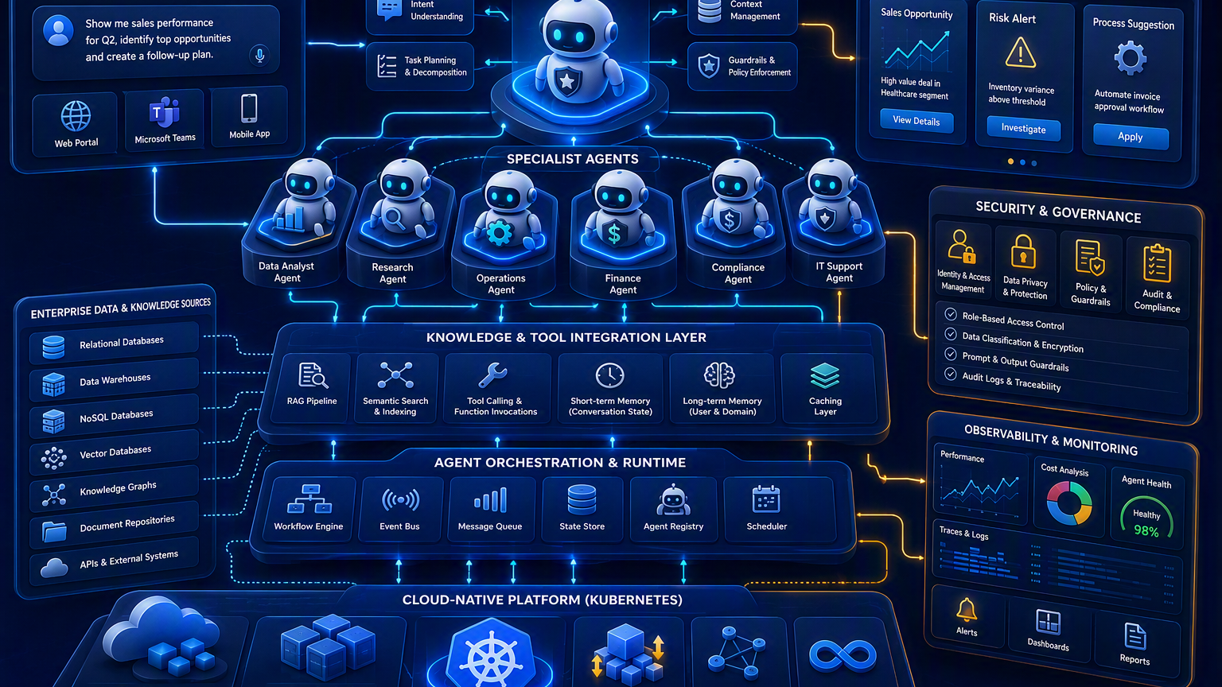
Capstone: Enterprise AI Copilot for Operations Management
Integrate natural-language interaction, enterprise knowledge, collaborating agents, governance and cloud operations
Capstone goal: demonstrate one governed, observable, cloud-native workflow from business question to verified outcome.
Scalable Enterprise Architectural Deployments of Agentic AI Solutions
28
Notes:
[Sources]
Visual on this slide was generated with Microsoft Copilot.
[/Sources]

Slide 30
Capstone Functional Scope
Participants will build a scalable enterprise operations copilot
Natural-language business queries
Enterprise data retrieval
Collaborating agents
Accept operational questions, goals and follow-up requests.
Ground responses in approved databases and knowledge repositories.
Use a supervisor and specialized agents for analysis, operations and compliance.
Insights & recommendations
Governance & security
Cloud-native deployment
Generate evidence-based findings, options and next actions.
Enforce identity, authorization, privacy, policy, approval and audit controls.
Package and deploy with scalable runtime, resilient state and monitoring.
29
Scalable Enterprise Architectural Deployments of Agentic AI Solutions
29
Scalable Enterprise Architectural Deployments of Agentic AI Solutions
Notes:
[Sources]
Capstone scenario and required capabilities reproduced from the user-provided syllabus.
[/Sources]

Slide 31
CAPSTONE DELIVERABLES
Five artifacts that demonstrate enterprise architecture completeness
1
Architecture Diagram
Layers, components, trust boundaries and integrations
2
Agent Workflow Design
Roles, states, tools, handoffs, approvals and failure paths
3
Deployment Strategy
Runtime, scaling, resilience, environments and release
4
Security Model
Identity, authorization, secrets, privacy, guardrails and audit
5
Monitoring Dashboard Design
Health, trace, quality, safety, cost and business outcomes
34
Scalable Enterprise Architectural Deployments of Agentic AI Solutions
34
Scalable Enterprise Architectural Deployments of Agentic AI Solutions
Notes:
[Sources]
Deliverables reproduced from the user-provided syllabus.
[/Sources]

Slide 32
Capstone Presentation Rubric
Use the rubric to keep the 0.5-hour session focused on architecture decisions
Business fit
Architecture completeness
Agent design
Clear operations-management use case
Users and measurable outcome
All layers connected
Explicit state and interfaces
Appropriate pattern
Clear roles and bounded autonomy
Security & governance
Deployment & resilience
Observability & value
Identity, privacy, policy, approval and risk evidence
Scalable runtime
Failure handling
Rollback
Metrics, traces, evaluation, cost and business KPI
35
Scalable Enterprise Architectural Deployments of Agentic AI Solutions
35
Scalable Enterprise Architectural Deployments of Agentic AI Solutions
Notes:
[Sources]
Rubric is an instructional suggestion for the capstone presentation session.
[/Sources]

Slide 33
KEY TAKEAWAYS
Secure, govern, observe and prove the architecture end-to-end
Secure by default
Govern across lifecycle
Every actor, tool, data path and action must be authenticated and policy-controlled.
Risk tier, ownership, evidence and review continue from design through retirement.
Observe outcomes
Integrate the course
Trace the full workflow and measure service health, quality, safety, cost and business value.
The capstone demonstrates Modules 1 through 9 as one production-ready architecture.
36
Scalable Enterprise Architectural Deployments of Agentic AI Solutions
36
Scalable Enterprise Architectural Deployments of Agentic AI Solutions
Notes:
[Sources]
Summary synthesizes Modules 7 through 9 from the user-provided syllabus.
[/Sources]

Slide 34
THANK YOU
Capstone Presentations & Architecture Discussion
Chandravadhana TK
Senior AI/ML Architect, UHG-Optum.AI
Research Scholar, CEG Anna University Guindy
Modules 7–9 · Security & Governance · Observability & Optimization · Enterprise Capstone
Scalable Enterprise Architectural Deployments of Agentic AI Solutions
37
Notes:
[Sources]
Presenter details continued from the attached prior-session decks.
[/Sources]

