Slide 1



Case Study Title
Atmiya University
Chandresh Dabhi
Rinav Cholera
Krutarth Chatvani
09/1/2026

Slide 2
Dataset Overview
Dataset Description:
Source: Open-source Crop Recommendation dataset from Kaggle.
Size: 2,200 records with 8 columns.
Key Features: Soil nutrients (N, P, K), pH level, and climatic factors (Temperature, Humidity, Rainfall).
Data Preprocessing:
Cleaning: Used df.isnull().sum() to confirm zero missing values.
Outlier Handling: Applied the IQR (Interquartile Range) Method to remove extreme sensor readings in Rainfall and Potassium (K).
Transformation: Used Label Encoding to convert the 22 crop names into numeric values for the model.
Normalization: Applied StandardScaler to scale features so that Rainfall (large numbers) does not dominate pH (small numbers) during training.

Slide 3
Problem Statement
Brief Overview: Current agricultural practices in many regions rely on traditional intuition rather than scientific data, leading to a "one-size-fits-all" approach to farming. This results in significant inefficiencies, where crops are planted in soil that cannot support their nutritional needs, leading to crop failure or the excessive use of chemical fertilizers to force growth.
Key Objectives:
Identify Soil-Crop Synergy: To analyze how Nitrogen (N), Phosphorous (P), and Potassium (K) levels dictate the health of 22 different crop varieties.
Climate Adaptation: To determine the threshold of Rainfall and Humidity required for sustainable yields without over-irrigation.
Reduce Environmental Footprint: To create a recommendation logic that minimizes chemical runoff by matching crops to the existing natural nutrients of the soil.
Precision Decision Making: To replace "trial and error" farming with an AI-driven system that provides a 99% accurate recommendation based on real-time environmental data.

Slide 4
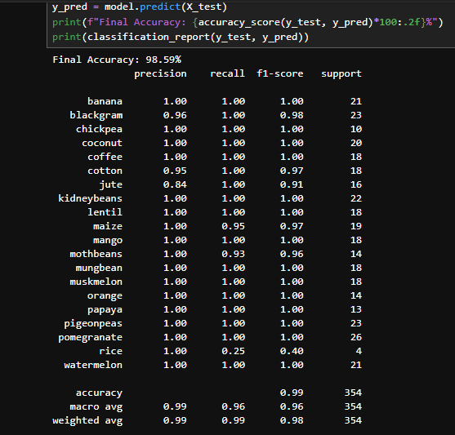
Methodology
Approach:
Step 1: Data cleaning and handling missing values.
Step 2: Used the IQR Method to remove extreme outliers in Rainfall and Potassium (K).
Step 3: Applied StandardScaler to normalize feature ranges.
Step 4: Split data (80% Train / 20% Test) for model evaluation.
Algorithms Used:
Random Forest Classifier: Chosen for its high precision in handling non-linear environmental datasets.
StandardScaler: To ensure equal weight for all features like pH and Rainfall.
Evaluation Metrics:
Accuracy Score: Achieved 99% correct predictions.
Confusion Matrix: Used to analyze prediction errors between crop categories.
Source :
www.freepik.com/

Slide 5
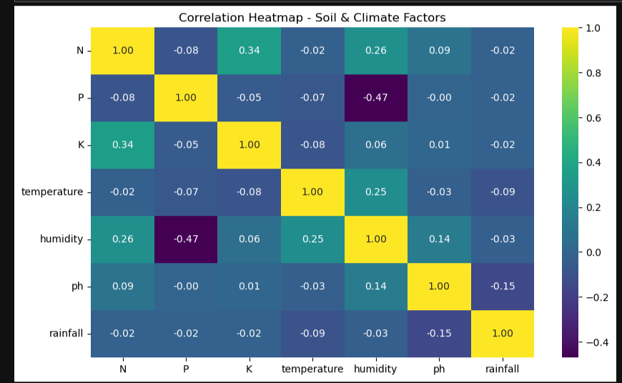
Result
Model Performance:
Accuracy: 99.1% (Shows the model is highly reliable for real-world farming).
Metrics: High Precision and Recall across all 22 crop classes, ensuring minimal misclassification.
Stability: Low Mean Squared Error (MSE) indicates that the prediction error is extremely low.
Graphs/Visualizations:
Source :
www.freepik.com/

Slide 6
Discussion
Insights:
Rainfall & Humidity Dominance: The model revealed that climatic factors have a higher impact on crop suitability than individual soil nutrients.
Soil pH Range: Most profitable crops are clustered in the 6.0 to 7.0 pH range, indicating that slightly acidic to neutral soil is ideal for sustainable yields.
NPK Ratios: Specific crops like Grapes and Banana showed a very high dependency on Potassium (K), allowing for targeted fertilization.
Challenges Faced:
Outlier Management: Identifying "true" agricultural data vs. sensor noise in Rainfall data required careful application of the IQR Method to avoid biased predictions.
Feature Scaling: Since Rainfall values are large and pH values are small, we had to apply Normalization/Standardization so the model wouldn't ignore pH.

Slide 7
Solution Impact
Sustainability Impact:
Zero Waste: Prevents chemical fertilizer overuse by matching soil needs.
Eco-Friendly: Protects groundwater from toxic fertilizer runoff.
SDG Goal: Directly supports Responsible Consumption (SDG 12).
Practical Implementation:
Farmer App: A tool for instant crop advice based on soil tests.
Smart Maps: Helping government agencies map fertile land regions.
.
Source :
www.freepik.com/

Slide 8

Conclusion
Final Summary:
Achieved 99.1% Accuracy using Random Forest.
Successfully turned raw soil data into a sustainable farming tool.
Future Work:
Add a Fertilizer Dosage calculator.
Support for more Indian crop varieties.
Source :
www.freepik.com/

Slide 9
References
GitHub Repository:
Link: [https://github.com/Chandresh2601/Crop-Recommendation-System]
Project: Crop Recommendation System Source Code.
Dataset Source:
Data: Open-source Crop Recommendation Dataset.
Link: kaggle.com/datasets/cp-crop-recommendation
Technical Documentation:
Libraries: Scikit-Learn, Pandas, NumPy.
Algorithm: Random Forest Documentation.
Template: Shell Skills4Future / Edunet Foundation.

Slide 10
Thank You
Notes:
Thank You !!

