Slide 1

Flying Fish
CONFIRMATION AI HACKATHON​

Slide 2
Chandresh Patel
Prakash Bhoi
Ronak Patel
Rachana Chag
Namrata Rathod
Kusum Mishra
Anurag Goyal
Ankur Awasthi
Team Name

Slide 3
Technology
Python
Introducing our newest innovation:
The Smart Chat Buddy! This innovative system is designed to be your friendly and knowledgeable companion, ready to assist you with any questions or data inquiries you may have. Whether you're curious about recent sales figures, employee statistics, or any other aspect of your business, the Smart Chat Buddy is here to help.
Library Used
Matplotlib, pyplot for plotting the charts
Scalability
To decrease token inputs we use scalability that improves output.utput

Slide 4
Imagine a chat interface where you can simply type in your query, such as "How many new employees did we hire last month?" or "Can you show me a graph of our sales for the past year?" The Smart Chat Buddy understands natural language and adept at interpreting your requests.
Problem Statement

Slide 5
Once you've submitted your question, the Smart Chat Buddy springs into action, retrieving the relevant data and presenting it to you in a clear and understandable manner. Need a quick summary? No problem. Prefer a detailed report or a visual representation like a graph or table? The Smart Chat Buddy has covered there too and we will create dashboard charts using Open AI
Problem Statement

Slide 6
But it's not just about delivering information; the Smart Chat Buddy is designed to be user-friendly and engaging. Its interface is intuitive and easy to navigate, ensuring that even those who aren't data experts can access the insights they need.
Problem Statement

Slide 7
With the Smart Chat Buddy by your side, accessing and understanding your data has never been easier. Say goodbye to complex spreadsheets and convoluted reports, and hello to a smarter, friendlier way of interacting with your data. Try it out today and experience the future of data analysis first hand!
Problem Statement

Slide 8
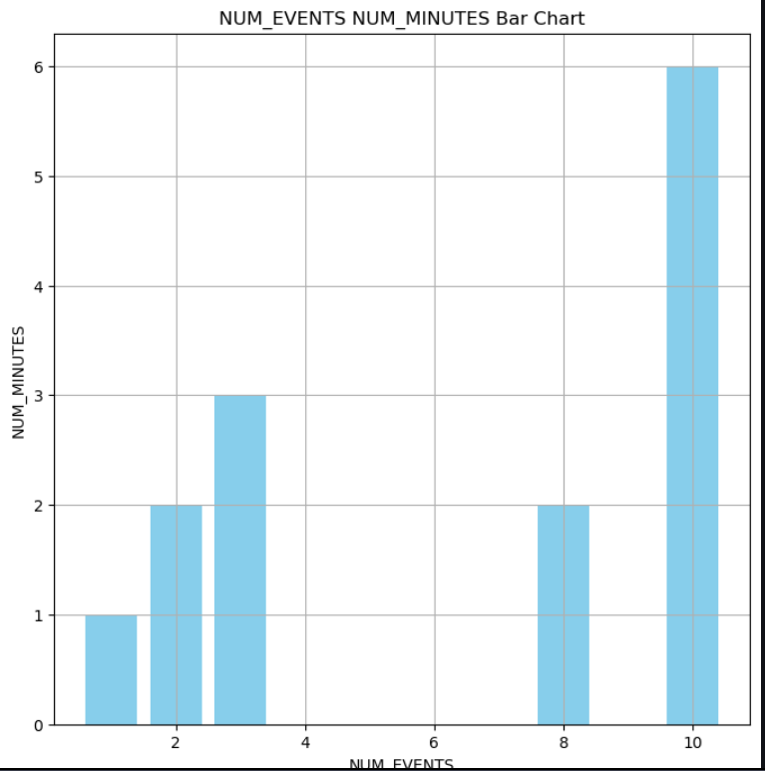
This graphs represent the number of events vs number of minutes

Slide 9
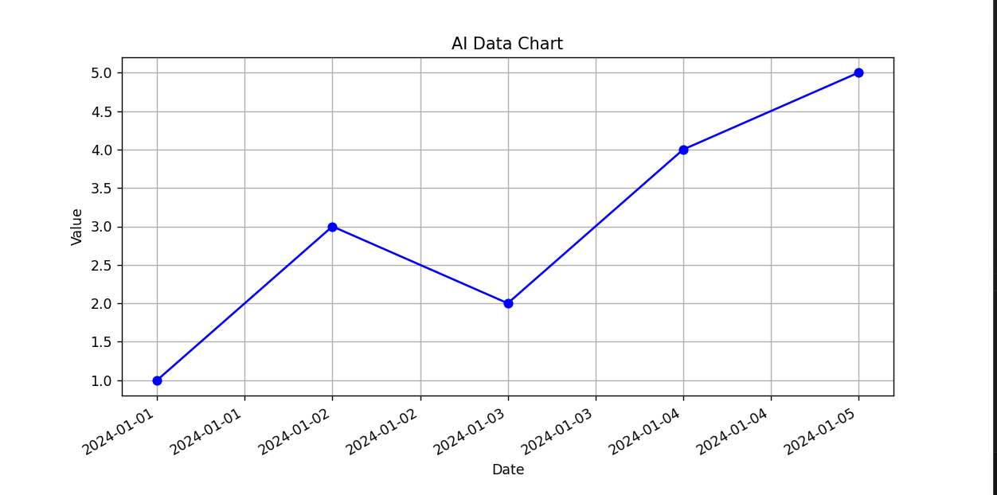
Line Chart

Slide 10
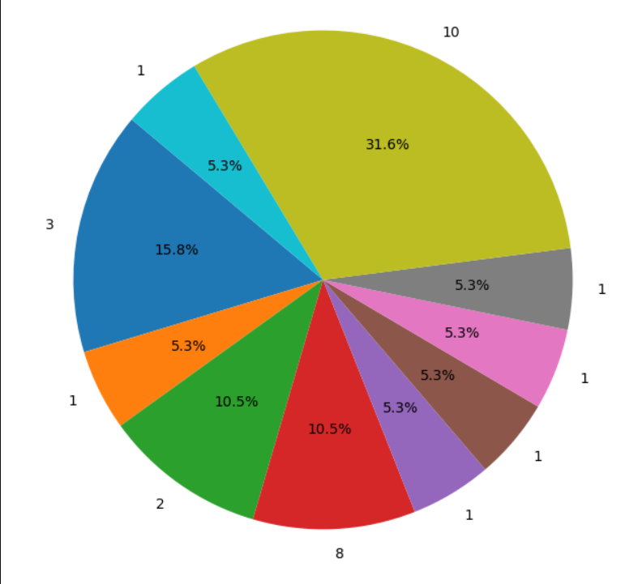
Pie Chart

Slide 11


26

