Slide 1
Bangla Handwritten Character Recognition Using Local Binary Pattern And Its Variants
Paper ID: 222
Chandrika Saha, Rahat Hossain Faisal and Md. Mostafijur Rahman
Presented by
Chandrika Saha
Department of Computer Science and Engineering,
University of Barisal

Slide 2
Outline
Introduction
Existing Works
Methodology
Experimental Eavluation
Conclusion and Future Works
References
Q & A

Slide 3
Introduction: Handwritten Character Recognition (HCR)
The process of digitizing human written text
Bangla Handwritten Character recognition is relatively less explored
Bangla language consists of:
50 basic characters (39 consonants + 11 vowels)
171 compound characters
10 digits
Primary goal of this study: Recognize Bangla isolated basic, compound characters and digits

Slide 4
Introduction: Application of HCR
Digitizing analog paper based system
Translation
Text to speech conversion
Signboard translation
Checking business documents
Scene image analysis
Artificial intelligence
Helping visually disabled people
Smart education

Slide 5
Introduction: General Technique
Input image
Feature extraction
Feature representation
Feature normalization
Classification

Slide 6
Existing Works: Basic Characters
Bangla Basic Characters
Bangla Compound Characters
Bangla Digits
Gradient based features [4]
centroid features, shadow features and longest run based features [1] [2]
Zoning and gabor filter[3]
Quad tree based features [5][6]
Zone density based features [7]
Local Binary Pattern based [8]
Gradient based [9]

Slide 7
Methodology: Feature Extraction (Local Binary Pattern[10])
Can detect micro-structures like corners, edges and line ends
Basic Local Binary Pattern (LBP) operation:
5 | 9 | 1
4 | 4 | 6
7 | 2 | 3
Threshold = 0
Fig.: Basic LBP

Slide 8
Methodology: Feature Extraction (Local Binary Pattern)
5 | 9 | 1
4 | 4 | 6
7 | 2 | 3
1
5 – 4 >= 0
Threshold = 0
Fig.: Basic LBP

Slide 9
Methodology: Feature Extraction (Local Binary Pattern)
5 | 9 | 1
4 | 4 | 6
7 | 2 | 3
1 | 1
9 – 4 >= 0
Threshold = 0
Fig.: Basic LBP

Slide 10
Methodology: Feature Extraction (Local Binary Pattern)
5 | 9 | 1
4 | 4 | 6
7 | 2 | 3
1 | 1 | 0
1 – 4 < 0
Threshold = 0
Fig.: Basic LBP

Slide 11
Methodology: Feature Extraction (Local Binary Pattern)
5 | 9 | 1
4 | 4 | 6
7 | 2 | 3
1 | 1 | 0
 |  | 1
6 - 4 >= 0
Threshold = 0
Fig.: Basic LBP

Slide 12
Methodology: Feature Extraction (Local Binary Pattern)
5 | 9 | 1
4 | 4 | 6
7 | 2 | 3
1 | 1 | 0
1 | - | 1
1 | 0 | 0
Threshold = 0
Fig.: Basic LBP

Slide 13
Methodology: Feature Extraction (Local Binary Pattern)
1 | 1 | 0
1 | - | 1
1 | 0 | 0
5 | 9 | 1
4 | 211 | 6
7 | 2 | 3
(11010011)₂
=> (211)₁₀
Fig.: Basic LBP

Slide 14
Methodology: Feature Extraction (Local Gradient Pattern[11])
5 | 9 | 1
4 | 4 | 6
7 | 2 | 3
1 | 5 | 3
0 | - | 2
3 | 2 | 1
Fig.: Basic LBP

Slide 15
Methodology: Feature Extraction (Local Gradient Pattern)
(1+5+3+2+1+2+3+0+1)/8
1 | 5 | 3
0 | - | 2
3 | 2 | 1
0 | 1 | 1
0 | - | 0
1 | 0 | 0
Average = 2.125
(01100010)₂
=> (98)₁₀
Fig.: LGP

Slide 16
Methodology: Feature Extraction (CENsus TRansform hISTogram[12])
5 | 9 | 1
4 | 4 | 6
7 | 2 | 3
1 | 1 | 0
1 | - | 1
1 | 0 | 0
Threshold = 0
(11011100)₂
=> (220)₁₀
Fig.: CENTRIST

Slide 17
Methodology: Feature Extraction (Noise Adaptive Binary Pattern[13])
5 | 9 | 1
4 | 4 | 6
7 | 2 | 3
0 | 1 | 1
0 | - | 1
1 | 1 | 0
Threshold = √4
(01110110)₂
=> (118)₁₀
Fig.: NABP

Slide 18
Methodology: Feature Extraction (Local Ternary Pattern [14] )
1 | 1 | 0
0 | - | 0
0 | 0 | 0
=> (11000000)₂
=> (192)₁₀
99 | 78 | 50
49 | 54 | 54
57 | 13 | 12
[54-5, 54+5]
1 | 1 | 0
0 | - | 0
0 | -1 | -1
0 | 0 | 0
0 | - | 0
0 | 1 | 1
=> (00001100)₂
=> (12)₁₀
Fig.: LTP

Slide 19
Methodology: Feature Extraction (Local Adaptive Image Descriptor [15])
[64-11.5, 64+11.5]
64 | 68 | 42
63 | 64 | 27
61 | 95 | 85
0 | 4 | -22
-1 | - | -37
-3 | 31 | 19
0 | 0 | -1
0 | - | -1
0 | 1 | 1
Fig.: LAID

Slide 20
Methodology: Feature Extraction (Local Adaptive Image Descriptor)
0 | 0 | 0
0 | - | 0
0 | 1 | 1
=> (00001100)₂
=> (12)₁₀
0 | 0 | -1
0 | - | -1
0 | 1 | 1
0 | 0 | 1
0 | - | 1
0 | 0 | 0
=> (00110000)₂
=> (48)₁₀
Fig.: LAID

Slide 21
Methodology: Feature Extraction (Discriminative Ternary Census Transform Histogram [16])
0 | 1 | 0
0 | - | 0
0 | 0 | 0
=> (01100000)₂
=> (96)₁₀
8 | 14 | 15
3 | 9 | 6
4 | 11 | 10
Threshold = √9
0 | 1 | 1
-1 | - | 0
-1 | 0 | 0
0 | 0 | 0
1 | - | 0
1 | 0 | 0
=> (00010100)₂
=> (20)₁₀
Fig.: DTCTH

Slide 22
Methodology: Feature Representation & Normalization
Feature Representation
Feature Normalization
Used to standardize the range of values of features.
Used to capture the global structure of an image
Equation used: $N\left(x_{i}\right)= \frac{(x_{i} − x_{μ})}{√\sum{(x −x_{μ})}}$
Equation used: 𝑁(𝑥_𝑖 )= ((𝑥_𝑖 − 𝑥_𝜇))/(√∑24▒〖(𝑥 −𝑥_𝜇)〗)
Method used: Spatial Pyramid Matching (SPM)
Takes histograms from sub-regions of an image to form a final histogram
Principe Component Analysis (PCA) is applied afterwards

Slide 23
Methodology: Classification
Support Vector Machine (SVM) with linear kernel is used:

Slide 24
Experimental Evaluation
s

Slide 25
Experimental Evaluation: Result & Discussion
Feature Descriptor | Basic Character | Compound Character | Digits
Local Binary Pattern (LBP) | 86.56% | 65.69% | 99.24%
Local Gradient Pattern (LGP) | 86.56% | 63.17% | 99.08%
CENsus TRansform hISTogram (CENTRIST) | 86.64% | 65.78% | 99.24%
Noise Adaptive Binary Pattern (NABP) | 93.40% | 72.11% | 99.08%
Local Ternary Pattern (LTP) | 90.34% | 72.84% | 99.16%
Local Adaptive Image Descriptor (LAID) | 82.16% | 73.78% | 97.26%
Discriminative Ternary Census Transform Histogram (DTCTH) | 93.24% | 73.3% | 99.2%

Slide 26
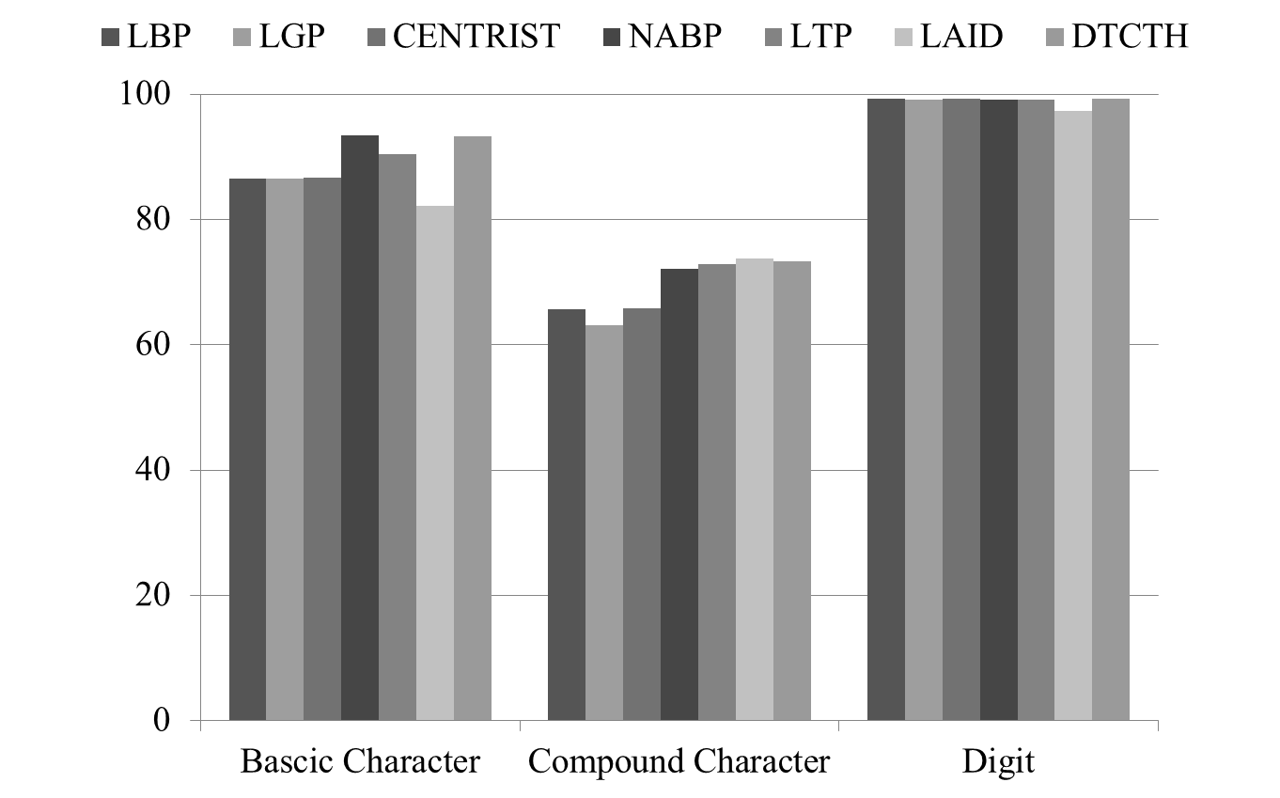
Experimental Evaluation: Result & Discussion

Slide 27
References
[1] S. Basu, N. Das, R. Sarkar, M. Kundu, M. Nasipuri, and D. K. Basu,“Handwritten bangla alphabet recognition using an mlp based classifier,”arXiv preprint arXiv:1203.0882, 2012.
[2] N. Das, S. Basu, R. Sarkar, M. Kundu, M. Nasipuriet al., “An improvedfeature descriptor for recognition of handwritten bangla alphabet,”arXivpreprint arXiv:1501.05497, 2015.
[3] M. T. Pervin, S. Afroge, and A. Huq, “A feature fusion based op-tical character recognition of bangla characters using support vectormachine,” inElectrical Information and Communication Technology(EICT), 2017 3rd International Conference on.IEEE, 2017, pp. 1–6
[4]U. Pal, T. Wakabayashi, and F. Kimura, “Handwritten bangla compoundcharacter recognition using gradient feature,” inInformation Technol-ogy,(ICIT 2007). 10th International Conference on.IEEE, 2007, pp.208–213
[5] . Das, S. Basu, R. Sarkar, M. Kundu, M. Nasipuri, and D. Basu, “Hand-written bangla compound character recognition: Potential challenges andprobable solution.” inIICAI, 2009, pp. 1901–1913.
[6] N. Das, B. Das, R. Sarkar, S. Basu, M. Kundu, and M. Nasipuri,“Handwritten bangla basic and compound character recognition usingmlp and svm classifier,”arXiv preprint arXiv:1002.4040, 2010.
[7] H. A. Khan, A. Al Helal, and K. I. Ahmed, “Handwritten bangla digitrecognition using sparse representation classifier,” in2014 InternationalConference on Informatics, Electronics & Vision (ICIEV). IEEE, 2014,pp. 1–6

Slide 28
References
[8] . Hassan and H. A. Khan, “Handwritten bangla numeral recognition using local binary pattern,” in Electrical Engineering and Information Communication Technology (ICEEICT), 2015 International Conferenceon. IEEE, 2015, pp. 1–4.
[9] T. I. Aziz, A. S. Rubel, M. S. Salekin, and R. Kushol, “Bangla handwritten numeral character recognition using directional pattern,” inComputer and Information Technology (ICCIT), 2017 20th International Conference of. IEEE, 2017, pp. 1–5.
[10] . Ojala, M. Pietikainen, and T. Maenpaa, “Multiresolution gray-scaleand rotation invariant texture classification with local binary patterns,”IEEE Transactions on pattern analysis and machine intelligence, vol. 24,no. 7, pp. 971–987, 2002.
[11] B. Jun, I. Choi, and D. Kim, “Local transform features and hybridizationfor accurate face and human detection.”IEEE Trans. Pattern Anal. Mach.Intell., vol. 35, no. 6, pp. 1423–1436, 2013.
[12] J. Wu and J. M. Rehg, “Centrist: A visual descriptor for scene categoriza-tion,”IEEE transactions on pattern analysis and machine intelligence,vol. 33, no. 8, pp. 1489–1501, 2011.
[13] M. M. Rahman, S. Rahman, M. Kamal, M. Abdullah-Al-Wadud, E. K.Dey, and M. Shoyaib, “Noise adaptive binary pattern for face imageanalysis,” inComputer and Information Technology (ICCIT), 2015 18thInternational Conference on. IEEE, 2015, pp. 390–395.

Slide 29
References
[14] X. Tan and B. Triggs, “Enhanced local texture feature sets for face recognition under difficult lighting conditions,” inInternational Work-shop on Analysis and Modeling of Faces and Gestures. Springer, 2007,pp. 168–182.
[15] . S. Zahid Ishraque, M. Shoyaib, M. Abdullah-Al-Wadud, M. M. Hoque,and O. Chae, “A local adaptive image descriptor,”New Review ofHypermedia and Multimedia, vol. 19, no. 3-4, pp. 286– 298, 2013.
[16] M. M. Rahman, S. Rahman, R. Rahman, B. M. Hossain, and M. Shoyaib,“Dtcth: a discriminative local pattern descriptor for image classification,”EURASIP Journal on Image and Video Processing, vol. 2017, no. 1,p. 30, 2017

