Slide 1
Mutual Fund Analytics Dashboard using Python, SQLite, SQL and Power BI
Submitted By:
Chandrika Katakam
Department:
Computer Science and Engineering
College:
Vignan's Lara Institute of Technology and Science

Slide 2
INTRODUCTION
Mutual funds are one of the most popular investment options.
Investors often find it difficult to compare funds based on returns and risk.
Manual analysis is time-consuming and prone to errors.
This project automates mutual fund data analysis using Python, SQLite, SQL, and Power BI.
It provides meaningful insights and investment recommendations through interactive dashboards.

Slide 3
Problem Statement
Large volumes of mutual fund data make manual analysis difficult.
Investors need to evaluate multiple financial metrics before investing.
Existing analysis methods are time-consuming and fragmented.
There is a need for an automated analytics system that simplifies mutual fund analysis and supports informed investment decisions.

Slide 4
Objectives
Collect mutual fund datasets.
Perform data cleaning and preprocessing.
Store processed data in SQLite.
Perform Exploratory Data Analysis (EDA).
Calculate financial performance metrics.
Develop interactive Power BI dashboards. Generate investment recommendations.

Slide 5
Technologies Used
Technology | Purpose
Python | Data Processing
Pandas | Data Analysis
NumPy | Numerical Computation
SQLite | Database
SQL | Data Retrieval
Matplotlib | Visualization
Power BI | Dashboard Development
Jupyter Notebook | Development Environment

Slide 6
Project Workflow
Raw Data Collection
Data Ingestion
Data Cleaning
SQLite Database
EDA Performance Analytics
Advanced Analytics
Power BI Dashboard
Recommendation Engine

Slide 7
Performance Analytics
Financial Metrics
CAGR
Sharpe Ratio
Sortino Ratio
Alpha
Beta
Maximum Drawdown
Purpose
Evaluate both return and investment risk for mutual fund schemes.

Slide 8
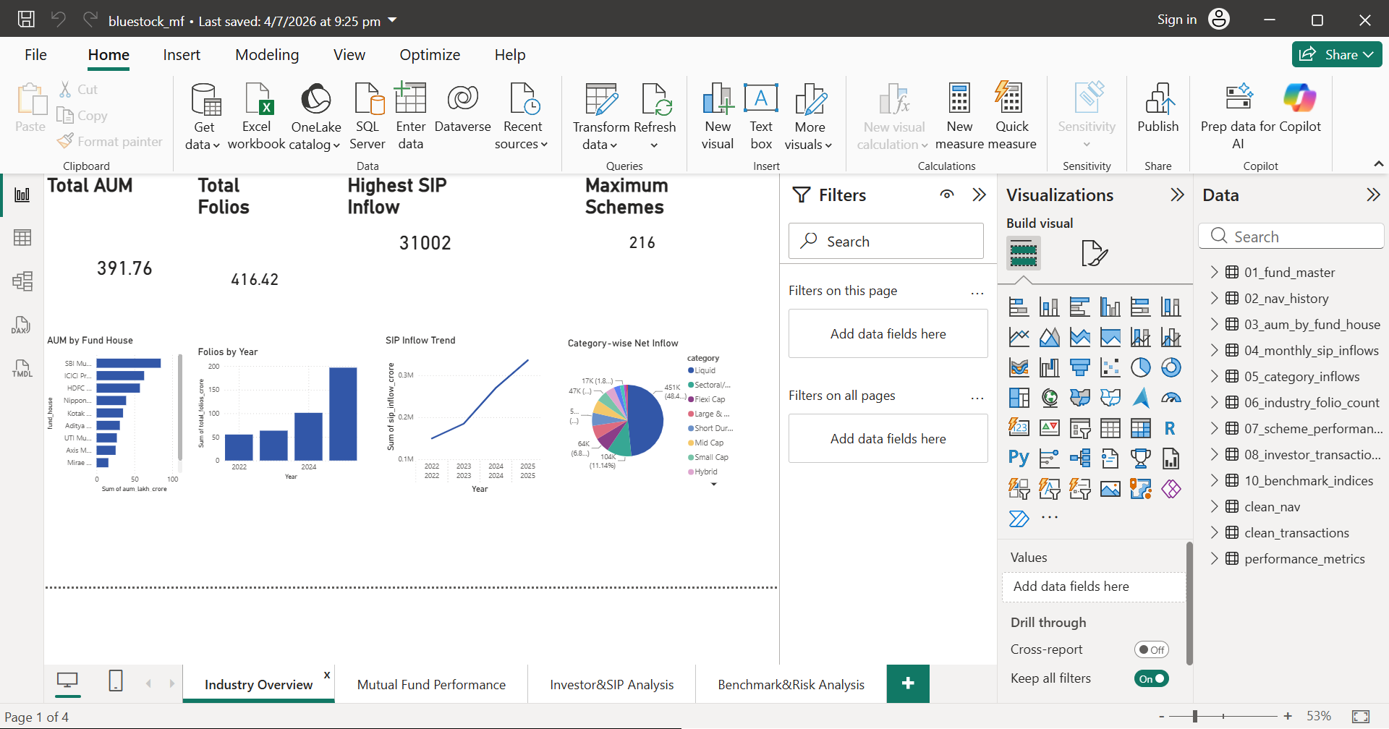
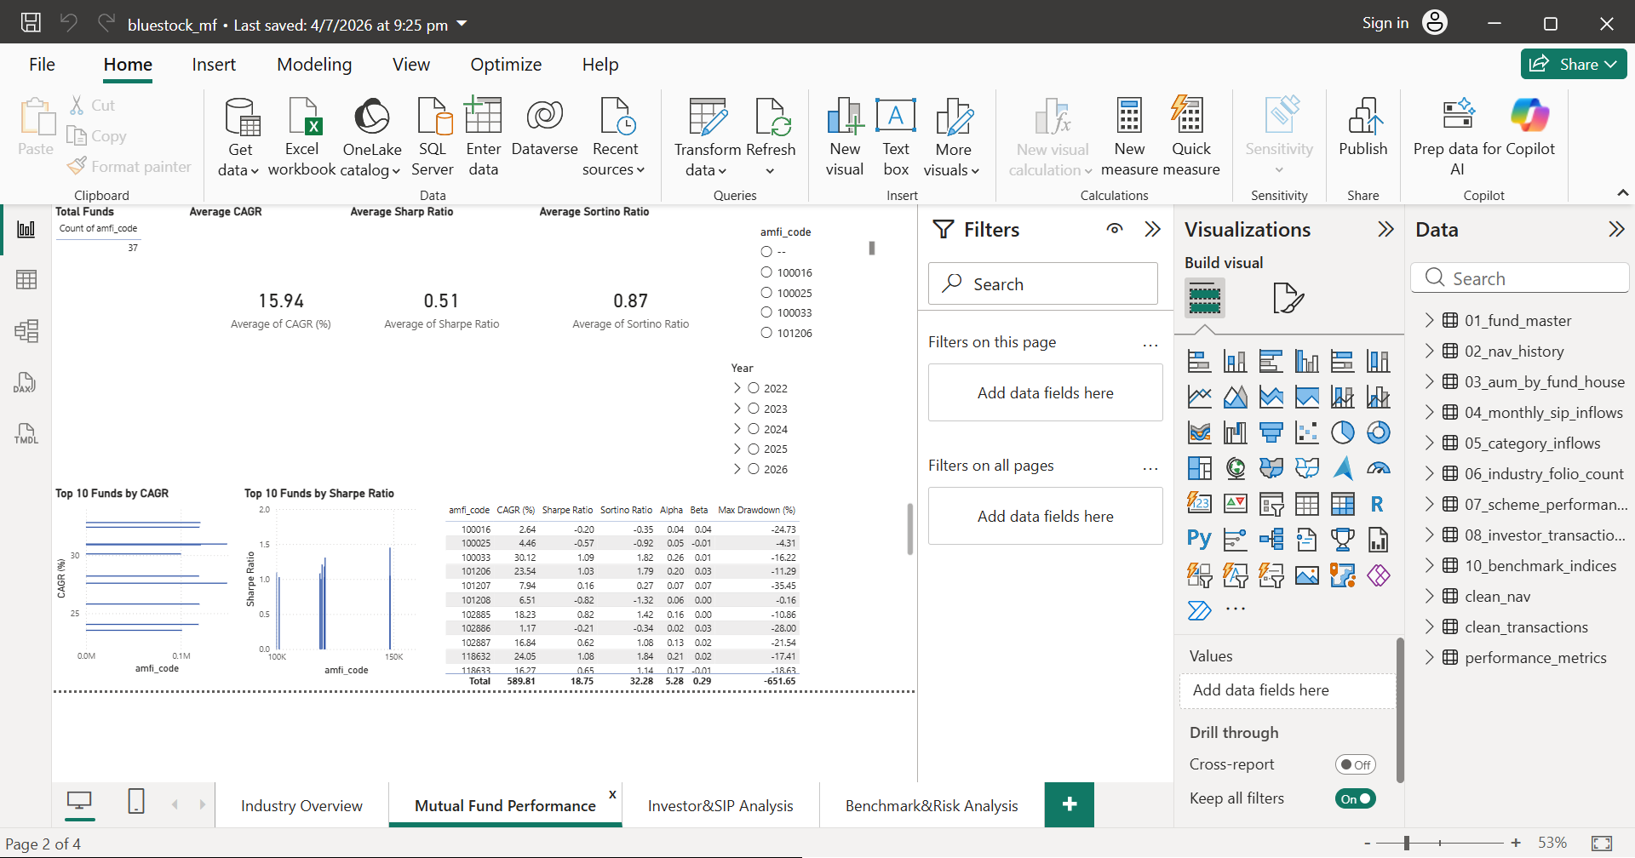
Power BI Dashboard
Page 1 – Executive Summary
Total Funds ,Average Returns, Total AUM ,NAV Trend, Overall Mutual Fund Overview
Page 2 – Fund Performance
CAGR Comparison ,Sharpe Ratio Analysis ,Sortino Ratio Analysis ,Alpha & Beta Comparison ,Fund Performance Evaluation

Slide 9
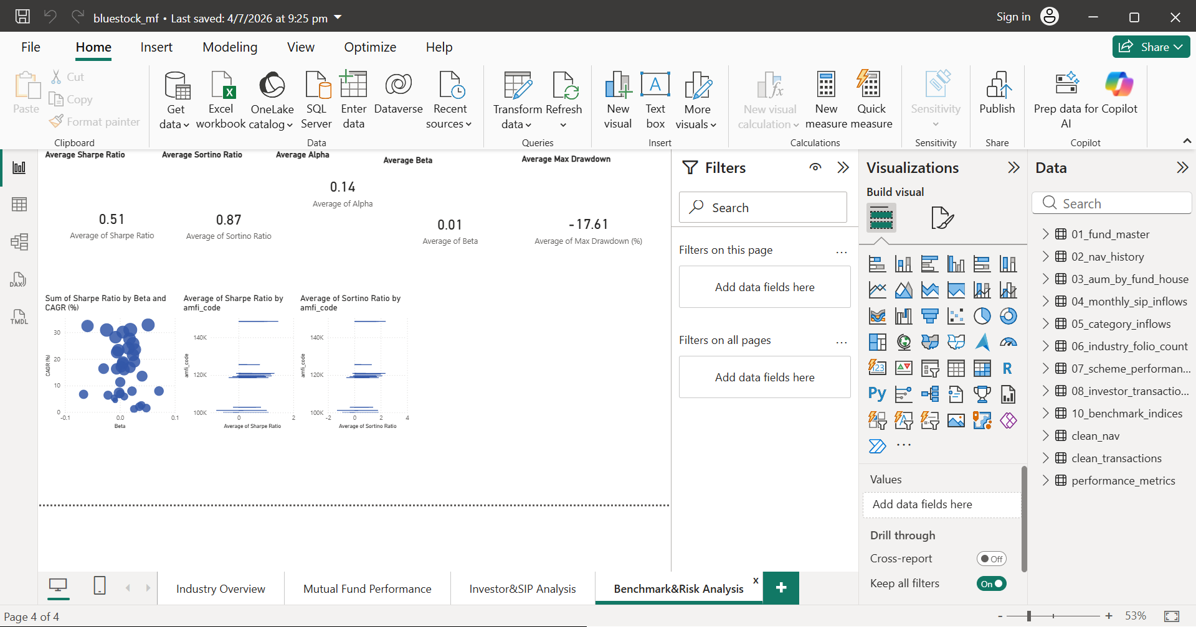
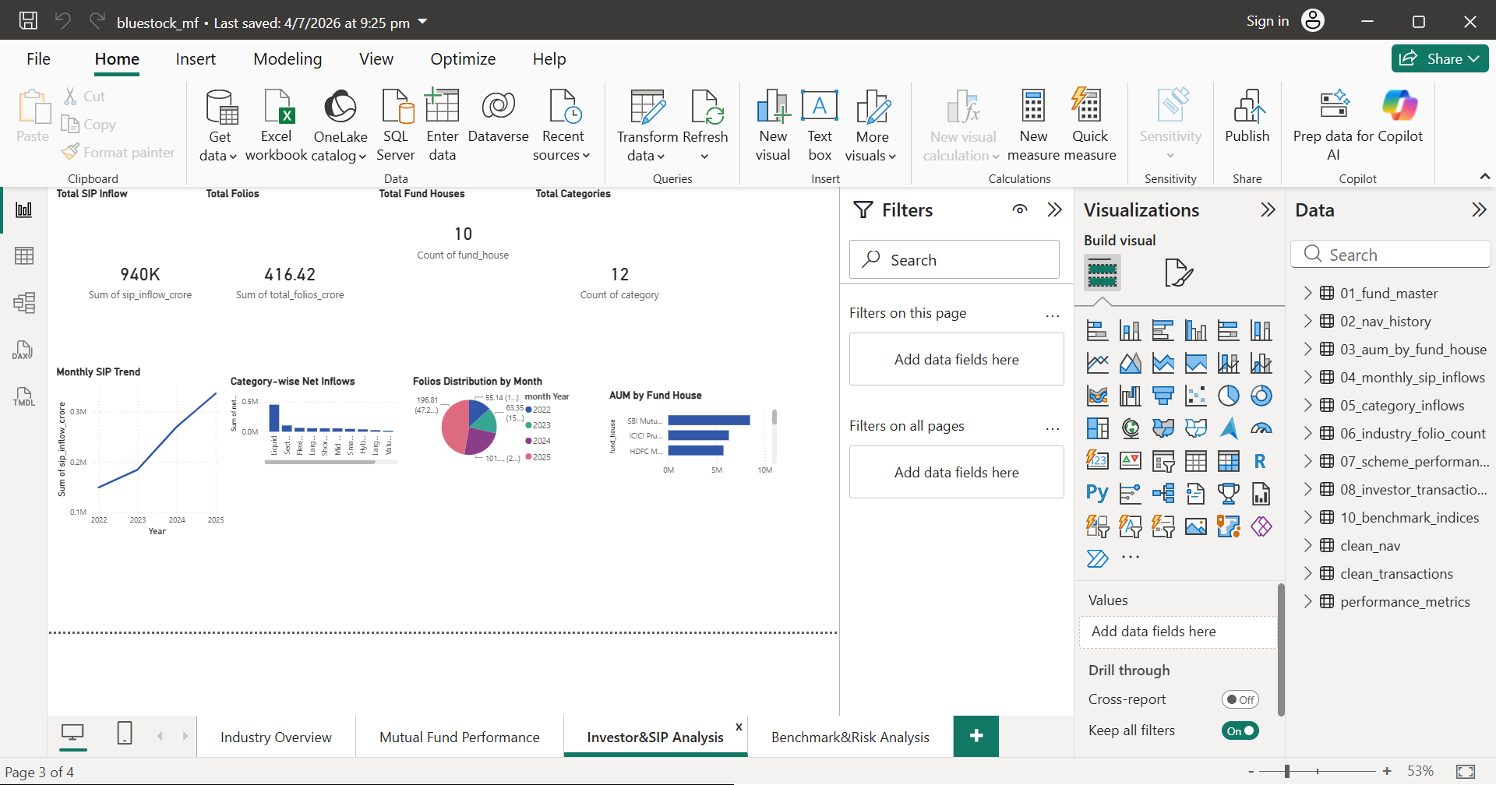
Power BI Dashboard
Page 3 – Investor & SIP Analysis
Monthly SIP Inflows ,Category-wise Inflows, Investor Transactions, Investment Trends, Investor Behavior Analysis
Page 4 – Benchmark & Risk Analysis
Maximum Drawdown, Benchmark Comparison ,Top Performing Funds ,Risk Distribution ,Risk Assessment

Slide 10
Results
Successfully collected and processed mutual fund datasets.
Built an automated ETL pipeline.
Stored cleaned data in SQLite.
Calculated financial performance metrics.
Developed interactive Power BI dashboards.
Generated mutual fund recommendations.
Enabled data-driven investment analysis.

Slide 11
Conclusion
Developed a complete Mutual Fund Analytics solution.
Integrated Python, SQL, SQLite, and Power BI.
Automated the complete data analytics workflow.
Provided meaningful financial insights.
Supported better investment decision-making.

Slide 12
Future Scope
Real-time dashboard refresh.
Machine Learning-based recommendation system.
Portfolio optimization.
Web application deployment.
Cloud database integration.

Slide 13
THANK YOU

