Slide 1
FINANCIAL SALES DASHBOARD

Slide 2
About the Dashboard
The Financial Sales Dashboard you shared is a well-designed visual tool used to monitor and analyze sales performance across different dimensions. Here's a detailed explanation of what this dashboard conveys:
Purpose of the Dashboard
To provide clear insights into:
Overall sales performance
Profitability
Discounting strategy
Product & market contributions
Trends over time

Slide 3
KEY METRICS
Total Sales
Total Profit
118.73M
16.89M
Avg Discounts
Total Units Sold
13.15K
1.13M

Slide 4
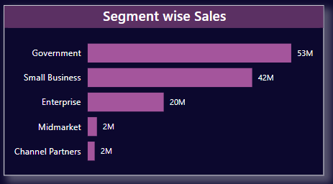
SEGMENT WISE SALES
sales by customer type:
Government (53M) and Small Business (42M) are top contributors.
Enterprise (20M) contributes moderately.
Midmarket & Channel Partners have minimal impact (2M each).
Useful for targeting marketing and sales efforts.

Slide 5
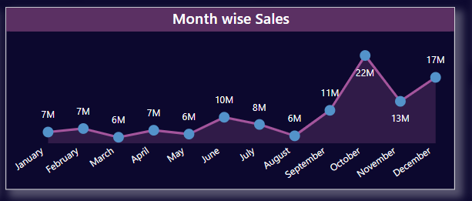
MONTHLY WISE SALES
Line chart showing seasonal or monthly trends.
October (22M) and December (17M) are peak months.
Helps in planning inventory, campaigns, or resources for high/low sales months.

Slide 6
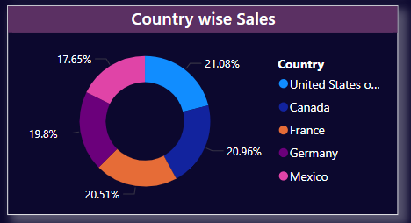
COUNTRY WISE SALES
Pie chart shows distribution by geography:
USA, Germany, France, Canada have nearly equal shares (~20%)
Mexico has the smallest share (~17.65%)
Useful for identifying strong markets and areas needing growth.

Slide 7
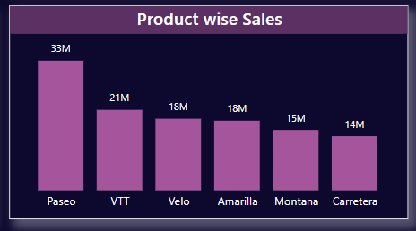
PRODUCT WISE SALES
Bar chart showing top-performing products:
Paseo (33M) leads, followed by VTT (21M).
Carretera is the lowest at 14M.
Helps in product planning and prioritization.

Slide 8
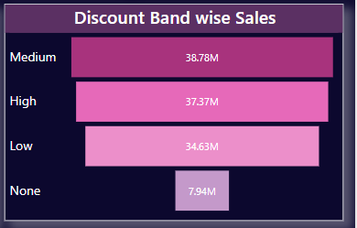
DISCOUNT BAND WISE SALES
Shows how different levels of discounting affect sales:
Medium (38.78M) and High (37.37M) discounts drive most sales.
No discount leads to the least sales (7.94M).
Helps in analyzing pricing strategy effectiveness.

Slide 9
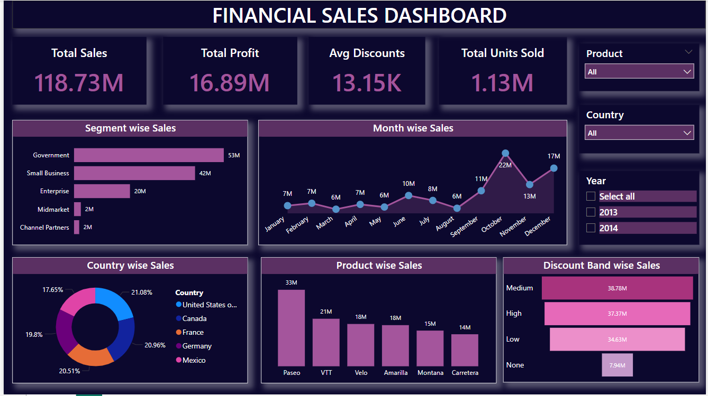

Slide 10
THANK YOU

