Slide 1
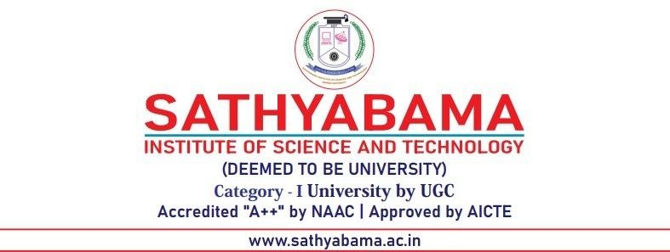
DEPARTMENT OF COMPUTER SCIENCE AND ENGINEERING
Codegene - Skill Enhacement Project
FULL STACK APPLICATION DEPLOYMENT USING DOCKER AND POSTGRESQL (TASKCAFE PROJECT)
PROJECT STUDENT
VEERNALA CHANDRIKA, 43110990

Slide 2
AGENDA
Abstract
Existing System
Proposed System
Advantages
Disadvantages
Hardware Requirements
Software Requirements
Modules
Module Description
Sample Output
Conclusion

Slide 3
ABSTRACT
This project, “Full Stack Application Deployment using Docker and PostgreSQL (Taskcafe Project),” demonstrates how to deploy a complete web application using Docker containers. The Taskcafe app combines a React frontend, a Go backend, and a PostgreSQL database. Using Docker simplifies setup and ensures all parts of the project run smoothly together. This project helps in understanding full stack deployment, database connection, and container-based application management.

Slide 4
EXISTING SYSTEM
The system follows a manual appointment or task scheduling method.
Users manage tasks using the paper records or basic spreadsheets.
No real-time collaboration between team members.
Difficult to track progress or assign responsibilities.
Time-consuming and prone to human errors.
No centralized system for the managing projects or appointments.

Slide 5
PROPOSED SYSTEM
A web-based full stack project management tool is developed.
The system allows users to create, assign, and track tasks easily.
Built using React for frontend and Docker with PostgreSQL for backend deployment.
Provides real-time collaboration among team members.
Enables secure login and user management.
Stores all data in a centralized database, reducing errors.
Offers a dashboard view to monitor project progress efficiently.

Slide 6
ADVANTAGES
A web-based full stack project management tool is developed.
The system allows users to create, assign, and track tasks easily.
Built using React for frontend and Docker with PostgreSQL for backend deployment.
Provides real-time collaboration among team members.
Enables secure login and user management.
Stores all data in a centralized database, reducing errors.
Offers a dashboard view to monitor project progress efficiently.

Slide 7
DISADVANTAGES
Requires internet connectivity to access the system.
Initial setup with Docker and database configuration can be complex.
May consume more system resources during development and deployment.
Limited offline functionality — users cannot manage tasks without network access.
Learning curve for beginners to understand Docker and backend configuration.

Slide 8
HARDWARE REQUIREMENTS
Processor: Intel i3 or higher (AMD equivalent)
RAM: Minimum 4 GB (8 GB recommended)
Hard Disk: At least 10 GB free space
Monitor: 15” or larger display
Keyboard & Mouse: Standard input devices
Internet Connection: Required for Docker setup and web access

Slide 9
SOFTWARE REQUIREMENTS
Operating System: Windows 10 / 11 (64-bit)
Frontend: React.js
Backend: Go (Taskcafe built-in API)
Database: PostgreSQL
Container Platform: Docker Desktop
Code Editor: Visual Studio Code
Version Control: Git & GitHub
Web Browser: Google Chrome / Microsoft Edge

Slide 10
MODULES
1. User Management Module
Handles user registration, login, and authentication.
Allows users to create and manage their personal accounts securely.
Uses PostgreSQL to store user credentials and details.
2. Project Management Module
Lets users create new projects and manage them easily.
Supports project details like title, description, and deadlines.
Allows assigning members and tracking overall progress.
3. Task Management Module
Enables users to create, assign, and track individual tasks.
Supports task priority, deadlines, and progress updates.
Helps organize work using boards and lists.

Slide 11
Module Description
4. Team Collaboration Module
Allows multiple users to work together on the same project.
Enables communication and coordination between team members.
Supports notifications and activity tracking.
5. Database Management Module
Manages all data storage using PostgreSQL.
Ensures data consistency, security, and quick access.
Handles tables for users, projects, and tasks efficiently.
6. Deployment & Integration Module
Uses Docker to containerize frontend, backend, and database.
Simplifies deployment and ensures platform independence.
Helps run the complete application smoothly on any system.

Slide 12
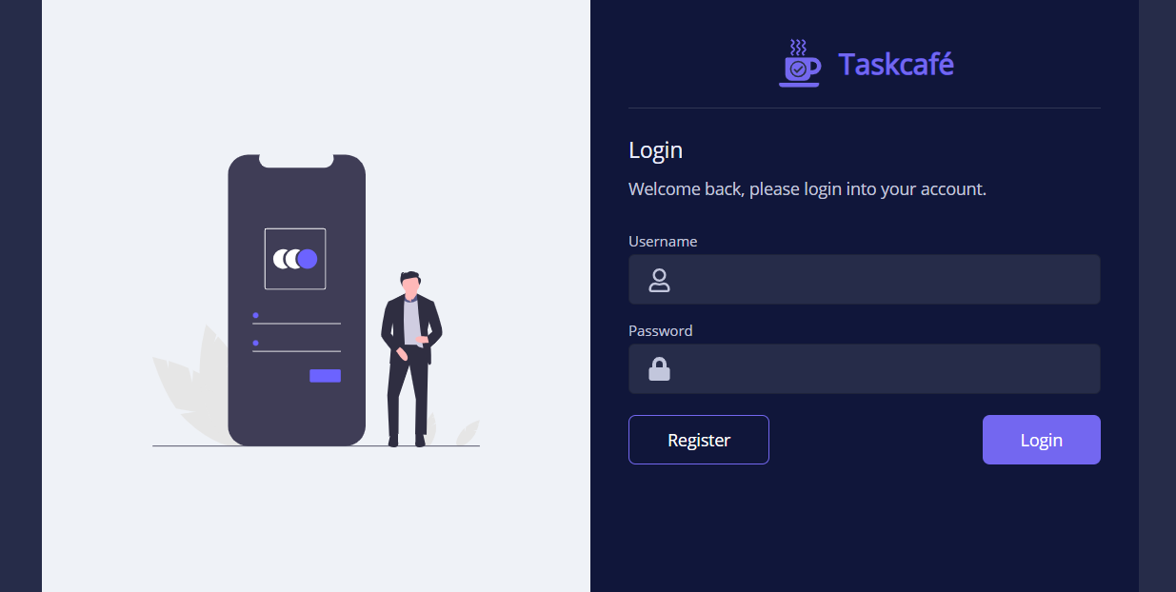
SAMPLE OUTPUT

Slide 13
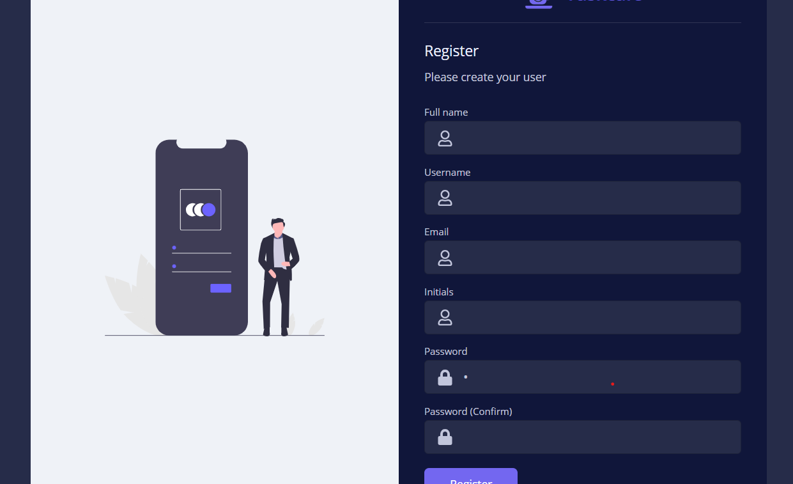

Slide 14
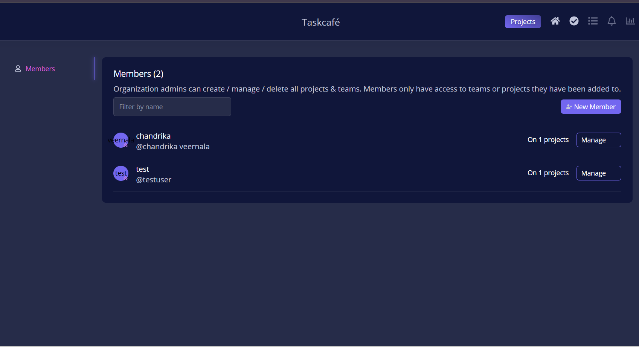

Slide 15
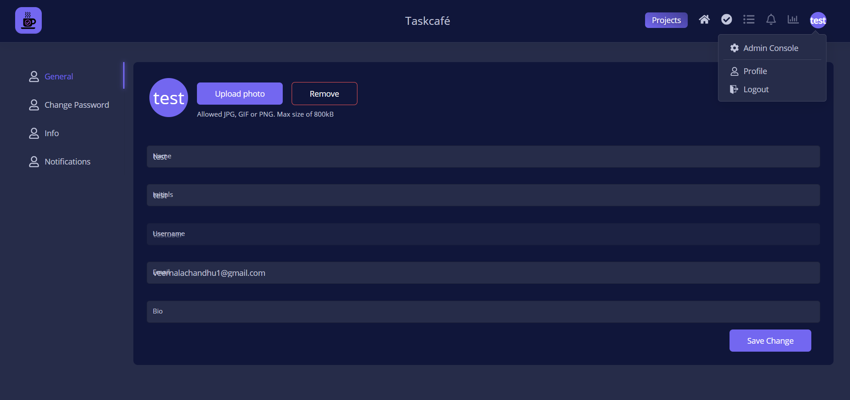

Slide 16
CONCLUSION
The Taskcafe Full Stack Application demonstrates the successful deployment of a modern web-based project management system using Docker and PostgreSQL. It integrates both frontend and backend components within a containerized environment, ensuring seamless performance, scalability, and easy maintenance. This project simplifies task organization and collaboration while highlighting the practical implementation of full stack development and deployment techniques in a real-world environment.

