Slide 1
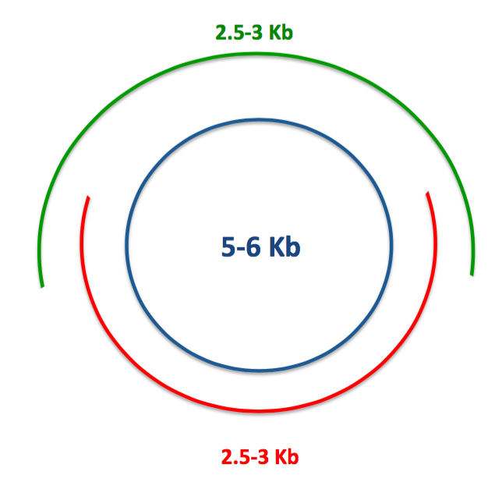
Experimental design
Circular genome
Amplicon 3
Amplicon 4

Slide 2
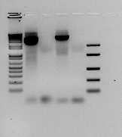
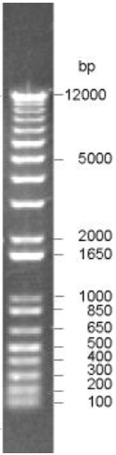
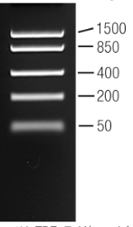
Gel electrophoresis
2.5-3 Kb
Amp1
Amp2
Amp1_ntc
Amp2_ntc

Slide 3
DNA quantification (Qubit HS)
Sample | Elution volume (μL) | DNA concentration (ng/μL)
Amplicon 3 | 50 | 44,6
Amplicon 3 ntc | 50 | -
Amplicon 4 | 50 | 41
Amplicon 4 ntc | 50 | -

