Slide 1
PREDICTIVE ANALYTICS FOR HR STRATEGY
PRESENTED BY :
CHANDRIMA BHOWMICK (AJU/242043)
URMILA DUTTA (AJU/242016)
SWATI KUMARI (AJU/241996)

Slide 2
SUMMARY OF PROJECT
In this project, we explore both predictive and descriptive methods to understand and forecast employee attrition using the IBM HR Analytics dataset. We developed three predictive models — C5.0, C&R Tree, and Linear Regression — to classify and score attrition likelihood. To complement this, we used TwoStep Clustering to uncover natural groupings in the workforce that may influence attrition. Our evaluation focuses on model performance metrics (accuracy, precision, recall, and ROC AUC) and cluster interpretation. This approach enables HR teams to not only predict attrition but also uncover behavioral patterns across employee groups,improving strategic retention planning.

Slide 3
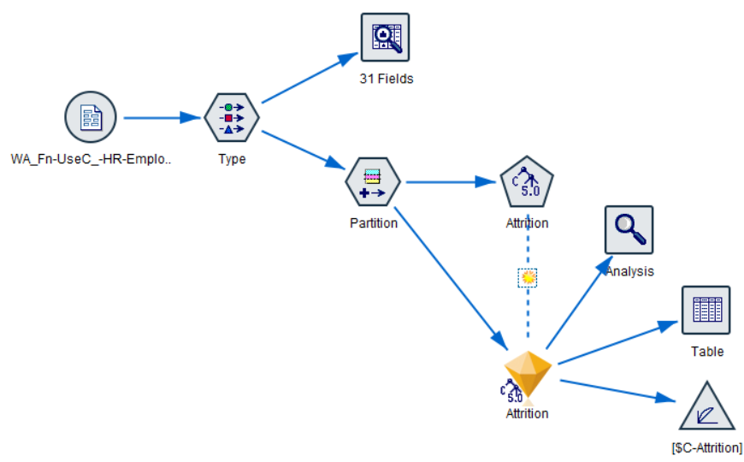
CLASSIFICATION MODEL: EMPLOYEE ATTRITION
Classification is a supervised machine learning technique used in IBM SPSS Modeler to predict categorical outcomes (e.g., “Yes/No”, “Low/Medium/High”, “Leave/Stay”, etc.) based on input features.
C5.0 ALGORITHM :The C5.0 algorithm is an advanced decision tree classification technique used to predict categorical outcomes. It builds a tree by splitting data based on the most significant predictors and generates simple, easy-to-interpret rules.

Slide 4
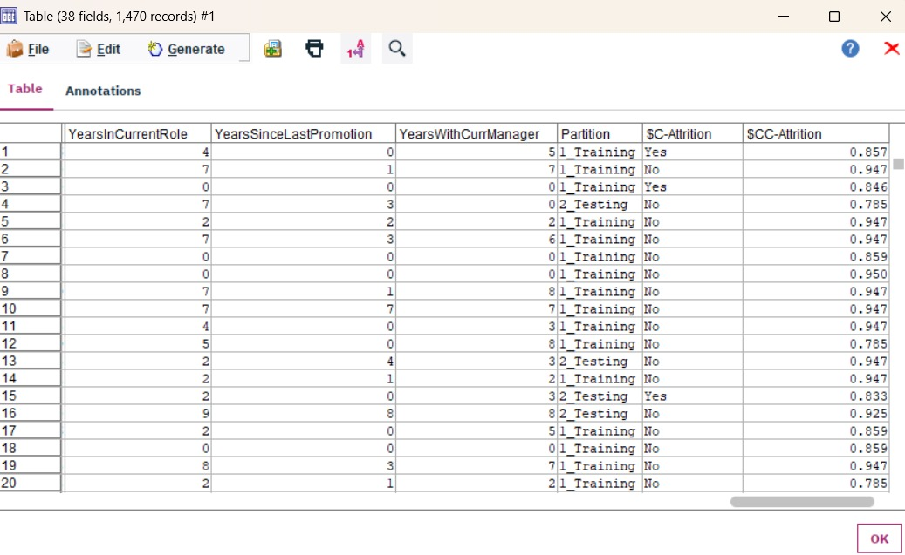
OUTPUT:

Slide 5
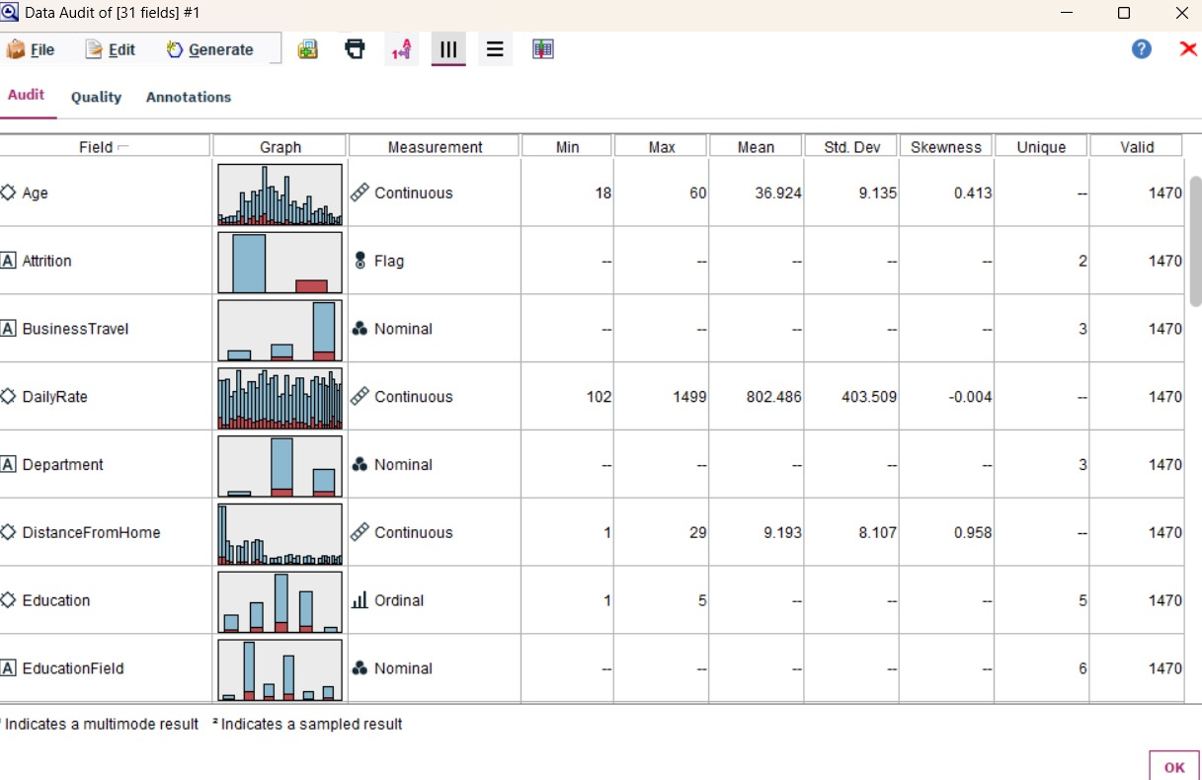

Slide 6
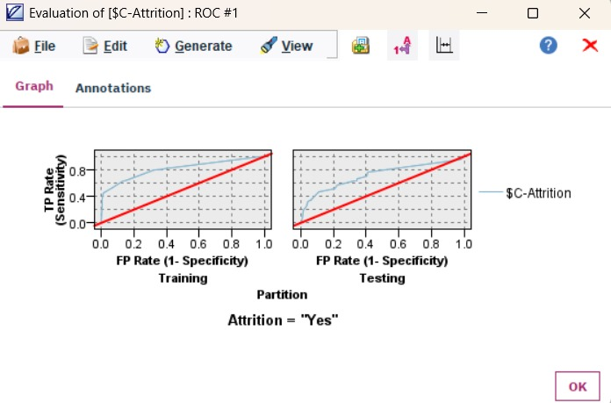

Slide 7
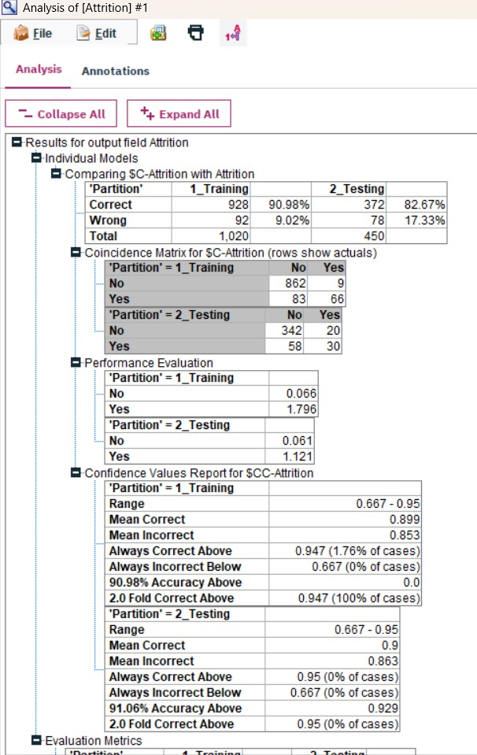


Slide 8
KEY INSIGHTS:
A predictive classification model was developed in IBM SPSS Modeler to forecast employee attrition.
The C5.0 Decision Tree algorithm was used due to its interpretability and ability to handle both categorical and continuous data.
The model achieved an accuracy of 86.69% on test data.
Key factors influencing attrition included:
  OverTime
  Low Job Satisfaction
  Low Total Working Years
The final model nugget generates two key fields for scoring:
  $C-Attrition: Predicted outcome (Yes/No)
  $CC-Attrition: Confidence or probability of the predicted outcome

Slide 9
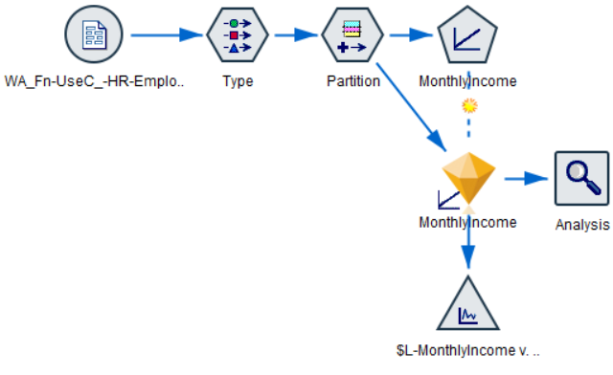
REGRESSION MODEL: EMPLOYEE MONTHLY INCOME
Regression analysis in IBM SPSS Modeler is a supervised learning technique used to predict continuous numeric outcomes (e.g., salary, sales, age, performance score).
It relies on predictor (independent) variables to estimate the dependent (target) variable.
Linear Regression in SPSS Modeler is suitable for explaining and predicting numeric trends using data-driven relationships.
The technique assumes a linear relationship between the input variables and the target variable.
It helps in understanding how changes in predictors influence the numeric outcome.

Slide 10
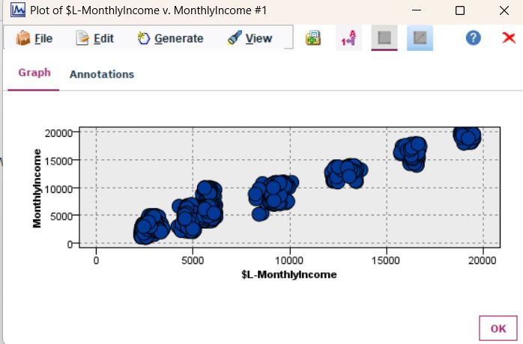
OUTPUT:

Slide 11
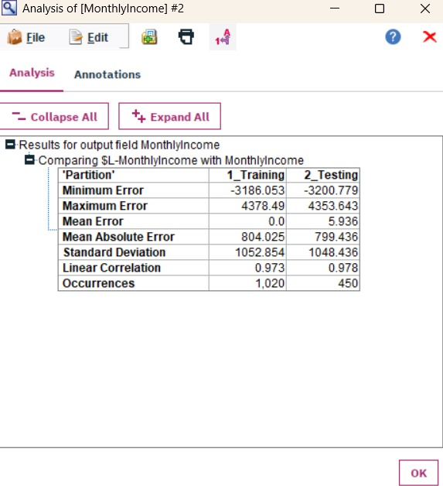

Slide 12
KEY INSIGHTS:
Target Variable: The model is predicting MonthlyIncome.
Data Handling: Automatic data preparation was turned on, meaning missing values, categorical encoding, and normalization were handled automatically.
Model Selection Method:Forward Stepwise selection was used, which iteratively adds predictors that improve the model performance.
Information Criterion: The value is 14,224.308. Lower values indicate a better-fitting model relative to alternatives.
Model Accuracy:The model achieved 94.6% accuracy, indicating a very strong predictive performance for MonthlyIncome.

Slide 13
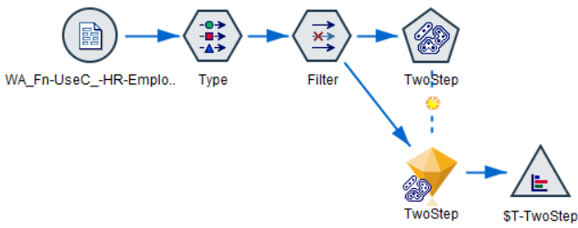
CLUSTERING MODEL: EMPLOYEE SEGMENTATION
A clustering model is an unsupervised machine learning technique used to group similar data points into clusters based on their characteristics or patterns. It identifies natural groupings within data without using predefined labels, helping to discover hidden structures, customer segments, or behavioural patterns

Slide 14
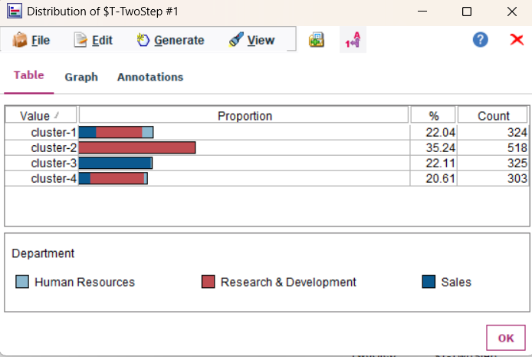
OUTPUT:

Slide 15
KEY INSIGHTS:
Distinct Segments: Four clear employee clusters were identified, mainly grouped by job role and seniority (job level).
Main Drivers: Job Role is the strongest factor influencing segmentation, followed by Job Level.
Less Impactful Factors: Monthly Income and Distance from Home had minimal influence on clustering.
Cluster Composition:
Cluster 1: Core Sales employees.
Cluster 2 & 3: Two R&D groups differentiated by seniority or roles.
Cluster 4: Diverse mix, primarily HR staff.
Overall Insight: Employee segmentation is primarily based on occupation and seniority, resulting in specialized clusters for Sales and R&D, and a mixed HR-oriented group.

Slide 16
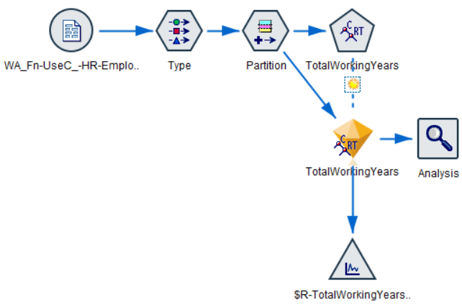
Regression model: Total working years

Slide 17
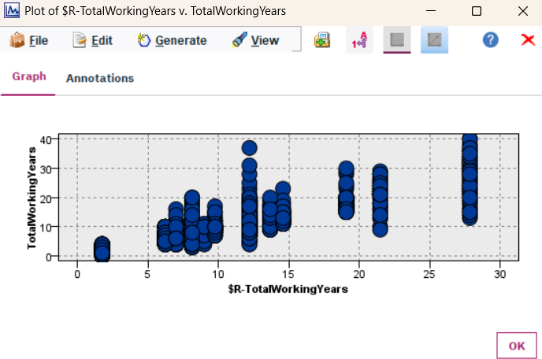
OUTPUT:

Slide 18
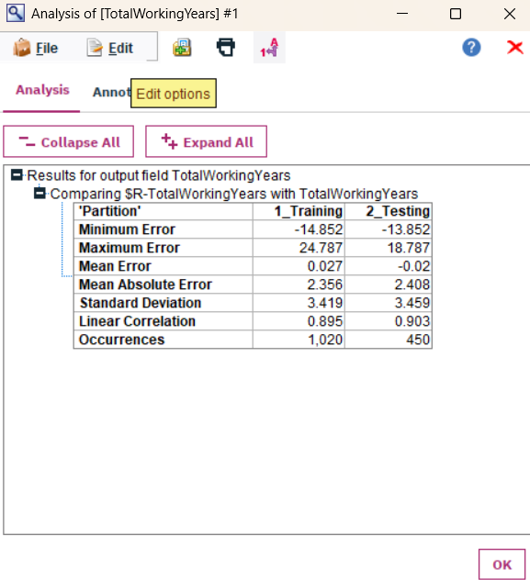

Slide 19
KEY INSIGHTS:
Employee segmentation is primarily based on occupation and seniority, resulting in specialized clusters for Sales and R&D, and a mixed HR-oriented group.
The model's Prediction Structure is Rule-Based, confirmed by the vertical clusters in the plot, showing it segments employees into specific experience groups (e.g., Junior, Senior).
The model is Highly Predictive, demonstrated by a strong Linear Correlation of approximately 0.90 between the actual and predicted working years.
The Prediction Error is Low, with the Mean Absolute Error (MAE) being only around 2.4 years, meaning the model's estimate is very close to the true experience level.
The model is Stable and Reliable for new data, as the prediction error is consistent across both the training and testing partitions.
This model creates Actionable Career Benchmarks, providing the rules needed to assess if an employee's profile aligns with their expected total working years for proactive career planning.

Slide 20
Conclusion:
The completion of four analytical models has created a strong data-driven framework for human capital management, enabling a shift from reactive HR decisions to a proactive, evidence-based approach. The analysis revealed two key focus areas:
Retention Risk Identified: The C5.0 model’s low recall (~25%) shows most at-risk employees are being missed—re-tuning is urgently needed.
Targeted Interventions: The Two-Step Clustering model defined four employee segments, highlighting the High-Risk group (low income, high overtime) for focused action.
Structural Fairness Insights: Regression models revealed a strong link between Job Level and pay, exposing a “loyalty penalty” for long-tenured employees without promotion.
Policy Recommendation: Use these insights to revise compensation structures, address salary stagnation, and promote equitable growth opportunities.

