Slide 1
PREDICTION OF LIFE_EXPECTANCY AGE
By-
CHANDRIMA THAKUR

Slide 2
CONTENT
OBJECTIVE
DEPENDENT VARIABLE
VARIABLE AND OBSERVATION
UNIVARIATE ANALYSIS
BIVARIATE ANALYSIS
SIGNIFICANT VARIABLES
INSIGNIFICANT VARIABLES
VARIABLE RELATIONSHIP
RESULTS OBTAINED
SUGGESTIONS

Slide 3
OBJECTIVE
The dataset comes from the Global Health Observatory (GHO) data repository under World Health Organization (WHO) keeps track of the health status .
The dataset is related to life expectancy.
All categories of health-related factors only those critical factors are chosen that affect the Life Expectancy.
To predict the future Life Expectancy Age of the people.
To analyze how each factors help in the future prediction

Slide 4
DEPENDENT VARIABLE
The target variable for the case-study is Life_Expectancy
It is a continuous variable
It contains the Life Expectancy age of people
we can see the maximum age of people lies between 60 to 80 years

Slide 5
VARIABLES AND OBSERVATIONS
There are total 23 variables in the case study.
The variables are Life_Expectancy , Alcohol , Adult_Mortality , Infant_Deaths , Percentage_Expenditure ,Hepatitis_B ,Measles ,BMI ,Under.five_Deaths ,Polio ,HIV.AIDS ,GDP , Total_Expenditure,Diphtheria , Per_Capita_GDP , Population,Thinness_1.19_Years ,Thinness_5.9_Years, Schooling, Income_Composition_of_Resources are continuous variables.
The variables Country,Year and Status are categorical variables.
The missing value treatment was done using mean and median.
The Outliers treatment was done using boxplot.
The target variable is Life_Expectancy .
The are variables that have strong relation with target variable and we consider them. There are also variables that has weak relation with target variable and are not useful for the prediction we discard them.

Slide 6
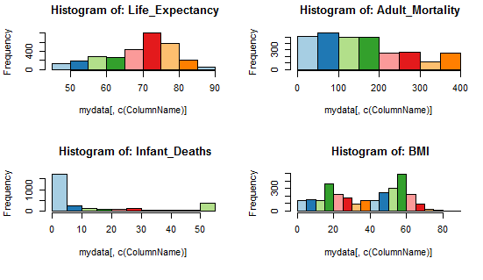
UNIVARIATE ANALYSIS : HISTOGRAM FOR CONTINUOUS VARIABLE

Slide 7
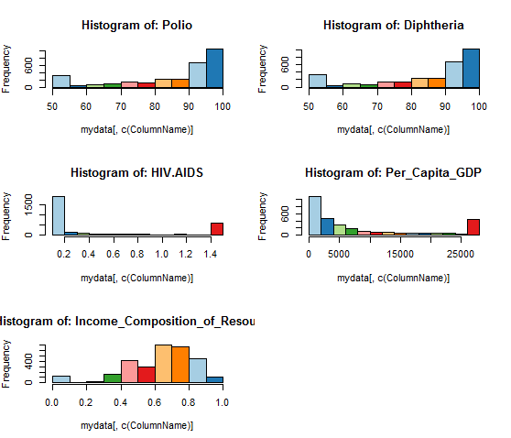
UNIVARIATE ANALYSIS : HISTOGRAM FOR CONTINUOUS VARIABLE

Slide 8
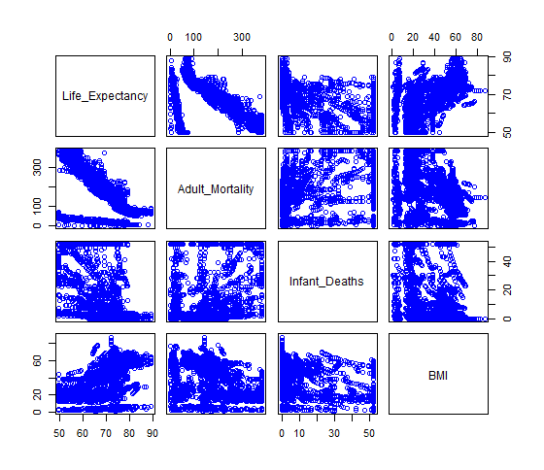
BIVARIATE ANALYSIS : SCATTER-PLOT FOR CONTINUOUS VARIABLE

Slide 9
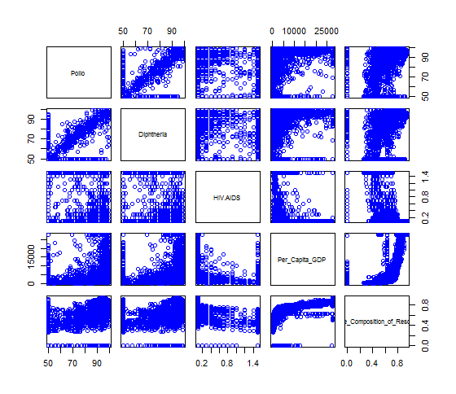
BIVARIATE ANALYSIS : SCATTER-PLOT FOR CONTINUOUS VARIABLE

Slide 10
SIGNIFICANT VARIABLES
The Significant variables (having strong co-relation with the target variables and less p-value ,having no multicollinearity and auto-corelation ) are:
Adult_Mortality
Infant_Deaths
Polio
Diphtheria
HIV.AIDS
Per_Capita_GDP
Thinness_5.9_Years
Income_Composition_of_Resources

Slide 11
INSIGNIFICANT VARIABLES
The Insignificant variables (having poor co-relation with the target variables , high p-value ,showing high multicollinearity ,having no relation with the target variables) are:
Country
Year
Status
Schooling
Alcohol
Percentage_Expenditure
Hepatitis_B
Measles
Total_Expenditure
GDP
Population
Under.five_Deaths
Thinness_1.19_Years
BMI

Slide 12
VARIABLE RELATIONSHIP
Positive variables:Polio, Diphtheria, Per_Capita_GDP , Income_Composition_of_Resources
Negative Variables:Adult_Mortality, Infant_Deaths, HIV.AIDS, Thinness_5.9_Years

Slide 13
RESULTS OBTAINED
Multiple R-squared :0.8513
Adjusted R-squared :0.8507
DW = 0.67128(no auto-correlation)
VIF for all significant variables < 4(no multi-collinearity )
Accuracy: 85%
Mean Accuracy :96.0690183360353
Median Accuracy :97.2630023747313

Slide 14
SUGGESTIONS
If the Adult_Mortality rate increases there will be a decrease in the rate of Life_Expectancy of people. So we should keep a check in the Adult_Mortality.
If the Infant_Death rate increases there will be a decrease in the rate of Life_Expectancy of people. So we should keep a check in the Infant_Death.(we should try to save more infants)
If the HIV_AIDS rate increases there will be a decrease in the rate of Life_Expectancy of people. So we should keep a check in the HIV_AIDS.(people having hiv-aids are prone to die more)
If the Life_Expectancy rate increases there are chances of increasing Polio,Per_Capita_GDP, Income_Composition_of_Resources rate.

Slide 15
THANK YOU.

