Slide 1
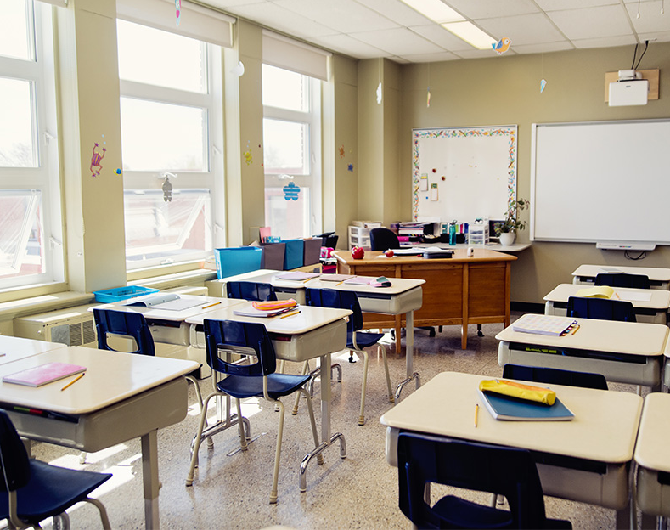
STUDENT ATTENDANCE MONITORING USING FACIAL RECOGNITION IN A CLASSROOM 25th Nov 2020
15EC401M – Multidisciplinary Design
Batch number:18
Team members
1) K CHANDRASEKARAN RA1711004040028
2) S AATHITH RA1711004040030

Slide 2

Existing problem
Student’s attendance in the classroom is a very an important task.
The existing method of taking attendance consumes a finite of amount of time which can be used for other productive action.
We are focused on addressing this problem on schools and universities only.

Slide 3
Motivation
We found this problem in many universities and schools.
We want a reliable system which identifies which student is present in the classroom and gives the attendance based on his presence.
This system must not be complex and very easy to interact with it.

Slide 4

Literature Survey

Slide 5
Existing Recognition systems
Fingerprint based recognition system
Distracts the attention of students during lecture time
Queuing takes place
RFID based recognition
Possibilities that Fraudulent may occur
Cheat the system by giving proxy (for example a student misuse it by wearing another student’s ID card )
IRIS based recognition system
Can't use a regular camera
Visible light must be minimized for maximum accuracy

Slide 6

Proposed work
Attendance is monitored and marked present or absent depending upon the presence of the student inside the class at the particular time of lecture.
Our solution uses a camera that takes photo of a group of students, and then uses facial recognition for marking attendance for a student.
We found that facial recognition overcomes some of the problems that exist in the previously mentioned attendance systems .
Our solution makes sure that there is a minimal interaction between students and the attendance monitoring system .

Slide 7
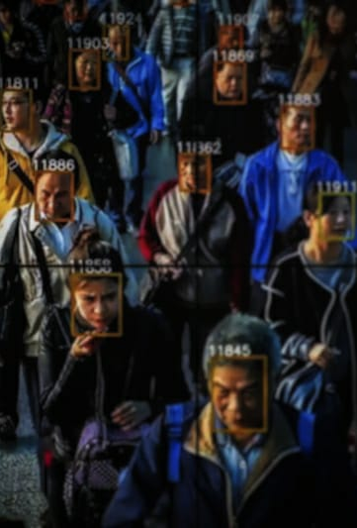
Facial recognition
Any facial recognition has 2 steps
Facial detection – the process of finding a face in a given image
Facial recognition – the process of identifying the person from the image of a face (example : face id in apple )
Every 5 minutes the camera takes the picture and facial recognition is done on the picture.
The process of facial recognition can be implemented in a separate computer as the burden on the camera system must be reduced.

Slide 8
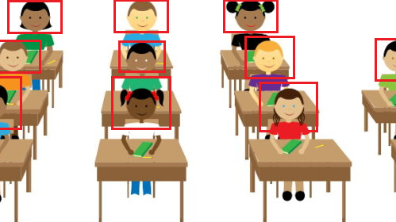
An example of Facial recognition in class

Slide 9

Sub Systems

Slide 10
Major Sub systems
System Attached in the class to take photos (Image processing)
System that marks the attendance against the face in the photos(ML/DL)

Slide 11
System that takes photo
Camera
System that signals the camera
System that transports the photo to next system for processing the photos

Slide 12

System that marks the attendance
Contains the following systems inside it
System that receives the photo
System that runs the face detection algorithm that outputs “m” detected faces
System that outputs a descriptor for “m” faces
System that iterates through “m” descriptor and marks the attendance

Slide 13

More explanation about a few systems that is inside the sub systems

Slide 14
System that marks the attendance - System that outputs a descriptor for “m” faces
System that iterates through the “m” detected faces and calls the following sub systems
System that outputs a descriptor(fixed size) for one face (Facial recognition)
System that stores these “m” descriptors

Slide 15
System that marks the attendance – System that iterates through “m” descriptors and marks the attendance
System that iterates through the database containing “n” descriptors
System that checks whether 2 descriptors are same
System that gives the register number of a given descriptor
System that marks the attendance against the register number

Slide 16

Mathematical Modelling

Slide 17
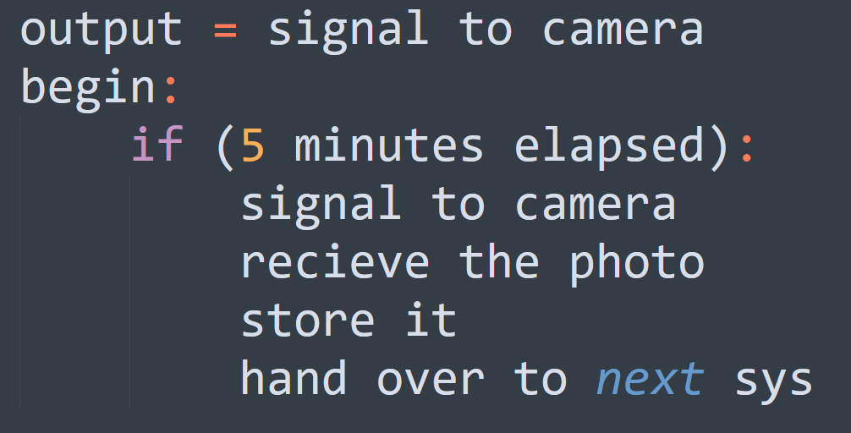
System that takes photo - System that signals the camera

Slide 18
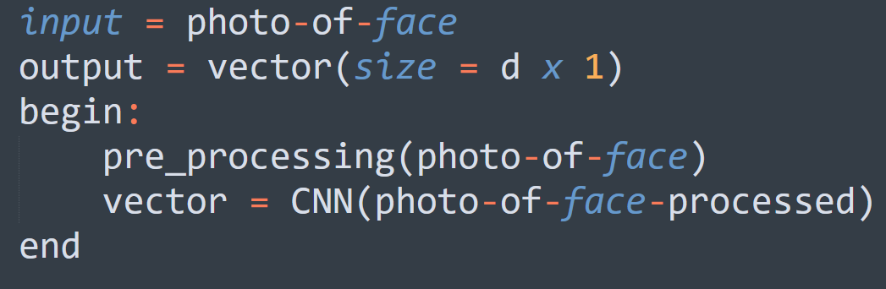
System that marks the attendance - System that outputs a descriptor(fixed size) for one face (Facial recognition)

Slide 19
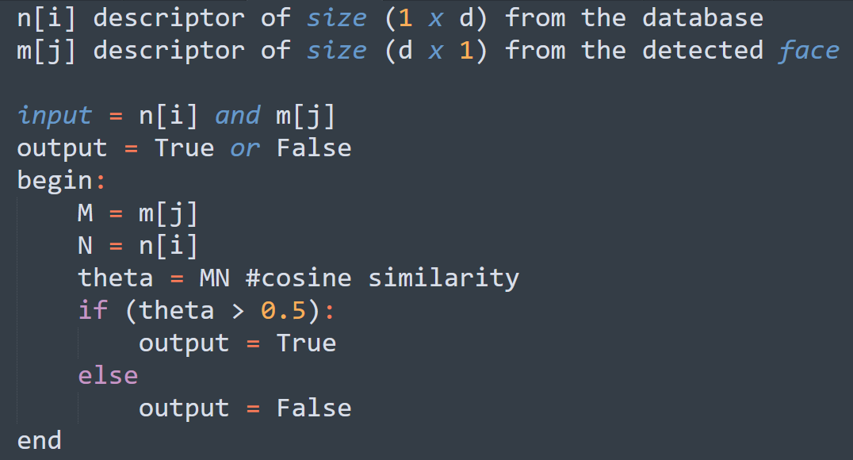
System that marks the attendance - System that checks whether 2 descriptors are same

Slide 20

Objectives

Slide 21
1st Objective
One camera
One person to stand before the camera
Detect the face in the image and run the face recognition
2nd Objective
One person
A group of people
Run a face detection model to find the faces in the picture and face recognition algorithm against it

Slide 22
3rd Objective
Try different face detection algorithms
Select the algorithm which has lowest false negatives
Note down other metrics like
The least dimension of the facial image that is required for the face detection algorithm.
4th Objective
Design the camera position , the angle etc.
The algorithm that was decided on 3rd objective to be used here to test the camera angle and other metrics like finding how many persons can be covered.

Slide 23
5th objective
Find the best camera angle and algorithm (both face detection and face recognition) that has reduced false negatives, is fast etc.
Iterate through 3 and 4 objective to find the best combination of camera and algorithm

Slide 24

Constraints

Slide 25
Camera
Proper lighting should be there.
The position of camera should not be changed as it is fixed (depends on the algorithm ).
As when the distance increases the image resolution of detected face decreases.

Slide 26
Face detection and recognition
The face or faces should not be covered.
There is a maximum distance till which a student can sit for the camera to detect the face beyond that facial recognition won't work.
When the photo is taken if he/she covers their face then the algorithm can miss the attendance of the person in that time frame.
If physical characteristics of people change over time — if they gain weight, lose their hair, grow a beard or start wearing glasses, it is tough for face recognition.

Slide 27

Conceptual Design

Slide 28
3 Questions
What are the needs
A reliable system which identifies which student is present in the classroom and gives the attendance based on his presence
How can the needs be met
uses a camera that takes photo of a group of students, and then uses facial recognition for marking attendance for a student
How well the needs are met
found that facial recognition overcomes some of the problems that exist in the previously mentioned bio metric attendance systems subjected to the constraints mentioned in the previous slides

Slide 29

A basic block diagram

Slide 30
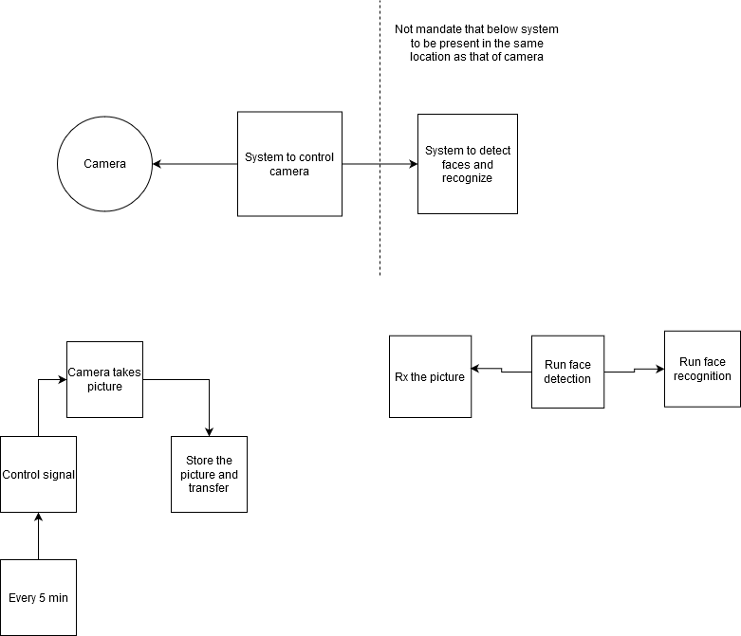

Slide 31
Our implementation
Using this 2 algorithms
Facial detection - DLIB HOG (Histogram of Oriented Gradients)
Facial recognition – Facenet (A deep learning based model that has 128 descriptors )
Raspberry pi can be programmed to perform the role of all the major sub systems discussed before

Slide 32
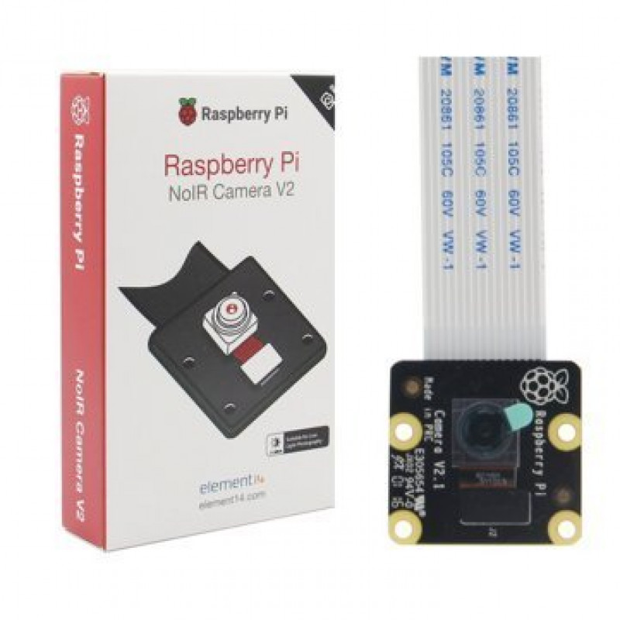
Raspberry Pi 8MP Camera Module V2 with Cable

Slide 33
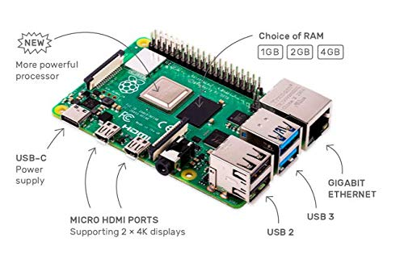
Raspberry pi 4 (4GB RAM)

Slide 34

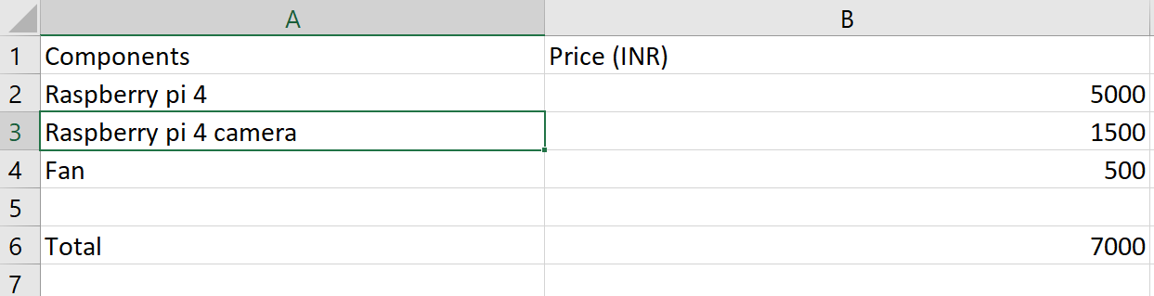
Estimated Cost

Slide 35
Future work
In the future we can implement a separate system for running face recognition, connecting the system in class with the other system wirelessly
Using lidar we can try to improve the facial recognition algorithm which depends on 2D image
An IR lidar will enable us to detect face even in darkness
Also we will try to integrate surveillance into this system

Slide 36
References
C. Ding and D. Tao. Trunk-branch ensemble convolutional neural networks for video-based face recognition. IEEE Trans Pattern Anal Mach Intell, 40(4):1002–1014, apr 2018.
Y. Chen, Y. Tai, X. Liu, C. Shen, and J. Yang. FSRNet: End-to-end learning face super-resolution with facial priors. In 2018 IEEE Conference on Computer Vision and Pattern Recognition (CVPR). IEEE, 2018.
https://www.learnopencv.com/face-detection-opencv-dlib-and-deep-learning-c-python/
https://www.electronicscomp.com/raspberry-pi-8mp-noir-camera-module-v2-india?gclid=CjwKCAiA2O39BRBjEiwApB2Ikjhc_K3Lxq-xtrgZNZA4mhJy12pRJj8mdGWV0sX2t-iGZRdeBfWyRBoCfuAQAvD_BwE

Slide 37

Thank You

