Slide 1
CYBER SECURITY PROJECT
STEGANOGRAPHY
Presented By:
1. CHANDRU PADMANABHAN S | VV College Of Engineering | CSE

Slide 2
OUTLINE
Problem Statement
Proposed System/Solution
System Development Approach
Algorithm & Deployment
Result (Output Image)
Conclusion
Future Scope
References

Slide 3
Problem Statement
This project aims to create a Python script using OpenCV for steganography, allowing users to hide messages within image files. Users input an image and message, which are encrypted using a password. Decryption requires the correct password to reveal the hidden message. The script outputs the encrypted image, with an option to view it, and displays the original message upon decryption. Key tasks include algorithm design, user input handling, error management, and testing. Deliverables include the Python script and comprehensive documentation. Enhancements could include supporting additional file types, improving encryption security, adding a graphical interface, and implementing image compression.

Slide 4
Proposed Solution
The proposed solution involves creating a Python script named steganography.py using OpenCV for steganography with the following steps:
User Input Handling:Prompt users for image file path, message, and encryption password. Handle errors for invalid inputs.
Encryption:Read the image with OpenCV. Encode the message into the image's RGB pixels.
Decryption:Retrieve the encrypted message from the image using the password.
Output Handling:Save the encrypted image as EncryptedImage.jpg.
Error Handling:Ensure graceful error handling and guide users in case of errors.
Testing:Test with various inputs to ensure functionality and security.
Documentation:Provide detailed instructions, including installation steps and output interpretation.
Potential Enhancements:Support different file formats.
Enhance encryption methods for better security.
Develop a user-friendly graphical interface.
Implement features like image compression.

Slide 5
System Approach
The "System Approach" section outlines the steganography system's development strategy. Hardware requirements: dual-core processor, 4GB RAM, ample storage; GPU optional for faster processing. Software: Python 3.x, OpenCV (via pip), numpy, argparse. Supported image formats: JPEG, PNG, BMP. OpenCV (cv2) is the primary library, known for image manipulation. Integration is simple via pip or conda. Adherence to these requirements enables efficient development and deployment for concealing and retrieving secret messages within image files.
Hardware requirements: dual-core processor, 4GB RAM, ample storage space.
Optional GPU usage for accelerated processing.
Software requirements: Python 3.x, OpenCV (installable via pip), numpy, argparse.
Supported image formats: JPEG, PNG, BMP.
OpenCV (cv2) serves as the primary library, renowned for its image manipulation capabilities.

Slide 6
Algorithm & Deployment
Algorithm:
Encryption: Read image, convert message to binary, modify LSBs of RGB, scramble with password, save.
Decryption: Read encrypted image, extract LSBs, decrypt with password, convert binary to original message.
Deployment:
Development: Write Python script with OpenCV, ensure error handling and robustness. Consider modular design for scalability.
Environment Setup: Install Python 3.x, OpenCV, numpy, argparse. Deploy on target system(s) meeting hardware and software requirements.
Usage Instructions: Provide clear instructions with examples, and consider developing a user-friendly GUI for enhanced usability.
Maintenance and Updates: Schedule regular updates, incorporate user feedback for feature enhancements, and stay informed about steganography advancements to ensure the system's effectiveness and security. Regularly update documentation for clarity and ease of use.

Slide 7
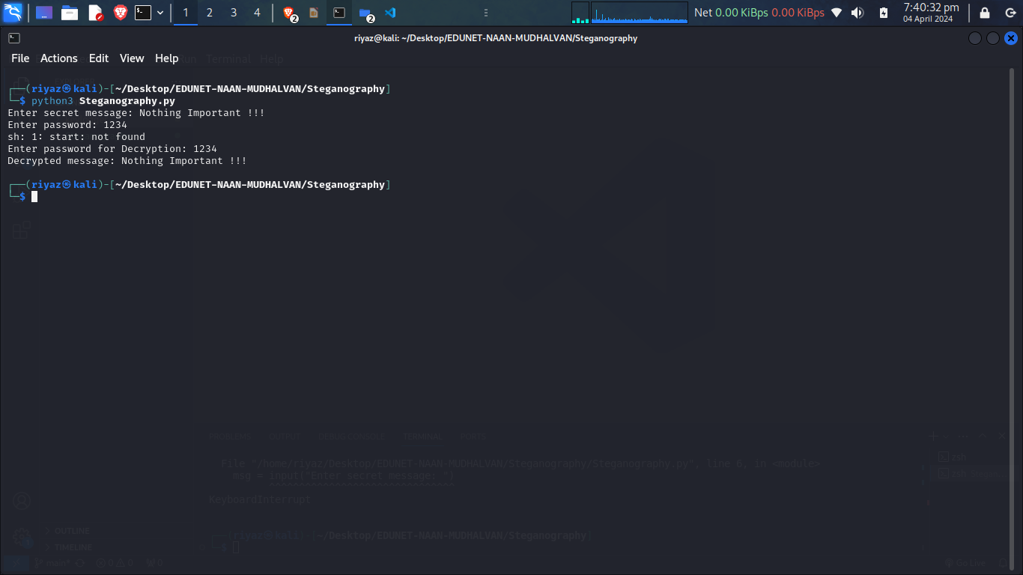
Result

Slide 8
Conclusion
In conclusion, the development and deployment of the steganography system present a robust solution for concealing and retrieving secret messages within image files. By adhering to the outlined algorithm and deployment strategy, users can efficiently encrypt and decrypt messages while maintaining security and usability. Leveraging Python with OpenCV and additional libraries ensures flexibility and scalability in implementing the system across different platforms. Regular maintenance, updates, and user feedback integration are essential for continuous improvement and adaptation to evolving steganography techniques. Overall, the steganography system offers a reliable and effective means of secure communication through hidden messages within images.

Slide 9
Future scope
In steganography, future development focuses on enhancing security through advanced encryption techniques and stronger cryptographic algorithms. Performance optimization is crucial, especially for handling large image files. Supporting various image formats and file types improves versatility. A user-friendly graphical interface and cross-platform compatibility enhance accessibility. Integration with communication tools streamlines secure message transmission. Automated key management simplifies encryption while ensuring security. Advanced image processing techniques bolster message hiding and resist detection. Cloud-based solutions offer scalable and distributed message storage and transmission. Continuous research and development drive innovation, ensuring ongoing enhancement of steganography system capabilities and security.

Slide 10
References
OpenCV Documentation: https://docs.opencv.org/
Python Documentation: https://docs.python.org/3/
NumPy Documentation: https://numpy.org/doc/stable/
os module Documentation: https://docs.python.org/3/library/os.html

Slide 11
THANK YOU

