Slide 1
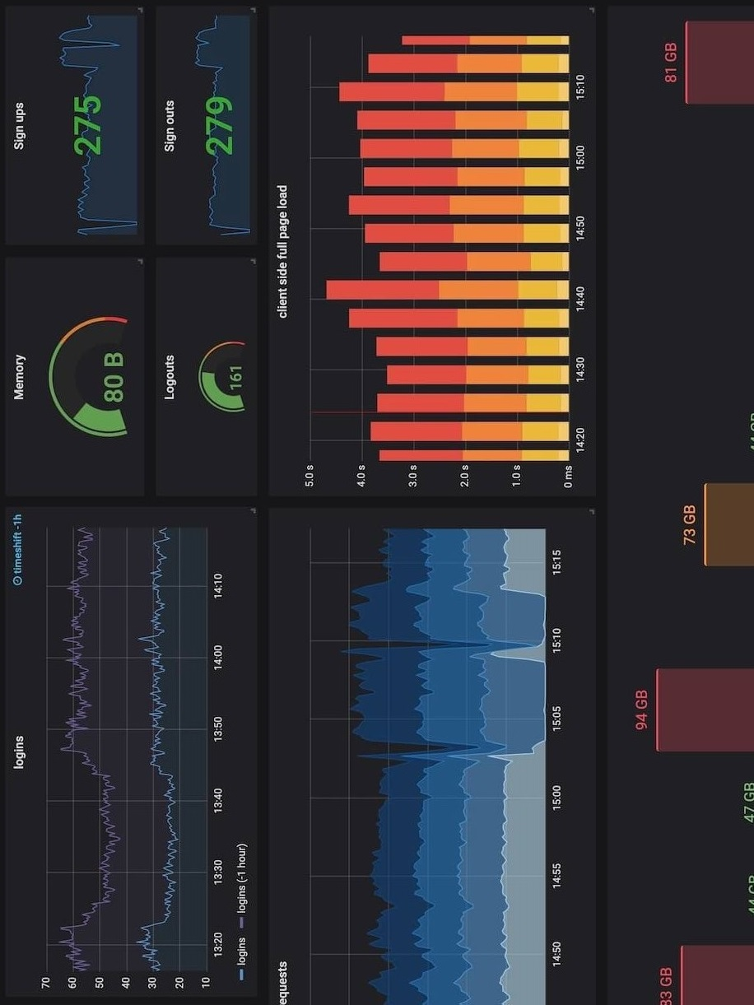
PERFORMANCE TESTING YOUR
OBSERVABILITY STACK
- K6 to the Rescue
Chandra Mohan Dhanasekaran
@ Chandru D

Slide 2
Session Topics
About Me ☺
Observability Landscape
Challenges
Need for Performance Testing
Grafana K6
Setup and Demo

Slide 3






About Me
A Proud Dad of 2 Amazing Boys
Senior AWS Cloud Architect @ Philips
15+ Years experience
Docker Captain
Terraform Book Author
Speaker and Active Blogger
Grafana & Serverless Fan
https://www.linkedin.com/in/chandrud
https://chandrud.substack.com
My mission is to reach the student community and early career professionals to make the right career choices and excel in it with the right skillsets to be deemed 100% fit!

Slide 4
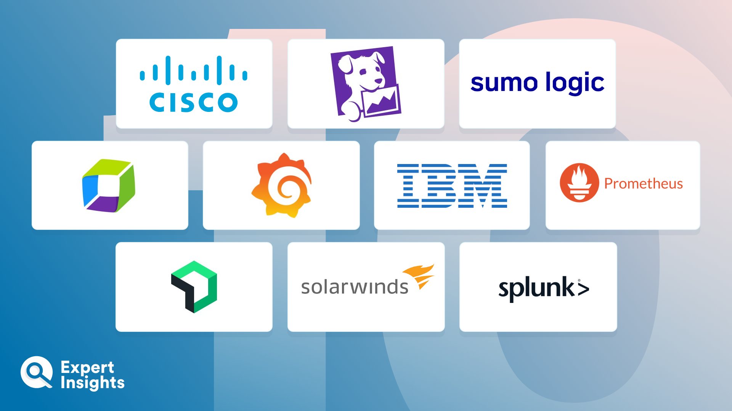
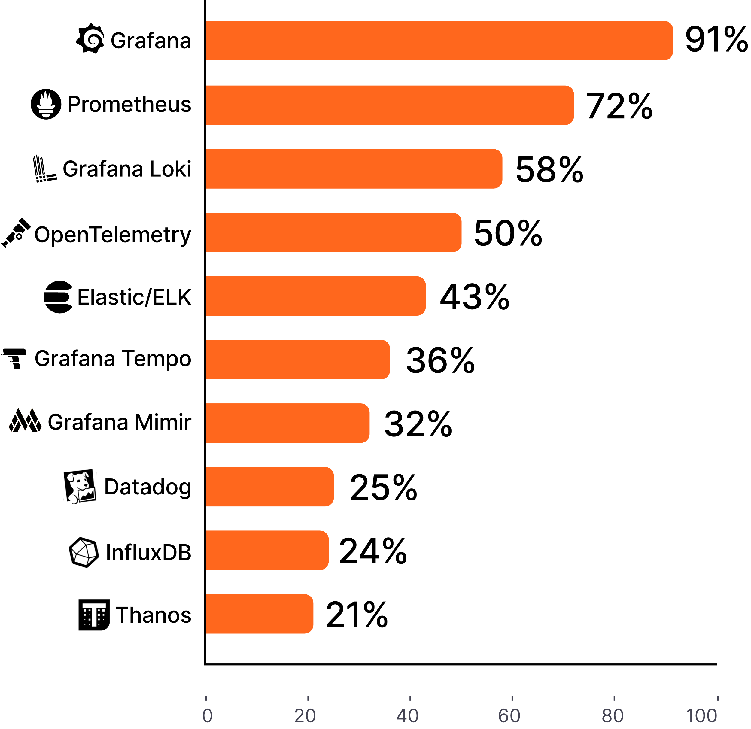
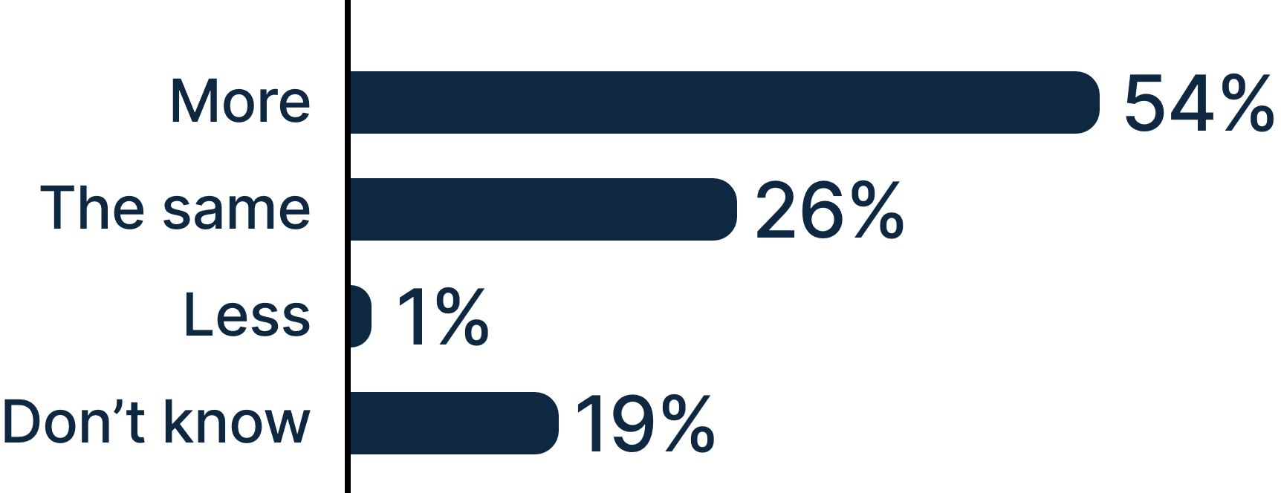

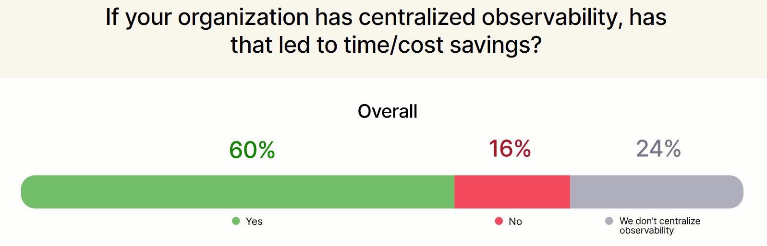
Observability Landscape

Slide 5
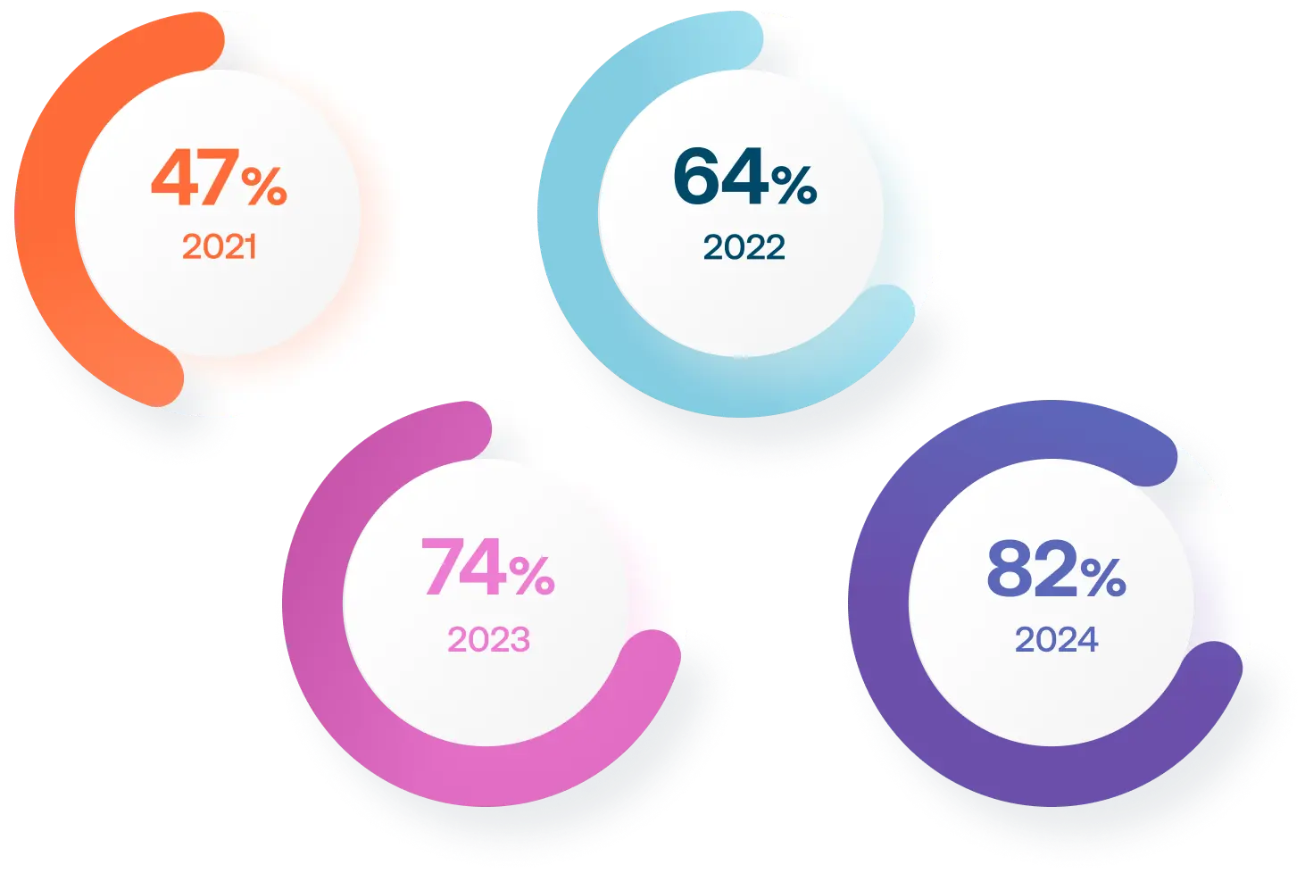
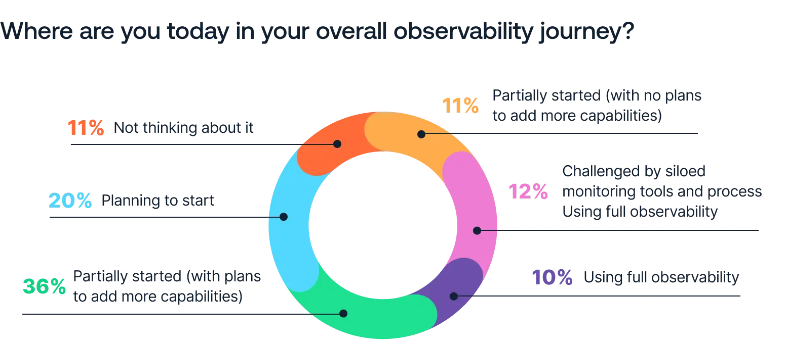
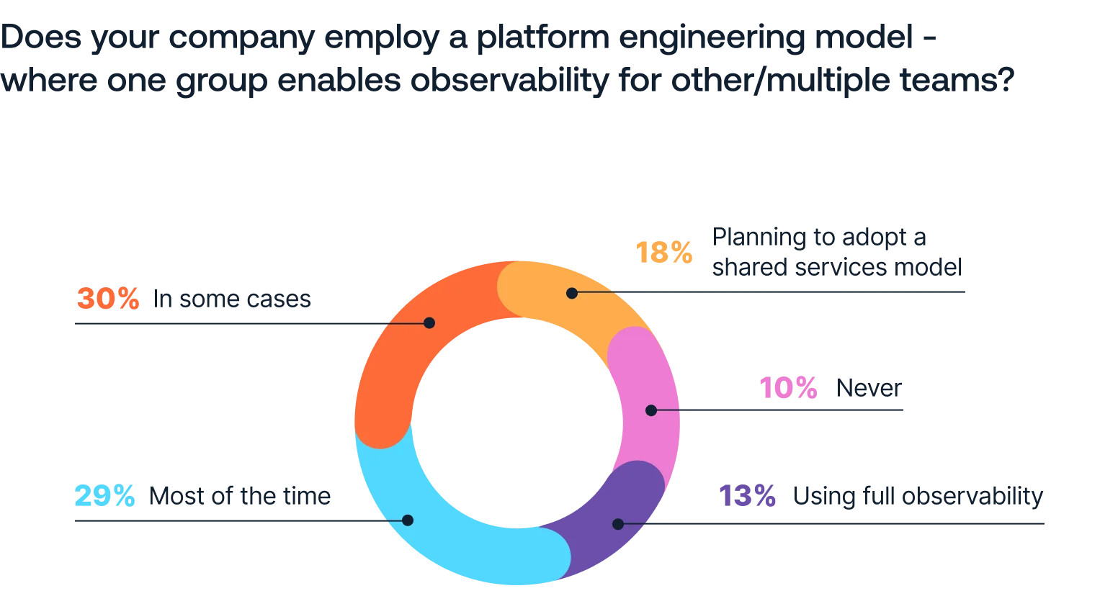
Challenges
Just one out of 10 organizations are utilizing full observability
Increase in MTTR during production incidents
Lack of knowledge among teams in cloud-native environments
Costs are forcing organizations to adapt and evolve their observability practices

Slide 6




RELIABILITY
UNDER LOAD
Helps to identify if the observability tools can handle large amounts of data and traffic without failure
SCALABILITY VALIDATION
Ensures the stack can handle an increasing load of logs, metrics, and traces
RESOURCE OPTIMIZATION
Identifies bottlenecks and resource-intensive processes ensuring optimal usage
LATENCY MINIMIZATION
Ensuring real-time visibility and rapid insights during critical operations
Need for Performance testing

Slide 7

Grafana
Grafana k6 is an open-source, developer-friendly, and extensible load testing tool. k6 allows you to prevent performance issues and proactively improve reliability.
Go based installation
Can run in Linux Docker & Windows
Available in Grafana Cloud
Simple yet powerful

Slide 8
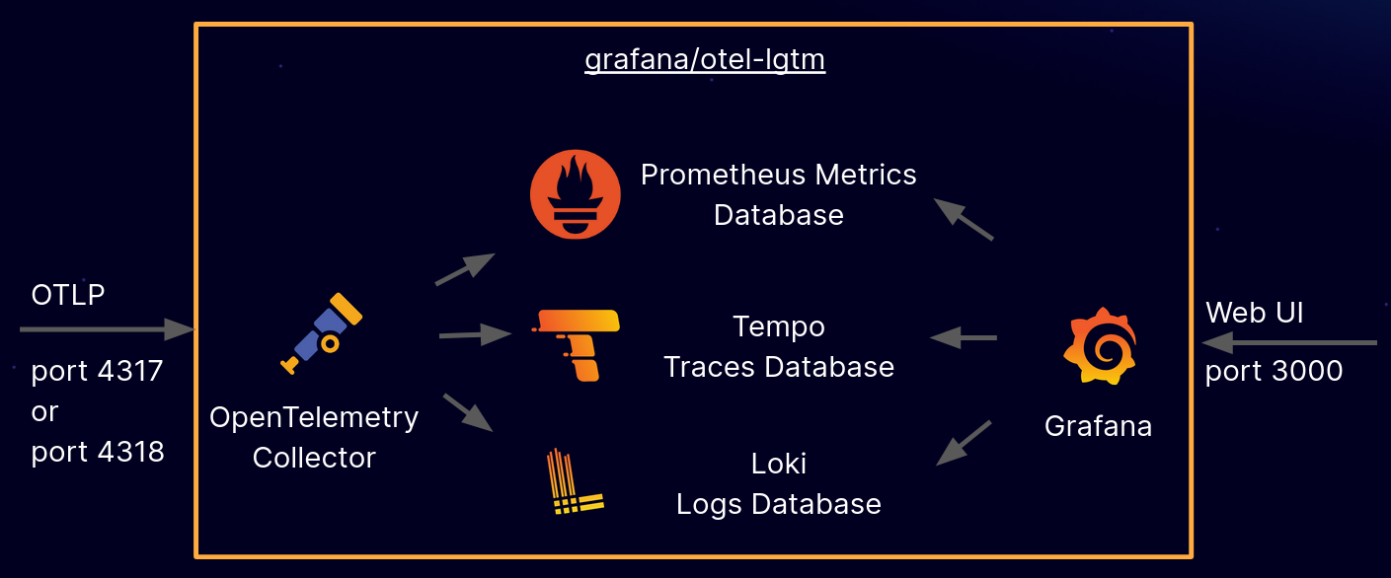
Setup and Demo

Slide 9
Setup and Demo – Commands & Links
docker run -p 3000:3000 -p 4317:4317 -p 4318:4318 --rm -ti --network-alias lgtm --network k6-network grafana/otel-lgtm
docker run -e API_ENDPOINT=http://lgtm:4318 -e TEST_SCOPE=loki -e SCRIPT_NAME=logs-k6-api-loadtest-30s.js --network k6-network --rm -ti k6-performance-tester:v1
Grafana Dashboard - Login
http://localhost:3000 (username: admin, password: admin)
Useful Metrics
http_server_request_duration_seconds_count http_server_request_duration_seconds_sum http_server_request_duration_seconds_bucket
PromQL query
rate(http_server_request_duration_seconds_count[$__rate_interval])

Slide 10
DEMO
TIME

Slide 11

References
Observability Pulse 2024 – Logz.io
https://logz.io/observability-pulse-2024/
Observability Survey 2024 – Grafana Labs
https://grafana.com/observability-survey/2024/
Grafana K6 – Latest Documentation
https://grafana.com/docs/k6/latest/
Grafana LGTM Stack – GitHub Project
https://github.com/grafana/docker-otel-lgtm

Slide 12


Session
Presentation and
demo code
can be accessed
from here

Slide 13


THANK YOU!

Slide 14
THANK YOU!

