Slide 1



Getting Started with Kubescape
Practical Kubernetes Security Scanning
Cloud Native Mysore
Kickoff Event
April 25th 2026
Chandra Mohan Dhanasekaran
Senior Cloud Infrastructure Architect
IBM Labs, Bengaluru

Slide 2
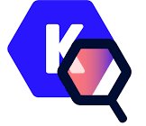
Agenda
About Me
Phippy and Friends ☺
What is Kubescape?
The Core Problem
Security Frameworks
Advantages of Kubescape
Hands-On Demo
Q&A

Slide 3



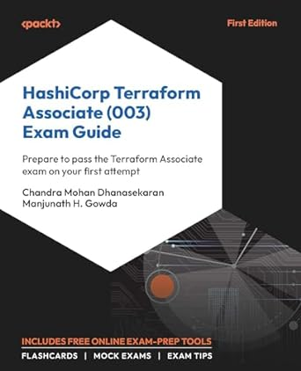
About Me
A Proud Dad of 2 Amazing Boys
Senior Cloud Infra Architect @ IBM Labs
16+ Years experience in software
Grafana & Kubernetes Fan
Docker Captain and HashiCorp Ambassador 2025
Event Speaker and Terraform Book Author
Passionate to connect with students and help building the right skills!

Slide 4

An Illustrated Guide to K8S
Nice video!! ☺

Slide 5

PHIPPY & FRIENDS
https://www.cncf.io/phippy/
Phippy is a simple PHP app, exploring the cloud native world with her friends.

Slide 6
What is Kubescape?
Kubescape is an open-source Kubernetes security platform designed to provide practical, end-to-end security for Kubernetes environments.
Kubescape was created by ARMO and is a Cloud Native Computing Foundation (CNCF) incubating project.
Key capabilities:
Configuration and vulnerability scanning
Policy and compliance enforcement
Network policy and seccomp validation
Runtime detection
Developer and CI/CD integration
Multi-cloud and distribution support

Slide 7
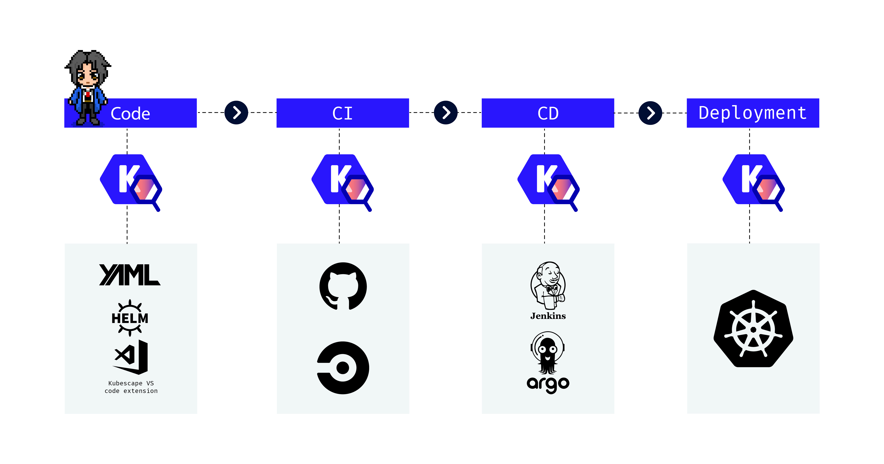
What is Kubescape?
Under the hood
Kubescape uses Open Policy Agent to verify Kubernetes objects against a library of posture controls.
For image scanning, it uses Grype.
For image patching, it uses Copacetic. For eBPF, it uses Inspektor Gadet.

Slide 8
The Core Problem
Kubernetes security isn’t “broken,” but it is dangerously easy to get wrong.
Kubernetes is exceedingly powerful for orchestrating containerized applications at scale. But without proper monitoring and observability—especially in self-managed infrastructure—it can quickly become a security disaster waiting to happen.
Some of the common pitfalls are,
The Open Door to Kubernetes
Overly permissive Network Policies
Neglecting Real-time Security Monitoring
Unnecessary Exposure of Public Services
Version Drift, Outdated Kubernetes and A Patchwork of Vulnerabilities
Hardening Kubernetes Components – Beyond Defaults
The Tooling Stack For Augmenting Kubernetes Security

Slide 9
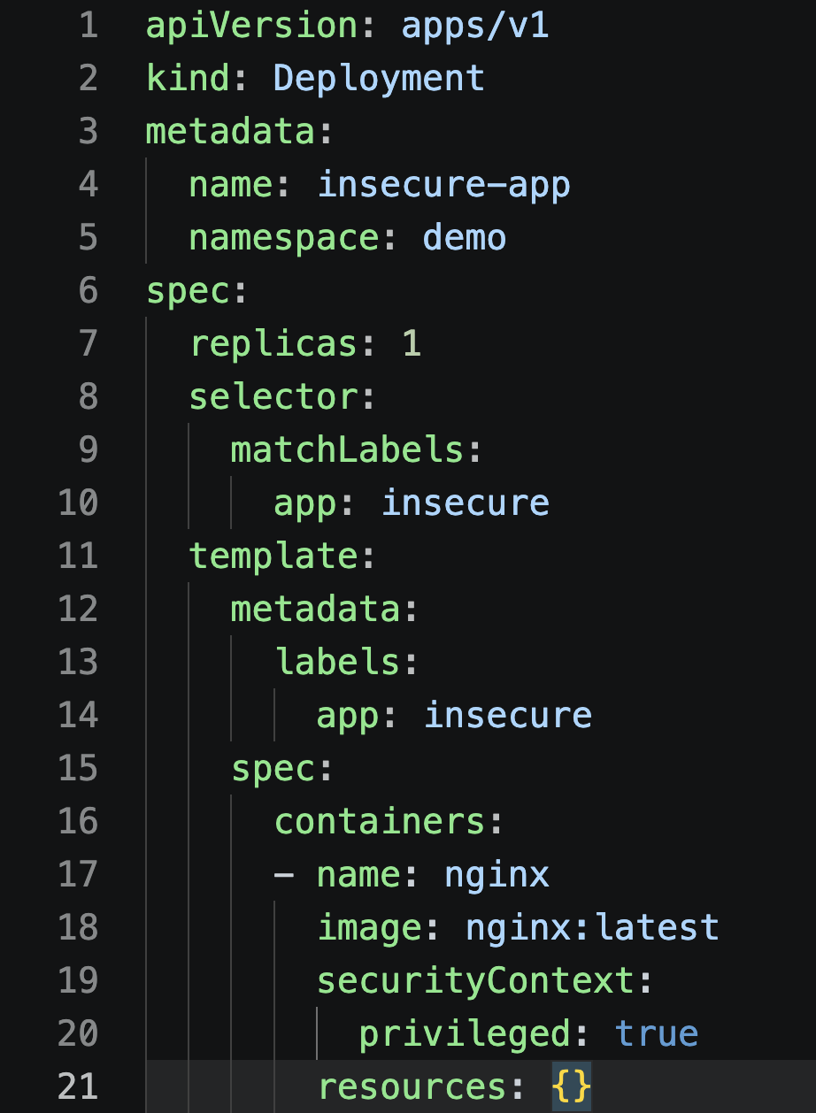
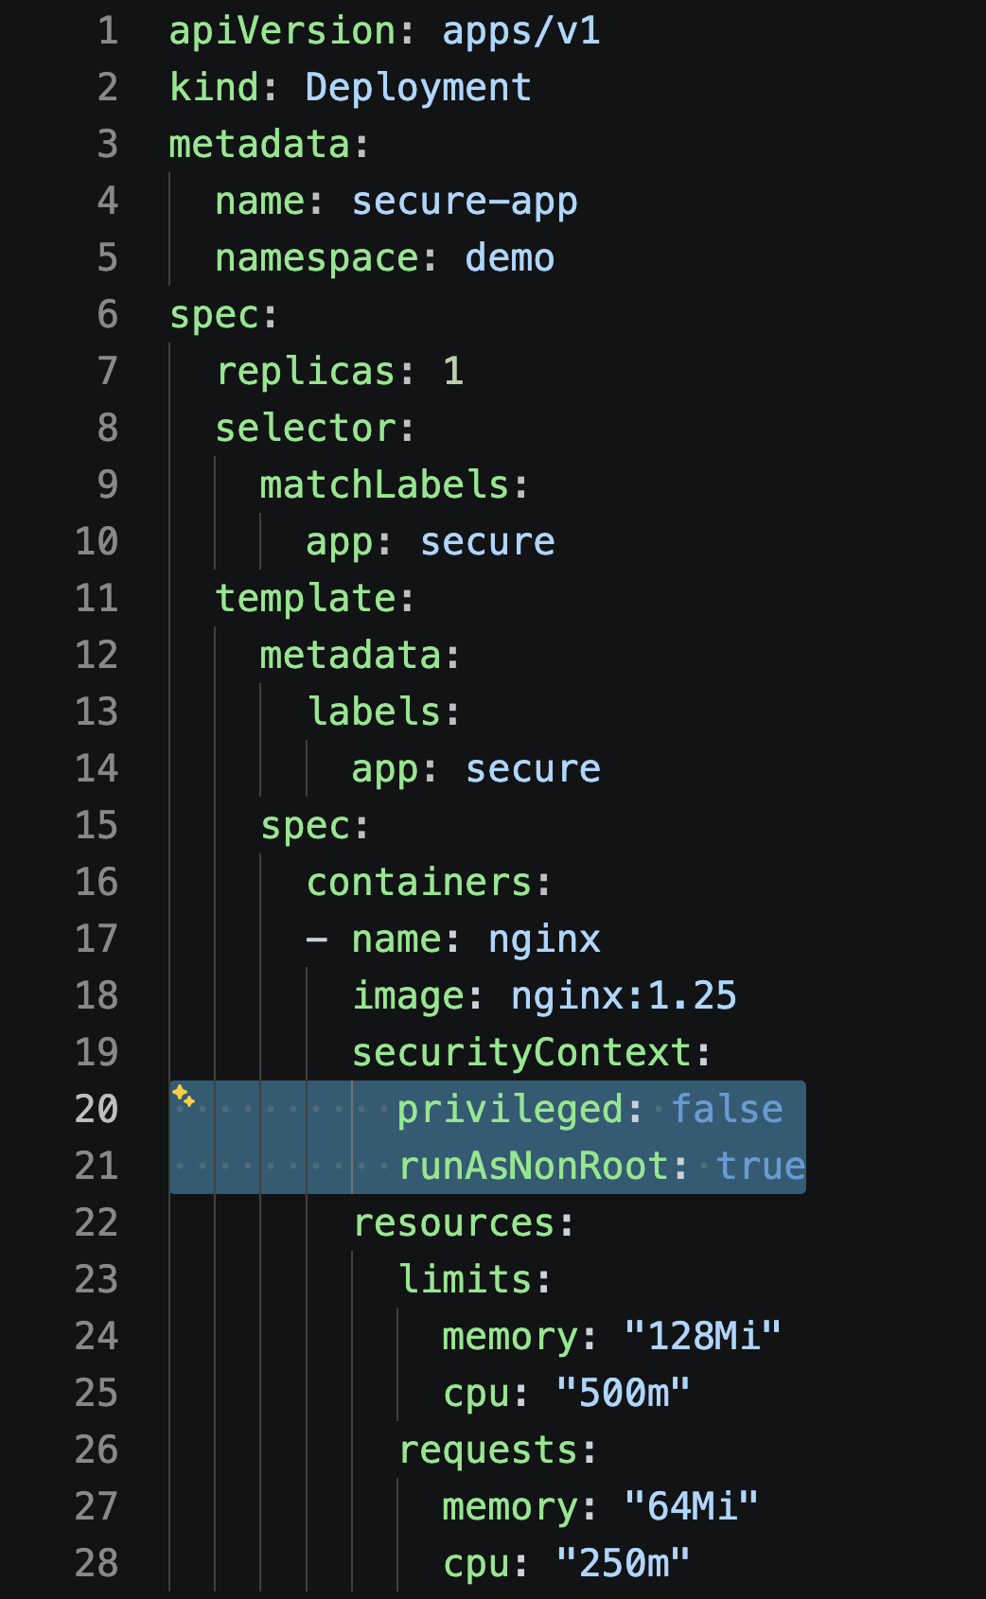
Privileged
Containers
vs
Non-privileged
Containers

Slide 10
Security Frameworks
A security framework is a set of guidelines, best practices, or standards, usually codified as a number of controls. Security frameworks are often published by government agencies or non-profit research centers. Many groups have published guidance on how to improve the security posture of a Kubernetes environment.
By default, ARMO Platform validates against all available frameworks to verify how compliant your Kubernetes environment is with those frameworks.
Commonly referenced security frameworks:
NSA-CISA Kubernetes Hardening Guide
CIS Benchmarks
MITRE ATT&CK Threat Matrix

Slide 11
DEMO
TIME!!

Slide 12
References
Security Frameworks:
https://www.cisecurity.org/cis-benchmarks
https://www.armosec.io/blog/nsa-cisa-kubernetes-hardening-guide/
https://microsoft.github.io/Threat-Matrix-for-Kubernetes/
CNCF Blog:
https://www.cncf.io/blog/2025/04/22/these-kubernetes-mistakes-will-make-you-an-easy-target-for-hackers/
Kubescape:
https://kubescape.io
https://kubescape.io/docs/
https://kubescape.io/docs/controls/
https://github.com/kubescape/regolibrary/tree/master/frameworks

Slide 13

Thank You!

Slide 14



