Slide 1
Radial Basis Function Networks
Session 4

Slide 2
contents
Introduction
Architecture
Designing
Learning strategies
MLP vs RBFN

Slide 3
introduction
Completely different approach by viewing the design of a neural network as a curve-fitting (approximation) problem in high-dimensional space ( I.e MLP )

Slide 4
In MLP
introduction

Slide 5
In RBFN
introduction

Slide 6
Radial Basis Function Network
introduction
A kind of supervised neural networks
Design of NN as curve-fitting problem
Learning
  find surface in multidimensional space best fit to training data
Generalization
  Use of this multidimensional surface to interpolate the test data

Slide 7
Radial Basis Function Network
introduction
Approximate function with linear combination of Radial basis functions
F(x) = Σ w_{i} h(x)
h(x) is mostly Gaussian function

Slide 8
architecture
x₁
h₁
W₁
h₂
x₂
W₂
h₃
x₃
W₃
f(x)
W_{m}
x_{n}
h_{m}
Input layer
Hidden layer
Output layer

Slide 9
Three layers
architecture
Input layer
  Source nodes that connect to the network to its environment
Hidden layer
  Hidden units provide a set of basis function
  High dimensionality
Output layer
  Linear combination of hidden functions

Slide 10
Radial basis function
architecture
m
f(x) = ∑ w_{j}h_{j}(x)
j=1
h_{j}(x) = exp( -(x-c_{j})² / r_{j}² )
Where c_{j} is center of a region,
r_{j} is width of the receptive field

Slide 11
designing
Require
  Selection of the radial basis function width parameter
  Number of radial basis neurons

Slide 12
Selection of the RBF width para.
designing
Not required for an MLP
smaller width
  alerting in untrained test data
Larger width
  network of smaller size & faster execution

Slide 13
Number of radial basis neurons
designing
By designer
Max of neurons = number of input
Min of neurons = ( experimentally determined)
More neurons
  More complex, but smaller tolerance

Slide 14
learning strategies
Two levels of Learning
  Center and spread learning (or determination)
  Output layer Weights Learning
Make # ( parameters) small as possible
  Curse of Dimensionality

Slide 15
Various learning strategies
learning strategies
how the centers of the radial-basis functions of the network are specified.
Fixed centers selected at random
Self-organized selection of centers
Supervised selection of centers

Slide 16
Fixed centers selected at random(1)
learning strategies
Fixed RBFs of the hidden units
The locations of the centers may be chosen randomly from the training data set.
We can use different values of centers and widths for each radial basis function -> experimentation with training data is needed.

Slide 17
Fixed centers selected at random(2)
learning strategies
Only output layer weight is need to be learned.
Obtain the value of the output layer weight by pseudo-inverse method
Main problem
  Require a large training set for a satisfactory level of performance

Slide 18
Self-organized selection of centers(1)
learning strategies
Hybrid learning
  self-organized learning to estimate the centers of RBFs in hidden layer
  supervised learning to estimate the linear weights of the output layer
Self-organized learning of centers by means of clustering.
Supervised learning of output weights by LMS algorithm.

Slide 19
Self-organized selection of centers(2)
learning strategies
k-means clustering
  Initialization
  Sampling
  Similarity matching
  Updating
  Continuation

Slide 20
Supervised selection of centers
learning strategies
All free parameters of the network are changed by supervised learning process.
Error-correction learning using LMS algorithm.

Slide 21
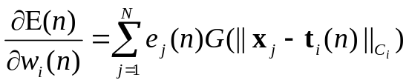
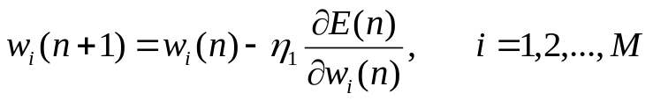
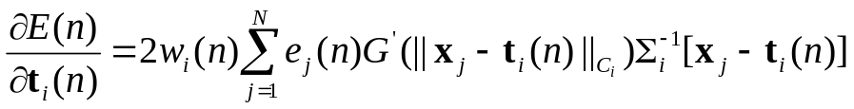
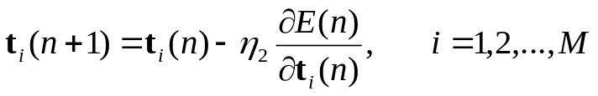
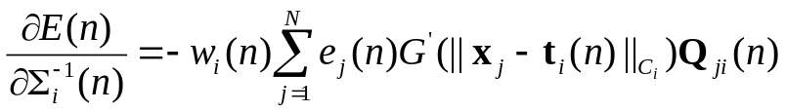

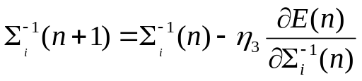
Learning formula
learning strategies
Linear weights (output layer)
Positions of centers (hidden layer)
Spreads of centers (hidden layer)

Slide 22
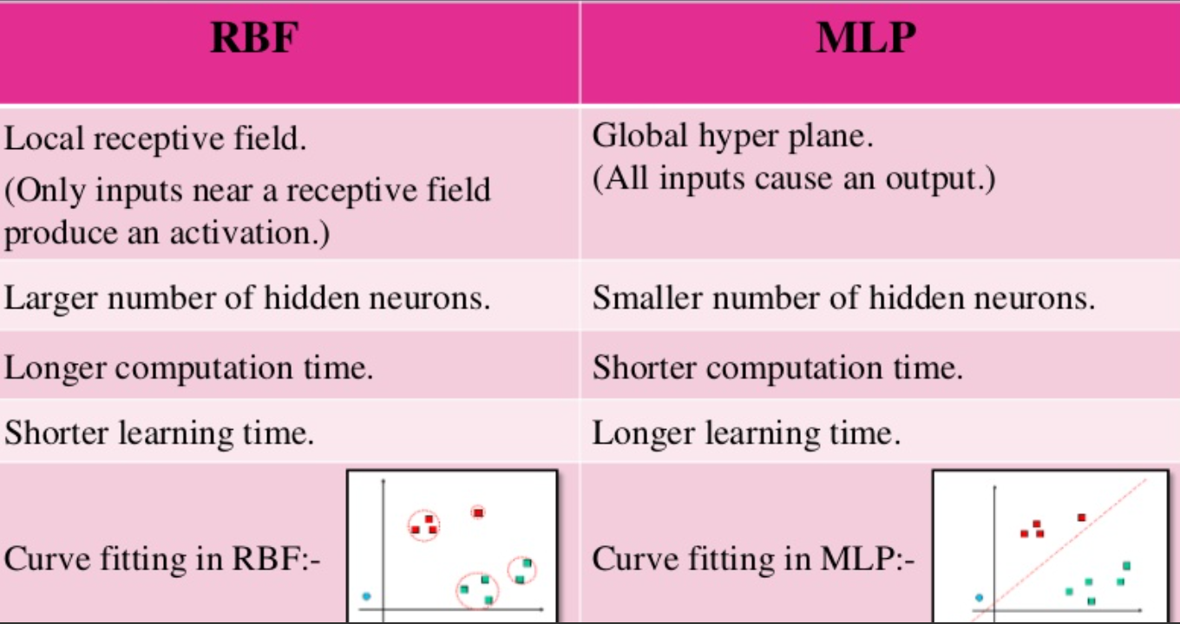
MLP vs RBFN

Slide 23
Approximation
MLP vs RBFN
MLP : Global network
  All inputs cause an output
RBF : Local network
  Only inputs near a receptive field produce an activation
  Can give “don’t know” output

Slide 24
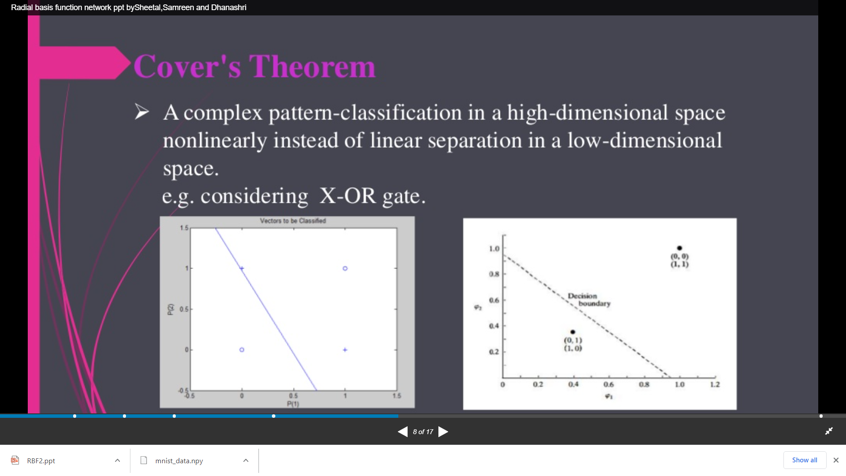

Slide 25
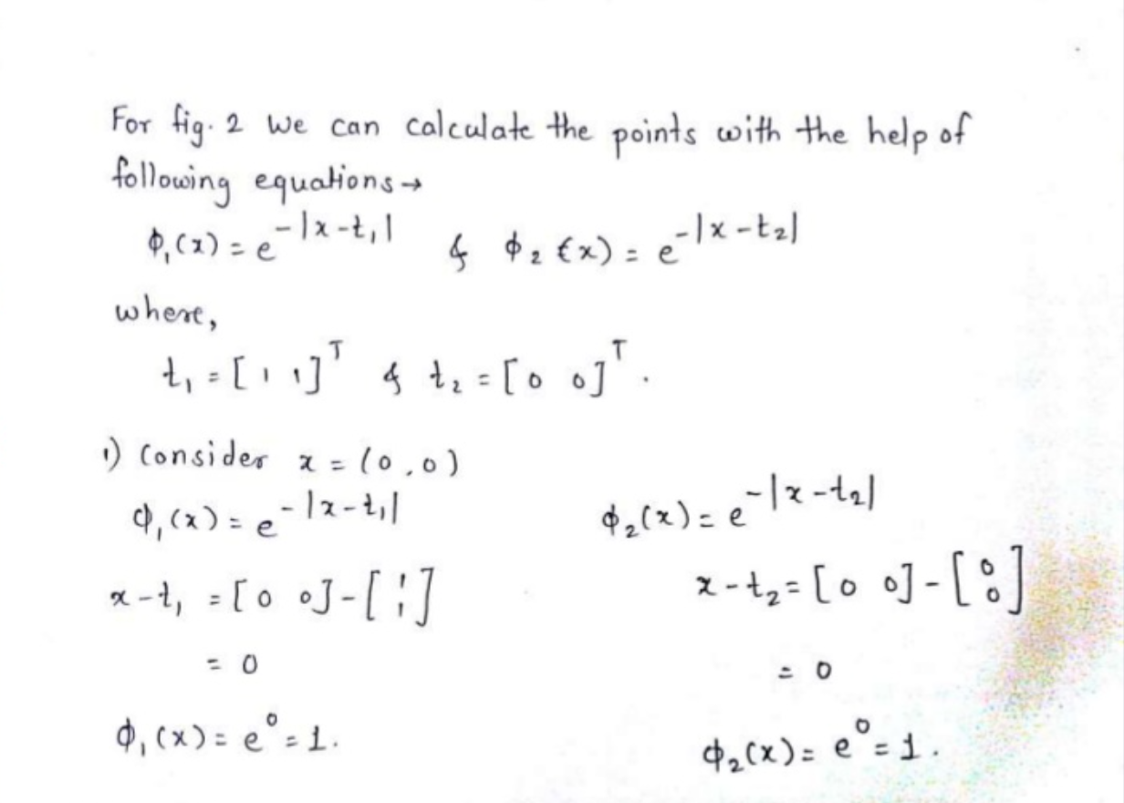

Slide 26
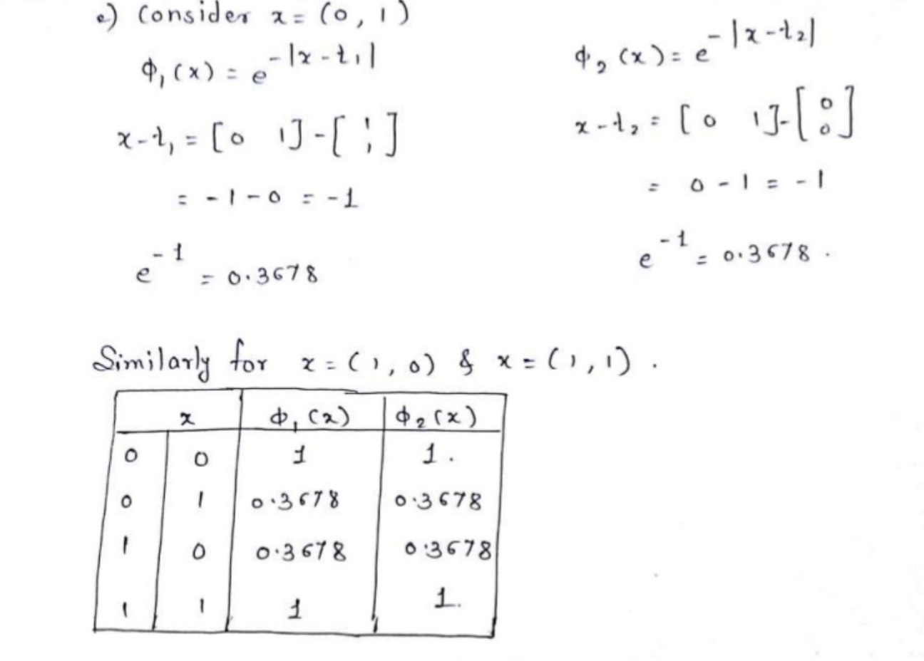

Slide 27
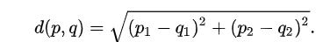
Euclidean distance
x | y | T1(0,0) | T2 (1,1)
0 | 0 | 1 | 0.243
0 | 1 | 0.368 | 0.368
1 | 0 | 0.368 | 0.368
1 | 1 | 0.243 | 1

Slide 28
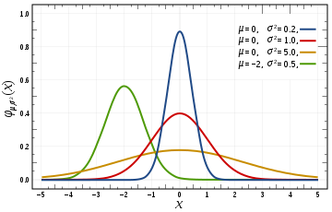
Three types of functions
Multi Quadratic
ᴓ(x) = (r² + c² )^{1/2 C>0}
Inverse Multi Quadratic
ᴓ(x) = 1/ (r² + c² )^{1/2 C>0}
Gaussian
ᴓ(x) = exp -(r² / 2* theta² )^{1/2}

