Slide 1
Student Performance Prediction Using Machine Learning
presentation by Chandu Neelam

Slide 2
Introduction
Objective: To predict student performance based on various demographic, social, and academic features.
Dataset: UCI Machine Learning Repository - Student Performance Dataset (Mathematics and Portuguese)
Key Challenges: Identifying key factors affecting student performance and building accurate predictive models.

Slide 3
Dataset Overview
Description: Brief overview of `student-mat.csv` and `student-por.csv` datasets.
Features: 33 attributes including demographic details (e.g., age, gender), family background, and academic performance. The dataset contains both numerical and categorical features that helps in prediction.
Target Variable: Final Grade (G3) ranges 1 to 20

Slide 4
Data Preprocessing
Data Cleaning: Handling missing values, removing duplicates.
Feature Engineering: Creating new features (e.g., average grade, family support level).
Data Transformation: Encoding categorical variables with One Hot encoding.
Scaling numerical features using MinMaxScaling which ranges from 0 to 1.

Slide 5
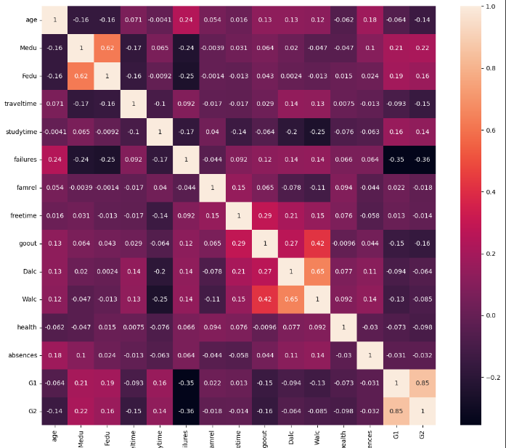
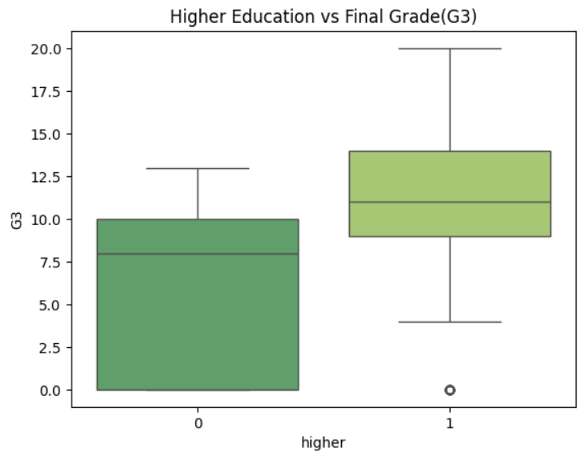
Exploratory Data Analysis (EDA)
Visualisations
Correlation matrix to explore relationships between features.
Key Findings: Relationships between study time, parental education, and student performance.

Slide 6
Insights from Visualisations
Positive Impact:
Mother and father with higher education had a positive impact on student performance
The students who wants to take higher education are having also good grades.
Negative Impact:
Going out with friends is effecting the student performance very badly.
Age and failures are other features that impact negatively the student performances.

Slide 7
Machine Learning Models for Prediction
Models Used: Linear Regression, Logistic Regression, Lasso and Ridge Regression, Clustering Algorithms, SVM, Decision Trees and Ensemble methods like Random Forest, XGradient Boosting, etc.
Evaluation Metrics: RMSE, MSE, R² Score.
Model Comparison: Performance comparison of models using a table.

Slide 8
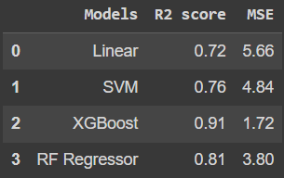
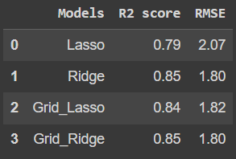
Model Comparison

Slide 9
Model Results and Evaluation
Best Model: XGBoost achieved the lowest RMSE and highest R².
Model Accuracy
XGBoost - MSE: 1.72, R²: 0.91
Random Forest - MSE: 3.80, R²: 0.81

Slide 10
Best Performing Model
Selected Model: XGBoost Regression
Reasons for Selection:
High accuracy, robustness, ability to handle feature interactions.
Feature Importance:
Parental education, study time, and absences are key features impacting performance.

Slide 11
Insights and Recommendations
Key Insights: Factors significantly impacting student performance.
Recommendations: Interventions for low-performing groups, importance of family and school support, policy implications.
Actionable Steps: Tailored programs for students based on their cluster groupings.

Slide 12
References
https://archive.ics.uci.edu/dataset/320/student+performance
https://github.com/Chandu-324/StudentPerformancePrediction

