Slide 1
Multi-language Course Content Translator Agent
Presented by:
Name : Chandrasekhara Reddy Vangala
Institution: KBN College, Vijayawada Department: MCA

Slide 2
Problem Statement
In India, many students struggle to understand academic materials due to language barriers.
Most course content is available only in English, limiting access for non-English-speaking learners.
There is a need for a solution that provides accurate translations of academic content into multiple Indian regional languages.
The translation must preserve technical accuracy, subject-specific meaning, and educational integrity.

Slide 3
Proposed System/Solution
An AI-powered translator agent that converts academic content into Indian regional languages.
Uses Retrieval-Augmented Generation (RAG) to provide accurate, context-aware translations.
Ensures subject-specific terms are retained by retrieving content from glossaries and notes.
Built with IBM Watsonx.ai, it supports inputs like PDFs, DOCX, and text from users.

Slide 4
System Development Approach (Technology Used)
Platform: IBM Watsonx.ai
Model: Granite-3-3-8b-instruct
RAG Support: Document Search Tool (vector index for glossary & notes)
Fallback Tools: Google Search, Wikipedia Search (optional)
LangGraph: Used for designing flow of input → retrieval → translation → output
Data Source: Uploaded glossary and academic notes (DOCX)
Workflow: User inputs content → Document Search retrieves context → Granite generates translation → Output delivered
Deployment: Manual testing via Watsonx UI preview panel; public links unsupported in Lite plan

Slide 5
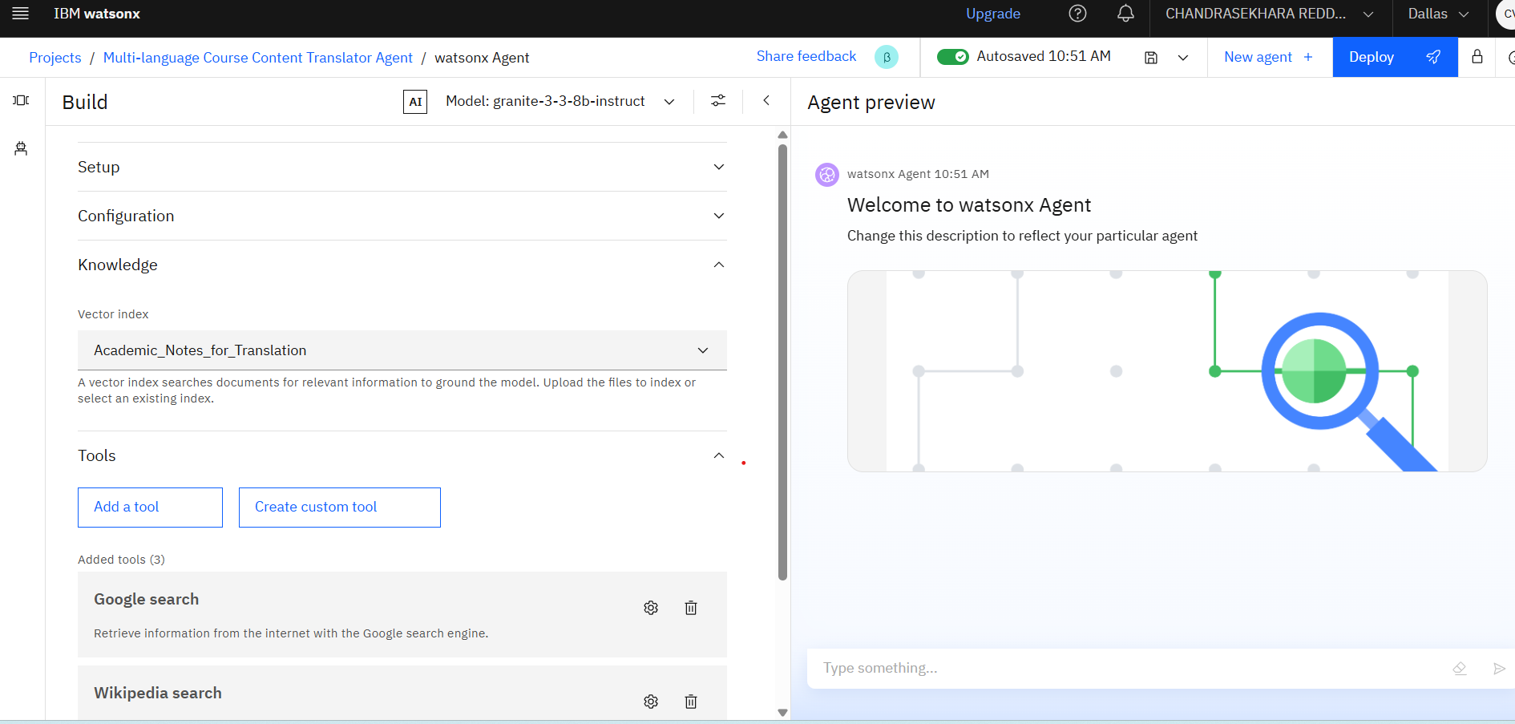
Result (Output Image)

Slide 6
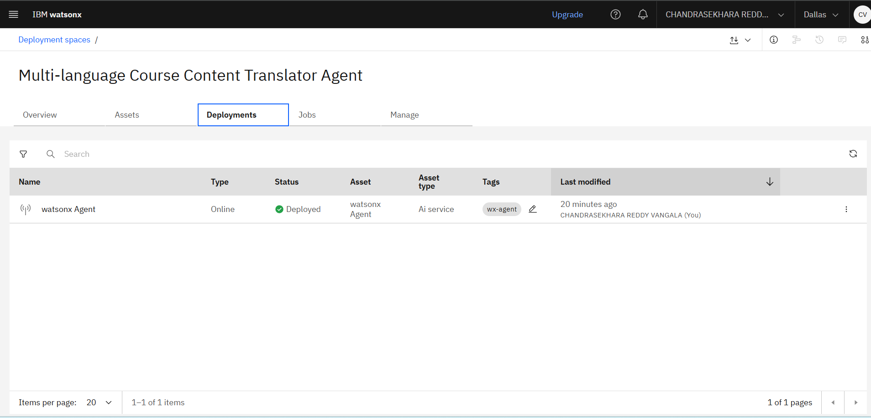
Deployment

Slide 7
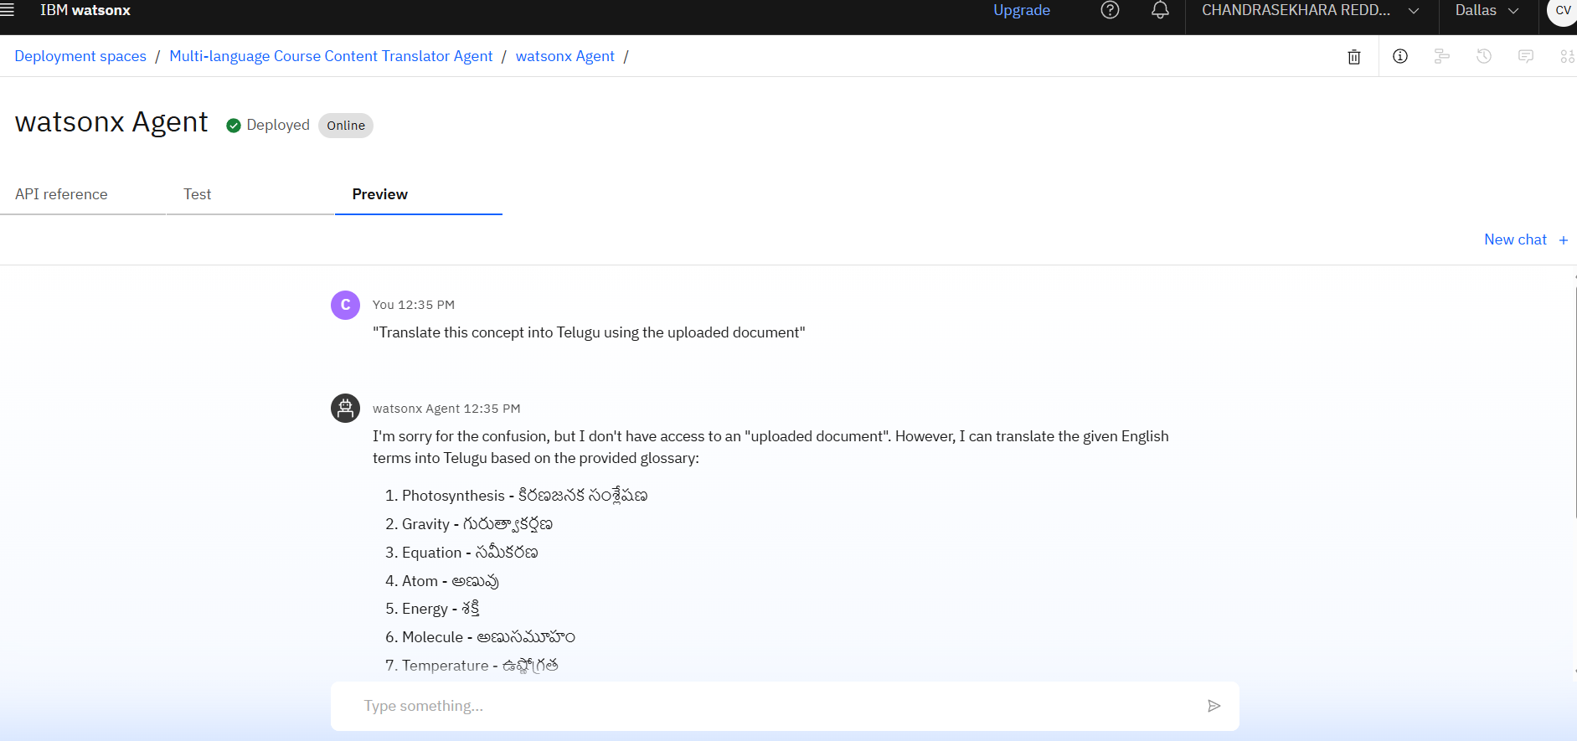
Final Out Put

Slide 8
Conclusion
The system successfully bridges language barriers in academic learning.
Translations retain technical accuracy using glossary-driven RAG.
Easy to test, modular to expand, and built on IBM's no-code AI platform.
Enables equitable learning environments for students across India.

Slide 9
Future Scope
Add support for more Indian languages (Kannada, Punjabi, Gujarati).
Enable full file upload and parsing within the agent UI (available in paid plans).
Build a public-facing web or mobile app for broader reach.
Integrate curriculum-specific glossaries for CBSE and state boards.
Include voice input/output for accessibility.

Slide 10
References
IBM Watsonx.ai Documentation
IBM Granite LLMs
LangGraph Builder
Academic Glossary Resources (NCERT, CBSE)
Project Files & Sample Notes by Author
https://github.com/Chandu-AB/Multi-language-Course-Content-Translator-Agent

Slide 11
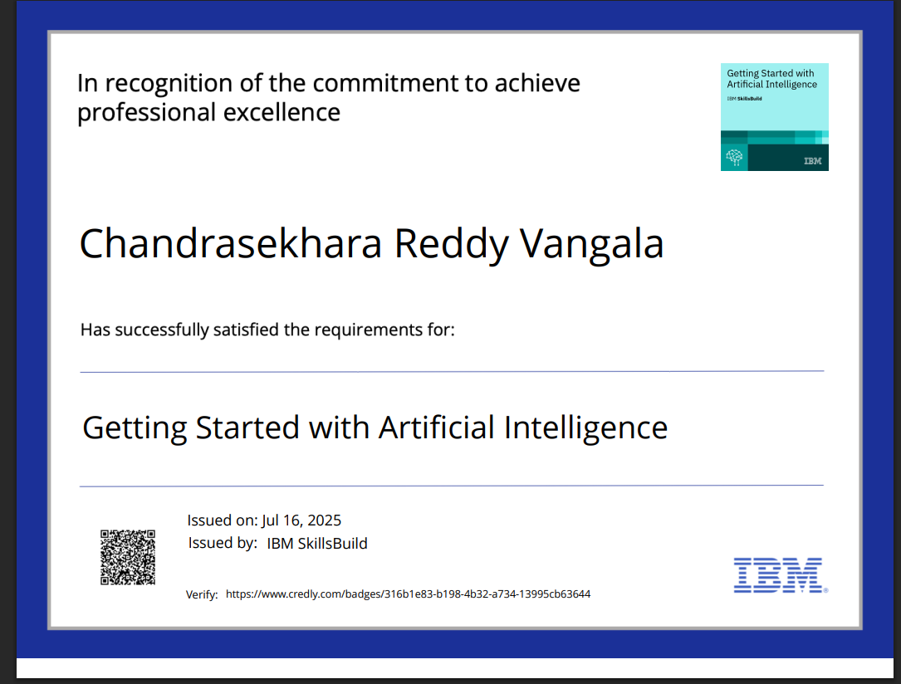
Getting Started With AI

Slide 12
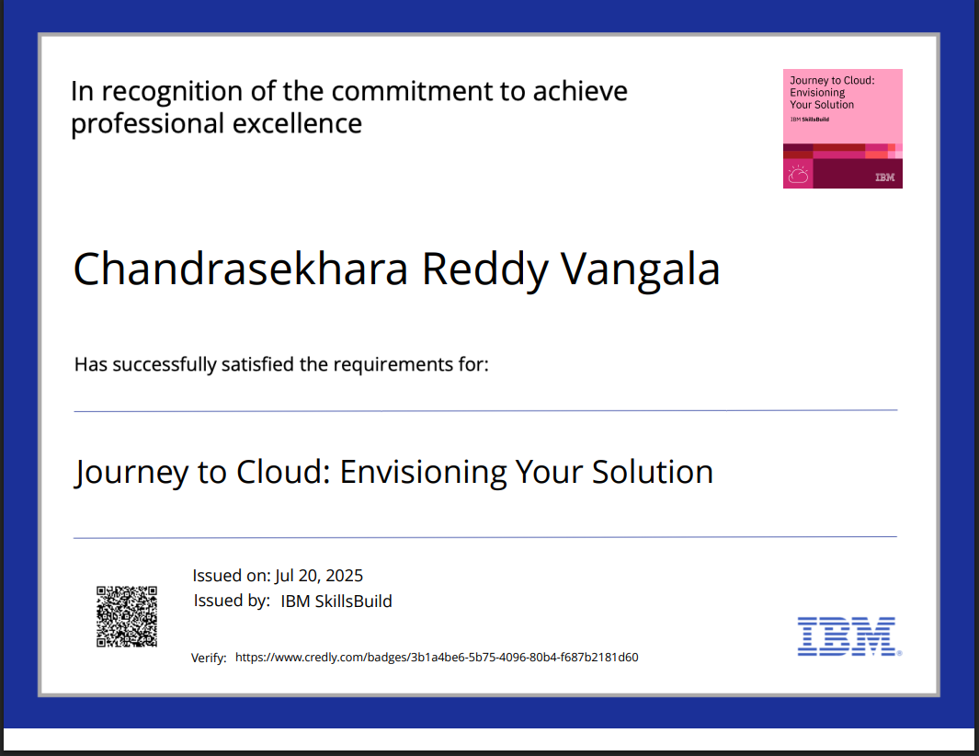
Journey to Cloud

Slide 13
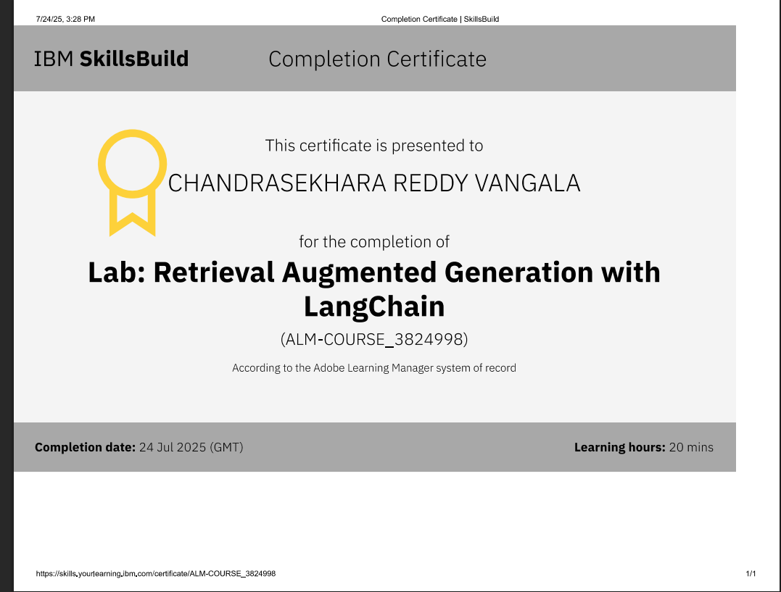
RAG LAB

Slide 14
Thank you for your attention!

