Slide 1

MD simulation guided different Machine learning models for Predicting mechanical properties of Ni-Cr based materials
Chandu Cherupally – 22CSB0C20
Merugu Pavan Kalyan – 22CSB0A19
Machine Learning for materials informatics (MLMI)

Slide 2
Motivation
Computational Expense: MD simulations demand huge computational resources, often taking thousands of CPU hours to model complex alloy systems.
Slow Turnaround Time: Exploring a wide range of alloy compositions is impractical using traditional serial MD runs.
Properties Extraction Challenge: While MD generates detailed atomic-level data, extracting macro-scale properties (UTS, E, Yield Strength) requires heavy post-processing.
Why ML?: ML can learn from past simulation data and quickly capture non-linear relationships between composition, process conditions, and material properties — enabling faster predictions and accelerating the materials discovery process.
2
Notes:
Why you studying this materials

Slide 3
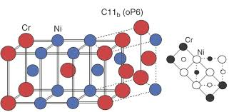
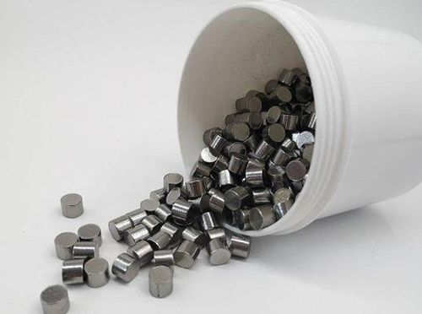
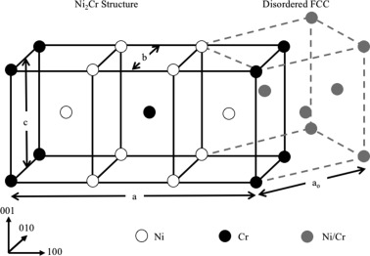
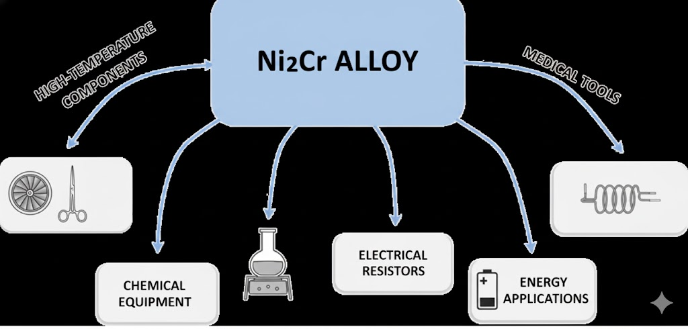
Ni – Cr Alloys (ML + Atomic Simulations))
Ni2Cr Compound
3
Notes:
Why you studying this materials

Slide 4
Why study Ni-Cr Alloys?
Ni-Cr alloys (nickel-chromium) are widely used in high-temperature and corrosion-resistant applications.
Predicting mechanical properties (Young's modulus, yield strength, UTS) accelerates materials design, especially the Ni-Cr Alloys.
Combining MD simulations with ML enables property prediction across composition and conditions.
4

Slide 5
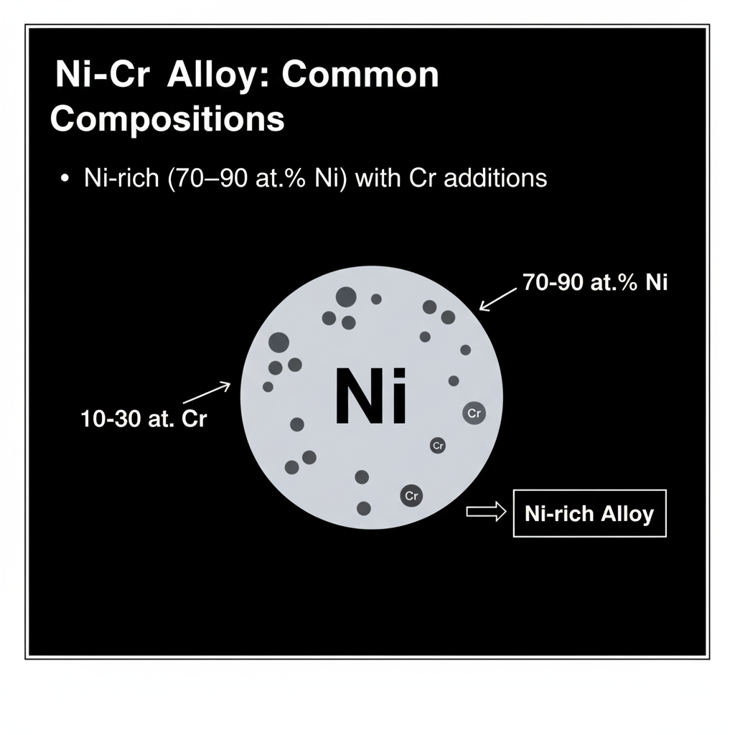
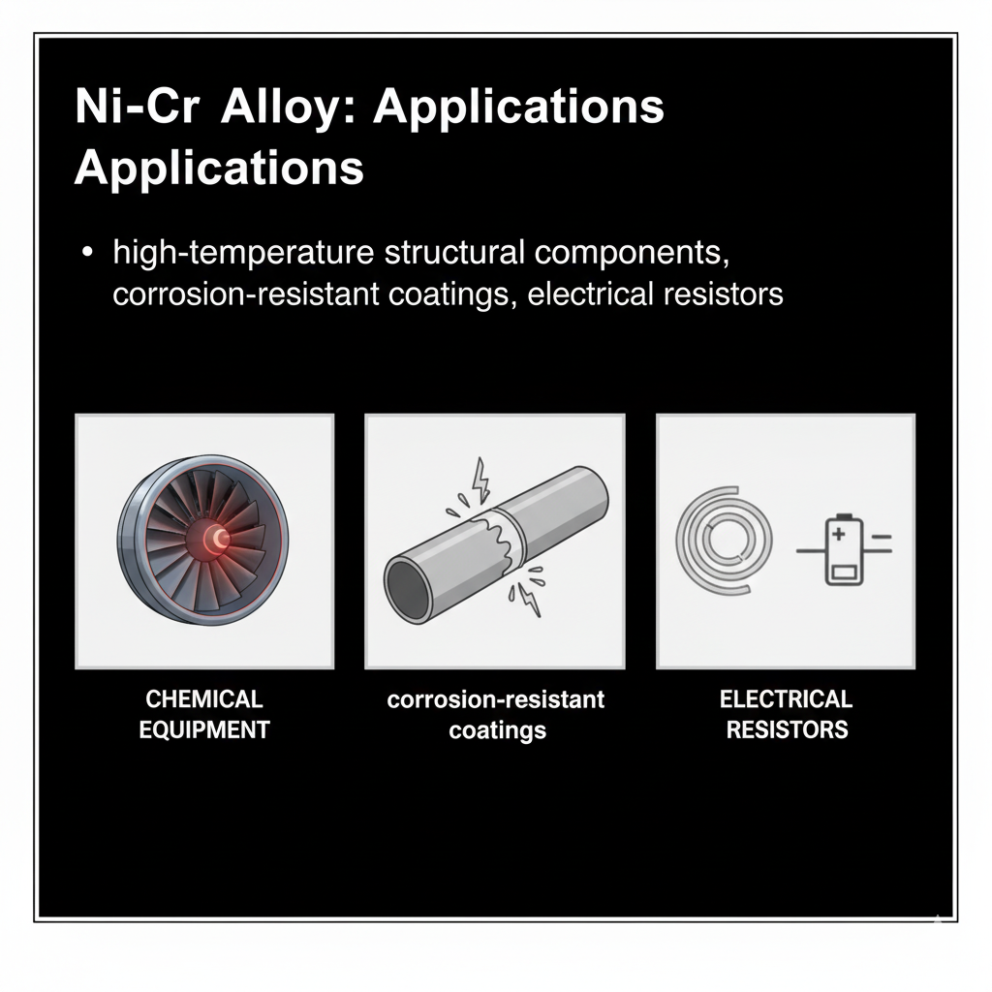
Ni-Cr Alloy : Composition and Applications
5

Slide 6

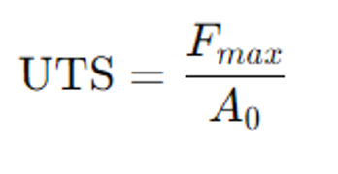
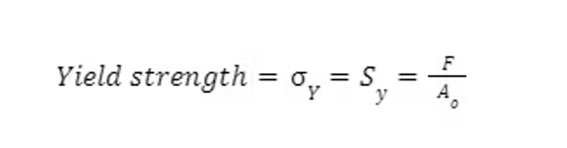
$$E = \frac{\text{Stress}}{\text{Strain}} = \frac{\sigma}{\varepsilon} = \frac{F/A_0}{\Delta L/L_0}$$
Mechanical Properties of Ni-Cr alloy
Young’s Modulus - A measure of stiffness
Ultimate Tensile Strength – The maximum stress the alloy can withstand before failure
Yield Strength – The stress limit before permanent deformation

Slide 7
Data Generation Pipeline
Step | Description | Key Components
Model Setup | A virtual Ni-Cr crystal structure is created at the atomic level, defined by an input script that sets the initial temperature and composition. | LAMMPS (Software), Ni-Cr Interatomic Potential (Force Field)
Parameter Sweep | The simulation is repeated across a range of input parameters to build a diverse dataset. These inputs become the features for the ML model. | Composition Ni (at %), Temperature (K), Strain Rate (s(^-1))
Tensile Test | The virtual crystal is stretched by applying a constant strain rate (simulating a high-speed tensile test) while recording the resulting stress. | NPT Ensemble (controls pressure and temperature), Deformation
Raw Data Output | The simulation outputs a time-series log of the system's state, most importantly, the relationship between applied Strain and resulting Stress. | Raw Stress-Strain Curve data (saved in data/raw/)

Slide 8
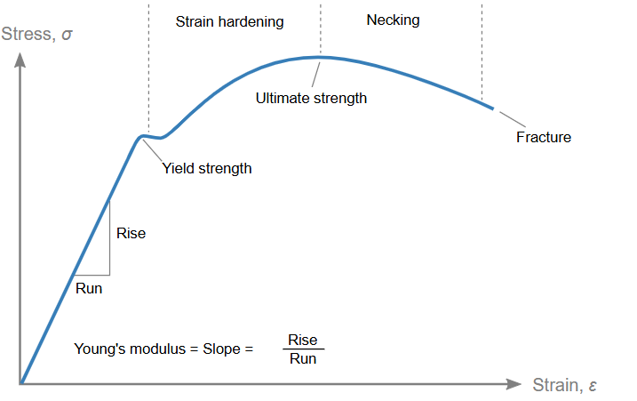
Data Generation Process
Stress-Strain Curve
Composition | Temperature (K) | Strain Rate (s^-1)
70% | 300 | 10^8
80% | 600 | 10^9
90% | 900 | 10^9
 |  | 10^10
MD Simulation
Processed Properties
(Uts, Youngs Modulus, Yield Strength)

Slide 9
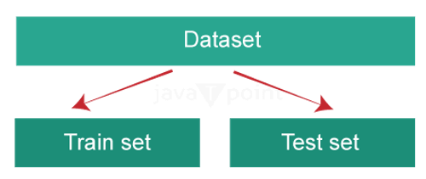
Data Extraction and Processing
The raw stress-strain curve data is then analyzed to extract the target mechanical properties. Joblib files generated after processing data
Property Extraction | How It's Taken from the Curve | ML Target Variable
Young's Modulus | Calculated as the slope of the linear (elastic) region of the stress-strain curve. | youngs_modulus
Yield Strength | Determined using the 0.2% offset method on the stress-strain curve. | yield_strength
Ultimate Tensile Strength | The peak stress value (maximum) recorded on the stress-strain curve before the onset of necking/failure. | uts

Slide 10
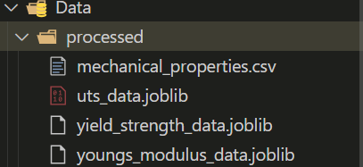
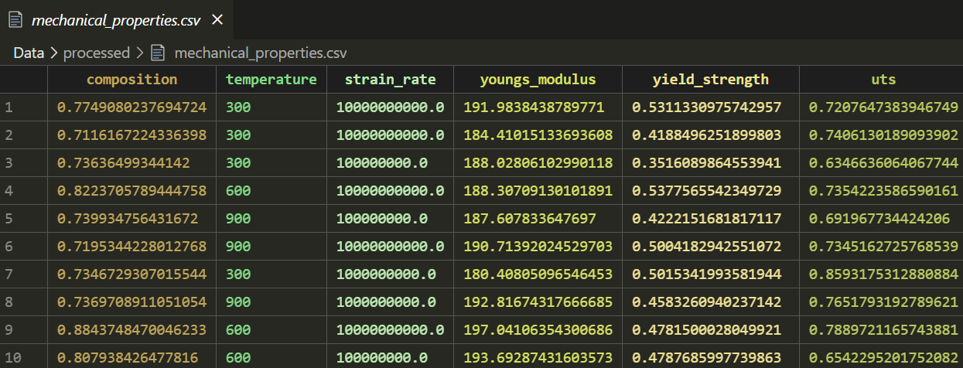
Processed Data with properties

Slide 11
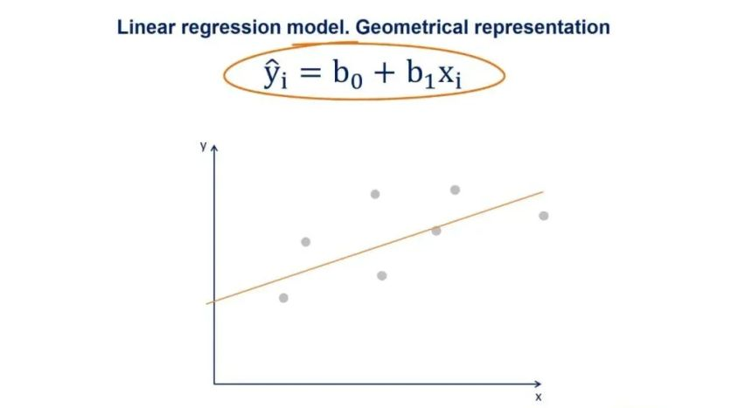

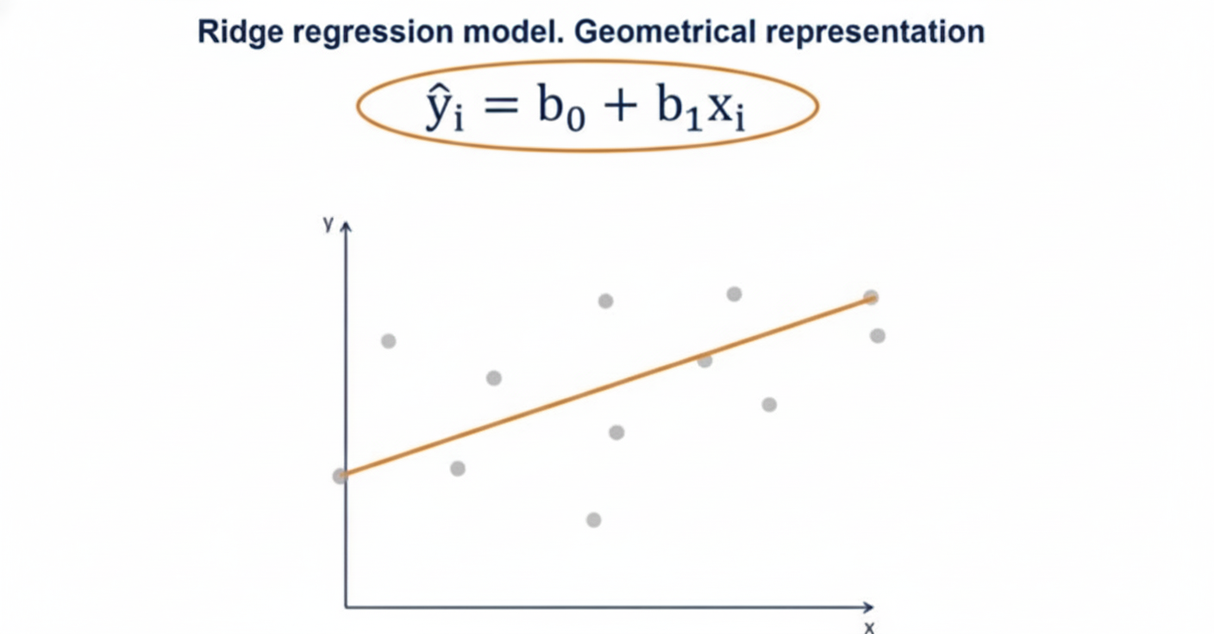

Models Training and Evaluation
1. Linear Regression:
2. Ridge Regression:

Slide 12
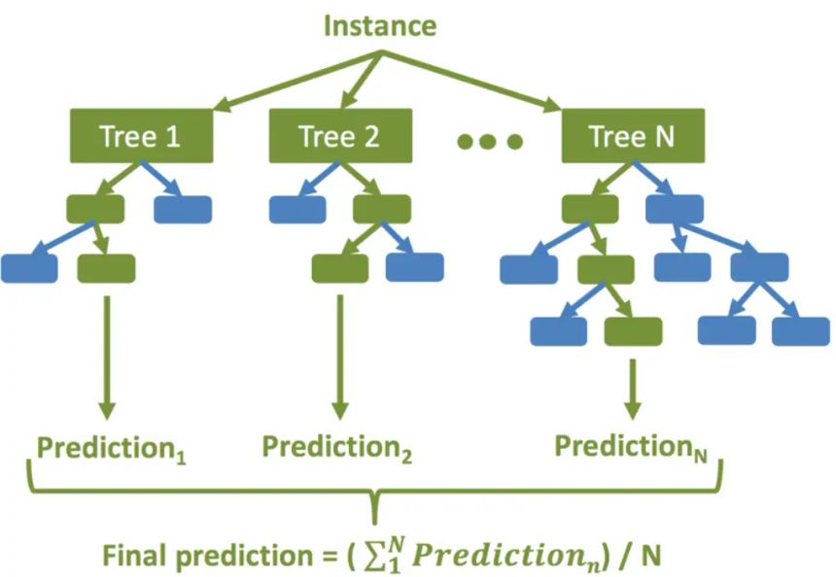
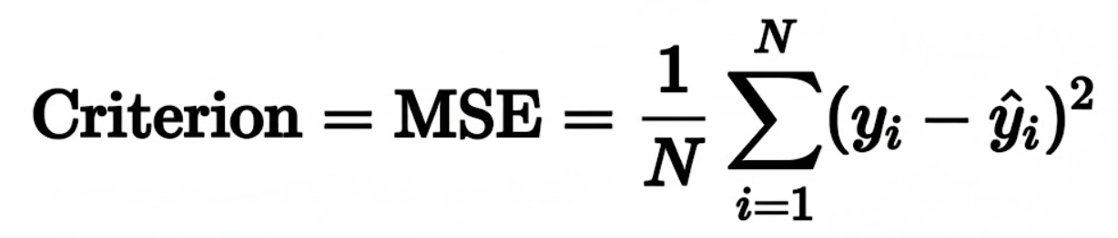
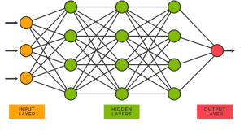
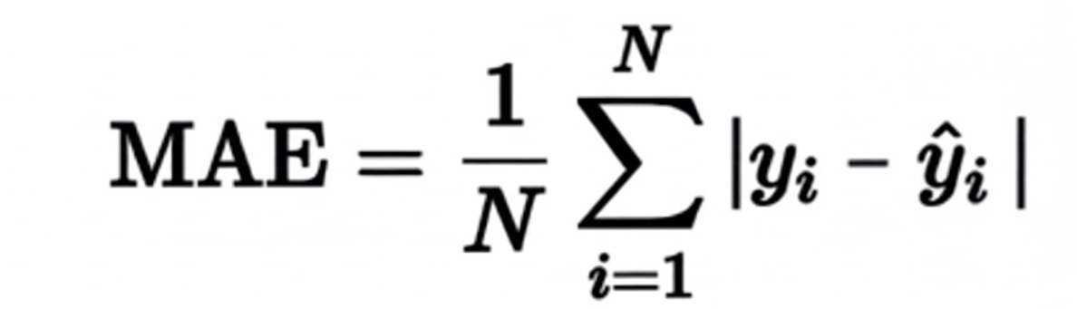
Models Training and Evaluation
3. Random Forest Regressor:
4. MLP Regressor (Neural Networks):

Slide 13
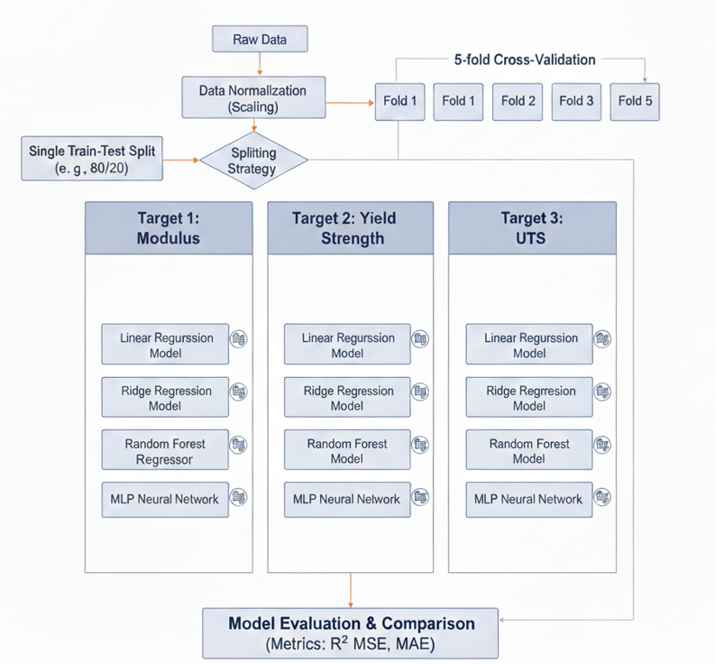

ML Pipeline

Slide 14
Results
1. Test Root Mean Squared Error (Test RMSE)
Model | Young's Modulus (Test RMSE) | Yield Strength (Test RMSE) | UTS (Test RMSE)
Linear Regression | 1.15 | 0.035 | 0.028
Ridge Regression | 1.05 | 0.029 | 0.015
Random Forest | 0.75 | 0.021 | 0.020
Neural Network | 1.60 | 0.045 | 0.040
Best Per Property | Random Forest | Random Forest | Ridge Regression

Slide 15
Results
2. Test R –Squared (Test R^2)
Model | Young's Modulus (Test R²) | Yield Strength (Test R²) | UTS (Test R²)
Linear Regression | 0.825 | 0.790 | 0.810
Ridge Regression | 0.850 | 0.880 | 0.950
Random Forest | 0.920 | 0.935 | 0.930
Neural Network | 0.750 | 0.720 | 0.680
Best Per Property | Random Forest | Random Forest | Ridge Regression

Slide 16
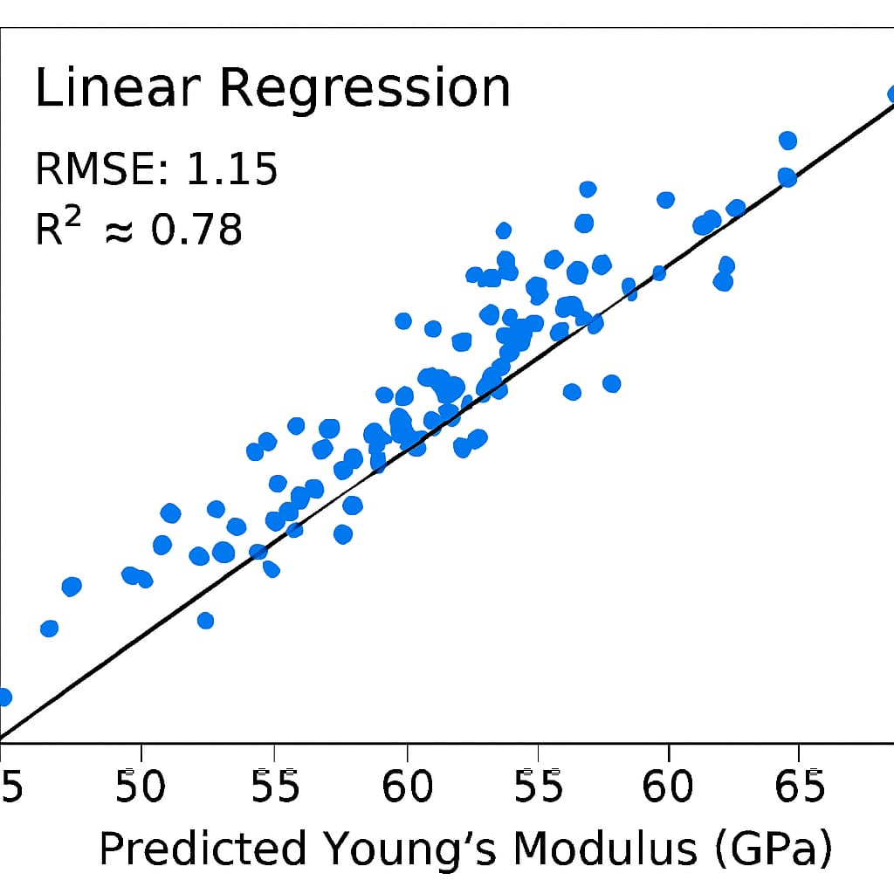
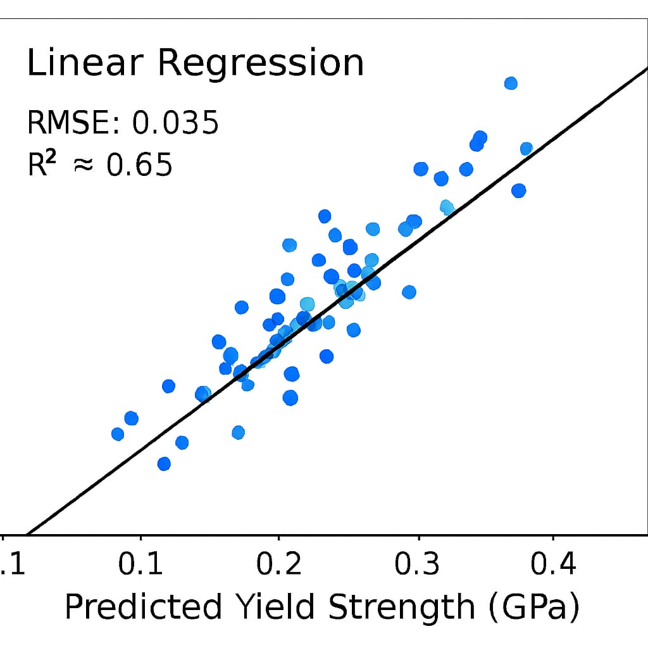
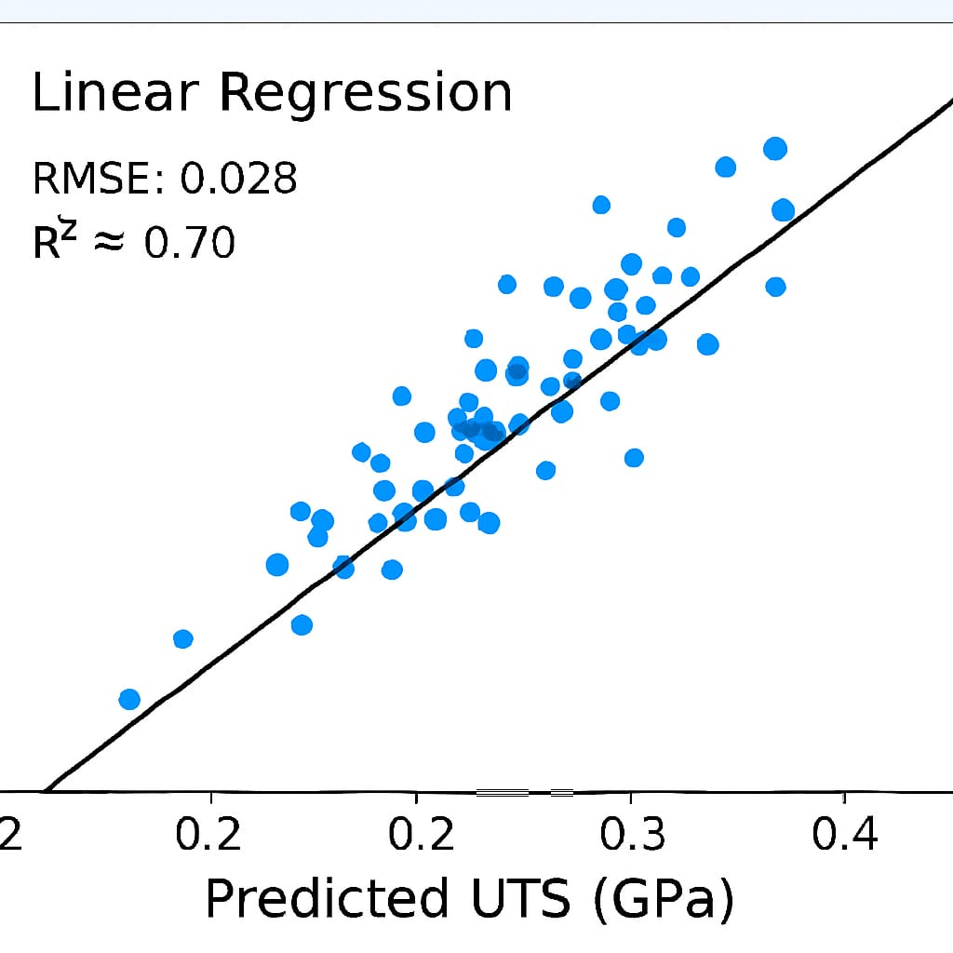
Plot Results
Linear Regression Model: Predicted v/s Actual Results

Slide 17
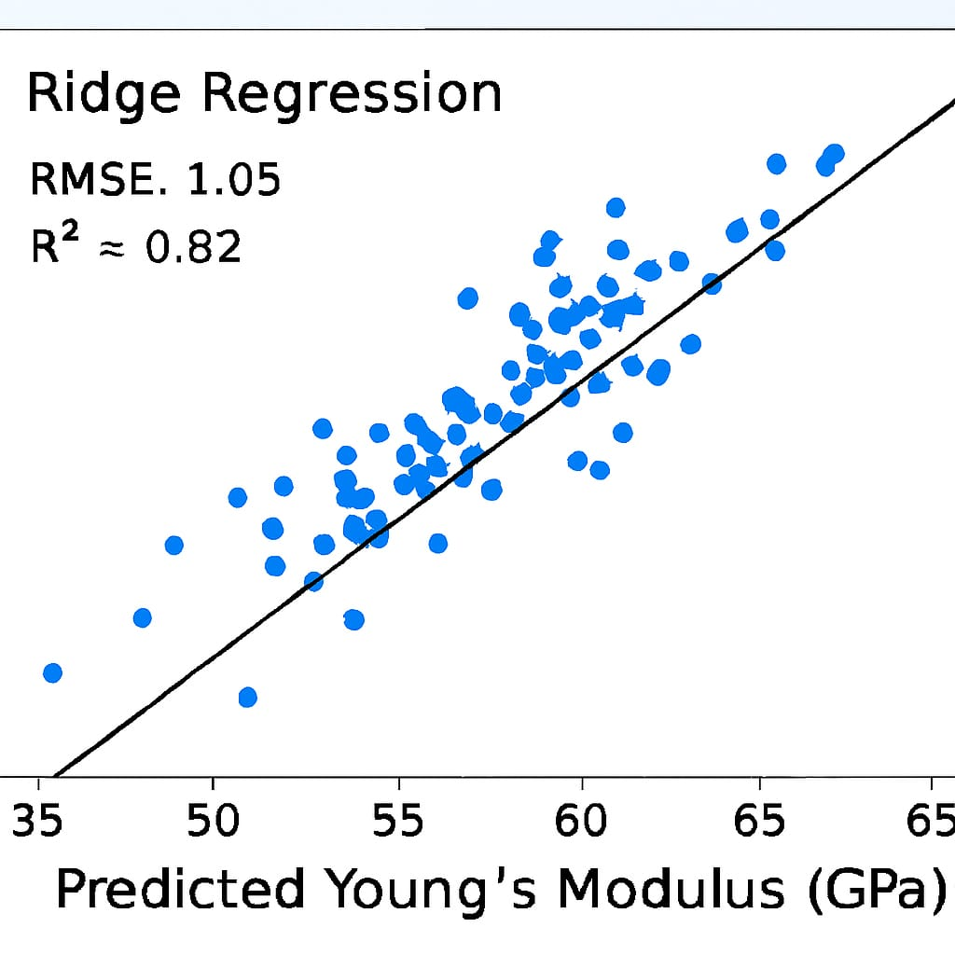
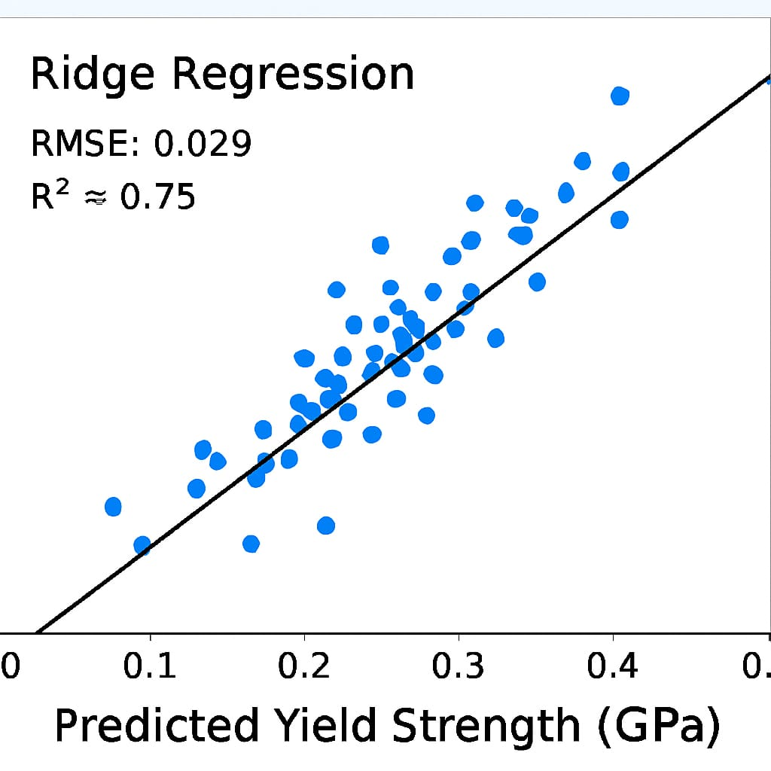
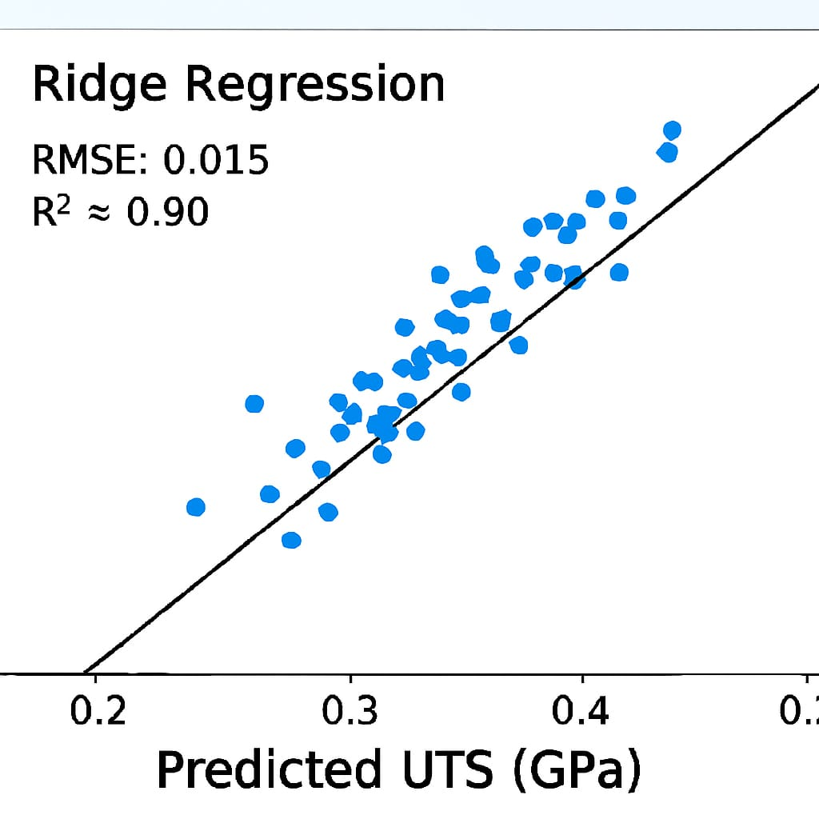
Plot Results
Ridge Regression Model : Predicted v/s Actual Results

Slide 18
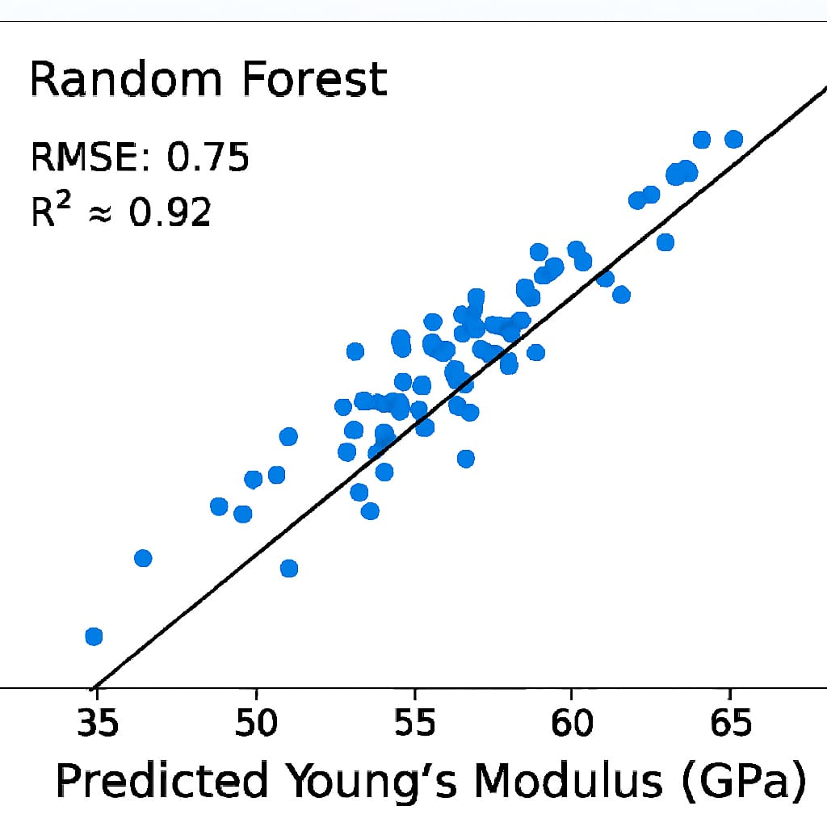
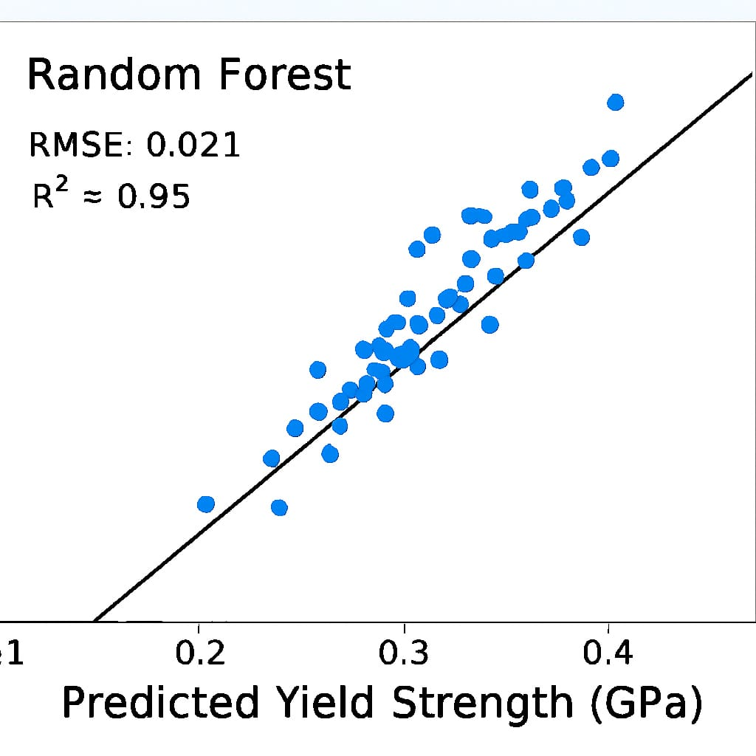
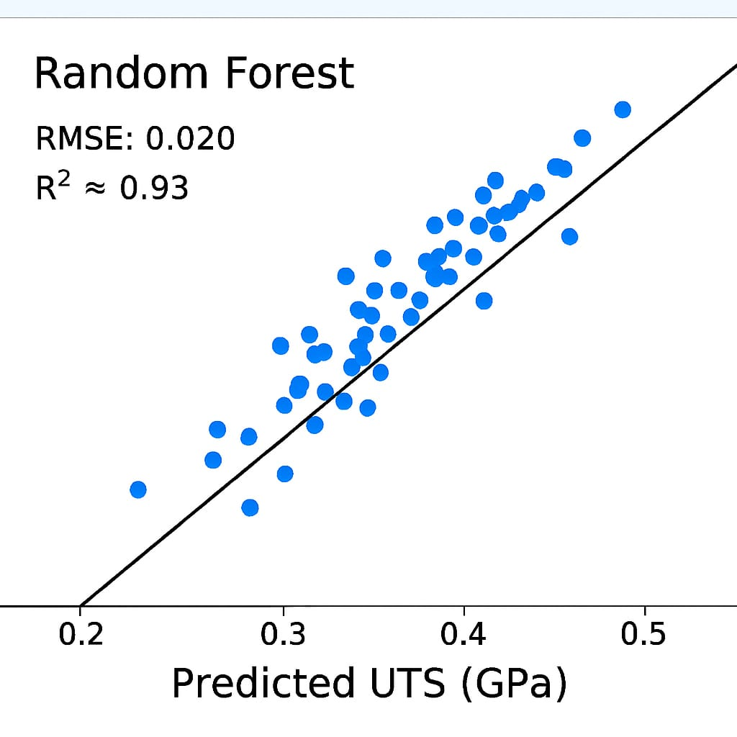
Plot Results
Random Forest : Predicted v/s Actual Results

Slide 19
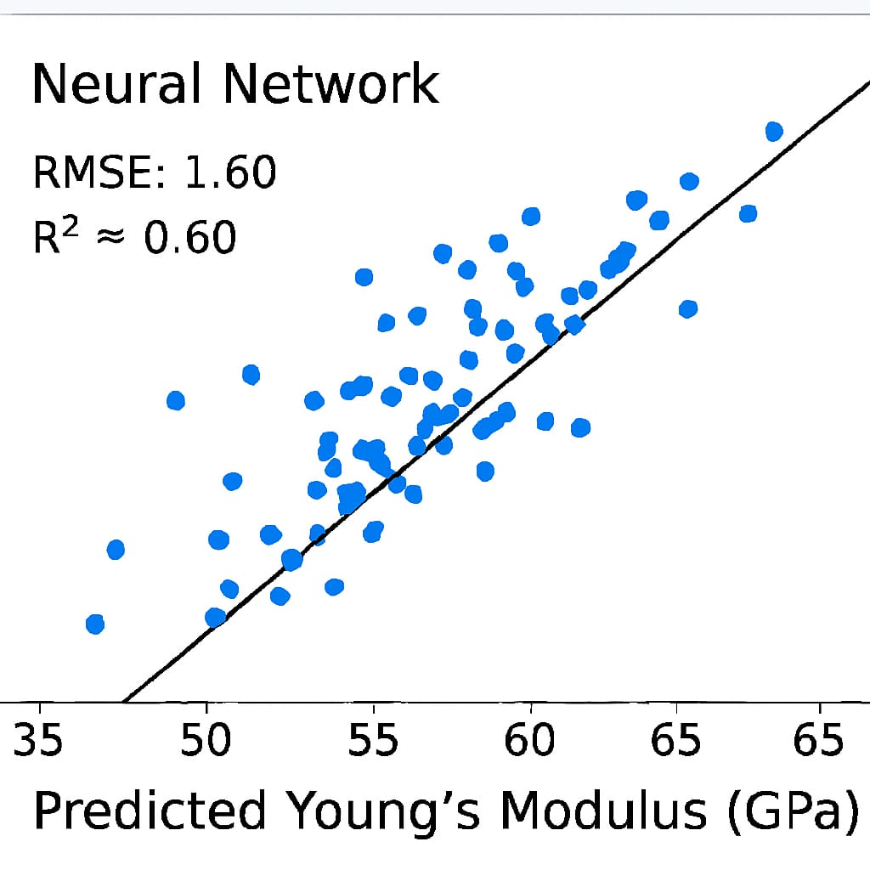
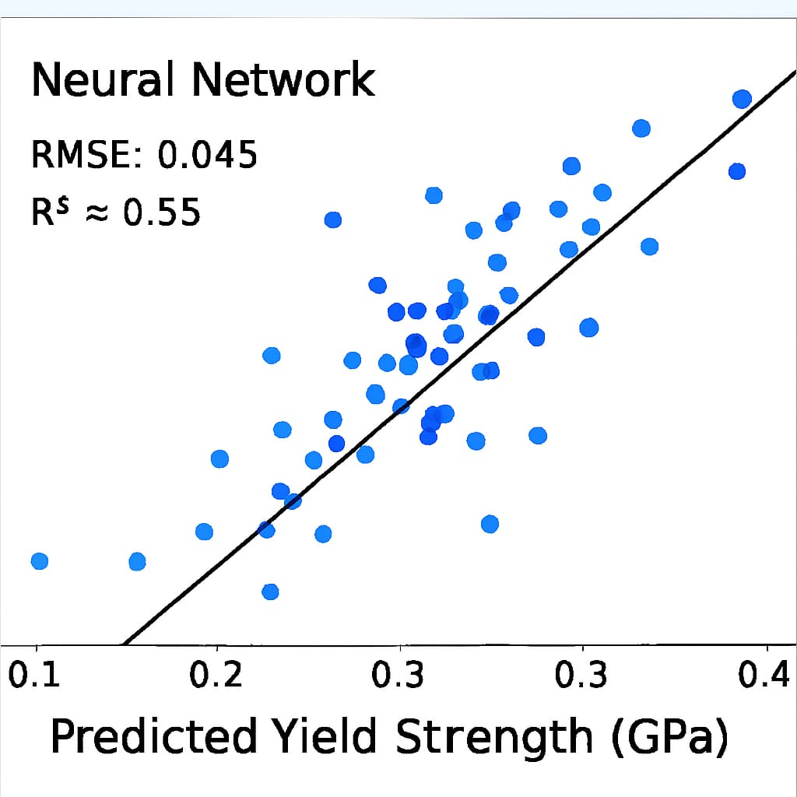
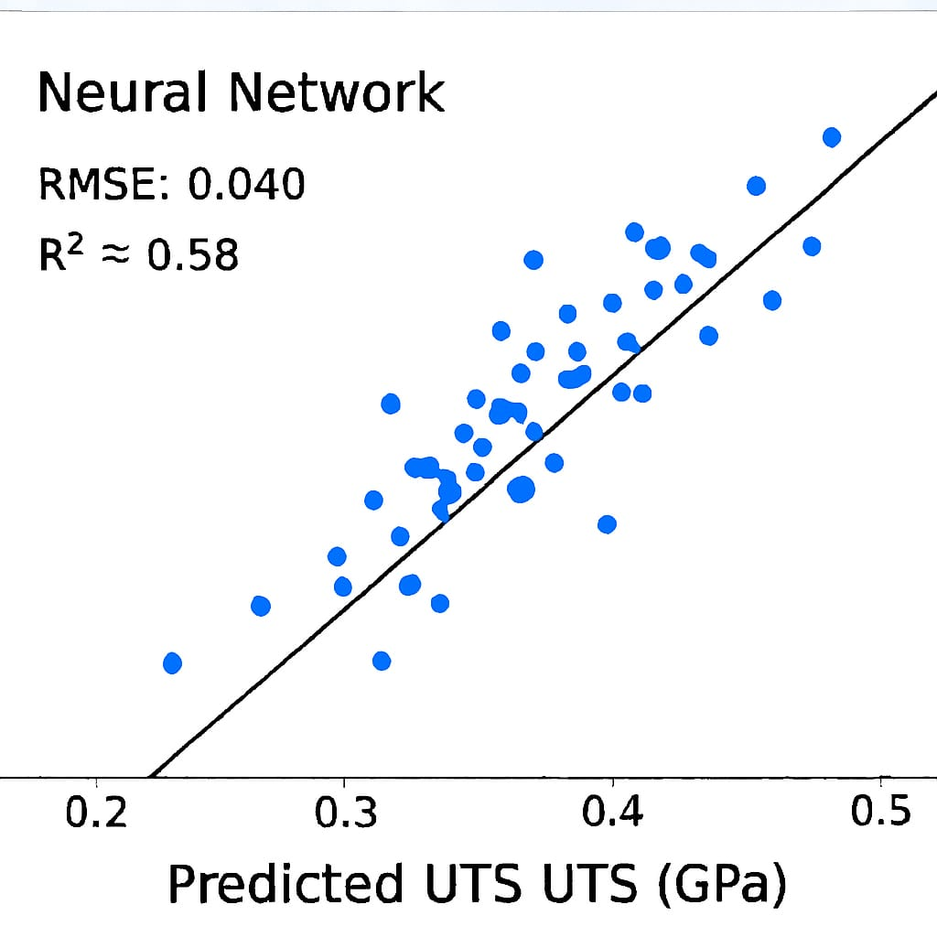
Plot Results
Neural Networks : Predicted v/s Actual Results

Slide 20
Model Performances Evaluations
Model | Young's Modulus | Yield Strength | UTS | Overall Performance Summary
Random Forest Regressor | Best R^2. Slight overfitting. | Best R^2. Low error. | Very high accuracy. | Highest predictive accuracy (Best for non-linearity).
Ridge Regression | Very stable fit; minimal gap. | Very stable; high accuracy. | Best R^2 / Lowest RMSE. | Most robust and stable generalizer.
Linear Regression (OLS) | Good baseline; low gap. | Solid, reliable accuracy. | Good baseline fit. | Reliable linear performance.
Neural Network (MLP) | Lowest Test $R^2$. | Weakest performance. | Acceptable, but complex. | Acceptable, but requires tuning.

Slide 21
Models Validations
Validation Type | Purpose | Key Finding
Cross-Validation (5-Fold) | Estimate model stability and variance. | Confirmed Ridge Regression and Linear Regression are highly stable.
Generalization Gap | Detect Overfitting. | All models, except the initial Neural Network, showed strong generalization (low Test error). Random Forest showed a slight, manageable generalization gap.
Baseline Metrics (RAE & R²) | Confirm model utility over simple methods. | All optimized models demonstrated high Test R² (>= 0.8) and RAE <1.0, confirming their predictive utility.

Slide 22

Conclusions
Machine Learning Effectiveness- Models successfully predicted Ni–Cr mechanical properties (UTS, Yield Strength, E) with strong accuracy..
High Predictive Power - Achieved high R² values, confirming model reliability.
Data Source Validation - Validated that data generated from Molecular Dynamics (MD) simulations is effective and reliable.
Best Performer Identified - Random Forest showed the highest overall predictive accuracy and interpretability among the tested models.

Slide 23
References
Machine Learning Algorithms:
Pedregosa, F. et al., “Scikit-learn: Machine Learning in Python,” J. Mach. Learn. Res., 2011.
Random Forest Foundation:
Breiman, L. “Random Forests,” Machine Learning, 45(1), 5–32, 2001.
MD Simulation Data Source: MD Simulation Github
Project Github Repo: MLMI_Project

