Slide 1
FULL-STACK AI + ML + OPTIMIZATION
AI Travel Copilot
PLAN • PREDICT • OPTIMIZE
DAY 01
Goa Heritage
₹2,450
DAY 02
An intelligent travel platform that turns a traveler’s intent, budget and constraints into an optimized trip — and adapts when conditions change.
Beach + Adventure
₹3,100
DAY 03
Dudhsagar
₹2,750
React + TypeScript
FastAPI
Scikit-learn
RAG
Project Showcase
Prepared for Interview / Project Evaluation
01

Slide 2
01 • THE OPPORTUNITY
Travel planning is fragmented — the Copilot unifies it
The project is designed around one question: “Can the system make the trip decision for me, not just show me options?”
THE PROBLEM
THE COPILOT APPROACH
• Flights, hotels, attractions, weather and expenses are spread across separate tools.
• Travelers must manually balance budget, time, interests and route distance.
• A delay can invalidate a carefully planned itinerary.
• Keyword search alone is not enough for personalized destination discovery.
One decision layer over the whole trip
1
UNDERSTAND
Intent, destination, duration, budget, travelers
2
RETRIEVE
Verified POIs, hotels and contextual travel data
3
OPTIMIZE
Budget allocation + geographic route ordering
4
ADAPT
Delay / disruption response + weather alternatives
AI TRAVEL COPILOT • INTERVIEW PRESENTATION
02

Slide 3
02 • PRODUCT
What the AI Travel Copilot actually does
The implementation combines autonomous planning, classical ML, retrieval, optimization and a production-style web experience.
01
AI Trip Planner
02
Flight Intelligence
03
Smart Discovery
Generates multi-day itineraries from destination, duration, budget, travelers and interests.
Predicts airfare and classifies delay risk before the traveler commits.
Retrieves attractions and ranks recommendations using TF-IDF + cosine similarity.
04
Budget Optimizer
05
Adaptive Travel
06
AI Assistant
Splits the trip budget across stay, transport, activities, food and emergency buffer.
Checks disruption records and can simulate itinerary changes; weather can trigger indoor alternatives.
Conversational travel support with multilingual intent detection and optional Gemini generation.
AI TRAVEL COPILOT • INTERVIEW PRESENTATION
03

Slide 4
03 • ARCHITECTURE
From traveler intent to an executable itinerary
A modular architecture keeps UI, APIs, intelligence engines, optimization and persistence independently testable.
Traveler / UI
API Layer
Intelligence
ML + Optimization
React 19 + TypeScript Vite + Tailwind CSS
FastAPI REST endpoints Pydantic schemas
Agents + RAG + Gemini Multilingual engine
Random Forest • TF-IDF • Cosine Knapsack allocation • TSP heuristic
Knowledge & Datasets
Persistence
External / Optional
300k+ flight records • 20k+ hotel reviews 152 POIs • 372 rich knowledge entries
SQLite + SQLAlchemy Users • Trips • Itinerary Days • Expenses • Bookings
Gemini API when configured Curated weather & disruption feeds in current build
CORE IDEA
The backend does the reasoning; the frontend turns the reasoning into a decision-friendly travel experience.
AI TRAVEL COPILOT • INTERVIEW PRESENTATION
04

Slide 5
04 • AGENTIC WORKFLOW
How a request becomes a personalized trip
The current implementation separates request parsing, retrieval, planning, budget allocation and route sequencing.
1
2
3
4
5
Parse request
Retrieve POIs
Allocate budget
Build itinerary
Optimize route
Destination • days • budget • travelers • interests
Destination-aware retrieval from curated knowledge
Stay • transport • activities • food • buffer
Select unique attractions day-by-day
Order daily sights by geographic proximity
Intent + entity extraction
RAG / TF-IDF retrieval
Budget optimizer
Planner agent
Haversine + nearest-neighbor TSP heuristic
EXAMPLE REQUEST
“Plan a 5-day Goa trip for 2 travelers under ₹40,000 with beaches + adventure.”
Output: unique day plan + optimized route + budget allocation + supporting flight/hotel recommendations.
AI TRAVEL COPILOT • INTERVIEW PRESENTATION
05

Slide 6
05 • MACHINE LEARNING
Three trained ML/NLP models make the platform predictive
Metrics below are taken from the serialized model evaluation report in the project.
0.9738
₹1,912
86.22%
Flight price R²
Flight price MAE
Hotel sentiment accuracy
RandomForestRegressor • 60 trees • max_depth 16
Mean absolute error on the held-out test set
TF-IDF (5k features) + Logistic Regression
FLIGHT DELAY RISK CLASSIFIER
FLIGHT PRICE MODEL
Accuracy 100% • F1 1.00
32,000 train • 8,000 test
RandomForestClassifier • classes: Low / Moderate / High
Features: airline, source/destination, departure/arrival time, stops, class, duration, days_left
Interview note: the delay classifier is trained on synthetic risk labels generated from airline, time, route and weather features — not live airline telemetry.
AI TRAVEL COPILOT • INTERVIEW PRESENTATION
06

Slide 7
06 • RETRIEVAL & RECOMMENDATION
The system does not rely on an LLM alone
Retrieval grounds recommendations in project data; ranking then combines semantic similarity, destination match and rating.
User query
TF-IDF vectorizer
Cosine similarity
Final ranking
“Goa beaches nightlife”
Text → sparse feature vector
Compare query ↔ POI vectors
Similarity + city boost + rating boost
RAG / KNOWLEDGE LAYER
RECOMMENDER BUNDLE
• 372 rich destination knowledge entries are loaded by the RAG engine.
• 152 curated attraction records contain name, city, category, tags, description, rating, cost and coordinates.
• Destination matching is attempted first; semantic similarity is the fallback.
13 indexed POIs • 259 TF-IDF features
The serialized recommender currently contains 13 POIs; the source attractions dataset contains 152 records.
AI TRAVEL COPILOT • INTERVIEW PRESENTATION
07

Slide 8
07 • OPTIMIZATION
Mathematical logic keeps the itinerary practical
Two optimization ideas are central: budget partitioning and geographic route sequencing.
BUDGET ALLOCATION
DAILY ROUTE OPTIMIZATION
A 5-bucket allocation prevents the planner from treating attractions, hotels and transport independently.
Haversine distance + nearest-neighbor TSP heuristic
Stay
35%
Transport
25%
Activities
20%
Food
15%
The implementation orders each day’s attractions by repeatedly choosing the nearest unvisited POI.
Buffer
5%
Current default benchmark: Mid_Range_Explorer
Important: the current code uses a nearest-neighbor heuristic; it does not implement the 2-opt swap described in an older project document.
AI TRAVEL COPILOT • INTERVIEW PRESENTATION
08

Slide 9
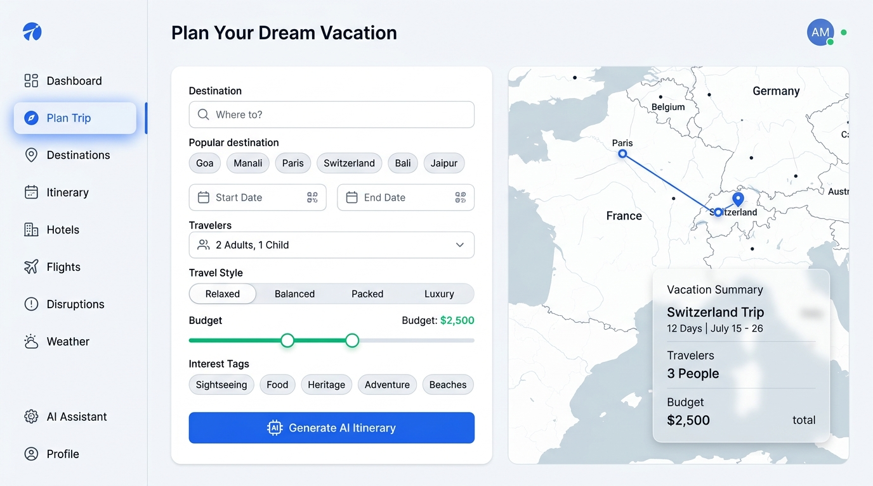
08 • PRODUCT EXPERIENCE
A decision-first interface — not a model demo
The sample project UI emphasizes a clean, premium travel workflow with maps, filters, cards and actionable outputs.
WHAT AN INTERVIEWER CAN SEE
• Destination + date inputs
• Traveler count and travel style
• Budget control in one place
• Interest tags for personalization
• Interactive map context
• One-click itinerary generation
React • TypeScript • Leaflet
Use this slide during the demo: enter a real request, generate the plan, then open the itinerary map.
AI TRAVEL COPILOT • INTERVIEW PRESENTATION
09

Slide 10
09 • SUPPORTING INTELLIGENCE
Flights, hotels, weather and disruptions complete the travel loop
These modules make the planner useful beyond itinerary generation.
FLIGHTS
Predicted fare + delay risk
HOTELS
Review sentiment + aspects
Random Forest price model + Random Forest delay classifier
TF-IDF + Logistic Regression; hotel cards expose sentiment and aspect scores
WEATHER
5-day forecast + rerouting
DISRUPTIONS
Check + rebook simulation
Current build uses curated destination forecast data; ≥40% rain can trigger indoor alternatives
CSV disruption events + itinerary adjustment logic; rebooking is a simulation in the current build
Design principle: every intelligence module should end in an action — choose, re-route, rebook, save or ask.
AI TRAVEL COPILOT • INTERVIEW PRESENTATION
10

Slide 11
10 • ENGINEERING
A modular full-stack implementation with clear separation of concerns
The repository is organized into API, agents, ML, optimization, RAG, services, frontend pages and reusable components.
FRONTEND
BACKEND
AI / ML
DATA
✓
React 19
✓
FastAPI
✓
Scikit-learn
✓
300,153 flight rows
✓
TypeScript
✓
Pydantic
✓
Random Forest
✓
20,491 hotel reviews
✓
Vite 8
✓
SQLAlchemy
✓
TF-IDF
✓
152 attraction rows
✓
Tailwind CSS 3.4
✓
SQLite
✓
Cosine similarity
✓
372 rich POI entries
✓
Leaflet / Recharts
✓
REST APIs
✓
Optional Gemini API
✓
10 disruption events
CORE API SURFACE
/trips /flights /hotels /budget /disruptions /chat /weather /recommendations /dashboard
AI TRAVEL COPILOT • INTERVIEW PRESENTATION
11

Slide 12
11 • EVIDENCE
What is already implemented — and what should be stated honestly
Strong interview answers distinguish measured model results from prototype simulations and future integrations.
MEASURED / SERIALIZED
CURRENT LIMITS / NEXT LEVEL
• Flight price model: R² 0.9738, MAE ₹1,912.04, RMSE ₹3,640.80.
• Flight delay classifier: 100% accuracy and F1 1.00 on the generated test split.
• Hotel sentiment model: 86.22% accuracy and F1 0.8402.
• 152 attraction records are available for destination retrieval; the recommender bundle currently indexes 13.
• Automated backend tests and a serialized model pipeline are included in the repository.
• Weather is currently curated/static by destination rather than a verified live weather API feed.
• Disruption data is CSV-backed; rebooking is simulated rather than connected to an airline reservation system.
• Flight delay labels are synthetic risk classes, so 100% accuracy should not be presented as real-world airline accuracy.
• The Gemini layer is optional and depends on a configured API key.
• Next: live flight/weather APIs, larger recommender index, real booking integrations and stronger evaluation on real delay labels.
AI TRAVEL COPILOT • INTERVIEW PRESENTATION
12

Slide 13
THE 60-SECOND DEMO STORY
Show the system thinking, not just the screens.
AI TRAVEL COPILOT
1
Ask
“5 days in Goa • ₹40k • 2 people • beaches + adventure”
PLAN
2
Generate
Planner retrieves POIs + allocates budget
PREDICT
Optimize
Daily sights are reordered geographically
OPTIMIZE
3
ADAPT
4
Inspect
Open map, flights, hotels and budget breakdown
5
Adapt
Simulate a delay → itinerary changes
Thank you
Questions & live demo
13

