Slide 1







YUKTI Innovation Challenge 2023
Institution’s Innovation Council (IIC),
Ministry of Education’s Innovation Cell
Submission of Assignments 1-5 for 1st Stage Evaluation
Proto ID:
IIC Institute Name:
Team Lead Name:Chiranjeevi Chathresh Vasagiri
Theme/Sector of Focus:
Mentor Name:
Team Members:4
Innovation Title:
Sanitron

Slide 2
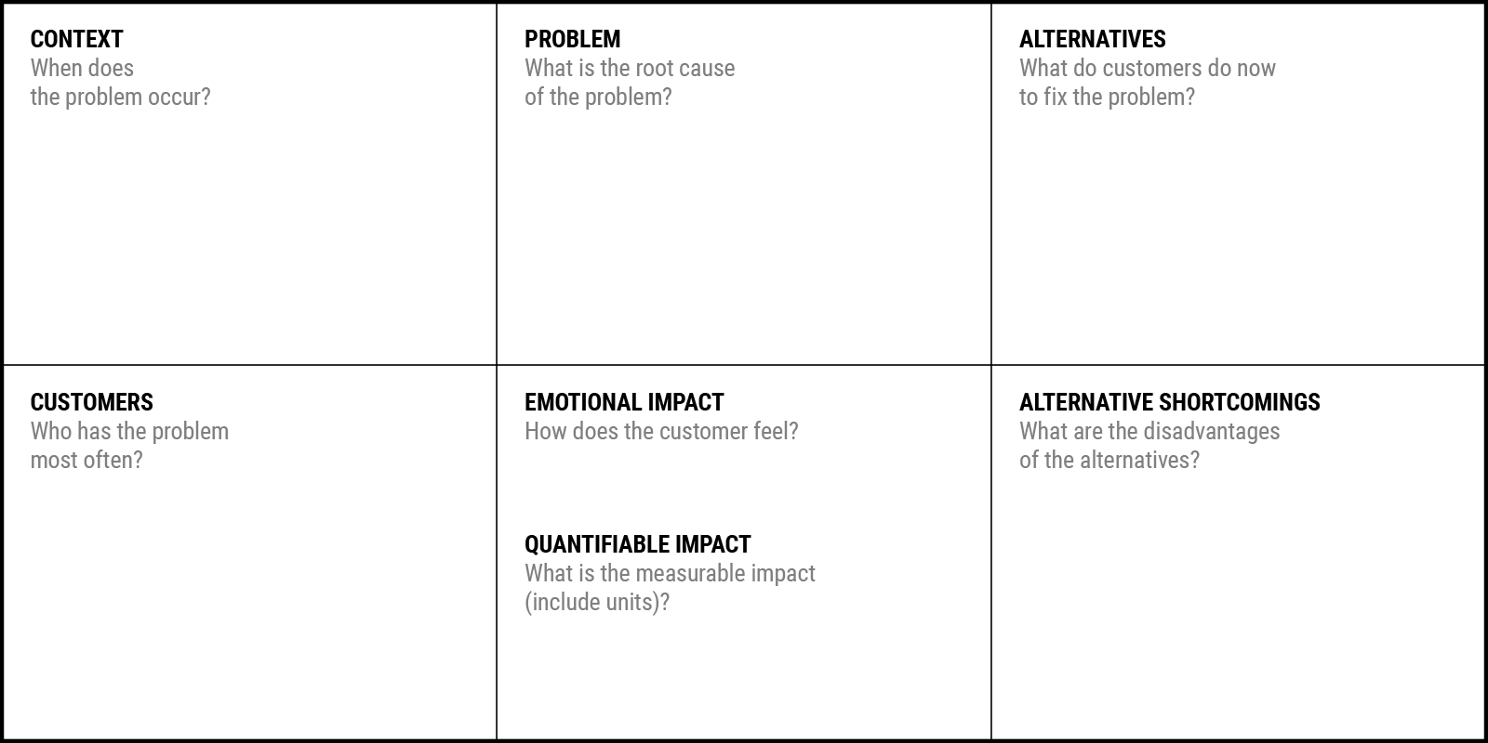
Problem Statement Canvas
YUKTI Proto ID:
Idea/Innovation Title:
Sanitrom
Date of Submission:
Who is your Customer Segment:
Prepared By:Chiranjeevi
Contact No: 6302529167
Your Answer:
During peak public use hours and between tight cleaning intervals in high-footfall zones — trains, metros, hospitals, airports — where manual sanitation can’t keep up.
Your Answer:
Public sanitation today is manual, inconsistent, and unsafe — relying on overworked staff, limited tools, and zero hygiene data visibility.
Your Answer:
Manual sweeping/mopping
Disinfectant spraying by staff
UV sterilizers (in select high-end zones)
Fogging machines (non-autonomous, mostly event-based)
Your Answer:Frustrated by inefficiency, anxious about hygiene risks, and under pressure to meet safety mandates without reliable tools.
Your Answer:
Railway zone managers
Hospital facility heads
Metro/Airport Ops teams
Municipal sanitation officers
Smart City project coordinators
Your Answer:
Manual methods = inconsistent + labor-intensive
UV/Chemical fogging = non-targeted, health risks
No data tracking = zero hygiene accountability
Not scalable = can't cover multiple spaces autonomously
Your Answer:What is the measurable impact?
Up to 40% delays in cleaning schedules (Railways)
12–18% patient infection risk tied to poor sanitation (Hospitals)
₹2,000–₹5,000/month lost per coach due to uncleanliness fines or cancellations
Thousands of avoidable man-hours spent in manual sanitization

Slide 3
Idea/Innovation Title:
Sanitron
YUKTI Proto ID:
Design and manufacturing of robots
Integration of navigation and sanitation tech
Field testing in varied public environments
Maintenance and technical support
Continuous software updates and ML improvements
Dedicated support and maintenance teams
Custom training for on-site staff
Regular performance updates and data analytics dashboards
After-sales servicing and warranties
Feedback loops for product updates
Government bodies (railways, municipalities, airports)
Private hospitals and metro operators
Facility management companies
Corporate campuses
Malls and commercial complexes
Smart City project bodies
Hardware suppliers (motors, LIDAR, disinfectant sprayers)
Logistics partners for deployment
Hygiene audit agencies and regulatory bodies
Colleges/incubators for technical mentorship
Automates and optimizes sanitation in public spaces
Reduces dependence on manual labor
Ensures real-time hygiene monitoring and reporting
Reduces health risks and improves public perception
Scalable and cost-efficient over time
Robotics engineers and software developers
Sensors, cleaning modules, and microcontrollers
Manufacturing and assembly partners
Cloud infrastructure for data and analytics
Pilot testing and R&D facilities
Direct sales to government/public agencies
Strategic partnerships with facility management companies
B2B expos (Swachh Bharat events, smart city forums)
Online demonstrations and digital marketing
Pilot programs in hospitals, stations, or airports
R&D and prototyping
Manufacturing and assembly
Sensor/hardware procurement
Staff salaries (technical and operations)
Marketing, sales, and distribution
Maintenance/logistics infrastructure
Robot unit sales (one-time)
Annual maintenance contracts (AMC)
Subscription model for sanitation analytics/reporting dashboard
Leasing model for short-term public events
Custom branding for municipalities or sponsors

Slide 4
1. The Overview
Create a very high-level overview of your product or service
Sanitron, your autonomous hygiene partner. Built for crowded public spaces to disinfect, detect, and deliver real-time cleanliness — making sanitation smart, safe, and effortless.
LEARN NOW

Slide 5
2. The Problem
What problem are you trying to solve? Is it really a problem?
Sanitron is an AI-driven autonomous robot that cleans crowded public spaces using smart sensors and 360° fogging. It plans routes, detects high-risk areas, and provides real-time sanitation data via the cloud, making cleaning faster, safer, and fully automated
Manual cleaning of crowded public spaces is slow, risky for workers, costly, and often misses critical areas. Without real-time hygiene tracking, authorities can’t ensure proper sanitization, leading to increased health risks and challenges scaling sanitation efforts across India’s vast, busy infrastructure.
Rajesh Kumar Facility/Operations Manager at Railways, Metro, Hospitals, or Smart Cities. Needs efficient, reliable sanitation to protect public health, reduce manual labor risks, and ensure compliance. Seeks smart, cost-effective automation with real-time monitoring to manage large, crowded spaces easily.
LEARN NOW

Slide 6
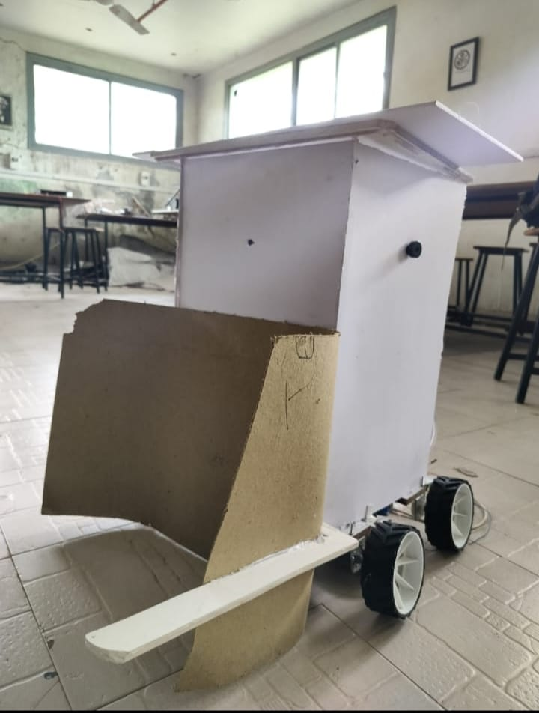
3.The Solution
Describe how are you solving the problem
Sanitron is an autonomous sanitation robot that uses AI and sensors to clean public spaces efficiently with 360° disinfectant fogging, providing real-time monitoring and data analytics to ensure thorough, safe, and scalable cleaning without human risk.
Sanitron combines full autonomy, smart AI, and real-time data to solve sanitation challenges that manual cleaning can’t—making public spaces safer, cleaner, and easier to manage at scale, all while reducing health risks and costs.
LEARN NOW

Slide 7
4. The Product/Service
Describe how are you solving the problem
Sanitron leverages AI-driven autonomous navigation and sensor fusion for precise, full-coverage 360° fogging, eliminating human exposure to pathogens. Its cloud-connected platform delivers real-time hygiene analytics and compliance reporting, reducing operational costs and enabling scalable deployment across complex, high-traffic public environments.
LEARN NOW

Slide 8
5. Market & Opportunity
Describe/Highlight the size of your target market
Total Addressable Market
Serviceable Addressable Market (SAM)
Target Market - The portion of SAM that you can capture
Provide Primary/Secondary Research Data
LEARN NOW

Slide 9
6. Funding Requirements
Total Grant Requirement: ₹10,00,000
1. Technology Development / Process Development / Innovation Refinement / Market Research
Total: ₹7,00,000
Drone hardware & components (3–5 units): ₹2,10,000 Thermal Imaging Sensors / Obstacle Detection Sensors: ₹1,20,000 AI module (Raspberry Pi or equivalent) + software development: ₹1,80,000
App development and dashboard integration: ₹60,000 Market research, user feedback, and pilot testing: ₹1,30,000
2. Startup Registration / IP Filing Related Expenses
Total: ₹2,00,000
Company registration and legal compliances: ₹50,000
Patent/IP filing (hardware + software design): ₹1,50,000
3. Participation in Innovation Challenges / Competitions / Training / Travel
Total: ₹1,00,000
Hackathons and demo events: ₹60,000
Training, certifications, and workshops: ₹40,000

Slide 10
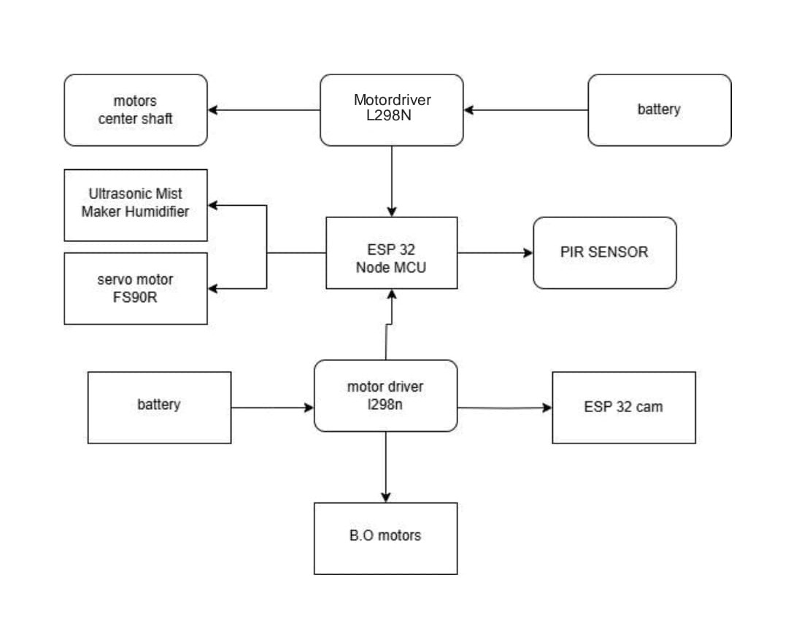
Process Flow Chart

Slide 11
7. The Technology/Innovation
Describe the technologies you are using to solve the problem
Sanitron is at TRL 4 — technology validated in the lab with working prototypes of core systems like AI navigation, fogging mechanism, and sensors. The next step is integrated system testing in controlled real-world environments to advance towards pilot deployments.
Sanitron combines a proprietary eco-friendly disinfectant with a smart sensor-based fogging system and a SaaS platform for real-time monitoring and compliance. Our AI-driven cleaning schedules ensure safe, customizable sanitation for sensitive environments. Fully modular and regulatory-compliant, Sanitron delivers scalable, tech-powered hygiene solutions that stand apart in efficiency and safety.
LEARN NOW

Slide 12
8. Competitive Landscape
What are the alternative solutions available in the market?
Manual cleaning, UV robots, spray drones, and basic floor cleaners.
Sanitron stands out with full AI-driven autonomy, a unique 360° wet/dry fogging system, real-time hygiene data analytics, and modular design adaptable across diverse public spaces—delivering safer, smarter, and more effective sanitation than any competitor.
Barriers to Entry Patents on AI and fogging tech, key partnerships with Railways and hospitals, and complex AI-hardware integration protect Sanitron from competitors. Collaboration Opportunities Work with transport, healthcare, smart cities, tech firms, and disinfectant companies to customize and scale the solution.
LEARN NOW

Slide 13
9. Business Model
What is your revenue model?
Clearly and concisely explain how you generate Money: Source of RevenueRobot Sales: One-time purchase by institutions. Maintenance Contracts: Annual service fees. Data Subscriptions: Monthly access to usage and hygiene analytics. Leasing: Rental model for temporary needs. Custom Upgrades: Paid customizations and branding.
We have a viable business model based on multiple revenue streams—robot sales, leasing, annual maintenance contracts, and data subscriptions. These ensure recurring income and long-term sustainability, even as we scale. While we’re not yet profitable, our model is built for steady growth and profitability with increased adoption.**
LEARN NOW

Slide 14
10. Way forward Strategy
What is your implementation strategy in short-term, midterm and long-term?
Year 2: Scaling & Diversification Expand to multi-city operations via regional field teams. Launch new product lines: eco-friendly disinfectant sprays, portable UV units, etc. Set up franchise/partner models in smaller towns. Build mobile app for service booking, tracking, and feedback..
Year 3+: Automation & Growth Acceleration Implement IoT-based monitoring for large commercial clients (e.g., sanitation frequency, air quality). Explore export or regional market entry (Sri Lanka, Middle East). Develop subscription models for SMEs with bundled products and services. Target government/public sector tenders (schools, railways, etc.).
Year 1: Market Penetration & Brand Establishment Focus on Tier-1 & Tier-2 cities (Hyderabad, Bangalore, Chennai, Pune, Vizag, etc.) Offer pilot programs or free demo services to build client trust. Build a lean team and optimize operations for quality and speed. Invest in branding, digital presence, and certification/accreditation.
LEARN NOW

Slide 15
11. The Team
Show the people behind the idea and briefly describe their role
Founders Chandrashekar -Founder
Team member’s history Aditi Joshi-CS DeviSri-EC Chiranjeevi Chathresh Vasagiri-EC
Explain the unique value each person brings to the startup
Talk about their passion for the project and why they decided to work for a startup
We share common goals, visions and missions towards making a stress-free experience for cattle owners. My mates share my dreams along with with my responsibilites.
LEARN NOW

Slide 16
12. Contact
Leave your contact details and let people know how to reach you quickly
Chiranjeevi Chathresh Vasagiri Phone Number:6302529167 Email:chiranjeevivasagiri@gmail.com
Aditi Joshi Phone Number:6301932007 Email:jaditi055@gmail.com
LEARN NOW

Slide 17
Thankyou

