Slide 1
Car Washing Management System Developed in PHP & MySQL
YERRASANI CHANDRA SEKHAR REDDY
BU22CSCI0100254
Under guidance of
HELEN PARIMALA

Slide 2
Project Overview
*Our goal is to lead the car washing industry by focusing on customers, employees, growth, innovation, and efficiency.
*The Car Washing Management System is fully automated, covering foaming, washing, drying, and brushing.
*Experienced workers ensure thorough cleaning, and the system is visually monitored step by step.
*Currently, car washing details are maintained on paper, leading to several issues:
-Data storage is inefficient.
-Maintenance is difficult.
-Updating or changing details is time-consuming.
-Performance does not meet expectations.

Slide 3
Introduction
*This service helps managers assess transportation costs while maintaining quality.
*The Car Washing Management System automates the entire cleaning process with expert workers and step-by-step visualization.
*The project is built using PHP and MySQL.
*It has two modules:
Admin
User

Slide 4
Existing System
Manual record-keeping using paper
Difficult to update or modify records
Time-consuming and error-prone process
Limited tracking of car washing activities

Slide 5
Updated System
Automated car washing management
Online booking system for users
Admin dashboard for managing bookings & locations
Database storage for efficient record management

Slide 6
Admin Module
Secure admin login system
Dashboard: In this section, admin can see two wheeler and four wheeler vehicle detail in brief.
Washing Points: In this section, admin can manage washing location (Add/Update).
Add Car Washing Booking: In this section, admin add car washing booking on his/her end.
Car Washing Booking: In this section, admin can view booking details of car washing which is booked by users.
Manage Enquiries: In this section, admin can read the enquiries of users.
Pages: In this section, the admin can manage about us and contact us pages.
Admin can also change the password of his/her account.

Slide 7
User Module
Users
Home Page: Users can see the listed vehicles on the home page.
About Us: Users can view about us page.
Washing plans: User can view car washing plans and book that plans.
Washing points: User can view car washing location.
Contact us: Users can view the contact us page and do enquiry.

Slide 8
Requirement Specification
Hardware Configuration:
Client Side
Server Side
RAM | 512 MB
Hard Disk | 10GB
Processor | 1.0 GHz
RAM | 1 GB
Hard Disk | 20GB
Processor | 2.0GHz

Slide 9
Software Requirement:
Client Side
Server Side
Web Browser | Google Chrome or any compatible browser
Operating System | Windows or any equivalent OS
Web Server | APACHE
Server side Language | PHP5.6 or above version
Database Server | MySQL
Web Browser | Google Chrome or any compatible browser
Operating System | Windows or any equivalent OS

Slide 10
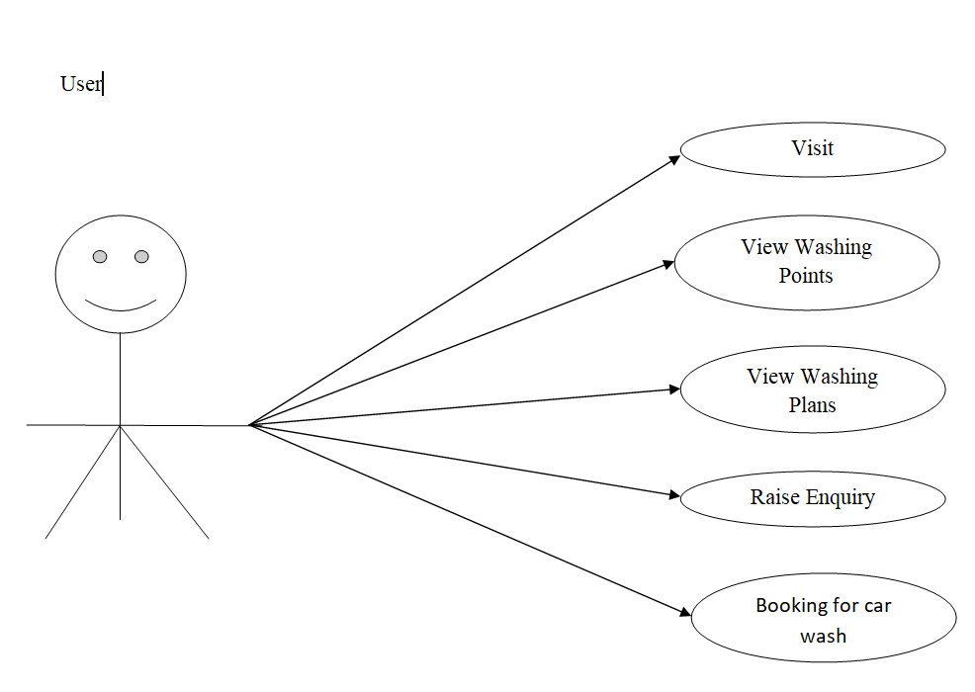
Use Case Diagram
Notes:
USECASE DIAGRAM: A Use case is a description of set of sequence of actions. Graphically it is rendered as an ellipse with solid line including only its name. Use case diagram is a behavioral diagram that shows a set of use cases and actors and their relationship. It is an association between the use cases and actors. An actor represents a real-world object. Primary Actor – Sender, Secondary Actor Receiver.

Slide 11
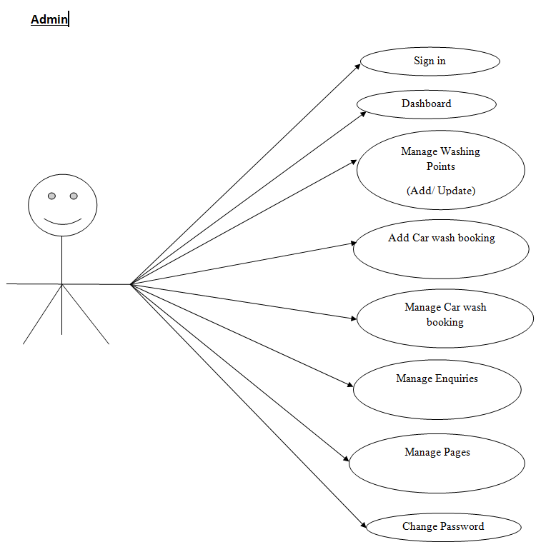


Slide 12
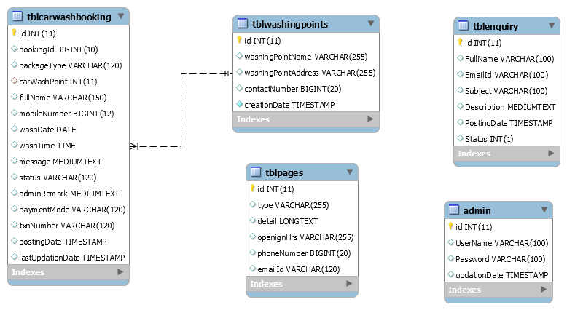
Class Diagram
Notes:
Class Diagram:
A description of set of objects that share the same attributes operations, relationships, and semantics

Slide 13
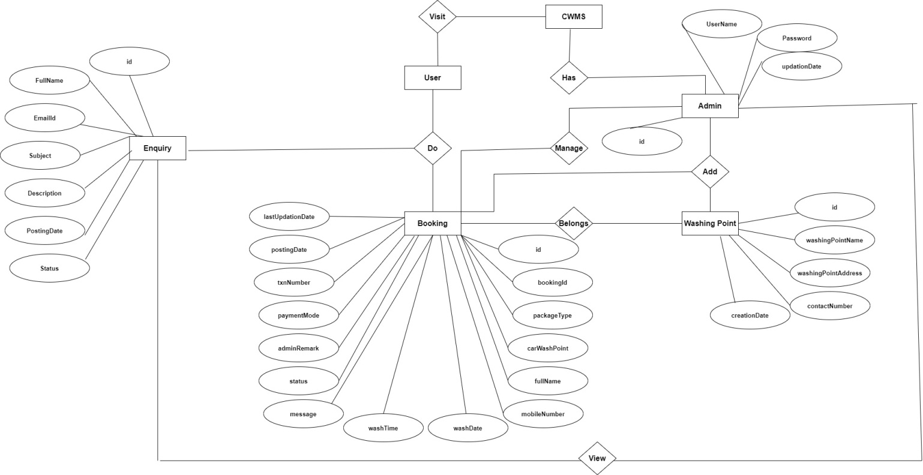
ER Diagram

Slide 14
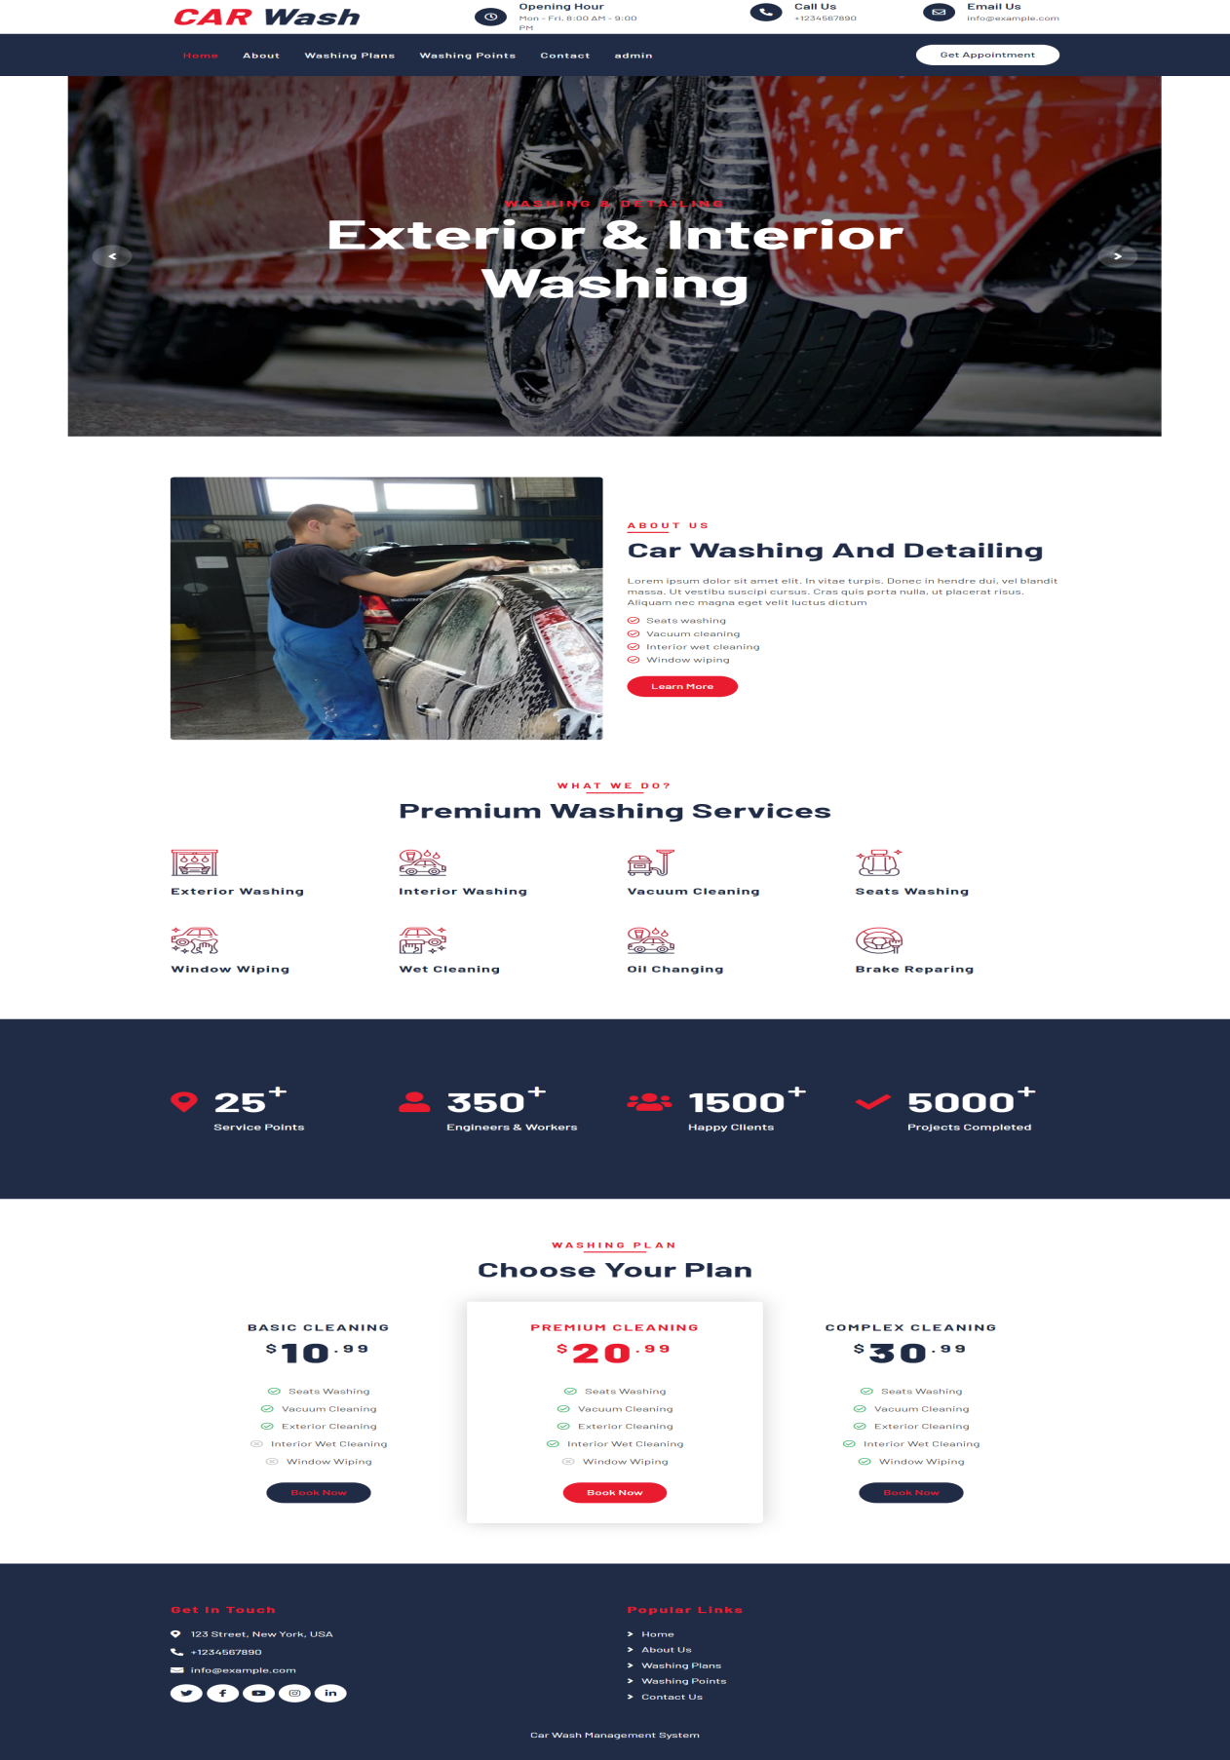
Project Screens

Slide 15
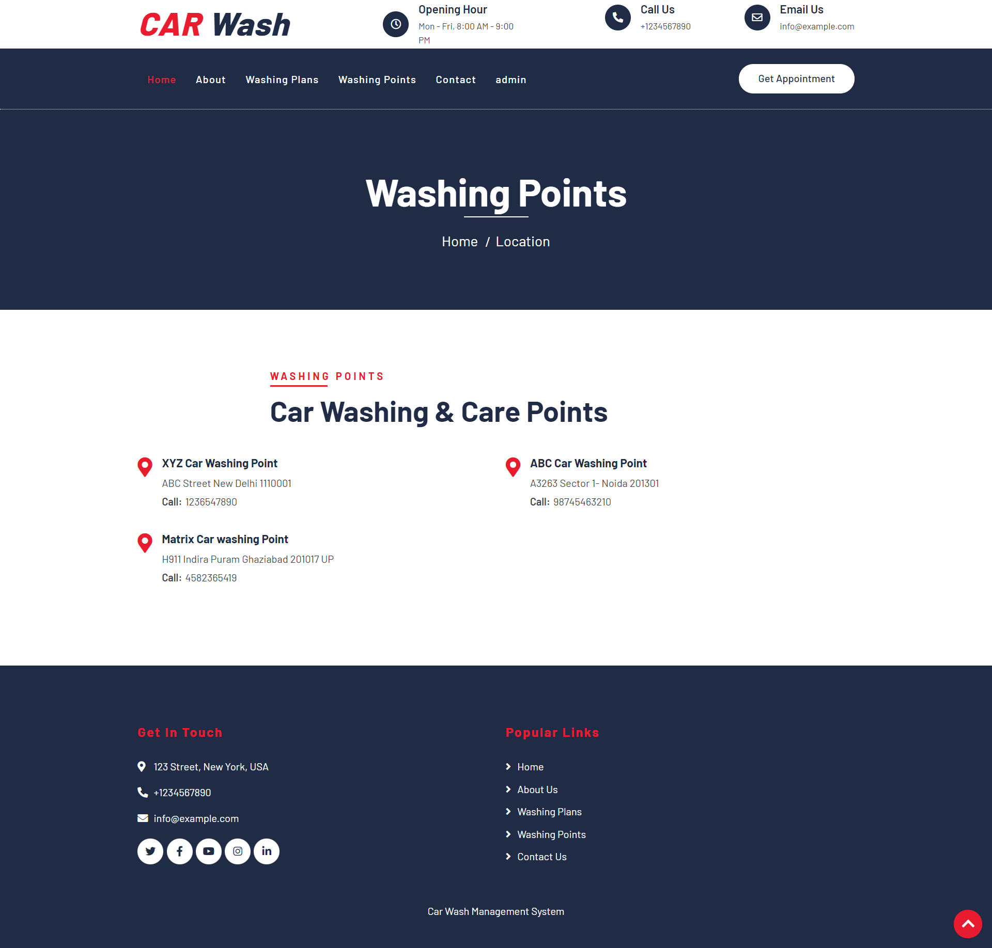

Slide 16
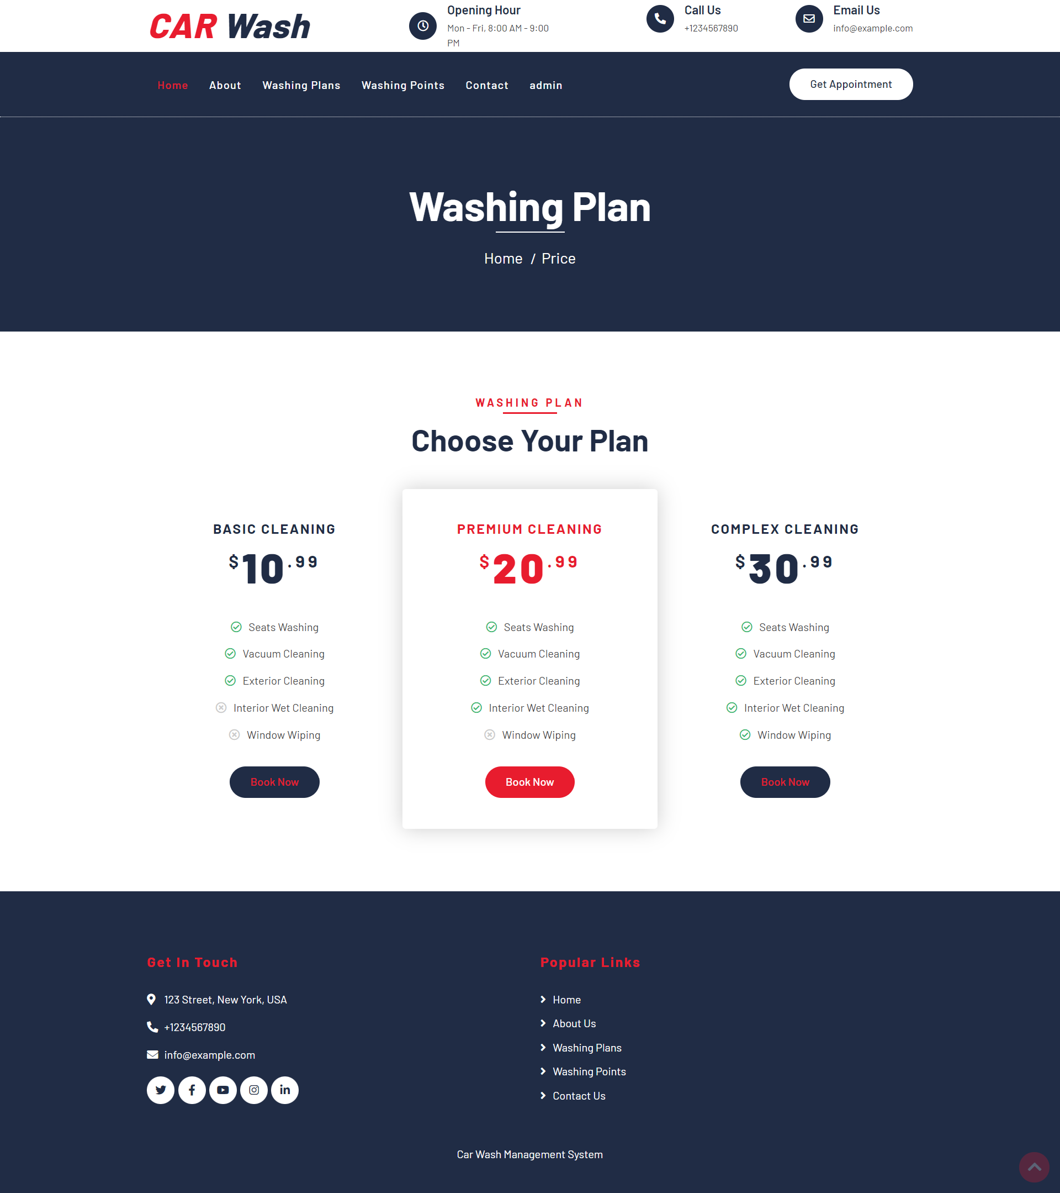

Slide 17
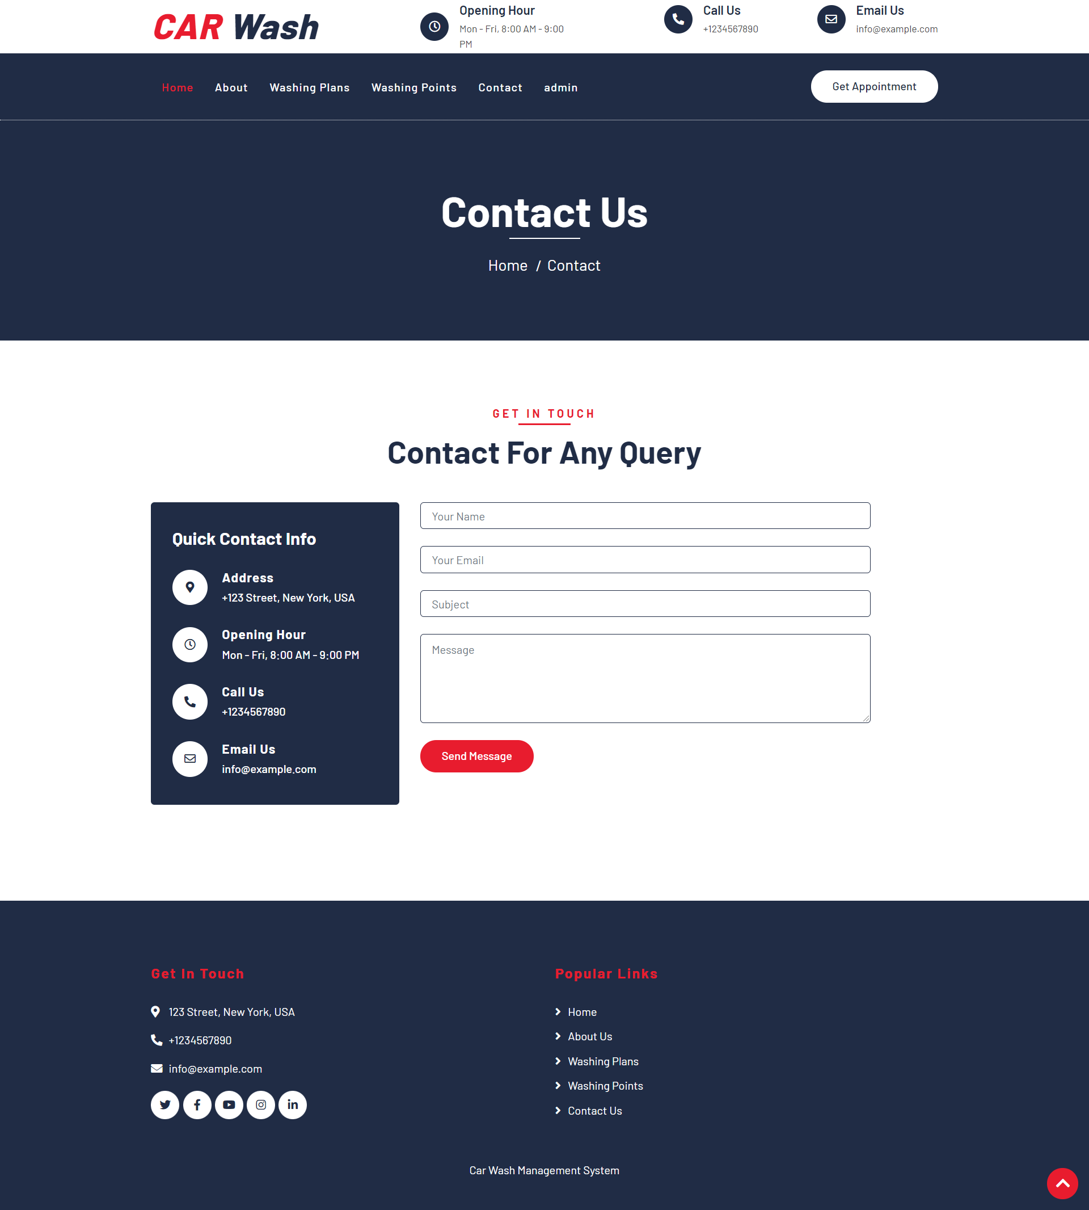

Slide 18
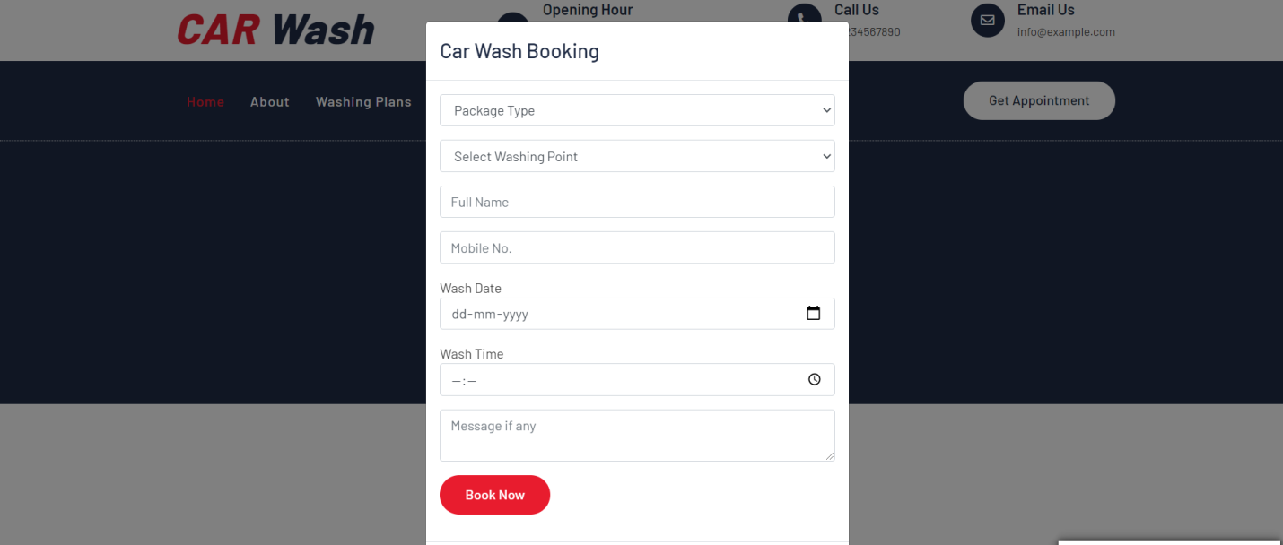
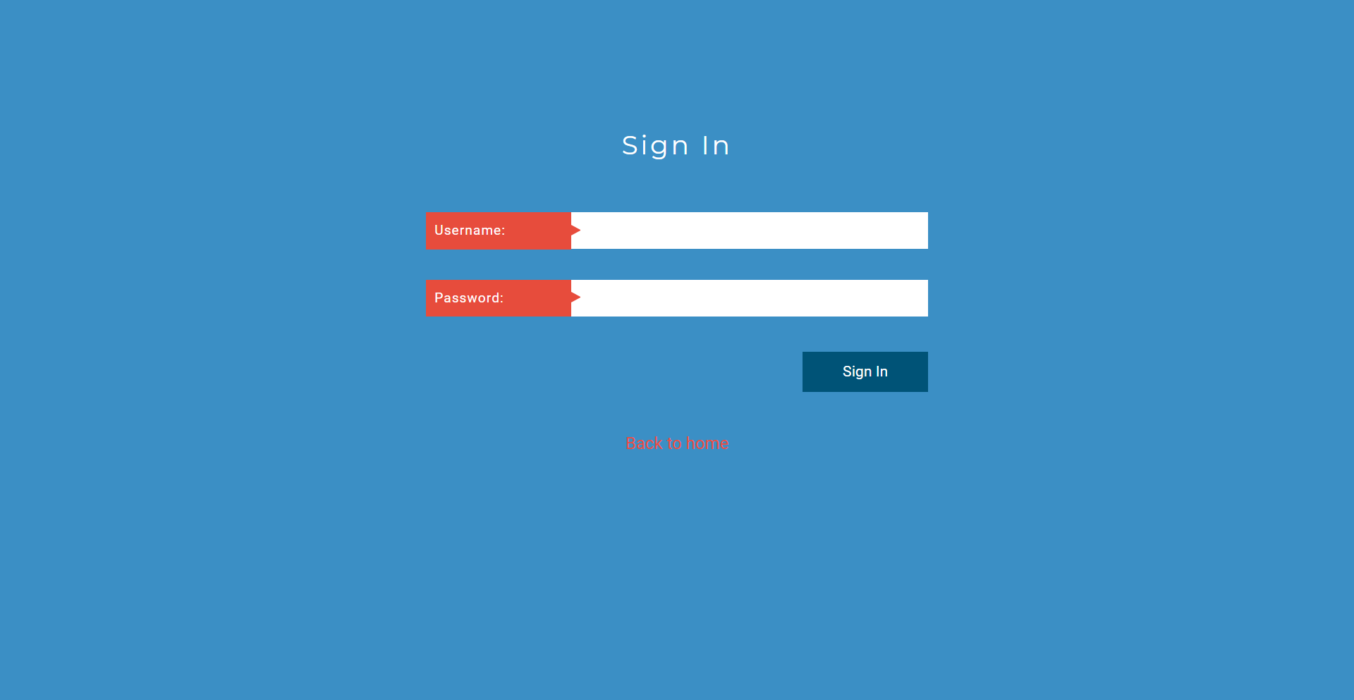

Slide 19
Future Enhancements
Integration of AI-based washing recommendations
Mobile application for user convenience
Automated billing and payment gateway
Live tracking of washing process
Integration with vehicle service history

Slide 20
Conclusion
The Car Washing Management System was carefully planned and developed.
All necessary requirements were considered to ensure a smooth and efficient system.
The system manages car washing bookings efficiently.
This web application ensures high-quality car washing results.
It is user friendly and capable of washing multiple cars simulteneously

Slide 21
References
For PHP
https://www.w3schools.com/php/default.asp
https://www.sitepoint.com/php/
https://www.php.net/
For MySQL
https://www.mysql.com/
http://www.mysqltutorial.org
For XAMPP
https://www.apachefriends.org/download.html

Slide 22
Thank You

