Slide 1

Collecting and Managing Provenance Data for HPC Datacenters
Harichandana Byna
Advisors
Dr. Yong Chen, Associate Professor, TTU
Dr. Alan Sill, Managing Director, HPCC, TTU
Mr. Misha Ahmadian, Research Assistant, TTU

Slide 2
Index
What is Provenance?
Why do we need provenance for HPC?
Lustre Parallel File System
Lustre JobStats
Lustre Changelogs
Graph Database
TimeSeries Database
Design and Implementation
Demo

Slide 3
What is Provenance?
Provenance describes the detailed information about the origin and history of piece of data.
- the actions performed on the data.
- relationships among process/jobs, users, data and workflows that contribute to the existence of data.
Provenance can answer many questions:
- From where a data product was acquired?
- By whom and when the data product was created?
- In what transformations and computations, it has been used?
- What were the inputs for a generated output data item?
- Which criterion was applied for generating a data product?

Slide 4
Why do we need provenance for HPC?
Provenance is key to supporting many data management functionalities:
I/O monitoring
Auditing data usage
To optimize HPC resource usage
To Improve the performance of HPC systems
To improve user’s application performance
To quickly find the root cause when any fault is reported

Slide 5
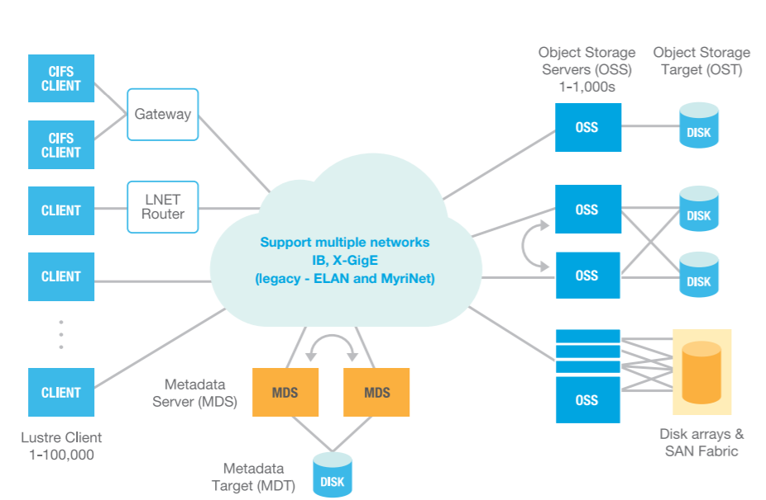
Lustre Parallel File System
Components of Lustre File system:
Metadata Server (MDS)
- manages metadata
- allocation of storage objects on OSS
Object Storage server(OSS)
- provides data storage
- follows round robin manner
Client
- acts as logical interface
https://www.seagate.com/files/www-content/solutions-content/cloud-systems-and-solutions/high-performance-computing/_shared/docs/clusterstor-inside-the-lustre-file-system-ti.pdf

Slide 6
Lustre Jobstats
The Lustre jobstats feature collects file system operation statistics for user processes running on Lustre clients
Jobstats are disabled by default. The current state of job stats can be verified by checking lctl get_param jobid_var on a client
To enable jobstats on the file system(testsfs) with SLURM
To enable jobstats on a client that do not use a job scheduler
$ lctl get_param jobid_var
jobid_var=disable
Job Scheduler | Environment Variable
SLURM | SLURM_JOB_ID
SGE/UGE | JOB_ID
LSF | LSB_JOBID
# lctl conf_param testfs.sys.jobid_var=SLURM_JOB_ID
# lctl set_param jobid_var=procname_uid

Slide 7
Lustre Jobstats
Lustre collects jobstats on MGS, OSS servers
MDS Jobstats
- lctl get_param mdt.*.job_stats
OSS Jobstats
- lctl get_param obdfilter.*.job_stats
Auto-Cleanup Interval
- [mgs#] lctl conf_param testfs.mdt.job_cleanup_interval={max_age}

Slide 8
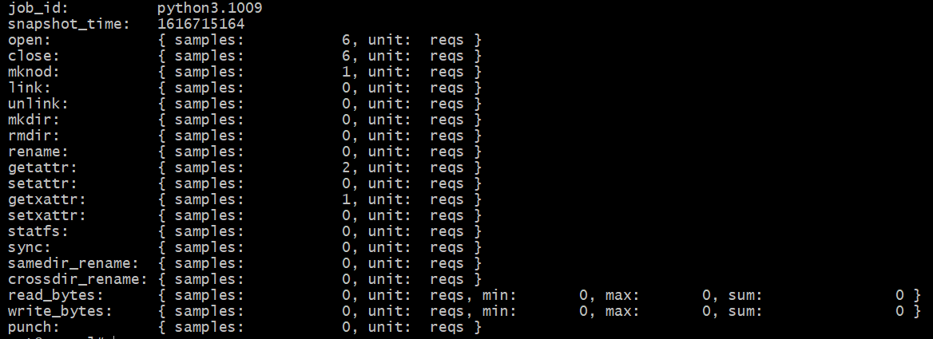
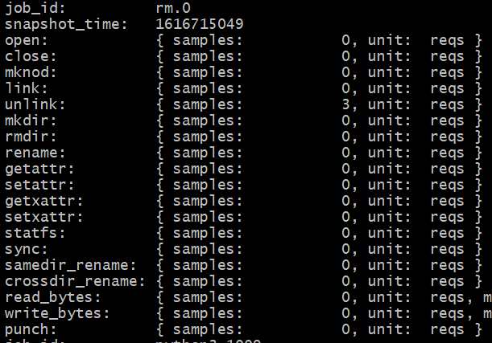
Lustre JobStats - MDS
Properties | Values
Job_id | rm.0
Snapshot_time | 1616715049
unlink | 3 samples
Properties | Values
Job_id | python3.1009
Snapshot_time | 1616715164
open | 6 samples
close | 6 samples
mknod | 1 sample
getattr | 2 sample

Slide 9
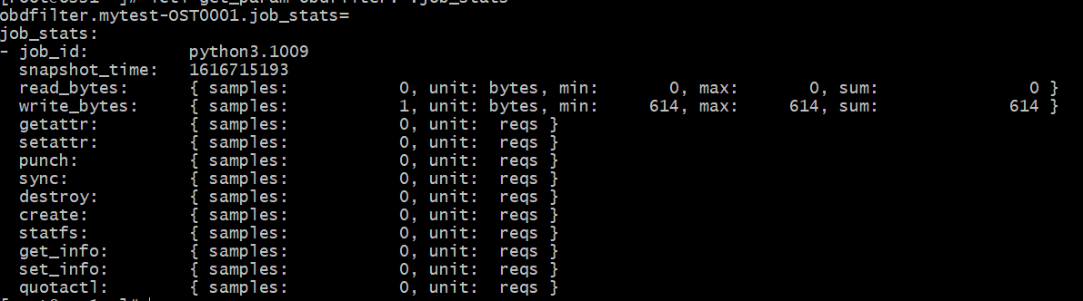
Lustre JobStats - OSS
Properties | Values
job_id | python3.1009
snapshot_time | 1616715193
write_bytes | 1 sample [bytes] 614 614 614

Slide 10
Lustre Changelogs
The changelogs feature records events that change the file system namespace or file metadata
Changes such as file creation, deletion, renaming, attribute changes, etc.
Changelogs are recorded with target and parent file identifiers, timestamp, user information
Changelogs are disabled by default
To register a new changelog user
- [mds]#lctl fsname-MDTnumber changelog_register
Changelogs are accessible in the client machine
- lfs changelog fsname-MDTnumber
Clearing Changelog records
- lfs changelog_clear mytest-MDT0000 cl1 345

Slide 11
Lustre Changelogs
Sample changelog records
rec# operation_type(numerical/text) timestamp datestamp flags t=target_FID \ ef=extended_flags u=uid:gid nid=client_NID p=parent_FID target_name
2304 10OPEN 23:32:44.115896026 2021.03.25 0x1 t=[0x20000d6f1:0x4:0x0] j=python3.1009 ef=0xf u=1009:1011 nid=192.168.24.6@tcp m=r--
2305 19ATIME 23:32:44.117201017 2021.03.25 0x1 t=[0x20000d6f1:0x4:0x0] j=python3.1009 ef=0xf u=1009:1011 nid=192.168.24.6@tcp
2306 11CLOSE 23:32:44.117211763 2021.03.25 0x1 t=[0x20000d6f1:0x4:0x0] j=python3.1009 ef=0xf u=1009:1011 nid=192.168.24.6@tcp
2319 01CREAT 23:32:44.122469330 2021.03.25 0x0 t=[0x20000e691:0x1:0x0] j=python3.1009 ef=0xf u=1009:1011 nid=192.168.24.6@tcp p=[0x20000d6f1:0x3:0x0] user4_file.txt

Slide 12
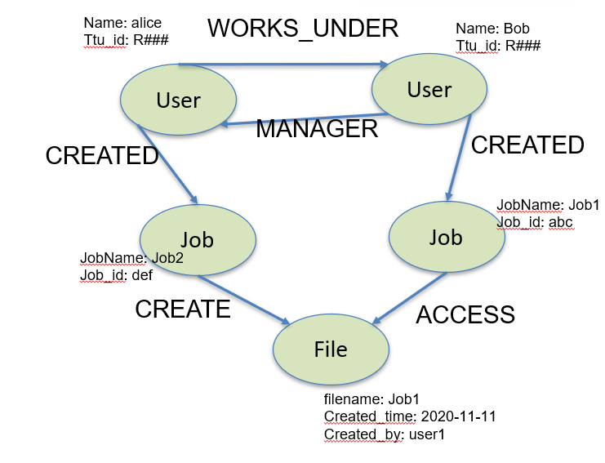
Graph Database – Neo4j
Composed of two main elements: a node and a relationship.
Nodes- Represents the objects in the
graph and can be labelled
Labels – Group Nodes by role
Relationships – connect entities
Properties – Name value pairs on nodes
And relationships.
Manages large volumes of data
Generates insights from existing data
Relationships between data points matter more than the individual points

Slide 13
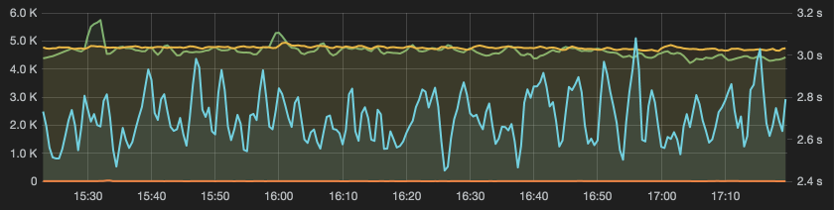
Time Series database(TSDB) - InfluxDB
Time-series data is a sequence of data points collected over time intervals, giving us the ability to track changes over time
TSDB - Built specifically for handling metrics and events that are time-stamped.
Optimized for measuring change over time

Slide 14
Why are two databases needed?
Every database has different conceptual aspects from each other, every database is used for different purpose(SQL/NoSQL)
TSDB
– Common in monitoring systems
– Sampling in interval basis approach
– Visualizing and querying the data on a particular time period
– Data Retention – may be 3 months or 6 months
– Real time Visualization by Grafana – Interacts directly with InfluxDB
Graph DB
– Not common in monitoring system
– to store past data
– Visualizes relations between data in graph format

Slide 15



Design and Implementation
Lustre Client
Monitoring Server
JobStats Publisher
Dashboards
(Grafana)
Message Broker
(e.g., RabbitMQ)
JobStats Consumer & Parser
MDT stats
OSS stats
TSDB (Influx DB)
Internal Network
MDS
OSS
OSS
Graph DB (neo4j)
File ops
Changelogs parser & collector

Slide 16
Simulation of Users Actions
No Cluster was used for this project
Done in local machine using virtual box
Simulated the user actions on lustre file system using python script
Simulation use case
- created folders for each users in lustre file system
- each user will be able to read from all other user's files and write the content in their own folder
- changelogs and job stats will be collected for all the operations

Slide 17
Steps for the implementation
Enable Jobstats and Changelogs
Clear JobStats on MDS, OSS
Send JobStats from MDS, OSS to Message Broker
Run JobStats Consumer Script
(Listener)
Clear Changelogs
Run File Ops Simulation script for user
Changelogs Collector & Parser

Slide 18

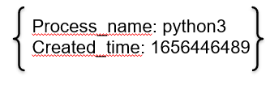
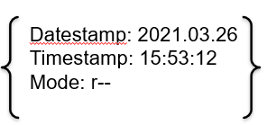
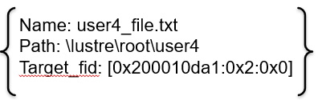
Graph Design
USER_ID
CREATED
JOB_ID
CLOSE
OPEN
File/Dir Name

Slide 19

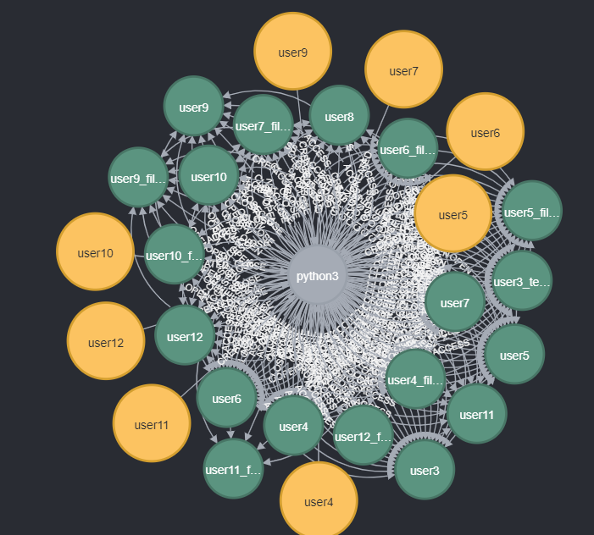
Graph – After simulating actions for 10 users

Slide 20
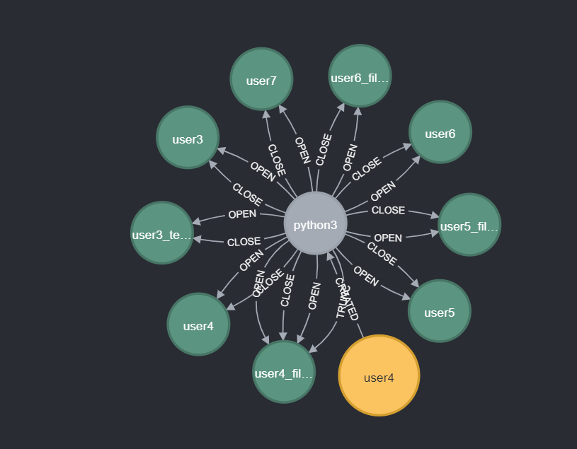
Graph – for one user actions

Slide 21
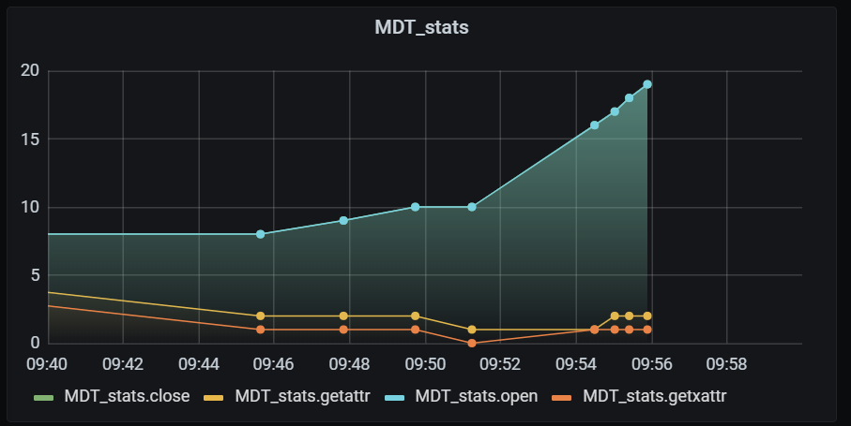
Visualization of JobStats - Grafana

Slide 22
DEMO

Slide 23
THANK YOU

