Slide 1

TrendzOle
( O n l i n e S h o p p I n g Z o n e )
Submitted by :
Chandu Mani Kumar ( 16CS036 )
N. Sunil ( 16CS042 )
Notes:
<number>

Slide 2


Notes:
<number>

Slide 3
Content :
Introduction
Purpose of project
Software used
Features of project
Screenshots of output
Future scope
Reference
Notes:
<number>

Slide 4
Introduction :
Webpage.
Online Shopping Zone on shirts.
Three type of shirts.
Providing Private security to the user.
User can order by his/her design.
Online-payment.
Notes:
<number>

Slide 5
Purpose of Project :
Provide latest designs.
Security.
User satisfaction.
Notes:
<number>

Slide 6


Software's Used :
HTML ( Hyper Text Markup Language )
CSS ( Cascading Style Sheet )
Notes:
<number>

Slide 7

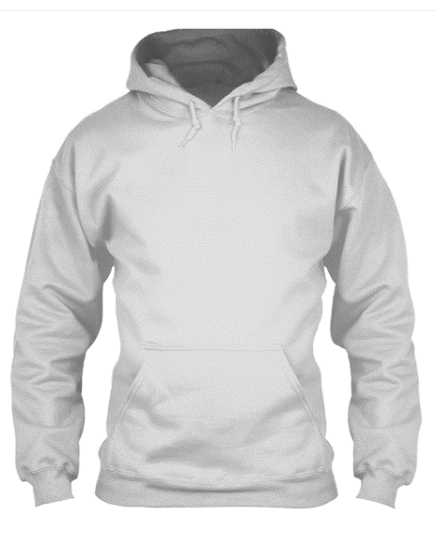
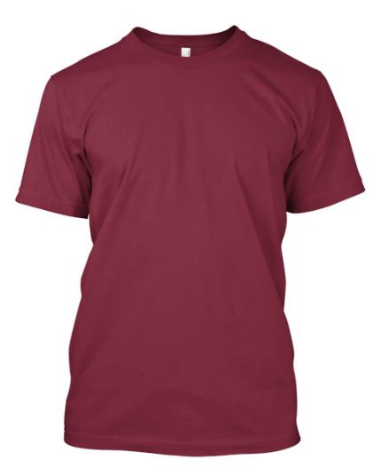

Features of Project :
Online shopping zone website.
Three types of shirts for the user.
Updates.
Shirt with his/her design.
Private security.
Notes:
<number>

Slide 8
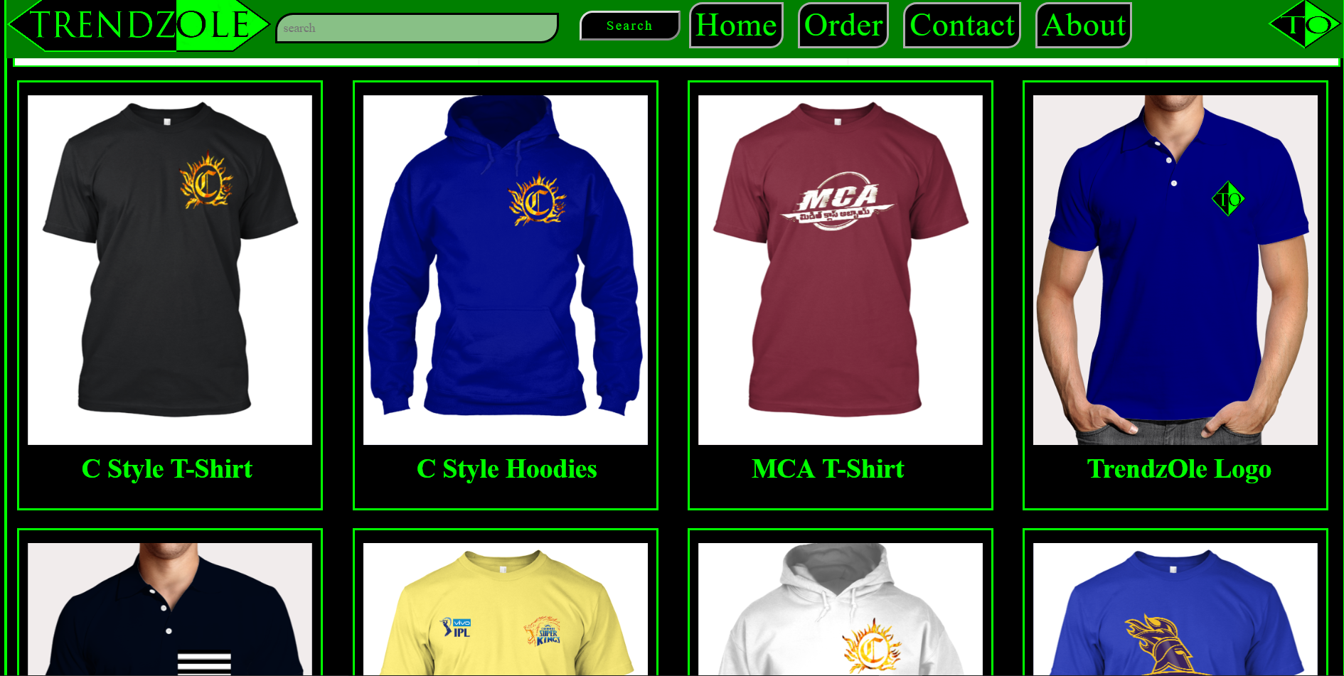
Screenshots of Output :
Notes:
<number>

Slide 9
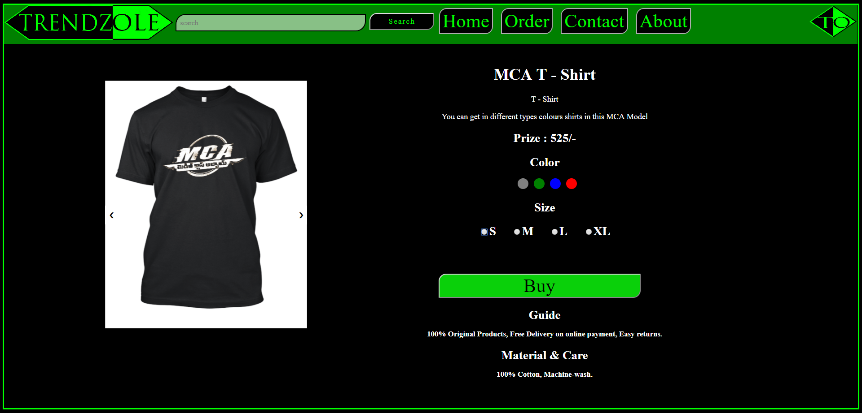
Notes:
<number>

Slide 10
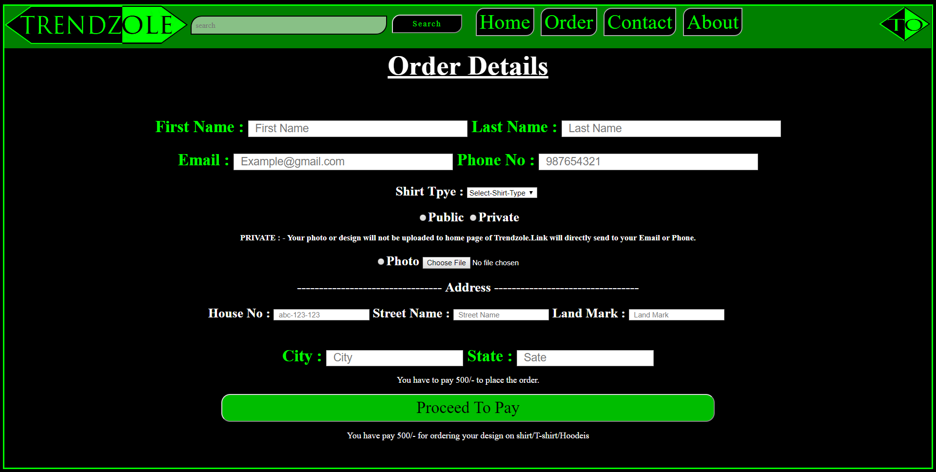
Notes:
<number>

Slide 11
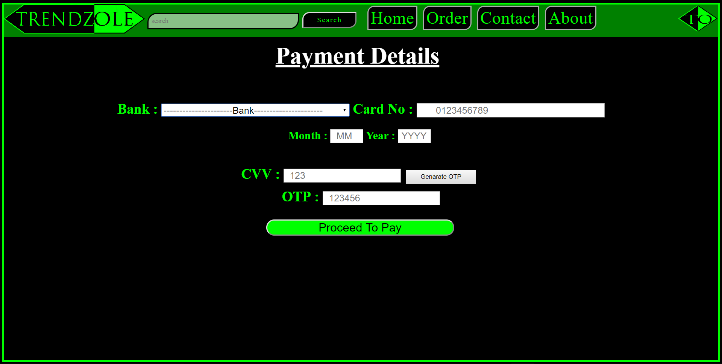
Notes:
<number>

Slide 12
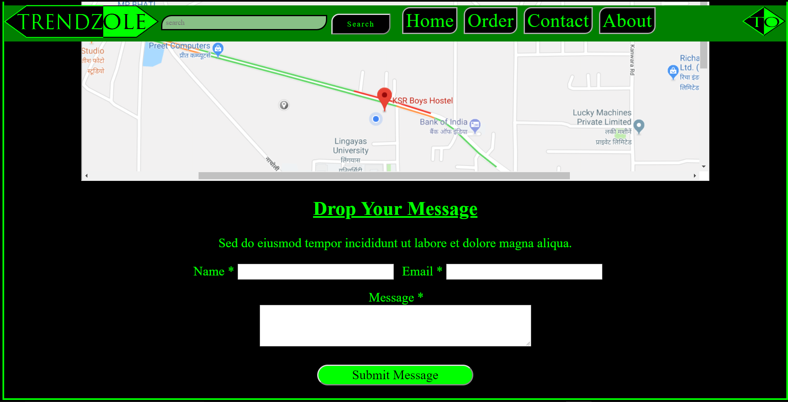
Screenshots of Output :
Notes:
<number>

Slide 13
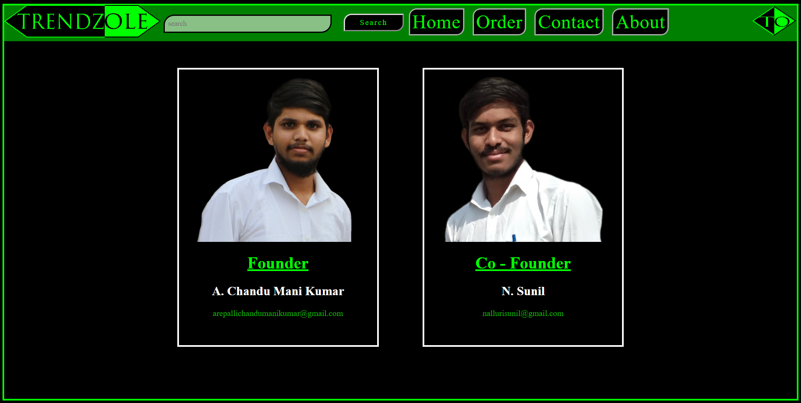
Notes:
<number>

Slide 14



Future Scope :
Softwares
Online user design flat form.
Seeing shirt-colors in the Home Page.
Notes:
<number>

Slide 15
Reference :
Coding Addict
https://www.youtube.com/watch?v=aYSgpR5VGPM&spfreload=10
https://www.tutorialspoint.com/html_online_training/index.asp
https://www.tutorialspoint.com/css_online_training/index.asp
Notes:
<number>

Slide 16
Thank you…………!
Notes:
<number>

