Slide 1

Hardware-rooted KAC for scalable data
sharing in cloud
Chandu komme-319570

Slide 2
Problem & Approach
My Approach
• Key–Aggregate Cryptosystem: one key authorizes a subset of classes.
• AES-GCM per file (fresh key + nonce; integrity tag).
• RFID presence gate; OLED status; optional ATECC608A liveness.
• Minimal Flask cloud stores ciphertext + compact header only.
The Problem
• Keys and files get copied; we lose control of where decryption happens.
• Per-file key management and rotation are heavy on edge devices.
• Cloud should remain plaintext-blind with a small attack surface.

Slide 3
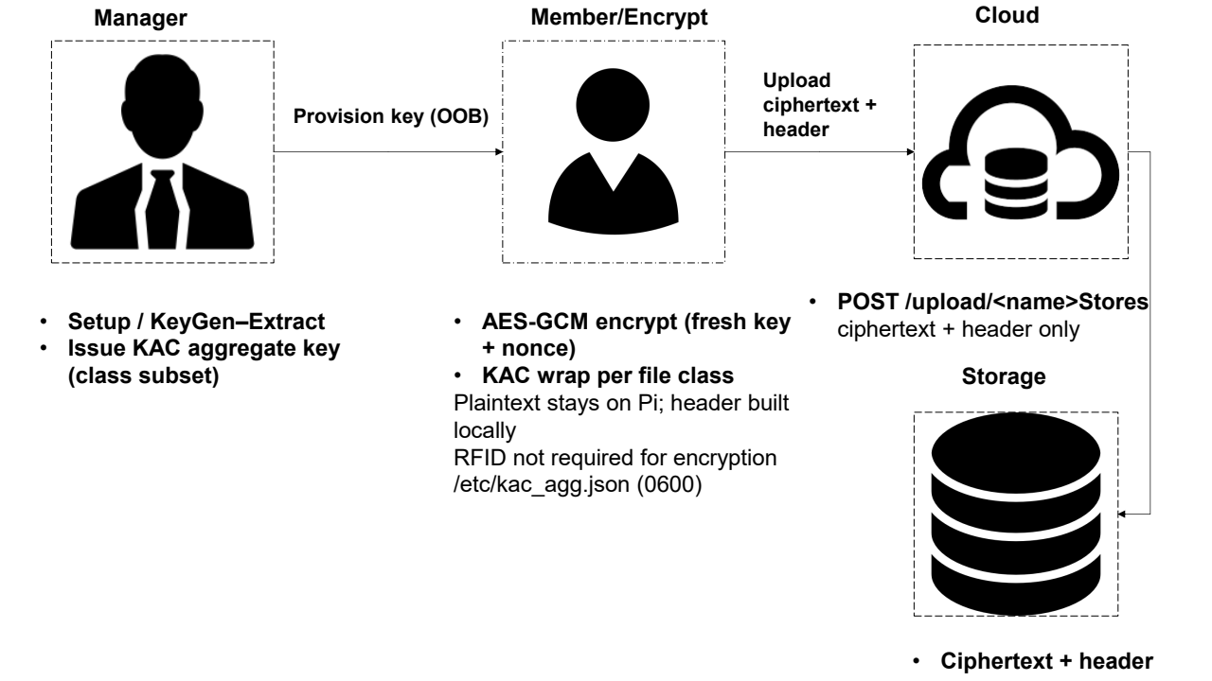
Encryption Flow (on the Pi)

Slide 4
Encryption Flow (on the Pi)
Steps
• Generate fresh 256-bit key and 96-bit nonce.
• AES-GCM ⇒ ciphertext + tag; compute SHA-256 digests for audit.
• KAC-wrap the file key for the chosen class.
• Upload ciphertext + header {class, nonce, tag, wrap, digests, env?}.
• Cloud stores bytes only; no plaintext and no long-term keys.

Slide 5
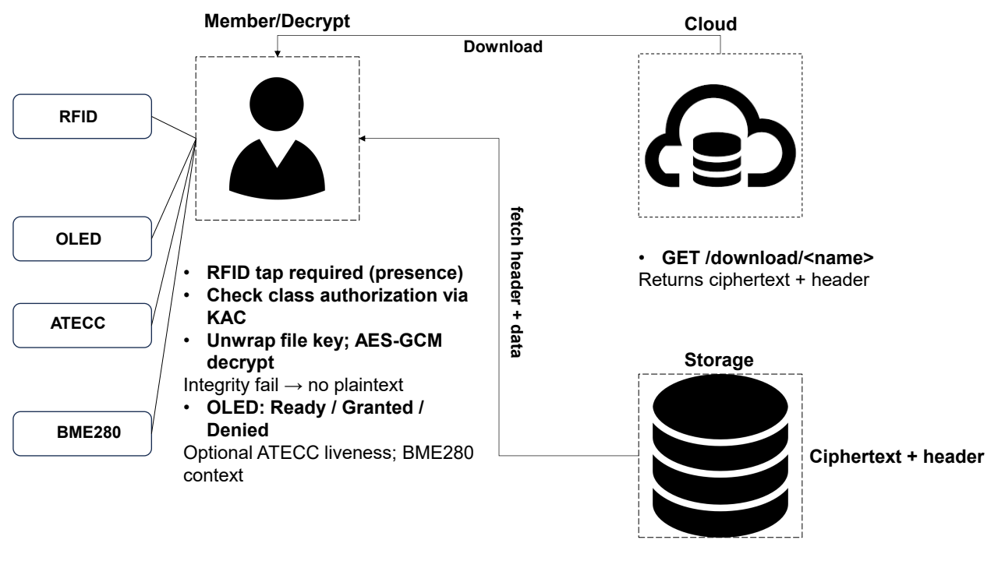
Decryption Flow (on the Pi)

Slide 6
Decryption Flow (on the Pi)
Steps
• OLED shows Ready; user taps enrolled RFID card.
• Download ciphertext + header from the cloud.
• Check class via aggregate key; unwrap the file key (KAC).
• Verify GCM tag; on success write plaintext and display text on OLED.
• On denial or tamper: no plaintext; clear device feedback.

Slide 7
Compact Header Design
Header Fields
• class, nonce, tag, wrap, digests, optional environment snapshot
• Bind class/kid as AEAD Associated Data (AAD) to detect header tampering

Slide 8
Hardware on Raspberry Pi
Peripherals
• MFRC522 (SPI) — RFID presence gate
• SSD1306 OLED (I²C 0x3C) — status & text viewer
• ATECC608A (I²C 0x60) — challenge signatures (liveness)
• BME280 (I²C 0x76/0x77) — environment snapshot

Slide 9
Live Demo

Slide 10
Member (Encrypt)

Slide 11
Member (Decrypt)

Slide 12
Results & Security
Results
• Interactive tap‑to‑decrypt latency on local network.
• Clear OLED feedback: Ready / Granted / Denied / Integrity Failure.
• Cloud remains plaintext‑blind; tiny auditable footprint.
• Policy changes via single‑key rotation; no mass re‑encryption.
Security
• Confidentiality: plaintext stays on device; fresh AES‑GCM per file.
• Integrity: tags cover ciphertext + policy context (AAD).
• Authorization: RFID presence + KAC class membership.
• ATECC608A liveness (server‑verified challenge signatures).
Hardware-Rooted KAC on Raspberry Pi • Plaintext stays at the edge
Secure-by-design at the edge

