Slide 1
Video Inpainting with Local and Global Refinement
Computer Science and Engineering
Section - B
Batch No: B9
Guide:
MRS. D. SRIVALLI
ASSISTANT PROFESSOR
Team Details:
VELDI DIVYA SRI - 208T1A05C4
MOHAMMAD MYMUNNISA BEGUM - 208T1A0582
NANDAM CHANDRA PRAKASH - 218T5A0509
RAMISETTI SAI KUMAR - 208T1A05B3
PUCCHA PALLAVI - 218T5A0510

Slide 2
Abstract:
Video inpainting is a crucial task in computer vision and video editing, involving the restoration of missing or corrupted regions within a video sequence. One approach that has gained prominence in recent years is the combination of local and global refinement techniques. This innovative strategy leverages the strengths of both local and global information to produce high-quality inpainted videos.
In the context of video inpainting, local refinement focuses on accurately restoring missing or damaged regions by considering nearby pixels or frames. Technique like Fast Marching Method (FMM) can be employed to fill in gaps with content that seamlessly blends with the surrounding context. On the other hand, global refinement seeks to ensure temporal consistency and smooth transitions between frames, preventing noticeable artifacts or jittering in the inpainted video.
In conclusion, by seamlessly blending local and global inpainting strategies, these methods can effectively remove unwanted elements from videos while preserving both spatial and temporal coherence. This technology finds applications in video editing, restoration of damaged archival footage, and even in the entertainment industry for special effects and scene corrections, ultimately contributing to the improvement of video quality and aesthetics.

Slide 3
Existing System:
The existing system focuses on image inpainting, which is the process of filling in missing or damaged portions of a single image.
In this approach, a damaged or incomplete image is taken as input.
The primary goal is to intelligently and seamlessly restore the missing regions, making the image visually coherent and complete.
Patch-based inpainting method have been used to perform image inpainting.
This approach finds applications in photo editing, restoring old photographs, and repairing damaged images.
The drawback of image inpainting is that it is designed for individual images, and it does not inherently consider the temporal aspect present in videos.

Slide 4
Disadvantage:
Texture-based image inpainting is that it is difficult to handle natural images through this approach.
It does not provide a good resolution image for large object removal.
They achieve less performance gain in the ﬁne-tuned setting.

Slide 5
Literature survey:
In the world of fixing pictures and videos, there are different methods that people use. First, there are techniques for fixing pictures, called image inpainting. These methods help to fill in missing or damaged parts of a picture. Imagine fixing a torn photograph so that it looks like new. For videos, there is a special kind of fixing called video inpainting. It's like fixing a whole series of pictures in a video. Some ways to do this include matching patches, which is like finding similar pieces from nearby, and using fancy computer calculations like the Fast-Marching Method (FMM) to make the fixes look natural. All these techniques are like puzzle pieces that can make your pictures and videos look better.
When fixing videos, we need to think about two things: the small details (like fixing a single frame) and the big picture (making sure all frames fit together). The small details are taken care of by local methods, like FMM, which work on each piece separately. Then there are global methods that help make sure the whole video looks good. They use things like the movement between frames to make everything flow smoothly. Deep learning, which is like teaching computers to learn on their own, has also made video fixing better. With all these tools, we can make videos look great and fix old, damaged ones. This can be helpful in movies, making home videos better, and restoring old films so they look new again.

Slide 6
Proposed system:
In proposed system, a dataset was taken as input. Then, we can implement the pre-processing step by converting the video into frames, resize the original image as well as grey scale conversion.
Extracts features from pre-processed frames, utilizing Gray Level Co-Occurrence Matrix (GLCM) to potentially capture spatial information.
Utilizes video inpainting techniques (e.g., Fast Marching Method) to restore missing regions across multiple frames, ensuring temporal coherence.
The proposed system was implemented in python.
Introduces machine learning classification, specifically Random Forest (RF) as the Proposed Method to improve inpainting quality.

Slide 7
Advantage:
The main advantages of this process is to improve the performance of the classification by minimizing the miss classification rate.
To stabilize the features by using the appropriate test and training model.
More feature extraction is implemented.

Slide 8
Software Requirements:
Python: Python is the primary programming language for implementing the system.
Python Libraries:
NumPy: For numerical operations and data manipulation.
OpenCV: For image and video processing tasks.
Scikit-learn: For machine learning algorithms like Random Forest.
SciPy: Potentially for GLCM feature extraction.
Matplotlib: For generating comparison graphs and visualization.
Anaconda Navigator: Spyder IDE (SPYDER 3.7), included in Anaconda, can be used for development.
Video Editing Software: You may need video editing software to convert videos into frames and perform other pre-processing tasks, depending on the project's specific requirements.
Operating System: Windows.

Slide 9
Hardware Requirements:
CPU: A multi-core processor (Intel Pentium) is recommended for efficient computation, especially when working with large video datasets.
RAM: At least 6 GB of RAM is recommended for smooth processing, but more may be necessary for large-scale video datasets.
Storage: Adequate storage space to store the dataset, pre-processed data, and model checkpoints. SSDs are preferable for faster data access.
Display: A monitor with sufficient resolution for comfortable code development and result visualization.
Internet Connection: Needed for accessing dataset repositories, libraries, and potential updates.
Peripherals: Standard input devices, such as a keyboard and mouse, are required for system interaction.

Slide 10
Algorithms or Techniques used:
Grayscale conversion (data preprocessing)
Gaussian or median filtering (remove noise data)
Gray Level Co-Occurrence Matrix (Feature Extraction)
Fast Marching Method (Inpainting Techniques)
Random Forest (Classification)
Decision Tree (Classification)

Slide 11
Flow Chart:
Input Video
Convert frames
video dataset
Resize
Preprocessing
Gray scale
Feature Extraction
GLCM
Train
Test
Image Splitting
Classification
Random Forest
Accuracy
Decision Tree
Error rate
Performance
Recognition
Inpaint the video

Slide 12
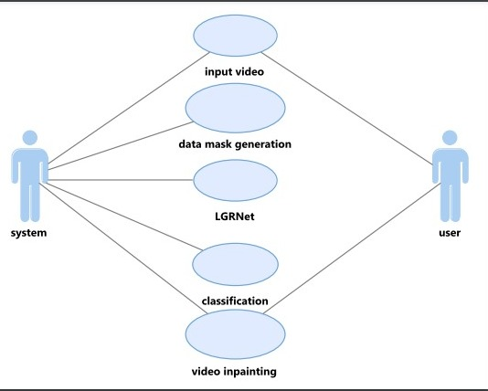
Use Case Diagram:
A use case diagram is a type of UML (Unified Modeling Language) diagram that provides a graphical representation of the functional requirements of a system from the perspective of users or actors interacting with the system. It describes the various ways users (actors) interact with the system to accomplish specific tasks or use cases.

Slide 13
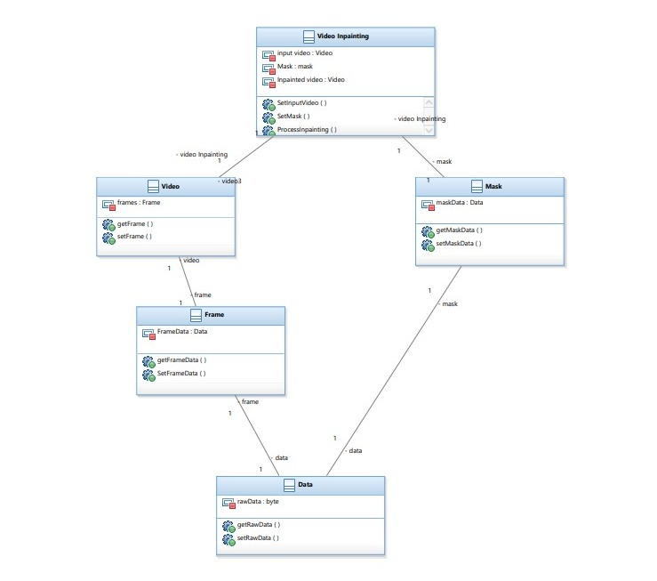
Class Diagram:
A class diagram in Unified Modeling Language (UML) is a type of static structure diagram that represents the structure and relationships of the classes in a system or software application. It visualizes the classes, their attributes, methods, and the associations between classes.
Attributes
Methods
Relationships
Association
Inheritance (Generalization)

Slide 14
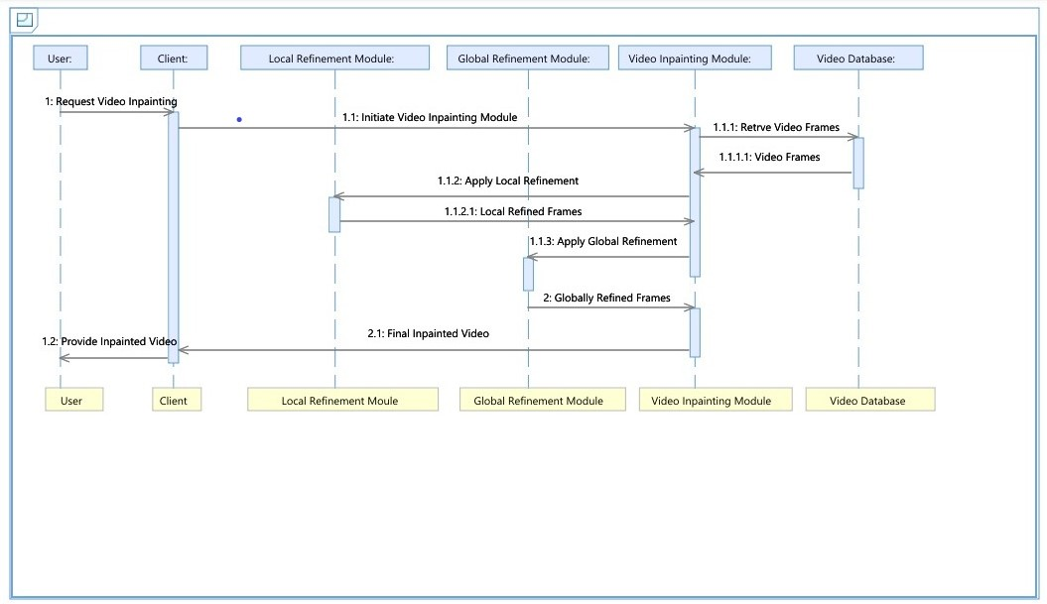
Sequence Diagram:
A sequence diagram is a type of interaction diagram in Unified Modeling Language (UML) that illustrates how objects interact in a particular scenario of a system. It portrays the sequence of messages exchanged between different objects or components within a specific time frame to accomplish a particular task or scenario.

Slide 15
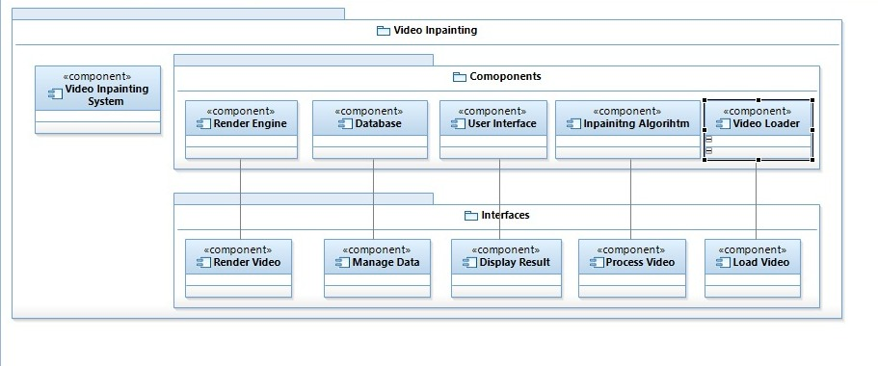
Component Diagram:
A component diagram in Unified Modeling Language (UML) is a type of static structure diagram that visualizes the high-level components and their relationships within a system or software application. It provides an overview of the physical components, their interfaces, connections, dependencies, and interactions.

Slide 16
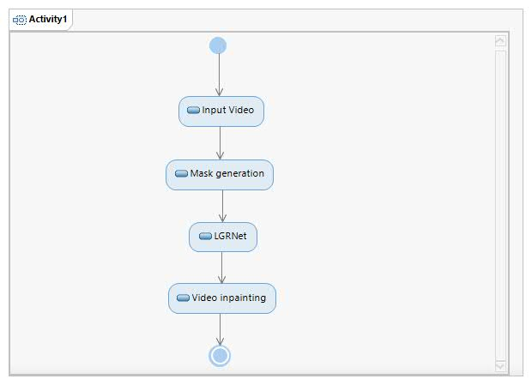
Activity Diagram:
An activity diagram is a type of Unified Modeling Language (UML) diagram that visually represents the flow of actions, activities, and transitions among various components (e.g., actions, decisions, control flows) within a system or a specific business process.
Key elements of an activity diagram include:
Activities
Transitions
Decisions
Forks and Joins
Initial and Final Nodes

Slide 17
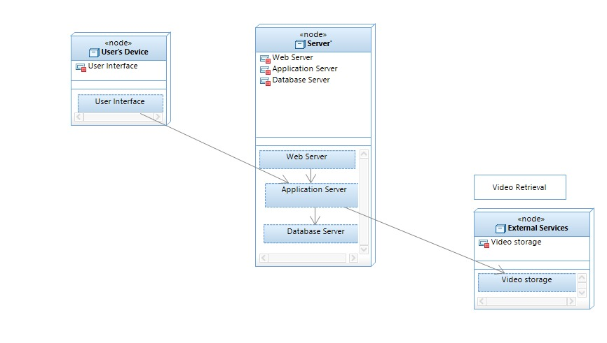
Deployment Diagram:
A deployment diagram is a type of Unified Modeling Language (UML) diagram that illustrates the physical deployment of software components (artifacts), hardware nodes, and their relationships in a system. It demonstrates how software components are deployed and distributed across different nodes (physical or virtual hardware entities) in a network or infrastructure.

Slide 18
References:
https://youtu.be/oOuswkbsBCU?si=iKUchg-qdnDk6SjB
https://ieeexplore.ieee.org/document/9730792
https://paperswithcode.com/task/video-inpainting
https://towardsdatascience.com/deep-video-inpainting-756e60ddcaaf

Slide 19
THANK YOU

