Slide 1
Gameday Analytics challenge 2023
Don’t Skip your Favorite Ad
Prepared by :
Grad 13 : Fantastic 4
Sai Bharadwaj Mamidi |Darshita Pallav
Ishita Pallav | Chandra Naga M

Slide 2
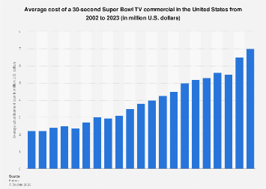
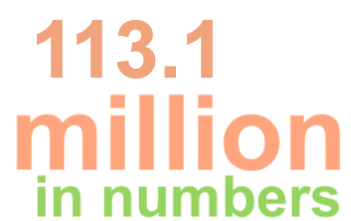
What is Superbowl?
The Super Bowl is an annual National Football League championship game (NFL), the highest level of professional American football in the United States. It is the most-watched television event in the United States, and the halftime show and commercials have become a cultural phenomenon. Several 113.1 million people watched the Superbowl this year. Game day commercials, also known as Super Bowl commercials, air during the Super Bowl broadcast. They are known for their high production value, celebrity appearances, and humorous or memorable content. The cost for a 30 Sec Ad was 7 Million.

Slide 3
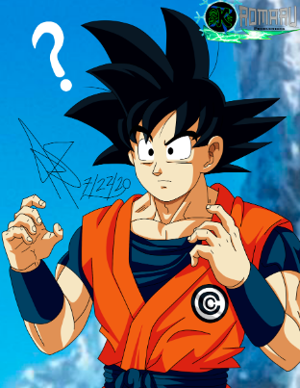
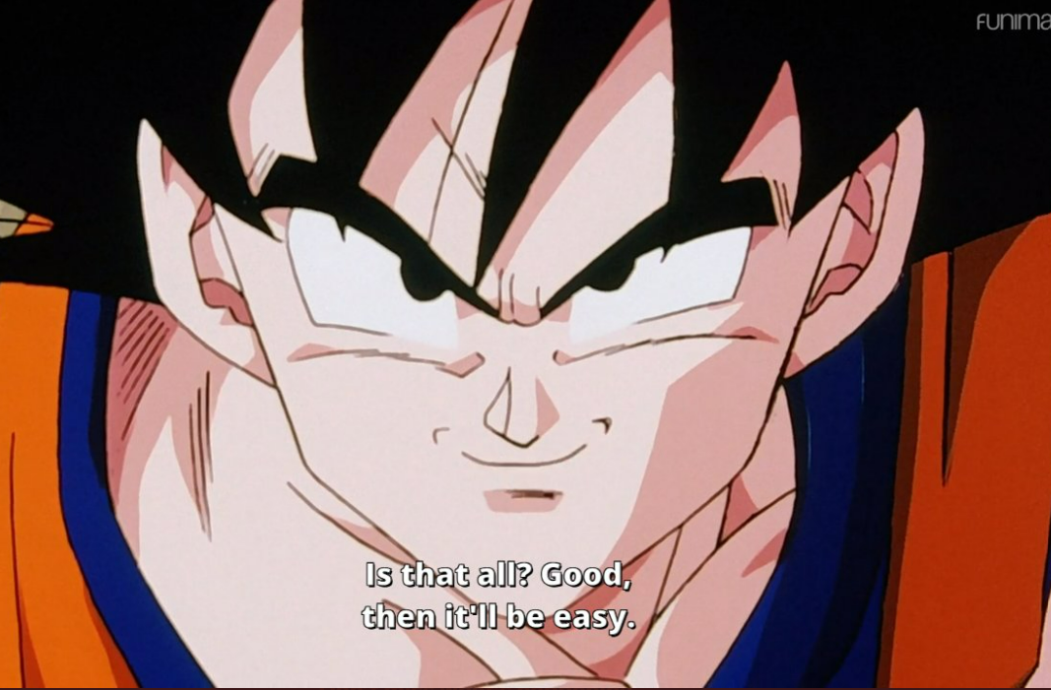
Data Cleaning
What
Why
How
Result: 1916335 rows to 1442987 rows

Slide 4
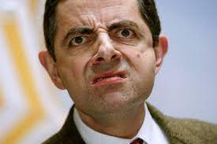
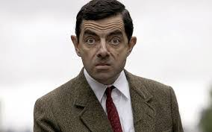
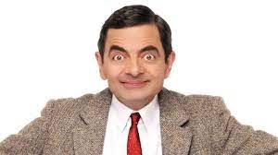
Sentiment Analysis
Sentiment analysis is a natural language processing technique that involves analyzing text data to determine the sentiment or emotional tone of the text. Sentiment analysis can be used to calculate the scores of tweets by assigning a sentiment score to each tweet based on the sentiment of the text.
We used Vader (Valence Aware Dictionary and Sentiment Reasoner) is a rule-based sentiment analysis tool designed to analyze social media text sentiments, such as tweets, Facebook posts, and online reviews. We discovered Disney 100, The Farmer's Dog – Forever, and Tubi.

Slide 5
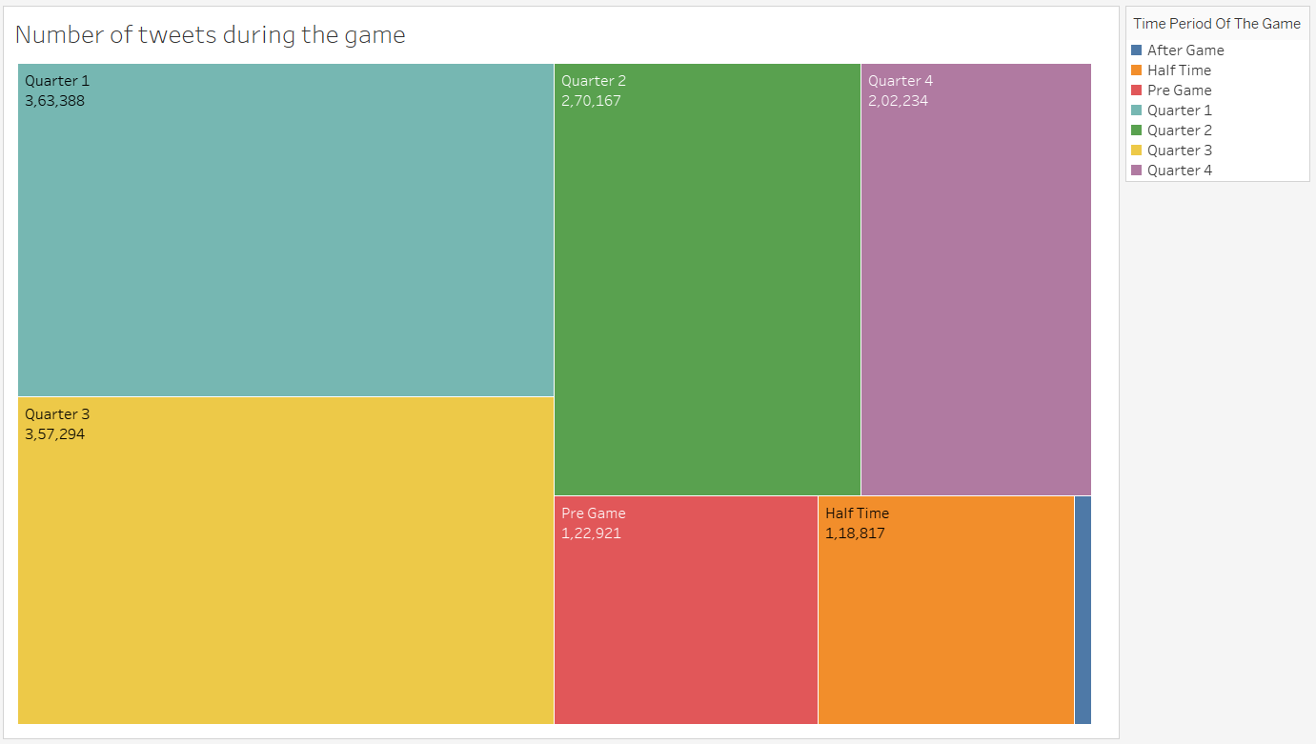
We can observe that Quarter 1 had a greater number of tweets that means a greater number of engagements in the viewers. Tubi, an advertisement with just 15 secs of run time had the highest number of tweets and retweets in quarter 1and we can view there is surge in the number of viewers.

Slide 6
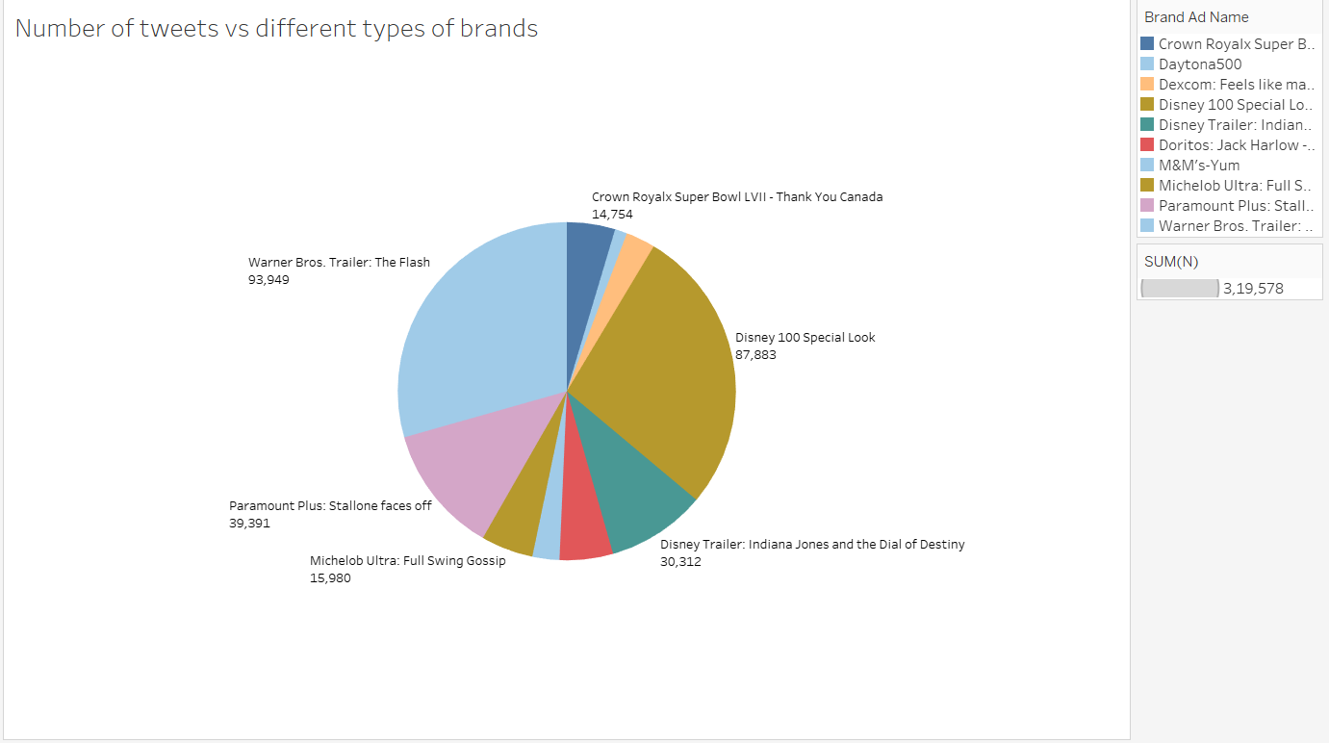
Warner Brothers Trailer: The Flash had the maximum number of tweets following up with Disney Trailer: 100 special look. They both have breathtaking visuals and amazing graphics which held the audience attention.

Slide 7
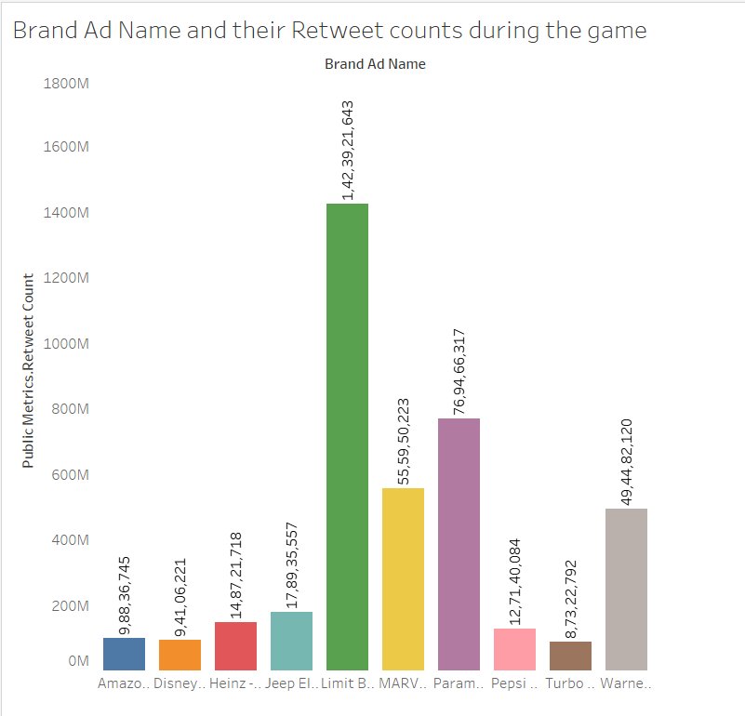
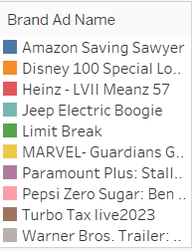
Limit Break advertisement had the highest number of retweets during the game. Limit Break is a blockchain company based game developer that is giving away 10,000 NFTs. This free token has built a lot of enthusiasm among the viewers

Slide 8
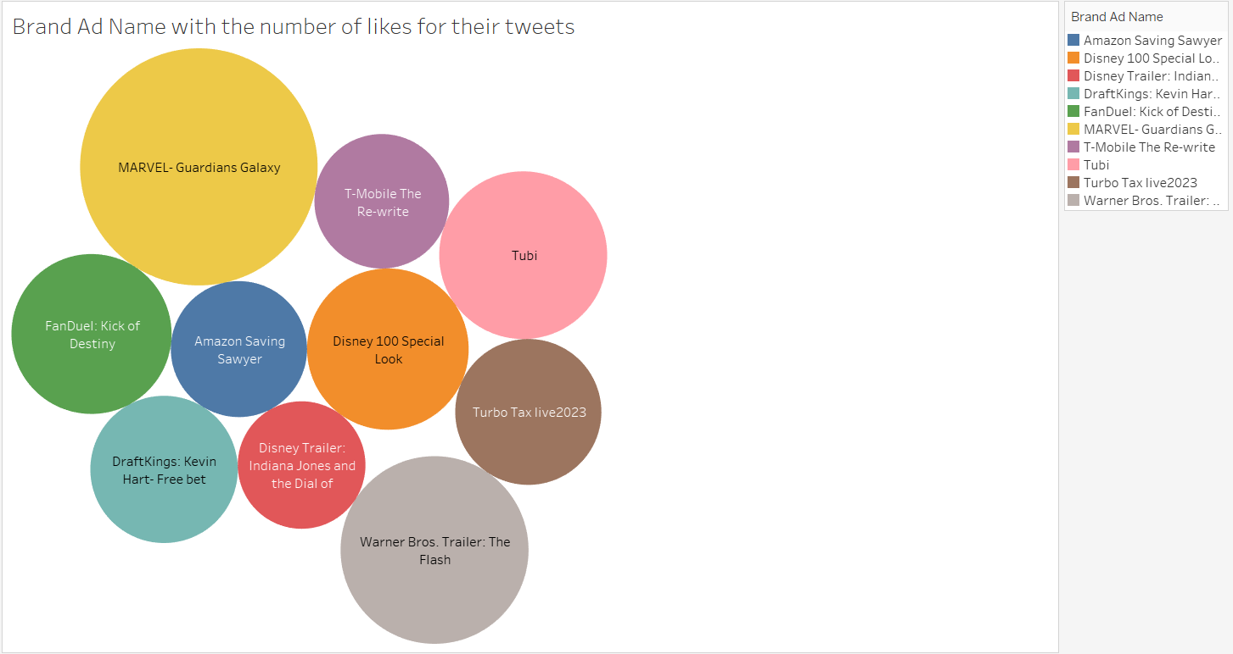
In the above packed bubbles, we can view that Marvel-Guardians of Galaxy tweets has the highest the number of likes from among the public and we can find out that it stood in top 10 for the most of retweets and spectacular crew.

Slide 9
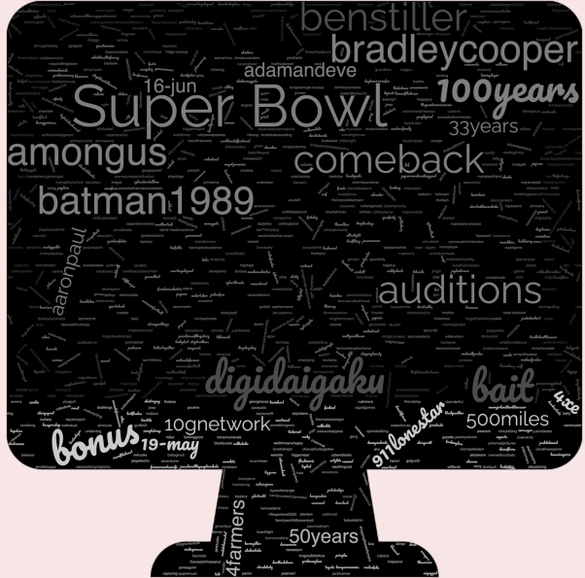
Word Cloud

Slide 10
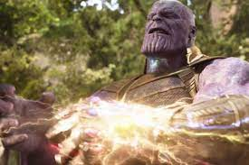
Key Findings
1. The number of likes during the game is directly linked to the number of retweets. The same is true for verified individuals.
2. Tubi’s has one of the highest number of tweets with just 15 second commercial with the return of investment at one of the highest.
3. The limit Break advertisement had the highest number of retweets during the game. This proves that the giveaways are more rewarding in terms of engagement of viewers.
4. Disney, Marvel and Dc had the highest number of likes because of their eye-catching visuals and fantabulous crew.

Slide 11
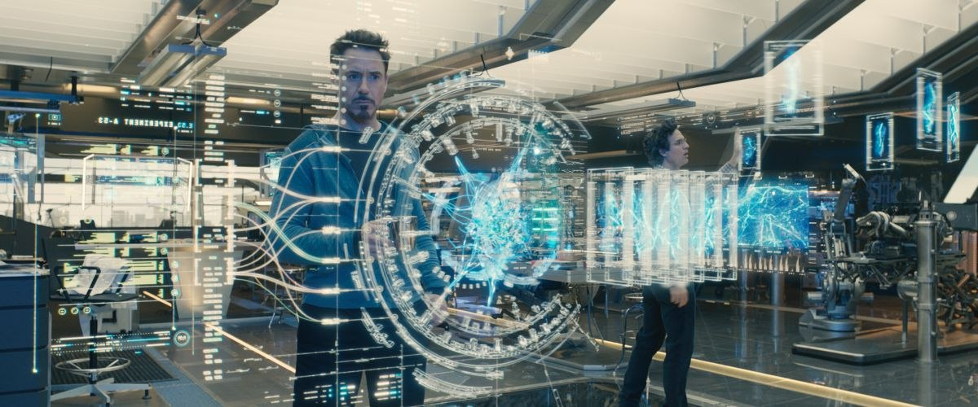
Challenges we have faced!!!!!
1. Not having proper infrastructure or computing power
2. Not having paid version Software’s
3. Understanding the data
4. Cleaning the data
5. Understanding the data to make meaningful conclusions

Slide 12
