Slide 1

Semi-Supervised Human Activity Recognition
Using Smartphone Sensor Data

Slide 2

Problem
Statement
Labeling sensor data is expensive
Limited annotation budget
Solution: Only 5% labeled data + Pseudo-labeling

Slide 3

Dataset overview
30 volunteers (19-48 years)
6 activities
561 features
7,352 training samples | 2,947 test samples

Slide 4
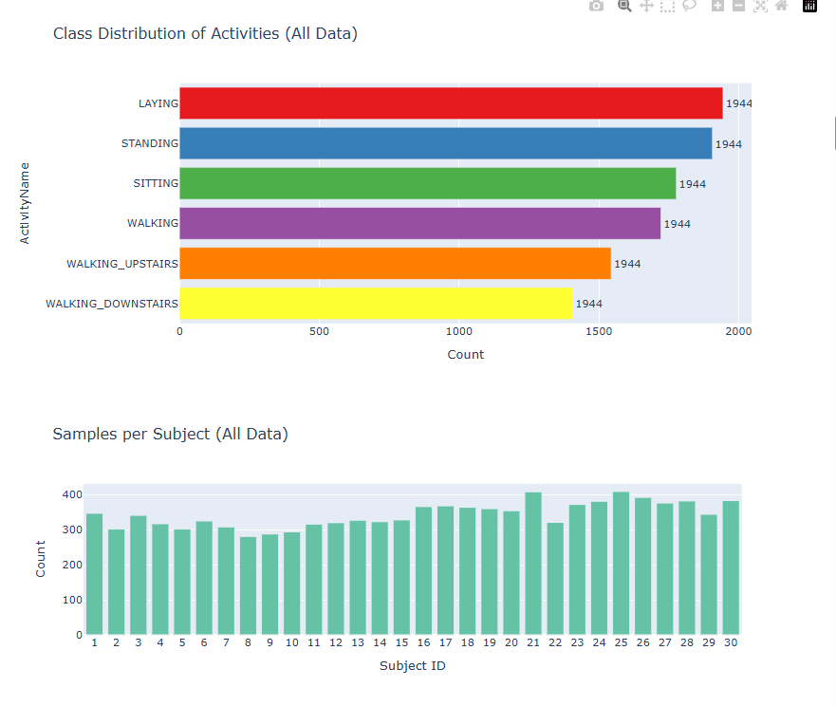
Exploratory Data Analysis
Class distribution chart
Feature importance plot
PCA/t-SNE visualization
Findings:
Balanced classes
Static vs dynamic activities cluster differently
No missing values

Slide 5
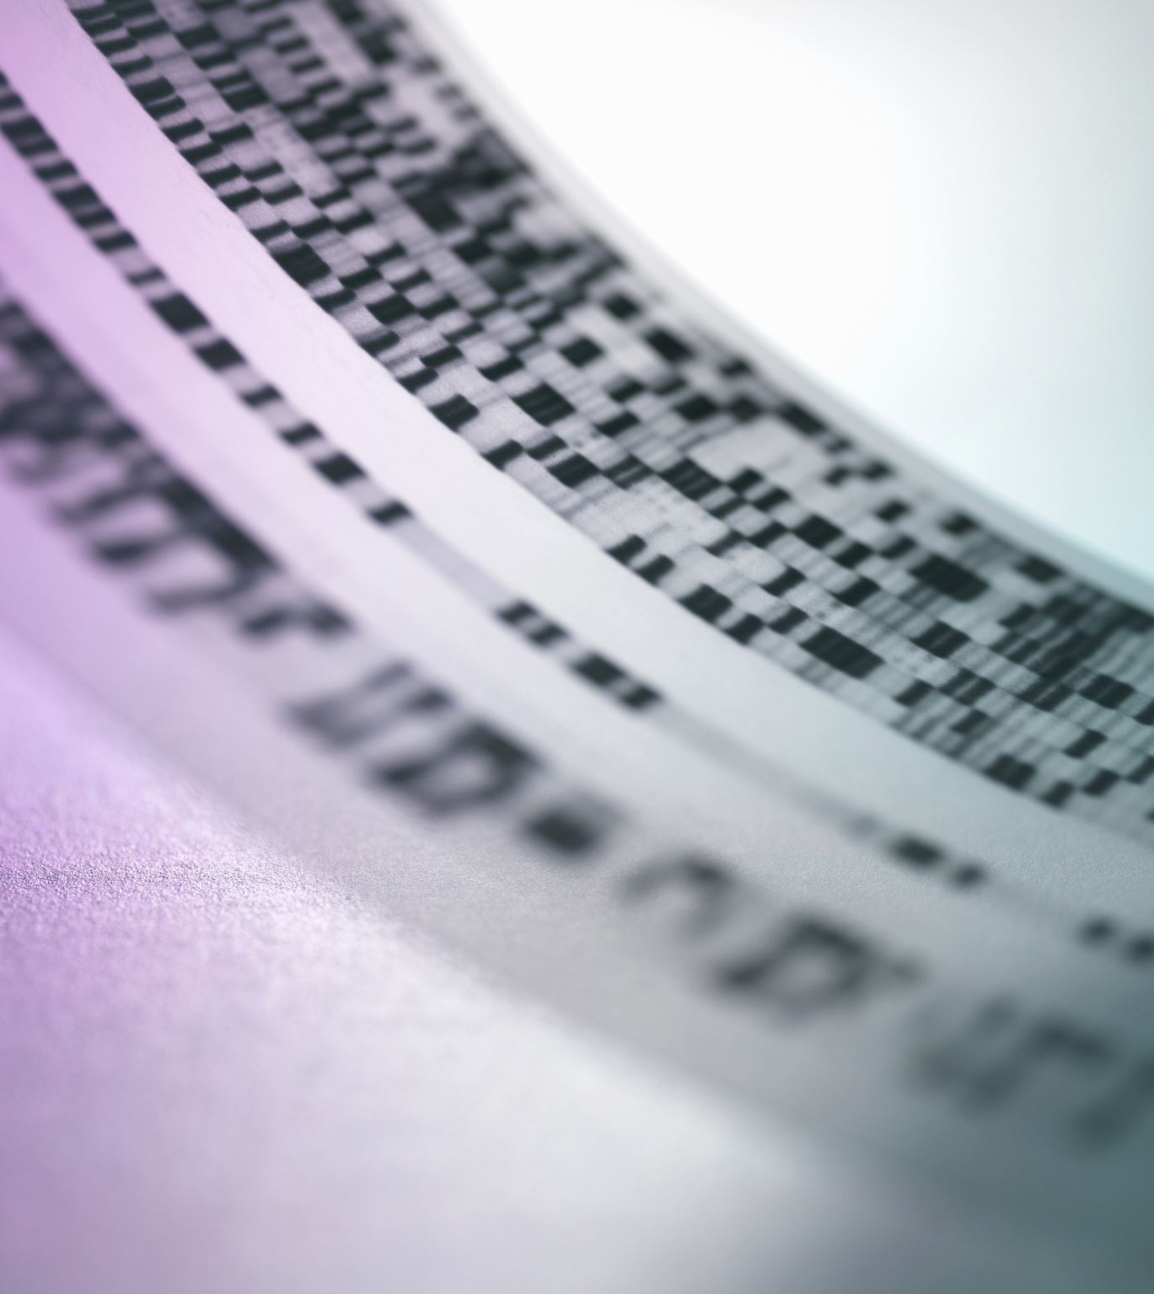
Pseudo-Labeling Approach
Labeled (5%)
Filter (≥95%)
Train Model
Predict
Retrain
90.6%

Slide 6
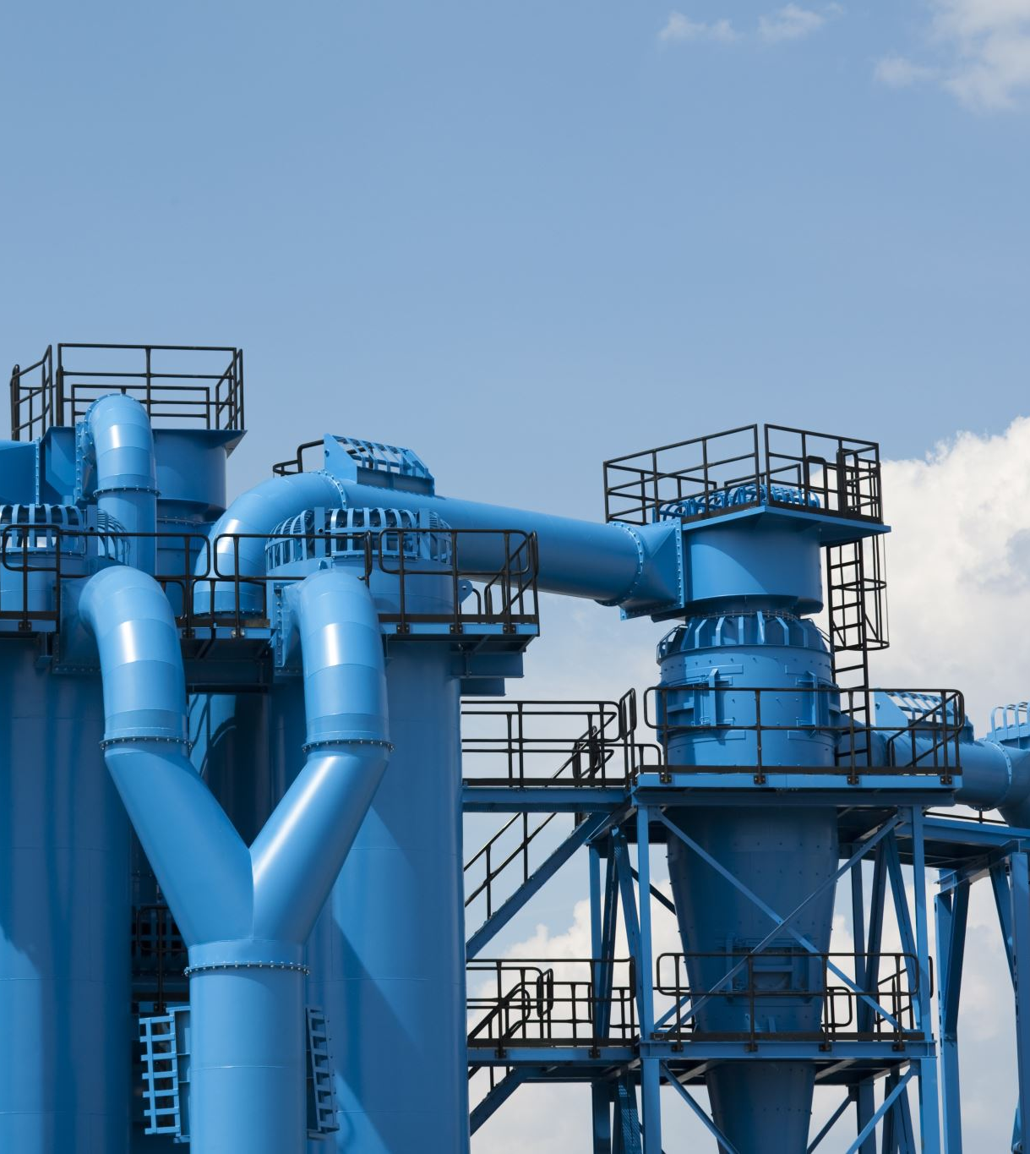
Technical Pipeline
Sensor Data (561)
Scaler
Logistic Regression
Prediction

Slide 7
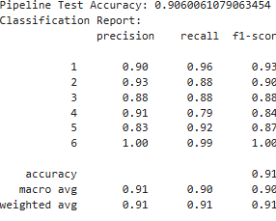
Metrics
Test Accuracy: 90.6%
F1-Score: 0.90

Slide 8
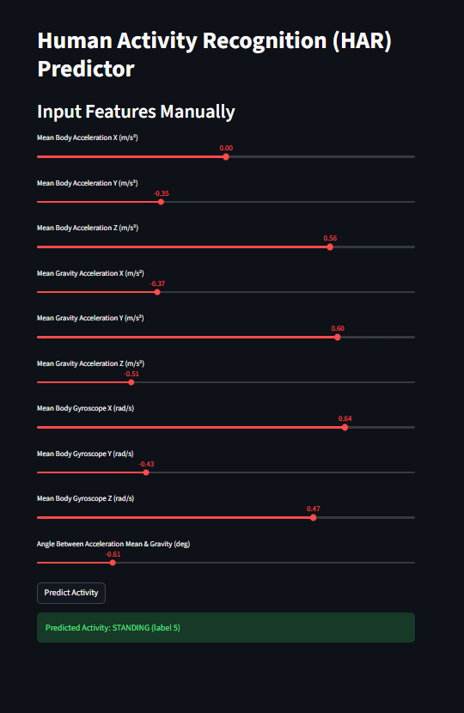
StreamLit Application
Manual Sliders - Interactive features

Slide 9
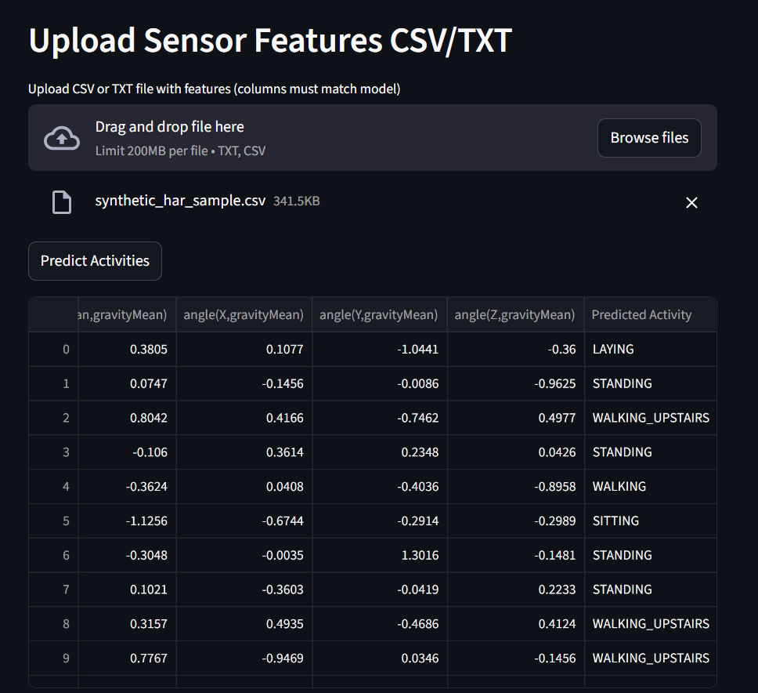
StreamLit Application
CSV Upload - Batch predictions

Slide 10
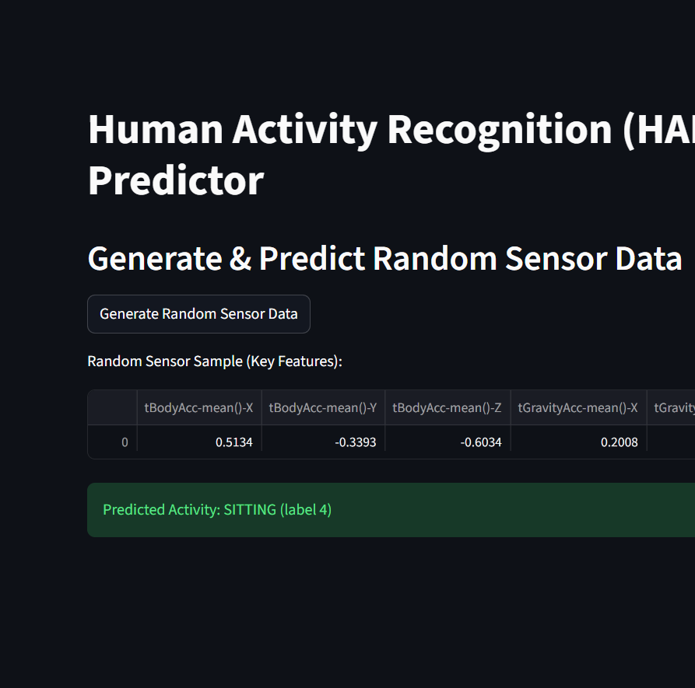
StreamLit Application
Random Generator - Synthetic data

Slide 11
Real-World Applications
Healthcare Applications
Elder Care Track daily activities, detect falls
Fitness & Wellness
Automatic activity detection, calorie tracking
Monitor post-surgery recovery progress
Study patient mobility patterns
Adapt workouts based on activity patterns
Activity-based wellness programs
Research & Industry
Analyze human movement patterns
Monitor worker activities in hazardous environments
Context-aware automation based on user activity

Slide 12
Future Work
Real-time smartphone streaming
Multi-user personalized models
Activity timeline & export (PDF/Excel)

Slide 13
Thank you

