Slide 1
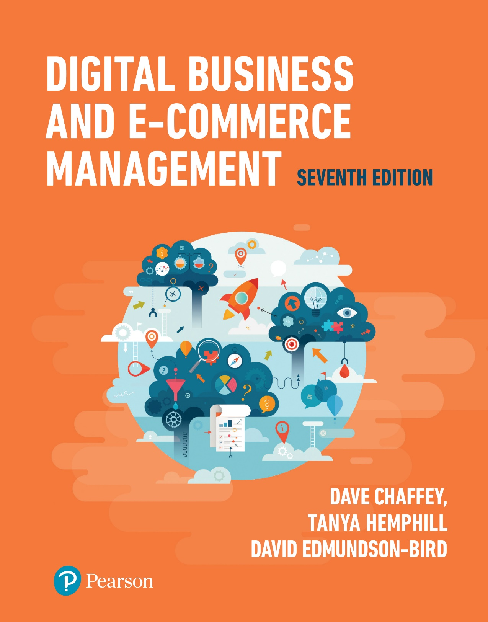
Digital Business and E-Commerce Management Seventh Edition
Part 1
Introduction
Chapter 2
Opportunity analysis for
digital business and e-commerce

Slide 2
Learning outcomes
Complete an online marketplace analysis to assess competitor, customer and intermediary use of digital technologies and media as part of strategy development
Identify the main business and marketplace models for digital communications and trading
Evaluate the effectiveness of business and revenue models for online businesses, particularly digital start-up businesses

Slide 3
Management issues
What are the implications of changes in marketplace structures for how we trade with customers and other partners?
Which business models and revenue models should we consider in order to exploit the Internet?
What will be the importance of online intermediaries and marketplace hubs to our business and what actions should we take to partner these intermediaries?

Slide 4
Opportunity(Online/Digital Marketplace) analysis
Online Marketplace
Exchanges of information and commercial transactions between consumers, businesses and governments completed through different forms of online presence such as search engines, social networks, comparison sites and destination sites.
Situation Analysis
Collection and review of information about an organisation’s external environment and internal processes and resources in order to inform its strategies

Slide 5
Opportunity(Online/Digital Marketplace) analysis - Environmental scanning and analysis
The process of continuously monitoring the environment and events and responding accordingly.
Knowledge of the opportunities and threats presented by the marketplace is essential to those involved in defining business, marketing and information system strategy.
To inform e-commerce strategy, the most significant influences are those of the immediate marketplace of the micro environment that is shaped by the needs of customers and how services are provided to them through competitors and intermediaries and via upstream suppliers

Slide 6
Opportunity(Online Marketplace) analysis - Strategic Agility
The capability to innovate and so gain competitive advantage within a marketplace by monitoring changes within an organisation’s marketplace and then to efficiently evaluate alternate strategies and select, review and implement appropriate candidate strategies.
Strategic agility is the capacity to respond to environmental opportunities and threats

Slide 7
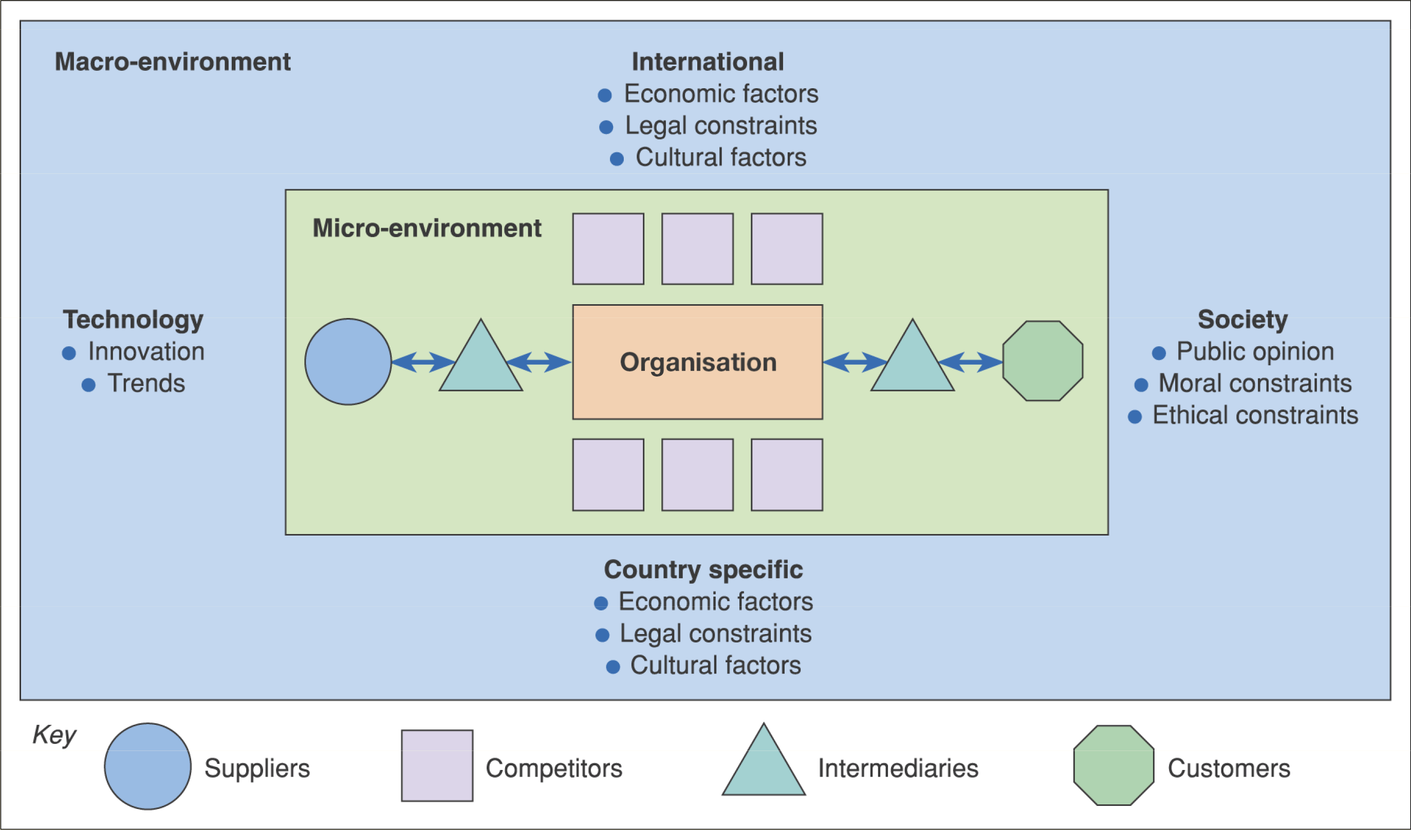
Figure 2.2 The environment in which digital business services are provided

Slide 8
Activity – the e-commerce environment
For each of the environment influences shown in Figure 2.2, give examples of why it is important to monitor and respond in an e-business context. For example, the personalisation mentioned in the text is part of why it is important to respond to technological innovation.

Slide 9
Environment constraints and opportunities
Customers – which services are they offering via their website that your organisation could support them in?
Competitors – need to be benchmarked in order to review the online services they are offering – do they have a competitive advantage?
Intermediaries – are new or existing intermediaries offering products or services from your competitors while you are not represented?

Slide 10
Environment constraints and opportunities (Continued)
Suppliers – are suppliers offering different methods of procurement to competitors that give them a competitive advantage?
Macro-environment
Society – what is the ethical and moral consensus on holding personal information?
Country specific, international legal – what are the local and global legal constraints, for example, on holding personal information, or taxation rules on sale of goods?

Slide 11
Environment constraints and opportunities (Continued)
Country specific, international economic – what are the economic constraints of operating within a country or global constraints?
Technology – what new technologies are emerging by which to deliver online services such as interactive digital TV and mobile phone-based access?

Slide 12
Process for online marketplace analysis
Marketplace analysis is an important part of
Developing long-term digital business plan and
Creating a shorter-term digital marketing campaign
Online ecosystem
Customer behavior or flow of online visitors between search engines, media sites, other intermediaries to an organization and its competitors
Online market ecosystem
That connects websites through data exchange, giving opportunities to enhance the customer experience and extend their reach and influence, for example, Facebook’s API
Notes:
Completing a marketplace analysis helps to define the main types of online presence that are part of an ‘ONLINE ECOSYSTEM’
Search engines act as a distribution system that connects searchers to different intermediary sites for different phrases, so the flow of visits between sites must be understood by the marketer in their sector.
Major online players such as Facebook, Google and Salesforce have developed their own infrastructure , or online market ecosystem, which connects websites through data exchange, giving opportunities to enhance the customer experience.
Google has developed its own ecosystem related to search marketing and mobile – the Android ecosystem

Slide 13
Process for online marketplace analysis
As part of marketplace analysis, companies have to evaluate the relative importance of these ecosystems and the resources they need to put into integrating their online services with them.
Most retailers take either a
Multichannel or
Omnichannel strategy approach.
Notes:
Completing a marketplace analysis helps to define the main types of online presence that are part of an ‘ONLINE ECOSYSTEM’
Search engines act as a distribution system that connects searchers to different intermediary sites for different phrases, so the flow of visits between sites must be understood by the marketer in their sector.
Major online players such as Facebook, Google and Salesforce have developed their own infrastructure , or online market ecosystem, which connects websites through data exchange, giving opportunities to enhance the customer experience.
Google has developed its own ecosystem related to search marketing and mobile – the Android ecosystem

Slide 14
Process for online marketplace analysis
Multichannel Strategy- offers a range of direct and indirect communication channels for consumers to interact with, but channels have limited or no integration and consumers are forced to repeat steps or receive different messages as they switch channels - e.g. websites, stores, mail order catalogues, direct mail, email, mobile etc.
Omnichannel strategy - fully integrates all consumer touchpoints and data sources to provide consumers with a seamless experience, regardless of how and where they choose to interact with the brand(Desktop or mobile, by phone or in a shop)
Notes:
Completing a marketplace analysis helps to define the main types of online presence that are part of an ‘ONLINE ECOSYSTEM’
Search engines act as a distribution system that connects searchers to different intermediary sites for different phrases, so the flow of visits between sites must be understood by the marketer in their sector.
Major online players such as Facebook, Google and Salesforce have developed their own infrastructure , or online market ecosystem, which connects websites through data exchange, giving opportunities to enhance the customer experience.
Google has developed its own ecosystem related to search marketing and mobile – the Android ecosystem

Slide 15
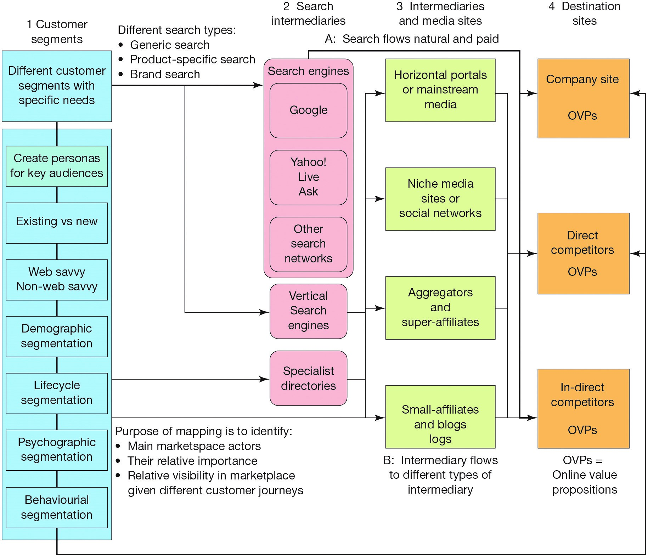
Figure 2.8 A digital marketplace map
Notes:
Vertical search engines:Travel, restaurants, medical, fashion, entertainment, news, car, jobs, and photography sites
Lifecycle segmentation – How toddlers desire certain meals etc
Psychographic segmentation – social status, daily activities, food habits etc
Behavioral segmentation – Loyalty, occasion purchasing, personalisation

Slide 16
Process of marketplace analysis- Online marketplace map- Main elements
Customer Segments
Marketplace analysis should identify and summarise different target segments for an online business to understand
Online media consumption
Buyer behaviour
Type of content
Customer experience
2. Search Intermediaries
Search engines, such as …
Google trends tool for assessing site popularity
Notes:
Baidu from China
Yandex from Russia
Naver from South Korea

Slide 17
Process of marketplace analysis- Online marketplace map- Main elements
Intermediaries, influencers and media sites are often successful in attracting visitors via search or direct since they are mainstream brands.
Mainstream news media sites or portals:FT.com, Google news an aggregator, confused.com an aggregator
Social networks
Niche or vertical media sites:SmartInsights.com, searchengineland.com,clickz.com, Econsultancy.com
Price comparison sites(aggregators):
Moneysupermarket.com,kelkoo.com, uSwitch

Slide 18
Process of marketplace analysis- Online marketplace map- Main elements
Super affiliates: Affiliate companies gain revenue from a merchant they refer traffic to using a commission-based arrangement based on the proportion of sale or a fixed amount
Niche affiliates, influencers or bloggers: These are often individuals, but they may be important. Moneysavingexpert.com, TheVerge, Zoella
Destination Sites
These are the sites that marketers are trying to generate visitors to.
OVP: Online Value Proposition, a summary of the unique features of the site

Slide 19
Research tools for assessing digital marketplace
Service | Usage
1. Google Tools. Mainly included within their AdWords service (http://adwords.google.com) | Google is one of the best sources of accurate tools for marketplace analysis including: Display planner (this adWords tool generates targeting ideas, impression estimates and historical costs) associated with running a campaign on Google’s display network Keyword planner - this tool available within AdWords gives additional detail (sign-in required) Google Trends- variation through time of search volume by country (no sign in required) Think with Google ( thinkwithgoogle.com) market reach and digital trends
2. Alexa(www.alexa.com) Free tool, but not based on a representative sample, see also www.similarweb.com | Free service owned by Amazon that provides traffic ranking of individual sites compared to all sites.
3. Connexity(www.connexity.com). Paid tool, but free research available in its ‘Resources’ section | Paid service available in some countries to compare audience size and search and site usage
4. Nielsen(www.Nielsen.com) Paid tool. Free data on search engines and intermediaries available from ‘Insights’ section | Panel service based on at-home and at-work users who have agreed to have their web usage tracked by software.

Slide 20
Research tools for assessing digital marketplace
Service | Usage
5. Google Analytics | Free and paid-for services, which provide insight into website audience behaviour
6. Forrestor(www,forrestor.com) Paid research service. Some free commentary and analysis within ‘Research’ section | Offers reports on Internet usage and best practice in different vertical sectors such as financial services , retail and travel.
7. Smart Insights Digital Marketing Statistics (http://bit.ly/smartstatistics) | A regulatory updated compilation of statistics including the top 10 recommended statistics sources
8. ComScore(www.comScore.com) Paid tool. Free data on search engines and intermediaries available from ‘Insights’ section | A similar panel service to Nielsen, but focusing on US and UK

Slide 21
Activity 2.1
Discuss in a group, or make notes to identify, the main companies (e.g. Facebook) and platforms (e.g. mobile phones) used by consumers that are important for companies to review their presence on. Once you have identified the main companies or service types, group them together so that their overall importance can be reviewed.
Explore different Google marketing tools on search intermediary such as a Google, Yahoo, Bing etc.
Visit as many tools as you can and familiarise with the tools
Questions
How many of them are paid and free?
What differences are there between paid and free ones?

Slide 22
Activity 2.2
Explore different Google marketing tools on search intermediary such as a Google, Yahoo, Bing etc.
Visit as many tools as you can and familiarise with the tools
Questions
How many of them are paid and free?
What differences are there between paid and free ones?

Slide 23
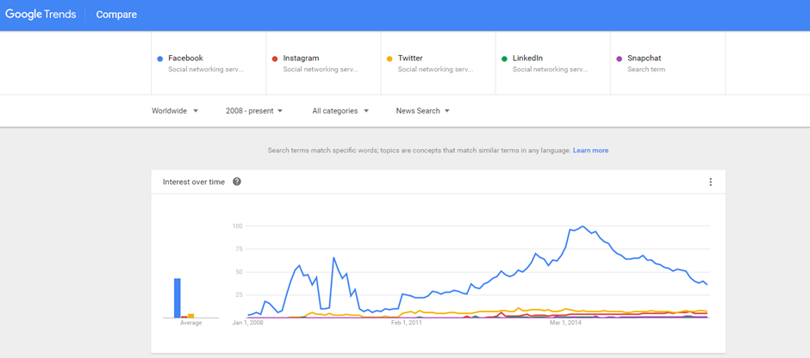
Figure 2.9 Google Trends – useful for consumer interest in products
Source: www.google.com/trends

Slide 24
Location of trading in the marketplace
Traditional marketplaces have a physical location, an Internet-based market has no physical presence.
Electronic marketplace
It is a virtual marketplace, with no physical presence
Marketplace channel structures
These describe the way a manufacturer or organization delivers products and services to its customers.
Notes:
Unicorns – tech startups valued at $1billion
Decacorns – valued at $10billions

Slide 25
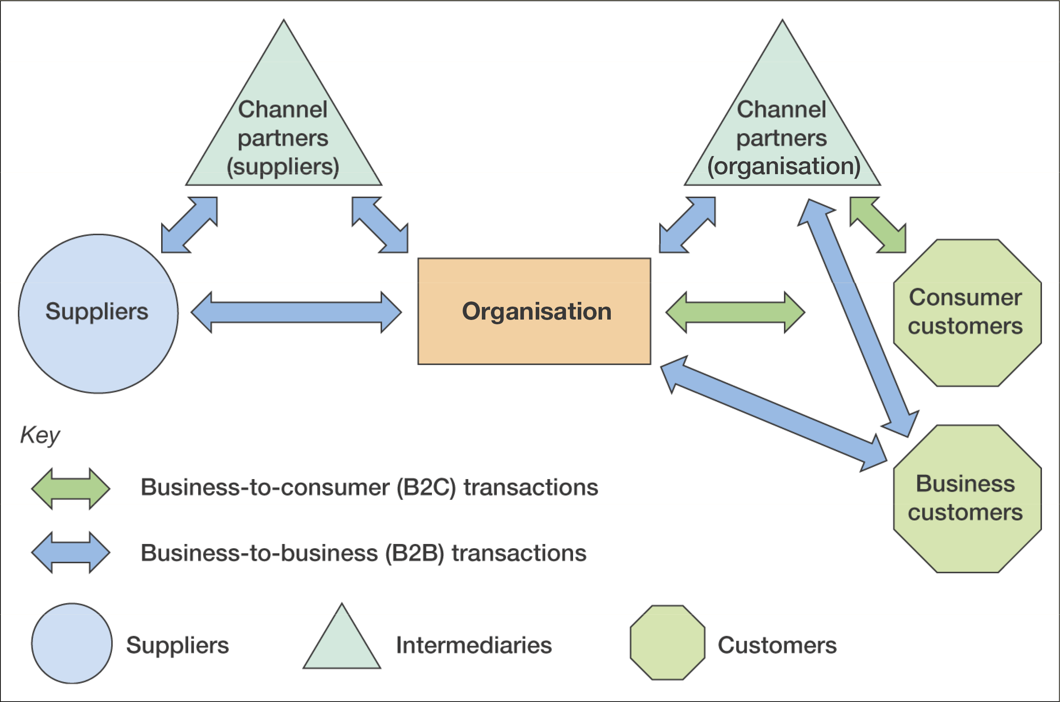
Typical channel structures between business and consumer organisations
Figure 2.10 B2B and B2C interactions between an organisation, its suppliers and its customers

Slide 26
Location of trading in the marketplace
Disintermediation
The removal of intermediaries such as distributors or brokers that formerly linked a company to its customers. Examples?
Reintermediation
The creation of new intermediaries between customers and suppliers providing services such as supplier search and product evaluation.
www.moneysupermarket.com, www.confused.com
Notes:
Music companies – iTunes, Spotify etc

Slide 27
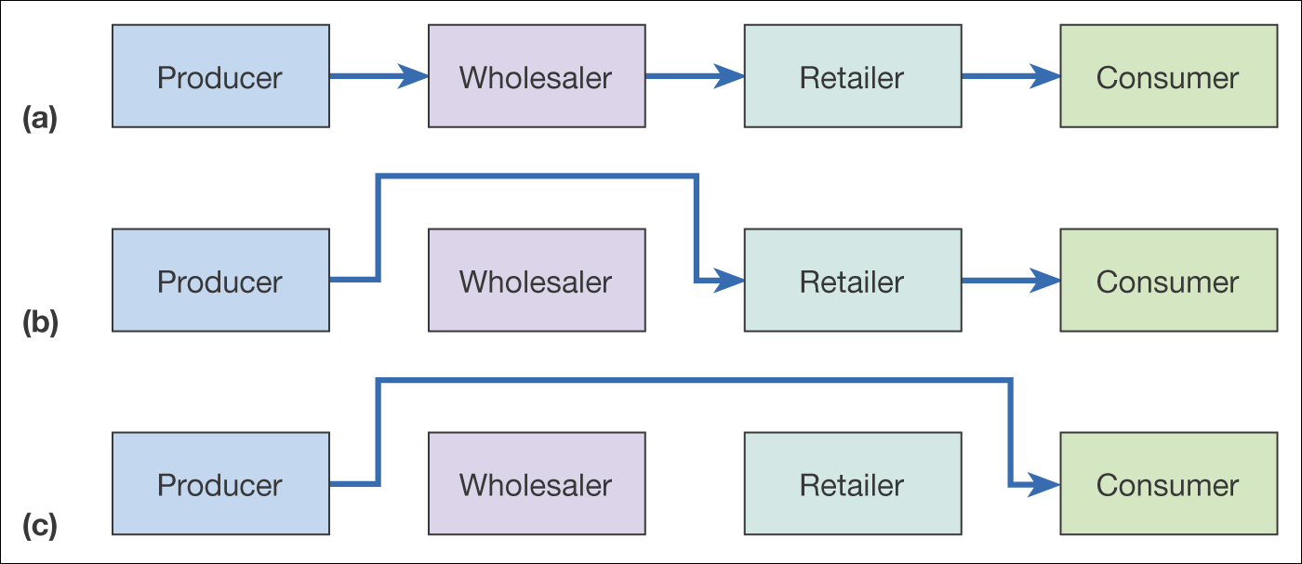
Figure 2.11 Disintermediation of a consumer distribution channel showing (a) the original situation, (b) disintermediation omitting the wholesaler, and (c) disintermediation omitting both wholesaler and retailer

Slide 28
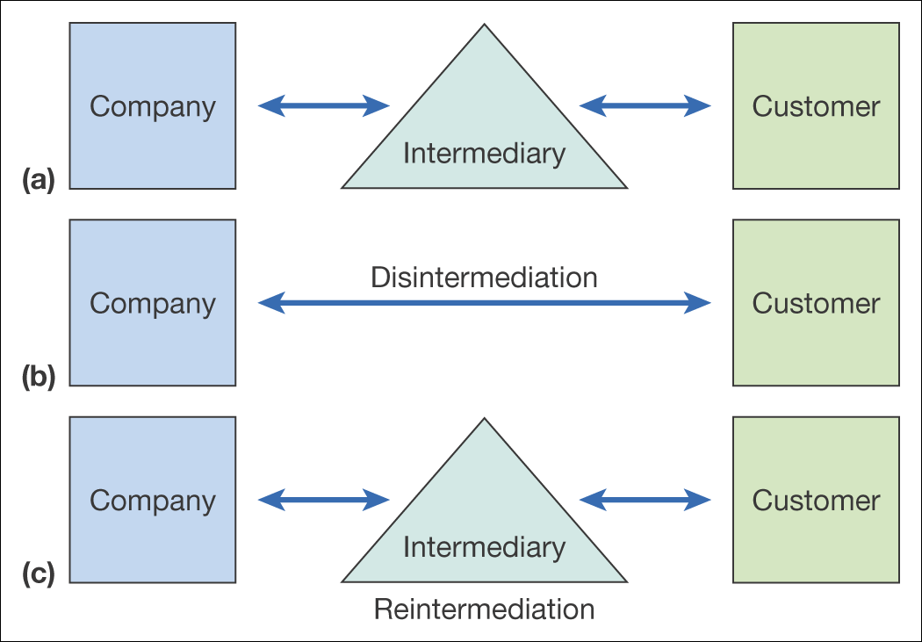
Figure 2.12 From original situation (a) to disintermediation (b) and reintermediation (c)

Slide 29
Countermediation
Creation of a new intermediary
Example:
B&Q www.diy.com
Opodo, setup by 9 European airlies, www.opodo.com
Acquiring an existing intermediary – Random House bought Figment.com, a community for aspiring writers of young adult fiction

Slide 30
Importance of Multichannel marketplace models
Customer Journey
A description of modern multichannel buyer behaviour as consumers use different media to select suppliers, make purchases, and gain customer support.
Multichannel marketing strategy
Defines how different marketing channels should integrate and support each other in terms of their proposition and development and communications based on their relative merits for the customer and the company

Slide 31
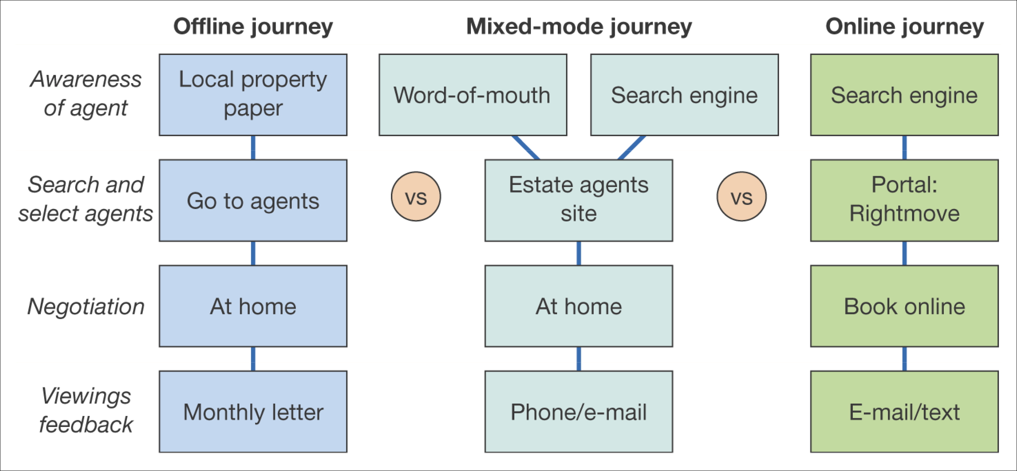
Figure 2.13 Example channel chain map for consumers selecting an estate agent
to sell their property

Slide 32
Business model
Timmers (1999) defines a ‘business model’ as:
An architecture for product, service and information flows, including a description of the various business actors and their roles; and a description of the potential benefits for the various business actors; and a description of the sources of revenue.
Online Business Model is a summary of how a company will generate a profit identifying its core product or service value proposition, target customers in different markets, position in the competitive online marketplace or value chain and its projections for revenue and costs

Slide 33
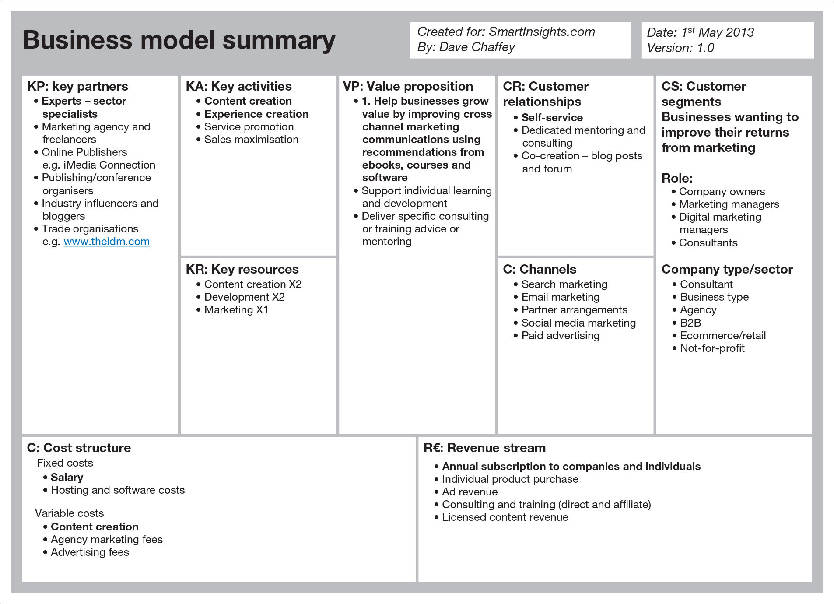
Figure 2.15 Business Model Canvas example
Source: Smart Insights. With permission.

Slide 34
Main sections of the canvas
Value Proposition
This is the heart of what the business offers to its audiences and is most important to success
Customer segments
Different target audiences to whom the value propositions will appeal. Ex: mass market, niche market, range of diverse segments.
Customer relationships
Type of relationships that will be formed, Example: self-service, automated services, communities or more personal service

Slide 35
Main sections of the canvas
Channels
The methods by which the organisation’s services will be delivered and the audiences reached.
Key Partners
To exploit online and offline value networks, forming partnerships gives an opportunity of expanding reach and taking advantage of existing organisations and online influencers that have built an audience
Activities
The main activities that need to be performed to deliver the value proposition to develop revenue.

Slide 36
Main sections of the canvas
Resources
Different types of process and people to complete the activities to create and deliver the value proposition.
Cost Structure
Different cost-elements, should be checked against activities and resources. Fixed, variable and economies of scale
Revenue Stream
By which a business derives income. Ex:ad revenue, subscription fees, sale of goods, commission, licensing, leasing etc
There are few missing elements in the canvas, for example, KPIs, Impact of Competitors

Slide 37
Revenue models – publisher example
Subscription access to content
Range of documents can be accessed from a publisher for a fixed period. Premium services on websites
Pay per view content access
Payment for single access to a document, video, music clip, which can be downloaded.
CPM display advertising
Cost Per Thousand(mille)-Number of times ads are served to site visitors
CPC advertising on site
Cost Per Click, cost can range from £0.40 to £20 per click

Slide 38
Revenue models – publisher example
Sponsorship of sections, content or widgets
Fixed fee for a period
Affiliate revenue (CPA or CPC).
Is commission based.
Subscriber data for e-mail marketing.
The data a site owner has about its customers are valuable as it can send different forms of email to its customers.
Transaction fee revenue.
A company receives a fee for facilitating a transaction.

Slide 39
Revenue models – publisher example
Subscription access to content
Pay per view content access
CPM display advertising
CPC advertising on site
Sponsorship of sections, content or widgets
Affiliate revenue (CPA or CPC)
Subscriber data for email marketing
Access to customers for research purposes.

Slide 40
Summary
You should be able to complete an online marketplace analysis to assess competitor, customer and intermediary use of digital technologies and media as part of strategy development
You should be able to identify the main business and marketplace models for digital communications and trading
You should be able to evaluate the effectiveness of business and revenue models for online businesses, particularly digital start-up businesses

Slide 41
Activity 2.3
Identify overlap between the different business models identified by Timmers (1999). Can you group the different business models into different types of services? Do you think these business models operate in isolation?
Summarise the revenue models that are used for each site by looking at the information for advertisers and affiliates.
econsultancy.com
marketingsherpa.com

