Slide 1
Chapter 2
Marketplace analysis for
e-commerce

Slide 2
Learning outcomes
  Complete an online marketplace analysis to assess competitor, customer and intermediary use of digital technologies and media as part
  of strategy development
  Identify the main business and marketplace models for electronic communications and trading
  Evaluate the effectiveness of business and revenue models for online businesses,
  particularly online start-up businesses

Slide 3
Management issues
What are the implications of changes in marketplace structures for how we trade with customers and other partners?
Which business models and revenue models should we consider in order to exploit the Internet?
What will be the importance of online intermediaries and marketplace hubs to our business and what actions should we take to partner these intermediaries?

Slide 4
Online Marketplace analysis
Online marketplace
  Exchanges of information and commercial transactions between consumers, businesses and governments completed through different forms of online presence such as search engines, social networks, comparison sites and destination sites.
Situation Analysis
  Collection and review of information about an organisation’s external environment and internal processes and resources in order to inform its strategies
Notes:
What type of influences are there and why are environment influences important?
Disruptive technologies’ impact on businesses

Slide 5
Online Marketplace analysis
Environmental scanning and analysis
The process of continuously monitoring the environment and events and responding accordingly.
Knowledge of the opportunities and threats presented by the marketplace is essential to those involved in defining business, marketing and information system strategy.
To inform e-commerce strategy, the most significant influences are those of the immediate marketplace of the micro environment that is shaped by the needs of customers and how services are provided to them through competitors and intermediaries and via upstream suppliers

Slide 6
Online Marketplace analysis
Strategic Agility
The capability to innovate and so gain competitive advantage within a marketplace by monitoring changes within an organisation’s marketplace and then to efficiently evaluate alternate strategies and select, review and implement appropriate candidate strategies.
Strategic agility is the capacity to respond to environmental opportunities and threats

Slide 7
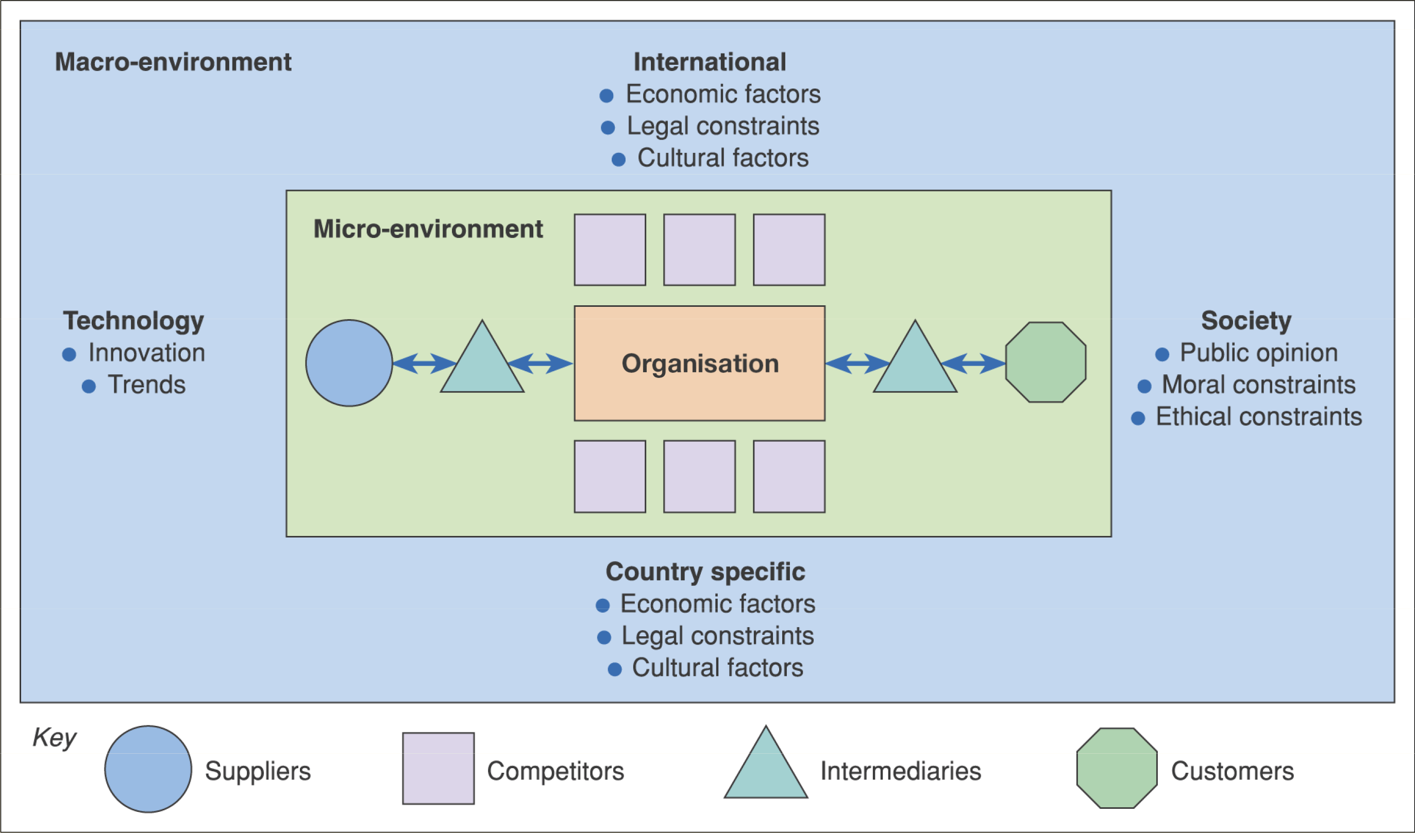
Figure 2.1 The environment in which digital business services are provided

Slide 8
Activity – the e-commerce environment
For each of the environment influences shown in Figure 2.1, give examples of why it is important to monitor and respond in an e-business context. For example, the personalisation mentioned in the text is part of why it is important to respond to technological innovation.

Slide 9
Environment constraints and opportunities
Customers – which services are they offering via their website that your organisation could support them in?
Competitors – need to be benchmarked in order to review the online services they are offering – do they have a competitive advantage?
Intermediaries – are new or existing intermediaries offering products or services from your competitors while you are not represented?

Slide 10
Environment constraints and opportunities (Continued)
Suppliers – are suppliers offering different methods of procurement to competitors that give them a competitive advantage?
Macro-environment
Society – what is the ethical and moral consensus on holding personal information?
Country specific, international legal – what are the local and global legal constraints, for example, on holding personal information, or taxation rules on sale of goods?

Slide 11
Environment constraints and opportunities (Continued)
Country specific, international economic – what are the economic constraints of operating within a country or global constraints?
Technology – what new technologies are emerging by which to deliver online services such as interactive digital TV and mobile
phone-based access?

Slide 12
Process for online marketplace analysis
Is an important part of
  Developing long-term digital business plan
  Creating a shorter-term digital marketing campaign
  Click ecosystem
    Customer behavior or flow of online visitors between search engines, media sites, other intermediaries to an organization and its competitors
  Online market ecosystem
    That connects websites through data exchange, giving opportunities to enhance the customer experience and extend their reach and influence, for example, Facebook’s API

Slide 13
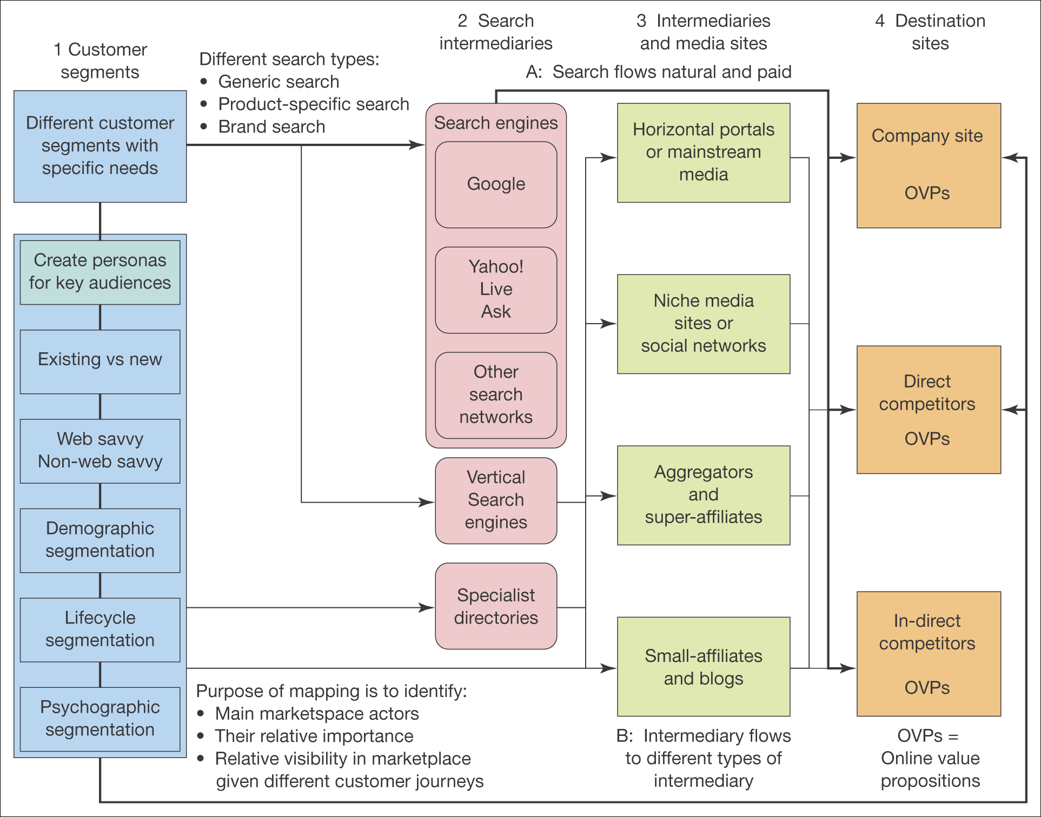
Process of marketplace analysis
Figure 2.4 An online marketplace map

Slide 14
Process of marketplace analysis-
Online marketplace map-
Main elements
Customer Segments
Marketplace analysis should identify and summarise different target segments for an online business to understand
  Online media consumption
  Buyer behaviour
  Type of content
  Experience
2. Search Intermediaries
  Search engines, such as …
  Google trends tool for assessing site popularity

Slide 15
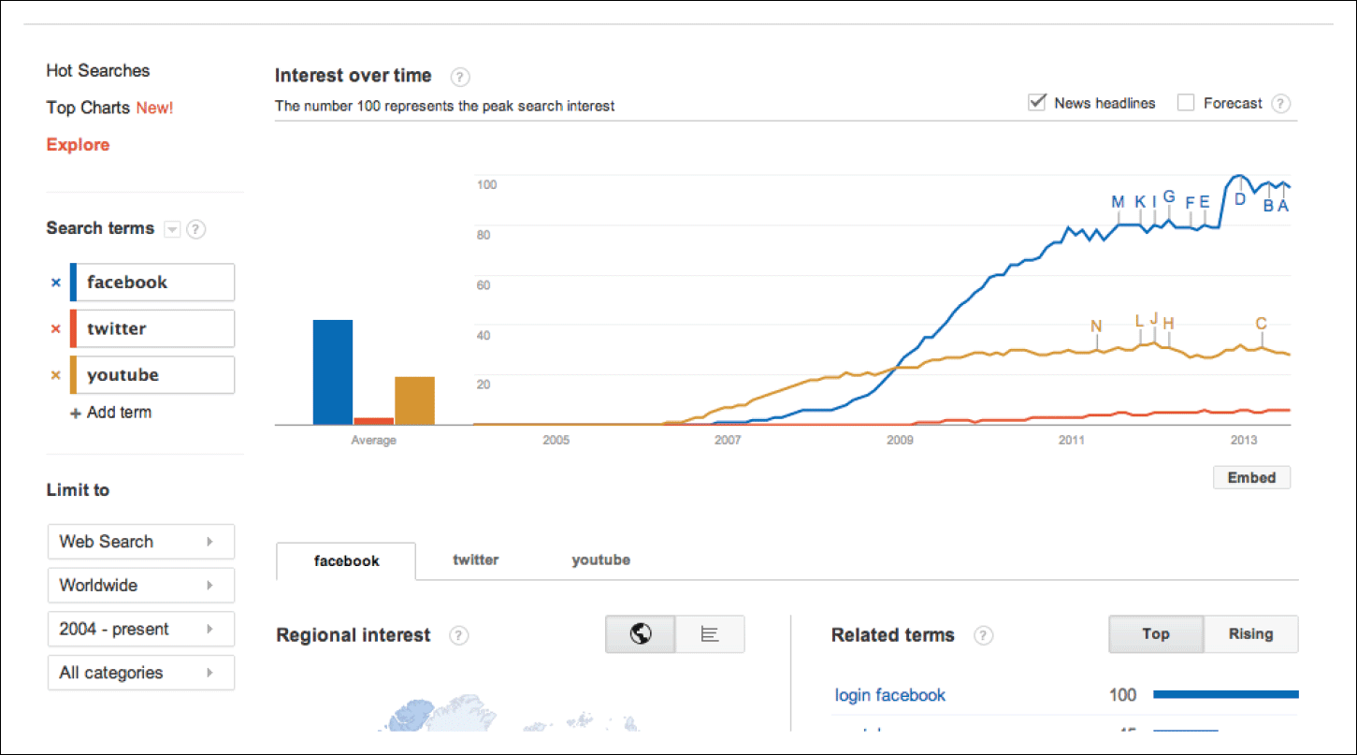
Figure 2.5 Google Trends – useful for consumer interest in products
Source: http://www.google.com/trends/.

Slide 16
Online marketplace map
Intermediaries, influencers and media sites are often successful in attracting visitors via search or direct since they are mainstream brands.
  Mainstream news media sites or portals:FT.com, Google news an aggregator, confused.com an aggregator
  Social networks
  Niche or vertical media sites:SmartInsights.com,searchengineland.com,clickz.com, E-consultancy
  Price comparison sites(aggregators):Moneysupermarket.com,kelkoo.com, uSwitch
Notes:
u

Slide 17
Online marketplace map
Super affiliates: Affiliate companies gain revenue from a merchant they refer traffic to using a commission-based arrangement based on the proportion of sale or a fixed amount
Niche affiliates, influencers or bloggers: These are often individuals, but they may be important. Moneysavingexpert.com
Destination Sites
These are the sites that marketers are trying to generate visitors to.
OVP: Online Value Proposition, a summary of the unique features of the site

Slide 18
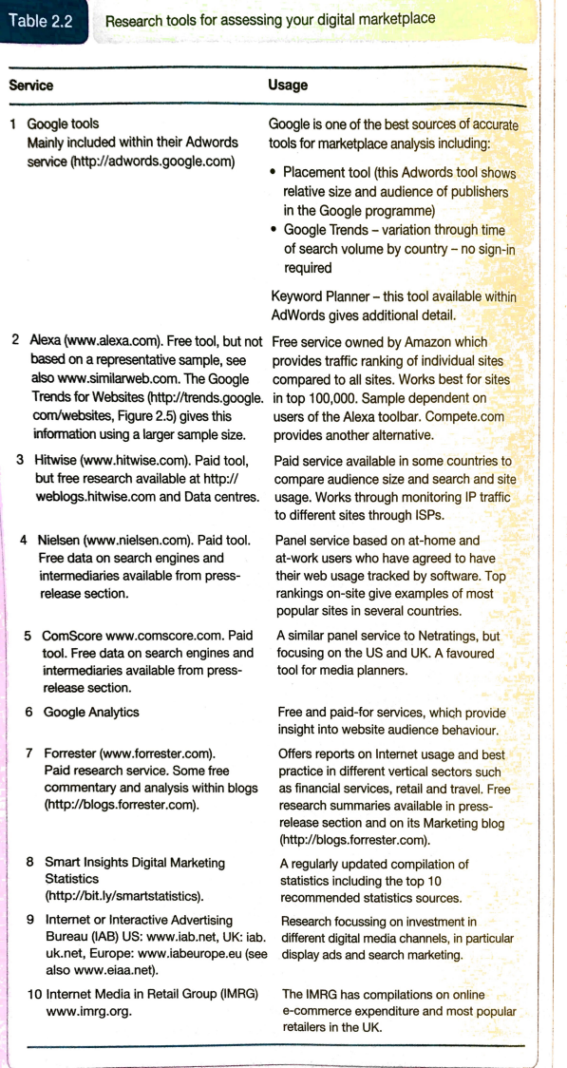
Resources for analysing the online marketplace

Slide 19
Location of trading in the marketplace
  Electronic marketplace
  It is a virtual marketplace, with no physical presence
  Marketplace channel structures
  These describe the way a manufacturer or organization delivers products and services to its customers.

Slide 20
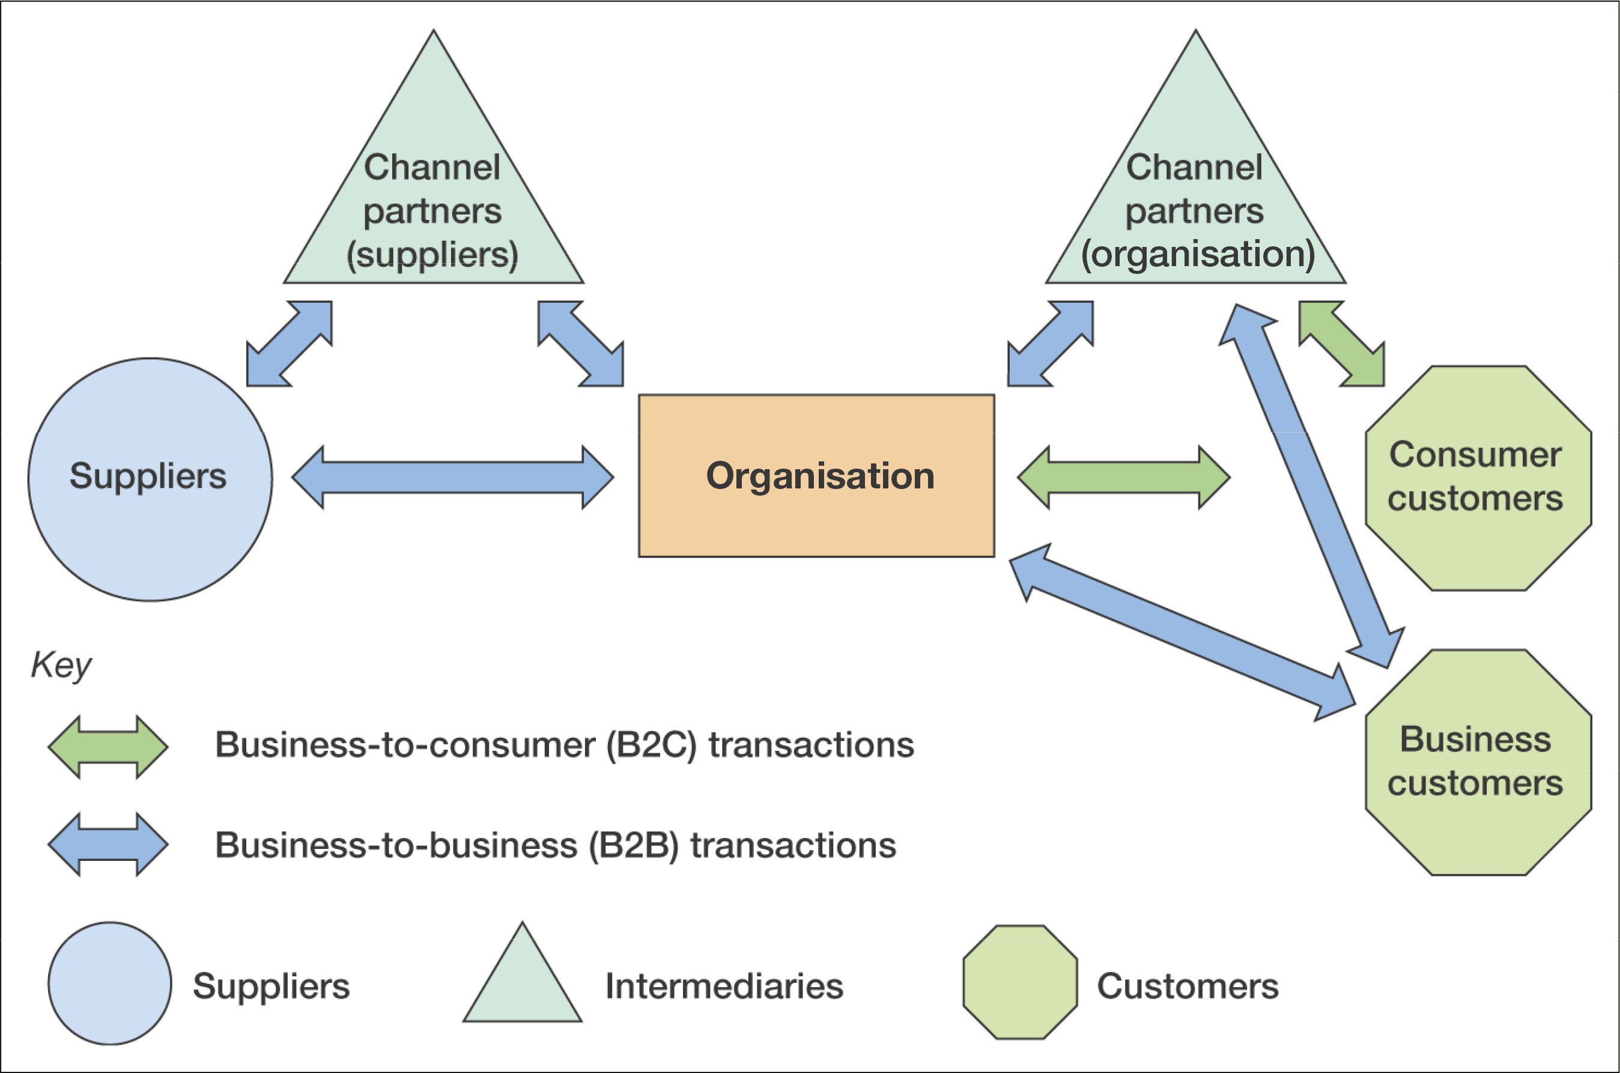
Typical channel structures between business and consumer organisations
Figure 2.6 B2B and B2C interactions between an organisation, its suppliers and its customers

Slide 21
Location of trading in the marketplace
  Disintermediation
    The removal of intermediaries such as distributors or brokers that formerly linked a company to its customers
  Reintermediation
    The creation of new intermediaries between customers and suppliers providing services such as supplier search and product evaluation.
    www.moneysupermarket.com, www.confused.com

Slide 22
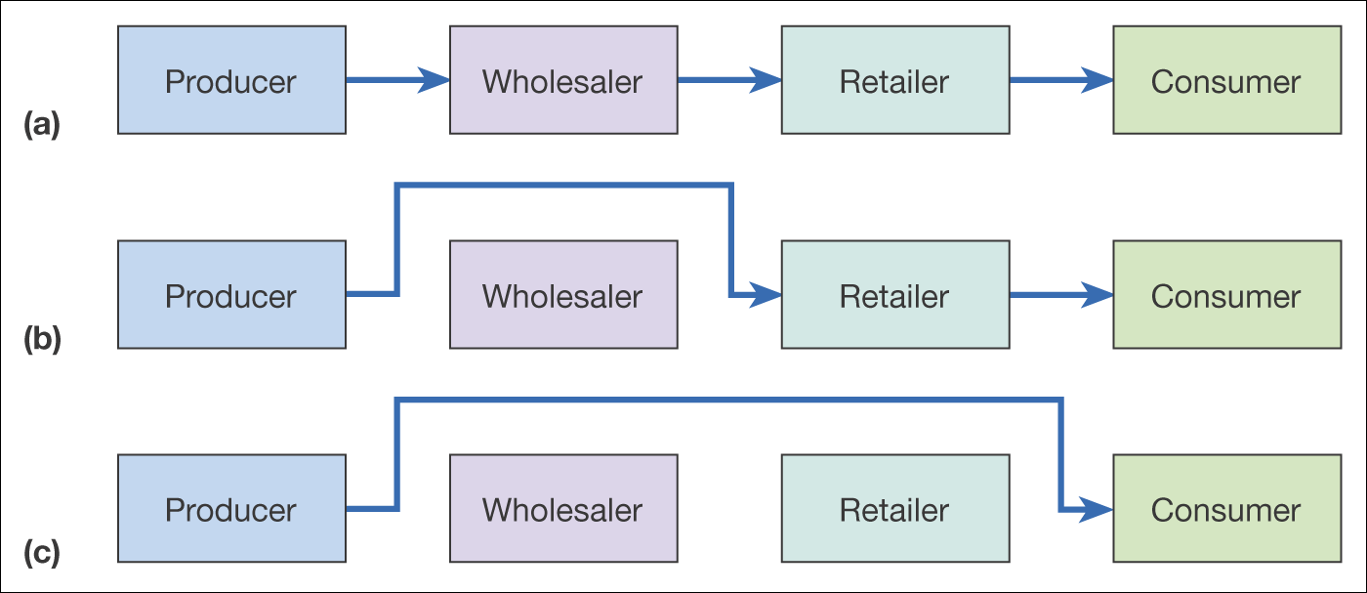
Figure 2.7 Disintermediation of a consumer distribution channel showing (a) the original situation, (b) disintermediation omitting the wholesaler, and
(c) disintermediation omitting both wholesaler and retailer

Slide 23
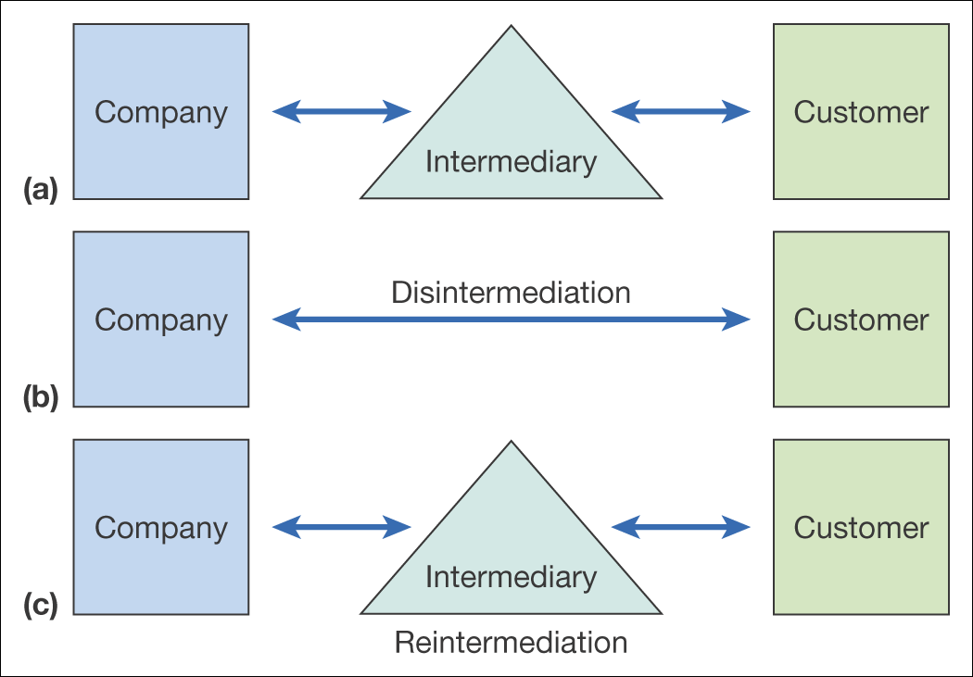
Figure 2.8 From original situation (a) to disintermediation (b) and reintermediation (c)

Slide 24
Counter-mediation
Creation of a new intermediary
Example:
  B&Q www.diy.com
  Opodo www.opodo.com
  Boots www.wellbeing.com www.handbag.com
  Ford, Daimler (www.covisint.com)
Partnering with existing intermediary – Mortgage broker Charcol and Freeserve.

Slide 25
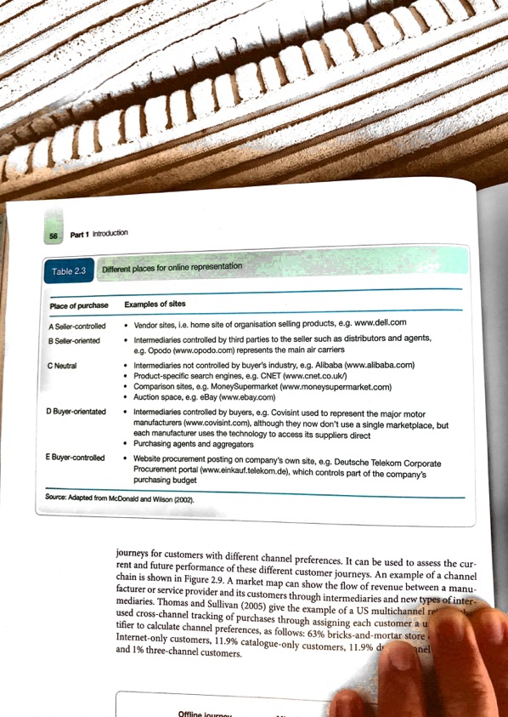
Places of trading in the marketplace

Slide 26
Importance of Multichannel marketplace models
Customer Journey
A description of modern multichannel buyer behaviour as consumers use different media to select suppliers, make purchases, and gain customer support.
Multichannel marketing strategy
Defines how different marketing channels should integrate and support each other in terms of their proposition and development and communications based on their relative merits for the customer and the company

Slide 27
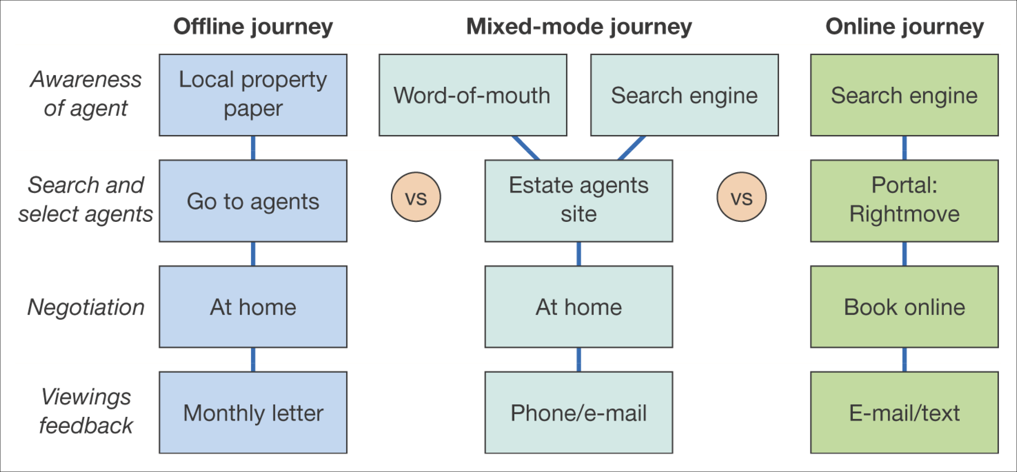
Figure 2.9 Example channel chain map for consumers selecting an estate agent to sell their property

Slide 28
Business model
Timmers (1999) defines a ‘business model’ as:
An architecture for product, service and information flows, including a description of the various business actors and their roles; and a description of the potential benefits for the various business actors; and a description of the sources of revenue.
Online Business Model is a summary of how a company will generate a profit identifying its core product or service value proposition, target customers in different markets, position in the competitive online marketplace or value chain and its projections for revenue and costs

Slide 29
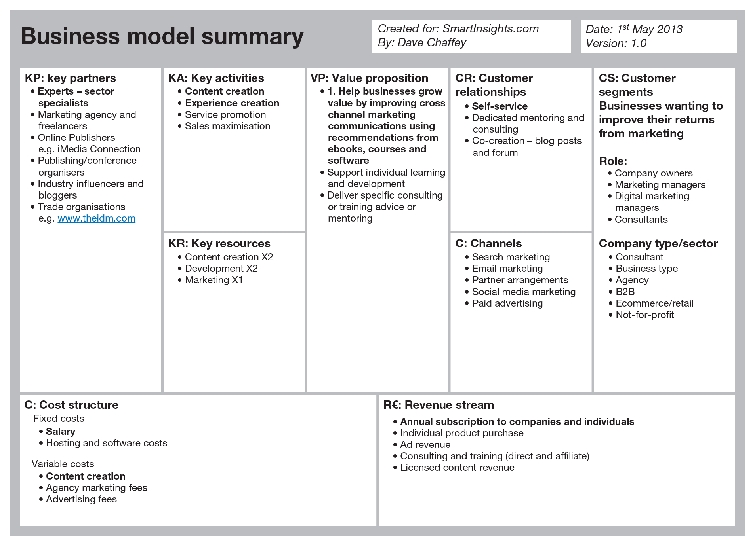
Framework for summarising strategy for online businesses
Figure 2.10 Business Model Canvas example
Source: Smart Insights. With permission.

Slide 30
Main sections of the canvas
Value Proposition
This is the heart of what the business offers to its audiences and is most important to success
Customer segments
Different target audiences to whom the value propositions will appeal. Ex: mass market, niche market, range of diverse segments.
Customer relationships
Type of relationships that will be formed, Example: self-service, automated services, communities or more personal service

Slide 31
Main sections of the canvas
Channels
The methods by which the organisation’s services will be delivered and the audiences reached.
Key Partners
To exploit online and offline value networks, forming partnerships gives an opportunity of expanding reach and taking advantage of existing organisations and online influencers that have built an audience
Activities
The main activities that need to be performed to deliver the value proposition to develop revenue.

Slide 32
Main sections of the canvas
Resources
Different types of process and people to complete the activities to create and deliver the value proposition.
Cost Structure
Different cost-elements, should be checked against activities and resources.
Revenue Stream
By which a business derives income.
There are few missing elements in the canvas, for example, KPIs, Impact of Competitors

Slide 33
Alternate business models
Three different perspectives from which a business model can be viewed.
Marketplace position perspective.
Revenue model perspective
Commercial arrangement perspective
Any business can focus on a single category for each perspective and this is used as a tool for formulating digital business strategy

Slide 34
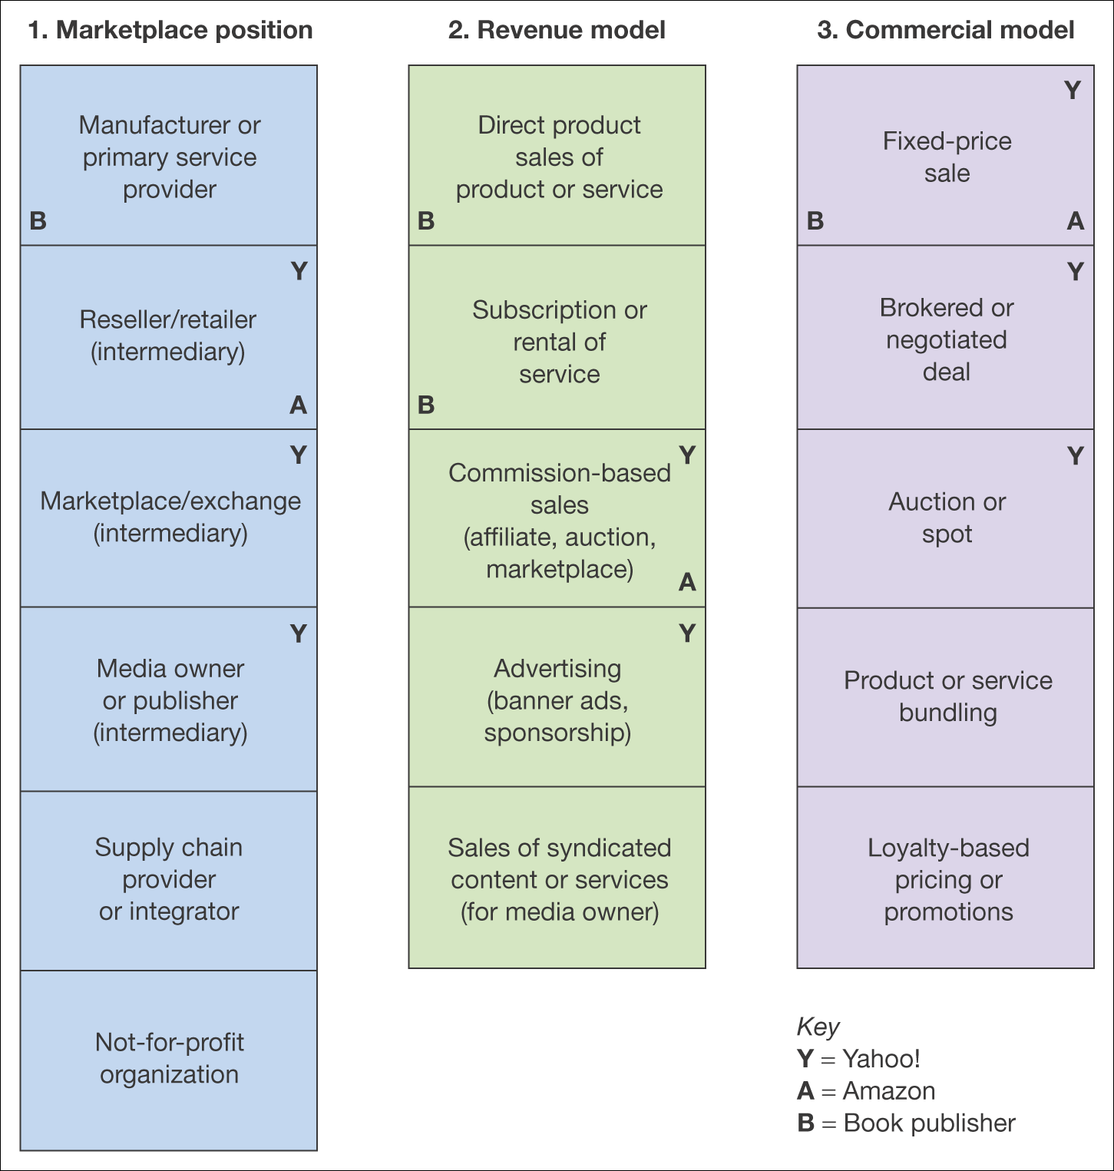
Marketplace position perspective. B is the manufacturer, A is a retailer and Y is both retailer and marketplace intermediary.
Revenue model perspective. B can use the web to sell direct, while Y and A can be commission based sales.
Commercial arrangement perspective. A, B and Y offer fixed-price sales
Figure 2.11 Alternative perspectives on business models

Slide 35
Revenue models – publisher example
Subscription access to content
  Range of documents can be accessed from a publisher for a fixed period. Premium services on websites
Pay per view content access
  Payment for single access to a document, video, music clip, which can be downloaded.
CPM display advertising
  Cost Per Thousand(mille)-Number of times ads are served to site visitors
CPC advertising on site
  Cost Per Click, cost can range from £0.40 to £20 per click

Slide 36
Revenue models – publisher example
Sponsorship of sections, content or widgets
  Fixed fee foe a period
Affiliate revenue (CPA or CPC).
  Is commission based.
Subscriber data for e-mail marketing.
  The data a site owner has about its customers are valuable as it can send different forms of email to its customers.
Transaction fee revenue.
  A company receives a fee for facilitating a transaction.

Slide 37
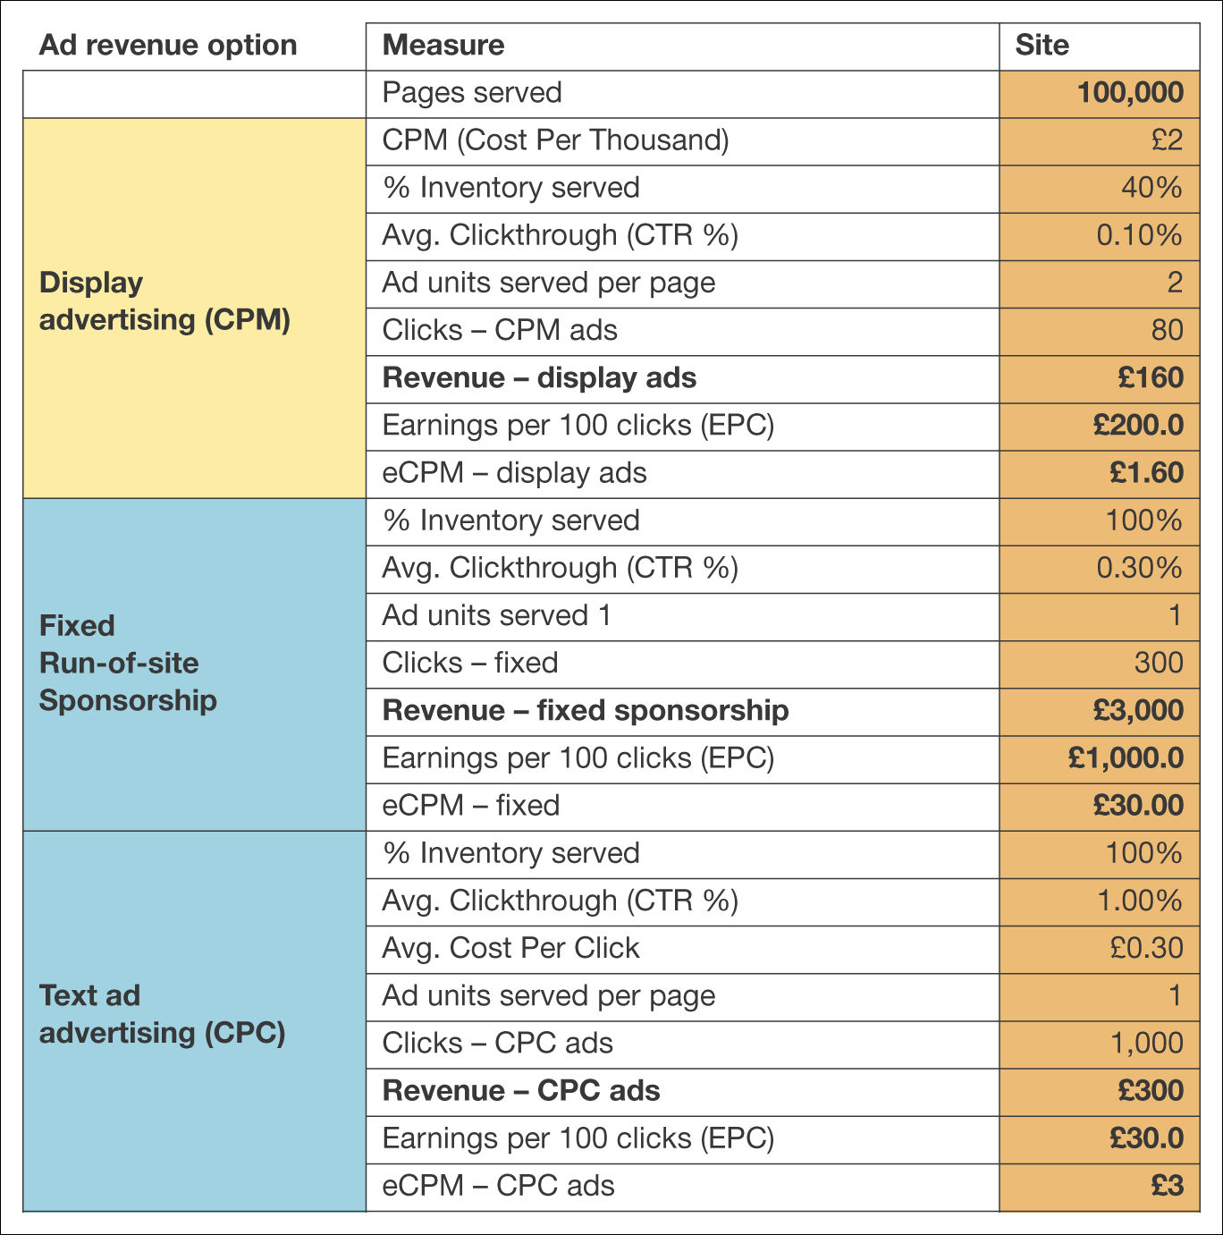
Figure 2.12 Example spreadsheet for calculating a site revenue model
Note: Available for download at www.smartinsights.com/conversion-model-spreadsheets/

Slide 38
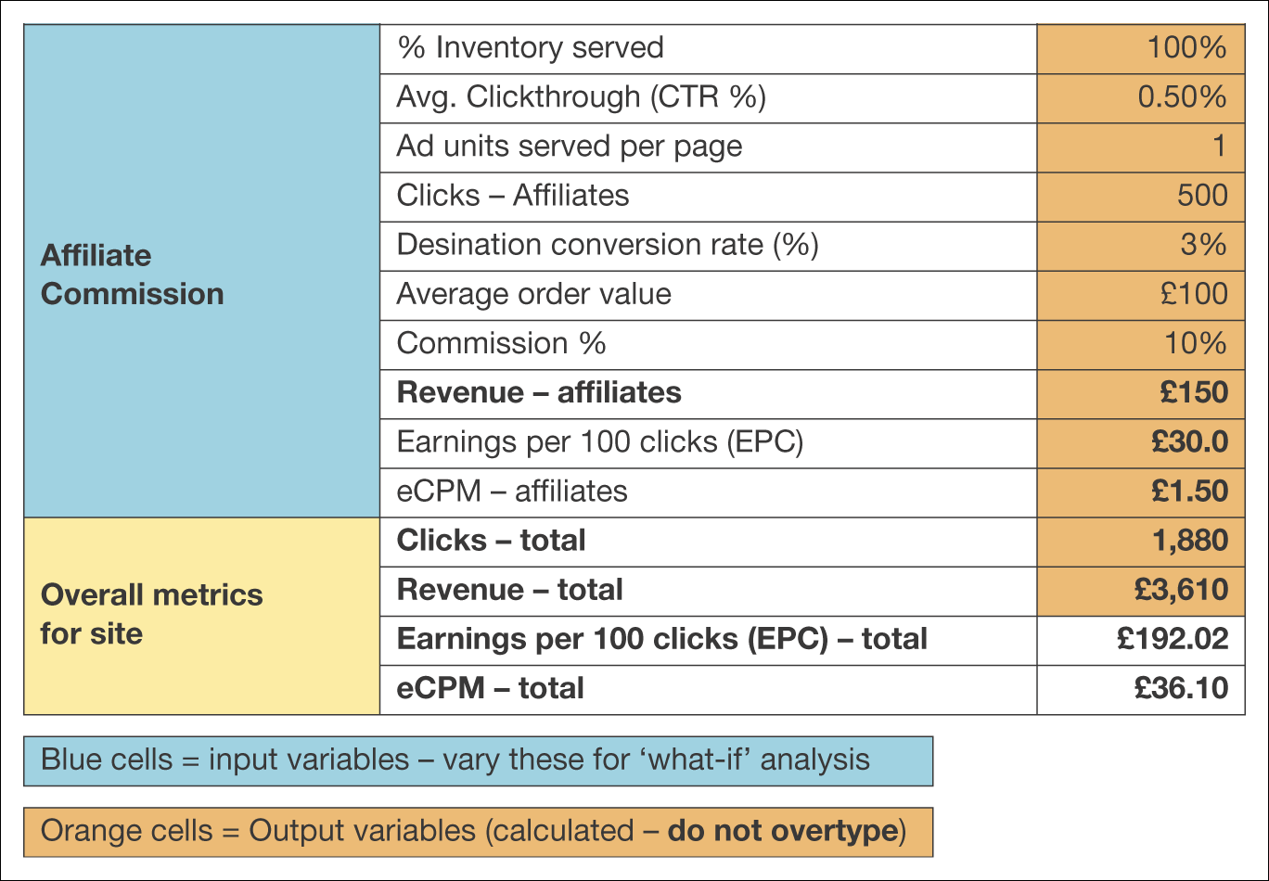
Figure 2.12 Example spreadsheet for calculating a site revenue model (Continued)
Note: Available for download at www.smartinsights.com/conversion-model-spreadsheets/

