Slide 1
Part 2
Strategy and applications
Chapter 5
Digital business strategy

Slide 2
Learning outcomes
Follow an appropriate strategy process model for digital business
Apply tools to generate and select digital business strategies
Outline alternative strategic approaches to achieve digital business.
How does digital business strategy differ from traditional business strategy?
How should we integrate digital business strategy with existing business and information systems strategy?
How should we evaluate our investment priorities and returns from digital business?
Management issues

Slide 3
Michael Porter on the Internet
‘The key question is not whether to deploy Internet technology – companies have no choice if they want to stay competitive – but how to deploy it.’
Porter, M. (2001) Strategy and the Internet,
Harvard Business Review, March 2001, 62–78.

Slide 4
Strategy
Strategy defines the future direction and actions of an organisation defined as approaches to achieve specific objectives.
Alternative definitions of Strategy:
  ‘Defines how we will meet our objectives’
  ‘Sets allocation of resources to meet goals’
  ‘Selects preferred strategic option to
  compete within a market’
  ‘Provides a long-term plan for the development of the organisation’.

Slide 5
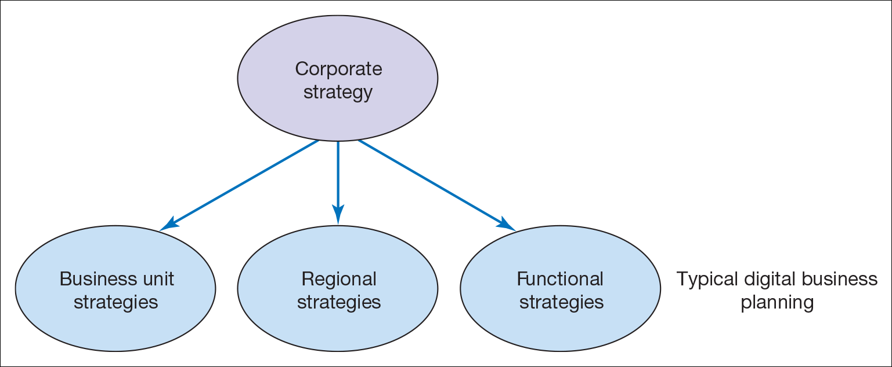
Different forms of organisational strategy
Corporate Strategy- concerned with the overall purpose and scope of the organisation
Business unit strategy – defines how to compete successfully in a particular market, and operational strategies, which are concerned with achieving corporate and business unit strategies
Functional strategies – describe how the corporate and business unit strategies will be operationalized in different functional areas or business processes.
Functional and process strategies refer to marketing, supply chain management, human resources, finance and information system strategies.

Slide 6
Digital Business Strategy
The approach by which the application of new technologies to existing business activities can support and influence business strategy and provide competitive advantage.
Where this will fit in the organisation?
This must be discussed and agreed. However, the tendency is to be incorporated within the functional strategies, for example within a marketing plan or logistics plan or as part of information systems.
DB strategy must be based on corporate objectives.
They must be based on new opportunities and threats related to digital network adoption, which are identified from environmental analysis.

Slide 7
What happens where there is no digital business strategy?
Missed opportunities for additional sales on the sell-side and more efficient purchasing on the buy-side
Fall-behind competitors in delivering online services – may become difficult to catch-up,
for example, Tesco, Dell
Inappropriate direction of digital business strategy, poorly defined objectives, for example, with the wrong emphasis on buy-side, sell-side or internal process support
Limited integration of digital business at a technical level, resulting in silos of information in different systems
Resource wastage through duplication of digital business development

Slide 8
Sell-side e-commerce strategy (Chapters 8 and 9) or e-marketing/CRM strategy
Sell-side e-commerce is a channel strategy
Objectives for online contribution percentage
should drive our strategy
Our e-commerce strategy defines how we should
    Hit our channel leads and sales targets
      Acquisition, Conversion, Retention, Service, Profitability
    Communicate benefits of using this channel
    Prioritise products available through channel
    Prioritise audiences targeted through channel
    Select partners for this channel
Channel strategy thrives on differentials
But, need to manage channel integration.

Slide 9
Buy-side e-commerce strategy (Chapters 6 and 7) or e-supply chain management strategy
Buy-side e-commerce strategy is about maximising operational efficiencies while improving customer service quality
Operational efficiency KPIs should drive our strategy
Our buy-side e-commerce strategy defines how we should
    Automate internal processes
    Link internal resource management systems with external purchasing systems
    Prioritise suppliers/partners collaborating using this channel
    Prioritise applications for SCM – create a roadmap
Involves selection of appropriate strategic partners.

Slide 10
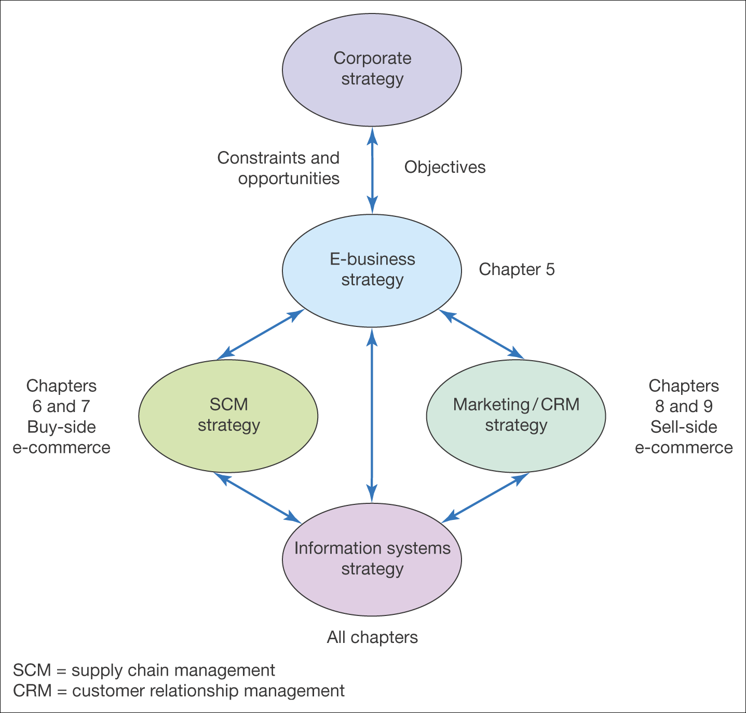
Figure 5.2 Relationship between digital business strategy and other strategies

Slide 11
Digital channel strategies(DCS)
DCS define how a company should set specific objectives and develop specific differential strategies for communicating with its customers and partners through electronic media.
Examples of DCS include:
  Overarching digital channel or multichannel strategy with specific channel strategies
  Mobile commerce strategy
  Social media strategy
  Social CRM strategy
  SCM or ERP strategy
  E-procurement strategy
Notes:
To prevent simply replicating existing processes through digital channels, which will create efficiencies but will not exploit the full potential for making an organisation more effective by utilizing digital technologies.

Slide 12
Digital channel strategies(DCS)
  Multichannel digital business strategy
    Defines how different marketing and supply chain channels should integrate and support each other to drive business efficiency and effectiveness.
  Omnichannel business strategy
    This is a cross-channel business model that organisations can use to provide their user/customer experience – it provides a seamless customer experience across offline and online channels, such as, a website, telephone, bricks-and-mortar store, live web chat, mobile apps etc.
  DCS also defines how an organisation gains value internally from using digital networks, such as sharing employee knowledge and improving process efficiencies through intranets etc

Slide 13
Digital channel strategies(DCS)
  Main characteristics of multichannel strategy is:
    Specific digital business objectives need to be set to benchmark adoption of e-channels
    Digital business strategy defines how we should:
      Communicate the benefits of using e-channels
      Prioritise audiences or partners targeted for e-channel adoption
      Prioritise products sold or purchased through e-channels
      Achieve our e-channel targets
    Digital channels do not exist in isolation
    Also defines how an organisation gains value internally from using electronic networks.

Slide 14
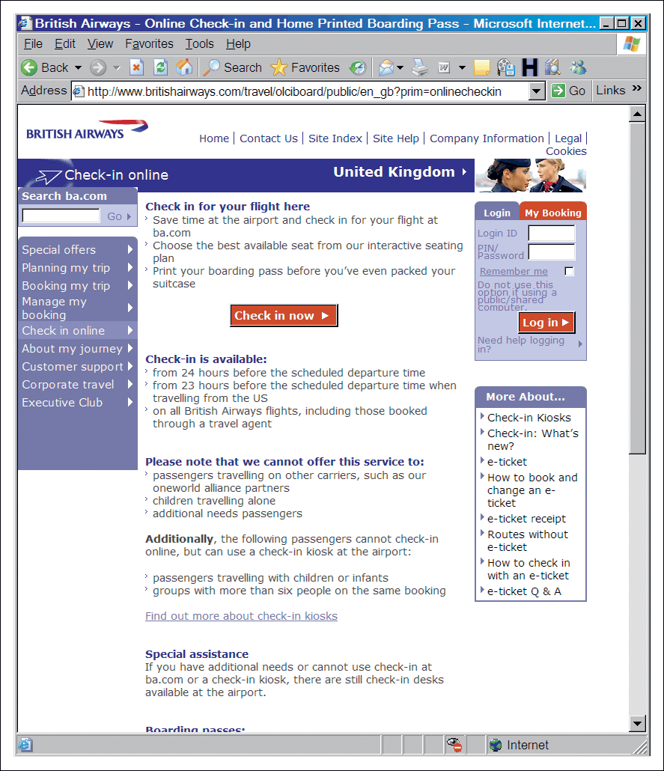
BA asks: ‘Have you clicked yet?
’In 2004, BA launched online services which allowed customers to take control of the booking process, so combining new services with reduced costs. BA decided to develop a specific online ad campaign to create awareness and encourage usage of its Online Value Proposition(OVP)
Figure 5.3 BA communicates its online value proposition
Source: Based on Revolution (2005); wwwbritishairways.com

Slide 15
Platform Strategy
  This is about entering a market that revolves around allowing platform participants to benefit from the presence of others i.e. creating community.
  Ex: Google, eBay, Facebook, video gaming platform etc, are about co-creating value
  Platforms also rely on the power of ’network effects’.
  Three technologies have risen the platforms:
    Cloud, Social and Mobile
  Platform strategy is determined by three things: (Bonchek and Choudary, 2013):
  Connection: how easy is it for others to use/join the platform and share/transact
  Gravity: how well the platform attract participants (producers and consumers)
  Flow: how well the platform foster the exchange and c-creation of value?

Slide 16
Common types of Platforms
  Hagel(2015) says that there are THREE common types of platforms:
  Aggregation platforms:
  They bring together a broad array of resources and help users connect with them.
    Data/information aggregation, such as scientific databases
    Marketplace/broker platforms, such as MoneySuperMarket, AppStore, eBay
    Contest platforms, where people can post a problem and offer a reward/payment to the user with best solution. E.g. InnoCentive and Kaggle
  Social platforms: They bring a lot of people together with common interest
  Mobilisation platforms
    They are about moving people to act together to accomplish something beyond an individual participant. E.g. Crowdsourcing(crowdfunding), such as CrowdFunder.co.uk, kickstarter.com etc, justgiving.com

Slide 17
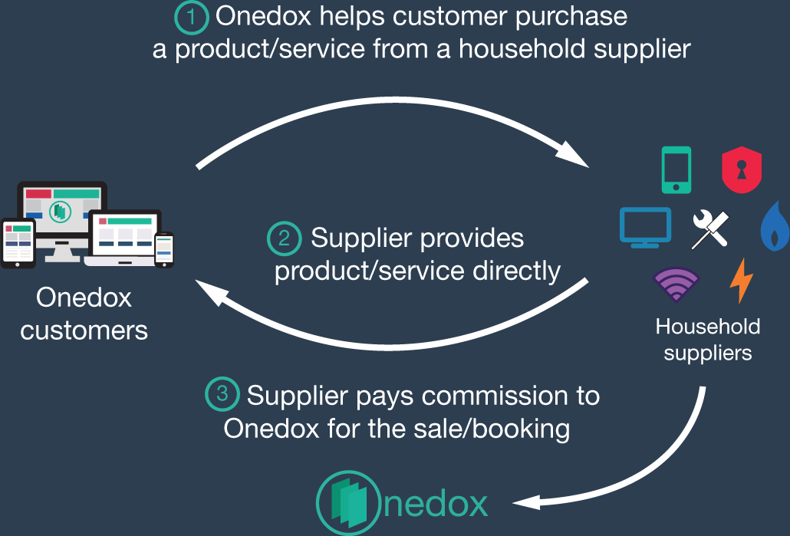
Figure 5.4 The Onedox revenue model
An example of how start-up company Onedox.com worked on defining its digital business strategy and used the crowdfuncding platform Crowdcude to raise money.
(Onedox closed in Dec 2019)
Source: https://www.crowdcube.com/companies/onedox/pitches/b9nE7q#categorise

Slide 18
Strategy process models for digital business
  Strategy process model is a framework for approaching strategy development.
  Framework gives a logical sequence to follow to ensure inclusion of all key activities of business strategy development, also can be evolved as part of a process of continuous improvement.
  Common elements include:
    Internal and external environment scanning or analysis.
    A clear statement of vision and objectives
    Strategy option generation, evaluation and selection
    Enactment of the strategy as implementation
    Control is required to monitor operational and strategy effectiveness problems and adjust the operations or strategy accordingly.

Slide 19
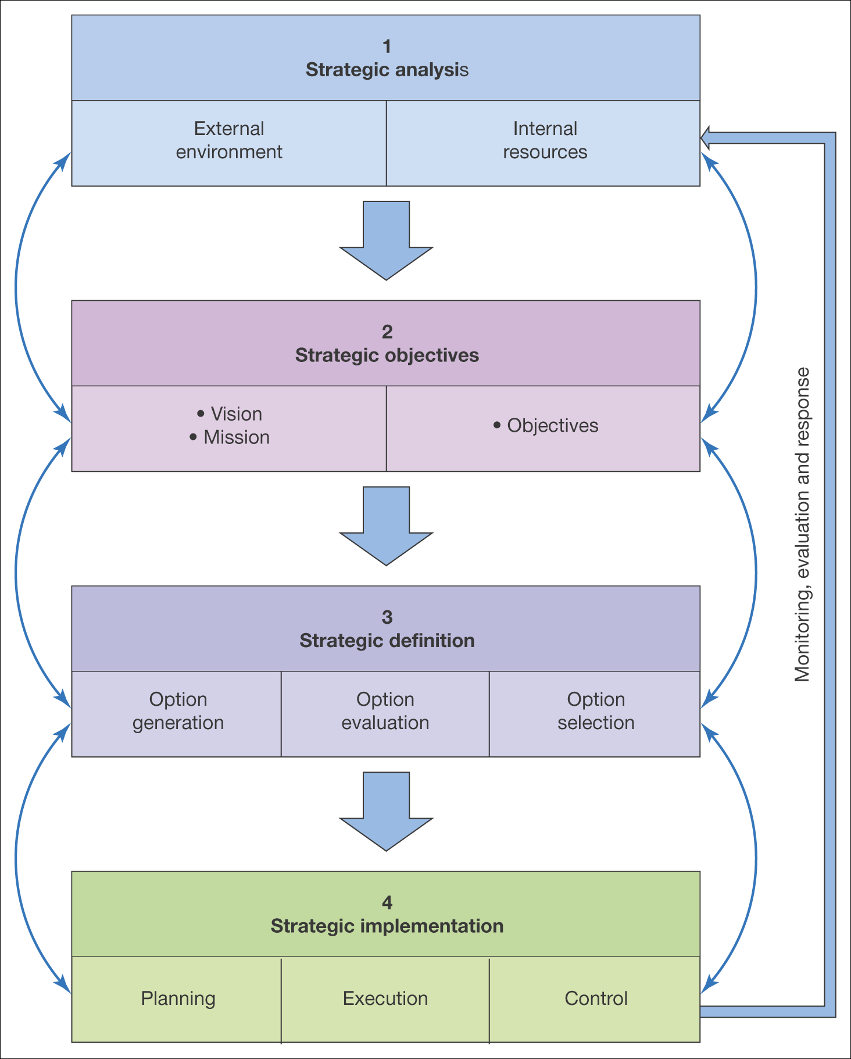
Figure 5.4 A generic strategy process model

Slide 20
How strategy process models are applied
  The arrows in the generic strategy process model highlight an important distinction in the way in which strategy process models are applied.
  Two approaches:
  Prescriptive strategy approach
    Strategic analysis, development and implementation are linked together sequentially.
  Emergent strategy approach
    Strategic analysis, strategic development and implementation are interleaved and developed together.
  However, in reality, in most strategy development and planning process have elements of both.

Slide 21
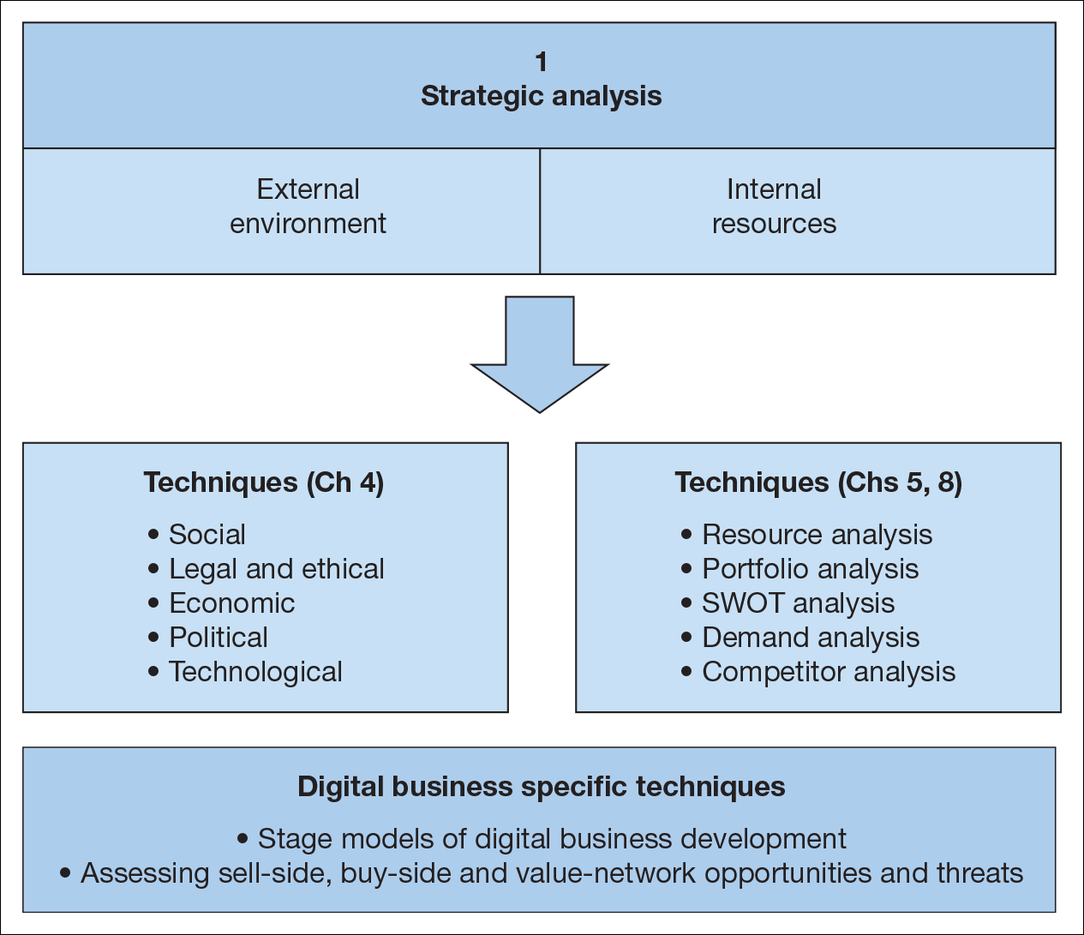
Figure 5.6 Elements of strategic situation analysis for the digital business

Slide 22
Strategic Analysis
  Strategic analysis involves a review of:
  Internal processes and resources to assess company’s digital business capabilities and results to date in the context of a review of its activity in the marketplace.
  The immediate competitive environment (micro-environment) including customer demand and behaviour, competitor activity, marketplace structure and relationships with suppliers, partners, intermediaries
  The wider environment(macro-environment) in which a company operates. This includes the social, legal, economic and political factors

Slide 23
Resource and Process Analysis
  Resource Analysis is the review of the technological, financial and human resources of an organisation and how they are utilized in business processes.
  Resources are the tangible and intangible assets which can be used in value creation
  Capabilities represent the ability of a firm to use effectively to support value creation.
  They are dependent on the structure and processes used to manage digital business.

Slide 24
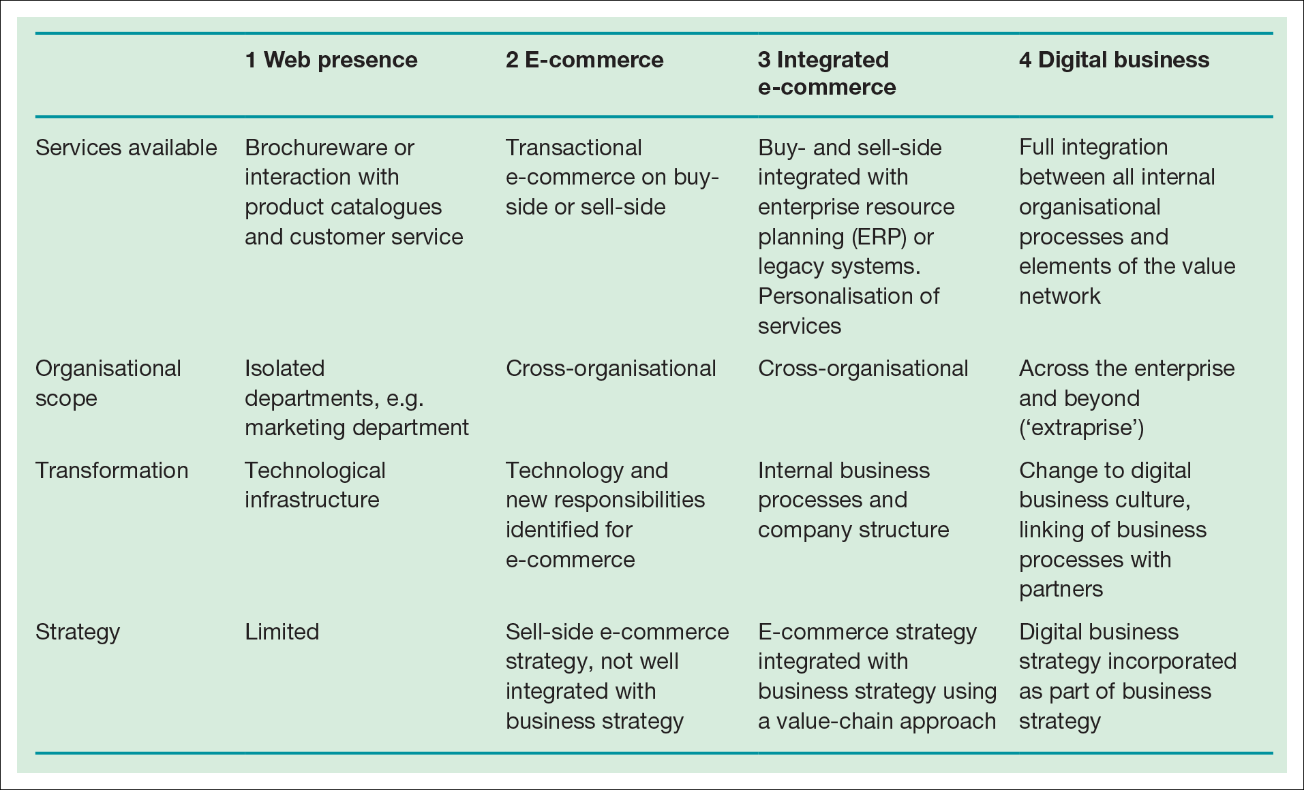
Stage models
Helpful in reviewing how advanced a company is in its use of ICT resources to support its processes
Table 5.3 A stage model for digital business development

Slide 25
Application Portfolio Analysis
  Analysis of the current portfolio of business applications within a business is used to assess current information systems capability and also to inform future strategies.
  The six areas of benchmarking in portfolio analysis are:
    Digital channel strategy
    Online customer acquisition
    Online customer conversion and experience
    Customer development and growth
    Cross-channel integration and brand development
    Digital channel governance

Slide 26
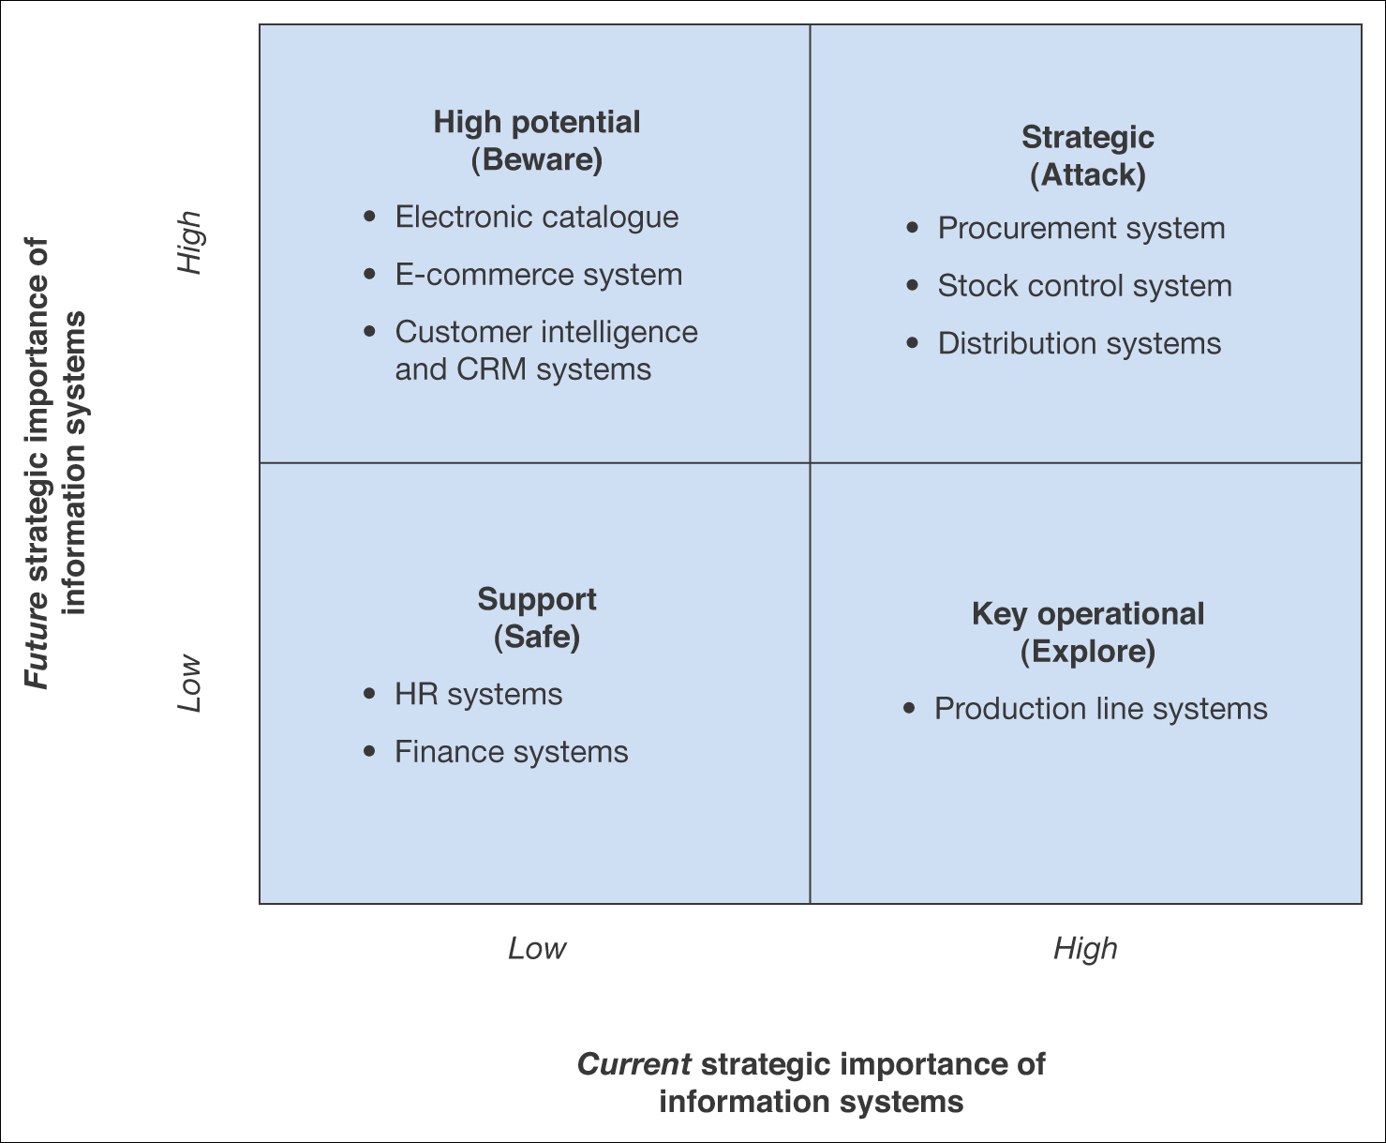
Figure 5.7 Summary applications of a portfolio analysis for an example B2B company

Slide 27
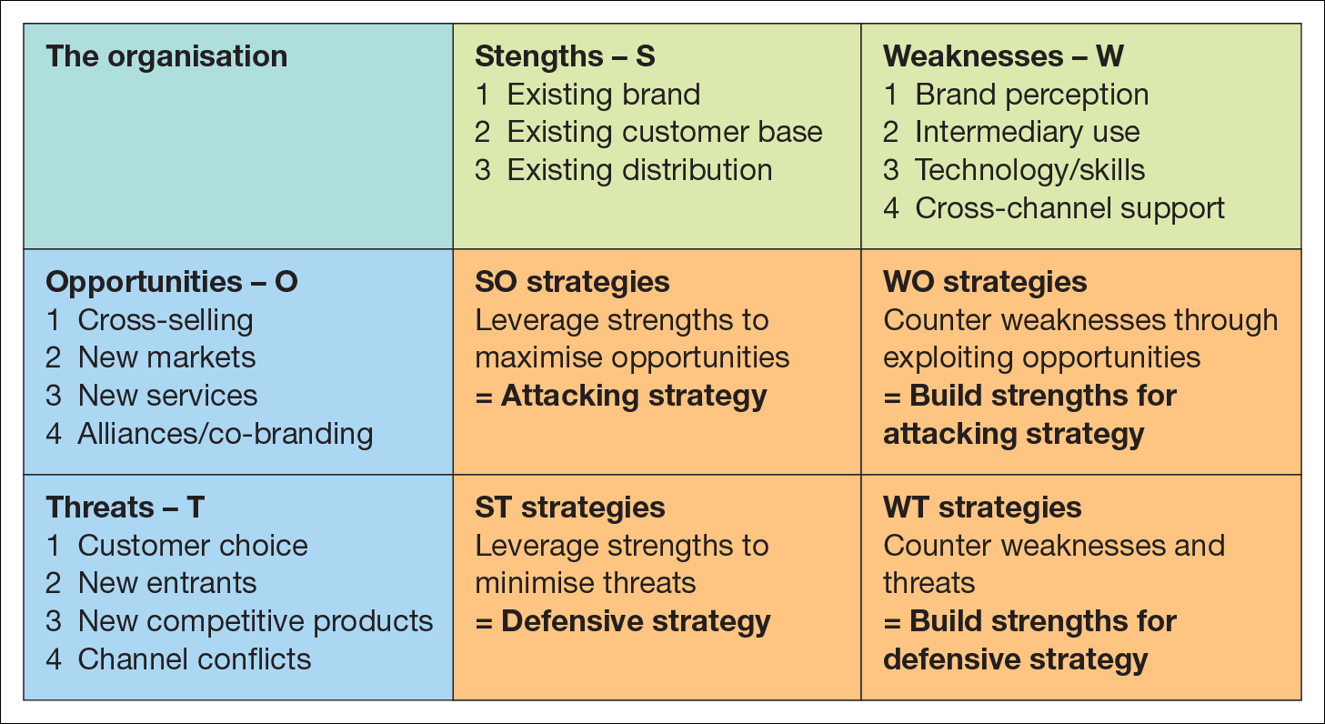
Organisational and IS SWOT analysis
Figure 5.8 SWOT/TOWS analysis, with strategies to counter the threats

Slide 28
Human and financial resources
Resource Analysis will also consider the two factors:
HR – To take advantage of the opportunities identified in strategic analysis, the right resources must be available to deliver digital business solutions.
Financial resources – Assessing financial resources for information systems is usually conducted as part of investment appraisal and budgeting for enhancements to new systems.
Evaluation of internal resources should be balanced against external resources.

Slide 29
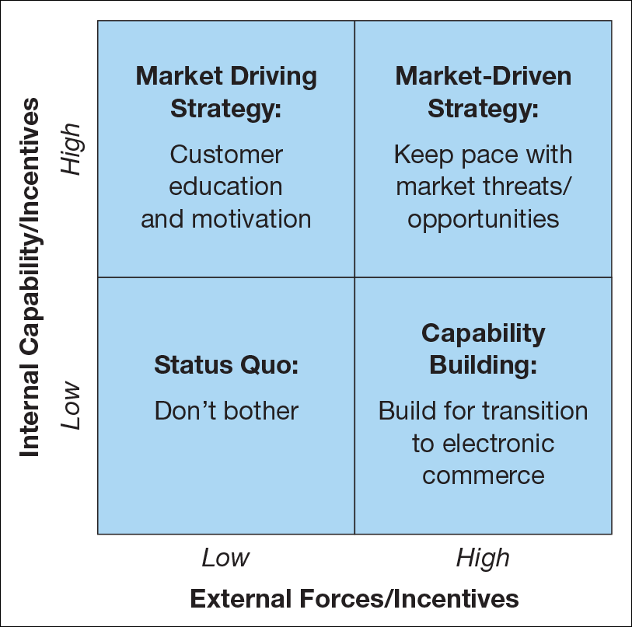
Market Driving Strategy is often the situation for the early adopters
Capability Building is for later adopters
Figure 5.9 Matrix for evaluation of external capability against internal capability
Source: Perrott (2005).

Slide 30
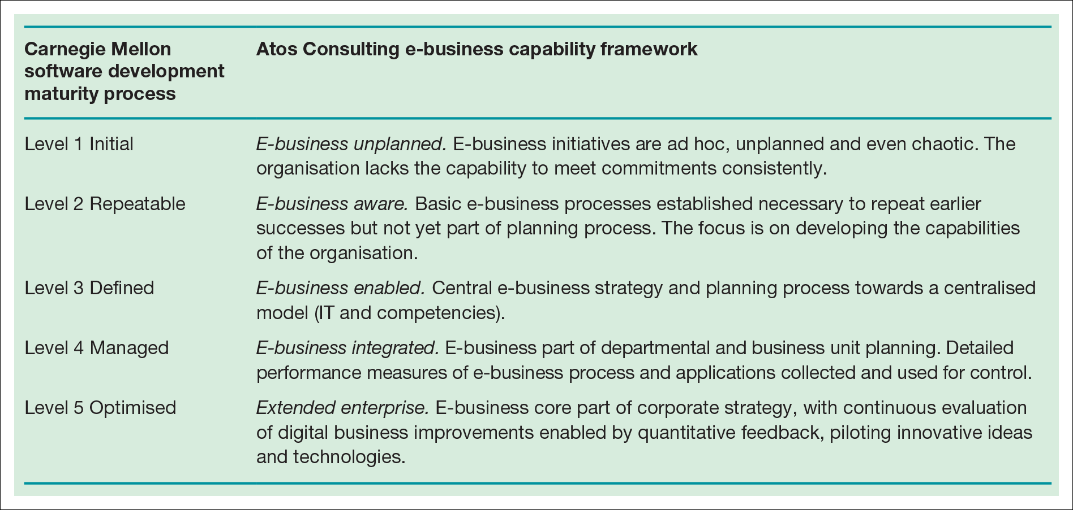
Table 5.4 Capability maturity model of the adoption of e‑business

Slide 31
Competitive environment analysis
External factors are also assessed as part of strategic analysis
Demand Analysis
  Assessment of the demand for e-commerce services amongst existing and potential customer segments
  Is a key activity in producing a digital marketing plan
Competitive Threats
  Threat of new e-commerce entrants
  Threat of new digital products
  Threat of new business models

Slide 32
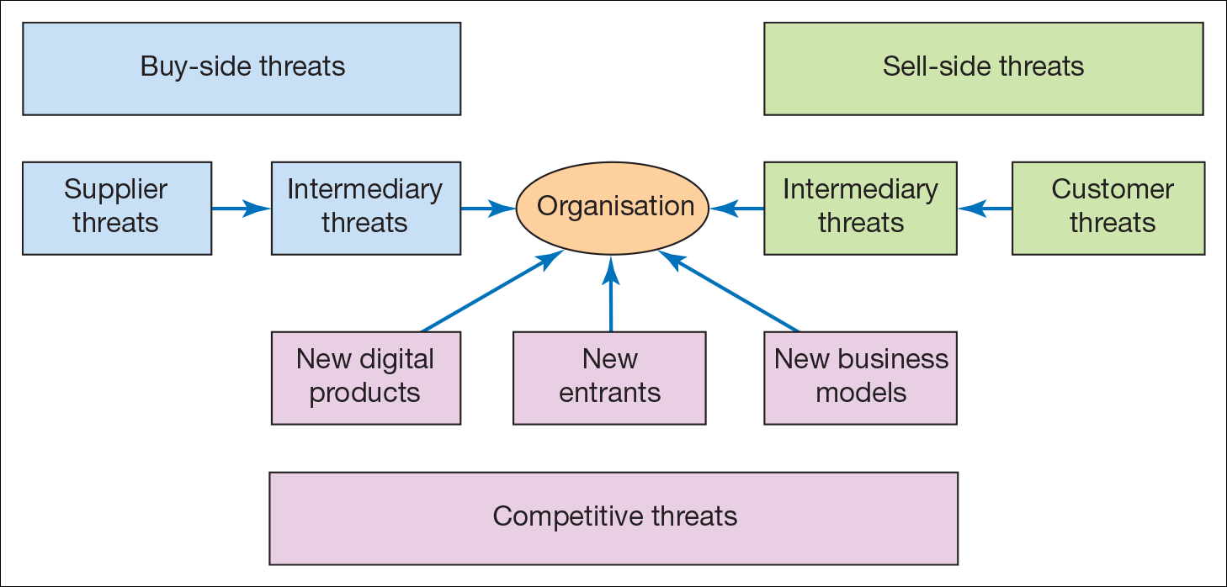
Sell-side threats:
Customer threats: power and knowledge
Intermediary threats: Potential loss of partners and distributors
Buy-side threats:
Supplier threats: Soft-lock-in
Intermediary threats: Costs of integration, increase in commission once established
Figure 5.10 Competitive threats (Michael Porter) acting on the digital business

Slide 33
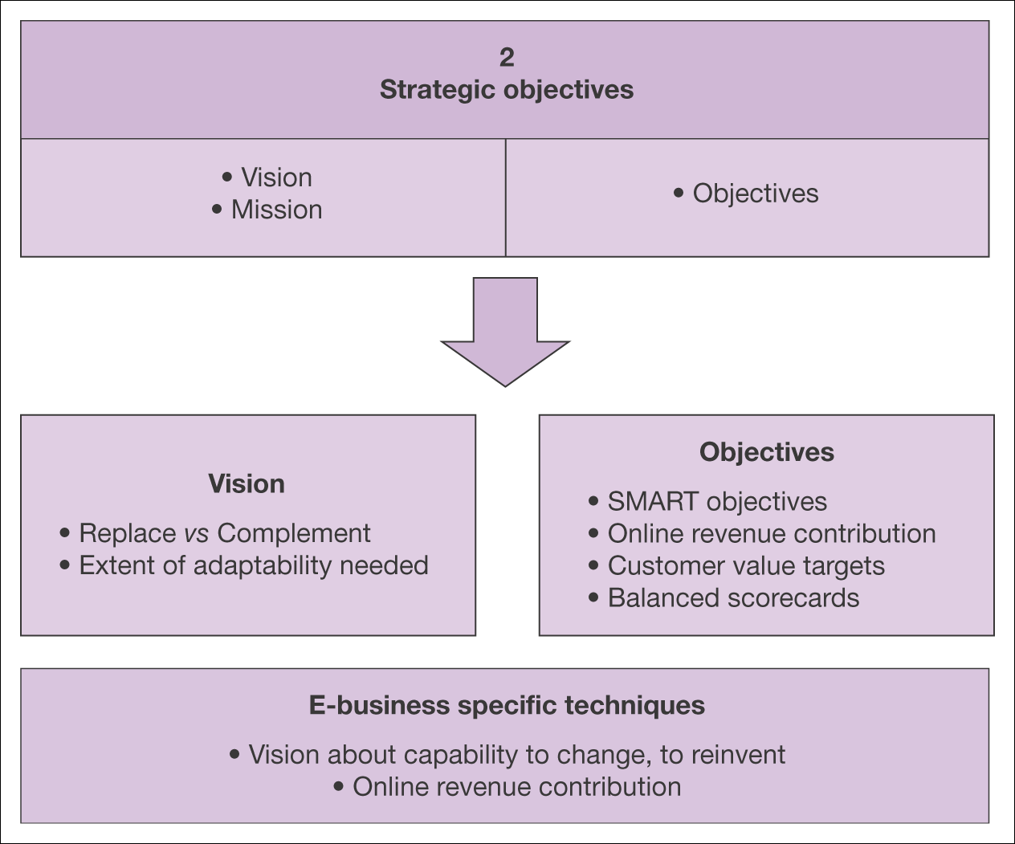
Figure 5.11 Elements of strategic objective setting for the digital business

Slide 34
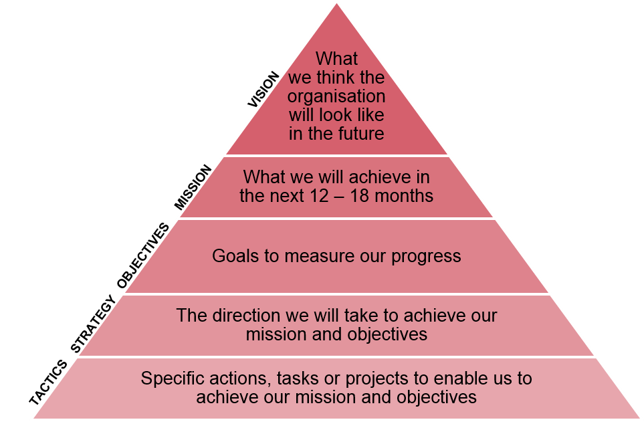
Figure 5.13 VMOST analysis
A good starting place for any business is to do VMOST analysis, a simple model that can be used to outline key elements of the business and help determine strategy

Slide 35
Strategic Objectives
Organisation’s strategic objectives is a key element of any strategy process model because:
Strategy definition and implementation elements of strategy must be directed at how best to achieve the objectives
The overall success will be assessed by comparing actual results against objectives and taking action to improve strategy
Clear, realistic objectives help communicate the goals and significance of a digital business initiative to. employees and partners

Slide 36
Strategic Objectives - How can digital business create business value?
Adding value
  Incremental value is delivered through providing better-quality products and services to an organisations customers.
  Information can be used to better understand customer preferences.
  Example, personal recommendations by Amazon
Reduce costs
  Cost reduction is achieved through making the business processes more efficient
Manage risks
  Risk management is a well-established use of information within organisations. Ex, finance, auditing
Create new reality – Innovation and creativity

Slide 37
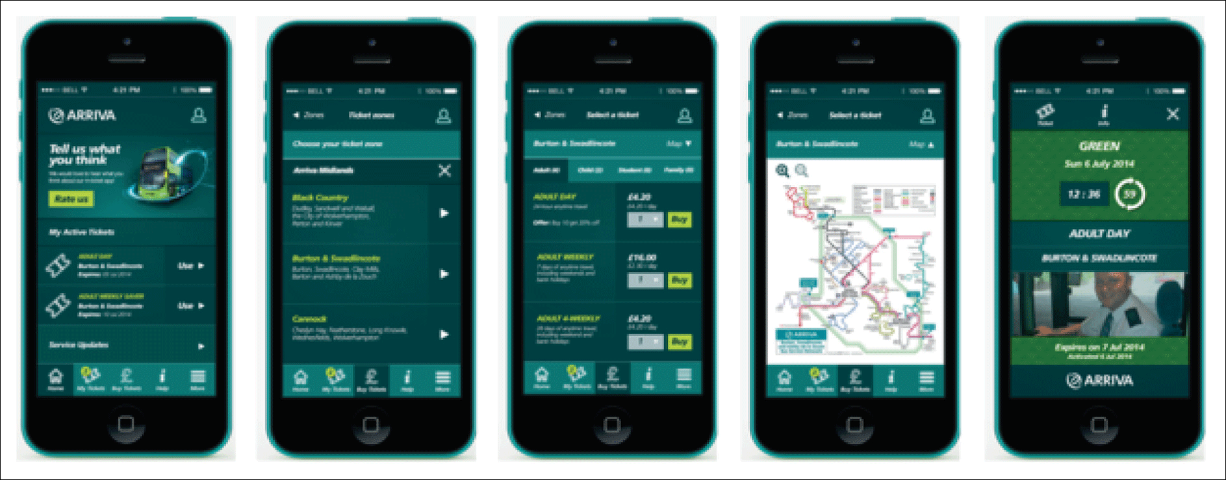
Figure 5.14 Arriva Bus app

Slide 38
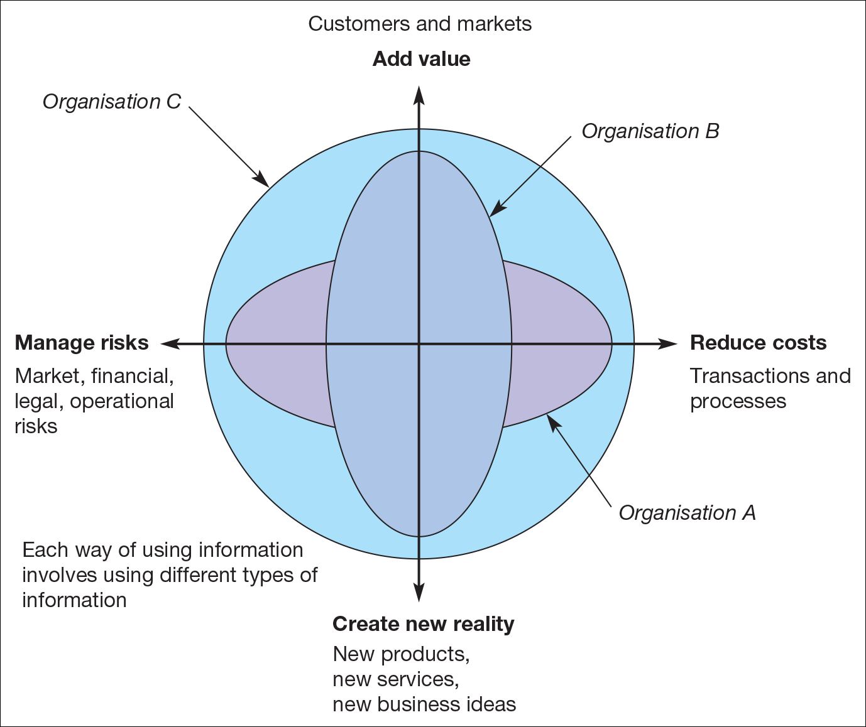
Figure 5.12 An evaluation tool relating information to business value. An organisation’s use of information on each axis can be assessed from 1 (low use of information) to 10 (high use of information)
Source: Marchand et al. (1999).

Slide 39
Objective Setting
An effective strategy development process links general goal, strategies and more specific objectives and performance measures.
One method of achieving this is tabulating goals, strategies to achieve goals and KPIs
All the objectives must follow SMART criteria to include both efficiency and effectiveness.
Efficiency – minimizing resources or time needed to complete a process: doing the thing right
Effectiveness – Meeting process objectives, delivering the required outputs and outcomes: doing the right thing

Slide 40
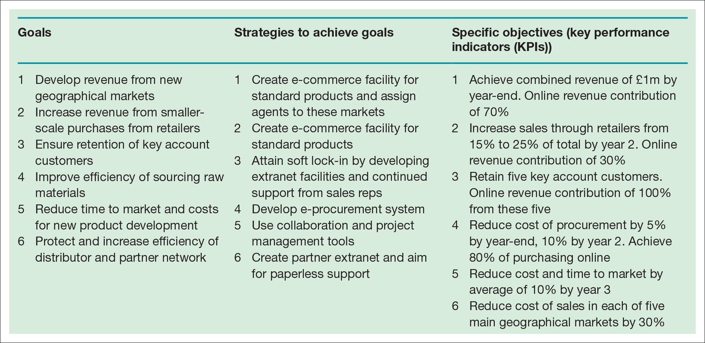
Table 5.6 Goals, strategies and objectives, performance indicators for an example
B2B company (in order of priority)

Slide 41
Objective setting
Online Revenue Contribution(ORC)
  This states the percentage of company revenue directly generated through online transactions.
  ORC can be set as an objective
  Indirect ORC is where the sale is influenced by the online presence, but purchase occurs using conventional channels.
  ORC can be set for different digital channels such as web or mobile commerce
Conversion marketing
  Using marketing communications to maximise conversion of potential customers to actual customers.

Slide 42
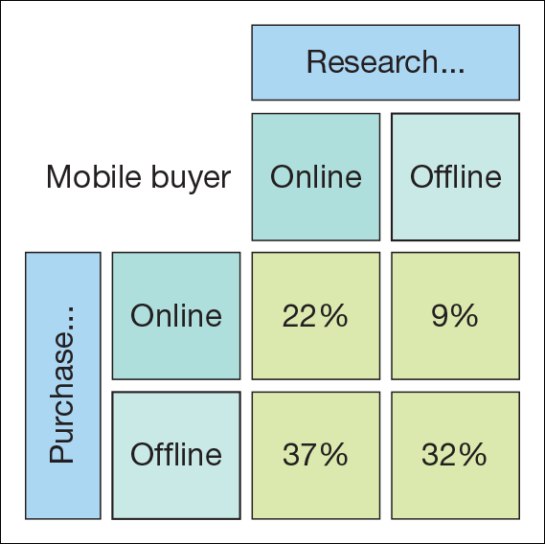
Figure 5.15 Research Online Purchase Offline example(ROPO)
Source: Google.

Slide 43
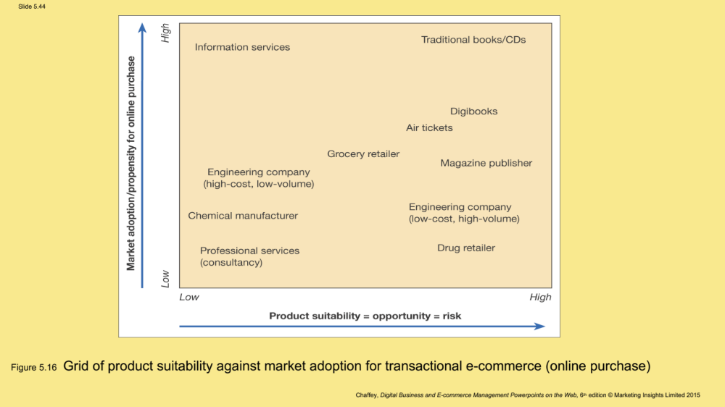
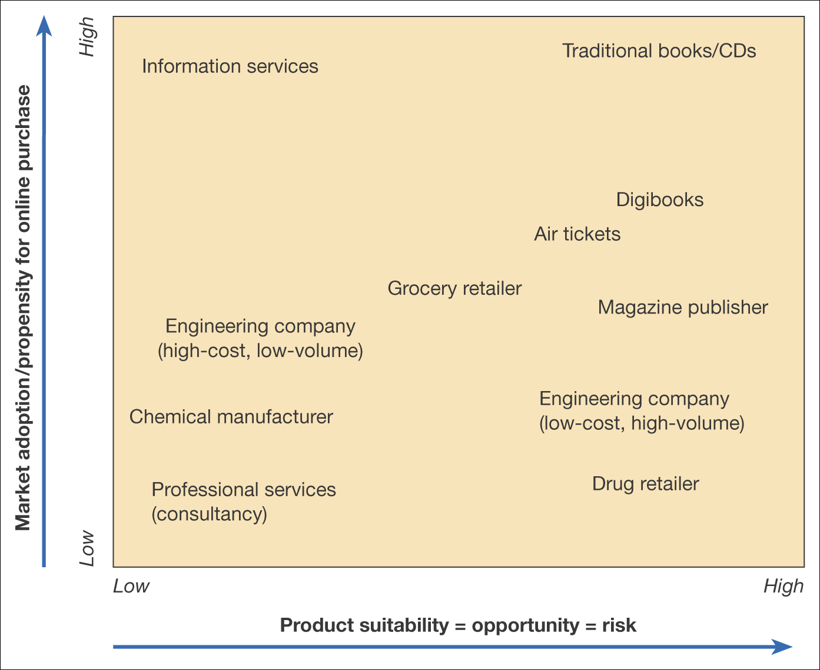
Figure 5.16 Grid of product suitability against market adoption for transactional e-commerce (online purchase)

Slide 44
Balanced Scorecard
Balanced Scorecard is a metrics/framework widely used as a means of translating organisational strategies into objectives and then providing metrics to monitor the execution of the strategy.
The main areas of the balanced scorecard are:
  Customer concerns – These include time, quality, performance, service and cost. Example, Halifax mystery shoppers
  Internal measures – Based on the business processes that have the greatest impact on customer satisfaction. Example, Halifax ATM availability
  Financial measures – traditional measures such as turnover, costs, profitability and return on capital. Example, Halifax gross receipts, mortgage offers, loans
  Learning and growth – Innovation and staff development.

Slide 45
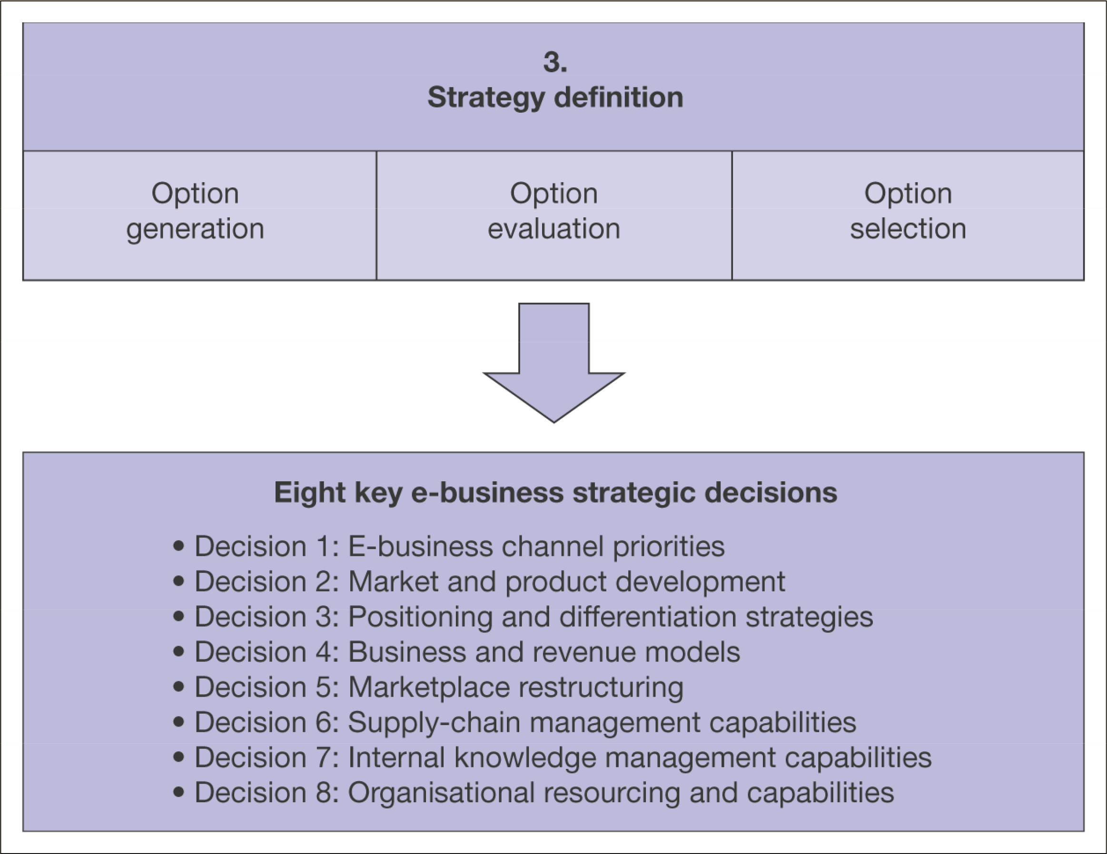
Strategy Definition:
Formulation, review and selection of strategies to achieve strategic objectives.
This is driven by the objectives and vision referred to in the previous sections.
Strategy is formulated based on vision and objectives, so it is necessary to frequently revisit and revise them
Figure 5.17 Elements of strategy definition for the digital business
Notes:
D1:Sell-side down stream(B2C) or Buy-side up stream.(B2B). For a multichannel businesses with offline and online stores, getting the right mix of ‘bricks and clicks’ as shown in the next slide
D2

Slide 46
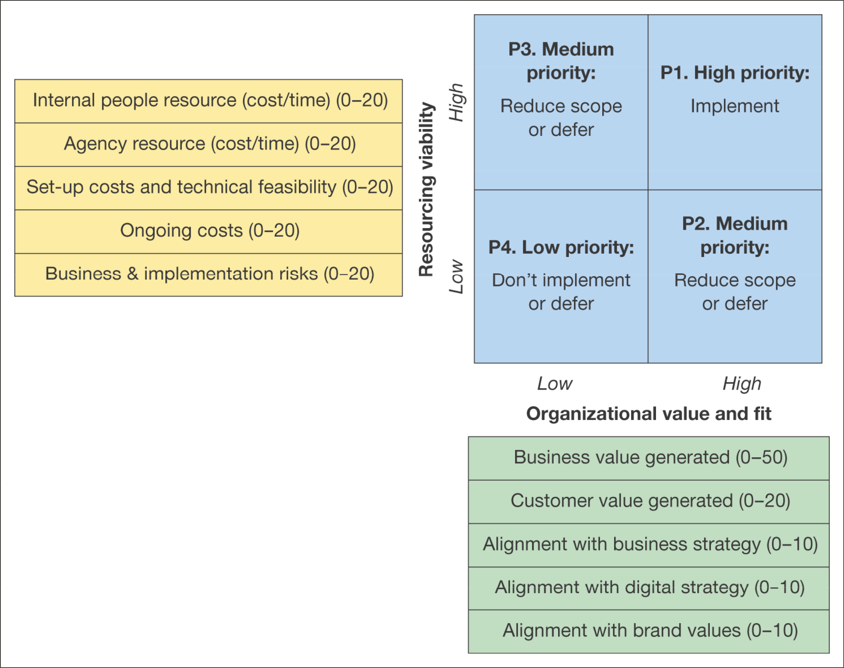
Portfolio Analysis:
Basis for bench marking current e-commerce capabilities and identifying strategic priorities
Figure 5.18 Matrix for evaluating digital business strategy alternatives
Source: E-consultancy (2008a)

Slide 47
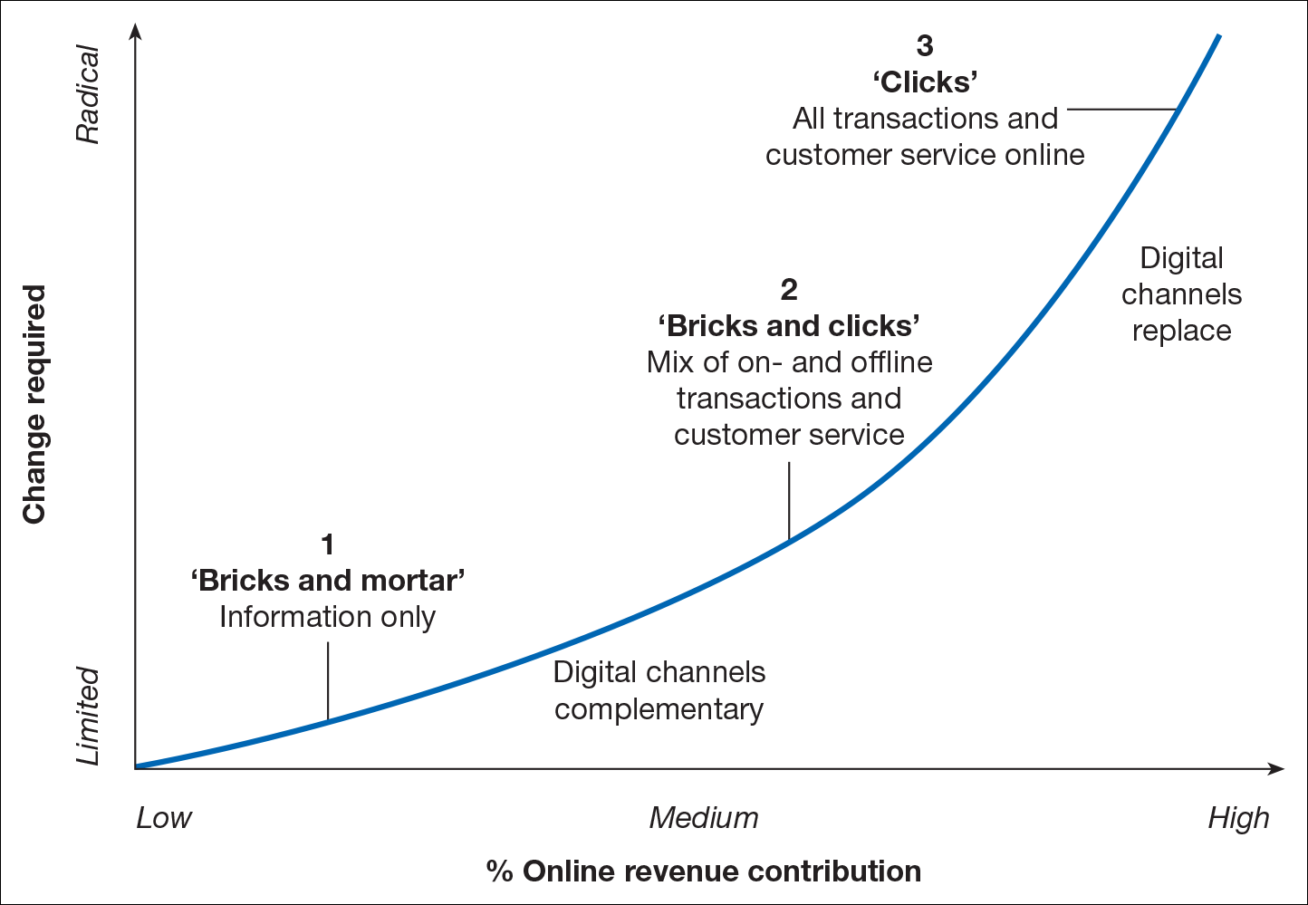
Eight key digital business strategic decisions
Decision 1:Digital business channel priorities
Figure 5.19 Strategic options for a company in relation to the importance of the Internet as a channel
Notes:
This slide is related with Decision 1
Diversification of digital platforms:
Investment and support for mobile applications
Investment in social media platform support

Slide 48
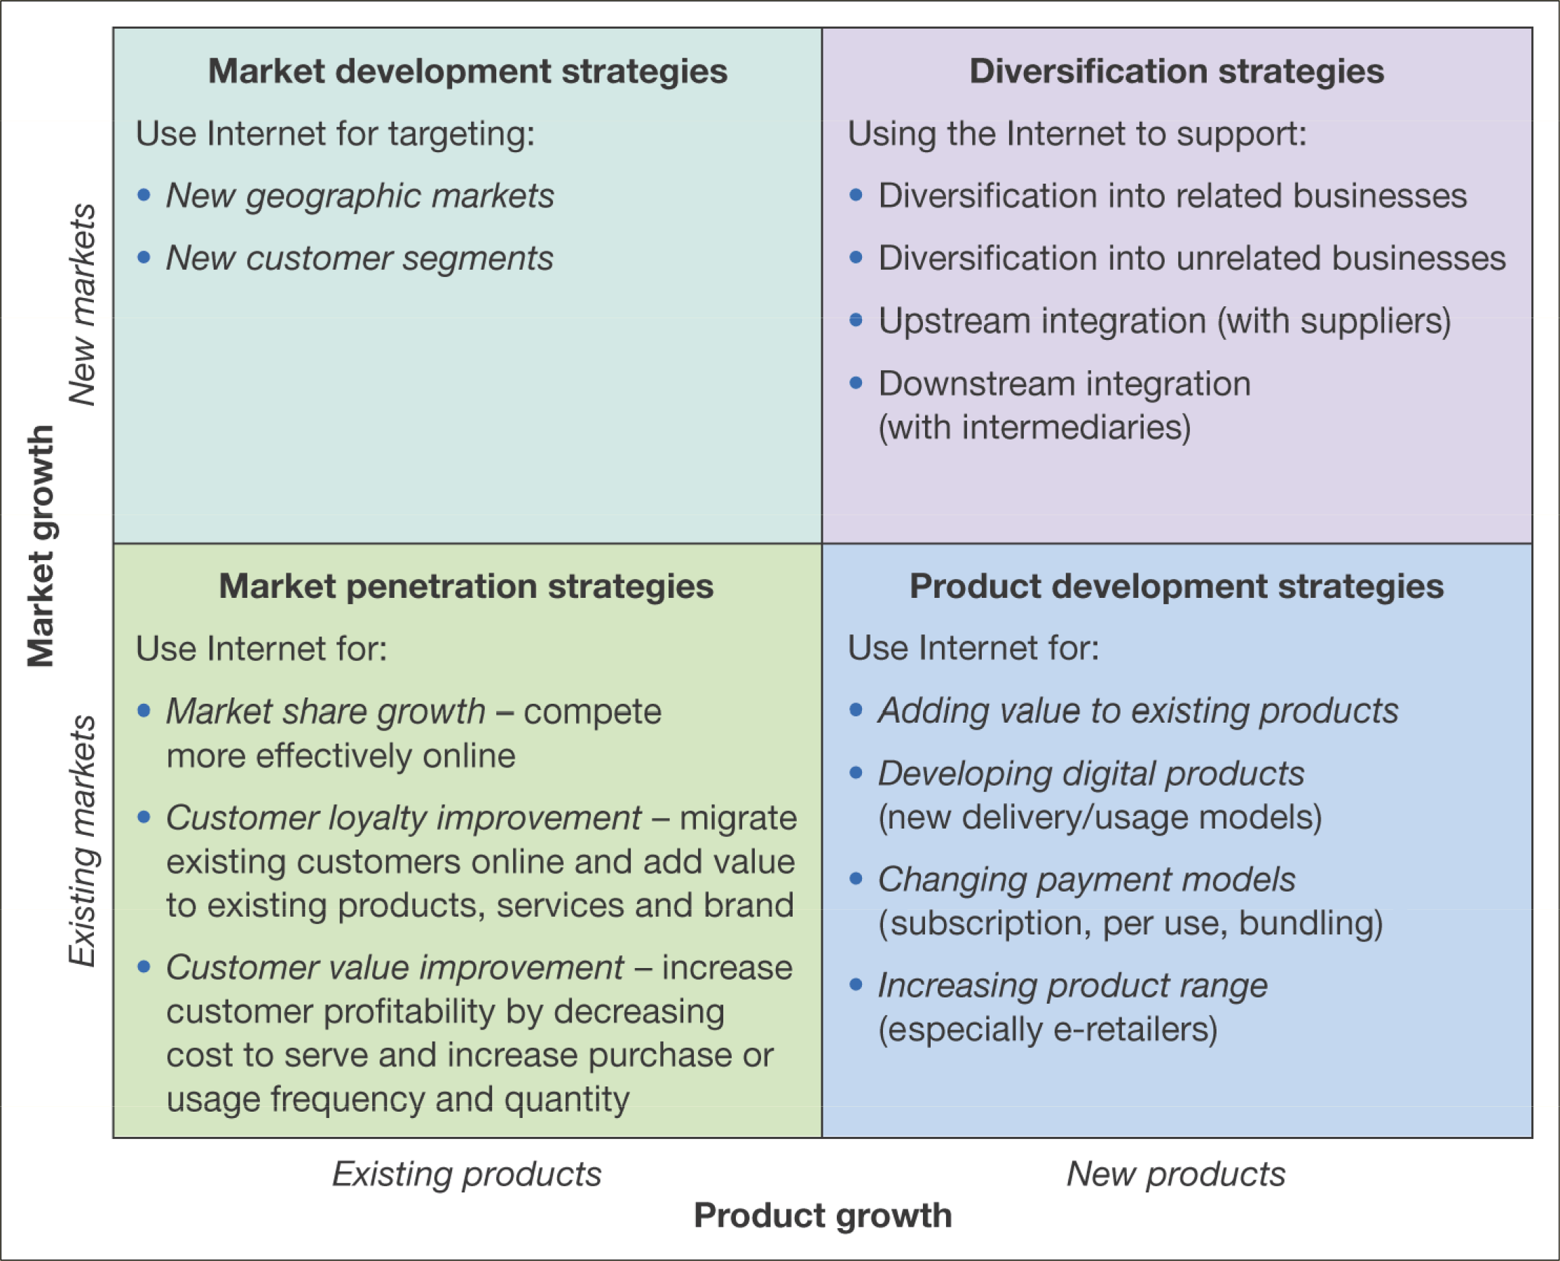
Eight key digital business strategic decisions
Decision 2:
Market and product development
Figure 5.20 Using the Internet to support different growth strategies
Notes:
This slide is related with decision 2

Slide 49
Eight key digital business strategic decisions
Decision 3: Positioning and differentiation strategies
  Once market segments have been identified from decision 2, organisations need to define how to best position their online services relative to competitors according to 4 main variable:
  Product quality,
  service quality,
  price and fulfilment time
  The above could be achieved by enhancing:
    Product performance excellence,
    Price performance excellence,
    Transactional excellence,
    Relationship excellence
Decision 4: Business, service and revenue models
  Constantly reviewing innovation in services to improve the quality of experience offered is also important for digital business

Slide 50
Eight key digital business strategic decisions
Decision 5: Marketplace restructuring
  Digital communications offer opportunities for new market structures to be created through
  disintermediation,
  reintermediation and
  Countermediation
Decision 6: Supply chain management capabilities
  How should we (company) integrate closely with our suppliers?
  Which types of materials and interactions with suppliers should we support through online procurement?
  Can we participate in digital marketplace to reduce costs?

Slide 51
Eight key digital business strategic decisions
Decision 7: Internal knowledge management capabilities
  How can our intranet be extended to support different business processes such as new product development, customer and supply chain management?
  How can we disseminate and promote sharing of knowledge between employees to improve our competitiveness?
Decision 8: Organisational resourcing and capabilities
  Once all the above 7 decisions have been reviewed and selected, decisions need to be made on how the organisation should change in order to achieve the priorities set for digital business

Slide 52
Eight key digital business strategic decisions
Decision 8: Organisational resourcing and capabilities
  Once all the above 7 decisions have been reviewed and selected, decisions need to be made on how the organisation should change in order to achieve the priorities set for digital business.
  Organisational resources and capability should be reviewed:
  Strategy process and performance improvement.
  Structure. Location of e-commerce, hardware, software, staff skills
  Senior management buy-in
  Marketing integration. Staff responsible for technology and marketing need to work together more closely to achieve this
  Digital marketing focus. Strategic initiatives will focus on customer acquisition, conversion, and retention
  Partnering with other organisations. Some services will be best delivered through other companies.

Slide 53
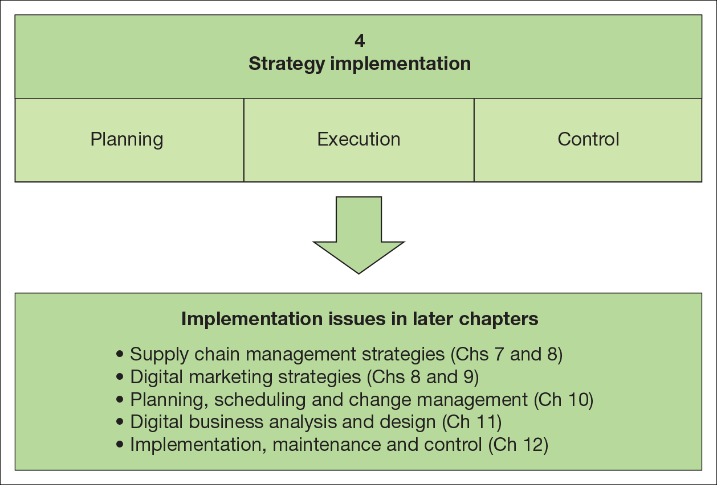
Figure 5.21 Elements of strategy implementation for the digital business

Slide 54
Boncheck, M. and Choudary S.P.(2013), Three elements of a Successful Platform Strategy. Harvard Business Review.
Hagel, J. (2015) The Power of Platforms. Accessed on 07 April 2020. Available at: https://www2.deloitte.com/global/en/insights/focus/business-trends/2015/platform-strategy-new-level-business-trends.html

