Slide 1
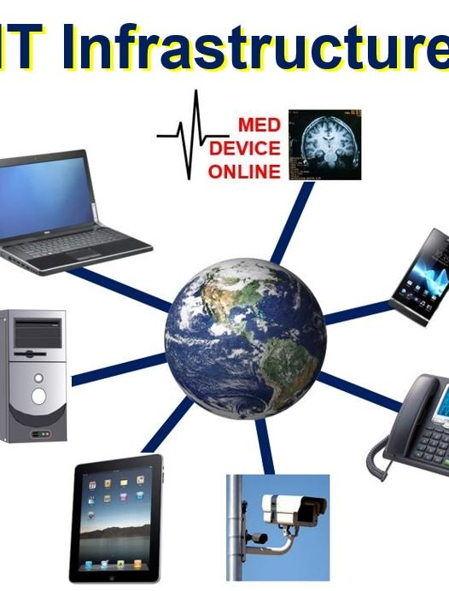
Chapter 3
Managing
digital
Business
infrastructure

Slide 2

Learning outcomes
Outline the range of hardware and software technologies used to build a digital business infrastructure within an organisation and with its partners
Review the management actions needed to maintain service quality for users of digital platforms

Slide 3
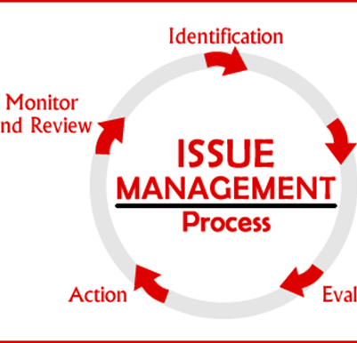
Management issues
What are the practical risks to the organisation of failure to manage the e-commerce infrastructure adequately?
How should we evaluate alternative models of delivering web services?

Slide 4

Why the jargon?
Why do business managers need to know about the jargon and technology?

Slide 5
Activity 3.1
Infrastructure risk assessment
Make a list of the potential problems for customers of an online retailer
You should consider problems faced by users
of e-business applications who are both internal and external to the organisation
Base your answer on problems you have experienced on a website that can be related
to network, hardware and software failures or problems with data quality.

Slide 6
Typical problems
Website communications too slow
Site is not viewable on mobile
Website not available
Bugs on site through pages being unavailable
or information typed in forms not being executed
Ordered products not delivered on time
E-mails not replied to
Customers’ privacy or trust is broken through security problems such as credit cards being stolen or addresses sold to other companies.

Slide 7
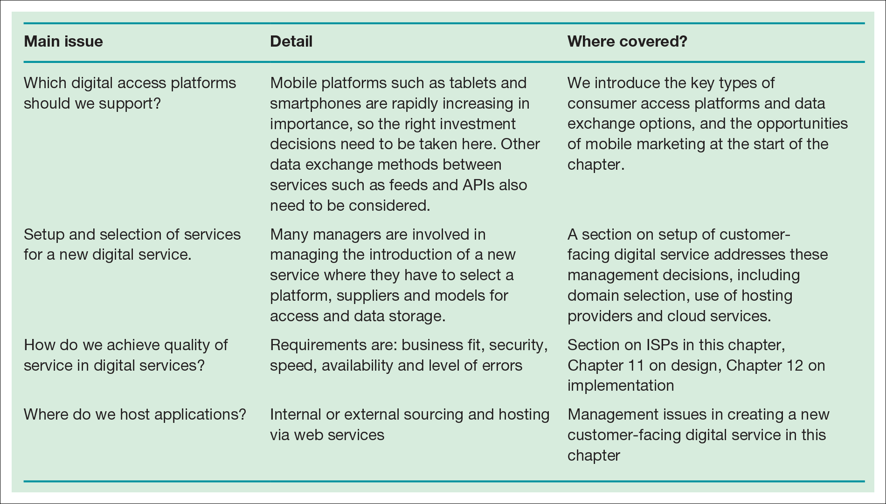
Table 3.1 Key management issues of digital business infrastructure

Slide 8
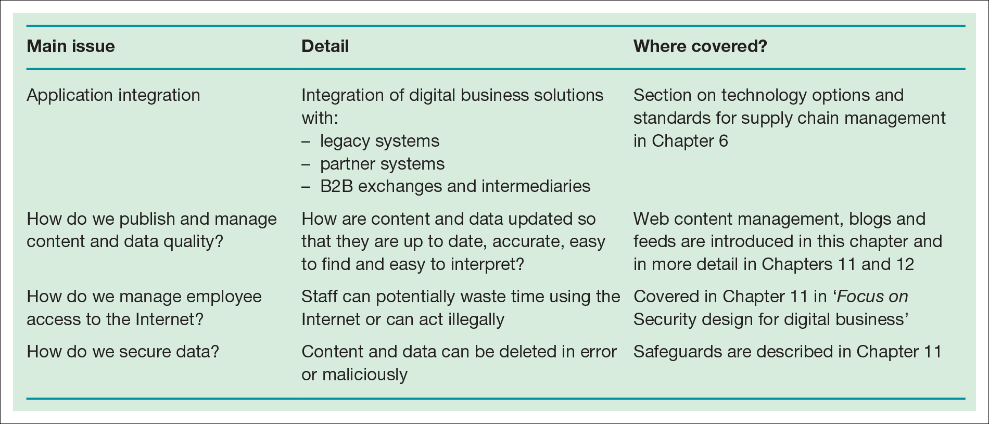
Table 3.1 Key management issues of digital business infrastructure (Continued)

Slide 9
Digital business infrastructure
The combination of hardware such as servers and clients’ computers and mobile devices, the network and the software applications used to deliver the services to workers within the business and also to its partners and customers.
This also includes the architecture of the networks, hardware and software and where it is located.
Can also be considered to include the methods of publishing data and documents accessed through applications

Slide 10
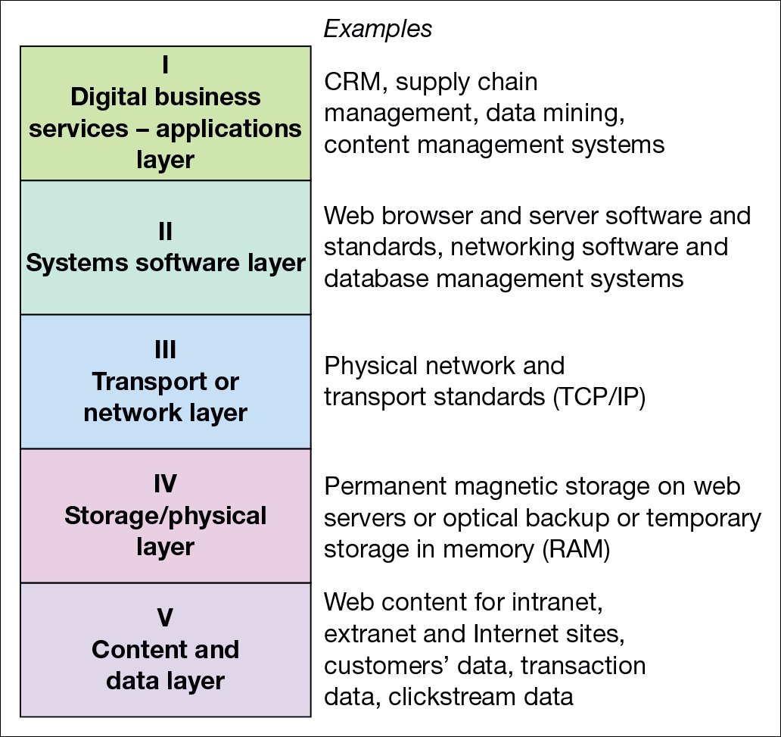
Figure 3.3 A five-layer model of digital business infrastructure

Slide 11
Activity
Internet infrastructure components
Can you write down all the different types of hardware
and software involved from when a user types
in a web address such as www.google.com to
the website being loaded?

Slide 12
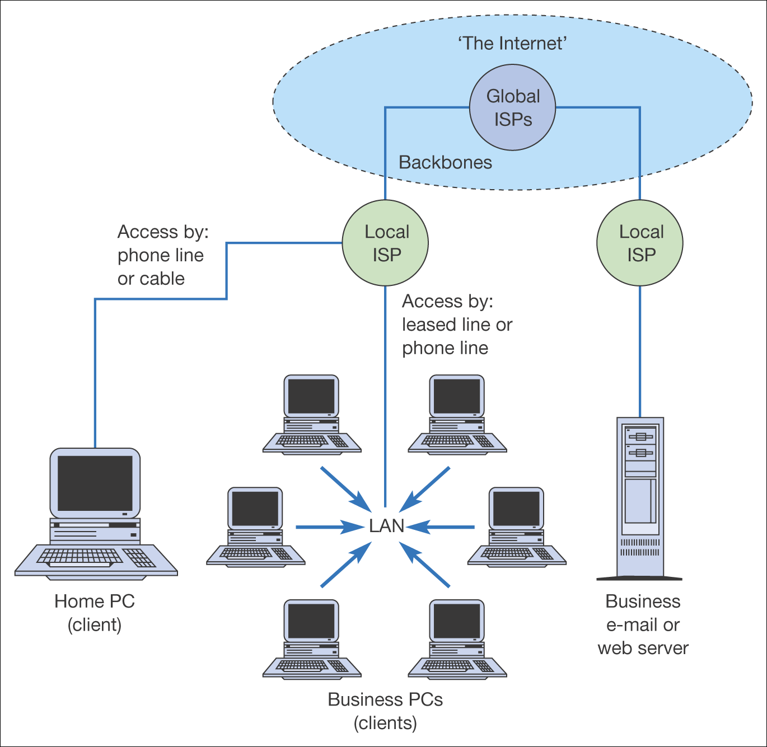
Figure 3.4 Physical and network infrastructure components of the Internet
(Levels IV and III in Figure 3.3)

Slide 13

Supporting the growing range of digital business technology platforms
For years, desktop and laptop have been dominant and are still important
However, mobile access has exceeded the above, though a growing range of mobile platforms.
Desktop browser-based platform
Desktop Apps
Email platforms
Feed-based and API data exchange platforms
Video-marketing platforms
Mobile operating system and browser
Mobile-based Apps

Slide 14
Other hardware platforms
Gaming platforms: PlayStation, Nintendo, Xbox
Indoor and outdoor kiosk-type apps: Interactive kiosks, augmented reality options.
Interactive signage: Closely related to kiosk apps, with touch-screens, Bluetooth, NFC or QR codes to encourage interaction.

Slide 15
Mobile access consumer proposition
No fixed location, Ubiquity
Location-based services
Instant access/convenience, latest 3G,4G,5G
Privacy
Personalisation
Security, Apple Pay, Android Pay

Slide 16
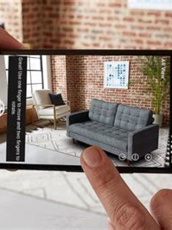
Augmented Reality(AR)
Blends real-world digital data captured typically with a digital camera or mobile phone to create a digital representation or experience mimicking that of the real word.
Lacoste used AR to allow shoppers to try-on trainers or sneakers in store without actually the real shoes on, and share the experience on social networks.
IKEA create an app that allowed users to see pieces of Ikea furniture in their own rooms by scanning a logo in the paper catalogue
Amazon Go, a real grocery shop

Slide 17
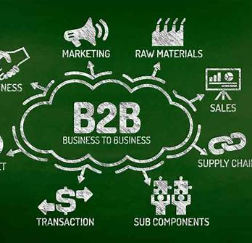
Activity 3.3
Overcoming limited use of intranets and extranets in a B2B company
A B2B company has found that after an initial surge of interest in its intranet and extranet, usage has declined dramatically. The
e-business manager wants to achieve these aims:
Increase usage.
Produce more dynamic content.
Encouraging more clients to order (extranet).
What would you suggest?

Slide 18
Suggested answers
Identify benefits
Involve staff with development
Find system sponsors, owners and advocates
Train on benefits
Keep content fresh, relevant and where possible, fun
Use e-mail to encourage usage.

Slide 19
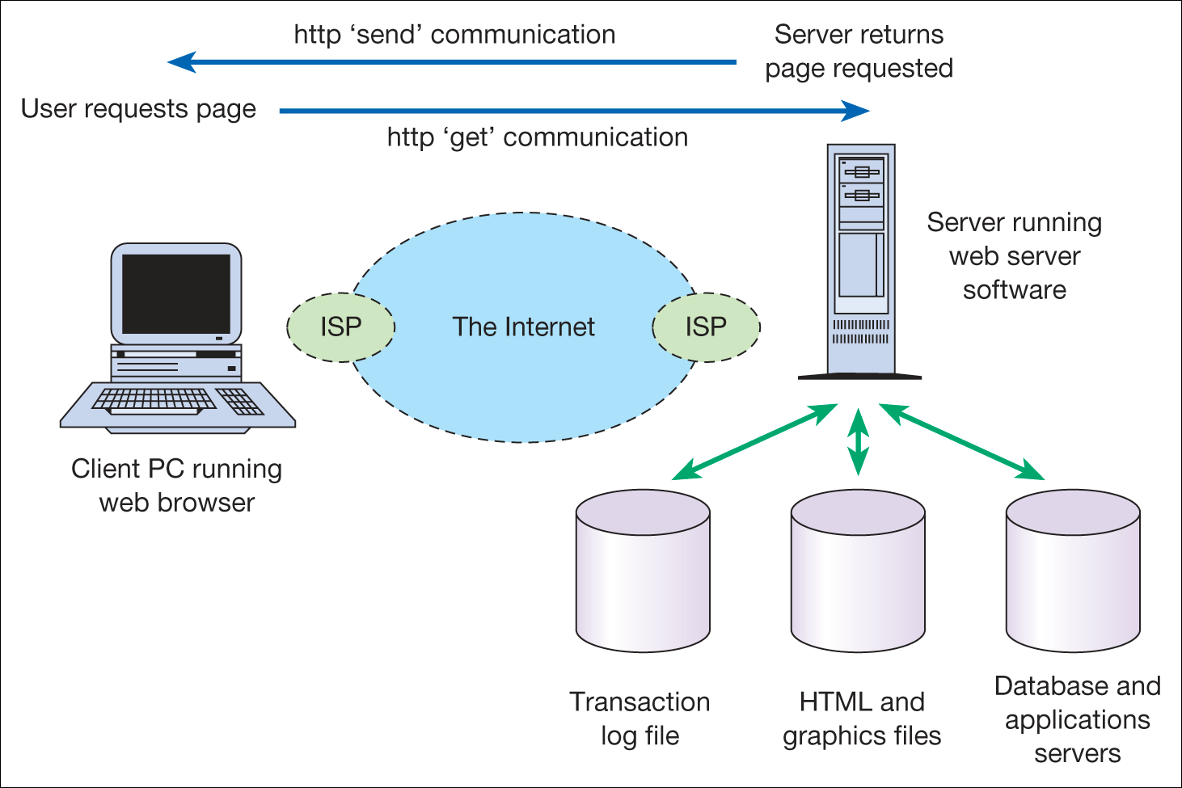
Information exchange between a web browser and a web server
Notes:
Place Figure 3.7 here

Slide 20
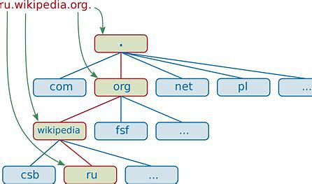
URLs and domain names
Web addresses are structured in a standard way as follows:
http://www.domain-name.extension/filename.html
What do the following extensions or global top level domains stand for?
  .com
  .co.uk, .uk.com
  .org or .org.uk
  .gov
  .edu, .ac.uk
  .int
  .net
  .biz
  .info

Slide 21
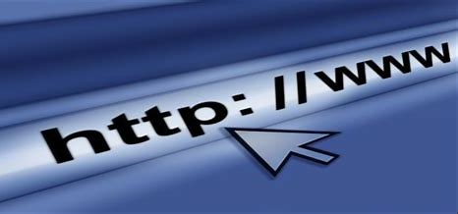
What’s in a URL?
Protocol
Host or hostname
Subdomain
Domain name
Top-level domain or TLD
Second-level domain (SLD)
The port
The path
URL parameter
Anchor or fragment
http://video.google.co.uk:80/videoplay?docid=7246927612831078230&hl=en#00h02m30s

Slide 22
Managing Digital Business applications infrastructure
Applications that provide access to services and information inside and beyond an organisation.
The main issue, which has been a concern for IS managers is to deliver access to integrated applications and data that are available across the whole company.
Traditionally, businesses have developed applications silos or islands of information as shown in the figure in the next slide.
These silos may develop at three different levels
There may be different technology architecture used in different functional areas.
There will be different applications and separate databases in different areas
Processes or activities followed in different functional areas may also be different.
Application silos are often a result of decentralization or poorly controlled investment in information systems, which can lead to more cost of purchase, maintenance and upgrade.
To avoid the above problems, many companies turned to ERP vendors such as SAP, Oracle and Peoplesoft etc.

Slide 23
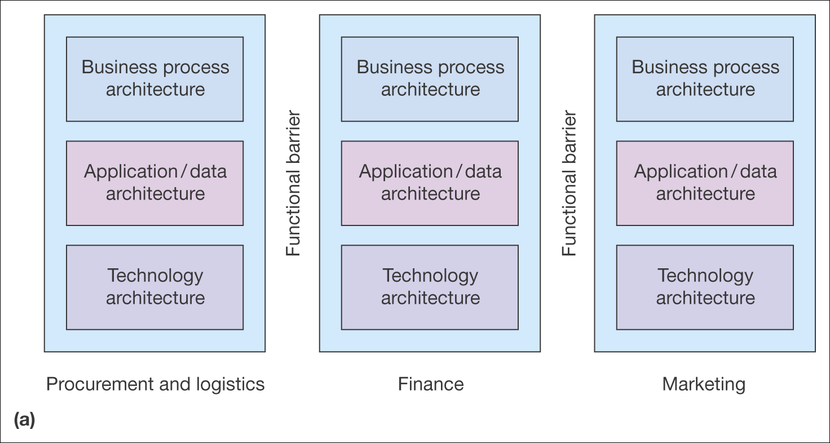
Figure 3.5 (a) Fragmented applications infrastructure
Source: Adapted from Hasselbring (2000).

Slide 24
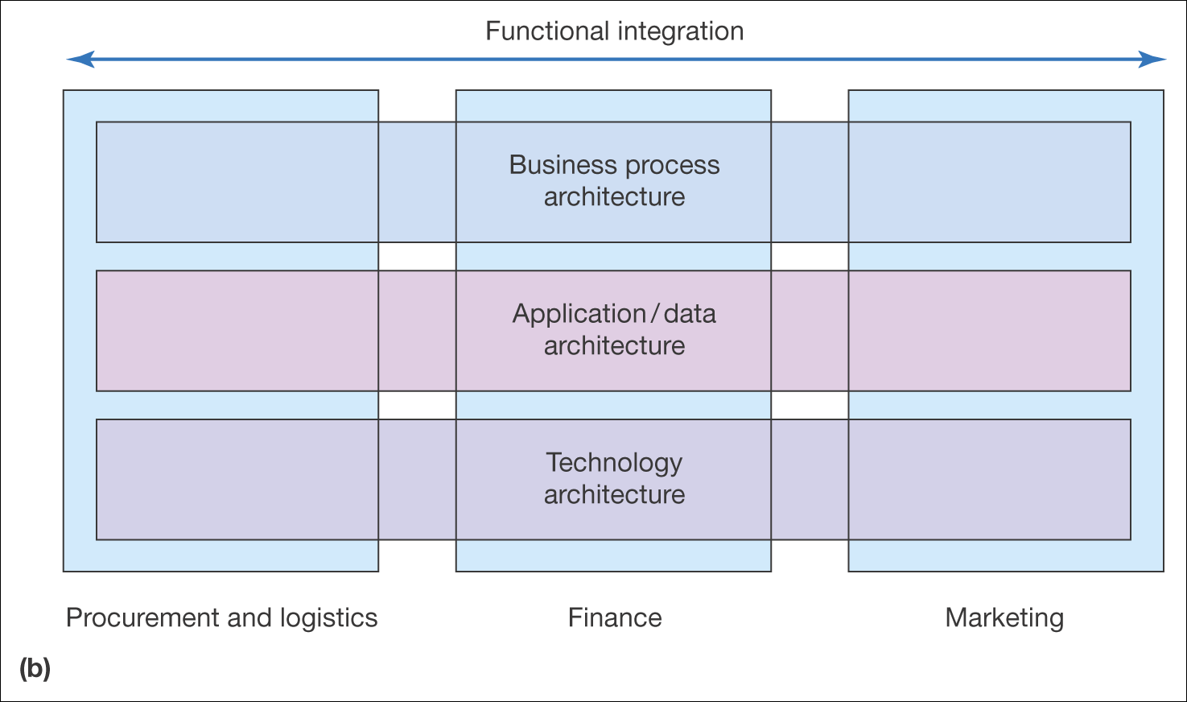
Enterprise Resource Planning(ERP) – SAP, PeopleSoft
Figure 3.5 (b) integrated applications infrastructure (Continued)
Source: Adapted from Hasselbring (2000)

Slide 25
Managing Digital Business applications infrastructure
The approach of integrating different applications through ERP is entirely consistent with the principle of digital business.
SAP has repositioned itself as a supplier of digital business solutions.
However, the difficulty is, a single ERP vendor cannot provide all innovative solutions.
ERP systems were originally focused on achieving integration at the operational level of an organisation.
Solutions for other applications such as BI in the form of data warehousing and data mining tended to focus on tactical decision-making based on accessing data from operational data from within ERP
Knowledge management software tends to cut across different levels of management as shown in the next slide.

Slide 26
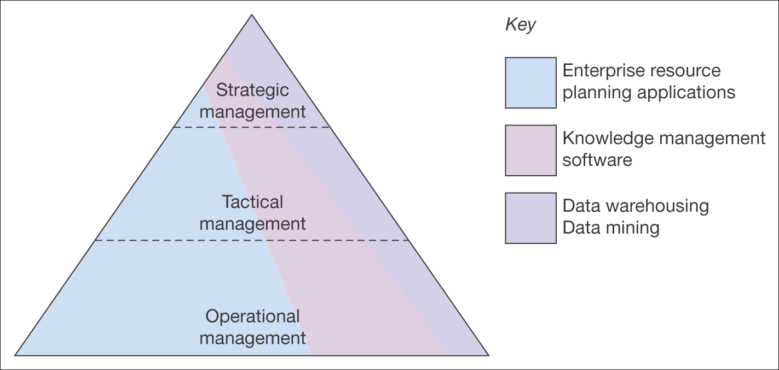
Figure 3.6 Differing use of applications at levels of management within companies

Slide 27
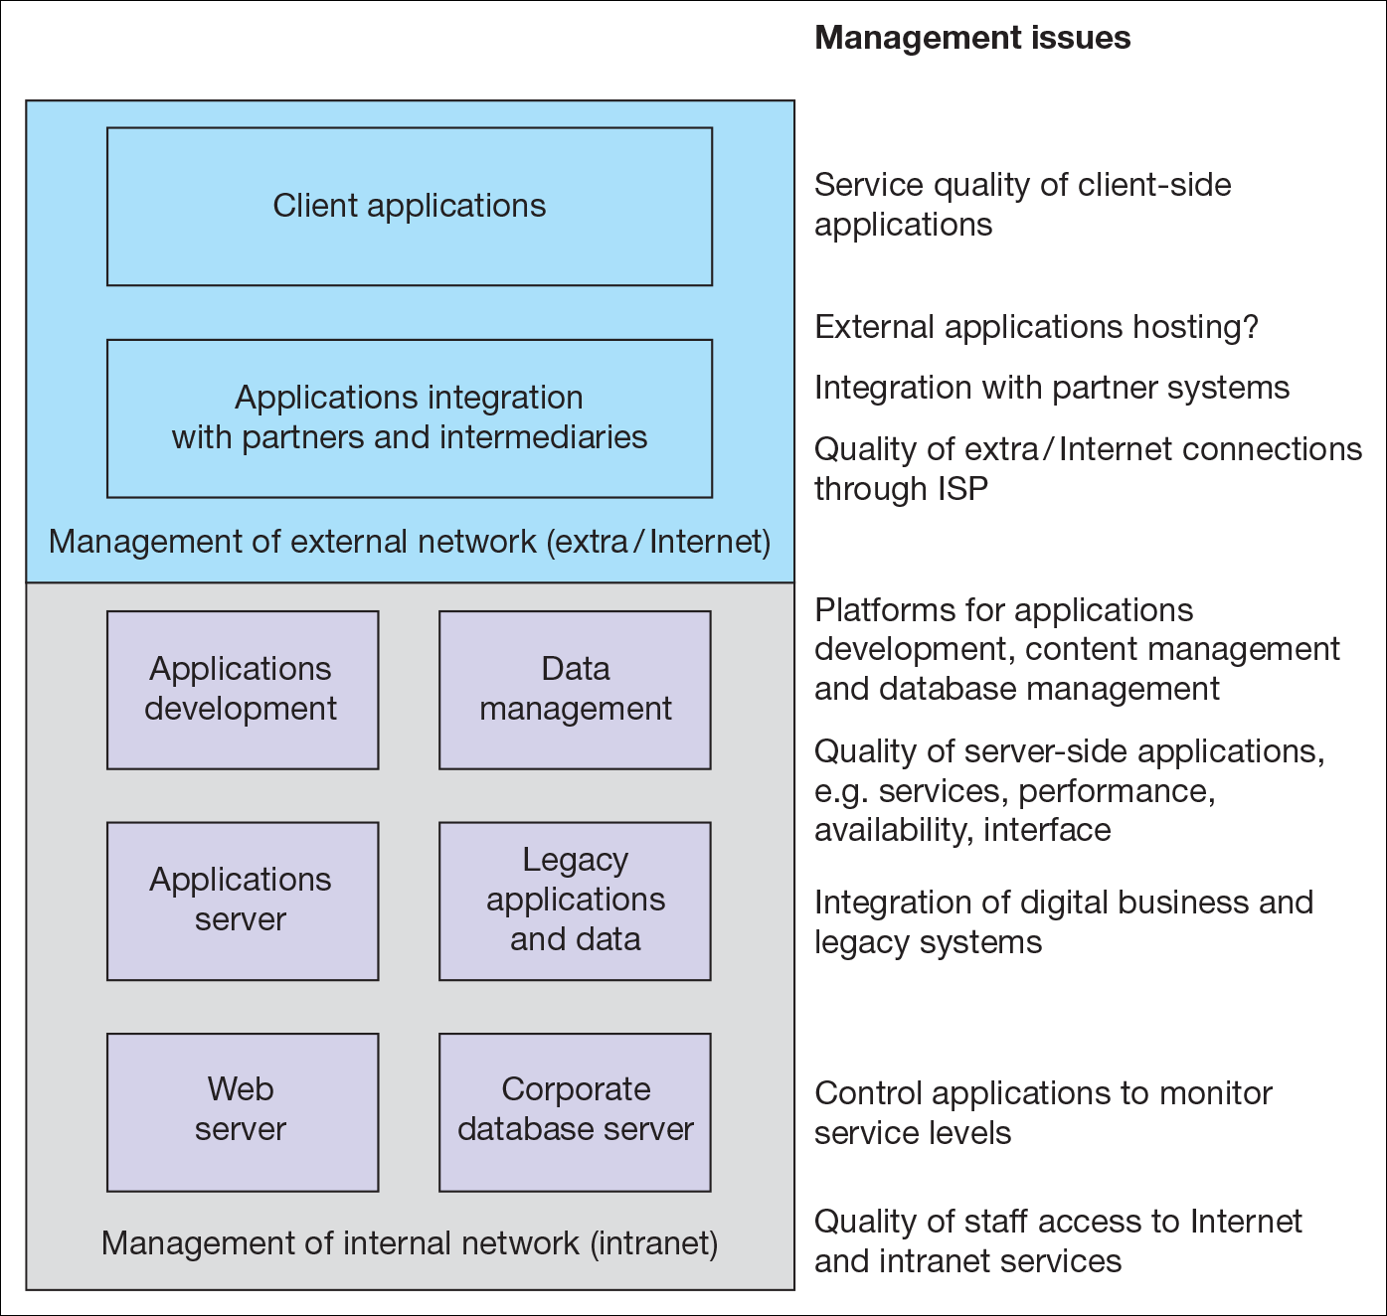
Figure 3.7 Elements of digital business infrastructure that require management(layered architecture)

Slide 28
Cloud Computing
The use of distributed storage and processing on servers connected by the Internet, typically provided as software or data storage as a subscription service provided by other companies.
Google revealed in March 2017, that it has spent $30 billion on data centres across the planet
Garner reported in 2016 that the estimated number of Google servers is around 2.5 million(Knowledge, 2017)

Slide 29
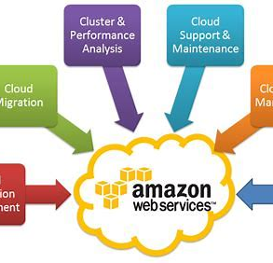
Cloud Computing Web services
Business applications and software services are provided through Internet and web protocols, with the application managed on a separate server from where it is accessed through a web browser on an end-user’s computer
Web mail readers
Google services such as Google Maps, Gmail, Google Analytics
Office application solutions, MSOffice365, Google Docs etc
Supply chain management solutions from SAP and Oracle
Social media services such as Facebook, Twitter, Instagram, Google+, Pinterest, Tumblr and LinkedIn.

Slide 30
Virtualisation
This is another approach to managing IT resources more effectively
It is mainly deployed within an organisation
VMWare is an example
Virtualisation has many benefits:
Running many operating systems on a single machine
Splits individual system resources between many virtual machines
Stops faults and security breaches at the hardware level
Maintains system performance

Slide 31
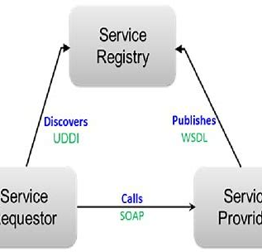
Service Oriented Architecture (SOA)
  SOA is a collection of services that communicate with each other as part of a distributed systems architecture comprising different services.
  This is an arrangement of software processes or agents that communicate with each other to deliver business requirements.
  The main role is to provide functionality, provided as:
    An interface with the service that is platform-independent
    The service, that can be dynamically located
    Service, that is self contained, that is not influenced by other services.

Slide 32
Semantic Web Standards
  The semantic web is a concept promoted by Sir Tim Berners-Lee and W3C to improve upon the capabilities of the current World Wide Web.
  Semantic web is an interrelated content including data with defined meaning, enabling better exchange of information between computers and between people and computers.
  The most visible application of the semantic web is Google’s Knowledge Graph, which it uses to improve and enhance search engine results for a user’s query

Slide 33
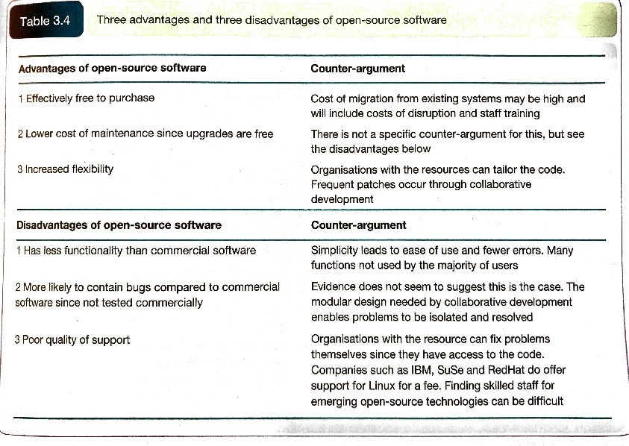
Open-source software
  Open-source software is developed collaboratively, independently of a vendor, by a community of software developers and users.

