Slide 1
Introduction to Computers

Slide 2
What Is A Computer?
A computer is an electronic device, operating under the control of instructions (software) stored in its own memory unit, that can accept data (input), manipulate data (process), and produce information (output) from the processing. Generally, the term is used to describe a collection of devices that function together as a system.

Slide 3
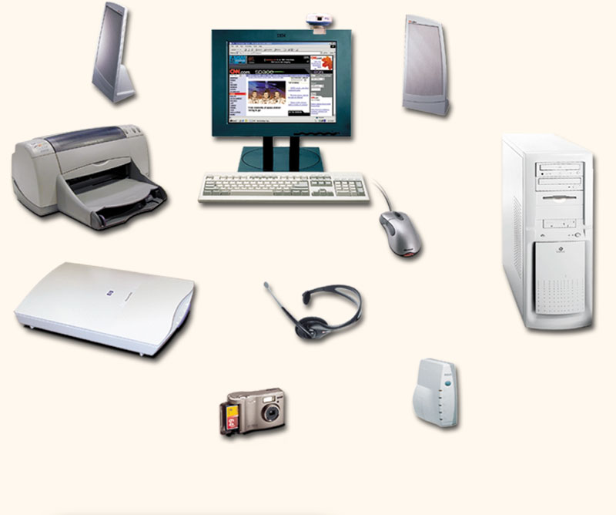
Devices that comprise a computer system
Monitor (output)
Speaker (output)
System unit
(processor, memory…)
Printer (output)
Storage devices
(CD-RW, Floppy, Hard disk, zip,…)
Mouse (input)
Scanner (input)
Keyboard (input)

Slide 4
What Does A Computer Do?
Computers can perform four general operations, which comprise the information processing cycle.
Input
Process
Output
Storage

Slide 5
What Do Computers Do?
Input, Process, Output, & Store data
Input
Process
Output
Store Data
Notes:
CEO: Intro to Computers
5

Slide 6
Data and Information
All computer processing requires data, which is a collection of raw facts, figures and symbols, such as numbers, words, images, video and sound, given to the computer during the input phase.
Computers manipulate data to create information. Information is data that is organised, meaningful, and useful.
During the output Phase, the information that has been created is put into some form, such as a printed report.
The information can also be put in computer storage for future use.

Slide 7
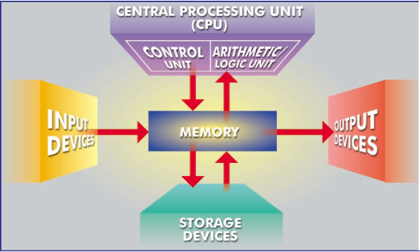
What Are The Primary Components Of A Computer ?
Input devices.
Central Processing Unit (containing the control unit and the arithmetic/logic unit).
Memory.
Output devices.
Storage devices.

Slide 8
Uses of Computer
Computers in Daily Life
Accounts
Games
Educational
On-line banking
Smart ID cards
Supermarkets
Working from home (Tele-working)
Internet

Slide 9
Types of Computers
Types of Computers
Microcomputer
Minicomputer
Mainframe
Supercomputer

Slide 10



Computer Input Devices
Keyboard
Mouse/Trackball
Joystick
Light pen
Pointing Stick
Touchpad
Touch screen
Bar code reader
Scanner
Microphone
Graphics Tablet
Digital Cameras

Slide 11
Computer Output Devices
Monitor: screen that display information such as text, numbers, and pictures-softcopy.
Printer: gives you information from the computer in printed form – hardcopy.
Speakers: allow you to hear voice, music, and other sounds from your computer.
Modem: allows you to use your computer to communicate with other computers.

Slide 12
The Parts of a Computer System
A complete computer system includes four distinct parts:
Hardware
Software
Firmware
User

