Slide 1

Technology in Action
15th Edition
Chapter 4
Application Software: Programs That Let You Work and Play
Notes:
If this PowerPoint presentation contains mathematical equations, you may need to check that your computer has the following installed:
1) MathType Plugin
2) Math Player (free versions available)
3) NVDA Reader (free versions available)

Slide 2
Learning Objectives (1 of 3)
4.1 Compare application software and system software.
4.2 Explain the differences between commercial software and open source software, and describe models for software distribution.
4.3 Explain the different options for purchasing software.
4.4 Describe how to install and uninstall software.
4.5 Explain the considerations around the decision to upgrade your software.
4.6 Explain how software licenses function.
Notes:
Slide 2 is a partial list of textbook Learning Objectives numbers and statements.

Slide 3
Learning Objectives (2 of 3)
4.7 Categorize the types of application software used to enhance productivity, and describe their uses and features.
4.8 Summarize the types of software that large and small businesses use.
4.9 Describe the uses and features of digital multimedia software.
4.10 Describe the uses and features of digital audio software.
Notes:
Slide 3 is a continued list of textbook Learning Objectives numbers and statements.

Slide 4
Learning Objectives (3 of 3)
4.11 Describe the features of app creation software.
4.12 Categorize educational and reference software and explain their features.
Notes:
Slide 4 is the final list of textbook Learning Objectives numbers and statements.

Slide 5
Software Basics Application vs. System Software (Objective 4.1)
Software: A set of instructions that tells the computer what to do
Two basic types of software
Application software
System software
Notes:
Software refers to instructions that tell the computer what to do.
Your computer has two basic types of software:
Application software is used to do tasks at home, school, and work.
System software helps run the computer and coordinate instructions between application software and the computer’s hardware devices.

Slide 6
Software Basics Distributing Software (Objective 4.2)
Ways software is created
Proprietary (Commercial)
Open-source (free)
Ways to distribute software
Local installation
Software as a Service (SaaS)
Subscription, fee for certain period of time, then it is free, for example, Adobe Creative Cloud
Notes:
There are two ways software is created:
Proprietary (commercial) software is created by companies for profit and then sold to you.
Open source software is software that is available free of charge and with few licensing and copyright restrictions.
There are various ways to distribute software:
Local installation
Software as a Service (SaaS)
Subscription

Slide 7
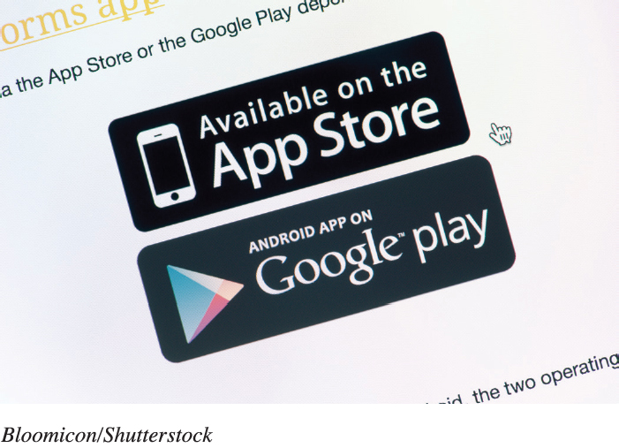
Managing Your Software Purchasing Software (Objective 4.3)
DVD from brick and mortar store
Downloading from the Internet (as purchase or subscription)
Student discounts
Freeware
Beta version
Notes:
Normally software can be acquired through a brick and mortar store or by downloading it from the Internet.
Students can often find discounted software.
Freeware is software that you do not have to pay for.
A Beta version is a trial version used to help the company debug its software.

Slide 8
Managing Your Software Installing and Uninstalling Software (Objective 4.4)
System requirements
Restore point
Full installation
Custom installation
Recovering from a computer crash
Uninstalling Software
Recovery drive
Notes:
Every program has a set of system requirements that specify the minimum recommended standards.
It is good to set a restore point before installing new software.
A full installation copies all the most commonly used files to your hard drive.
In custom installation, you decide which features you want installed.
Uninstalling software removes it from your hard drive.
Creating a Recovery drive helps to recover from a computer crash.

Slide 9
Managing Your Software Upgrading Software (Objective 4.5)
Not needed for subscriptions or SaaS
Is it cost effective?
Backwards compatibility
Notes:
Upgrades and updates are not required if you have a subscription to the software or are using software as a service.
There’s no need to rush out and buy the latest version of a software program every time one is available.
Vendors make new versions backward compatible, meaning that the new versions can recognize (open) files created with older versions.

Slide 10
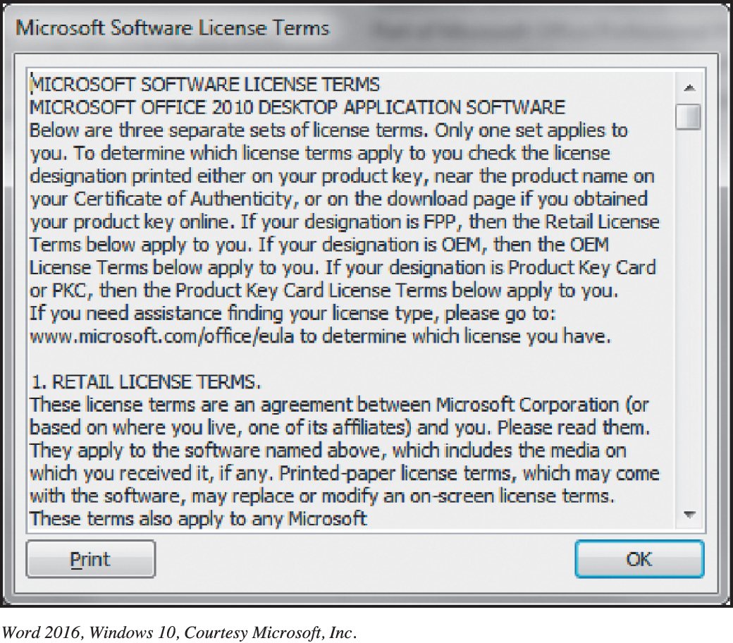
Managing Your Software Software Licenses (Objective 4.6)
End User License Agreement (EULA)
States the following:
Ultimate owner
Copies allowed
# of installations allowed
Warranties
Copyleft
Notes:
A software license, also known as an End User License Agreement, is an agreement between you, the user, and the software company.
Generally, the agreement states who the ultimate owner of the software is, under what circumstances copies of the software can be made, and whether the software can be installed on any other machine. Finally, the license agreement will state what, if any, warranty comes with the software.
This concept of redistributing modified open source software under the same terms as the original software is known as copyleft.

Slide 11
Productivity and Business Software Productivity Software (1 of 9) (Objective 4.7)
Lets you perform various tasks required at home, school, and business
Proprietary (Microsoft Office and Apple iWork)
Installed: Open Source (LibreOffice)
Web-Based (Microsoft Office Online, Google Docs, Zoho, and ThinkFree
Notes:
Productivity and business software lets you perform various tasks required at home, school, and business.
Proprietary (Microsoft Office and Apple iWork)
Installed: Open Source (LibreOffice)
Web-Based (Microsoft Office Online, Google Docs, Zoho, and ThinkFree

Slide 12
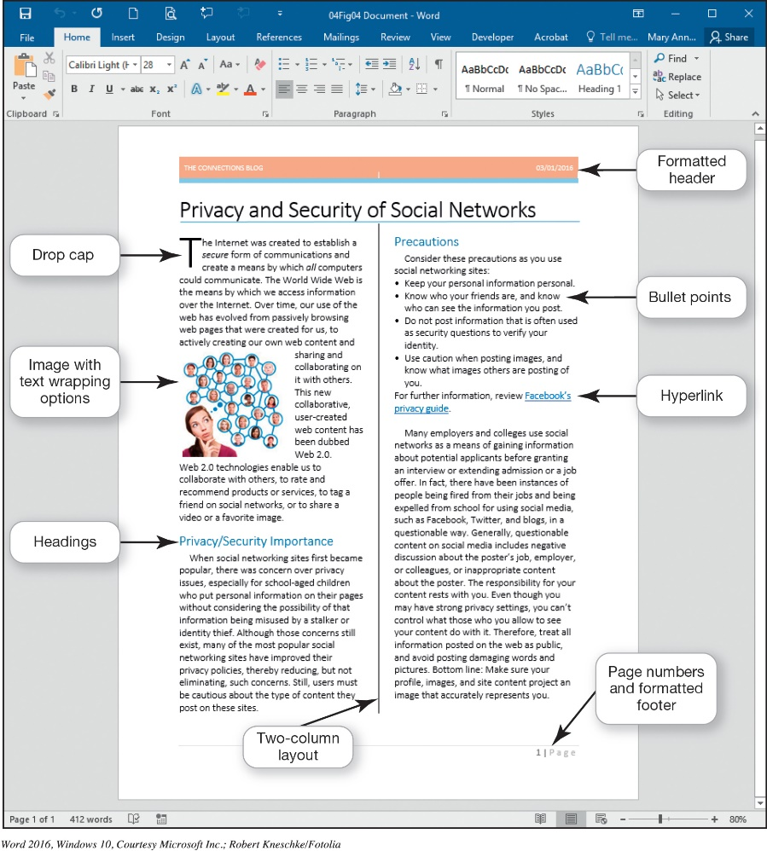
Productivity and Business Software Productivity Software (2 of 9) (Objective 4.7)
Word processing software
Create and edit documents for:
Research papers
Class notes
Résumés
Program Examples
Microsoft Word
Writer
Notes:
Word processing software is used to create and edit documents such as research papers, class notes, and resumes. Microsoft Word is the most popular word processing program that you can buy and install on your computer.
If you are looking for a more affordable alternative, you might want to try an open source alternative such as Writer, a word processing program from the Apache OpenOffice suite.

Slide 13
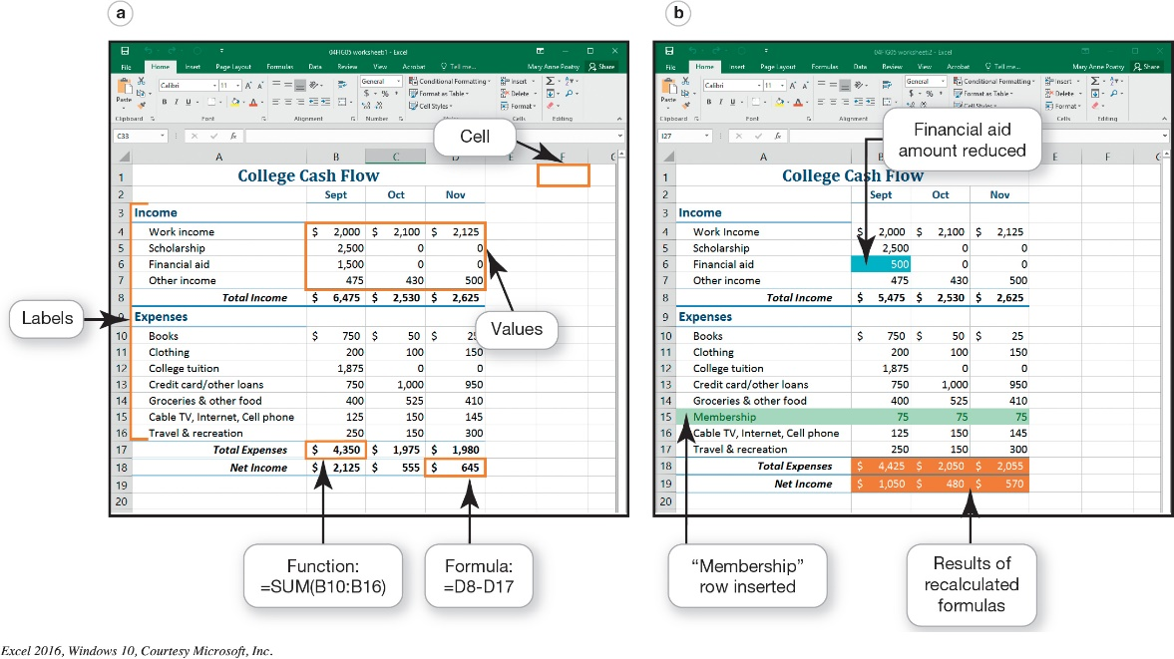
Productivity and Business Software Productivity Software (3 of 9) (Objective 4.7)
Spreadsheet software
Performs calculations and numerical analyses
Text
Values and dates
Formulas
Functions
Examples
Microsoft Excel
OpenOffice Calc
Notes:
Spreadsheet software lets you make calculations and perform numerical analyses.
Microsoft Excel and Apache OpenOffice Calc are two examples of spreadsheet software. One benefit of spreadsheet software is that it can automatically recalculate all formulas and functions in a spreadsheet when values for some of the inputs change.

Slide 14
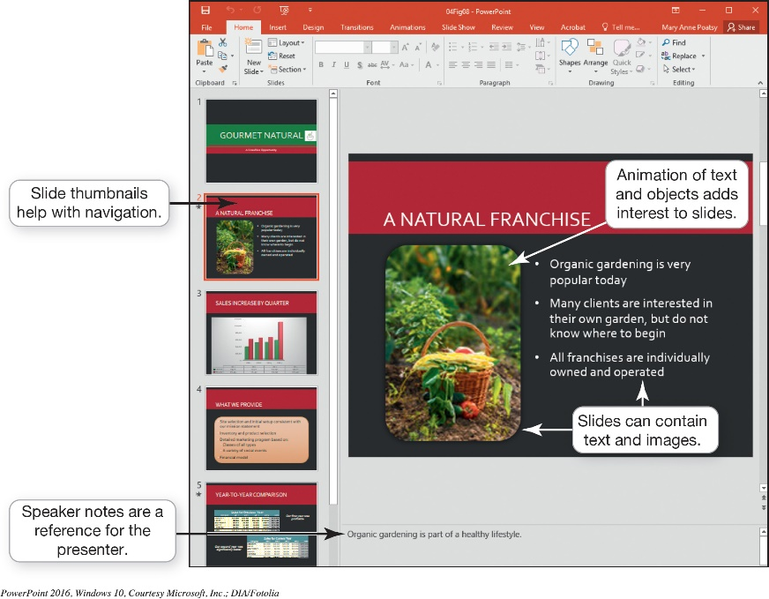
Productivity and Business Software Productivity Software (4 of 9) (Objective 4.7)
Presentation software
Tips for designing good presentations
Use images
Be careful with color
Use bullets for key points
Consider font size and style
Keep animation and background audio to a minimum
Notes:
Here are tips for designing good presentations:
Use images: Images can convey thoughts or illustrate points.
Be careful with color.
Use bullets for key points: the limit is four to six bulleted points per slide.
Consider font size and style: Keep the font size large enough to read from the back of the room.
Keep animation and background audio to a minimum.

Slide 15
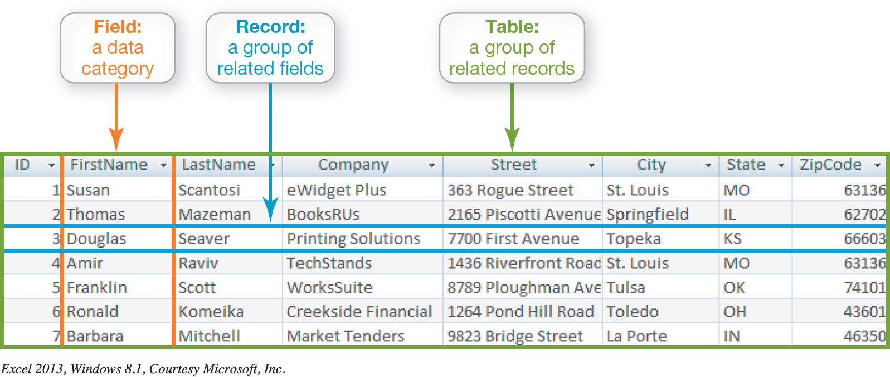
Productivity and Business Software Productivity Software (5 of 9) (Objective 4.7)
Database software
Store and organize data
Fields -> Records -> Tables
Notes:
Database software such as Oracle, MySQL, and Microsoft Access are powerful applications that let you store and organize data.
As mentioned earlier, spreadsheet applications are easy to use for simple tasks such as sorting, filtering, and organizing data.
Traditional databases are organized into fields, records, and tables.

Slide 16
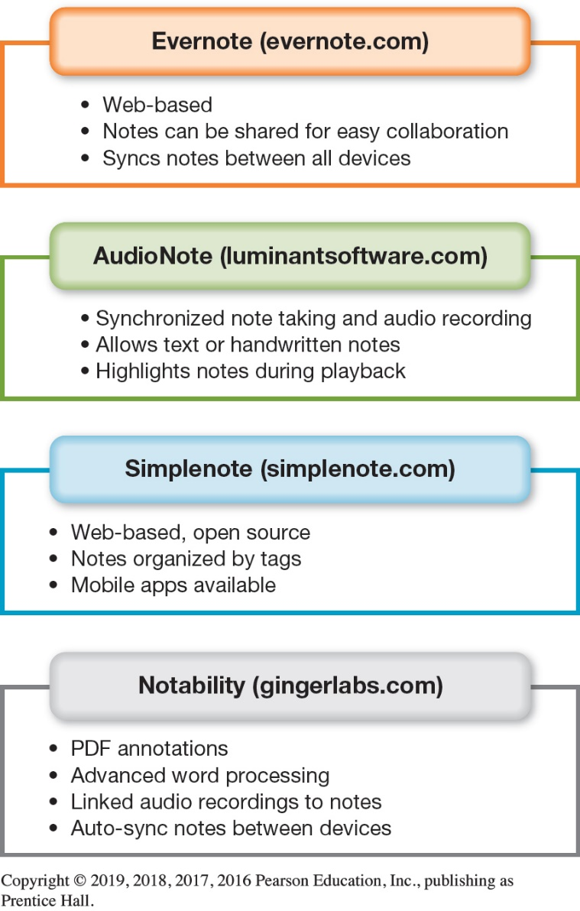
Productivity and Business Software Productivity Software (6 of 9) (Objective 4.7)
Note-Taking software
OneNote
Evernote
Notes:
Microsoft OneNote is a popular note-taking and organizational tool you can use for research, brainstorming, and collaboration.
You can organize notes into tabbed sections.
You can access notes from other Microsoft Office applications.
A free online option, Evernote, lets you take notes via the web, your phone, or your computer and then sync your notes between your devices. You can share your notes with other Evernote users for easy collaboration.

Slide 17
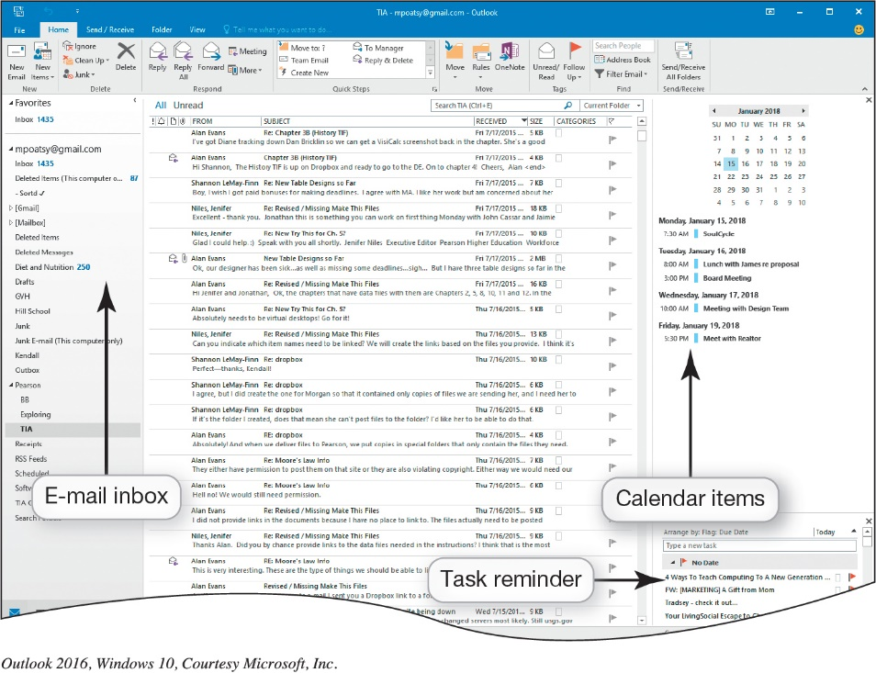
Productivity and Business Software Productivity Software (7 of 9) (Objective 4.7)
Personal Information Manager Software
Manage e-mail, contacts, calendars, and tasks
Web-based PIMs
Yahoo!
Google
Other options
Toodledo
OmniFocus
Notes:
Most productivity suites contain some form of personal information manager (PIM) software to help you manage e-mail, contacts, calendars, and tasks. Microsoft Outlook is the most widely used PIM program.
Yahoo! and Google also include coordinating calendars and contacts similar to Microsoft Outlook.
Toodledo is a free program that coordinates well with Microsoft Outlook, and OmniFocus is a more full-featured option for Mac devices.

Slide 18
Productivity and Business Software Productivity Software (8 of 9) (Objective 4.7)
Productivity software features
A wizard walks through the steps necessary to complete a task
A template is a predesigned form
A macro is a small program that groups a series of commands
Notes:
A wizard walks through the steps necessary to complete a task.
A template is a predesigned form.
A macro is a small program that groups a series of commands.

Slide 19
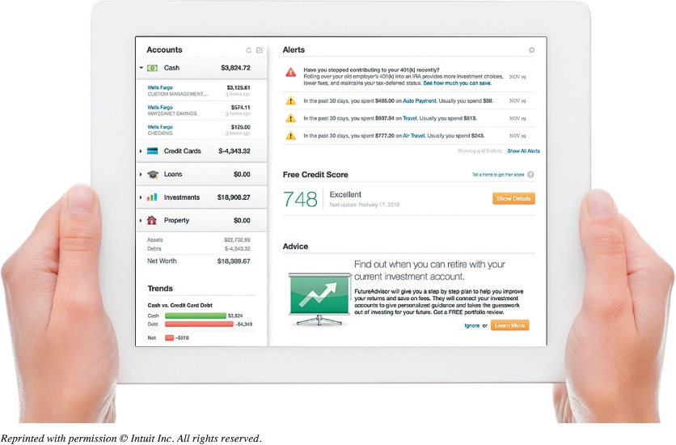
Productivity and Business Software Productivity Software (9 of 9) (Objective 4.7)
Personal Financial Software
Manage daily finances
Electronic checkbook registers
Automatic bill payment tools
Example, mint.com
Tax preparation software
Intuit TurboTax
H&R Block At Home
Notes:
Financial planning software helps you manage your daily finances.
Financial planning programs include electronic checkbook registers and automatic bill payment tools. With these features, you can make recurring monthly payments, such as rent or student loans, with automatically scheduled online payments.
Tax preparation software, such as Intuit Turbo Tax and H&R Block At Home, lets you prepare your state and federal taxes on your own.
Both Quicken and Mint integrate seamlessly with TurboTax.

Slide 20
Productivity and Business Software Business Software (1 of 2) (Objective 4.8)
Small business software
Accounting software
Track accounts receivable and payable
Inventory management, payroll, and billing
Desktop publishing (DTP) software
Design books and publications
Web authoring software
Design web pages
Notes:
Accounting software helps small business owners manage their finances more efficiently by providing tools for tracking accounts receivable and accounts payable. In addition, these applications offer inventory management, payroll, and billing tools.
If your business requires newsletters, catalogs, annual reports, or other large, complicated publications, consider using desktop publishing (DTP) software.
Web authoring software allows even a novice to design interesting and interactive web pages without knowing any HTML code.

Slide 21
Productivity and Business Software Business Software (2 of 2) (Objective 4.8)
Software for Large and Specialized Businesses
Vertical market software is designed for a specific industry
Computer-aided design (CAD) creates automated designs, technical drawings, and 3D model visualizations
Home or landscape planning
SketchUp Make
Notes:
Vertical market software is designed for a specific industry.
Computer-aided design (CAD) create automated designs, technical drawings, and 3D model visualizations.
Home or landscape planning can be used in designing home improvements.
SketchUp Make is an example of this type of software.

Slide 22
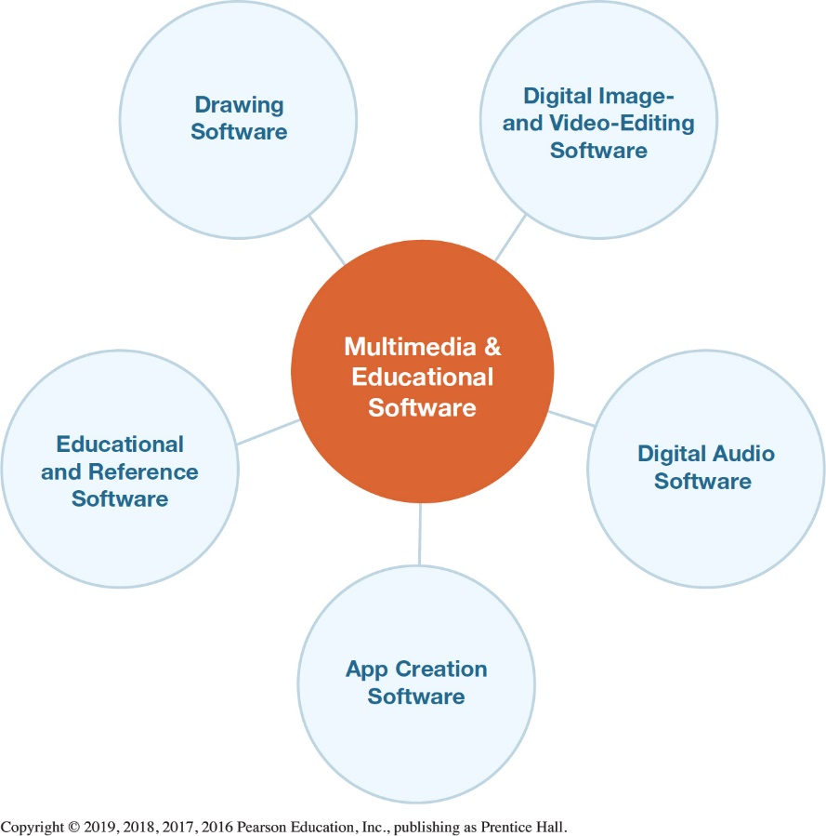
Multimedia and Educational Software Digital Multimedia Software (1 of 2) (Objective 4.9)
Multimedia software
Required to produce computer games, animations, and movies
Photo and image editing software used to edit photos
Digital video-editing software used to refine videos
Notes:
Multimedia software is required to produce computer games, animations, and movies.
Photo and image editing software are used to edit photos.
Digital video-editing software is used to refine videos.

Slide 23
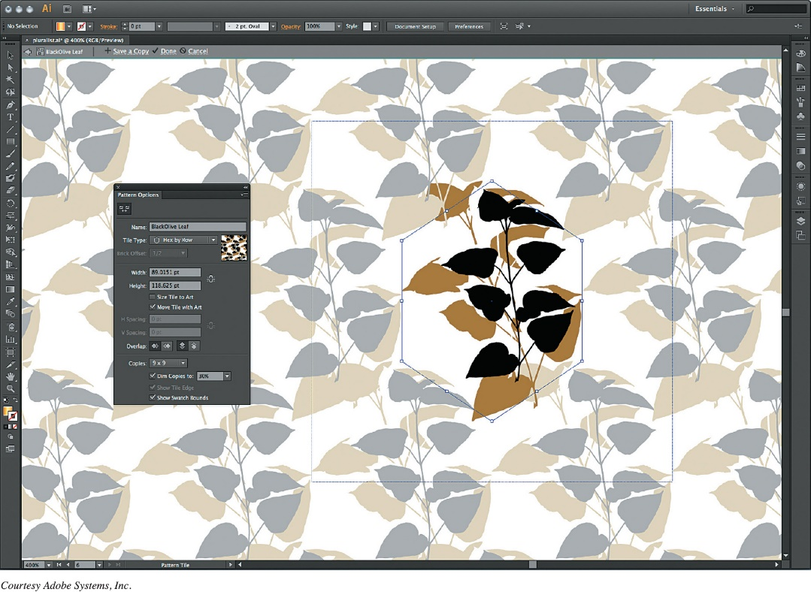
Multimedia and Educational Software Digital Multimedia Software (2 of 2) (Objective 4.9)
Drawing software lets you create:
Two-dimensional, line-based drawings
Technical diagrams
Animations
Professional-level
Adobe Illustrator
Notes:
Drawing software lets you create or edit 2-D, line-based drawings. You can use it to create technical diagrams or original nonphotographic drawings, animations, and illustrations using standard tools.
Adobe Illustrator includes tools that let you create professional-quality creative and technical illustrations.
There are many software packages to help plan the layout of homes and landscapes, such as those offered by Broderbund.

Slide 24
Multimedia and Educational Software Digital Audio Software (Objective 4.10)
Digital audio files
Downloaded music files, audiobooks, or podcasts
Compressed:
MP3(MPEG – Motion Pictures Expert Group,
AAC (Advanced Audio Coding),
WMA (Windows Media Audio)
Uncompressed: WAV(Waveform Audio), AIFF(Audio Interchange File Format)
Digital audio workstation software, lets you create individual tracks to build songs, sound tracks, with virtual instruments, voice recorders, synthesizers etc.
Audio-editing software, like Audacity (audacity.sourceforge.net)
Notes:
Digital audio files, such as downloaded music files, audiobooks, or podcasts, may be stored on your computer.
MP3 is the most common audio compression format, but there are other compressed formats, such as AAC and WMA.
You might also see uncompressed audio files on your computer, such as WAV and AIFF files.
Digital audio applications let you create and record your own audio files.
Audio-editing software includes tools that make editing audio files easy.

Slide 25
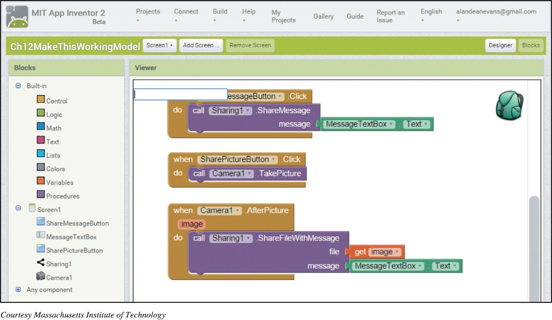
Multimedia and Educational Software App Creation Software (Objective 4.11)
App Inventor, Scratch from MIT are open source
Create characters to extend a game
EverQuest, Oblivion, Unreal Tournament
Create your own games
Unity, Adobe Flash, RPG Maker VX, GameMaker
Notes:
You can use the editors and game engines available for games such as EverQuest, Oblivion, and Unreal Tournament to create custom levels and characters to extend the game.
Multimedia applications such as Unity, Adobe Flash, and RPG Maker VX provide the tools you need to explore game design and creation. The program GameMaker is a free product that lets you build a game without any programming.

Slide 26
Multimedia and Educational Software Educational and Reference Software (Objective 4.12)
Educational and Reference Software: A Sample
Test Preparation
Simulation
Instructional
Trip Planning
Home design/Improvement
Course Management
Brain Training
Genealogy
Notes:
Educational and Reference Software: A Sample
Test Preparation
Simulation
Instructional
Trip Planning
Home design/Improvement
Course Management
Brain Training
Genealogy

Slide 27
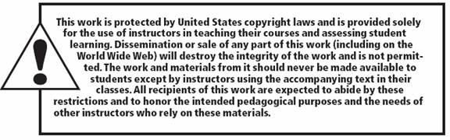
Copyright
All rights reserved. No part of this publication may be reproduced, stored in a retrieval system, or transmitted, in any form or by any means, electronic, mechanical, photocopying, recording, or otherwise, without the prior written permission of the publisher. Printed in the United States of America.

