Slide 1
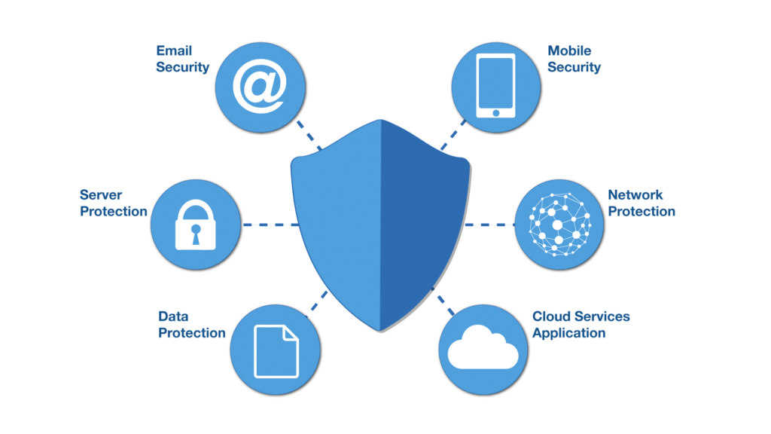
Computer and Network Security

Slide 2
What security is about in general?
Security is about protection of assets
D. Gollmann, Computer Security, Wiley
Prevention
take measures that prevent your assets from being damaged (or stolen)
Detection
take measures so that you can detect when, how, and by whom an asset has been damaged
Reaction
take measures so that you can recover your assets

Slide 3

Real world example
Prevention
locks at doors, window bars, secure the walls around the property, hire a guard
Detection
missing items, burglar alarms, closed circuit TV
Reaction
attack on burglar (not recommended ☺), call the police, replace stolen items, make an insurance claim

Slide 4

Internet shopping example
Prevention
encrypt your order and card number, enforce merchants to do some extra checks, using PIN even for Internet transactions, don’t send card number via Internet
Detection
an unauthorized transaction appears on your credit card statement
Reaction
complain, dispute, ask for a new card number, sue (if you can find of course ☺)
Or, pay and forget (a glass of cold water) ☺

Slide 5
Information security in past & present
Traditional Information Security
keep the cabinets locked
put them in a secure room
human guards
electronic surveillance systems
in general: physical and administrative mechanisms
Modern World
Data are in computers
Computers are interconnected
Computer and Network Security
Notes:
Traditionally information security provided by physical (eg. rugged filing cabinets with locks) and administrative mechanisms (eg. Personnel screening procedures during hiring process).
Growing computer use implies a need for automated tools for protecting files and other information stored on it.
This is especially the case for a shared system, such as a time-sharing system, and even more so for systems that can be
accessed over a public telephone network, data network, or the Internet.

Slide 6
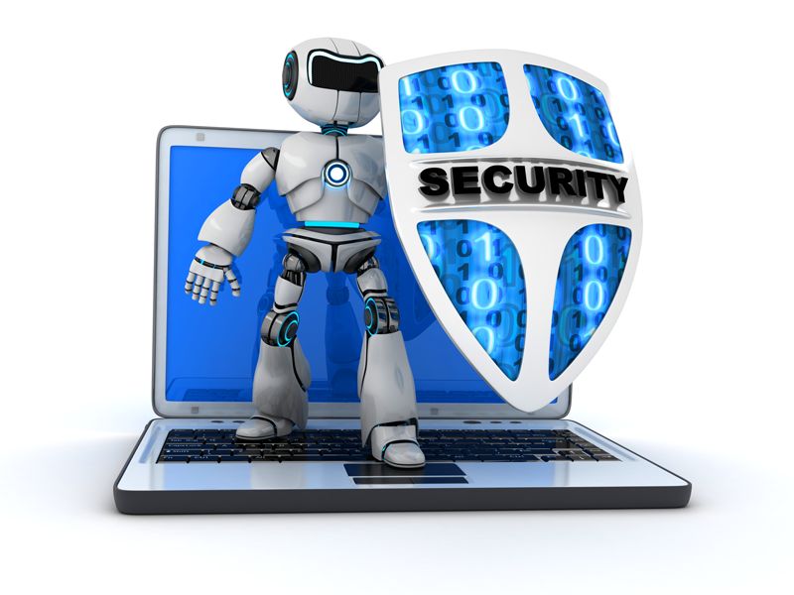
Terminology
Computer Security
2 main focuses: Information and Computer itself
tools and mechanisms to protect data in a computer (actually an automated information system), even if the computers/system are connected to a network
tools and mechanisms to protect the information system itself (hardware, software, firmware, *ware ☺)
Against?
against hackers (intrusion)
against viruses
against denial of service attacks
etc. (all types of malicious behavior)

Slide 7
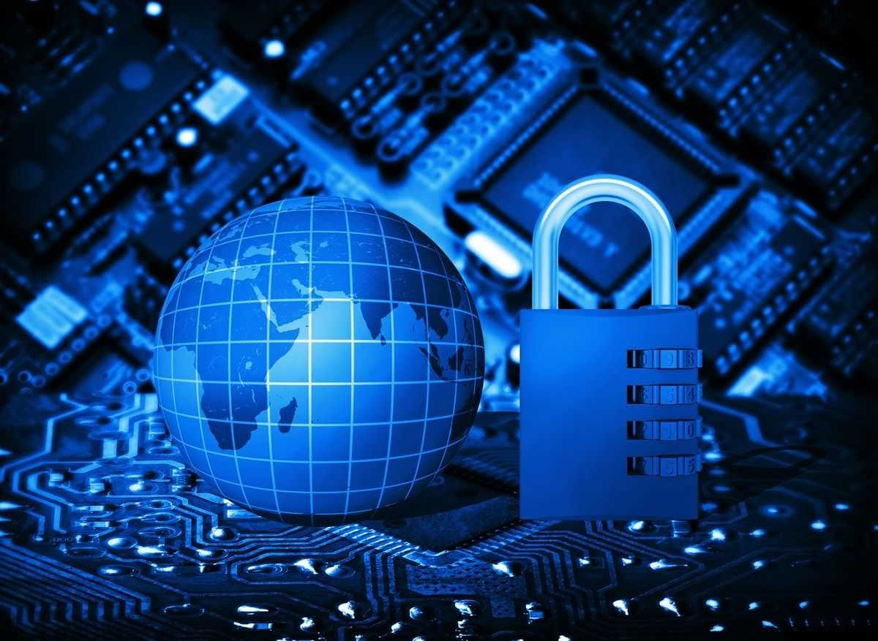
Terminology
Network and Internet Security
measures to prevent, detect, and correct security violations that involve the transmission of information in a network or interconnected networks

Slide 8
Computer Security Objectives
Confidentiality
Data confidentiality
Assures that private or confidential information is not made available or disclosed to unauthorized individuals
Privacy
Assures that individuals control or influence what information related to them may be collected and stored and by whom and to whom that information may be disclosed
Integrity
Data integrity
Assures that information changed only in a specified and authorized manner
System integrity
Assures that a system performs its intended function in an unimpaired manner, free from deliberate or inadvertent unauthorized manipulation of the system
Availability
Assures that systems work promptly and service is not denied to authorized users
Notes:
This definition introduces three key objectives that are at the heart of computer
security:
• Confidentiality: This term covers two related concepts:
Data confidentiality: Assures that private or confidential information is
not made available or disclosed to unauthorized individuals.
Privacy: Assures that individuals control or influence what information
related to them may be collected and stored and by whom and to whom
that information may be disclosed.
•Integrity: This term covers two related concepts:
Data integrity: Assures that information and programs are changed only in
a specified and authorized manner.
System integrity: Assures that a system performs its intended function in
an unimpaired manner, free from deliberate or inadvertent unauthorized
manipulation of the system.
• Availability: Assures that systems work promptly and service is not denied to
authorized users.

Slide 9
Additional concepts:
Authenticity
Verifying that users are who they say they are and that each input arriving at the system came from a trusted source
Accountability
Being able to trace the responsible party/process/entity in case of a security incident or action.
Notes:
Although the use of the CIA triad to define security objectives is well established,
some in the security field feel that additional concepts are needed to present
a complete picture. Two of the most commonly mentioned are as follows:
• Authenticity: The property of being genuine and being able to be verified and
trusted; confidence in the validity of a transmission, a message, or message
originator. This means verifying that users are who they say they are and that
each input arriving at the system came from a trusted source.
• Accountability: The security goal that generates the requirement for actions
of an entity to be traced uniquely to that entity. This supports nonrepudiation,
deterrence, fault isolation, intrusion detection and prevention, and after action
recovery and legal action. Because truly secure systems are not yet an
achievable goal, we must be able to trace a security breach to a responsible
party. Systems must keep records of their activities to permit later forensic
analysis to trace security breaches or to aid in transaction disputes.

Slide 10
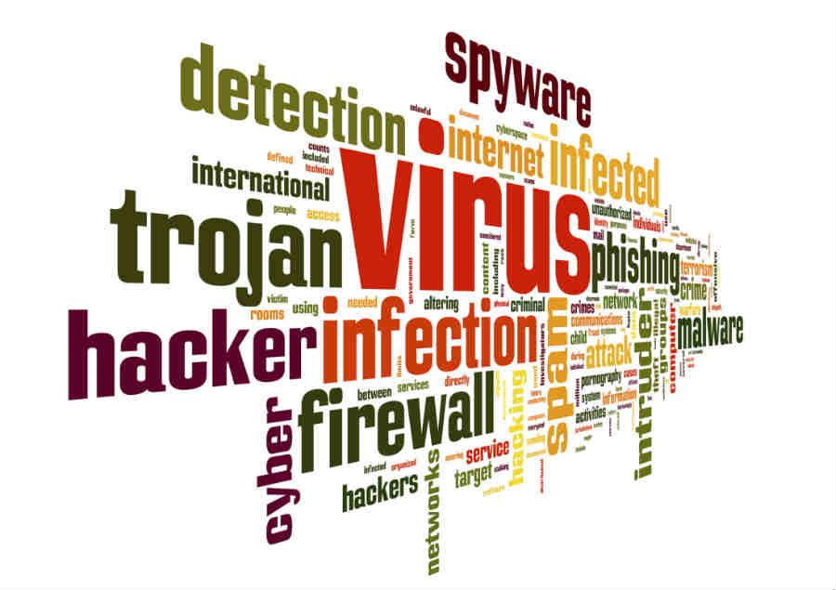
Attacks
Attacks on computer systems
break-in to destroy information
break-in to steal information
blocking to operate properly
malicious software
wide spectrum of problems
Source of attacks
Insiders
Outsiders

Slide 11
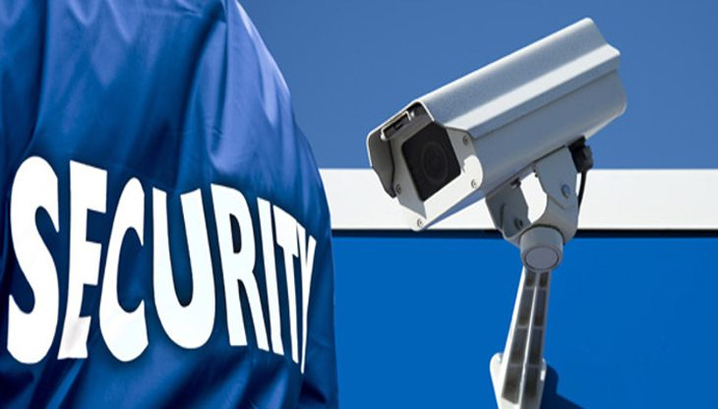
Security Services
to prevent or detect attacks
to enhance the security
replicate functions of physical documents
e.g.
have signatures, dates
need protection from disclosure, tampering, or destruction
notarize
record

Slide 12
Basic Security Services
Authentication
assurance that the communicating entity is the one it claims to be
peer entity authentication
mutual confidence in the identities of the parties involved in a connection
Data-origin authentication
assurance about the source of the received data
Access Control
prevention of the unauthorized use of a resource
to achieve this, each entity trying to gain access must first be identified and authenticated, so that access rights can be tailored to the individual

Slide 13
Basic Security Services
Data Confidentiality
protection of data from unauthorized disclosure (against eavesdropping)
traffic flow confidentiality is one step ahead
this requires that an attacker not be able to observe the source and destination, frequency, length, or other characteristics of the traffic on a communications facility
Data Integrity
assurance that data received are exactly as sent by an authorized sender
i.e. no modification, insertion, deletion, or replay

Slide 14
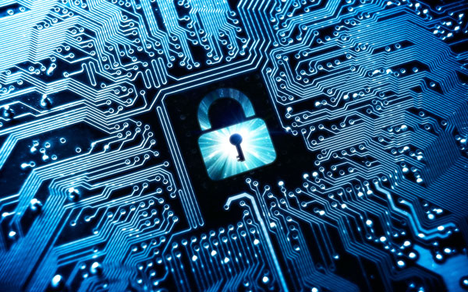
Basic Security Services
Non-Repudiation
protection against denial by one of the parties in a communication
Origin non-repudiation
proof that the message was sent by the specified party
Destination non-repudiation
proof that the message was received by the specified party

