Slide 1

Database Management System

Slide 2
Learning Outcomes
Applications of DBMS
Information and Information System
Data and Database
Database Management System(DBMS)
Components of DBMS
Examples of DBMSs
Database System
Information System in more detail
Advantages of DBMS
Disadvantages of DBMS
Types of Database
Current Trends

Slide 3
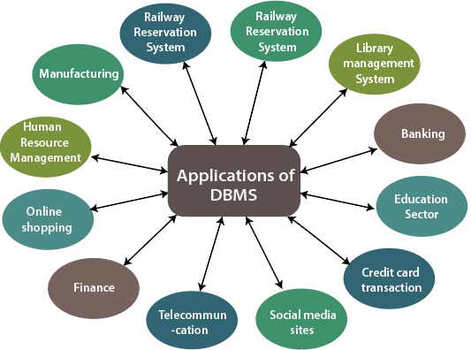
Database Management System Applications
(Applications of DBMS - Tutorial And Example, 2021)

Slide 4
Information
Dimensions of Information
Information: data processed to increase knowledge in the person using the data
Syntactic
Semantic and
Pragmatic

Slide 5
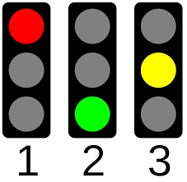
Traffic Signal
Semantic: Colours are linked with meanings. Red means STOP, Green means GO
Syntactic: We differentiate three colours as red, yellow and green
Pragmatic : Traffic light becomes usable. Red means driver must stop

Slide 6
Information System
Information Systems extends the database with a couple of software tools for querying, presenting, transforming and analysing the data in the database.
Components of an Information System
Backend(Behind the scenes)
Data and Databases
Database Management System
Database System
Frontend(What user sees and interacts with)
Application Software System

Slide 7
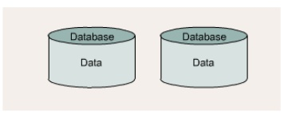
Data and Database
Database is a collection of related data and data is a collection of facts and figures that can be processed to produce information
Metadata
Metadata
Data can be:
Structured: numbers, text, dates
Unstructured: images, video, documents
Metadata: data that describes the properties and context of user data

Slide 8
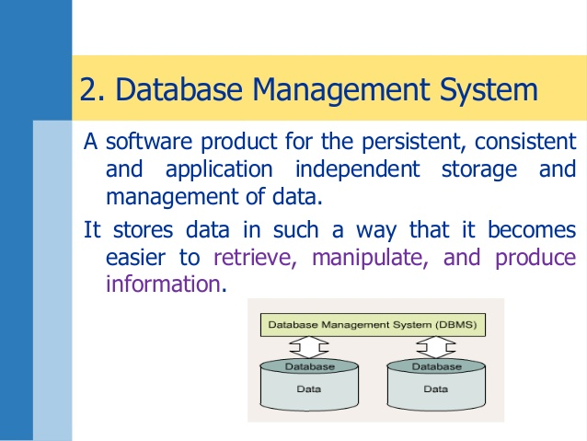
Database Management System
A software product for the persistent, consistent and application independent storage and management of data.
It stores data in such a way that it becomes easier to retrieve, manipulate, and produce information.
Metadata
Metadata

Slide 9
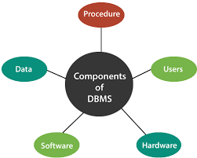
Database Management System Components

Slide 10
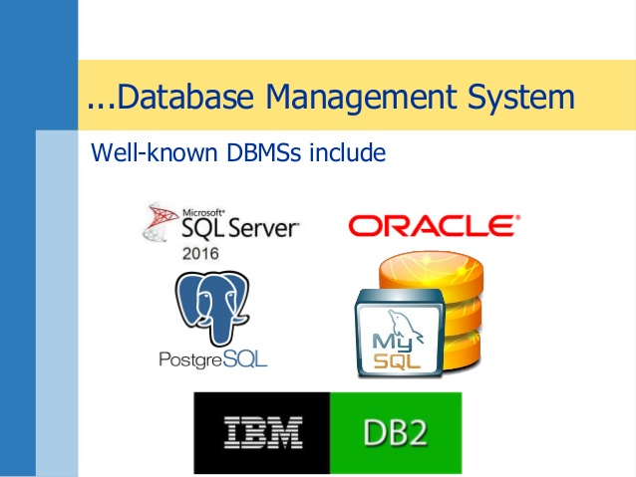
Database Management System Examples

Slide 11
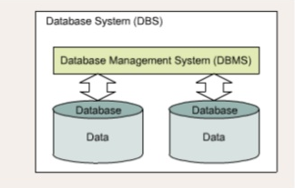
Database System
A database system (DBS) consists of a DBMS and one or more database.
Metadata
Metadata

Slide 12
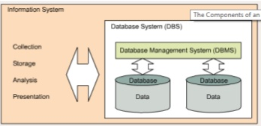
Information System
An information System extends the database with a couple of software tools for retrieving, transforming, analysing and presenting data
Metadata
Metadata

Slide 13
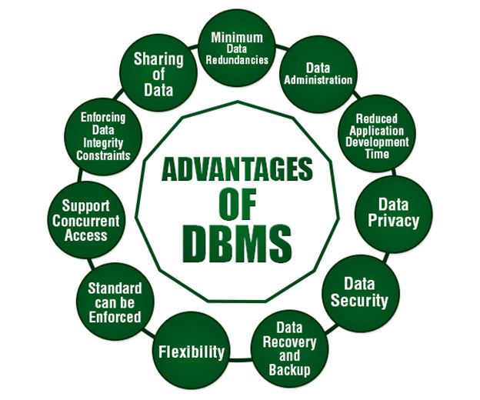
Advantages of DBMS
Metadata
Metadata
(What is Database Management System (DBMS)? - Ducat Tutorials, 2021)

Slide 14
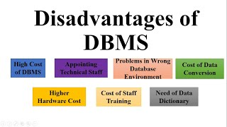
Disadvantages of DBMS

Slide 15
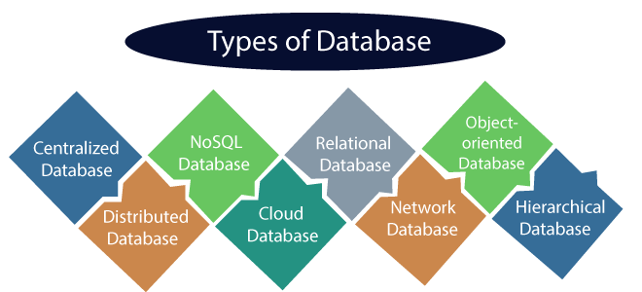
Types of Database

Slide 16
Current Trends
Multimedia Database
Document Oriented Databases
Mobile and embedded databases
Distributed Databases

Slide 17

Thank You

Slide 18
References
Emasri R and Navathe S (2017), Fundaments of Database Systems, 7th Edition, Pearson Education Ltd
Negi M, (2019), Fundamentals of Database Management System, BPB Publications
Zygiaris S (2018), Database Management Systems, Emerad Publishing Limited.
Tutorial And Example. 2021. Applications of DBMS - Tutorial And Example. [online] Available at: <https://www.tutorialandexample.com/applications-of-dbms/> [Accessed 22 June 2021].
Ducat Tutorials. 2021. What is Database Management System (DBMS)? - Ducat Tutorials. [online] Available at: <https://tutorials.ducatindia.com/dbms/what-is-database-management-system-dbms/> [Accessed 22 June 2021].

