Slide 1
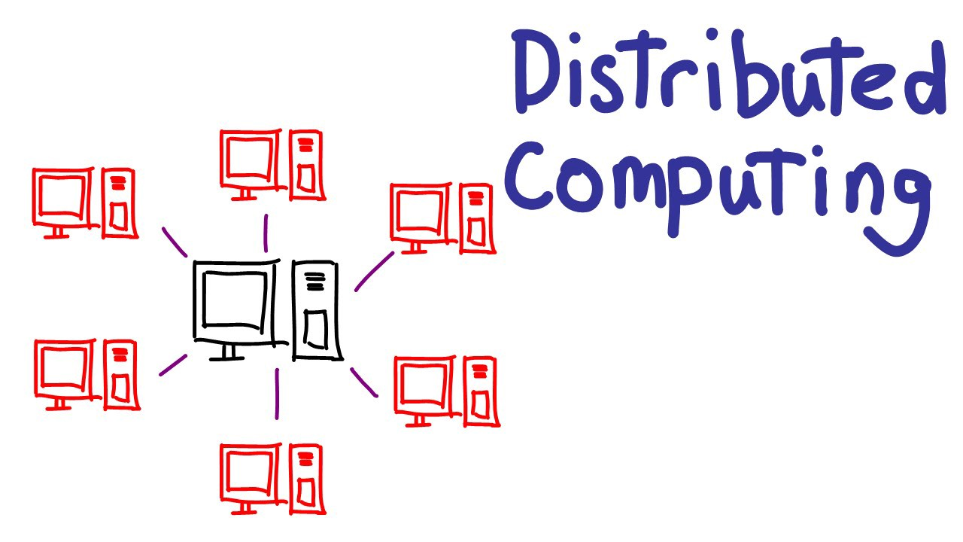
Distributed Systems
Distributed Systems

Slide 2
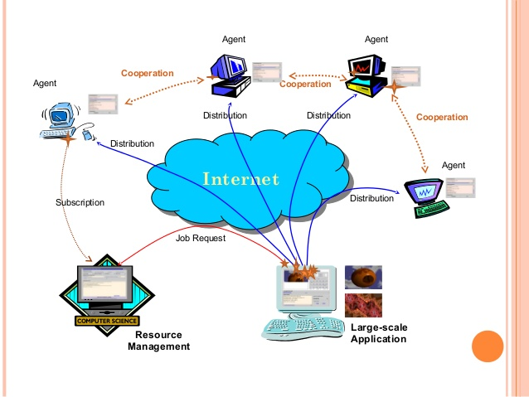
Distributed Systems
Topics
  What is a Distributed System?
  Why Distributed Systems?
  Examples of Distributed Systems
  Distributed System Requirements
  Transparency in Distributed Systems
Distributed Systems

Slide 3
Distributed Systems
Can think of DS as:
  breaking down an application into individual computing agents
  distributed over a network
  work together on a cooperative task
Motivation for DC:
  Scalability: can solve larger problems without larger computers
  Openness and heterogeneity: applications and data may be difficult to relocate and reconfigure
  Fault-tolerance: redundant processing agents for system availability
Distributed Systems

Slide 4
What Is a Distributed System?
Ingredients of a Distributed System
Component-1
…
Component-n
Component-1
…
Component-m
Network OS
Network OS
Hardware
Hardware
Host-1
Host-n
Component-1
…
Component-n
Middleware
Network OS
Hardware
Host-1
Distributed Systems

Slide 5
What Is a Distributed System?
Component-1
…
Component-n
Component-1
…
Component-n
Middleware
Middleware
Network OS
Network OS
Hardware
Hardware
Host-1
Host-2
Network
Component-1
…
Component-n
Component-1
…
Component-n
Middleware
Middleware
Network OS
Network OS
Hardware
Hardware
Host-n
Host-3
Distributed Systems

Slide 6

What is a Distributed System
Distributed System Definition:
  A distributed system is a collection of autonomous hosts that are connected through a computer network.
  Each host executes components and operates a distribution middleware.
  Middleware enables the components to coordinate their activities.
  Users perceive the system as a single, integrated computing facility.
Distributed Systems

Slide 7
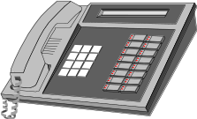
Why Distributed Systems?
Every application is part of your business model
  must make them work together!
Payables/ Receivables
Sales
Accounting
Manufacturing
Inventory
Shipping/ Receiving
Engineering
Distributed Systems

Slide 8
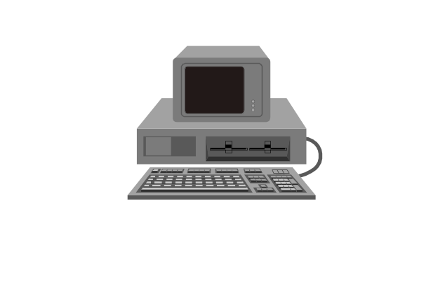
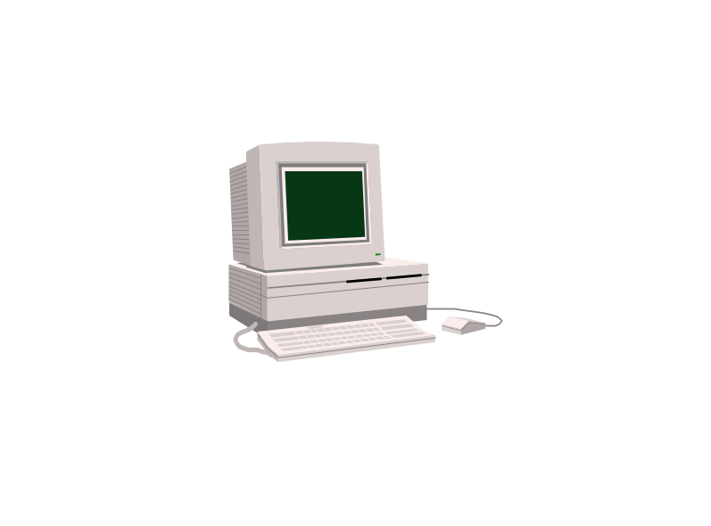
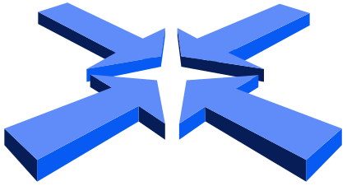
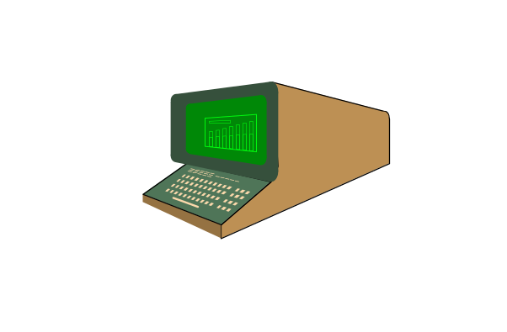
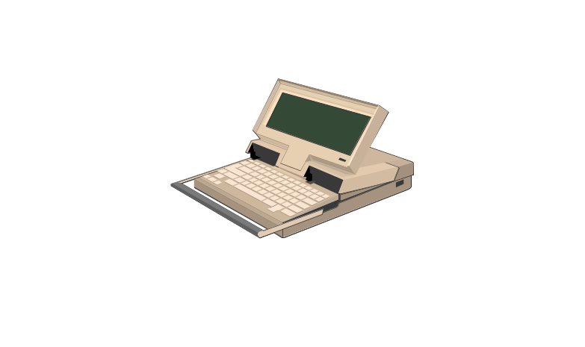
Why Distributed Systems?
Application Integration and Distributed Processing are the same thing
  Constructing information-sharing distributed systems from diverse sources:
    heterogeneous
    networked
    physically disparate
    multi-vendor
Distributed Systems

Slide 9
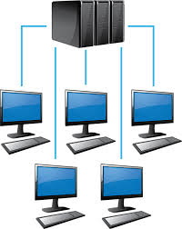
Why Distributed System?
Application Requirements
  Functional
  Non-Functional
Non-functional requirements drive distribution of a system
  Scalability
  Concurrency
  Openness
  Heterogeneity
  Resource sharing
  Fault-tolerance
Distributed Systems
Notes:
Scalability denotes the ability to accommodate a growing load in the future.
Open systems can easily be extended and modified. It is achieved by communicating using well-defined interfaces.
Heterogeneity of components can arise in the programming languages, operating systems, hardware platforms and network protocols. Component heterogeneity can be accommodated by distributed systems.
Often resources, i.e., hardware, software, and data need to be shared by more than one user. Distributed objects provide a sophisticated model of resource sharing.
Security needs to be considered when it comes to sharing
Fault-tolerance refers that operations can continue even in the presence of faults. It is achieved in distributed system by means of replication

Slide 10
Centralised vs Distributed Systems
Centralised Systems
  Centralized systems have non-autonomous components
  Centralized systems are often build using homogeneous technology
  Multiple users share the resources of a centralized system at all times
  Centralized systems have a single point of control and of failure
Distributed Systems
  Distributed systems have autonomous components
  Distributed systems may be built using heterogeneous technology
  Distributed system components may be used exclusively
  Distributed systems are executed in concurrent processes
  Distributed systems have multiple points of failure
Distributed Systems

Slide 11

Advantages and Disadvantages of Distributed Systems
Advantages
  Shareability
  Expandability
  Local autonomy
  Improved performance
  Improved reliability and availability
  Potential cost reductions
Disadvantages
  Network reliance
  Complexities
  Security
  Multiple point of failure
Distributed Systems

Slide 12
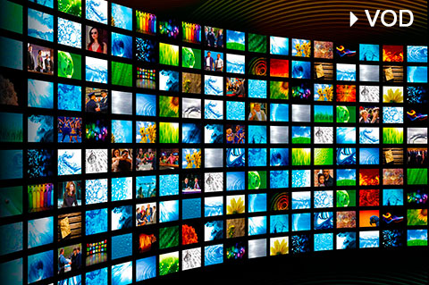
Examples of Distributed Systems
Video-on-Demand
  Client components are used to display videos
  Clients are hosted in the homes of the customers of the service
  Server components load and transmit videos
  Multiple servers are needed in order to scale
Distributed Systems

Slide 13
Examples of Distributed Systems
IT Service Architecture of a Swiss Bank
  Service architecture consists of heterogeneous new and legacy components
  Hardware platforms range from mainframes to NTs
  Programming languages including Assembler, Cobol, C, C++, Java, …
  Different types of middleware can be used to resolve distribution and heterogeneity
Authorization Services
Customer Information Services
Trading Services
ATM Services
Distributed Systems

