Slide 1
Climate change and Sustainability

Slide 2
Learning outcomes:
What is Climate Change?
Key environmental problems at a local and global scale
The concept of sustainability
How organisations impact on the environment
Pressures driving corporate environmental performance
Managing sustainability threats and opportunities
Process of becoming a more sustainable as an organisation

Slide 3
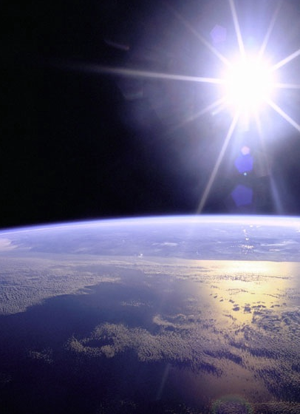
Greenhouse Effect
earth is surrounded by a think layer of gases – greenhouse gases
this makes up the earth’s atmosphere

Slide 4
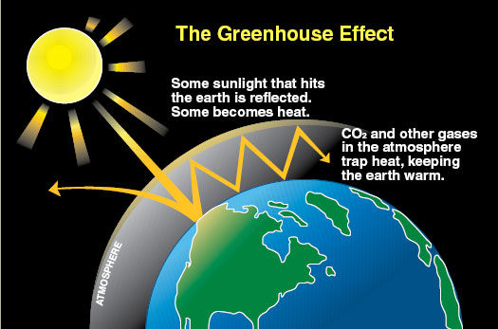
Notes:
Source: Climate Commission http://www.climatecouncil.org.au/

Slide 5
Global Warming
The increase of the Earth’s average surface temperature due to a build-up of greenhouse gases in the atmosphere.

Slide 6
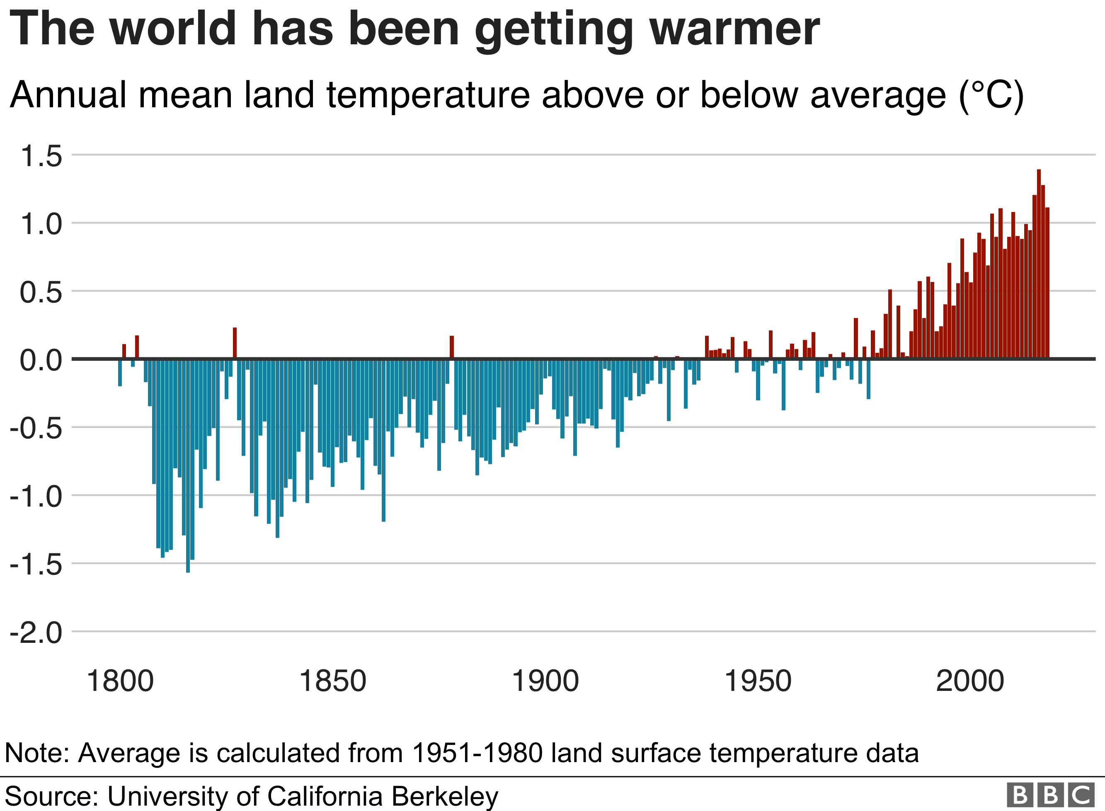

Slide 7
Evidence for Global Warming
World is one degree Celsius warmer than before widespread industrialization
20 warmest years on record all occurred over the past 22 years
2015 – 2018 making the top four
Across the globe. Average sea level increased by 3.6mm between 2005 and 2015
2019 second hottest year on record
(WMO World Meteorological Organisation)

Slide 8
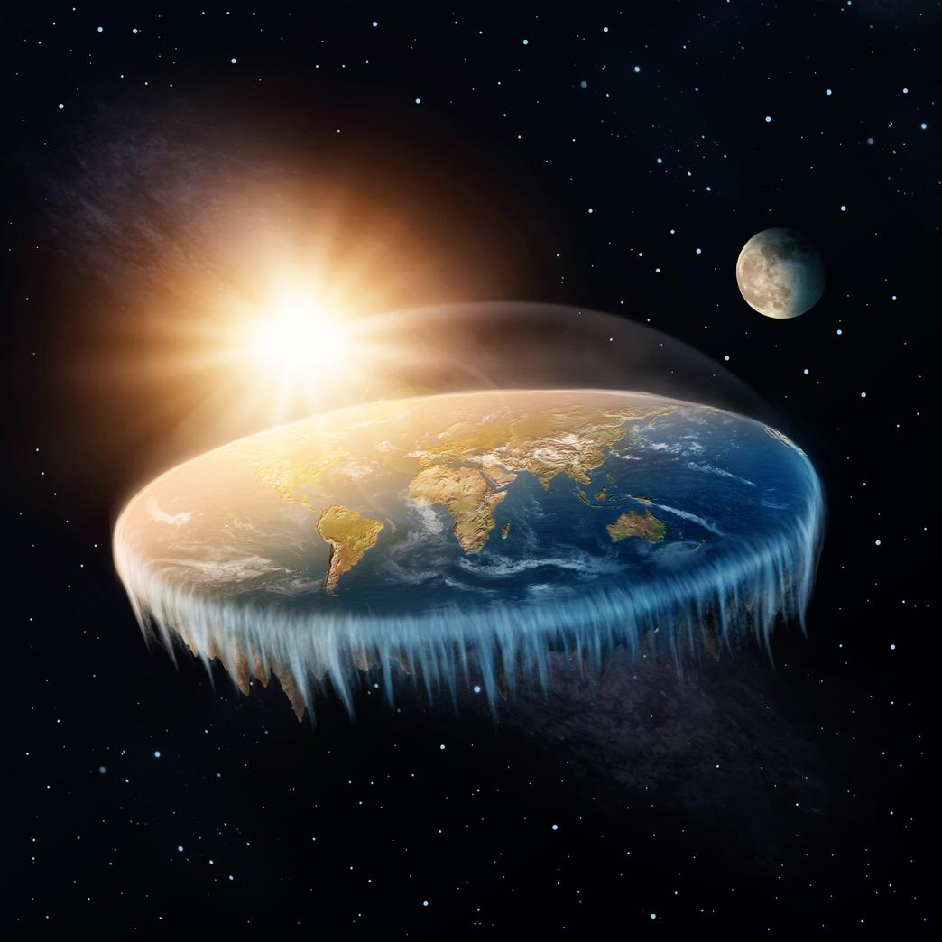
Does Climate Change Exist?
Flat Earth Society

Slide 9

We must reject the perennial prophets of doom and their predictions of the apocalypse
Its freezing in New York – where the hell is global warming?
The weather has been cold for so long that the global warming HOAXSTERS were forced to change the name to climate change to keep $ flow!
The badly flawed Paris Climate Agreement protects the polluters, hurts Americans, and
I don’t think it’s a hoax, I think there’s probably a difference. But I don’t know that it’s manmade

Slide 10
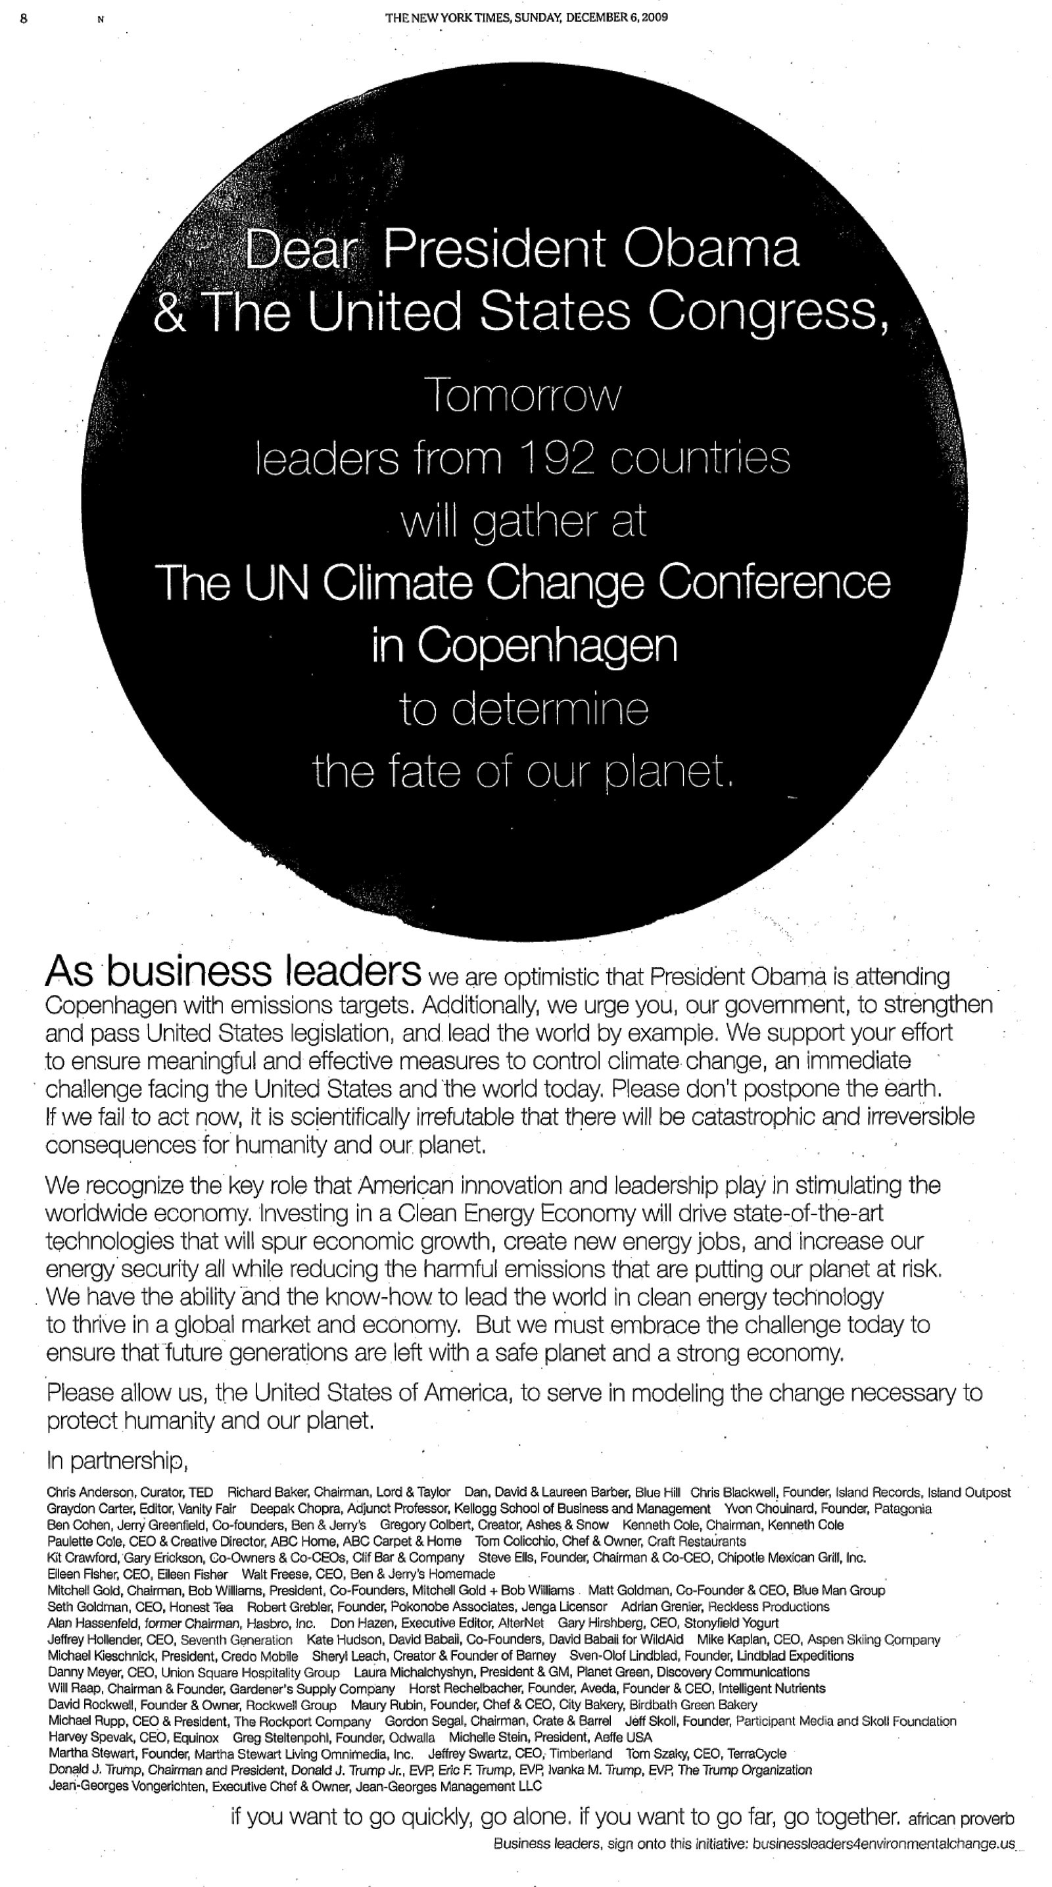
New York Times December 6 2009
Signed Donald Trump
shift to clean energy “will spur economic growth” and “create new energy jobs

Slide 11
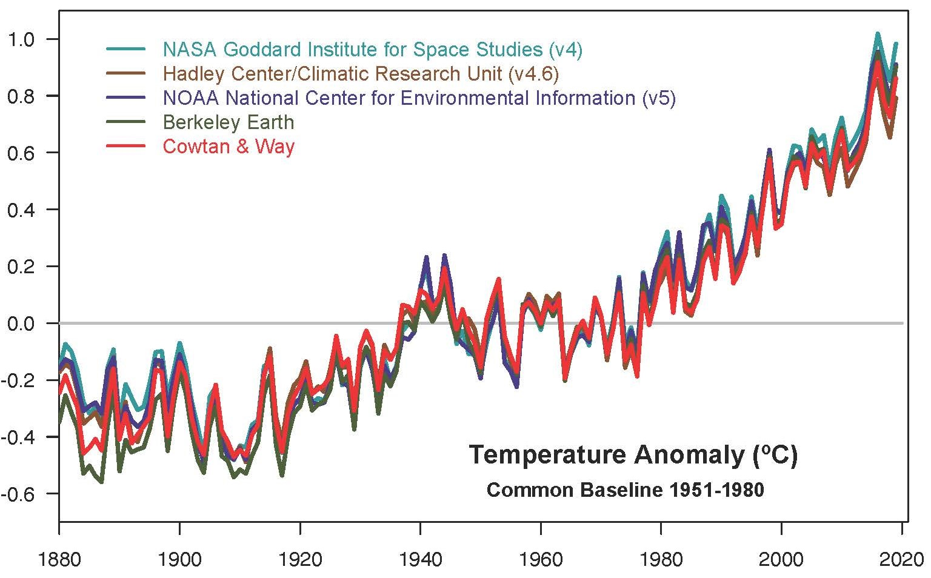
Evidence for Climate Change
Climate.Nasa.gov

Slide 12
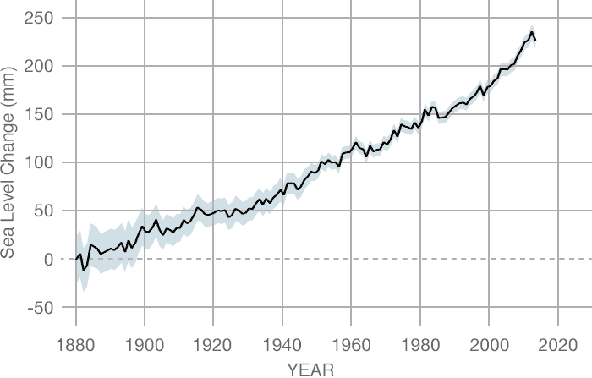
Sea Level Change
Nasa Climate Change

Slide 13
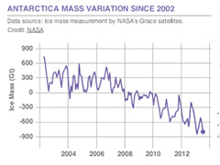
Reduction in Antarctic Mass
NASA Climate Change

Slide 14
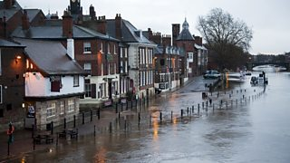
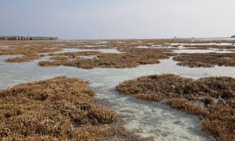
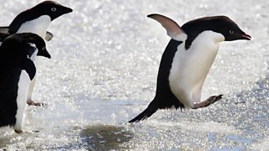
What does it mean locally?

Slide 15
History of Climate Change Agreements
Start of the 20th Century seen as “esoteric study into a theoretical phenomenon”
1972 First International environmental summit – Stockholm, Sweden
1979 First World Wide Climate conference
1988 Toronto Conference on Changing Climate
1988 WMO and UNEP jointly establish intergovernmental assessment

Slide 16
History of Climate Change Agreements
IPCC (Intergovernmental Panel on Climate Change established to carry out assessment,
Produced 5 reports
6th due in 2021
1992 UNFCCC (UN Framework Convention on Climate Change – Earth Summit)

Slide 17
History of Climate Change Agreements
1995 Kyoto Protocol
Binding GHG reduction targets
US did not ratify it….

Slide 18
Paris Agreement
12 December 2015 parties to the UNFCCC* agreement to combat climate change
UNFCCC has 196 member and only 7 are not party to it
Iran
Turkey
America signed, didn’t ratify and….
*United Nations Framework Convention on Climate Change

Slide 19
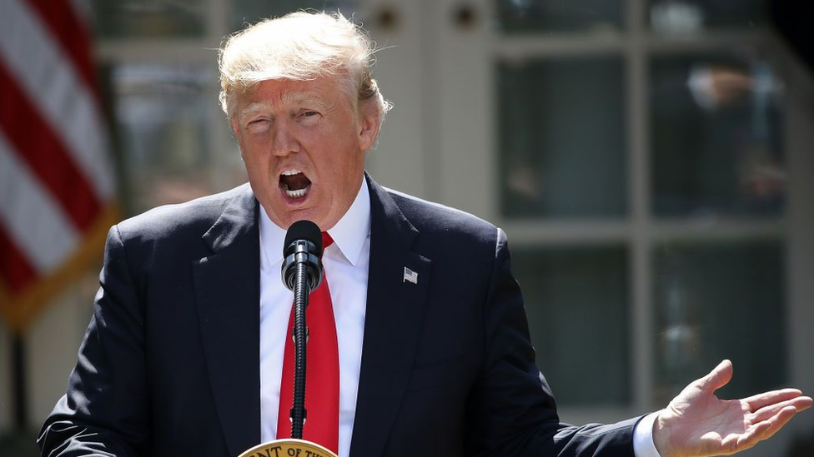
US formally withdraws from the Paris agreement
President Trump announced in June 2017
UN regulations meant it came affective on the 4th November
Trump said the deal struck in 2015 would disadvantage US businesses and workers.

Slide 20
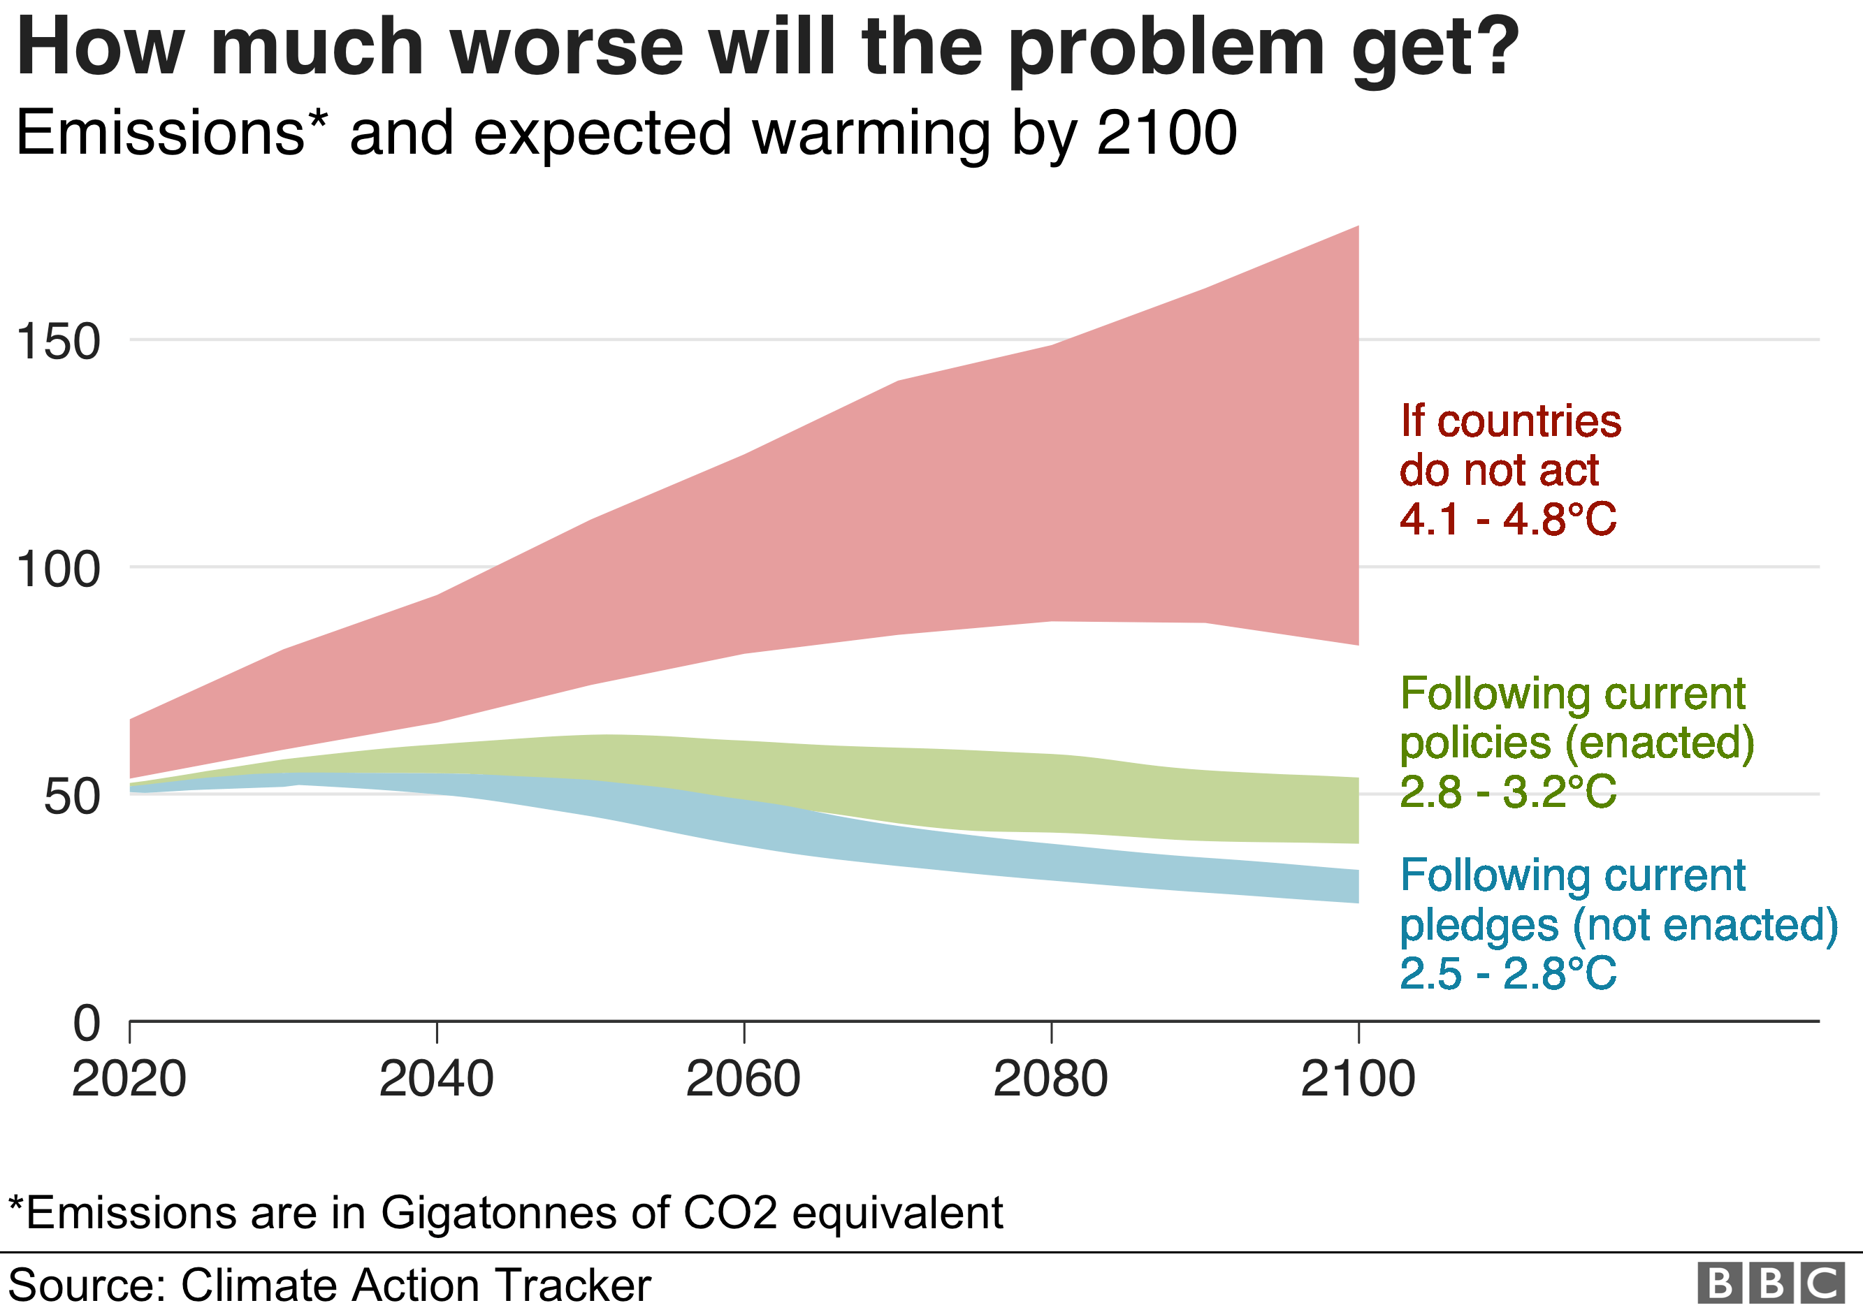

Slide 21
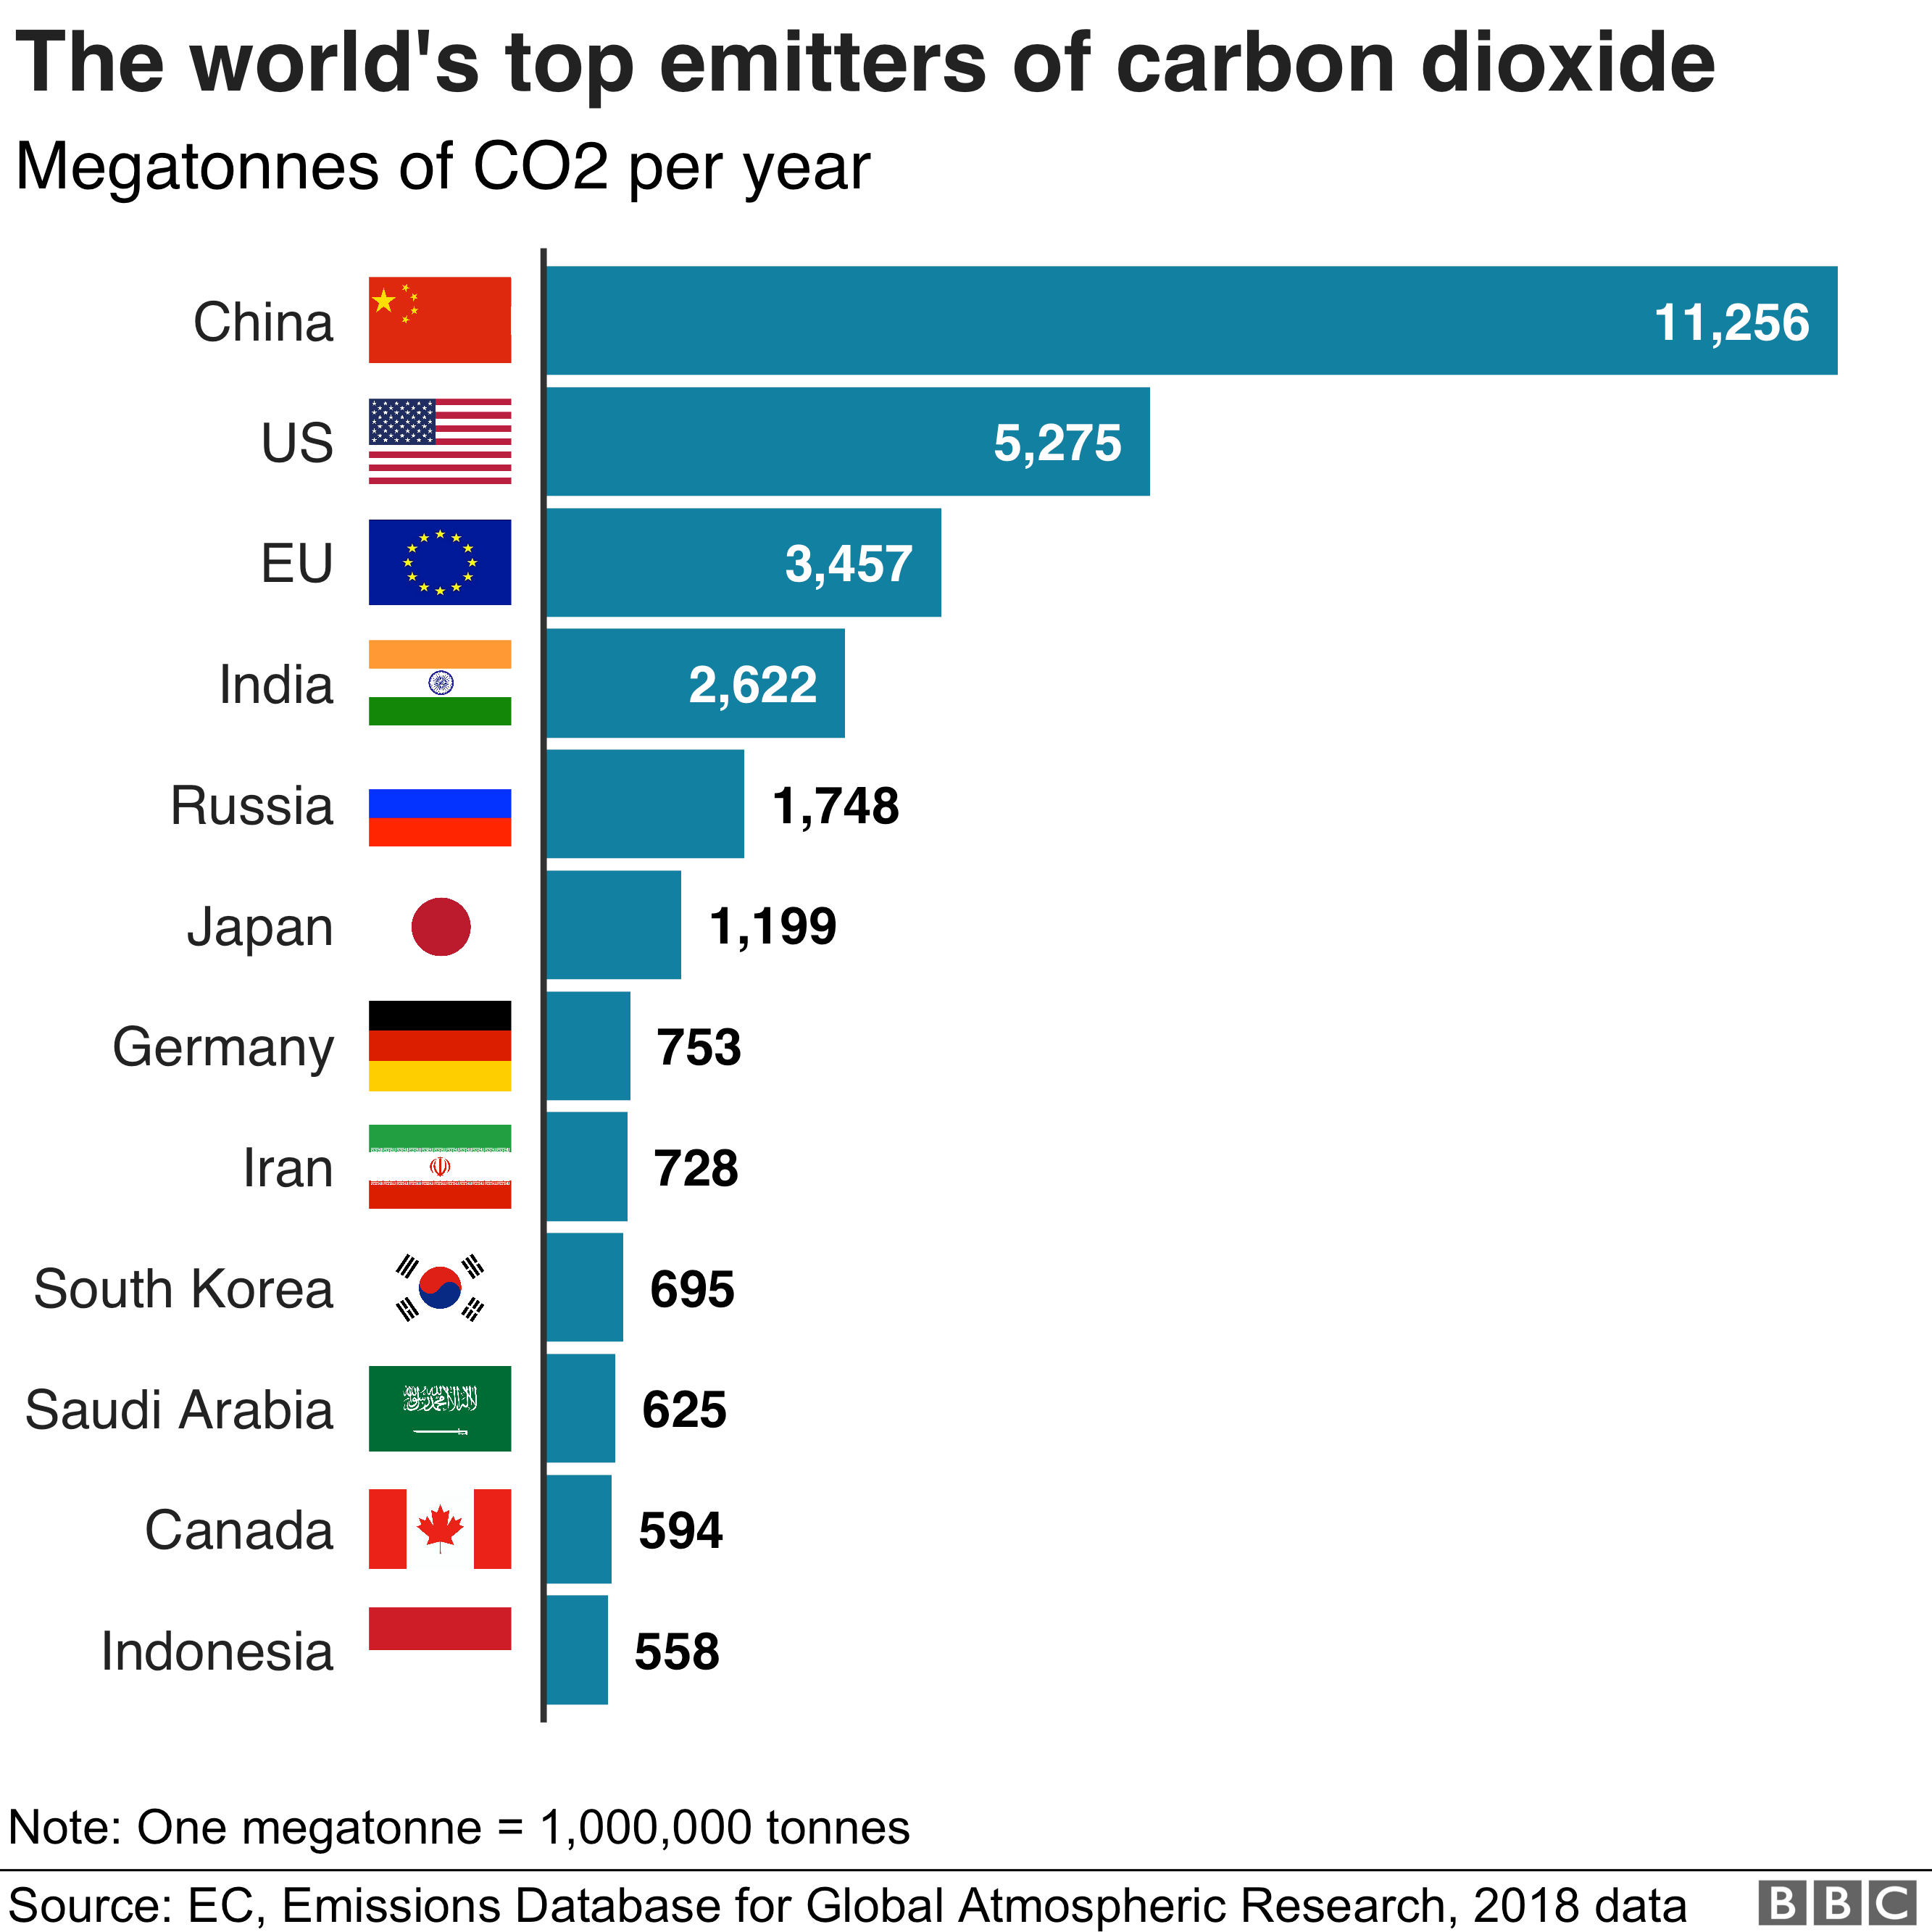

Slide 22
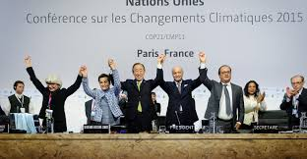
Why is the Paris Agreement important?
Legally binding agreement
Universal participation
New elements to address climate change

Slide 23
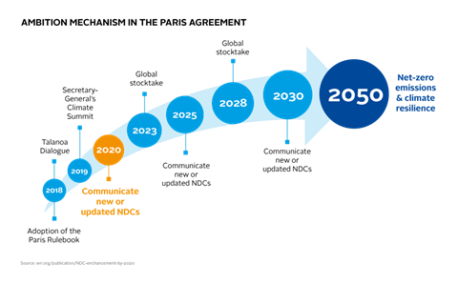
Ambition Mechanism in the Paris Agreement

Slide 24
But….
Climate target would not meet the goal of limiting warming to 1.5 degrees C
Undertook to update their targets for 2030

Slide 25
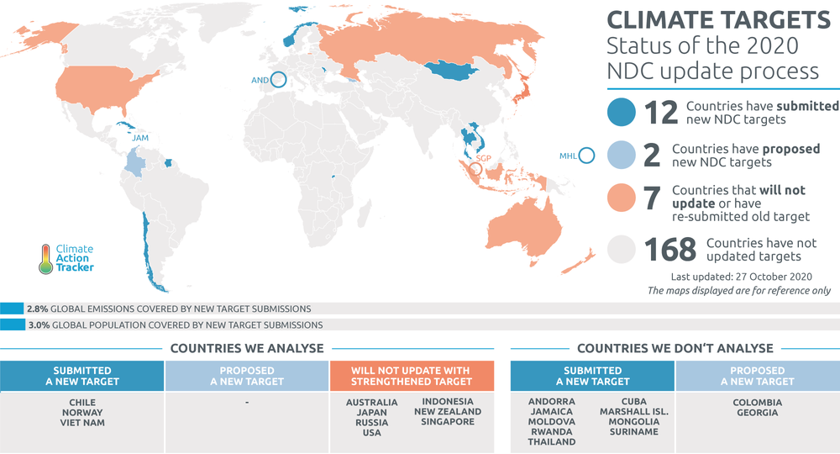
CAT Climate Target Update Tracker
https://climateactiontracker.org/climate-target-update-tracker/

Slide 26
COVID – opportunity to change?
Even if some lockdown measures in place end 2021 only 0.01 degree Celsius drop
Polices to cut greenhouse gas emissions as part of prioritising low carbon industries …prevent half global warming expected by 2050
Net Zero emissions economic recovery from COVID-19
Grantham Institute – Climate Change and the Environment

Slide 27
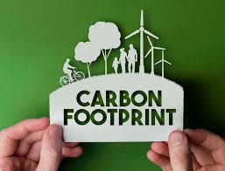
What can a person do to reduce global warming?
Take 15 minutes to work out what you as an individual could do to reduce climate change
You can work in safely distanced groups

Slide 28
What can a person do to reduce global warming?
Renewable energy…
Energy efficient appliances
Reduce water waste
Eat the food you buy…
Light bulbs
Pull the plugs
Fuel efficient vehicles – public transport?
Keep tyres inflated

Slide 29
Sustainability

Slide 30
What is sustainable development?
“Making the necessary decisions now to realise our vision of stimulating economic growth and tackling the deficit, maximising wellbeing and protecting our environment, without negatively impacting on the ability of future generations to do the same” (Environment Agency)
“Development that provides economic, social and environmental benefits in the long term having regard to the needs of living and future generations” (European Environment Agency)

Slide 31
Put simply….
"Development that meets the needs of the present without compromising the ability of future generations to meet their own needs.“ (Brundtland Commission, 1987)

Slide 32
Rio Declaration on Environment and Development
June 1992
Conference on Environment and Development (Earth Summit UNCED)
27 principles to sustainable development
127 countries

Slide 33
Rio +20
The aim is to have clear and practical measures for implementing sustainable development through:
Development of set of Sustainable Development Goals (SDGs)
Ground-breaking guidelines on green economy policies
Adoption of 10-year framework of programmes on sustainable consumption and production patterns

Slide 34
RIO Principle of Environmental development
Principle 1. Human beings are at the centre of concerns for sustainable development. They are entitled to a healthy and productive life in harmony with nature.
Principle 4. In order to achieve sustainable development, environmental protection shall constitute an integral part of the development process and cannot be considered in isolation from it.
Principle 8. To achieve sustainable development and a higher quality of life for all people, States should reduce and eliminate unsustainable patterns of production and consumption and promote appropriate demographic policies.

Slide 35
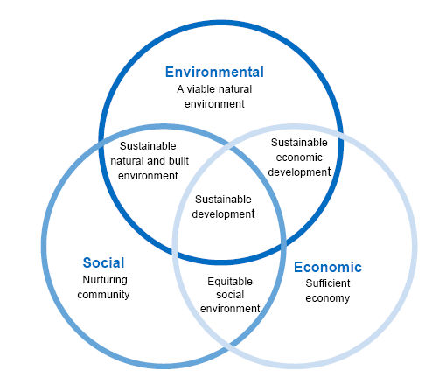
Sustainability – not just the environment

Slide 36
Pressures driving environmental corporate performance
Legal pressure EU legislation
Financial pressure – lenders “green” conscious
Operational costs
Share holder pressures
Market Pressures
Social Pressures

Slide 37
How do organisations/industry impact the environment?
Water
Energy
Air
Waste

Slide 38
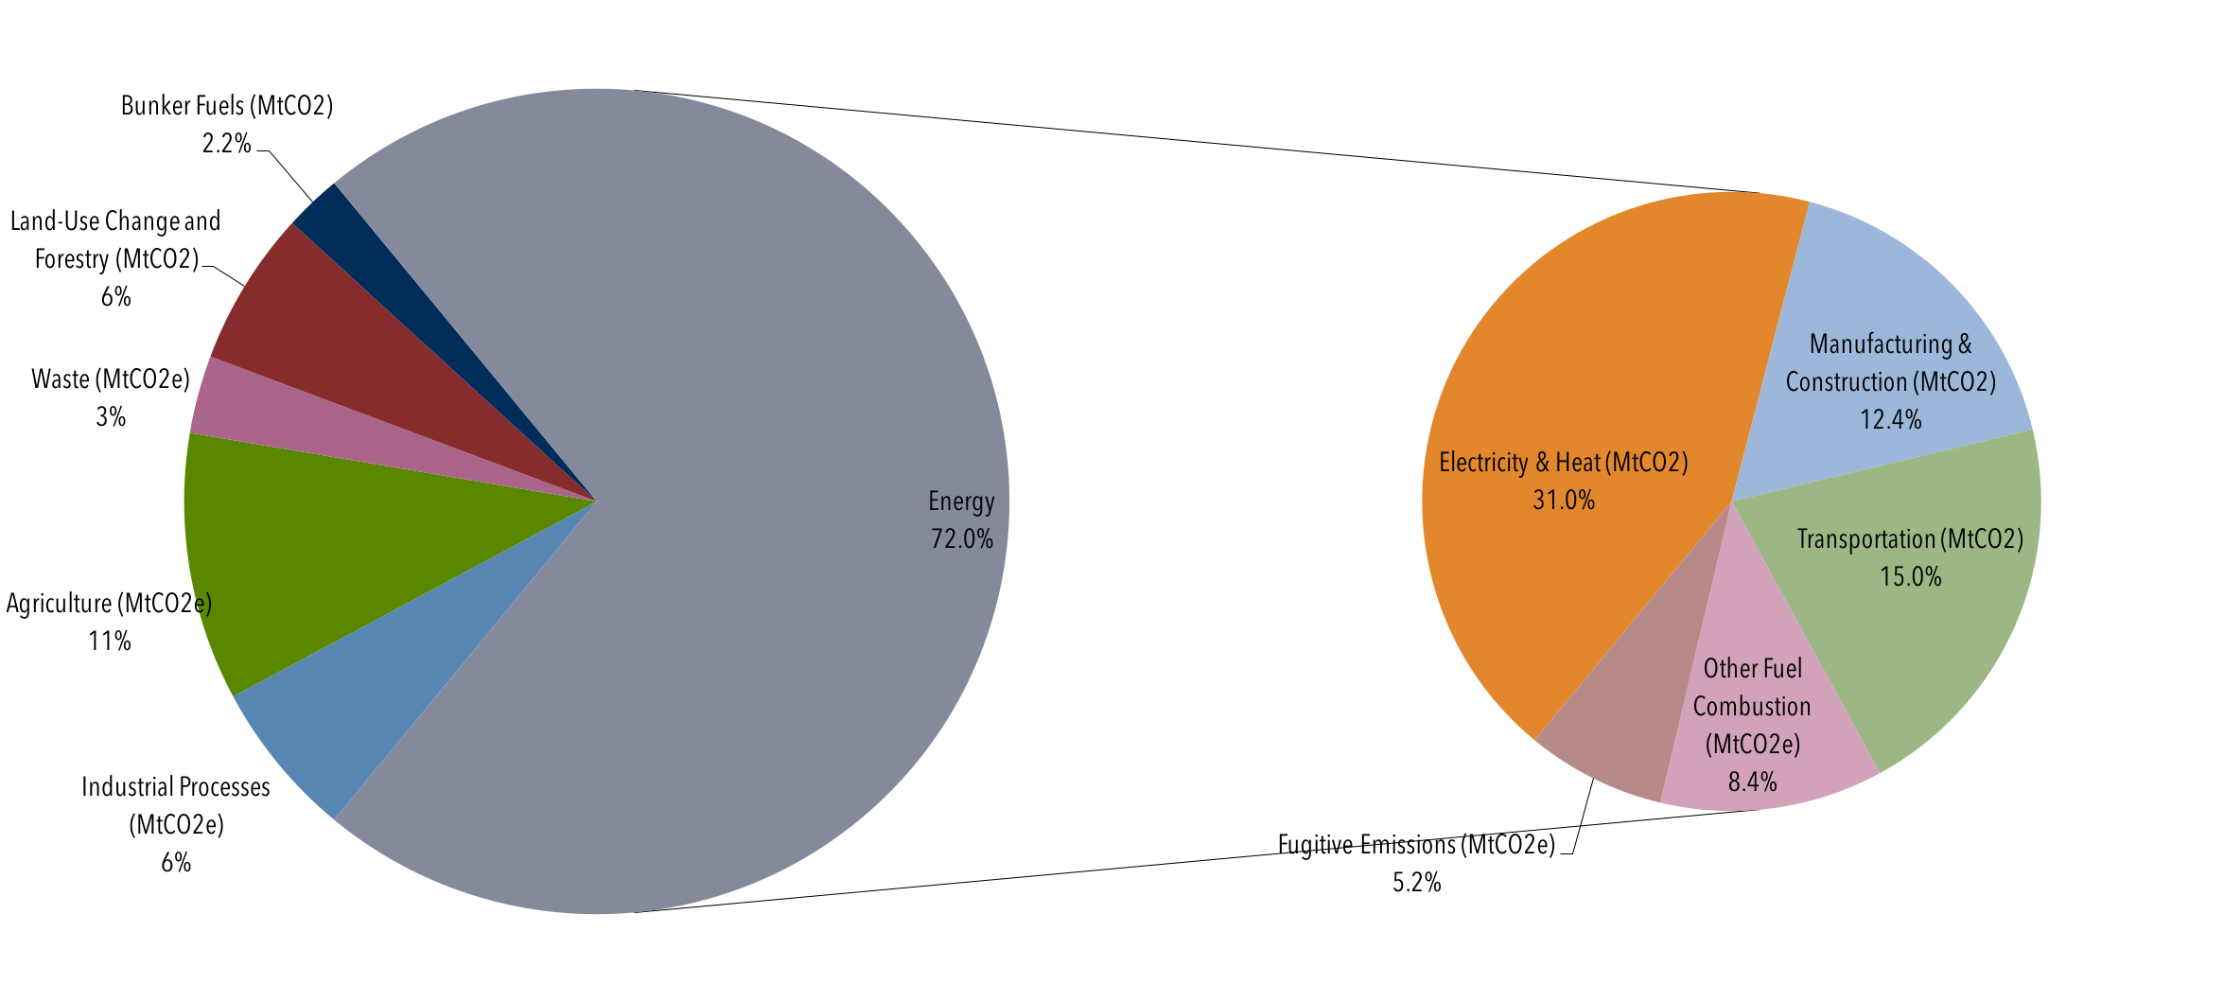
Global Manmade Greenhouse Gas emission by Sector 2013

Slide 39
Renewable Energy – is it sustainable?
Hydropower
Wind
Solar
Biomass
Geothermal
Take 20 minutes and think about what might be the adverse effects of each of these types of renewable energy.

Slide 40
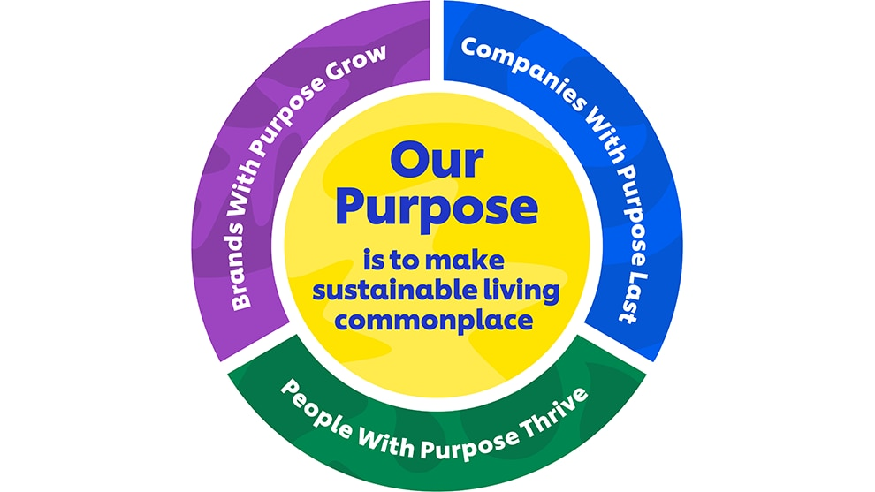
What have companies done?
UNILEVER – Unilever Sustainable Living Plan (USLP)
2010
World’s most sustainable business
Growth doesn’t come at the expense of the planet
Business is a force for good
So what happened?

Slide 41
What have companies done?
Mars, Unilever and Nespresso - invested in the rainforest alliance
Coca Cola faced a water shortage in India – invested $2bn reduce water use and improve quality
Proctor and Gambol – cold-water detergents 50% less energy than warm water washing
Wal-Mart double fleet efficiency 2005 – 2015 – improved by 87%. Avoided 15,000 tonnes CO2 emissions saving nearly $11m

Slide 42
Drivers to sustainability

Slide 43
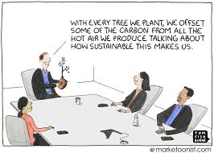

Slide 44
Further reading/viewing
Nasa Climate and Global Warming
Paris Agreement COP24 update: everything you need to know
Joint statement on US Withdrawal from the Paris Agreement
Rio Declaration on United Nations Conference and Development
Global Emissions C2ES
Climate Change the Facts – David Attenborough

