Slide 1

International Standards
An Introduction

Slide 2
Learning Outcomes
History of ISO standards
How well are they used?
Structure of standards
What are the advantages?
Plan Do Check Act
ISO 9901:2015, ISO 14001:2015, ISO 45001:2018 (ISO 18001 withdrawn Sept 2021)

Slide 3

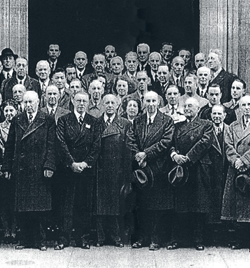
ISO (International Organization for Standardization)
world’s largest developer of voluntary International Standards
founded in 1947
have published 23684 International Standards covering almost all aspects of technology and business
members from 165 countries and about 160 people work full time for the Central Secretariat in Geneva, Switzerland.

Slide 4
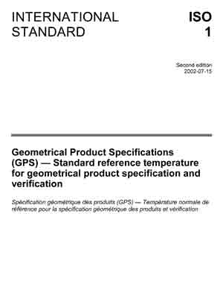
International Standard ISO 1
Latest version is ISO 1:2016

Slide 5

Environment on the Agenda
1971, ISO created its first two environmental technical committees in the environment
Air quality
Water Quality

Slide 6
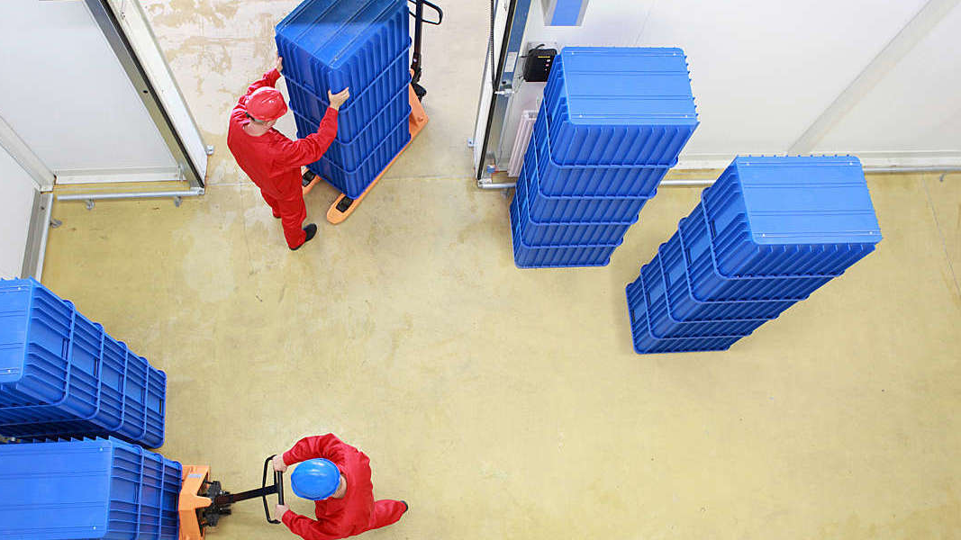
ISO 9000 family
1987 – published the first quality management standard
ISO 9001 – Quality Management System
ISO 9001 – Debunking the Myths

Slide 7

ISO and the Environment
1996 ISO 14001 launched the environmental Management System
Helps organisations identify and control their environmental impacts
Introduction to ISO 14001:2015

Slide 8
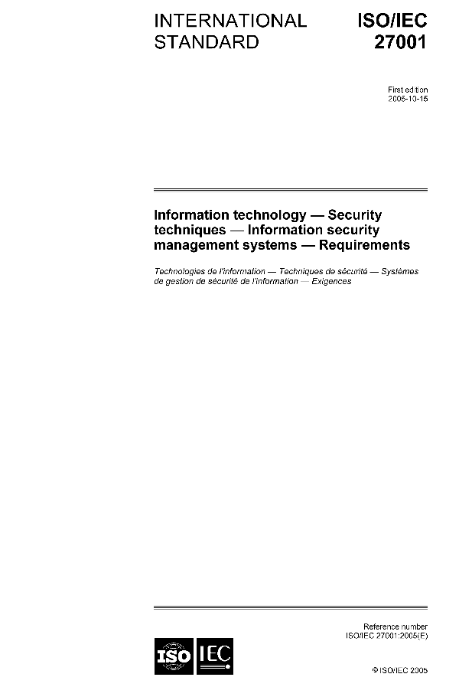
Information Security
2005, ISO management system standard on Information Security
ISO 27001

Slide 9
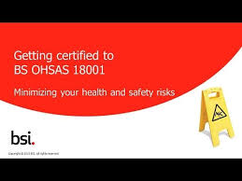
BSI OHSAS
1996 – BSI 8800
1999 OHSAS 18001:1999
2007 updated to align with ISO 14001

Slide 10
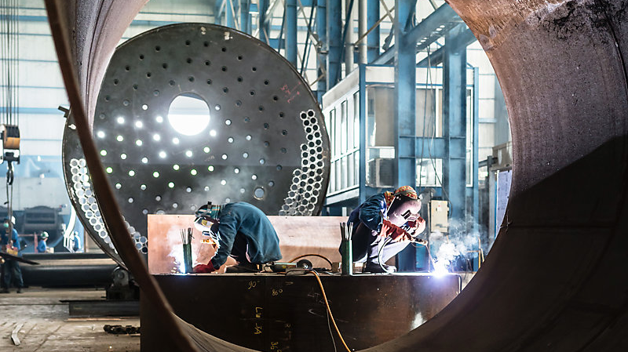
International standard for Occupational Health and Safety
ISO 45001:2018
OHSAS 18001 withdraw Sept 2021

Slide 11
Most popular standards
ISO 13485 – medical equipment
ISO 31000 – risk management
ISO 26000 – Social Responsibility
ISO 20121 Sustainability Standard
ISO 9001, ISO 14001, ISO 27001, ISO 45001
ISO 22000 – food safety management
ISO 5001 Energy Management System
ISO/TS 16949 Automotive industry

Slide 12


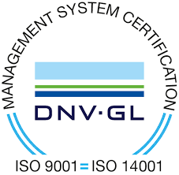
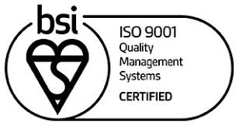
Certification
Certification
The provision by an independent body of written assurance (a certificate) that the product, service or system in question meets specific requirements

Slide 13
Accreditation
The formal recognition by an independent body, generally known as an accreditation body, that a certification body operates according to international standards.
UKAS – United Kingdom Accreditation Service (UKAS)
Appointed under The Accreditation Regulations 2009 as the sole national accreditation body

Slide 14



Accredited by more than one body..
BSI
UKAS
DAkkS in Germany
ANAB in America

Slide 15
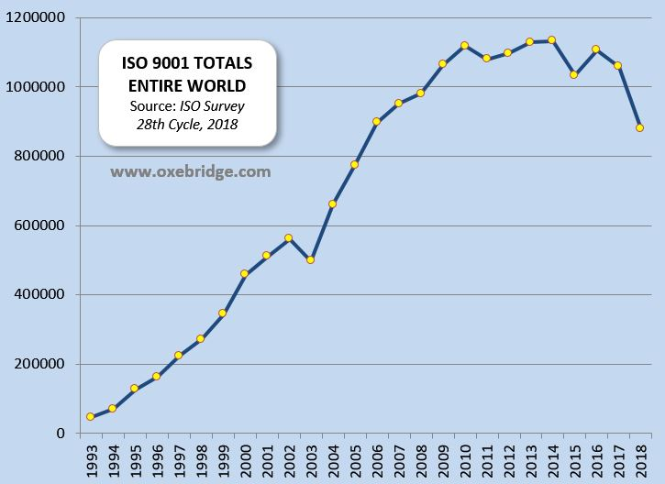
Manufacturing and Construction
Engineering services

Slide 16
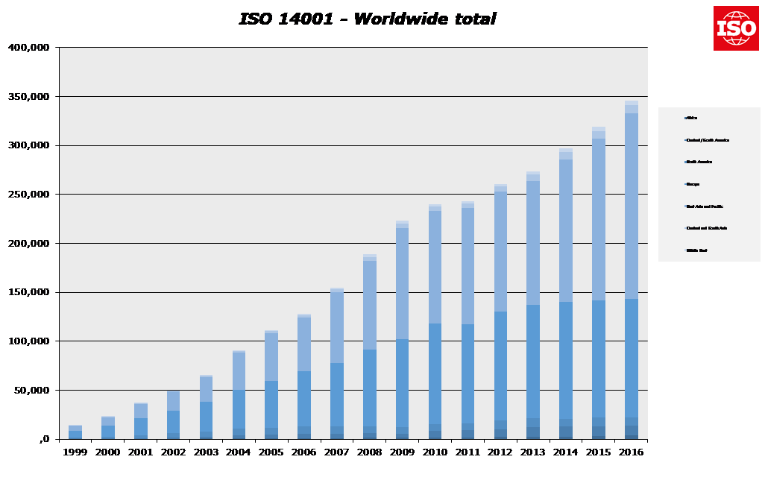
ISO 14001 - Worldwide

Slide 17
Common Elements ISO 9001 – 14001 - 45001
1. Scope
2. Normative References
3. Terms and Definitions
4. Context of the organisation
5. Leadership
6 Planning
7. Support
8. Operation
9. Performance evaluation
10. Improvement

Slide 18
1. Scope
“Located in Manchester Company XYZ is a high-volume machine shop that specialises in the precision machining of aluminium brake, steering and suspension components, in accordance with OEM specifications and government regulations, for use in the automotive industry.”
Describes the products and/or services, the regulatory requirements, activities , remote locations and facilities supported and documented by ethe quality management system of your company.
What your business does
Short and simple
Customers can read and understand it.

Slide 19
2. Normative reference
Any other documents which are referenced within the management system standard.
In the case of 9001:2015, there are many references made to ISO 9000:2015 Quality Management Systems.

Slide 20
3. Terms and Definitions
Using terms which are already defined clarifies the meaning and intention behind the terms. ISO 9000:2015 defines some terms.
Product
Process
Interested Party
Risk Based Thinking
Objective
Audit
Etc..

Slide 21
4. Context of the organisation

Slide 22
5. Leadership
Leadership is involvement with the Management System
An external Auditor will expect to discuss leadership with those who manage the organisation
Demonstrating leadership
Setting Policy
Roles and Responsibilities

Slide 23
6. Planning
What are we trying to achieve ?
What could stop us from reaching our objectives?
How will we address these issues?
How can risks be turned into opportunities?
How can opportunities help us improve?
Who will be responsible for actions?
When will we need to take action by?
How ill we know whether the actions are affective?

Slide 24
7. Support
This is about resources.
People
Infrastructure
Environment
Monitoring and measuring
Organisational knowledge
Formal learning and development etc.

Slide 25
8. Operation
Establishing requirements
Managing Change
Design and development
Inputs, Control, Outputs changes
Managing external providers
Understanding operational processes
Controlling non-conformances

Slide 26
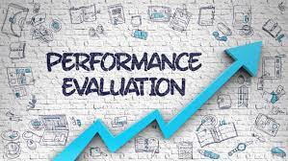
9. Performance Evaluation
Process performance
Customer Satisfaction
Internal Audits
Management Review

Slide 27

10. Improvement
Using knowledge and evidence gathered through effective monitoring and measuring processes make improvements
Record non-conformity
Continual Improvement

Slide 28
Common Elements ISO 9001 – 14001 - 45001
1. Scope
2. Normative References
3. Terms and Definitions
4. Context of the organisation
5. Leadership
6 Planning
7. Support
8. Operation
9. Performance evaluation
10. Improvement

Slide 29

Steps to gaining Certification
Gap Analysis
Identify gaps and areas requiring additional attention to meet the requirements of the standards

Slide 30
Steps to gaining Certification
Implementation
Close the gaps form the Gap analysis

Slide 31

Steps to gaining Certification
Certification
Audit form UKAS accredited Auditor.
Re-audit every 3 years…

Slide 32
What are the benefits of ISO 9001 certified system
demonstrates your organisation’s ability to consistently meet and exceed customer expectations.
many enterprise buyers and retailers require their suppliers to be ISO 9001 certified in order to minimise their risk of purchasing a poor product or service
ISO 9001 certification can attain significant improvements in organisational efficiency and product quality by minimising waste and errors and increasing productivity.

Slide 33
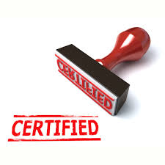
What are the mistakes with ISO?
Wrong project leader
Lack of management commitment
Getting the requirements wrong
Doing “ISO”
Procedures and documentation
Wrong certification body/auditor
Ineffective internal auditors

Slide 34
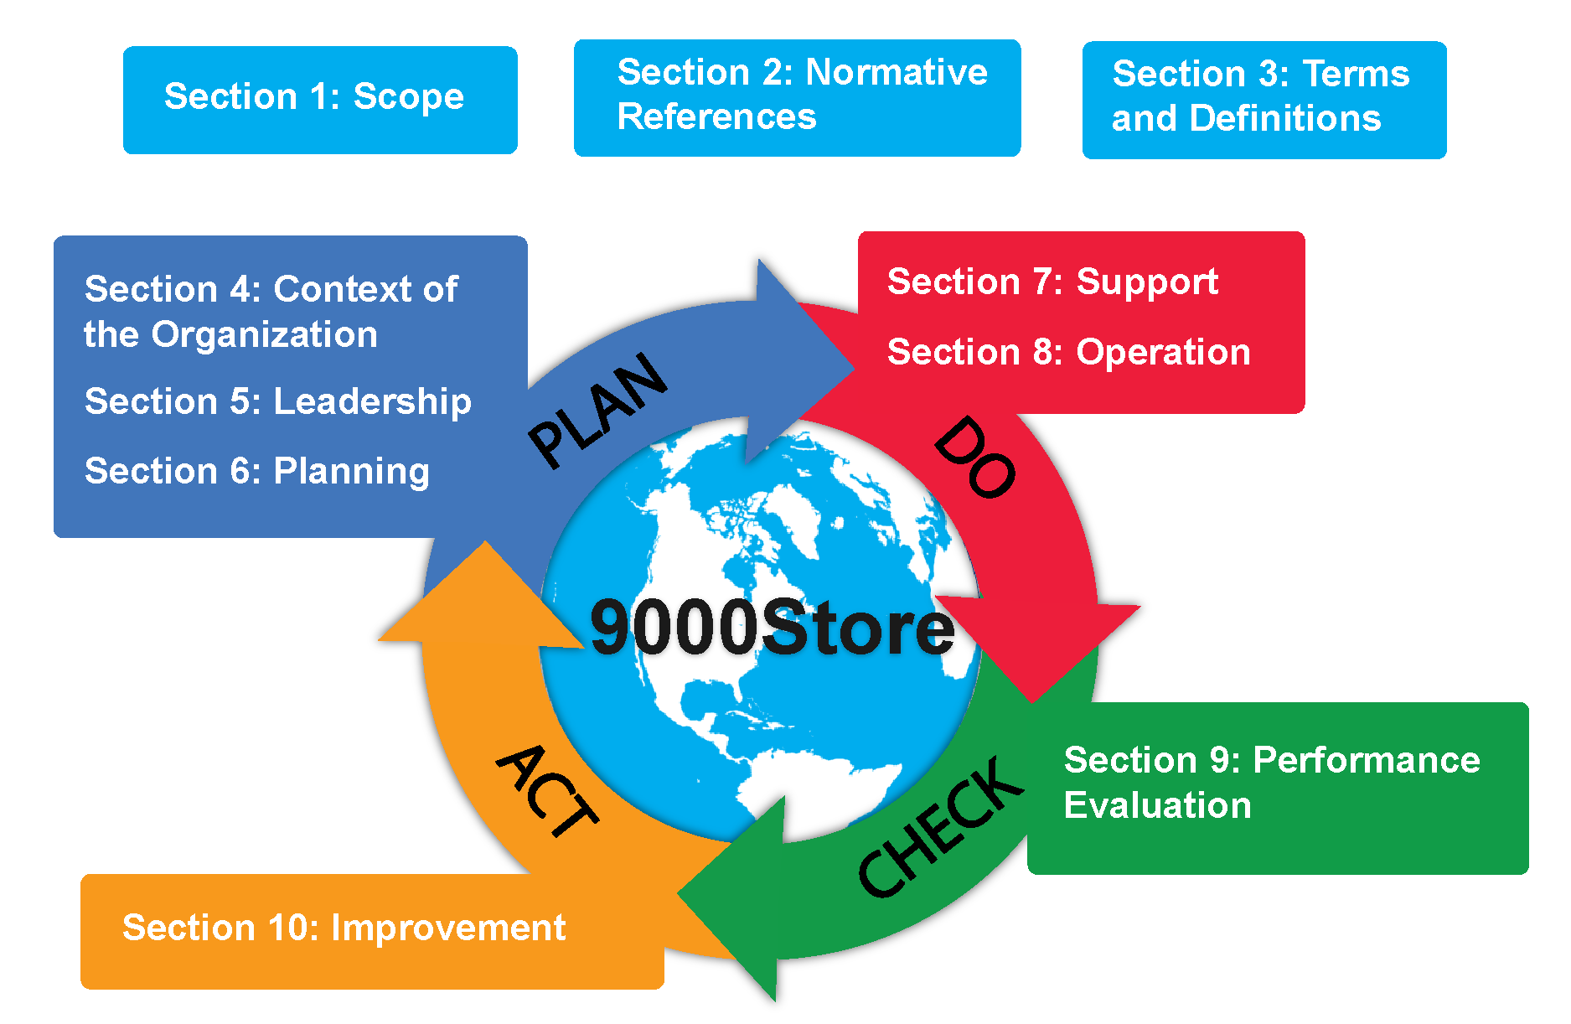

Slide 35
Any Questions?

