Slide 1

ETHICAL THEORIES - DEONTOLOGICAL (NON-CONSEQUENTIAL), TELEOLOGICAL (CONSEQUENTIAL), VIRTUE

Slide 2

LEARNING OBJECTIVES
After completion of this topic, you will be able to:
Describe the main ethical theories and apply it to business scenarios

Slide 3
ETHICAL CONCEPTS & THEORIES
Developed by moral philosophers over generations to distinguish ethical from unethical behaviour
Viewpoints from which guidance can be obtained along the pathway to a decision
Each theory emphasizes different points in order to reach an ethically correct decision
Theories are directed towards achieving a common set of goals (Ethical principles)

Slide 4
ETHICS DEFINED
The domain of ethics is centrally concerned with human CHARACTER (the kind of people we are) and CONDUCT (how we relate to others)
Three key questions comprise the focus of this domain:
1. What is good or bad for humans?
2. What constitutes right or wrong conduct?
3. How ought we to live and treat others?

Slide 5

CONSEQUENTIALISM
The rightness/wrongness of an action is determined by its consequences or results
The right action is the one that:
Promotes the greatest happiness of the greatest number (maximizes social utility) = Utilitarianism
Produces results that maximise a person’s self-interest = Ethical Egoism

Slide 6
CONSEQUENTIALISM - UTILITARIANISM
Jeremy Bentham (1748-1832) - Creator of Utilitarianism
Goodness = human well-being – what benefits is good and what harms is evil
Two concepts of importance:
  Pleasure and pain governs our lives
  Pleasure makes life happier and pain makes it worse
Utility – net benefits and usefulness produced by an action
  An action is right if the act is greater than the sum total of utilities produced by any other act
Hedonistic Calculus – system to measure amount of pleasure and pain that an action produces

Slide 7
CONSEQUENTIALISM- UTILITARIANISM
John Stuart Mill (1806-1873) – qualitative separation of pleasures
Bentham treats all forms of happiness as equal, whereas Mill argues that intellectual and moral pleasures (higher pleasures) are superior to more physical forms of pleasure (lower pleasures)
Mill's argument is that the "simple pleasures" tend to be preferred by people who have no experience with high art, and are therefore not in a proper position to judge

Slide 8
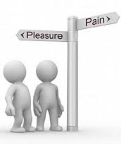
CONSEQUENTIALISM –
ACT AND RULE UTILITARIANISM
Rule Utilitarianism - an action is right if it conforms to a set of rules which produce the greatest balance of pleasure over pain
Act Utilitarianism – an action is right if and only if it produces the greatest balance of pleasure over pain for everyone

Slide 9
CONSEQUENTIALISM –
ETHICAL EGOISM
One’s self is, or should be, the motivation and the goal of one’s own action
Three categories: individual, personal, and universal
An individual ethical egoist would hold that all people should do whatever benefits them
A personal ethical egoist would hold that he or she should act in his or her self-interest, but would make no claims about what anyone else ought to do
A universal ethical egoist would argue that everyone should act in ways that are in their self-interest

Slide 10
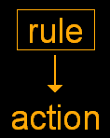
NON-CONSEQUENTIALISM -DEONTOLOGY
Emphasis on rules, duty, rights
Actions are right if they respect rules and wrong if they violate them
Golden rule – Do unto others as you would have them do unto you (human dignity, respect for people, obligation, duty)

Slide 11
DEONTOLOGY
Morality and ethics are to be understood as systems of rules meant to govern and guide conduct
Deontological ethical theories are agent-relative as opposed to agent neutral - you have a duty
If an action is of the wrong kind, it is forbidden, no matter how good its consequences are
Rejects both Utilitarianism and Ethical Egoism

Slide 12
DEONTOLOGY –
KANTIANISM
Immanuel Kant (1724-1804) - Ends, not mere means: don’t treat rational agents (others or yourself) as mere objects to be used or exploited
Categorical imperative – everyone should be treated as a free person equal to everyone else (unconditional)
Everyone has a moral right to such treatment and a correlative duty to treat others in this way
Mustn’t sacrifice the few even to benefit the many

Slide 13
DEONTOLOGY –
KANTIANISM
Performing an action solely because it is our duty is what Kant refers to as a good will – being good without qualification
Act only according to that maxim by which you can at the same time will it that it should become a universal law of nature – offers consistency

Slide 14
DEONTOLOGY –
NATURAL LAW AND HUMAN RIGHTS
Another approach to Deontology and complementary to Kantianism
Natural rights:
    Right to freedom/ liberty – freedom from coercive powerful rulers
    Right to ownership and property – each person has a right to ownership over own body and own labour and is free to decide what will be done with what he or she owns, without interference

Slide 15
NATURAL LAW AND HUMAN RIGHTS
Moral rights –by virtue of being human
Each right has a corresponding duty and these duties may be perfect or imperfect
Rights play an important role in business ethics – stakeholders have rights
Many rights however come into conflict and it is difficult to decide whose rights receives priority (victims or criminals)

Slide 16
DEONTOLOGY –
JUSTICE AND FAIRNESS
Fair and equitable distribution of opportunities and hardships to all
Ask how fairly benefits and costs are distributed to everyone regardless of power, position, wealth, etc.
Seven categories:
Distributive Justice – concerned with fair distribution of society’s benefits and burdens
Cooperation and competition – taking a proper share of some good
Procedual justice – fair, decisive practices, procedures and agreements among parties

Slide 17
DEONTOLOGY –
JUSTICE AND FAIRNESS
Retributive Justice – just imposition of punishment and penalties upon wrong-doers – does the punishment fit the crime
Compensatory justice – compensating people for losses they have suffered when they were wronged by others – losses due to Apartheid
Corrective justice – laws themselves as instruments of justice should be considered as just
Distribution – take into account who has suffered an unfair share of the costs of a policy and others who have unfairly benefitted from a policy

Slide 18
RAWLS’ PRINCIPLES OF JUSTICE
All social values – liberty and opportunities, income and wealth, and the bases of self-respect – are to be distributed equally unless unequal distribution of any, or all of these values, is to everyone’s advantage
Two principles
Basic freedoms - Freedom of speech, liberty and pursuit of happiness
Difference principle -There can be inequalities as long as it makes the worst person better off

Slide 19
ARISTOTELIANISM –
VIRTUE APPROACHES
Examines a person’s moral character and whether or not this exhibits virtue
Aristotle – a moral virtue is a habit that enables one to exercise reason in all actions
Action of giving people goods they exactly deserve is justice (virtue) or giving too little/ too much is injustice (vice)
Virtues are means to and constituents of happiness
Virtue ethics makes being virtuous an essential element of leading a moral life

Slide 20

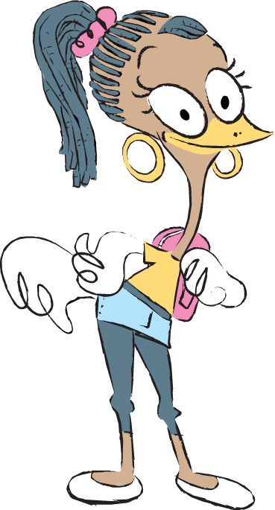
Any questions?

