Slide 1

ETHICAL DILEMMAS

Slide 2

LEARNING OBJECTIVES
After completion of this topic, you will be able to:
Describe ethical issues/dilemmas and the challenges of defining it in business
Identify different types of ethical dilemmas and behaviours
Explain how people avoid ethical dilemmas due to rationalisation
Identify the dilemmas due to a conflict with core values
Describe common elements and methods to reduce ethical dilemmas

Slide 3
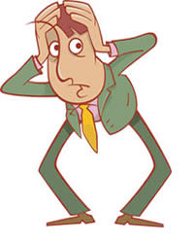
ETHICAL ISSUES AND DILEMMAS IN BUSINESS
An ethical issue = a problem or opportunity that requires an individual or group to choose among actions that are evaluated as ethical or unethical
    Failure to do so puts corporations at great risk
An ethical dilemma = a problem, situation, or opportunity that requires an individual or group to choose among several wrong or unethical actions
  Common rationales for “bending the rules”
        Performance-based judgment calls
        Faulty rules with “loop-holes”
        Socially embedded norms

Slide 4
TYPES OF ETHICAL DILEMMAS
Taking things that don’t belong to you
Saying things you know are not true
Giving or allowing false impressions
Buying influence or engaging in a conflict of interest
Hiding or divulging information
Taking unfair advantage
Committing acts of personal decadence
Perpetrating interpersonal abuse
Permitting organizational abuse
Violating rules
Condoning unethical actions
Balancing ethical dilemmas

Slide 5
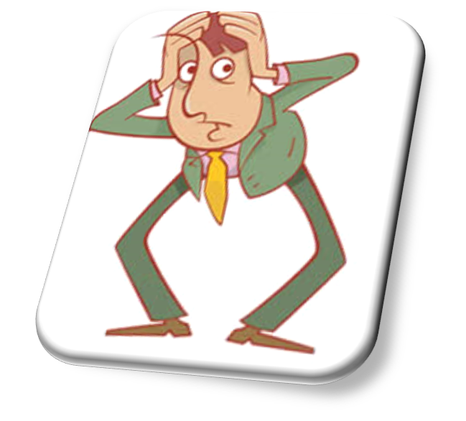
ETHICAL DILEMMAS – CONFLICT WITH CORE VALUES
Each side is rooted in one of our basic, core values
    Truth versus loyalty
    Individual versus community
    Short-term versus long term
    Justice versus mercy

Slide 6
ETHICAL DILEMMAS: CALLING IT BY A DIFFERENT NAME!
“Cooking the books”
“Copyright infringement”
“Manipulated appraisal”
“Changed the numbers”
“Backdating Options”
“You lied”
“Financial engineering”
“Managing earnings”
“Smoothing earnings”
“Getting results”
“Peer-to-Peer file sharing”
“I got a second opinion”
“Pro forma adjustment”
“Deseasonalized the data”
“Periodic look-backs”
“No, I misremembered.”
“No, I misspoke.”
“No, I managed expectations.”

Slide 7
ETHICAL DILEMMAS: CALLING IT BY A DIFFERENT NAME!
“The employee stole from inventory.”
“He was accepting cash for political favours.”
“Bribes”
“Suspended from school”
“Conflict of interest”
“That’s cheating!”
“The employee showed
poor judgment.”
“He was just accessible.”
“Useful expenditures”
“Restricted”
“It wasn’t so much a conflict of interest as it was a confluence of
conflicting motives.”
“That’s creative thinking!”

Slide 8
HOW WE AVOID ETHICAL DILEMMAS: RATIONALISING
“Everybody else does it.”
“If we don’t do it, someone else will.”
“That’s the way it has always been done.”
“We’ll wait until the lawyers tell us it’s wrong.”
“It doesn’t really hurt anyone.”
“The system is unfair.”
“It’s a gray area.”
“I was just following orders.”
“We all don’t share the same ethics.”
“If you think this is bad, you should have seen.”

Slide 9
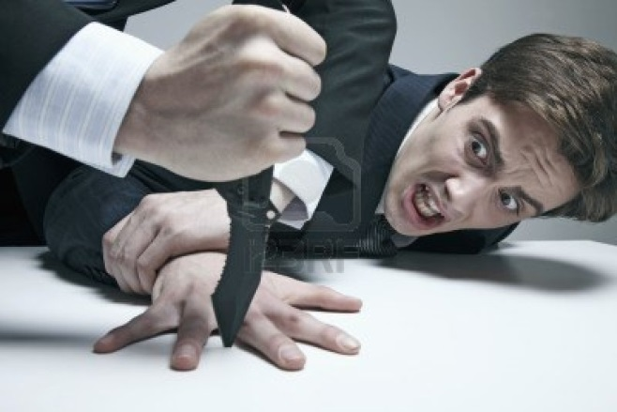

ABUSIVE OR INTIMIDATING BEHAVIOUR
One of the most common ethical problems
Can mean anything from:
    physical threats
    false accusations
    bad language
    insults
    ignoring someone
    unreasonableness
Bullying is a growing legal problem in the workplace

Slide 10
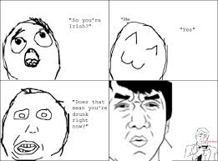

LYING
Three types of lies:
  Joking without malice – hurtful/ insulting joking although not intended
  Commission lying - telling a lie
  Omission lying - withholding the truth

Slide 11
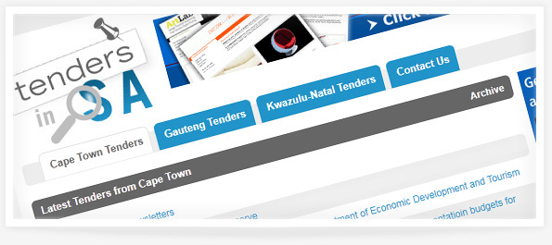
CONFLICTS OF INTEREST
Exist when an individual must choose whether to advance his or her own personal interests, those of the organisation, or some other group
Have two interests - cannot pursue one without having negative impact on other
    Two Types
      Private Interest Conflicts with Corporate
      Business Interest Conflicts with Public

Slide 12
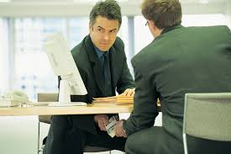
BRIBERY
Bribery is the practice of offering something in order to gain an illicit advantage
Different types of bribery
    Active bribery - offence committed by the person who promises or gives the bribe
    Passive bribery – offence committed by the official who receives the bribe
    DO YOU THINK ALL BRIBES ARE BAD?

Slide 13


DISCRIMINATION
A company in can be sued for discrimination if it:
  Refuses to hire an individual for discriminatory reasons
  Unreasonably excludes an individual from employment
  Unreasonably discharges an individual
  Discriminates against an individual with respect to hiring, employment terms, promotion, or privileges

Slide 14


SEXUAL HARASSMENT
A repeated, unwanted behaviour of a sexual nature perpetrated upon one individual by another
Hostile Work Environment
    The conduct was unwelcome
    The conduct was severe, pervasive, and regarded by the claimant as so hostile or offensive as to alter his or her conditions of employment
    The conduct was such that a reasonable person would find it hostile or offensive

Slide 15

ENVIRONMENTAL ISSUES
The environment is a significant and growing issue in business
The Kyoto Protocol: An international treaty on climate change that commits nations to reducing greenhouse gas emissions
Water pollution: Results from dumping sewage and toxic chemicals in places where they can filter into water supplies
Green energy sources are perceived to have lower emissions or waste than traditional ones

Slide 16


FRAUD
Any purposeful communication that deceives, manipulates, or conceals facts in order to create a false impression is fraud
Accounting fraud
    Misrepresentation of company’s financial reports
    2008-2009 Wall Street financial meltdown and recession revealed continuing problems
Marketing fraud
Consumer fraud

Slide 17
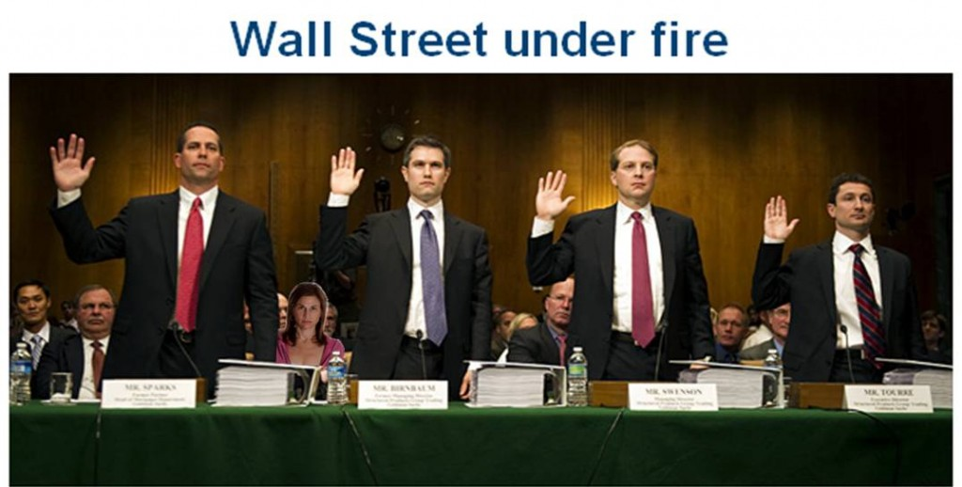
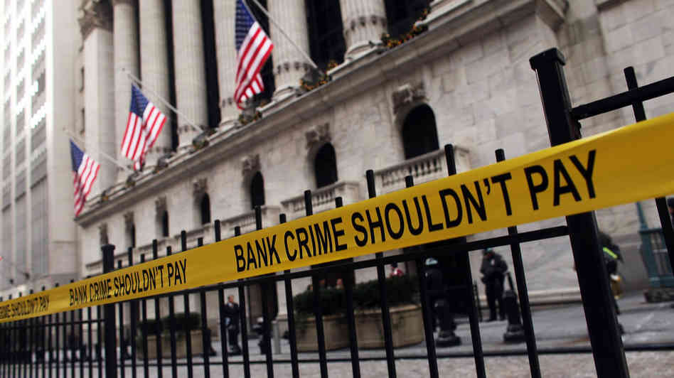
FINANCIAL MISCONDUCT
The failure to understand and manage ethical risks played a key part in the financial meltdown and recession of 2008-2009

Slide 18
INTELLECTUAL PROPERTY RIGHTS AND PRIVACY
Intellectual Property Rights involve the legal protection of intellectual properties, such as music, books, and movies
Many privacy issues in the business world
    Employee use of technology
    Consumer privacy
    It can be a challenge for businesses today to meet the needs of consumers while protecting their privacy
    Plagiarism

Slide 19
THE CHALLENGE OF DETERMINING ETHICAL ISSUES IN BUSINESS
Most ethical issues will become visible through stakeholder concerns about an event, activity, or the results of a business decision
Determining ethical issues is a challenge
The ethical decision making process starts when ethical issue awareness occurs and individuals begin discussion

Slide 20
RESOLVING ETHICAL DILEMMAS
COMMON ELEMENTS
Peter Drucker Above all, do not harm
Blanchard/Peale Is it legal?
Is it balanced?
How does it make me feel?
Warren Buffett Would you be willing to see your actions reported on the front page of the newspaper?
Wall Street Journal Compliance
Contributions
Consequences
Golden Rule Treat others as you want to be treated
Categorical Imperative Could you live in a world with your standards?

Slide 21
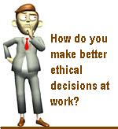
METHODS TO RESOLVE DILEMMAS
Question 4:
Is it illegal?
What does your gut tell you?
How would you define the problem if you stood on the other side of the fence?
  Define the problem/ moral issue accurately
  Determine the actor affected & your role
  Gather the facts and analyse it
  Test for right versus wrong issues
  Test for right versus right paradigms
  Apply the resolution principles
  Investigate if there is a third way out of the situation
  Make a decision and take action
  Revisit and reflect on the decision
Question 5:
Truth vs loyalty
Self vs community
Short-term vs long term
Justice vs mercy
Question 6:
Utilitarianism
Rule-based and care-based thinking
Do to others as you would like them to do to you

Slide 22
PRESCRIPTIVE ETHICAL MODELS
Mason, Mason, and Culnan’s 6 questions:
    What are the facts?
    What ethical principles, standards, or norms should be applied?
    Who should decide?
    Who should benefit from decisions?
    How should the decisions be made?
    What steps should be taken to prevent this issue from occurring again?
Badarocco’s 4 enduring questions:
    What course of action will do the most good and least harm?
    Which alternative best serve others’ rights, including shareholders’ rights?
    What plan can I live with, which is consistent with the basic values and commitments of my company?
    Which course of action is feasible in the world as it is?
Anand, Ashforth, and Joshi’s method for dealing with rationalization and socialization of unethical behaviour
    Prevention – foster awareness of rationalization and socialization tactics
    Use performance evaluations beyond numbers
    Nurture an ethical environment in your organisation
    Top management serve as role models

Slide 23

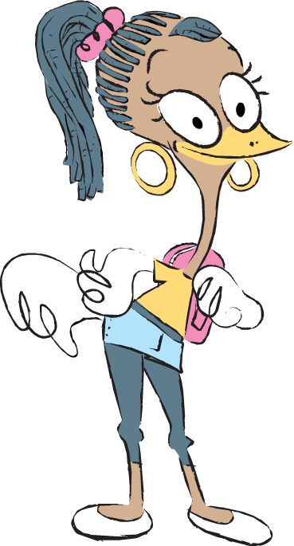
Any questions?

